Slide 1

Bootup #4
November 19, 2009

Slide 2
Typejack in a nutshell…
A better way to read (more on that in a sec)
Seed funded, incorporated as sub chapter S
Subscription based
Launched iPhone app in September, 2009
Ruby on Rails with Flex
Team of 4 with deep industry experience
Seeking to augment group with technical team leader

Slide 3
Typejack: the idea
For consumers, reading news online is hard
  RSS readers present a bad user experience
  Lots of ads, multiple-pages, too many clicks
For publishers, advertising revenue model is broken
Typejack is for Real Readers
  A “lean back” reading experience
  Clean & Uncluttered
  Real Reading is often event based or ritualized (eg. on the train, in bed, on the john)
We believe there are millions of serious readers who will pay for a better way to read news and periodical content

Slide 4
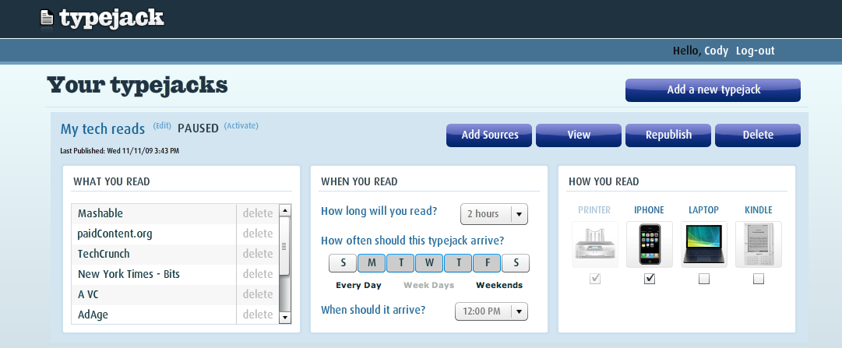
Meet Typejack
A typejack is a collection of reading sources.
Choose sources of reading– search by keyword or by popularity
Set schedule of delivery – set email reminders at whatever time-of-day
Pick devices – choose among print, iPhone or Kindle-based delivery

Slide 5
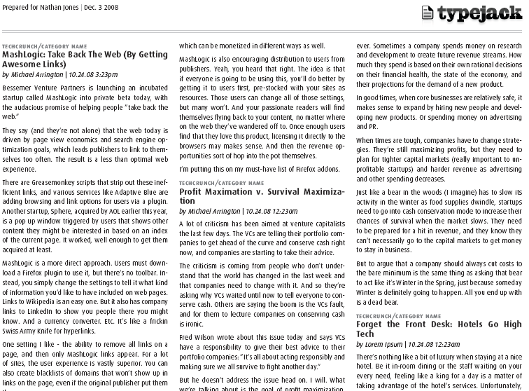
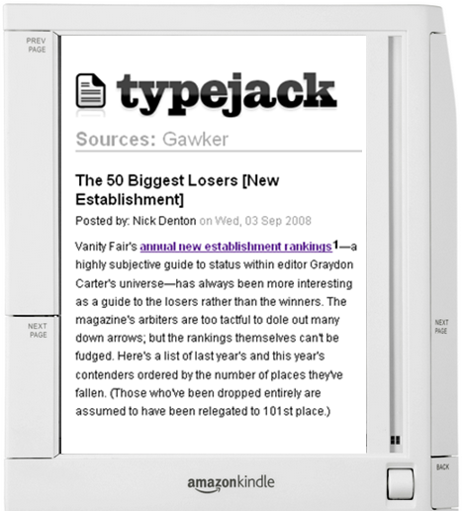
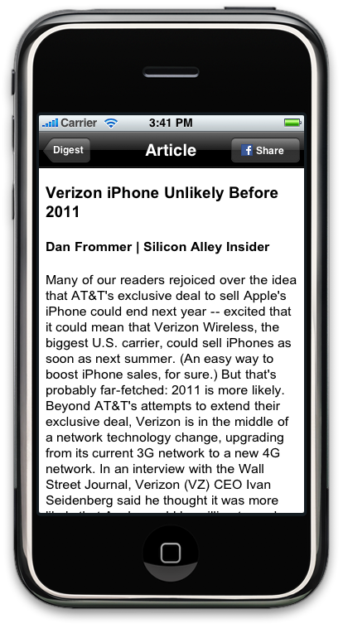
Reading as a playlist, across devices
A synced reading experience across devices and media (available right now: printed, Kindle, and iPhone)

Slide 6
The Model

Slide 7
Typejack is subscription based
Typejack will sell access to feeds for small, subscription-based amounts that start at $0.99/month.
Publishers can self-submit RSS feeds, or provide their content via API, and set the price of their feeds.
Simpler payment methods from iPhone, Amazon and Facebook make smaller-dollar subscriptions feasible.
iPhone & iTouch devices reach over 50mm credit cards.

Slide 8






Readers already pay for content
Unique content commands subscription fees
ConsumerReports.org has 3.3 million subscribers who pay $25 annually
MLB.tv had 500,000 paid subscribers in 2008 who paid $120 annually
WSJ.com has over one million subscribers who pay $99 annually
Dow Jones & Factiva have 2.3 million subscribers to their services
Barron’s has 150,000 subscribers online; FT.com has 99,000

Slide 9
Publishers see new revenue
Content is licensed and revenue is shared – this is not being done by any other news reading aggregator.
Publishers can submit existing RSS feeds, or provide full-text content via API – no new work is required.
Publishers, sites and bloggers can promote ‘Send to Typejack’ via badges similar to those that promote Digg, StumbleUpon, Reddit and similar social sites – the difference is Typejack’s transactional revenue.

Slide 10
What’s next?
Typejack is currently live on the web, iPhone and Kindle
Relationship with one of the largest news organizations in the world already in place
Typejack will begin delivering full (ad free!) content to subscribers in January, 2010.
Looking to augment founding group with a technical team member
Please check out Typejack in the Apple App Store or online at http://www.typejack.com
Email Us: founder@typejack.com

