Slide 1
Experiences with AWS and RightScale
By: Max Gribov
max@sigilsoftware.com
Presented at New York PHP, March 22, 2011
http://www.nyphp.org

Slide 2
AWS Basic Services
EC2 – Elastic Computing platform, “servers”
EBS – Elastic Block Storage, “presistent storage”
S3 – Simple Storage, “offline backups”
API to manage it all

Slide 3
AWS Advanced Services
These are all supported by RightScale
Elastic Load Balancing
Relational Database Service (RDS)
Simple Queue Service (SQS)
Virtual Private Cloud (VPC)

Slide 4
AWS Advanced Services
These are NOT supported by RightScale (at least on my paid account)
Simple Notification Service (SNS)
Simple Email Service (SES)

Slide 5
AWS Advanced Services
These will compete with RightScale (uh-0h)
Elastic Beanstalk
CloudFormation

Slide 6
AWS Regions
US East
US West
EU
AP-Tokyo
AP-Singapore
Different pricing
Extra charge when transferring data between regions

Slide 7
AWS Availability Zones
Contained with a Region
US East has 4
No extra charge to transfer data within same zone
Extra charge to transfer data between availability zones
Will also have to pay if using public IP's during transfer (EIP to EIP) regardless of zoning

Slide 8
AWS Instances
On-Demand Instances – the basic instance
Reserved Instances - pay low fee, reserve instance, pay less per hour and don't pay if not using. End up being cheaper than on-demand.
Spot Instances (NOT in RightScale) - bid on unused capacity, pricing fluctuates with demand. Can use it as long as your bid exceeds current price. Good for batch processing.
Micro Instances – do not have their own storage, have to use EBS to boot. Weak and cheap.

Slide 9
Question!
I have all these EC2 instances and EBS volumes and S3 snapshots, but how do I make them into an architecture?

Slide 10
Well, what did we do before AWS
Buy some machines
Put some OS on them
Configure some services
Deploy as an “architecture” (redundancy, monitoring, etc)
Deploy our application
Monitor
Run out of capacity
Go to Step 1

Slide 11
The Promise of the Cloud
Provisioning is fast
Pay for what you use
Use no more than you need now
Grow and shrink as needed

Slide 12

The Promise of the Cloud
@devops_borat: Cloud is rarely fail. Is only when datacenter segfaults.

Slide 13
Enter RightScale
An advanced web GUI, built on top of AWS API, to manage and monitor a cloud deployment
Has a RESTful API to perform same tasks as the GUI (in beta)
Handles provisioning, configuration, management and monitoring of cloud servers (EC2+EBS+S3)
Also allows management of some of the advanced AWS services

Slide 14
RightScale basics
Free account:
  No access to advanced Server Templates
  No auto-scaling Server Arrays
  No multiple user accounts
  http://www.rightscale.com/products/plans-pricing

Slide 15
RightScale Basics
Multicloud Images – turn EC2 instances into servers
Templates – turn a generic server into “web server”, “database server”, etc
RightScripts – essential components of templates, run during boot/shutdown/operation

Slide 16
RightScale Basics
Deployment – contains individual servers and Server Arrays (e.g. QA, Prod, Dev)
Server Array – contains a number of identical servers performing same function (i.e. a cluster)
Server Arrays can grow and shrink based on Alert Escalations or on a schedule
Alert - “My CPU is 100% used” ( + notification)
Alert Escalation - “Now that my CPU is so used, I vote to grow array by n members”

Slide 17
Some Details
Everything can be cloned - make your QA deployment a copy of your Prod deployment
Everything can be customized – start with RightScale MySQL Template and turn it into your own MongoDB Template
RightScale keeps your custom stuff in Version Control

Slide 18
MultiCloud Images
AMI
Can be restricted to specific AWS Regions
Provides basic OS

Slide 19
Templates
Turns an instance into a specific server
Is a collection of RightScripts and their Inputs
For example, MySQL EBS template provides a MySQL server with a striped EBS volume, automated backups and replication
Can clone an existing template and customize it by manipulating its RightScripts
Live in revision control

Slide 20
RightScripts
Can be in any language a server supports
Get their parameters from the RightScale GUI
Configure servers on boot
Can be used during operation (ex: create full MySQL backup, promote slave to master)
Can run on server shut down
Can write your own and plug them into existing (or custom) ServerTemplates
Live in revision control

Slide 21
RightScale Monitoring
All servers run collectd
RightScale collects and graphs a lot of data
Email alerts
No SMS alerts – this can be changed by using mobile@carrier.com though

Slide 22
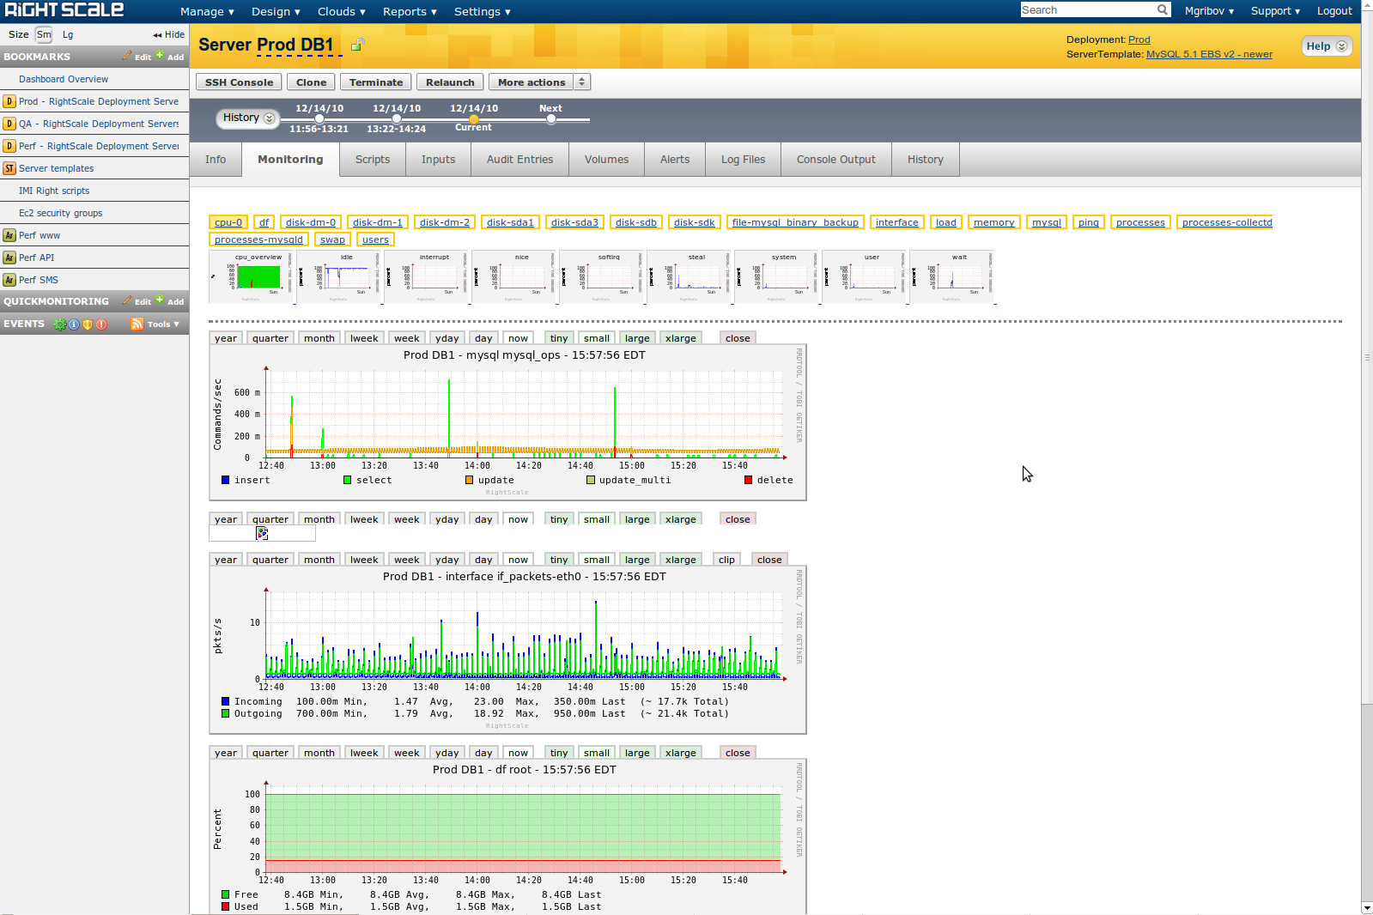
RightScale Monitoring

Slide 23
Our Setup
2 Deployments: QA and Prod
Built Prod first, then cloned it and changed instance types to build QA
Has 3 auto-scale web server arrays
Has MySQL master/slave
Has MongoDB replica pair

Slide 24
Load Balancing
Using RightScale template with nginx and haproxy as LB's
Haproxy is used because RightScale wrote pool management script for it – in reality could have used only nginx
Using real server instead of AWS LB provides greater flexibility and customization, like rewrite rules
Had to modify RightScripts and Templates to have a multi-pool LB

Slide 25
Database
RightScale MySQL failover is done via DNS and low TTL on the record
DNSMadeEasy is used to dynamically assign MySQL servers to master.domain.com and slave.domain.com
Failover is manual, as per RightScale suggestion (but could be automated)
MySQL backup is part of the template
MySQL template includes EBS striping
Had to roll own MongoDB template

Slide 26
Webserver Pools
Have 3 pools in each deployment
nginx+php-cgi
Heavily customized RightScale PHP server template – no nginx+php-cgi template
Customization was pretty easy
Auto-scale by 2 if CPU load is high on more than 51% of the servers

Slide 27
Backups
All backups are S3 snapshots
MySQL template comes with snapshotting out of the box
Created own scripts to do S3 snapshots on other servers

Slide 28
Conclusion
RightScale gave us a good base (templates and scripts) to set up our own architecture
RightScale provided good support for some high-level engineering/arch questions as well as small daily issues
Did not have to write any code to take advantage of the Promise of the Cloud(tm)

Slide 29
Resources
Cloud-related things I follow on twitter: https://twitter.com/#!/neuropunks/cloud/members
http://phpfog.com - Heroku-like environment for PHP apps
http://orchestra.io - Heroku-like environment for PHP apps
http://www.slideshare.net/ijansch/php-and-the-cloud

