Slide 1

Because you don’t always have what you need,
and you don’t always need what you have
September, 2009
This document is confidential and is intended solely for
the use and information of the audience to whom it is directly provided. This document is intended only for accredited investors.
CONFIDENTIAL

Slide 2
The Problem
  People often purchase “stuff” for specific occasions or that they envision using more often than they do
  Therefore, apartments and houses are filled with items that are owned but very rarely used
  Yet people continue to purchase these types of items when they need them or simply do without them
  Because…
  It is too difficult or time consuming to seek access to these items from friends or neighbors they may or may not know
Notes:
Neighbors used to know each other and help one another
I remember my neighbor across the street borrowing my father’s ride-on lawnmower
I went out and bought X when there is no doubt in my mind that someone in my apt building had one they weren’t using

Slide 3
The Solution
  A web-based platform that makes it easy for people to borrow things they need to use but don't need to own
  By…
  Allowing members of local networks access to what might be available next door or down the block
  To…
  Help our members save both money and the environment by avoiding purchases of items used infrequently

Slide 4
The Technology
  neigh*borrow is a highly scalable, searchable, browse-able database of items available for borrowing
  neigh*borrow’s membership rules and algorithms promote equitable participation and security through use of:
    Lending requirements to ensure supply
    Accountability metrics (e.g., e-Bay like rating system, access to items based on lending/borrowing history)
    Customizable privacy settings
  neigh*borrow’s inventory management system provides real time status tracking and facilitates exchanges

Slide 5
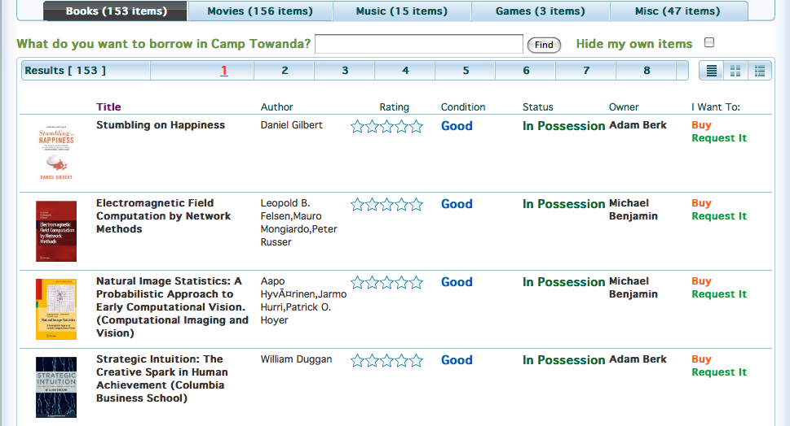
The Interface

Slide 6
The Business Model
  Basic membership offered free and supported by advertising
    Hyper-localized neigh*borrow-hoods provide extremely targeted audience to local businesses
    Revenue sharing model with community “mayors”
    Partnerships with local retail establishments based on foot traffic driven by sponsored exchange venues
Premium membership offered through paid subscriptions and/or transaction fees
    Group purchasing and co-ownership management of high value items
    Priority access and/or guaranteed availability

Slide 7
The Business Model (continued)
  Additional short-term sources of revenue include:
    Customized/branded n*b-hoods (e.g., building mgmt. companies, corporate offices)
    Partnerships with retailers for “try then buy” model
    Franchise model for local n*b-hoods
    Spreads on shipping for non-local, “global” n*b-hood
  Long-term, potential expansion into local n*b-hood franchising, community micro lending, property time sharing, corporate capital equipment co-ownership

Slide 8
The Competition
  Direct competitors are in early stages of development
  (e.g., borrowme, loanables, household network, lendaround)
  The borrow/lend model will also compete with swapping and rental sites (e.g., swaptree, zunafish, zilok)
    Swapping sites require finding a match and loss of item
    Rental sites require fee for rental service
  Key success factor will be generating a critical mass of active users and inventory items which will be accomplished through:
    Providing a safe and secure lending environment
    Capturing a targeted segmentation of the market and then expanding vertically and horizontally
Notes:
Create matrix: pros/cons, functionality, locations, items, etc.
Separate page for KSFs

Slide 9
The Risks
  Users do not list/lend items in quantity required for success
    Minimum listing requirements for free borrowing and currency system to motivate listing and lending of items
  Users do not feel comfortable lending items
    Private networks by invitation only, insurance coverage, intricate user rating and reputation algorithm
  Legal liability relating to lent items and dispute resolution
    Clear and firm terms of use and privacy policies

Slide 10
The Progress
  Built a functioning prototype website
  Registered over 5,000 members with $0 marketing budget
  Press received to date includes:
    NBC’s “Today Show”, CNBC’s “On the Money”, WNBC NY’s 11pm news
    Wall Street Journal, USA Today, Daily News (NY), Oprah.com, and numerous “green” and “tech” blogs
  Winner of spigit.com’s “Entrepreneur Challenge” and a finalist of Mashable’s “Open Web Awards”
Notes:
Put into timeline format
Perhaps one for technical progress and one for media/awards

Slide 11
The Next Steps
  Next step is to conduct a tightly focused private beta test to prove concept and gather feedback and data on:
    Website functionality and user experience
    Ideal target segmentation:
      n*b-ers (people): Eco-conscious, Students, DIY-ers
      n*b-hoods (places): Media, Tools, Sporting Equip.
      n*b-goods (things): Apt. buildings, Offices, Colleges
  Results will inform changes in preparation for public launch
  Pursue business development and partnership opportunities to expand inventory and user base

Slide 12
The Exit
  Public equity offering
  Acquisition by strategic buyer
    Social network looking to expand functionality and application offerings
    Electronic retailer (e.g., Amazon) interested in access to user preference data and/or ability to offer “try it before buy it” capabilities
Notes:
Funding requirements
Sources and uses
Financial projections

Slide 13


The Team
  Adam Berk, Co-Founder
  Adam came up with the concept of neigh*borrow and has been working on developing the product since inception. Previously, Adam successfully launched the financial website, jusTTradewith.us and has been engaged in the web 2.0 scene for the last few years. He earned a BA in economics from Emory University.
  David Tomback, Co-Founder
  Most recently, David was a Senior Associate with the management consulting firm Booz & Co. (formerly Booz Allen Hamilton) where he managed strategic consulting projects for corporations. David received a MBA from the Kellogg School of Mgmt. (Northwestern University) and a BA in economics from Tufts University.

