Slide 1



Commercial Open Source Workflow & BPM
Contact us: info@colosa.com
Visit us: http://www.processmaker.com/
Speaker: Brian S. Reale
Powered by

Slide 2

What is ProcessMaker?
Open Source PHP Workflow & BPM
Launched on SourceForge in October 2008
1,000 registered community members
10 languages
AGPLv3 License
WAMP/LAMP Stack

Slide 3
Mission & Vision
Mission
  Develop lightweight yet powerful open source workflow technology that automates and improves business processes and allows for easy integration.
Vision
  Eliminate paperwork as we know it.

Slide 4






















Sample Commercial Clients & Verticals
Banking
Insurance
Government
Industry

Slide 5


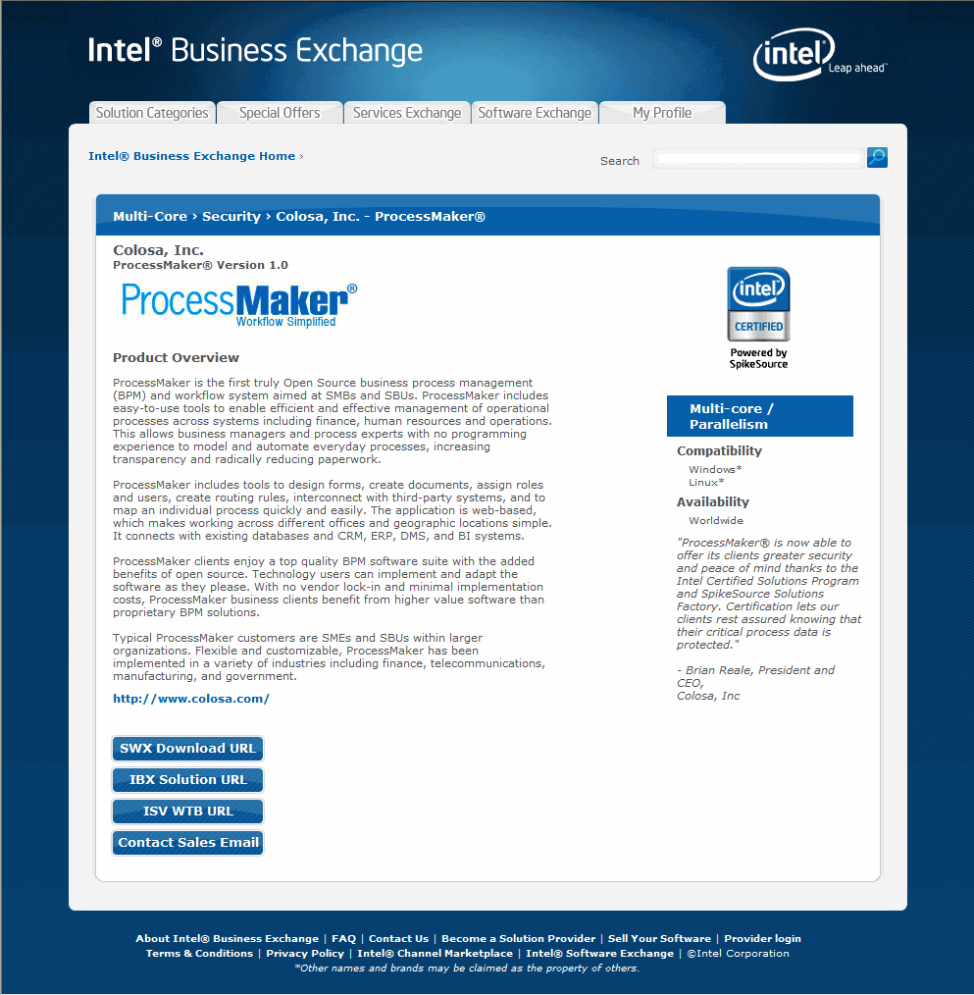

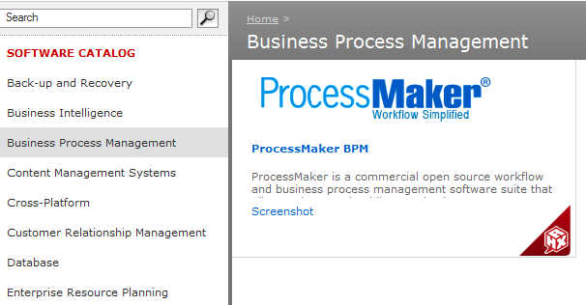
Worldwide Recognition by Intel & Red Hat

Slide 6
The Pain Points
SMBs/SBUs and Government Agencies need a simple, low-cost way to simplify paperwork.
Developers need an open source workflow engine to easily add the following functionality to existing software:
  Build forms
  Route data to multiple decision makers
  Track and report on data entered
  Generate customized alerts
  Produce personalized documents (contracts, acceptance / rejection notices, government documents, official letters)
System Integrators need a way to add greater value and more seamless process integration for ERP, CRM, and DMS installations.

Slide 7
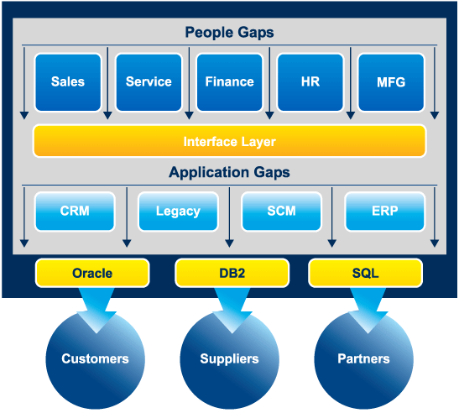
Sample Process Linking
A BPM platform can let you build customer-centric processes that span several systems, and fill in the gaps in your organization.
People Gaps
Interaction with the client
Information passing between departments
Approvals that cross between departments
Sharing information between departments
Gaps created by Software and Systems
Managing Exceptions
Implementation Limitations
IT Resource Limitations

Slide 8
Where to look for BPM Opportunities?
OPERATIONS
RMA
Help Desk
Access Authorization Request
Engineering Change Request
Inspection Forms
Survey Forms
HUMAN RESOURCES
Benefits Administration
Employee On-Boarding
Employee Off-Boarding
Hiring
ADMIN & FINANCE
Credit Application
Claims Forms
Purchase Request
MARKETING & SALES
Marketing Funds Usage Request
Marketing Collateral Approval
Contract On-Boarding
Special Pricing Approval
Contract Production and Management
NATIONAL / LOCAL GOVERNMENT
Licensing and Permit Applications
Online RFQ and RFPs

Slide 9





System Architecture
Cross Browser – PDAs
ProcessMaker
SOAP
SendMail
WS- Reliable
WSO2
MAIL
PHP Mailer
WS-Security
Open Mail
LDAP
Rbac
3rd Party
Libraries
Active
Directory
Gulliver
MySQL
PROPEL
Postgres
SQL Server, Oracle,
etc
PHP
Apache
Linux / Windows

Slide 10
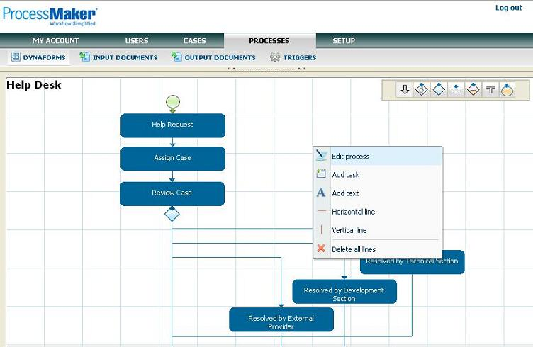
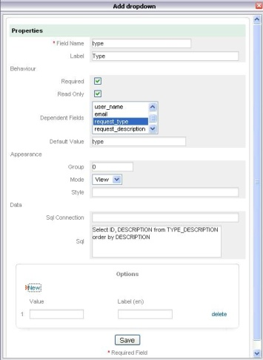
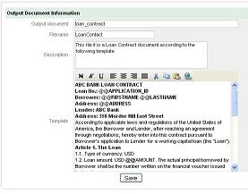
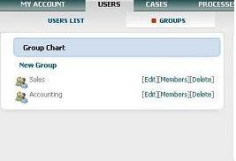
ProcessMaker Features
Management of processes, workflows and users
Creation of customized forms, documents and triggers
Real-time interaction among users or between 3rd party systems/modules
SOA – Service Oriented Architecture

Slide 11
Thank you for your time
Questions are welcome
Brian Reale
brian@colosa.com

