Slide 1
ZENTORA: AN ADAPTIVE AI FOR PERSONALIZED LEARNING ON
MENTAL HEALTH
Team Details:
Name: V.ANANTHITHA/211423104039 Name: ASHLIN RITHZIA GA/211423104061
Batch Number: A20
Domain: Artificial Intelligence and Machine Learning
Coordinator Name & Designation
Dr. Kavitha Subramani Professor
Guide Name & Designation:
Dr.M.Maheswari Associate Professor
Date:29.10.2025

Slide 2
Agenda
❖ Introduction: Overview of the Zentora Chatbot project and its role in promoting student mental well-being. ❖ Objectives: Define the goals of developing an AI-powered chatbot for emotional support and stress management. ❖ Literature Review: Study of existing AI-based mental health and emotion detection systems. ❖ Problem Statement: Identify the mental health challenges faced by students and the lack of accessible emotional support platforms. ❖ System Architecture & Diagrams: Visual representation of Zentora’s structure including use case, data flow, and sequence diagrams. ❖ Modules Description: Explanation of key modules such as User Interaction, Emotion Detection, Response Generation, and Image Integration. ❖ Dataset & Algorithm: Discussion of the Student Mental Health dataset and the Gradient Boosting Model used for mood prediction. ❖ Methodology: Outline of the step-by-step workflow followed for model training, chatbot development, and response generation. ❖ Testing & Performance Analysis: Validation of model accuracy, chatbot reliability, and performance comparison with other algorithms. ❖ Conclusion & Future Work: Summary of the project’s achievements and potential improvements such as advanced NLP integration and multimodal emotion recognition.

Slide 3

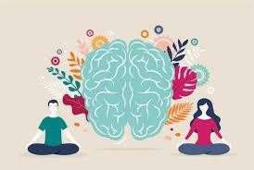
Abstract
In recent years, emotional well-being among students has become a critical focus, particularly in primary and secondary education. Many learners face stress, anxiety, and emotional challenges that often go unrecognized due to limited counselling resources and the stigma surrounding mental health.
To address this, the proposed system introduces ZENTORA — an AI-based chatbot and journaling platform that offers real-time emotional support and behavioural monitoring.
Using Natural Language Processing (NLP), the chatbot analyzes user input to detect emotions and provides personalized coping strategies inspired by Cognitive Behavioural Therapy (CBT) and Social and Emotional Learning (SEL). The data is securely stored and visualized through a counsellor dashboard, enabling timely interventions for at-risk students.
A complementary study on student depression prediction utilized six machine learning models — Logistic Regression, Decision Tree, Gradient Boosting, Random Forest, XGBoost, and Naive Bayes — achieving accuracy scores between 0.88 and 0.97. Gradient Boosting demonstrated the highest predictive capability (ROC AUC = 0.97) and was integrated into the ZENTORA chatbot for enhanced early detection and support.
This system bridges technology and mental health care, fostering safe, data-driven, and culturally sensitive counselling solutions that contribute to SDG 3 (Good Health and Well-Being) and SDG 4 (Quality Education).

Slide 4
Introduction
❖ Zentora is an AI-powered mental health chatbot designed to support students by providing real-time, empathetic, and motivational conversations. ❖ It helps users express emotions freely and receive instant guidance for stress, anxiety, and mood regulation. ❖ The system uses a Gradient Boosting Model (XGBoost/LightGBM) to predict emotional states based on user text input. ❖ The chatbot responds with personalized messages, coping suggestions, music or podcast links, and mood-based calming images. ❖ The frontend is built using React.js, while the backend (Flask/FastAPI in Python)** handles text processing, prediction, and response generation. ❖ The model is trained using the “Student Mental Health (Collection of Data)” dataset, which includes 101 records of students’ lifestyle and mental health attributes. ❖ This dataset helps Zentora identify patterns between academic stress, lifestyle habits, and emotions — enabling meaningful, data-driven mental health support.

Slide 5
Overview
❖ To provide an AI-powered chatbot platform that offers real-time emotional support and mental health guidance for students. ❖ To predict user emotions using a Gradient Boosting Model and deliver personalized, empathetic responses. ❖ To help users manage stress, anxiety, and motivation through mood-based suggestions, coping tips, and relaxation resources. ❖ To integrate multimedia elements such as calming visuals, music, and podcasts for enhanced emotional well-being. ❖ To develop a simple and interactive interface using React.js (frontend) and Python Flask/FastAPI (backend). ❖ To encourage mental wellness awareness among students through safe, private, and supportive digital communication. ❖ To create an intelligent system that continuously learns from user interactions for improved accuracy and empathy.

Slide 6


Problem Statement
🧠 Mental Health Challenges Among Students
Key Issues:
Increasing global concern impacting academic performance, social relationships, and overall well-being
Growing rates of anxiety, depression, and stress caused by:
Academic pressure and competitive learning environments
Social media influence and uncertainty about the future.
Barriers to Support:
Stigma around mental health discussions
Limited access to professional help or trained school counselors
Inadequate resources in many educational institutions
Consequences of Neglect:
Decline in learning outcomes and motivation
Higher dropout rates
Potential for self-harm or suicide in severe cases

Slide 7
Research and Literature Review
1. Development of an AI-Based System to Enhance School Counseling Models for Asian Elementary
Students With Emotional Disorders (IEEE-2024)
Aspect | Details
Author | SHIH-WEN SU, CHAO-HSIANG HUNG, LI-XIAN CHEN, and SHYAN-MING YUAN
Summary | This paper investigates a digital intervention approach using an AI-driven supportive system to enhance school counseling effectiveness for elementary students with emotional disorders in Asia.
Relevance | The paper highlights the importance of school counseling in nurturing students' psychological and academic development, especially for those with emotional disorders . It also emphasizes the transformative power of Social-Emotional Learning (SEL), which is crucial for student success, emotion regulation, and academic performance.
Gaps | The study included only 22 students from one primary school in Taiwan, primarily with ADHD, autism spectrum disorder, and emotional disorders. This limits the generalizability of the results.
Impact | This study highlights broader applications for AI technologies in school counseling, offering valuable insights for educators and policymakers.

Slide 8
Research and Literature Review
2. MOODIFY: AI Assistant for Young Adult Mental Health(IEEE-2023)
Aspect | Details
Author | Janak Limbachia, Yash Damani, Vidya Sagvekar, and Shubh Dave
Summary | Moodify is an Android application designed to identify, analyze, and alleviate early-stage mental health issues in young adults (20-35). It features facial emotion detection for personalized song/podcast recommendations, an autonomous AI chatbot for private discussions and coping strategies, and anonymous group chat rooms for peer support.
Relevance | Moodify responds to this critical need by providing a novel mobile approach to mental health care, representing a paradigm shift in how these issues are addressed in the digital age.
Gaps | The paper specifically highlights that no analogous concept-based initiatives for early mental instability are currently accessible..
Impact | Moodify enhances mental well-being by empowering users to privately manage mental health issues through increased self-awareness and personalized support57. It significantly lowers feelings of loneliness and promotes a sense of belonging by facilitating secure, anonymous peer connections1213. The app provides a valuable resource for introspection, personal growth, and a link to a supportive community

Slide 9
Research and Literature Review
3. Therapeutic Tech: A Comparative Study of AI-Driven Mental Health Interventions
(IEEE-2024)
Aspect | Details
Author | Aakriti Kheterpal and Kanwarpartap Singh Gill
Summary | This research investigates the application of machine learning algorithms to assess mental health1. It analyzes a large dataset that includes demographic, lifestyle, and social behavior information1. The study compared the performance of three models: a Boosting model, a Decision Tree Classifier, and a Logistic Regression model
Relevance | The research aims to promote the application of AI in mental health evaluation and highlight the benefits of data-driven methods for addressing social and health challenges
Gaps | While the paper itself aims to fill a gap in applying machine learning to diverse mental health data,.
Impact | The study's findings indicate that AI-based models can effectively identify individuals at risk for mental health issues

Slide 10
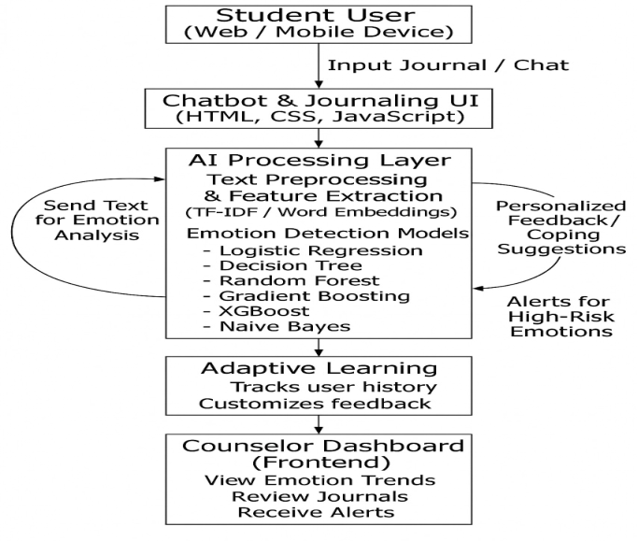
System Architecture

Slide 11
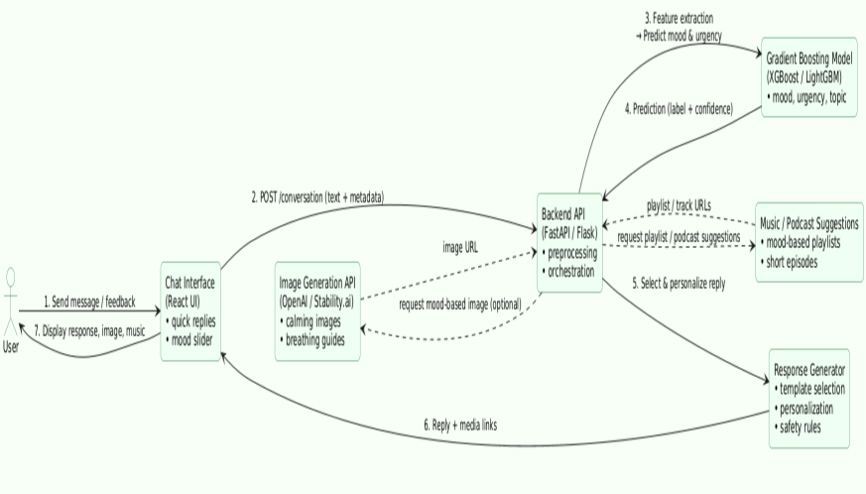
Product Architecture and Design/ Block Diagram

Slide 12
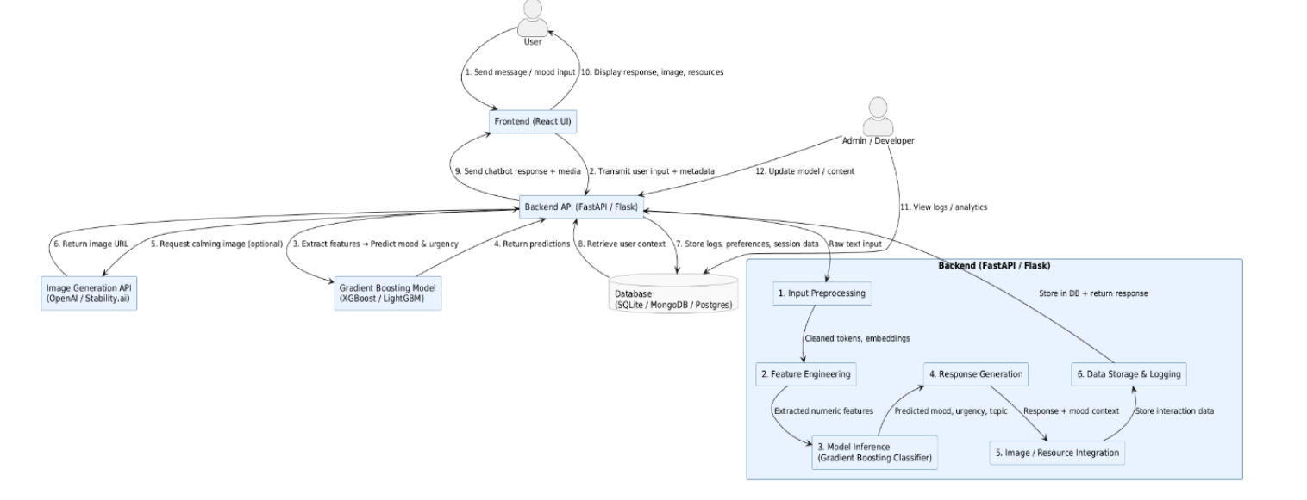
DATA FLOW DIAGRAM
The Level 2 Data Flow Diagram represents detailed interactions between the frontend, backend, and external modules of the Zentora system, showing how user input flows through different processing stages.
❖ The frontend (React UI) captures the user’s messages, mood levels, and media requests, then sends them to the backend through secure API calls while displaying responses and images in real time.
❖ The backend (FastAPI / Flask) performs input preprocessing, feature extraction, and mood prediction using the Gradient Boosting Model (XGBoost / LightGBM) to determine emotional state and urgency.
❖ The system then generates empathetic responses and integrates external media through the Image Generation API (OpenAI / Stability.ai) before sending results back to the frontend.

Slide 13
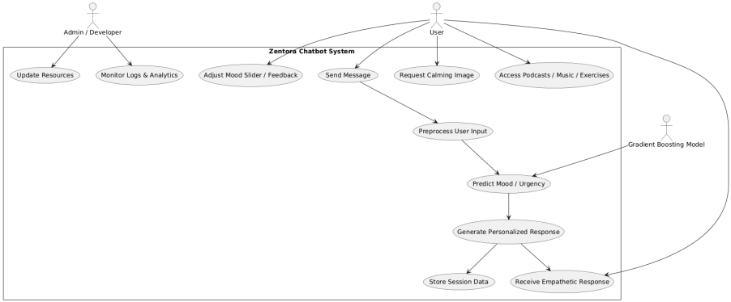
USECASE DIAGRAM
The Zentora Chatbot System involves three main actors — User, Admin/Developer, and the Gradient Boosting Model — each contributing to the chatbot’s functionality and intelligence.
❖ The User interacts with the chatbot by sending messages, adjusting the mood slider, requesting calming images, and accessing mental wellness resources like podcasts, music, or exercises.
❖ The Gradient Boosting Model processes user inputs, predicts the mood and urgency levels, and guides the chatbot to generate empathetic, context-aware responses.
❖ The Admin/Developer oversees the system’s maintenance by updating wellness resources, monitoring logs, analyzing chatbot performance, and improving model accuracy.

Slide 14
TOOLS USED
Real-time Conversational Chatbot: Provides instant, empathetic mental well-being support through natural text-based interaction.
❖ Machine Learning Core (Gradient Boosting Model): Uses XGBoost / LightGBM / CatBoost to predict the user’s mood, emotional state, and urgency, guiding the chatbot’s response generation.
❖ Empathetic Response Engine: Generates human-like replies, motivational affirmations, and coping suggestions for stress or anxiety.
❖ Multimedia Integration: Suggests curated podcasts, music playlists, and produces calming or motivational visuals via an image-generation API.
❖ Frontend (React UI): Displays chat messages, emotion sliders, quick-reply buttons, session history, and generated images.
❖ Backend (Flask / FastAPI API): Handles user requests, performs NLP preprocessing, invokes the gradient boosting model, and returns predictions and responses.
❖ Privacy and Safety Layer: Ensures user data confidentiality through local model inference or secure hosting, with transparent consent and logging mechanisms.

Slide 15
TOOLS USED
GET /resources – Media Access Endpoint: Provides curated podcasts, music playlists, and wellness exercises based on detected mood or emotional category.
❖ Core Backend Components: • Text Preprocessing & Embedding: Cleans and encodes user text using NLP libraries (spaCy, NLTK, SentenceTransformers). • Model Inference (Gradient Boosting): Predicts mood, urgency, and topic via XGBoost / LightGBM for context-aware responses. • Response Generator: Uses predefined templates with personalization and randomization for empathetic, human-like replies. • Image Generation Client: Connects to OpenAI / Stability.ai / Stable Diffusion APIs to produce mood-based visuals and calming images.
❖ Model Server and Feature Management: • Gradient Boosting model (pickle/joblib) is loaded in-process or through a microservice. • Feature store dynamically computes linguistic, sentiment, and contextual features from input text and metadata.
❖ Persistence and Monitoring: • Optional database (SQLite/Postgres) stores anonymized session data and feedback for model improvement. • Logging and analytics track model predictions, performance, and response accuracy for system optimization.
.

Slide 16
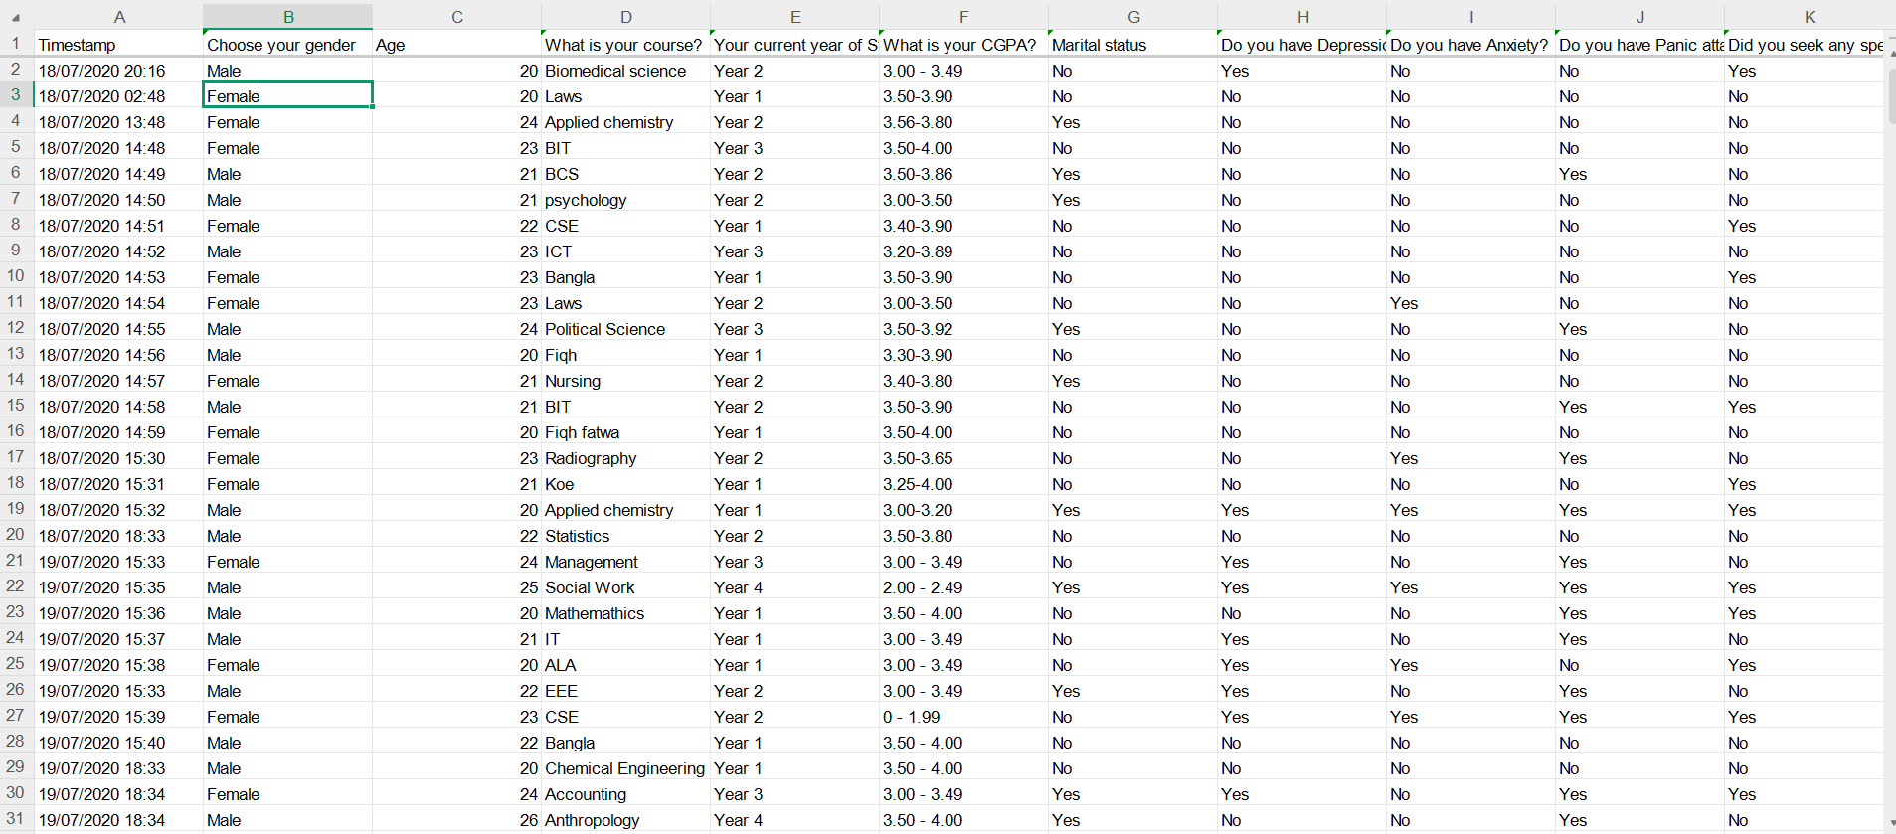
Mental Health Dataset

Slide 17
Dataset Overview: The Student Mental Health (Collection-of-Data) dataset contains responses collected from students to analyze factors influencing mental health conditions such as depression, anxiety, and panic attacks.
❖ Size and Structure: The dataset consists of 399 entries and 12 attributes, covering demographic, academic, and mental health-related information.
❖ Key Features: Includes fields such as gender, age, course, year of study, CGPA, and binary indicators for depression, anxiety, and panic attacks.
❖ Purpose: Designed to identify patterns between academic stressors and mental health conditions among students, serving as input for mood and risk prediction models.
❖ Relevance to Zentora: The dataset helped evaluate and train the Gradient Boosting model to predict mood and emotional state, confirming its high accuracy for mental health classification.

Slide 18
ALGORITHM
User message arrives.
Backend preprocess → extract features → call gradient-boosting model → get predicted
Decision rules:
If urgency == high or predicted_risk_prob > 0.6, escalate: show crisis resources; limit automated counseling; recommend contacting a professional. (Hard safety rule.)
Else: use response buckets (motivation, grounding, breathing, CBT tip, micro-action).
Response generation:
Pick a response template set based on bucket and user context.
Randomly select a template and fill with personalization tokens (name, reference to earlier remark).
Optionally attach a short image (calm scene), a short guided-breathing animation, or a 30-second micro-audio recommendation.
Log prediction, user feedback (thumbs up/down) to retrain later.

Slide 19
Module Description
1. User Interaction Module
Provides a chatbot and journaling interface for students to express emotions freely.
Includes features like quick replies, emotion sliders, and session history.
Offers a safe, user-friendly environment for open communication.
2. NLP & Emotion Detection Module
Uses Natural Language Processing (NLP) to analyze text input.
Detects emotional states such as happiness, sadness, anxiety, or stress.
Extracts linguistic and sentiment features for mood classification.
3. Machine Learning Module
Employs Gradient Boosting algorithms (XGBoost / LightGBM) to predict:
Mood category (calm, sad, anxious, motivated)
Urgency level (low, medium, high)
Topic (motivation, relationships, stress, sleep)
Delivers high predictive accuracy (ROC AUC up to 0.97).

Slide 20
Module Description
4. Response Generation Module
Generates empathetic and human-like responses using pre-defined templates.
Incorporates Cognitive Behavioural Therapy (CBT) and Social Emotional Learning (SEL) principles.
Provides motivational tips, stress-coping techniques, and personalized resources (podcasts, music, images).
Randomizes responses for natural, non-repetitive conversations.
5. Image & Media Generation Module
Integrates image-generation APIs (e.g., OpenAI, Stability AI) to produce:
Calming backgrounds
Breathing animations
Mood-based digital art
Suggests music and podcasts aligned with the detected emotional state.
6. Counsellor Dashboard Module
Displays real-time emotional analytics and student progress.
Helps counsellors identify high-risk cases and provide targeted interventions.
Supports data visualization and secure report generation.
7. Database & monitoring Module
Stores anonymized user interactions, emotional patterns, and session data.
Tracks chatbot performance, model confidence, and user engagement.
Collects feedback (e.g., thumbs up/down) to improve model accuracy.

Slide 21
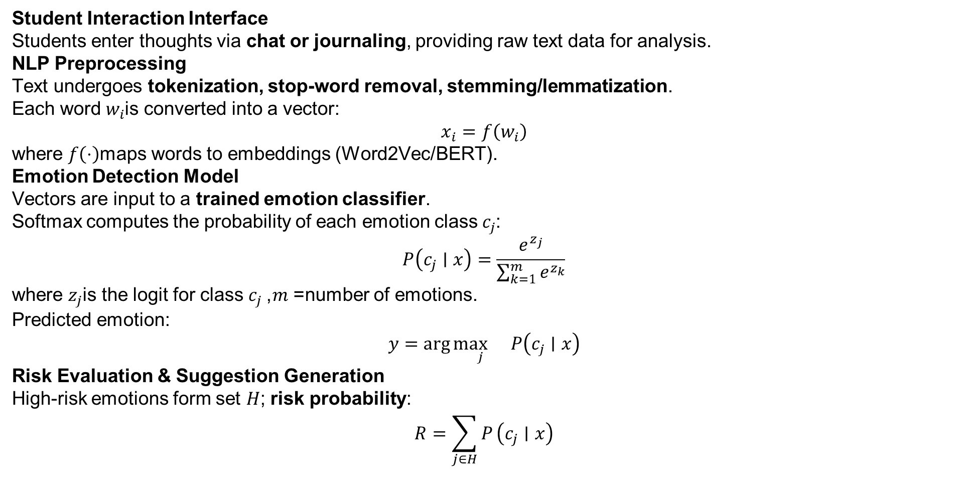
Methodology
Student Interaction Interface
Students enter thoughts via chat or journaling, providing raw text data for analysis.
NLP Preprocessing
Text undergoes tokenization, stop-word removal, stemming/lemmatization.
Each word $w_{i}$is converted into a vector:
$$x_{i}=f\left(w_{i}\right)$$
where $f\left(⋅\right)$maps words to embeddings (Word2Vec/BERT).
Emotion Detection Model
Vectors are input to a trained emotion classifier.
Softmax computes the probability of each emotion class $c_{j}$:
$$P\left(c_{j}∣x\right)=\frac{e^{z_{j}}}{\sum_{k=1}^{m}{e^{z_{k}}}}$$
where $z_{j}$is the logit for class $c_{j}$, $m$= number of emotions.
Predicted emotion:
$$y=\arg{\underset{j}{\max{}}}P\left(c_{j}∣x\right)$$
Risk Evaluation & Suggestion Generation
High-risk emotions form set $H$; risk probability:
$$R=\sum_{j∈H}{P}\left(c_{j}∣x\right)$$

Slide 22
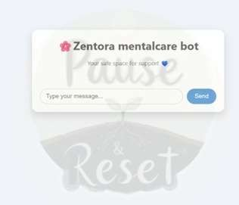
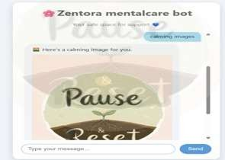
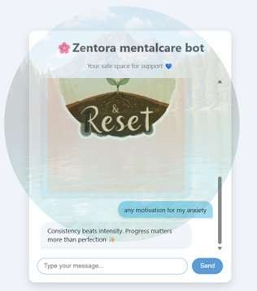
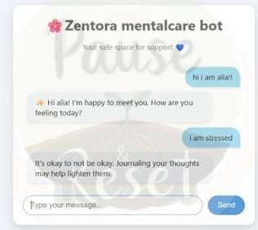
Screenshots

Slide 23
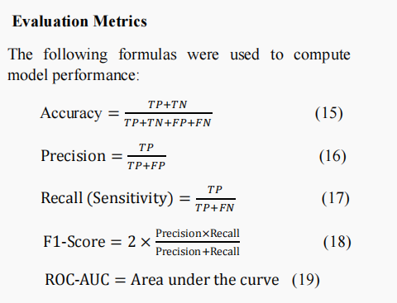
Testing

Slide 24
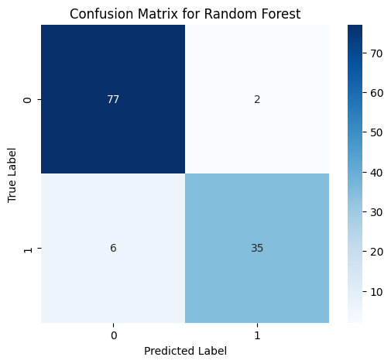
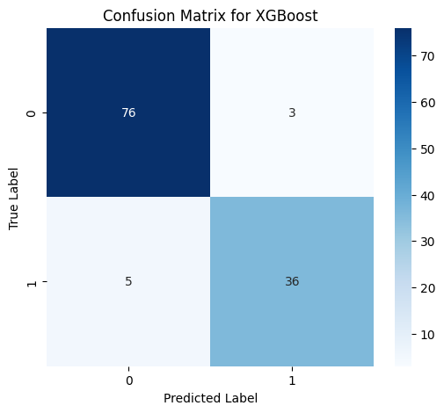


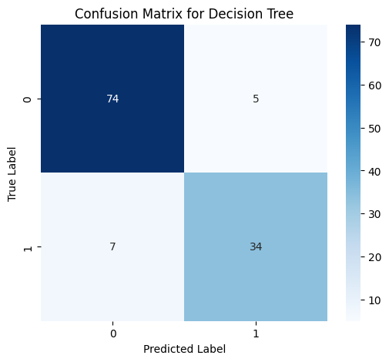

Testing

Slide 25
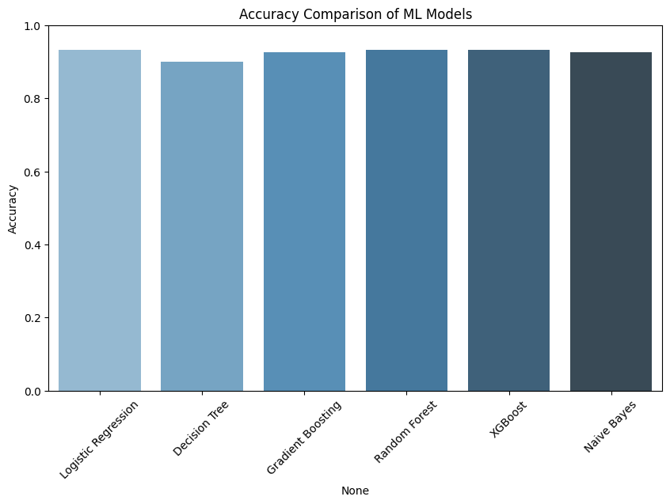
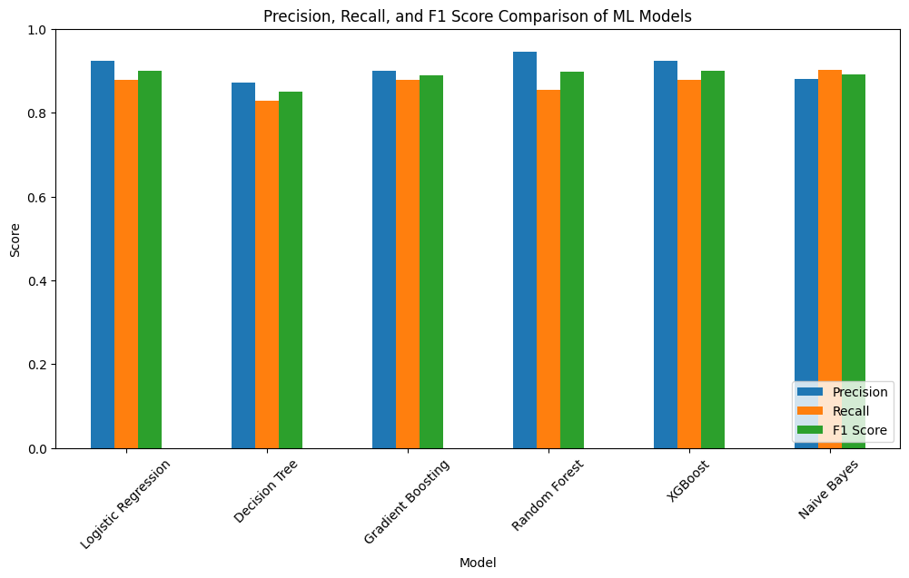
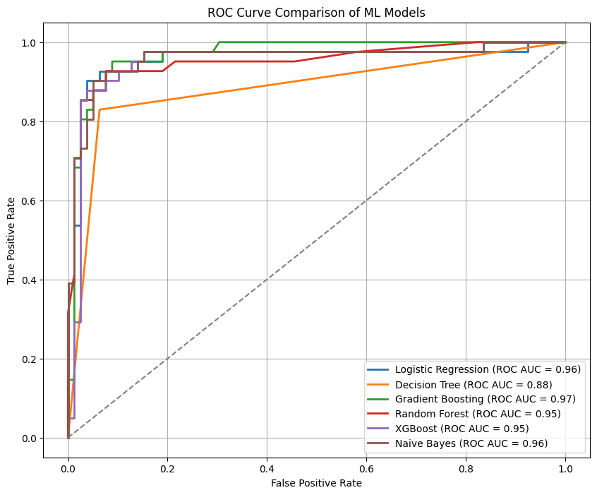
Test Cases

Slide 26
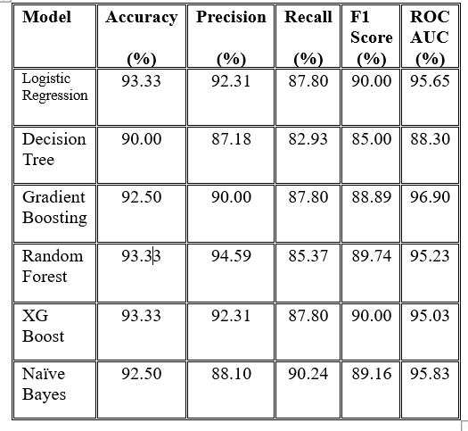
Performance Analysis

Slide 27
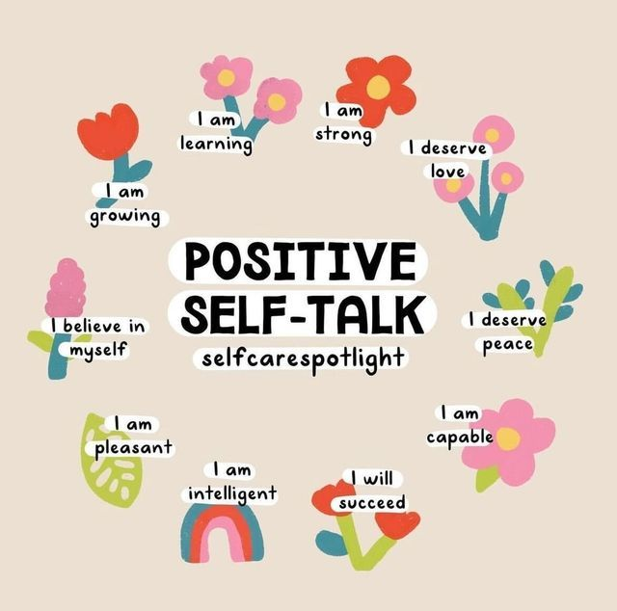
Conclusion and Future Work
❖ The Zentora Chatbot effectively combines Artificial Intelligence and Emotional Intelligence to provide real-time, empathetic mental health support for students. ❖ The Gradient Boosting Model achieved the best accuracy in mood prediction, enabling the chatbot to generate personalized and emotionally aware responses. ❖ Zentora demonstrates the potential of AI to promote mental well-being through technology-driven emotional analysis and compassionate digital interaction. ❖ Future enhancements include voice-based interaction, multilingual support, and mobile integration to make Zentora a more accessible and holistic mental wellness companion.

Slide 28
Reference
1.Limbachia J., Damani Y., Dave S., Sagvekar V., MOODIFY: Multifaceted AI Assistant for Young Adult Mental Health, ICAST 2023, Mumbai, India.
2.Kheterpal A., Gill K.S., AI-Driven Mental Health Interventions: Comparative Study, AECE 2024, Punjab, India.
3.Mary S.X., Prabakaran S., Mental Health Prediction for Metaverse Consumers, ICISS 2025, Chennai, India.
4.Revathi K., Priyanka S., Sumathi P., AI Approaches to Mental Well-Being & Stress Relief, ICMSCI 2025, Coimbatore, India.
5.Hanji B.R., Gupta D., Tone-Heal: AI Conversational Bot for Mental Health, CSITSS 2024, Bengaluru, India.
6.Kaushik P., Parihar S., Enhancing Emotional Support Chatbots Using NLP & Deep Learning, ICAC2N 2024, Chennai, India.
7.Jain E., Kaushik P., Gill K.S., Machine Learning for Mental Health Assessment, NMITCON 2024, Dehradun, India.
8.Benita J., Yuvaraj R., Phoenix: Conversational Agent for Emotional Support, ICMSCI 2025, Krishnankoil, India.
9.Gowroju S., Nakirekanti M., MindBridge: AI Mental Health Platform for Emotional Analysis, OTCON 2025, Hyderabad, India.
10.Jain A., Sandhu R., Role of AI Counselling in Journaling for Mental Health, ICEECT 2024, Phagwara, India

Slide 29
Reference
11.Thakkar R., Trivedi B., Kalbande D., AI-Driven Student Platform for Emotion Discovery & Career Guidance, INOCON 2024, Mumbai, India.
12.Mate A., Narkhede P., Musical Therapy for Stress Reduction Using ML & IoT, MITADTSoCiCon 2024, Pune, India.
13.Al-Atwi H.S., Al-Qarni S.M., AI for Mental Health Analysis of Tweets, ICCIT 2025, Tabuk, Saudi Arabia.
14.Murase S., Andritsch J., Sentiment Analysis to Enhance Mental Health Chatbots, ICCDA 2024, UK.
15.Laxman B.V.S., Enduri M.K., Depression Detection on Social Media Using ML, CICN 2024, Chennai, India.
16.Sri L.P., R. Rivanthika, MindMend: GANs for Therapist Training Scripts, ICEARS 2025, Chennai, India.
17.GalijaSevié D., Skarié M., Podolski E., Advances in AI Chatbots for Mental Health Services, SpliTech 2024, Croatia.
18.Jain A., Sandhu R., AI Counselling in Journaling for Mental Health, ICEECT 2024, Phagwara, India.
19.Chilukuri R.R., Devi B.M., Medarametla L., Enhancing Mental Wellbeing Among College Students Using Autogen, SCEECS 2025, Hyderabad, India.
20.Raja Rao P.B.V., Tejasri T., Mental Wellness Chatbot for Students Using NLP, ICMLAS 2025, Bhimavaram, India.

Slide 30
Thank You

