Slide 1
Eight languages Eight weeks
How I designed and implemented a teaching OO language in 4 days.

Slide 2
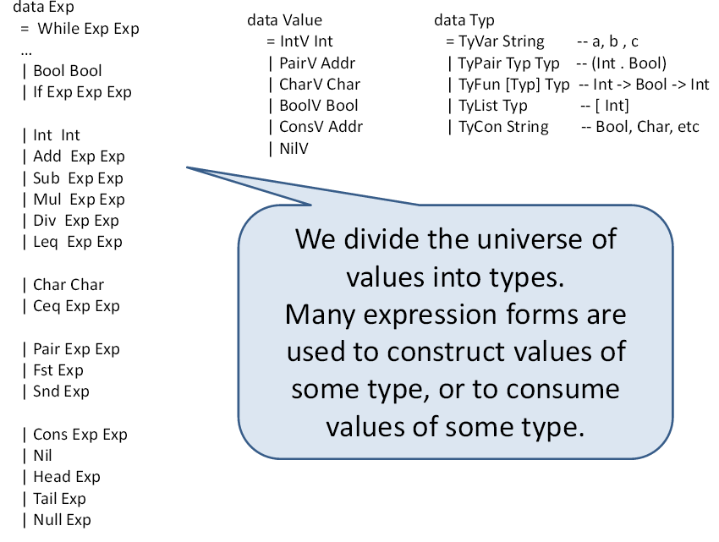
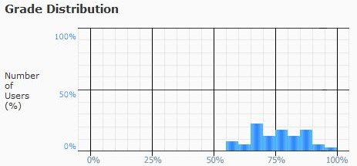
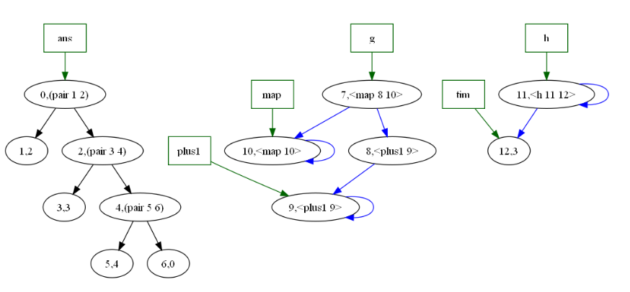
Eight languages, Eight weeks
Exp language
While language
Functional language
Multiple parameter passing
Exceptions
Typed language
Module language
Object Oriented
Garbage collection
prog := exp
exp := var
| int
| '(' ':=' var exp ')'
| '(' 'while' exp exp ')'
| '(' 'if' exp exp exp ')'
| '(' 'write' exp ')'
| '(' 'block' { exp } ')'
| '(' '+' exp exp ')'
| '(' '-' exp exp ')'
| '(' '*' exp exp ')'
| '(' '/' exp exp ')'
| '(' '<=' exp exp ')'
(for i i (block (:= i (+ i 2)) 10) (block (write i) (:= i (+ i 3))))

Slide 3
Friday
Andrew Black and I sit down an discuss “What do students who are studying languages need to understand about OO languages?”

Slide 4
Some thoughts
Objects
Encapsulation
Inheritance
Dynamic Method Binding
Classes
Name binding
Exceptions
Typing

Slide 5
We outlined the semantics of an interpreter
-- Environments
data Env = Env { self:: Object -- The dynamic part
, vars::[(Name,Binding)] -- The static part
}
data Binding = Val Object | Ref Addr | Action Code
data Code
= Prim ([Object] -> State -> IO(Object,State))
| Closure Name (Maybe Object) Env [Name] Exp
-- Semantic objects
data Value = DoneV | BoolV Bool | IntV Int
| StringV String | ExceptV Name deriving (Eq,Ord)
data Object = Obj{ value::(Maybe Value)
, fields::[(Name,Binding)]
, super:: (Maybe Object)}
| Thunk Name (State -> IO(Object,State))
-- The interpretor
eval :: Env -> Exp -> State -> IO (Object, State)

Slide 6
Sketch of abstract Syntax
data Exp
= Var SourcePos Name
| Bool SourcePos Bool -- Literal objects
| Int SourcePos Int
| String SourcePos String
| While Exp Exp -- Control structures
| Write String Exp
| Block [Exp]
| If Exp Exp Exp -- (if x y z) --> (x.ifTrueFalse y z)
| Asgn Exp Exp -- Only to Var not Def.
| Apply Exp [Exp] -- (Apply x y z) ---> (Request x "apply" y z)
| Lam [Name] Exp -- (\ ( a b c) e) this object has one method: apply
| Local [Decl] Exp
| ObjLit (Maybe Exp) [Decl] (Maybe Exp)
| Request Exp Name [Exp] -- (exp.field e1 e2 e3) set a handler for field.
| Return String Exp -- (return f x) return from the enclosing method f
| Self SourcePos
| Done SourcePos
| EmptyObj SourcePos
| Super SourcePos
| Op String [Exp] -- (+ 4 5 6 7) --> (((4.+ 5).+ 6).+ 7)

Slide 7
Binding
Methods introduce parameters which are statically scoped.
Should there be other ways of binding objects to names?
Inspiration. Let blocks and objects are different manifestations of binding.

Slide 8
Semantic Similarities
Both introduce mutually recursive set of declarations.
But
Let introduces a new local (static) scope which extends only over the the mutually recursive bindings and the body of the let. The body is executed. The value of the let is the value of the body.
Object encapsulates a new scope, it introduces no bindings at all. Each binding is reachable from the others via projection from “self”, the object itself. We run the body only to initialize the scope, and the value returned is the object itself.

Slide 9
Syntatctic Similarities
data Exp m= …
| Local [Decl] Exp
| ObjLit (Maybe Exp) [Decl] (Maybe Exp)
data Decl
= MethodDecl Name [Name] Exp -- procedure
| DefDecl Name Exp -- Immutable
| VarDecl Name (Maybe Exp) -- Mutable

Slide 10
Names
Let bound names and object fields live in two completely different name spaces.
They have two different roles.
Let bound names, name objects
Object fields select fields.
We use different key words in different contexts
Let (names) Object (fields)
fun method
val def
ref var

Slide 11
Examples
(fun plus2 (x) (+ x 2))
(val tim 99)
(ref tom)
(val test
(object
(var x)
(def color “red”)
(method inc () (:= (self.x) (self.x.(+ 1))))
init
(:= (self.x) 99)))

Slide 12
Invocation
Method request
(x . length)
(x .+ 4)
(x .(+ 4) . even)
Function invocation
(@ f x 3)
(f.apply x 3)
Operator invocation
(+ 3 4 5)
((3.+ 4).+ 5)

Slide 13
Let binding
run (Local ds body) state =
do { (bindings,state1) <-
fixIO (evalRec (Just (self env))
(ext env) –- extend static scope
ds ([],state))
; (bindings2,state2) <-
initialize state1 bindings
; eval (ext env bindings2) body state2}

Slide 14
Object creation
run (ObjLit parent ms init) state =
do { … -- inheritance stuff
; let extend allBs = -- extend dynamic scope
env{self=(Obj val
(allBs ++ inheritedms)
super)}
; (allBs,st1) <-
fixIO (evalRec Nothing extend ms ([],st0))
; let selfObj =
Obj val
(reverse allBs ++ inheritedms)
super
; … -- initializtion stuff
; return(selfObj,…)}

Slide 15
Encapsulation
(fun pair ( x y)
(object (def fst x)
(def snd y)
(method asString ( )
(++ "(" (self.fst.asString) ","
(self.snd.asString) ")"))))
An object is described by what requests it responds to (fst,snd)

Slide 16
Inheritance
(val bool
(object
(def true
(object
inherits True
(method and (x) x)
(method or (x) self)
(method not () (bool.false))
(method ifTrueFalse (x y) (x.apply))
))
(def false
(object
inherits False
(method and (x) self)
(method or (x) x)
(method not () (bool.true))
(method ifTrueFalse (x y) (y.apply))
))
))

Slide 17
Dynamic method binding
(val i3
(object inherits done
(def x 5)
(def y 3)
(method asString ()
(++ (super.asString)
" + "
(self.x.asString)
" + "
(self.y.asString)))))
enter Exp>
i3
done[x 5[+ <prim>,
- <prim>,
* <prim>,
/ <prim>,
asString <prim>,
= <prim>,
<= <prim>],
y 3[+ <prim>,
- <prim>,
* <prim>,
/ <prim>,
asString <prim>,
= <prim>,
<= <prim>],
asString <asString>,
asString <prim>]
Which asString method does it answer to?

Slide 18
Name Binding vs record field declaration
(fun temp (x y)
(local (val hidden x)
(object (def age y)
(method foo (w)
(+ hidden (self.age) w)))))
(val tt (@temp 4 7))

Slide 19
Exceptions
(fun elem (x xs)
(local (ref ptr xs)
(block (while (@not (ptr.null))
(if (ptr.head.= x)
(return elem 99)
(:= ptr (ptr.tail))))
0)))

