Slide 1
DUA_pptx

Slide 2
Overview
Create measure of data use by academia for each country
Train machine learning model on 900 human coded articles
87% accuracy when tested against hold-out set of 2,600 human coded articles
Country rankings correlated 0.99
Apply to corpus of 1 million academic articles
Database: Semantic Scholar (s2orc)
Language: English
Time period: 2000-2020
Subjects: Medicine, Economics, Psychology, Sociology, Political Science

Slide 3
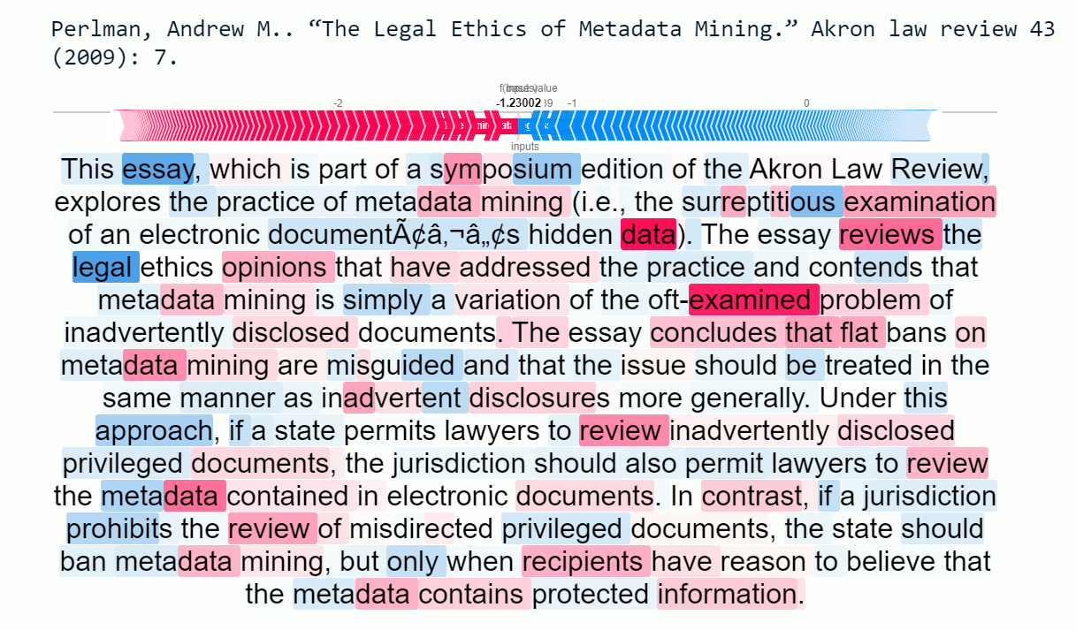
Articles Example - No Data Use

Slide 4
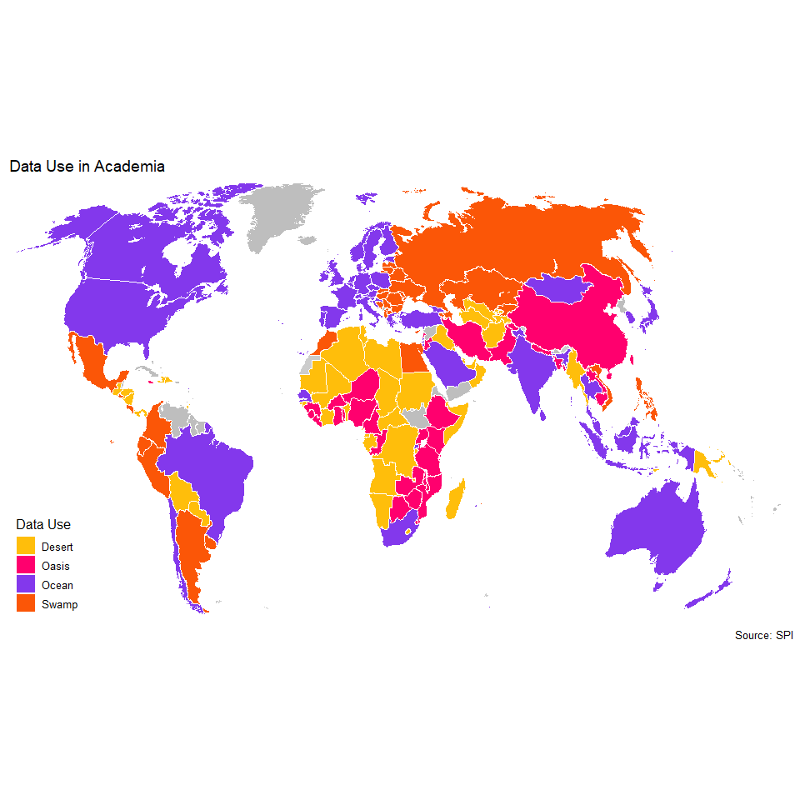
Research Deserts, Oasis, Oceans, and Swamps

