Slide 1
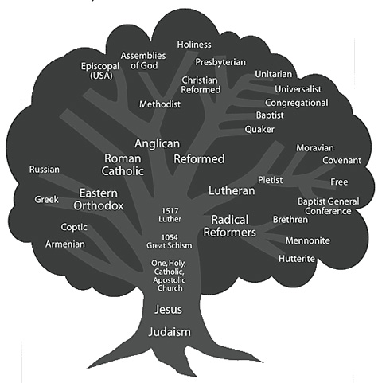

Slide 2
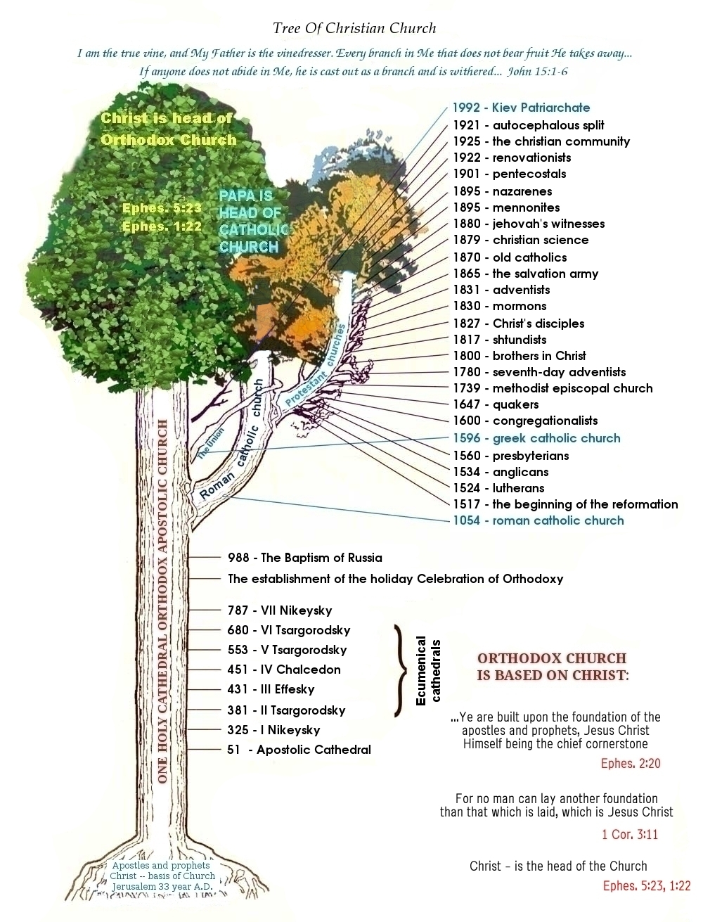
When we talk history, we must also consider perspective…
https://rarebible.wordpress.com/2014/07/01/the-christian-fairy-tale-vs-scholarly-christianity/

Slide 3
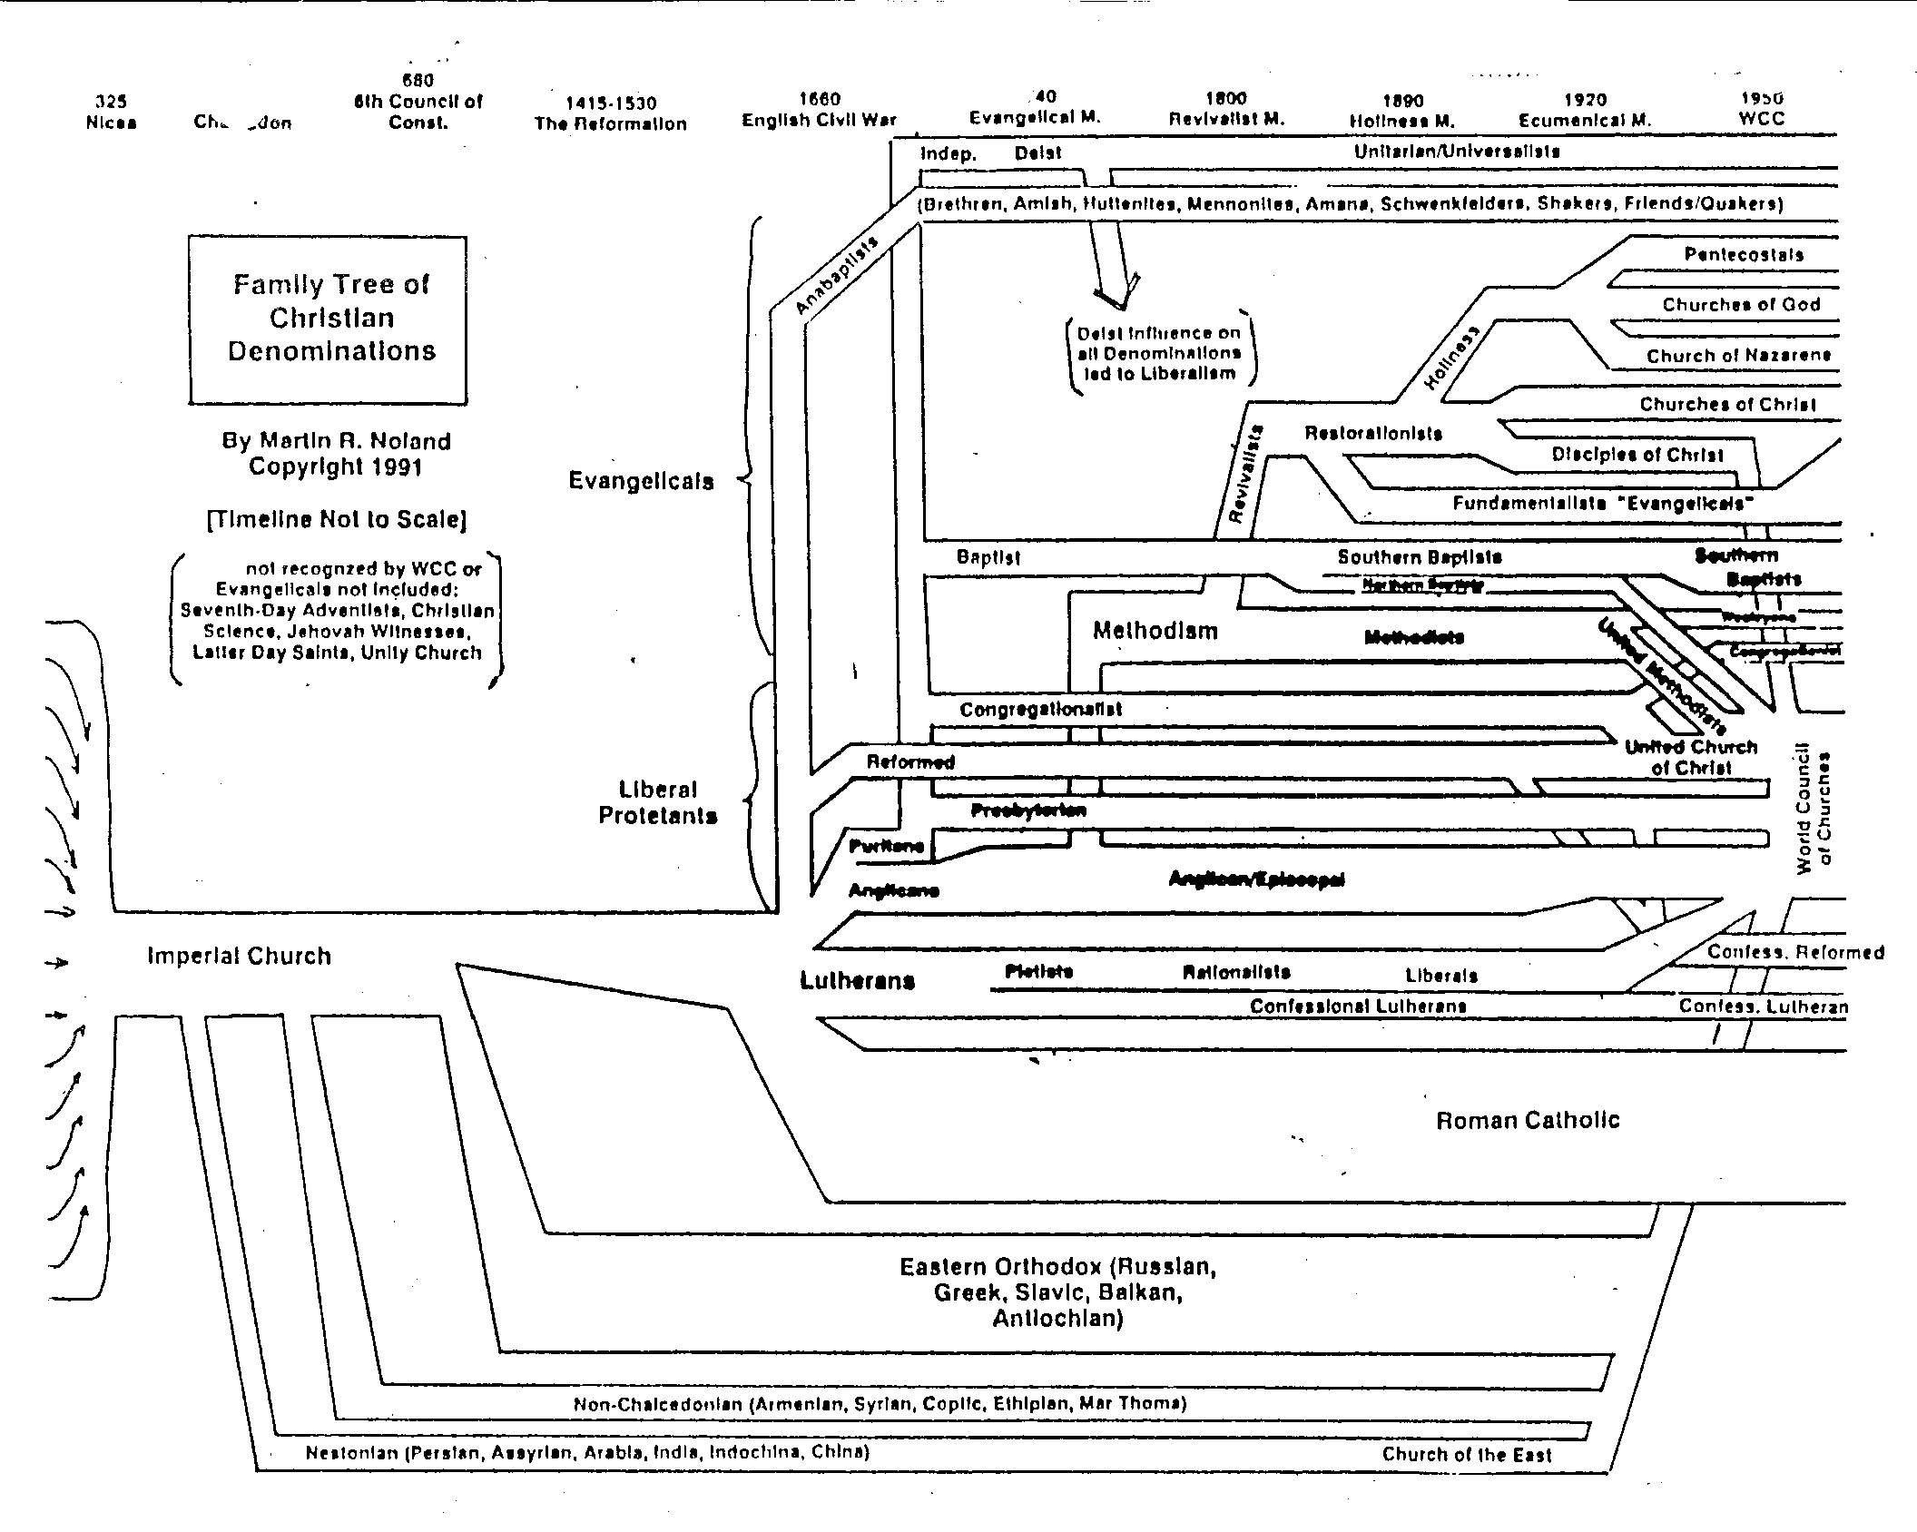
From: https://rarebible.files.wordpress.com/2014/07/best_church_tree.jpg Also check out: https://000024.org/religions_tree/religions_tree_8.html

Slide 4
Doctrinalist:
What do we believe?
“strong adherence to certain Christian doctrines as taught in the Scriptures and reflected in the confessions of the church”
Transformationalist:
How do we relate the gospel to the world?
“the relationship of Christianity to culture, to a world-and-life view, and to Christ as trans- forming culture.”
Pietist:
Personal relationship to God; How do we experience God in our daily walk of faith?
3 CRCNA
“Minds”

Slide 5
The “Reformed Accent”
All quotes from here on are from the CRCNA booklet, “What it means to be Reformed: An identity statement” (available on Moodle)

Slide 6
Doctrinal Distinctives
SCRIPTURE: Sola scriptura. 2 Timothy 3:16-17; 2 Peter 1:20-21
“Reformed Christians have a high view of Scripture. They believe that the Bible is the inspired, infallible, authoritative Word of God.”
inspired: “God himself speaking by his Holy Spirit through human authors”
“Infallible means that the Scriptures are true and absolutely unfailing in matters of faith and practice"
Authoritative: “Believers live ‘under,’ and are called to obey, God’s Word.”
CREATION-FALL-REDEMPTION: Colossians 1:15-20, Genesis 1:26-27
“a basic Re- formed way of organizing and understand- ing the Bible and its message, and of under- standing history. God created the world; the world fell into sin; God has redeemed and is redeeming the world through the work of Christ, a redemption that will one day be complete when God creates a new heaven and new earth.”
How we are created: “The biblical teaching that human beings are image bearers of God is pivotal for knowing ourselves and knowing God.”

Slide 7
Doctrinal Distinctives
GRACE: Ephesians 2:8-10; Romans 8:29-30, 35-39; John 6:44
“Grace is the unmerited favor of God toward those who do not deserve it. Grace is the unconditional and freely given love of God to people who can do nothing to earn it but can only accept it as a gift.”
“Grace is the astounding truth that nothing we do can make God love us more or less…. when Reformed folks have talked about grace, they have stressed how much salvation is a gift of God, not a human achievement.”
COVENANT: Jeremiah 31:31-34
Reformed Christians “see the Old Testament and the New Testament as revealing one covenant of grace—a single covenant beginning with God’s promise to Adam and Eve that he would crush the head of the serpent and spanning to the new city of God described in Revelation 22.”
“The concept of covenant—God binding himself to his people in promise and commitment—is a rich concept for understanding God’s saving activity today. In worship, God renews his covenant promises to us, and we renew our covenant vows to God. Preaching declares and offers the covenant promises of God. The Lord’s Supper is a sign of God’s new covenant. In baptism God promises to be faithful to our children. Fellow members of the church make promises to God and one another. Together these promises form a thick web of commitments, of communal connection that we know as the body of Christ, the church.”

Slide 8
Doctrinal Distinctives
COMMON GRACE: Matthew 5:43-48
“divine favor that extends to humanity in general; to believers and unbelievers alike.”
“God restrains sin in all people. Because of sin, human beings are not as good as they could be; but because of common grace, they are not as bad as they could be either.”
“Common grace reminds Christians that the conflict of this age (what Abraham Kuyper called the “antithesis”) is between God and Satan, not between Christians and non-Christians. The battle is not between two groups of people but between two spiritual powers, which, significantly, reside in and cut through every person.

Slide 9
Pietist Distinctives
PERSONAL RELATIONSHIP TO JESUS: Romans 8:38-39
Reformed “pastors often use the first question and answer of the Heidelberg Catechism to remind them of the heart of their faith: ‘What is your only comfort in life and in death? That I am not my own, but belong, body and soul, in life and in death, to my faithful Savior Jesus Christ.’ The heart of our faith is our personal relationship to Jesus Christ.”
“While Reformed Christians always see the work of Christ as encompassing more than the believer’s personal relationship to Jesus Christ, they never see it as less than this personal union with Christ.”
THE HOLY SPIRIT: Romans 8:1-17
“Biblical Christians seek a proper and balanced appreciation for the work of all three persons of the Godhead…The Holy Spirit is the giver of spiritual life; the one who is renewing believers to be like Christ; the one who gives believers his fruit— love, joy, peace, patience, kindness, goodness, gentleness, faithfulness, self-control; and the one who gives gifts to the church to empower ministry.”

Slide 10
Pietist Distinctives
GRATITUDE: Colossians 3: 15-17
“What motivates the believer? What is the root disposition that empowers everything one does in the Christian life? The Bible’s answer, and a Reformed emphasis, is gratitude-not guilt, not fear, not the obligation of law, but gratitude. The whole Christian life is an acting out of one response: Thank you!”
THE CHURCH: Ephesians 4:1-16, Ephesians 2:14-18, 1 Peter 2:9
“When Reformed people talk about the Christian life, they very quickly begin talking about the church. Reformed Christians hold strongly that to belong to Christ is to belong to those who belong to Christ…While a personal relationship to Jesus Christ and the indwelling presence of the Holy Spirit are an important part of the Christian experience, that relationship with Christ and the Spirit is fleshed out in the church, the covenant community of believers”
WORD AND SACRAMENT: Romans 10:14-15; Matthew 28:16-20; 1 Corinthians 11:23-26
“For Reformed Christians, the heart of Christian worship is the preaching of the Word and the celebration of the sacraments.”
Sacraments: communion and baptism; both involve both our action and God’s but both begin with God’s action

Slide 11
Transformational Distinctives
JESUS IS LORD: Philippians 2:11, Isaiah 52:7, Matthew 28:18, Ephesians 1:20-21
“The secular worldview, which is the air one breathes today in North America, would have Christians believe that the world is really split in two, split between the sacred and the secular…Reformed Christians strongly reject this sacred- secular dualism and declare that Jesus is Lord of all things.”
KINGDOM: Matthew 6:10, Mark 1:14-15, Micah 6:8
“The kingdom of God is the rule of God over all things. God is king. He is sovereign. He reigns…The kingdom is both a present and a future reality. It is “already now” and “not yet.” Jesus said the kingdom is at hand; he also prayed for the kingdom to come.”
“Closely related to an emphasis upon the kingdom is a commitment to seek justice in society…Christians construe God’s call to love as apply- ing to the personal relationships Christians have with people within the communities in which they live; whereas justice is something that Christians can seek for all people every- where.”

Slide 12
Transformational Distinctives
WORD AND DEED: James 2:14-17
“The church’s mission has a word (proclamation) component; it also has a deed (action) component…The church cannot divide the ministry of word and deed, and it certainly cannot choose between them.”
CULTURAL MANDATE: Genesis 1:27-28, Psalm 8:5-6, Psalm 19:1
“God gave Adam and Eve a position of dominion over the whole earth, a position that included the power to name, which, in significant ways, is the power to create.”
“The point here is not that human beings are in control and can do anything they want. The point is not that people can dominate and exploit. It’s quite the opposite. Human beings are appointed stewards; they are responsible to make the most out of this great world God has created.”
“When the book of science appears to conflict with the book of Scripture, Reformed Christians reread and study both books to see where they are misreading. Ultimately, these two books can’t contradict each other because God is the author of both.”

Slide 13
Transformational Distinctives
CHRISTIAN EDUCATION: Proverbs 9:10, Colossians 1:15-17
“Historically the CRC in particular has emphasized the importance of Christian education not only in home and church but also in educational institutions—elementary, high school, college, and university. Because Christ is Lord of all of life, including all spheres of learning, all education must be God-centered. In this understanding of the integration of faith and learning, God should not be left out of education at any level.”
“Christian schools started by Reformed Christians are built upon a positive vision: Learning is rooted in Christ. At the same time, they are not opposed to public education. As public citizens, Reformed Christians are typically very supportive of the local public education system…isolation is not the goal and in fact must be resisted at every turn.”

Slide 14
Transformational Distinctives
CHRISTIAN VOCATION: Ephesians 4:1
“The entire life of the Christian—not just on Sunday and not just church life—is a divine vocation, a response to God’s call to follow Christ.”
“Many people who hear the word Calvinist immediately think of ‘the Calvinist work ethic,’ an ethic of working hard, working honestly, and taking pride in one’s work. That work ethic is rooted in the Calvinist conviction that all human work—whether one calls it a job, a career, or a calling, whether it is high-powered or simple, high-paying or nonpaying—is a response to God’s call and is part of fulfilling God’s mandate to rule the earth and Christ’s command to follow him.”

