Slide 1
GRC Synthesis: Heaven & Immigration
CORE 100-04, Oct 9, 2024

Slide 2

Amanda Benckhuysen

Slide 3
Essay #2: Christian Perspectives

Slide 4
Reformed theology: Primacy of Scripture
Belgic Confession Article 2: The means by which we know God
Calvin’s Commentary on Hebrews: “sparks” of God’s glory…

Slide 5
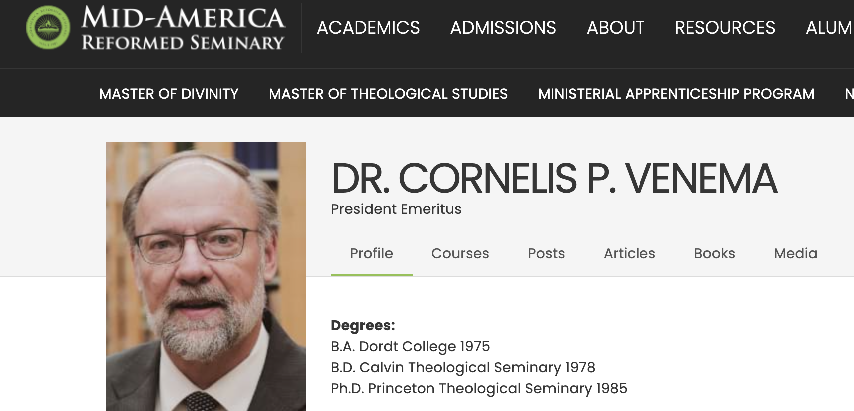
The new heavens and the new earth (bonus reading)

Slide 6
Surprised by Hope Chapter 12
In Chapter 12, Wright argues that the resurrection not only promises hope for the future (the next life) but also hope for the present. Find one quote from the first 5 pages of the chapter that communicates this idea best to you. Explain why you chose that quote.
Regarding Salvation, Wright reports that the normal Western Christian view (salvation is about “my relationship with God” in the present and about “going home to God and finding peace” in the future) is not what the New Testament teaches. What then does he claim is a better understanding of salvation? Try to put his thoughts in your own words.
What are the three most important things you learned about “the kingdom of God” from Wright’s teaching in chapter 12?
What is Wright’s “baseball analogy” from p. 200? Explain.

Slide 7
Surprised by Hope Chapter 13: Write-around
You will get one question. Write for 2 minutes…
Then pass it on! Read/write for 3 minutes.
Again, pass, then read/write 3 more minutes
Last round: pass, read. Choose one thing to share.

Slide 8
Immigration Debates
Imagine Benckhuysen had been able to join in the DIFA podcast conversation. What do you think she would have added or amplified? (Basically, this question asks you to compare and contrast Benckhuysen’s points and style with the ones Dykstra-Pruim, Katerberg, and Washington make in their conversation.)
Choose a point or a key quote from Wright or Venema, and explain how it relates to a point made in the podcast or video (on immigration), or otherwise could add depth and nuance to a conversation about immigration in the USA right now. (Basically: what connections can you find between Wright/Venema and today’s other GRC materials?)

