Slide 1
Love Across Diversity & Difference Case for Reparations?
CORE – 100 – 04
Sept 30, 2024

Slide 2
THIS WEDNESDAY, Oct 2: Structured Dialogue #1 (practice) Come only at your group’s time; may stay 5-10 min. after
11:00 – 11:10: Jaden, Will, Nathan, Ronald, Valeria, Olivia
11:15 – 11:25: Dean, Annelise, Alexis, Jimmy, Tanner
11:30 – 11:40: Leah, Luke, Nicholas, Brooke, Ava, Josh
11:45 – 12:00: Lily, Lilroy, Emma, Andy, Ben, Kaylynn

Slide 3
Example Prompt
Explain how the combination of history, data analysis, and graphics work together to help Coates make his points more convincing. (Or, if you think one of the three is out of place or ineffective, explain why.) Support your views with specific examples from the piece.
Goals: Stick to text; listen, question; respectfully explore disagreement

Slide 4
Structured Dialogs: Process
Your team of 5-6 students will discuss for 10 minutes (practice dialog) or 12-15 minutes (final dialog)
Prof will listen only
Preparation is allowed
Make sure to invite more-hesitant team members into conversation
Contribute without dominating
Converse rather than waiting your turn to make your point
Practice questioning and discourse!
After the conversation you’ll be given the name of 1 teammate. In ~5-10 minutes you’re asked to summarize their contributions in 0.5-1 page
Be honest but generous
Include specific examples and details

Slide 5
Today: Practice for the practice
Warm-up with your team
Elect 2 teammates to do 2 “demo” dialogs
Take notes!
Plan your questions/comments
During each demo dialog, those not speaking will assess
You may need to write a summary of one person’s points
You may keep track of each person’s contributions

Slide 6
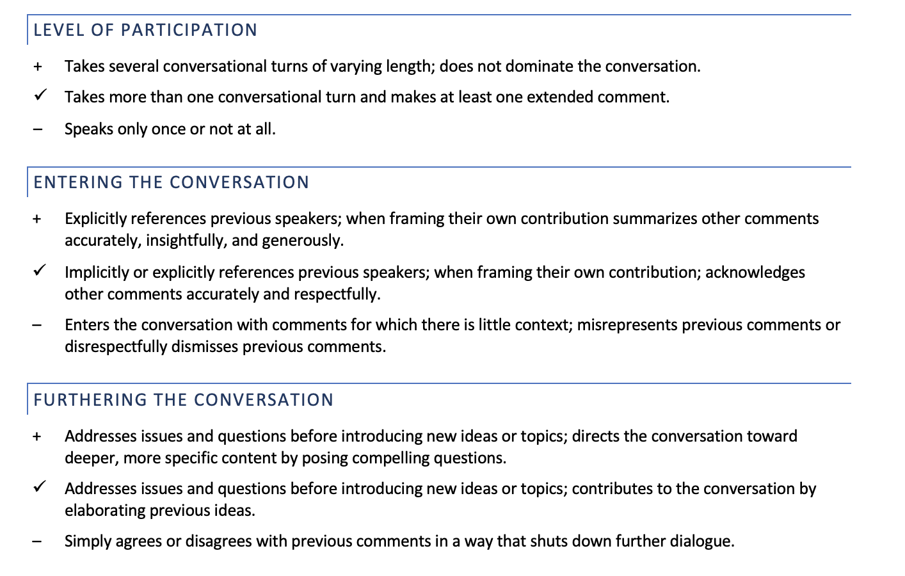

Slide 7
Today’s Discussion Prompts (small groups)
Which points from Coates and/or the videos did you find most convincing, and why? Identify a quote, example or explanation from Coates that helped you a point from one of the videos more deeply, or a point from a video that helped you to better understand Coates
Explain how the combination of history, data analysis, and graphics work together to help Coates make his points more convincing. (Or, if you think one of the three is out of place or ineffective, explain why.) Support your views with specific examples from the piece.
Coates' piece jumps around in time -- it doesn't start with the earliest history and then move forward to the present day. Instead, Coates juxtaposes events from different times to emphasize connections between them and make his points. Find an example (where he presents events or examples from different times, together); describe and explore it, trying to understand why Coates chose the combination he did.
What quote from Coates’ piece resonates most strongly with you? Explain what you think he means by it, and why it seems important or right to you.
What quote from Coates’ pieces troubles, confuses, or riles you the most? Explain what you think he means by it, and why it affects you as it does.
What connections do you find between Coates’ work and other course materials so far?

Slide 8
Today’s Discussion Prompts (small groups)
2 Explain how the combination of history, data analysis, and graphics work together to help Coates make his points more convincing. (Or, if you think one of the three is out of place or ineffective, explain why.) Support your views with specific examples from the piece.
4 What quote from Coates’ piece resonates most strongly with you? Explain what you think he means by it, and why it seems important or right to you.

Slide 9
Structured Dialog Preparation (for Wednesday) Discussion Prompts (Your team will choose the ones you prefer to discuss!)
Drawing on what you learned from today's materials, imagine Smith and Dykstra-Prium's answer to the question, "Why should Christians learn about Global Regions & Cultures?" Be sure to include citations as appropriate -- for the video, ideally give the approximate timestamp of the material being cited.
What does Adichie mean when she talks about a “single story”? Have you experience people who seem to believe a “single story” about you? How can you connect these experiences with a point from the Dykstra-Pruim conversation, or Riley’s “Dignity”?
Before, we discussed what Riley’s piece had to say about the meaning of humans being created in God’s image. What connections do you see between her articulation of what “God’s image” means, and the points that Adichie, Smith, of Dykstra-Pruim make?
Today's materials warn about the pitfalls of partial knowledge (particularly of those from other cultures). Can you think of an example -- related somehow to culture, whether international or a sub- or micro-culture within your own community -- of when you thought you understood something only to find out later that you misunderstood? How did you come to a deeper knowledge? What did it take to bring you there?
Compare and contrast today's materials. What common threads do you notice? Any important differences? Did you appreciate or learn from one more (because of the medium, written vs video; or the presentation style; or the identity/experience of the author(s); or the method of argument; or the tone; or...?)
Compare and contrast a position that Dykstra-Pruim or Smith takes in the video conversation with a specific quote exemplifying a position of one earlier course author (ideas: Wright, Augustine, Jamie Smith, Kimmerer, Warners, Al-Attas Bradford…).
Compare and contrast a point Adichie makes in her talk with a specific quote exemplifying a position of one earlier course author (ideas: Riley, Wright, Augustine, Jamie Smith, Kimmerer, Warners, Al-Attas Bradford…).
In their conversation, Dykstra-Pruim and Smith talk about some familiar bible stories that they were able to understand in totally new ways in light of cross-cultural experiences. Give and example that struck you. What do you take away from the story? How might it relate to other authors whose work we’ve read so far?
You are invited to add additional questions or points to discuss on your own, too! Keep these grounded in course readings, though…

