Slide 1
Bibliometric Analysis
of AI Research
Viktor Korotkov · Arystan Kamalov · Shitao Zhao
emlyon & ecole centrale| 2025
Peak: 16,867 papers published in 2024

Slide 2
20 min + 5 min Q&A
1. Agenda
1
Introduction & Big Data Context
2
Data Collection — SPARQL Queries
13 queries from DBLP endpoint
3
Geography of Research
4
Authors & Scientific Community
5
Institutions & Universities
6
Research Quality and Impact
7
Evolution of Science & Trends
8
Data Limitations
—
Publication Trends & Thematic Structure
—
Key Findings & Conclusions
Our bibliometric analysis

Slide 3
2. Big Data Context
Volume
Veracity
Variety
Thousands of papers
across multiple venues
over several decades
New papers published
continuously each year
— peak 16,867 in 2024
Multiple sources,
formats, topics,
venues, and authors
Why we did this project
"Rather than adding to the subjective noise around the 'AI boom,' this project uses real bibliometric data to objectively trace how the field has actually evolved — mapping shifts in research hotspots and the respective roles of academia and industry."

Slide 4
3. Data Sources & SPARQL Pipeline
DBLP — Primary Source
Query Summary (from report)
Q1
Pubs per year (7 venues)
(52, 2)
✓ 13 SPARQL queries executed
Q2
Pubs per topic (13 venues, 4 buckets)
(13, 2)
Q3
Topic × year time series
(64, 3)
✓ 483,361 paper–author pairs (Query 5)
Q4
Paper–affiliation pairs
(175K, 3)
Q5
Paper–author pairs
(483K, 3)
✓ 175,346 paper–affiliation pairs (Query 4)
Q6
Paper–affiliation–venue triples
(175K, 4)
Q7–8
Journals & conferences ranked
—
✓ Covers NeurIPS, ICML, ICLR, CVPR, ICCV, ECCV, ACL, EMNLP, NAACL, AAAI, IJCAI, KR, ISWC
Q9
Citation impact by subtopic
(9, 3)
Q10
Subtopic emergence timeline
—
Q11
Fundamental vs Applied split
(2, 3)
Q12–13
Metadata coverage audits
—
Full query list: github.com/stacyshki/Big-Data-and-AI-Publications-Analysis

Slide 5
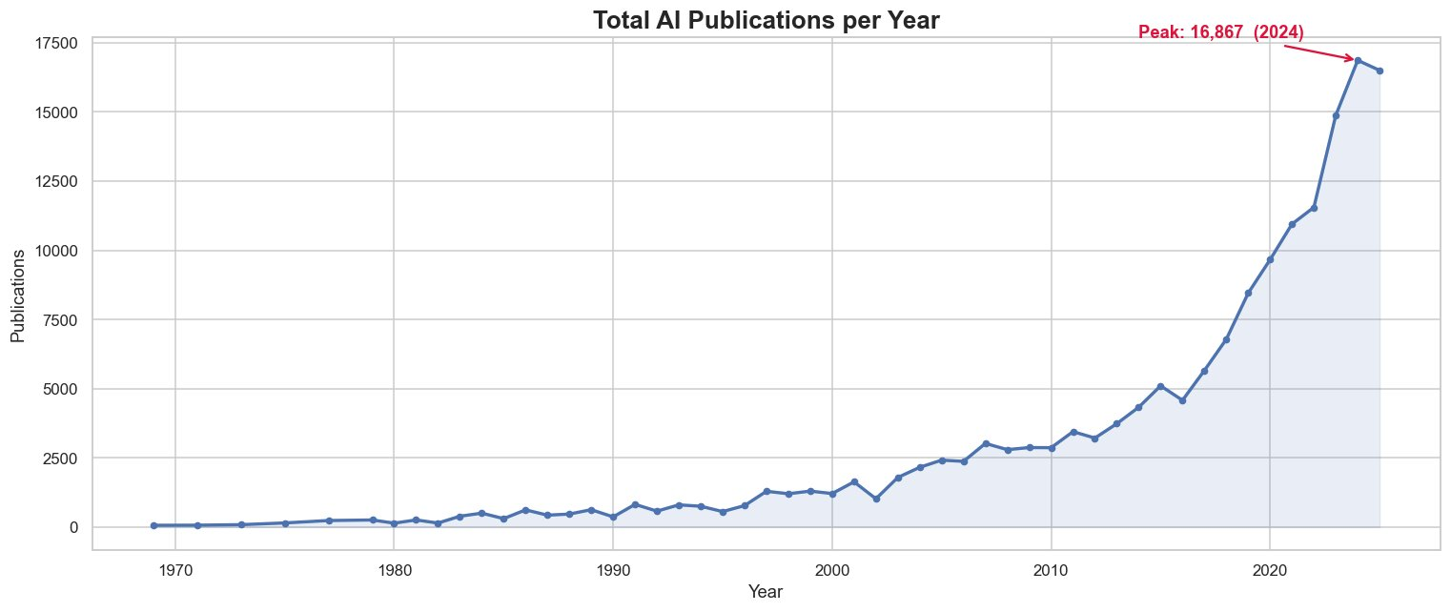
4. Publication Trends (1970–2025)
1970–2000
2000–2012
2012–2024
Early exploration
Steady growth
Exponential phase
Deep learning era

Slide 6
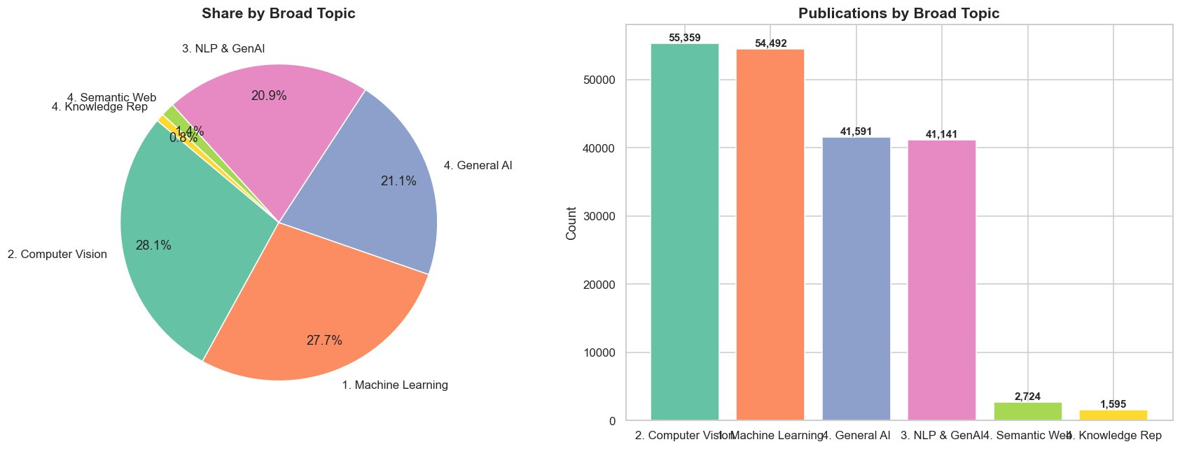
5. Thematic Structure — Topic Distribution & Evolution
Computer Vision
Machine Learning
General AI
NLP & GenAI
28.1% | 55,359
27.7% | 54,492
21.1% | 41,591
20.9% | 41,141

Slide 7
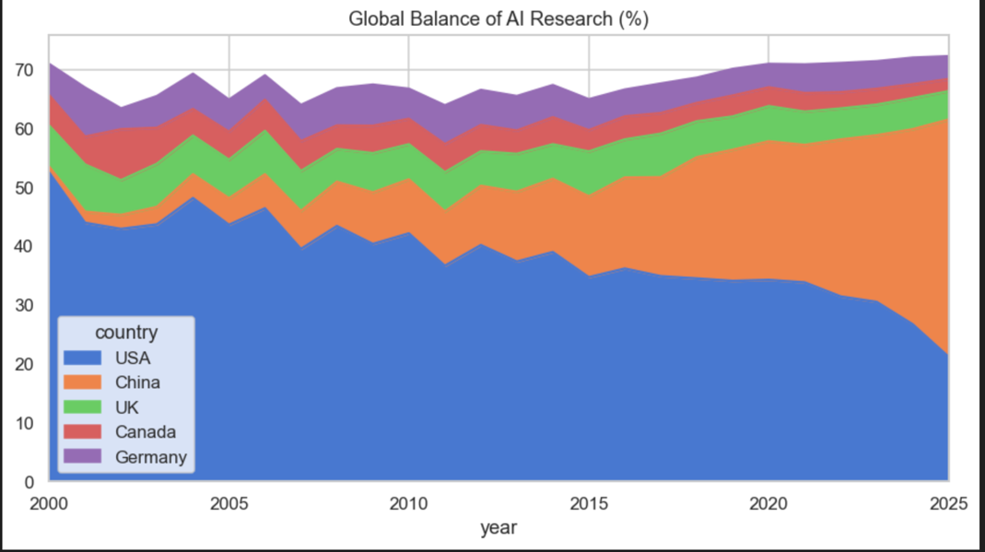
6. Geography of Research — Global Output
US leads historically (36,232 publications), China second (25,219). UK: 6,413, Germany: 5,318. Post-2023 China overtook the US in annual output. In 2000 the US held ~50% of top-tier research share; by 2025 that contracted to ~20%.

Slide 8
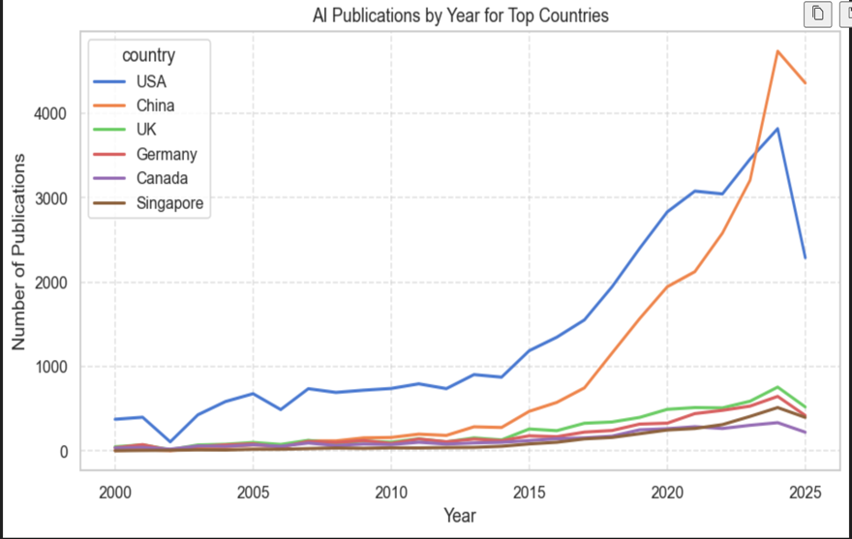
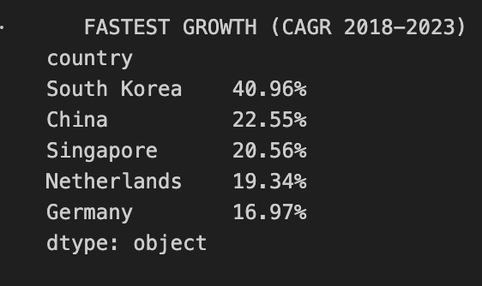
7. Geography — Growth Trends & Shifting Balance
2018–2023 CAGR
South Korea 40.96%
China 22.55%
Singapore 20.56%
Asia's rise is structural. The global balance of AI research power is shifting eastward — driven by national investments in China, South Korea, and Singapore. Traditional Western hubs (UK, Germany) maintain stable but compressed shares.

Slide 9
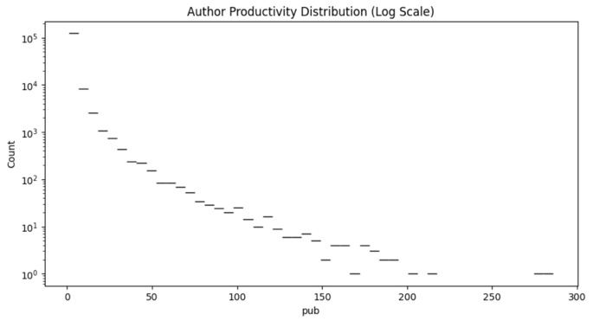
8. Authors & Scientific Community — Productivity
138,398
unique authors
Lotka's Law
heavy-tailed distribution
Top author
286 publications (Dacheng Tao)
The vast majority of researchers contribute only 1–2 publications. A tiny fraction of 'super-productive' researchers drives disproportionate output. This power-law distribution (Lotka's Law) is a universal pattern in scientific fields.

Slide 10
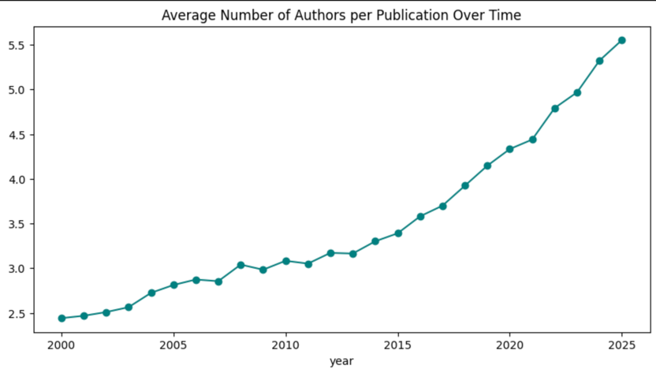
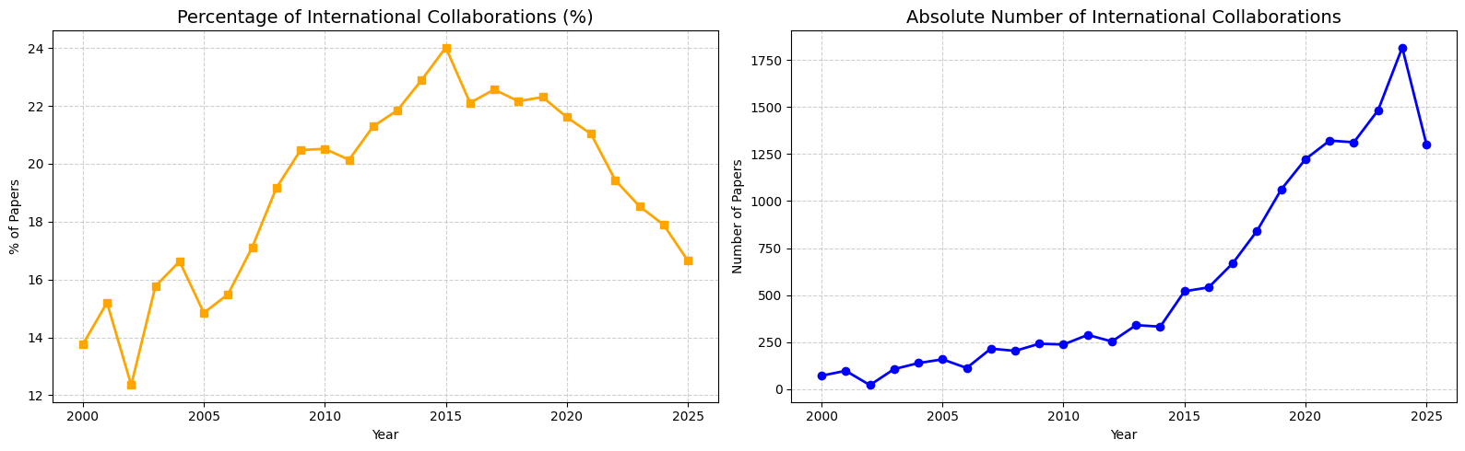
9. Team Sizes & International Collaboration
Key Findings
› Avg authors per paper: ~2.4 (2000) → 5.5+ (2025)
› AI transitioning to large-scale team science
› International collab share peaked ~24% in 2015
› Dropped to ~16.5% by 2025 — domestic output accelerating faster

Slide 11
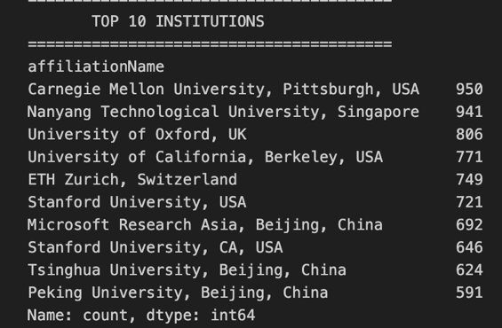
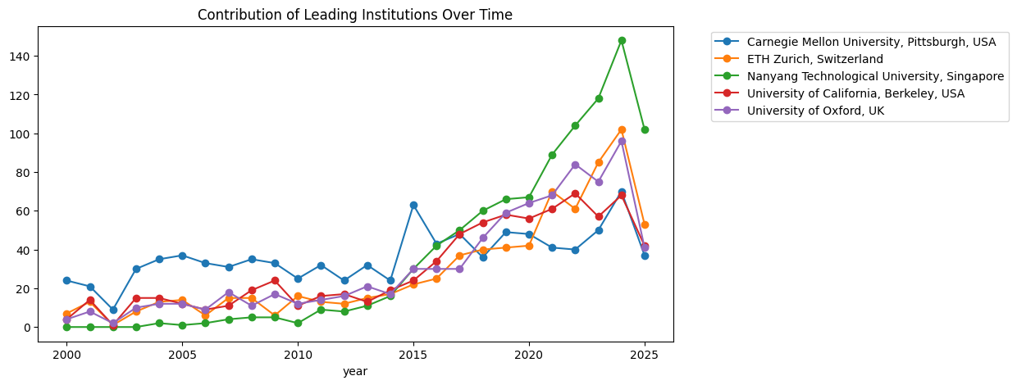
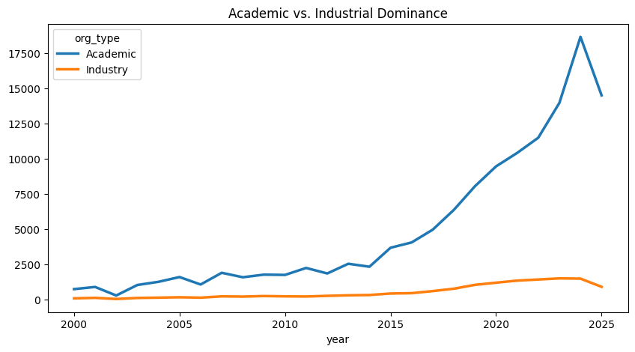
10. Institutions — Leaders & Temporal Dynamics
Key observations
› CMU leads historically (950 pubs)
› Academia dominates volume over industry
› NTU exploded post-2010 — now #1
› Only 1 corporate lab (Microsoft Research) in top 10

Slide 12
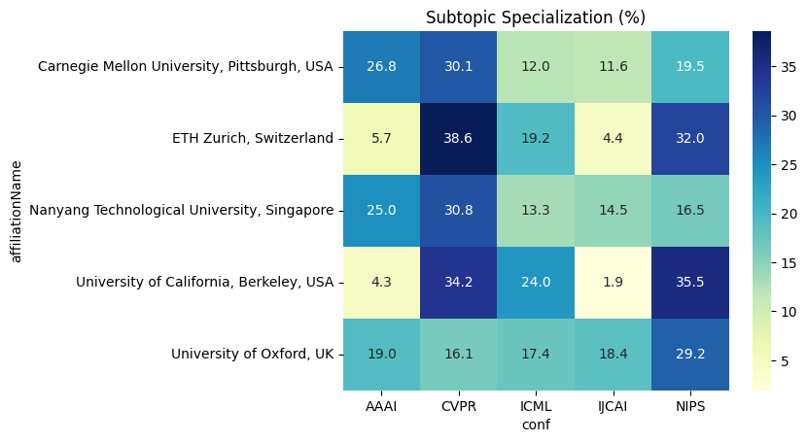
11. Institutional Specialization
ETH Zurich and UC Berkeley are highly specialized — directing most output toward Computer Vision (CVPR) and Neural Information Processing (NeurIPS). CMU and NTU maintain broader, more balanced portfolios covering General AI (AAAI, IJCAI) alongside specialized topics.

Slide 13
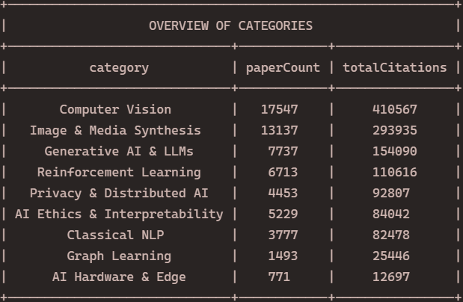
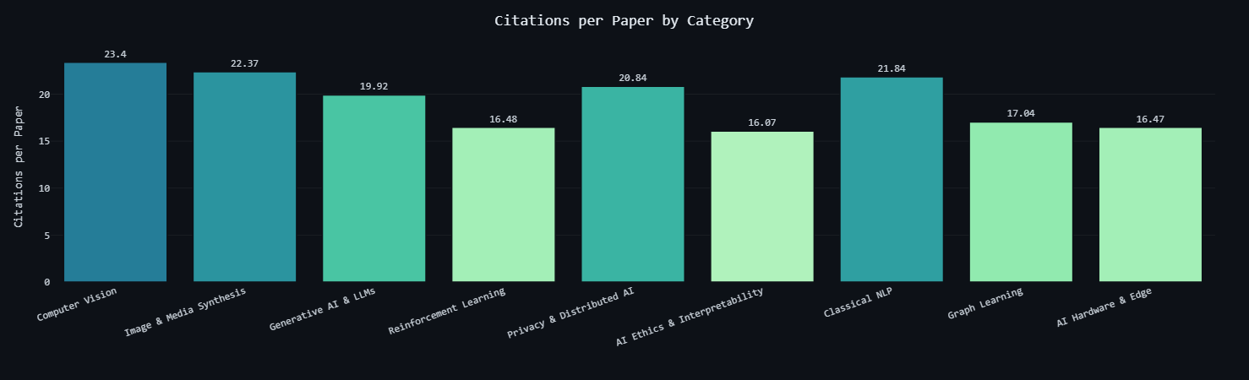
12. Research Quality & Impact — Venues and Citations
IEEE Access leads journals with 2× volume advantage over next competitor. IJCNN dominates conferences similarly. Top-10 journals account for 23.8% of citations; single top venue contributes 28.2% of that share. Computer Vision has highest citations-per-paper (23.4%), followed by Image & Media Synthesis (22.4%) and Classical NLP (21.8%). AI Ethics & Interpretability ranks lowest at 16.1%.
*Ranking of journals and conferences is according to the amount of citations

Slide 14
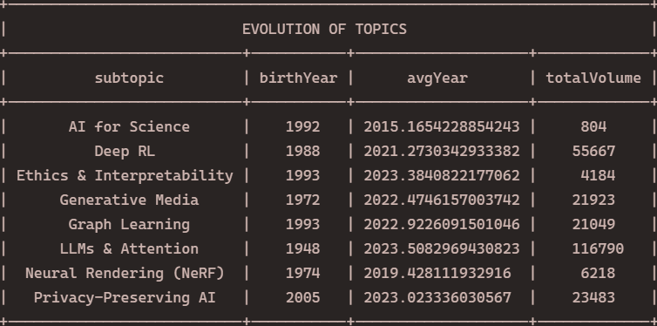
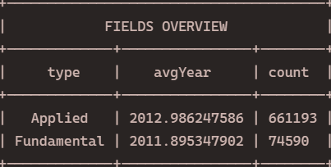
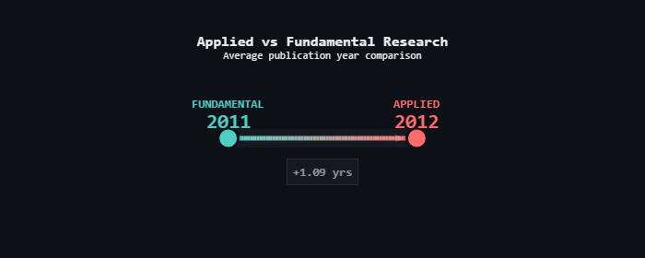
13. Evolution of Science — Emergence & Applied vs Fundamental

Slide 15
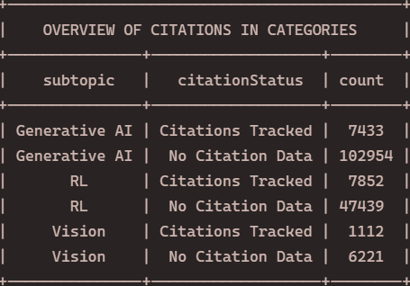
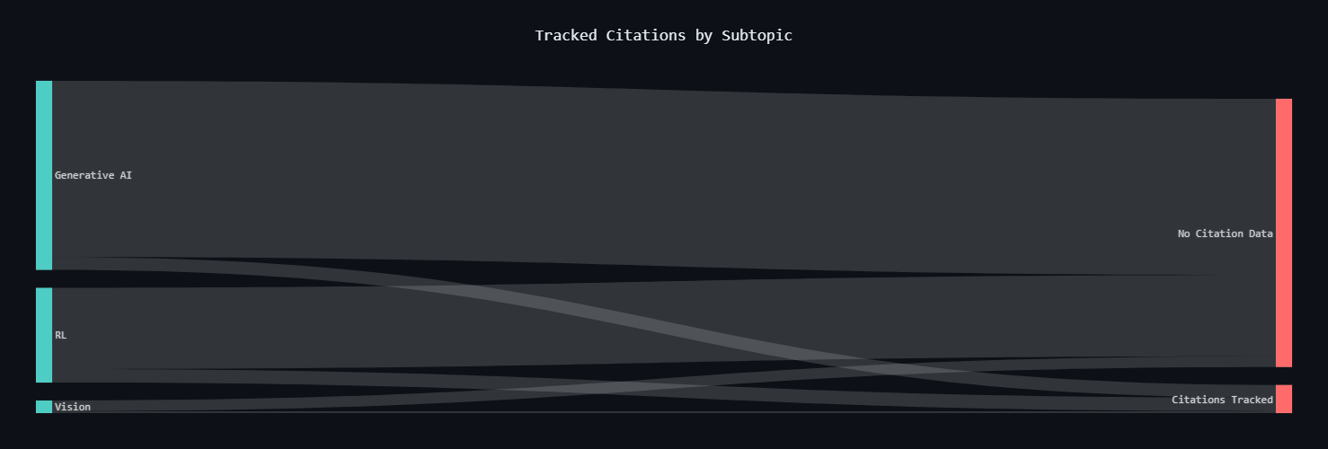
14. Data Limitations
Known limitations
⚠ Citation tracking: majority of papers have NO citation records
⚠ Affiliation coverage incomplete — country inferred via regex fallback
⚠ LLM/Transformer query also captures electrical-engineering papers (birth year skewed)
⚠ Sector and category labeling is heuristic, not authoritative
⚠ Query 10 split into 3 slices due to endpoint timeouts

Slide 16
15. Key Findings
Summary across all 8 dimensions
01
Big Data at scale:
163K+ papers, multi-source, growing at ~16K/year
02
NLP is the new frontier:
NLP & GenAI overtook all fields in 2025; ML peaked at 7,106 in 2024
03
China overtook the US:
Post-2023 China leads annual output; South Korea CAGR 40.96% (2018–2023)
04
AI is team science:
Authors per paper: ~2.4 (2000) → 5.5+ (2025); intl share declining
05
Academia dominates:
CMU, NTU lead; only 1 corporate lab in top 10; Lotka's Law holds

Slide 17
Thank you!
Questions & Discussion
5 min Q&A
github.com/stacyshki/Big-Data-and-AI-Publications-Analysis | emlyon & ecole centrale2025

