Slide 1

Report Out SportsStats

Slide 2
Summary
The data used is SportsStats (Olympics Dataset - 120 years of data). The dataset is made up of two files, athlete_events.csv and noc_regions.csv The dataset gives records of Olympics medal awards for different categories of sport, the countries participated in the games, names, age, medals and so on. The dataset is useful for reporting different feats in the 120 years of Olympics games.

Slide 3
Contents
Review of question to answer/ Initial Hypothesis
Discuss technical challenges
Detail: Entity Relationship Diagram(ERD)
Initial Finding
Deeper analysis
Hypothesis results

Slide 4
Question to Answer
Which country wins the most medals in the 120 years of Olympic Games?
The age of an athlete has relationship to win a medal?

Slide 5
Initial Hypothesis
More and more people participated in Olympics games
More male athletes then female athletes

Slide 6
Technical Challenge
Limitation of Pandassql made some SQL difficult to execute but manageable.
N/A values need to be removed or replaced in the table which will influence the results.

Slide 7
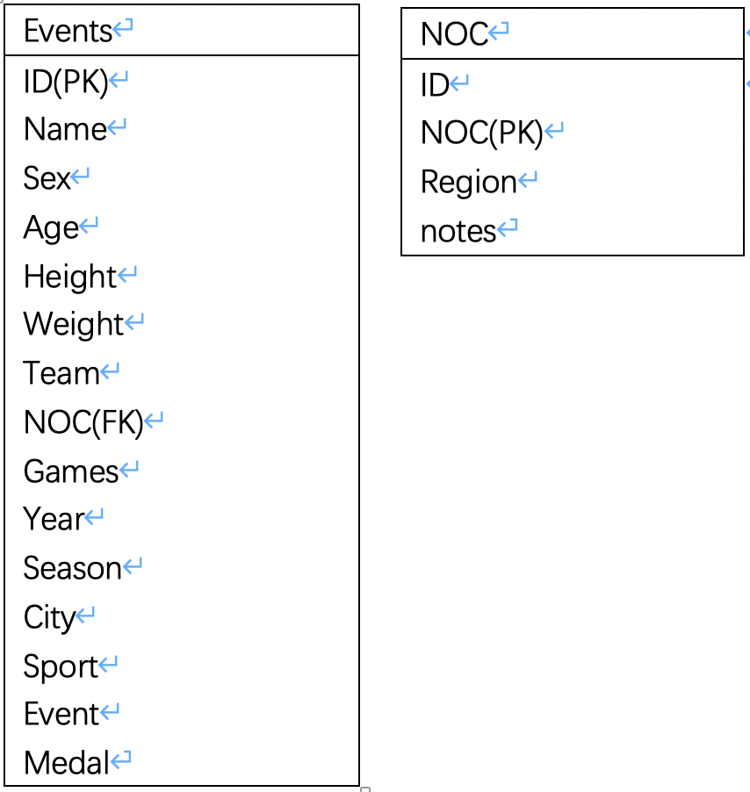
ERD

Slide 8
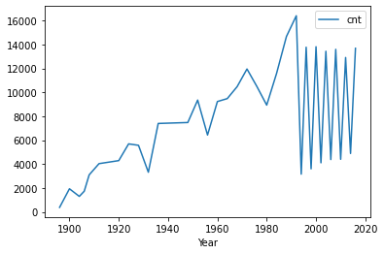
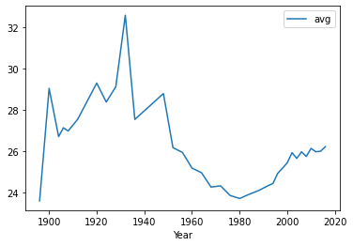
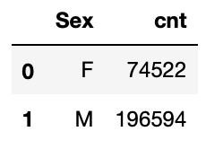
Initial Finding
Not more and more people participated in Olympics games. The max number of Athletes is in 1992.
The average age reach the lowest point in 1980, the average age is around 24-33.
More male athletes then female athletes.

Slide 9
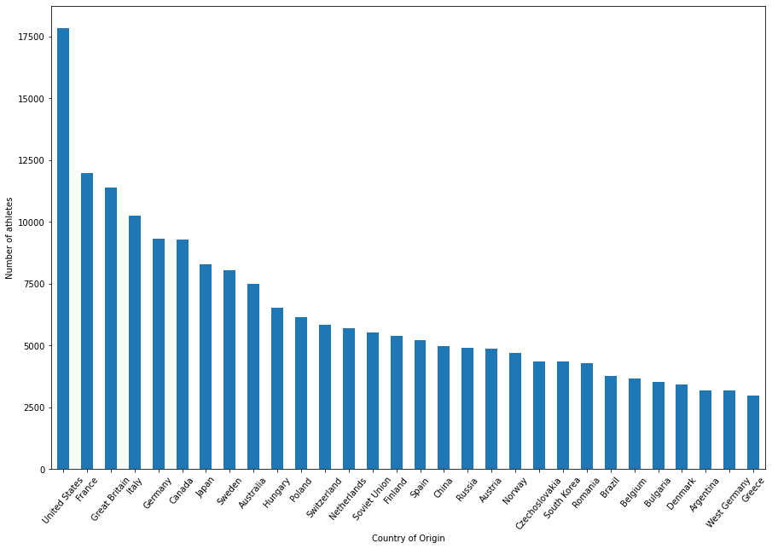
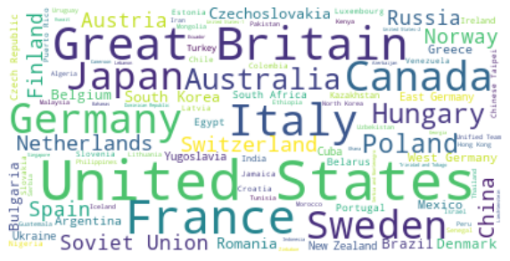
Deeper Analysis
United States is the country that participated the most games in the 120 year Olympic games.

Slide 10
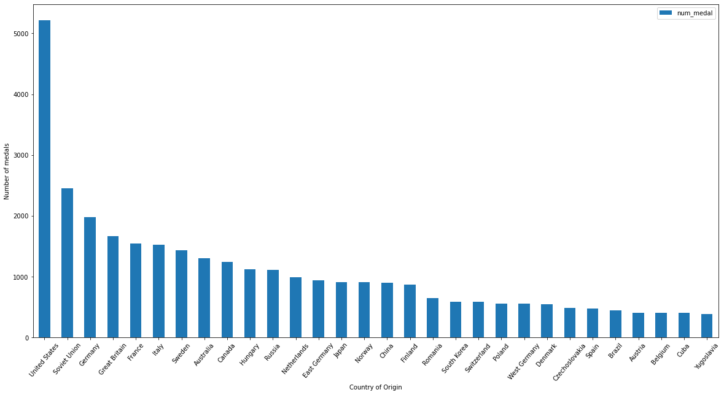
Hypothesis Results
The United States wins the most medals in the 120 years of Olympic Games, above 5000 medals.
It is also the country that most athletes participated the game.

Slide 11
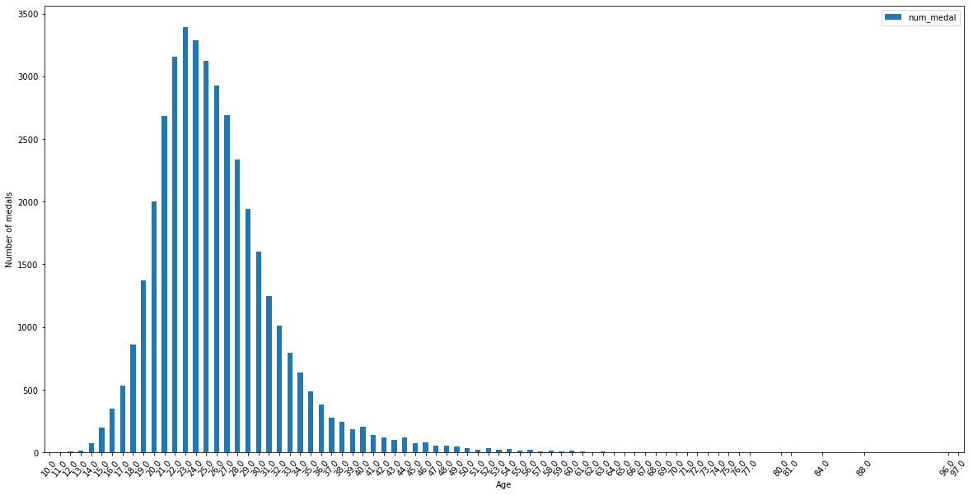
Hypothesis Results
The age range of an athlete more likely to win a medal 15-40.

Slide 12
Recommendation
The age around 23 and between 15-40 are more likely to win a medals.
The more athletes in one country could have more chance to win medals.

