Slide 1
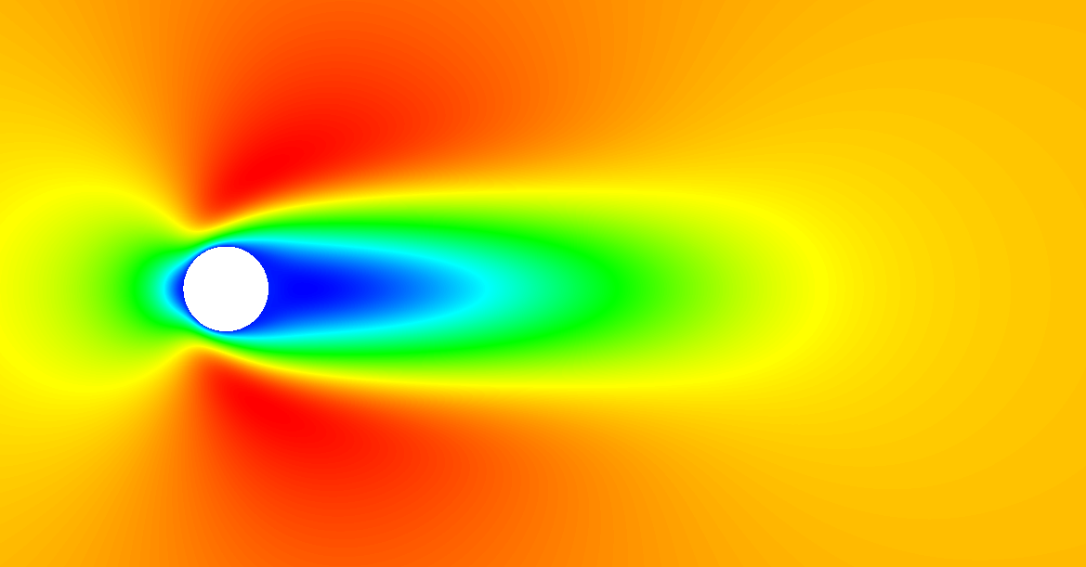
Validation of a discontinuous Galerkin based compressible CFD solver
Bachelor-Thesis: Lawrence Ayers
Prof. Dr.-Ing. habil. Martin Oberlack
Betreuer: Stephan Krämer-Eis M.Sc.
Darmstadt, 17. December 2015

Slide 2
Outline
Introduction and fundamentals
Simulation parameters
Results
Summary and outlook

Slide 3
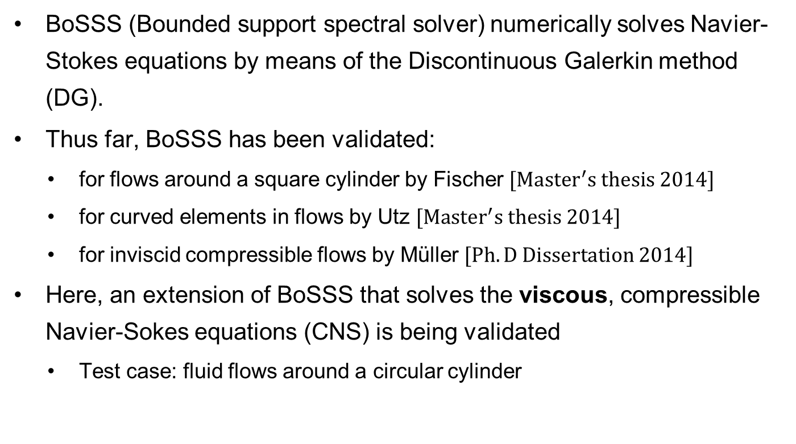
Introduction
BoSSS (Bounded support spectral solver) numerically solves Navier-Stokes equations by means of the Discontinuous Galerkin method (DG).
Thus far, BoSSS has been validated:
for flows around a square cylinder by Fischer $[{Master}^{′}s thesis 2014]$
for curved elements in flows by Utz $[{Master}^{′}s thesis 2014]$
for inviscid compressible flows by Müller $[Ph.D Dissertation 2014]$
Here, an extension of BoSSS that solves the viscous, compressible Navier-Sokes equations (CNS) is being validated
Test case: fluid flows around a circular cylinder

Slide 4
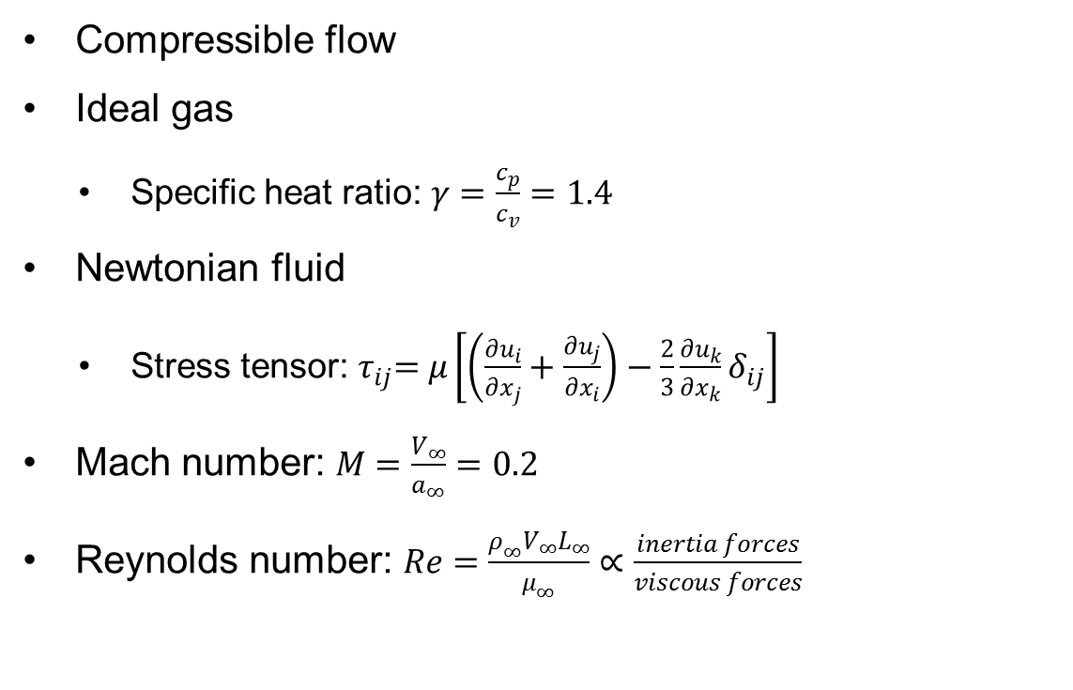
Flow properties
Compressible flow
Ideal gas
Specific heat ratio:$γ=\frac{c_{p}}{c_{v}}=1.4$
Newtonian fluid
Stress tensor:${ τ}_{ij}=μ\left[\left(\frac{∂u_{i}}{∂x_{j}}+\frac{∂u_{j}}{∂x_{i}}\right)−\frac{2}{3}\frac{∂u_{k}}{∂x_{k}}δ_{ij}\right]$
Mach number: $M=\frac{V_{∞}}{a_{∞}}=0.2$
Reynolds number: $Re=\frac{ρ_{∞}V_{∞}L_{∞}}{μ_{∞}}∝\frac{inertia forces}{viscous forces}$

Slide 5
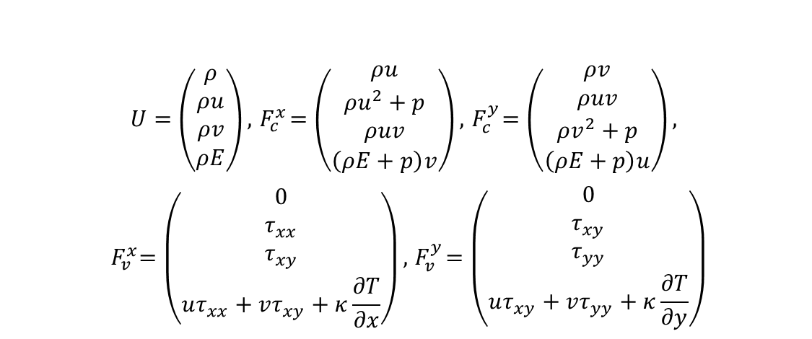
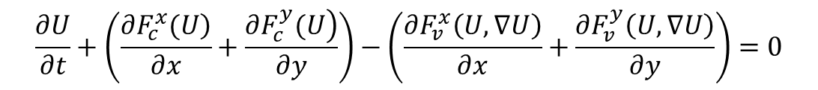
Compressible Navier-Stokes Equations
2D CNS equations with viscous terms
Conserved flow variables are density, momentum, and energy
All variables are dimensionless
$$\frac{∂U}{∂t}+\left(\frac{\left.∂F_{c}^{x}(U\right)}{∂x}+\frac{\left.∂F_{c}^{y}(U\right)}{∂y}\right)−\left(\frac{∂F_{v}^{x}\left(U,∇U\right)}{∂x}+\frac{∂F_{v}^{y}\left(U,∇U\right)}{∂y}\right)=0$$
$$U=\left(\begin{matrix}ρ \\ ρu \\ ρv \\ ρE\end{matrix}\right),{ F}_{c}^{x}=\left(\begin{matrix}ρu \\ ρu^{2}+p \\ ρuv \\ \left(ρE+p\right)v\end{matrix}\right), { F}_{c}^{y}=\left(\begin{matrix}ρv \\ ρuv \\ ρv^{2}+p \\ \left(ρE+p\right)u\end{matrix}\right),$$
$${ F}_{v}^{x}=\left(\begin{matrix}0 \\ τ_{xx} \\ τ_{xy} \\ uτ_{xx}+vτ_{xy}+κ\frac{∂T}{∂x}\end{matrix}\right), { F}_{v}^{y}=\left(\begin{matrix}0 \\ τ_{xy} \\ τ_{yy} \\ uτ_{xy}+vτ_{yy}+κ\frac{∂T}{∂y}\end{matrix}\right)$$
Temporal Derivative
Convective Fluxes
Viscous Fluxes

Slide 6
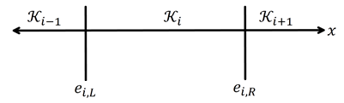
Temporal and convective flux discretization
Temporal discretization
The 4th order explicit Runge-Kutta (RK4) time stepping method
Convective flux spatial discretization
Discontinuous Galerkin method (DG)
Ansatz and Test functions are equivalent (Galerkin-FEM) and at a specified order (ex. DG1, DG2, etc.)
Uses HLLC flux functions at boundaries (FVM)
$$\int_{x_{i,R}}^{x_{i,L}}{\frac{∂U}{∂t}Φ_{i,j}∂x}+f\left(U_{i,L}^{+},U_{i,L}^{−}\right)Φ_{i,j}−f\left(U_{i,R}^{+},U_{i,R}^{−}\right)Φ_{i,j}−\int_{x_{i,R}}^{x_{i,L}}{F\left(U\right)\frac{∂Φ_{i,j}}{dx}∂x}=0.$$

Slide 7
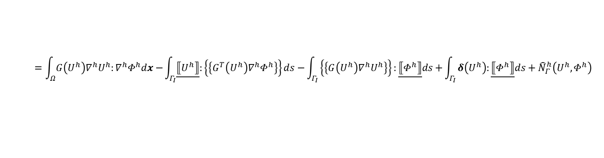
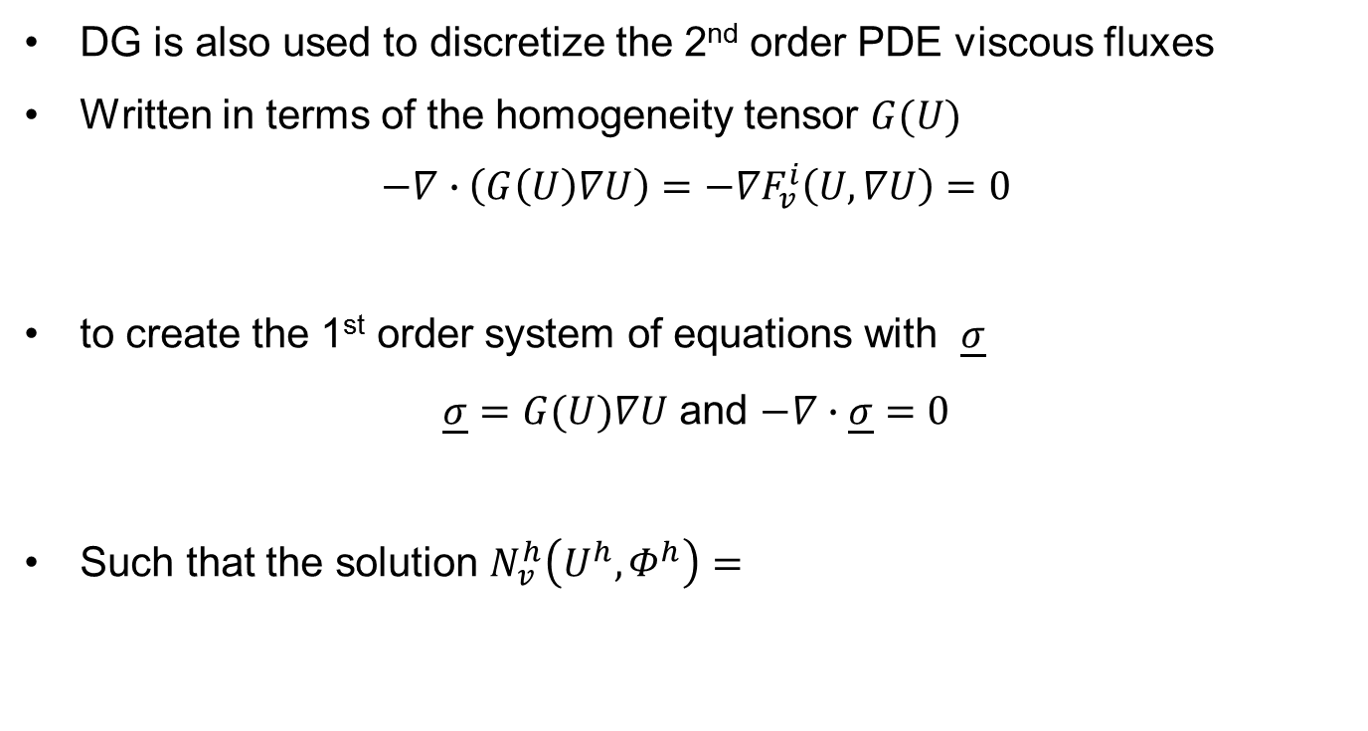
Viscous flux discretization
DG is also used to discretize the 2nd order PDE viscous fluxes
Written in terms of the homogeneity tensor $G(U)$
$$−∇∙\left(G\left(U\right)∇U\right)=−{∇F}_{v}^{i}\left(U,∇U\right)=0$$
to create the 1st order system of equations with $\underline{σ}$
$\underline{σ}=G(U)∇U$ and $−∇∙\underline{σ}=0$
Such that the solution $N_{v}^{h}\left(U^{h}, Φ^{h}\right)=$
$$=\int_{Ω}{G\left(U^{h}\right)∇^{h}U^{h}:∇^{h}Φ^{h}dx−}\int_{Γ_{I}}{\underline{⟦U^{h}⟧}:\left\{\left\{G^{T}\left(U^{h}\right)∇^{h}Φ^{h}\right\}\right\}ds−}\int_{Γ_{I}}{\left\{\left\{G\left(U^{h}\right)∇^{h}U^{h}\right\}\right\}:\underline{⟦Φ^{h}⟧}ds+}\int_{Γ_{I}}{δ\left(U^{h}\right):\underline{⟦Φ^{h}⟧}ds}+{\hat{N}}_{Γ}^{h}\left(U^{h},Φ^{h}\right)$$

Slide 8
Outline
Introduction and fundamentals
Simulation parameters
Results
Summary and outlook

Slide 9
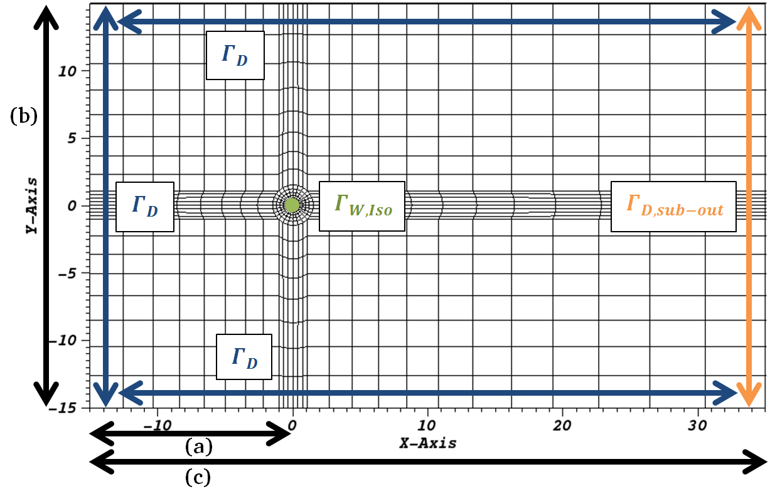
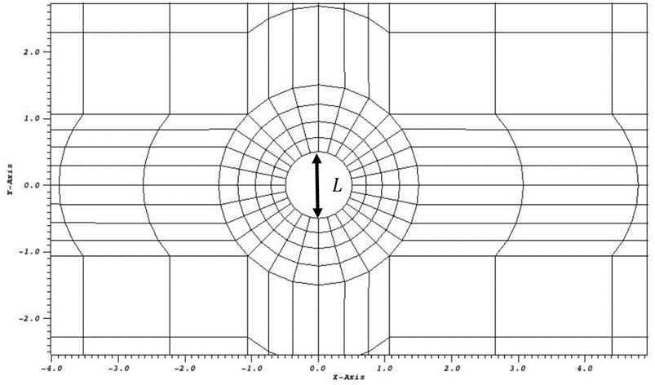
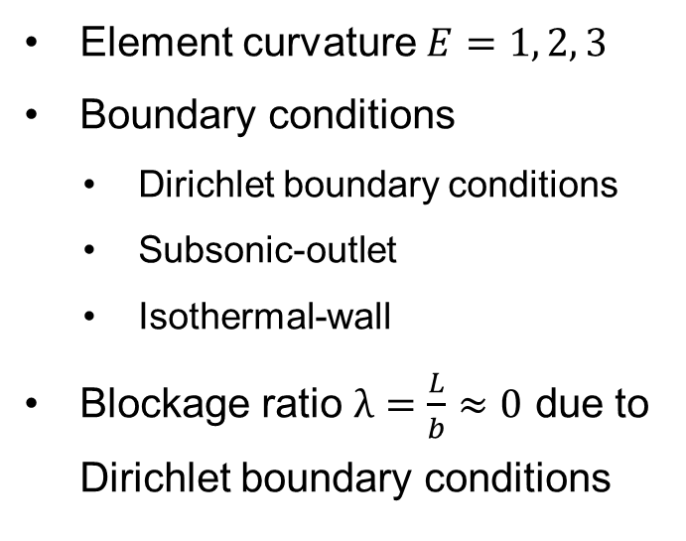
Mesh properties
Element curvature $E=1, 2, 3$
Boundary conditions
Dirichlet boundary conditions
Subsonic-outlet
Isothermal-wall
Blockage ratio $λ=\frac{L}{b}≈0$ due to Dirichlet boundary conditions
a | b | c | L
15 | 30 | 50 | 1

Slide 10
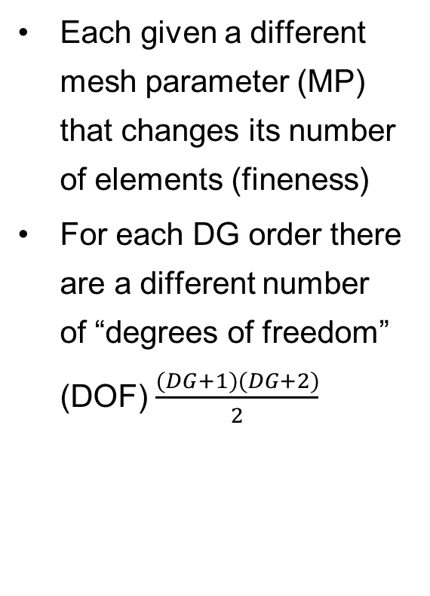
Meshes
Each given a different mesh parameter (MP) that changes its number of elements (fineness)
For each DG order there are a different number of “degrees of freedom” (DOF) $\frac{(DG+1)(DG+2)}{2}$
MP | # of elements
4 | 688
6 | 1548
8 | 2752
10 | 4300
11 | 5170
DG order | DOF
1 | 3
2 | 6
3 | 10
Total # of DOF
DG, E | MP
 | 4 | 6 | 8 | 10 | 11
DG1E1 | 2064 | 4644 | 8256 | 12900 | 15510
DG2E2 | 4128 | 9288 | 16512 | 25800 | -
DG3E3 | 6880 | 15480 | 27520 | 43000 | -
Similar total # of DOF

Slide 11
Simulation parameters
The parameters changed for these simulations were the
DG order (DG1, DG2, DG3)
Element curvature order (E1, E2, E3)
The fineness of the mesh (MP4, MP6, MP8, MP10)
For simulations conducted for both steady and unsteady flows
All simulations conducted at Mach number = 0.2
All simulations conducted on the same domain

Slide 12
Outline
Introduction and fundamentals
Simulation parameters
Results
Summary and outlook

Slide 13
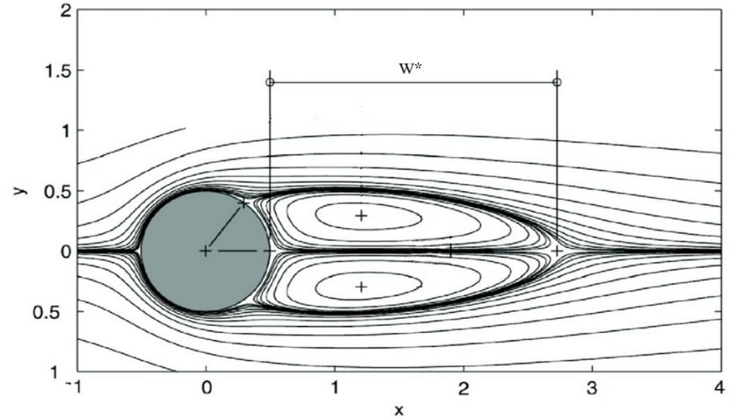


Steady flow
The range of Reynolds numbers at which a flow is steady is 0<Re<40-50
Two mirrored vortices occur in the wake of the cylinder
Values for $C_{D}$ and $W^{∗}$ are used to measure steady flows
Simulations conducted for $Re=20$ and $Re=40$ for $DG and E = 1, 2, 3$
$$C_{D}=\frac{d}{q_{∞}L_{∞}}$$
$$d=drag force$$
$$q_{∞}=dynamic pressure$$
$$L_{∞}=cylinder diameter$$

Slide 14
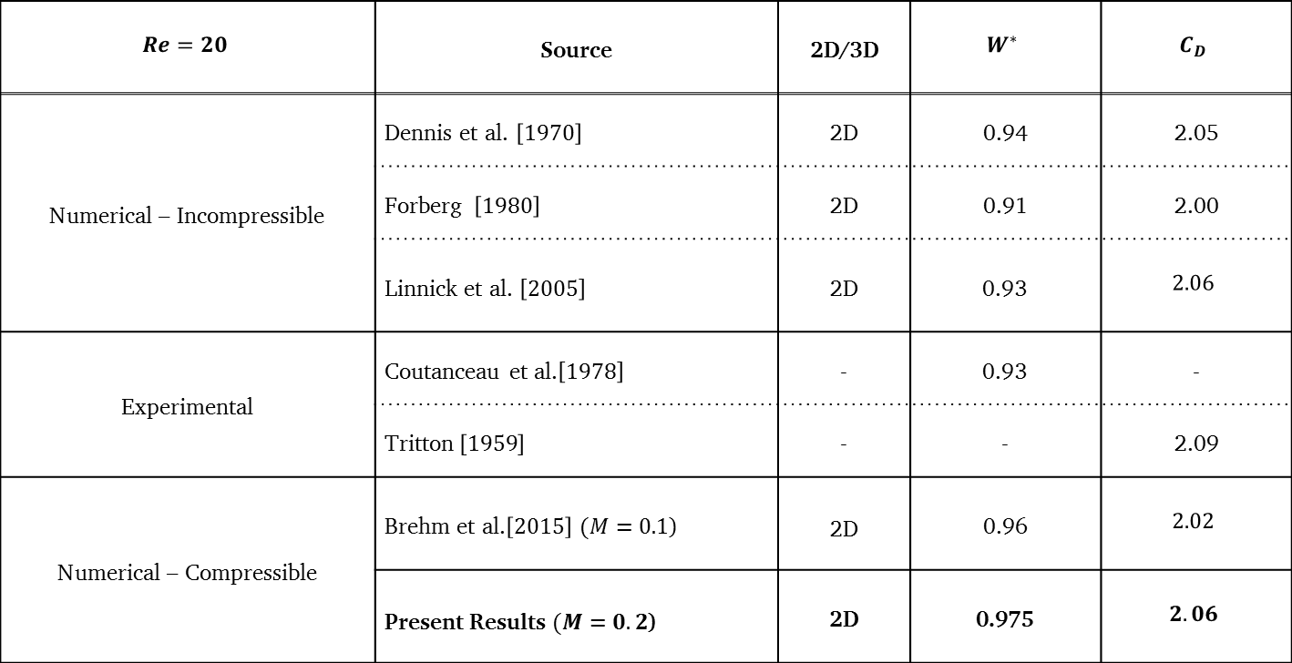
Re=20 comparison of results
$$Re=20$$ | Source | 2D/3D | $$W^{∗}$$ | $$C_{D}$$
Numerical – Incompressible | Dennis et al. $\left[1970\right]$ | 2D | 0.94 | 2.05
 | Forberg $\left[1980\right]$ | 2D | 0.91 | 2.00
 | Linnick et al. $\left[2005\right]$ | 2D | 0.93 | $$2.06$$
Experimental | Coutanceau et al.$\left[1978\right]$ | - | 0.93 | -
 | Tritton$\left[1959\right]$ | - | - | 2.09
Numerical – Compressible | Brehm et al.$\left[2015\right]$ $(M=0.1$) | 2D | 0.96 | $$2.02$$
 | Present Results $(M=0.2$) | 2D | 0.975 | $$2.06$$

Slide 15
Re=20 results

Slide 16
Re=20 DOF study
Accuracy increases with larger total numbers of DOF
Coarse mesh with high DG order produces accurate results
Low order DG on coarser meshes produces inaccurate results

Slide 17
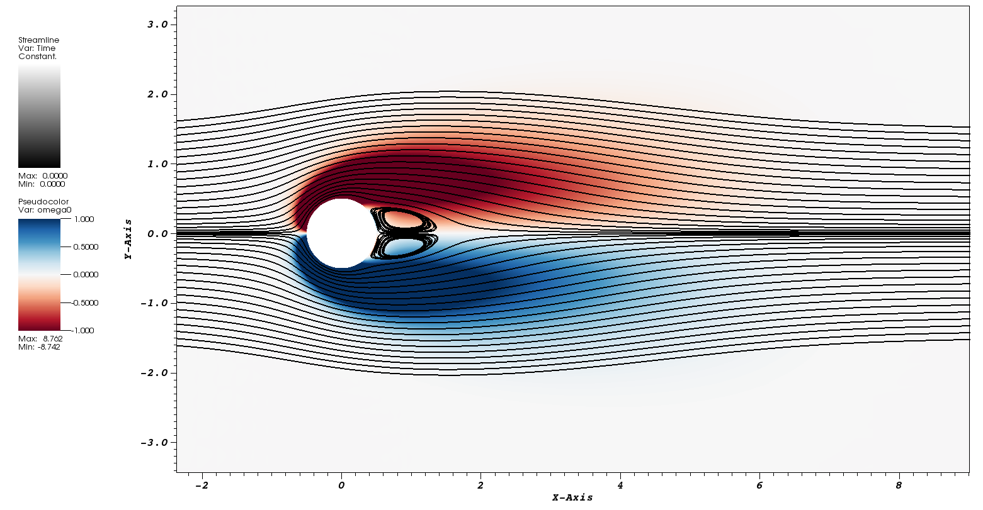
Re=20 results

Slide 18
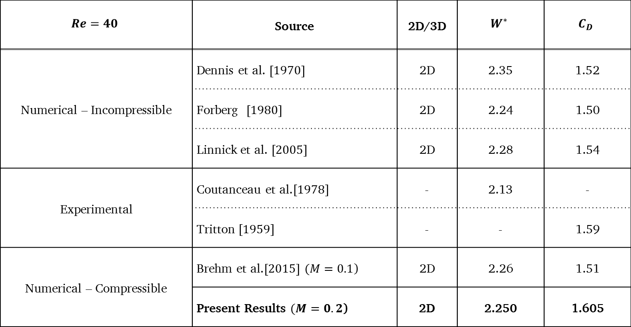
Re=40 comparison of results
$$Re=40$$ | Source | 2D/3D | $$W^{∗}$$ | $$C_{D}$$
Numerical – Incompressible | Dennis et al. $\left[1970\right]$ | 2D | 2.35 | 1.52
 | Forberg $\left[1980\right]$ | 2D | 2.24 | 1.50
 | Linnick et al. $\left[2005\right]$ | 2D | 2.28 | 1.54
Experimental | Coutanceau et al.$\left[1978\right]$ | - | 2.13 | -
 | Tritton$\left[1959\right]$ | - | - | 1.59
Numerical – Compressible | Brehm et al.$\left[2015\right]$ $(M=0.1$) | 2D | 2.26 | 1.51
 | Present Results $(M=0.2$) | 2D | 2.250 | 1.605

Slide 19
Re=40 results

Slide 20
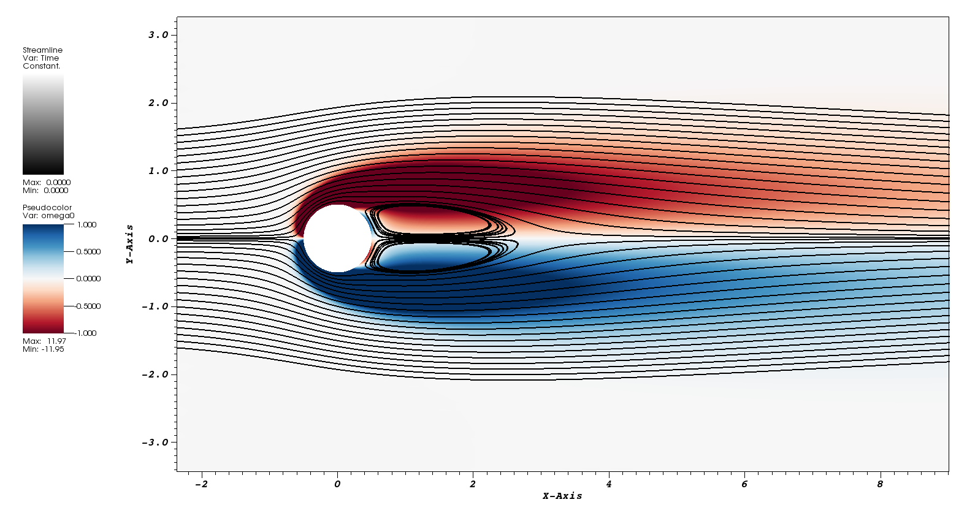
Re=40 results

Slide 21
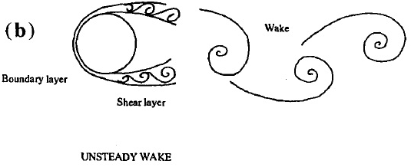
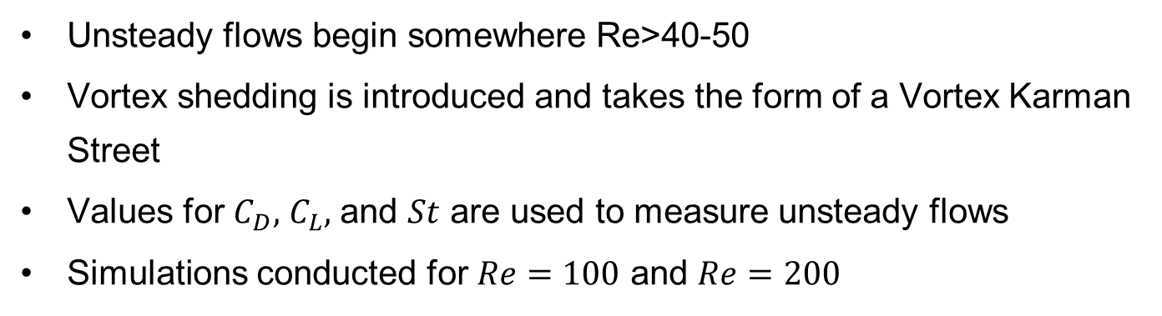
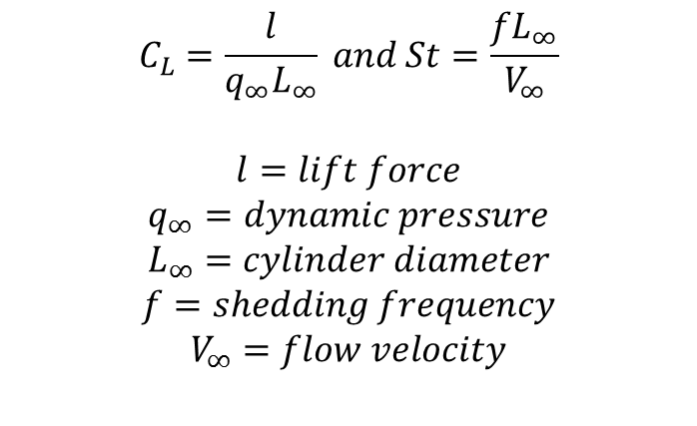
Unsteady flow
Unsteady flows begin somewhere Re>40-50
Vortex shedding is introduced and takes the form of a Vortex Karman Street
Values for $C_{D},$ $C_{L},$ and $St$ are used to measure unsteady flows
Simulations conducted for $Re=100$ and $Re=200$
$$C_{L}=\frac{l}{q_{∞}L_{∞}} and St=\frac{fL_{∞}}{V_{∞}}$$
$$l=lift force$$
$$q_{∞}=dynamic pressure$$
$$L_{∞}=cylinder diameter$$
$$f=shedding frequency$$
$$V_{∞}=flow velocity$$

Slide 22
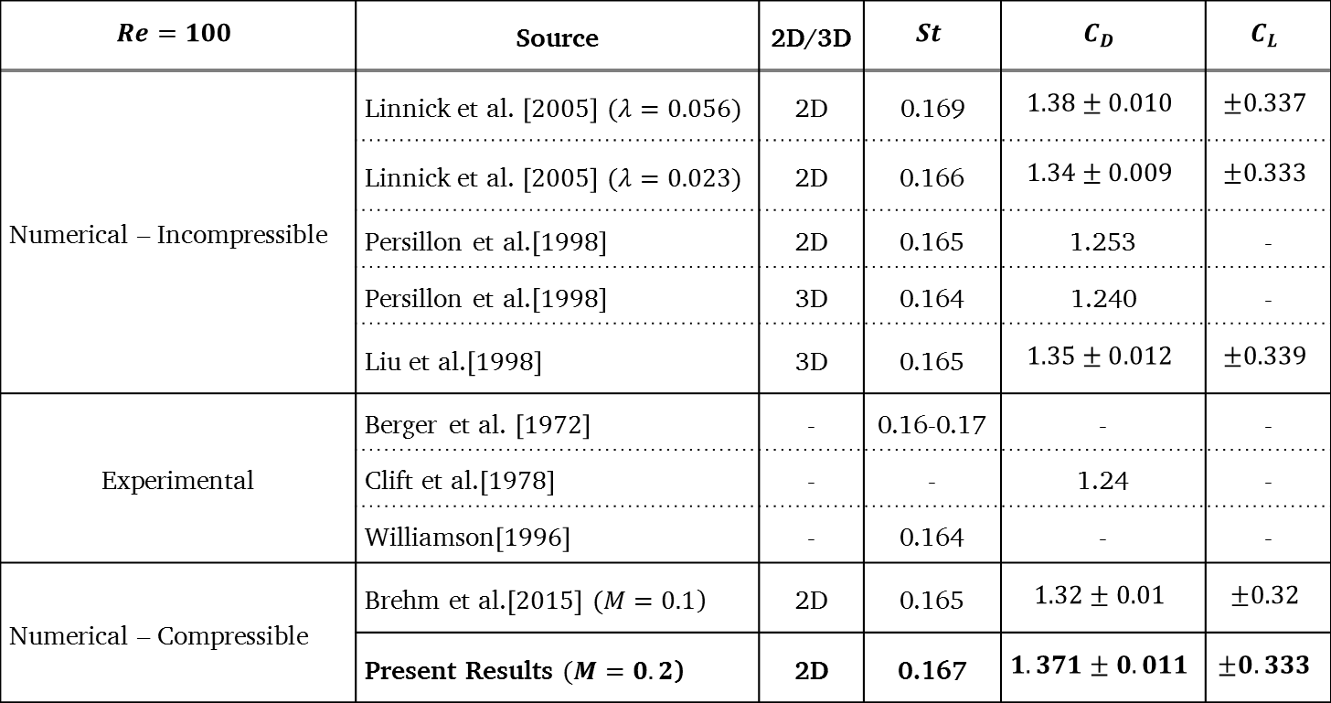
Re=100 comparison of results
$$Re=100$$ | Source | 2D/3D | $$St$$ | $$C_{D}$$ | $$C_{L}$$
Numerical – Incompressible | Linnick et al. $\left[2005\right]$ $(λ=0.056)$ | 2D | 0.169 | $$1.38±0.010$$ | $$±0.337$$
 | Linnick et al. $\left[2005\right]$ $(λ=0.023)$ | 2D | 0.166 | $$1.34±0.009$$ | $$±0.333$$
 | Persillon et al.$\left[1998\right]$ | 2D | 0.165 | 1.253 | -
 | Persillon et al.$\left[1998\right]$ | 3D | 0.164 | 1.240 | -
 | Liu et al.$\left[1998\right]$ | 3D | 0.165 | $$1.35±0.012$$ | $$±0.339$$
Experimental | Berger et al. $\left[1972\right]$ | - | 0.16-0.17 | - | -
 | Clift et al.$\left[1978\right]$ | - | - | 1.24 | -
 | Williamson$\left[1996\right]$ | - | 0.164 | - | -
Numerical – Compressible | Brehm et al.$\left[2015\right]$ $(M=0.1$) | 2D | 0.165 | $$1.32±0.01$$ | $$±0.32$$
 | Present Results $(M=0.2$) | 2D | 0.167 | $$1.371±0.011$$ | $$±0.333$$

Slide 23
Re=100 results

Slide 24
Re=100 DOF study

Slide 25
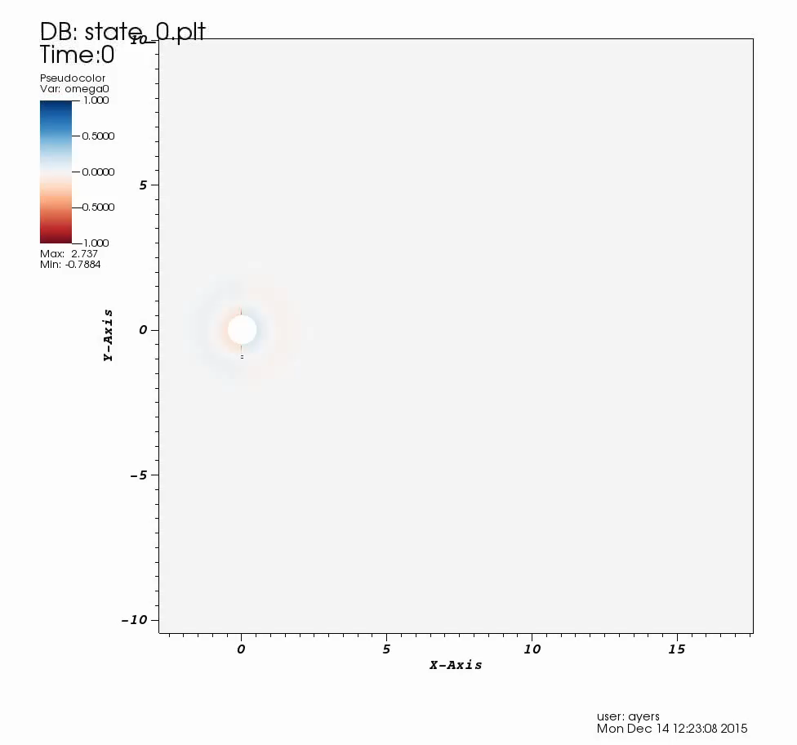
Re=100 video

Slide 26
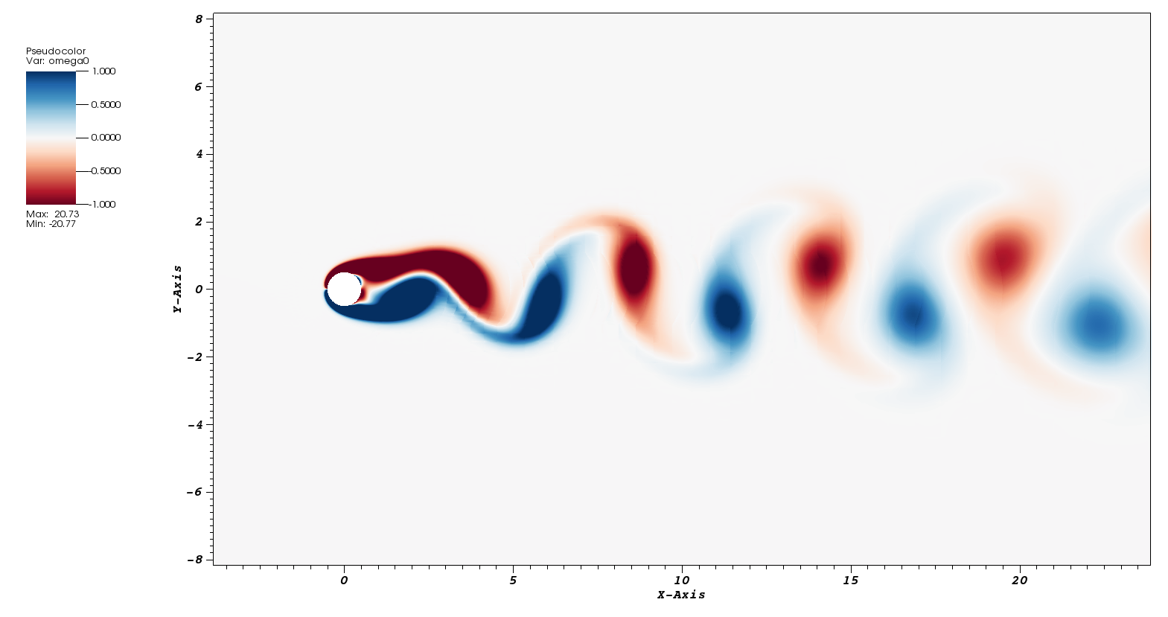
Re=100 vortex shedding

Slide 27
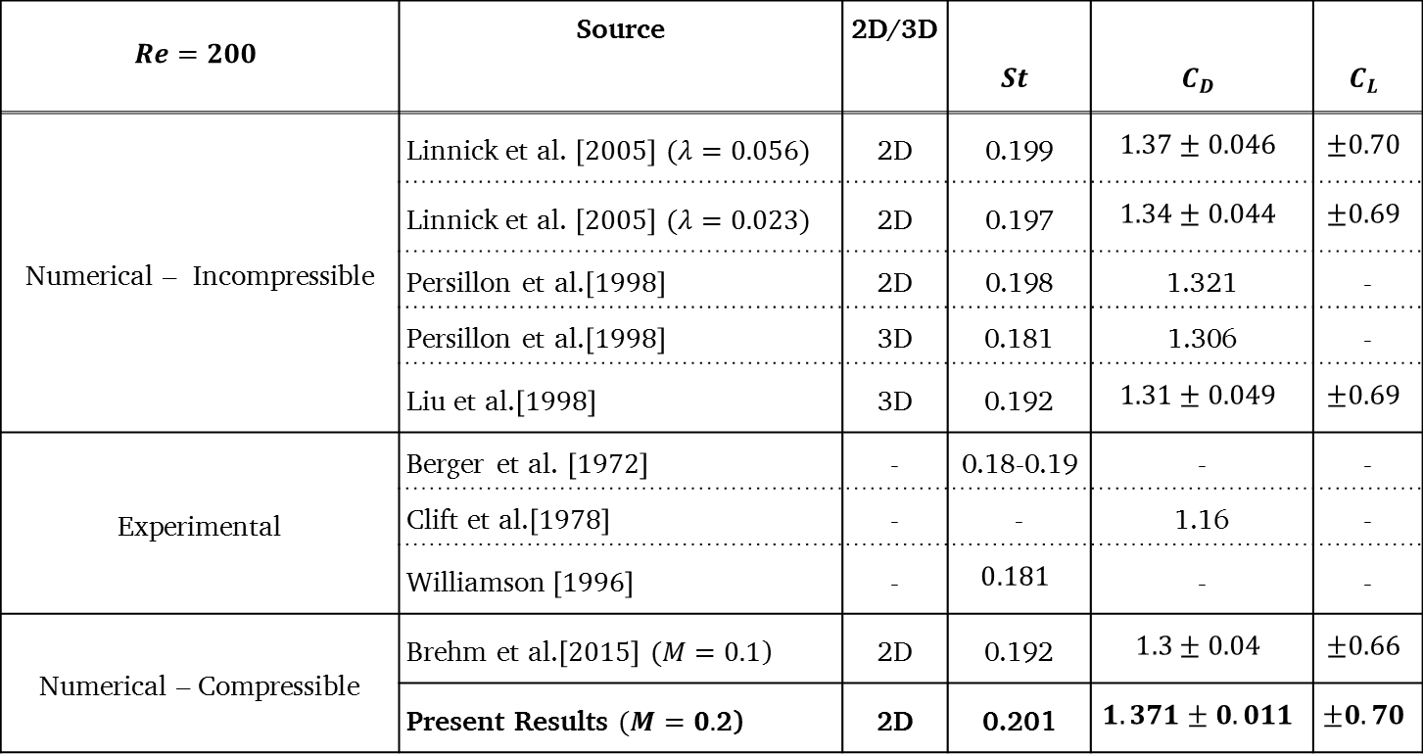
Re=200 comparison of results
$$Re=200$$ | Source | 2D/3D | $$St$$ | $$C_{D}$$ | $$C_{L}$$
Numerical – Incompressible | Linnick et al. $\left[2005\right]$ $(λ=0.056)$ | 2D | 0.199 | $$1.37±0.046$$ | $$±0.70$$
 | Linnick et al. $\left[2005\right]$ $(λ=0.023)$ | 2D | 0.197 | $$1.34±0.044$$ | $$±0.69$$
 | Persillon et al.$\left[1998\right]$ | 2D | 0.198 | 1.321 | -
 | Persillon et al.$\left[1998\right]$ | 3D | 0.181 | 1.306 | -
 | Liu et al.$\left[1998\right]$ | 3D | 0.192 | $$1.31±0.049$$ | $$±0.69$$
Experimental | Berger et al. $\left[1972\right]$ | - | 0.18-0.19 | - | -
 | Clift et al.$\left[1978\right]$ | - | - | 1.16 | -
 | Williamson$\left[1996\right]$ | - | $$0.181$$ | - | -
Numerical – Compressible | Brehm et al.$\left[2015\right]$ $(M=0.1$) | 2D | 0.192 | $$1.3±0.04$$ | $$±0.66$$
 | Present Results $(M=0.$2) | 2D | 0.201 | $$1.371±0.011$$ | $$±0.70$$

Slide 28
Re=200 results

Slide 29
Re=200 DOF study

Slide 30
Outline
Introduction and fundamentals
Simulation parameters
Results
Summary and outlook

Slide 31
Summary
The results from the simulations correlate well to those of previous simulations and experiments
Simulations of similar total number of DOF showed higher order results to be more accurate
Conduct 3D simulations
Produce same simulations with the “immersed boundary” technique
Outlook

Slide 32
Summary and outlook
Questions?

Slide 33
Summary and outlook
Thank you!

Slide 34
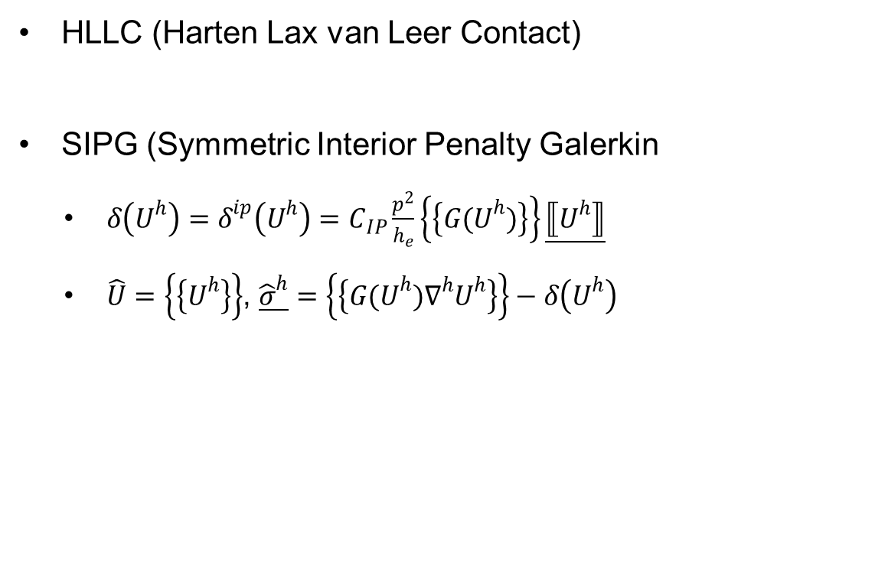
Reference
HLLC (Harten Lax van Leer Contact)
SIPG (Symmetric Interior Penalty Galerkin
$δ\left(U^{h}\right)=δ^{ip}\left(U^{h}\right)=C_{IP}\frac{p^{2}}{h_{e}}\left\{\left\{{G(U}^{h})\right\}\right\}\underline{⟦U^{h}⟧}$
$\hat{U}=\left\{\left\{U^{h}\right\}\right\}$, $\underline{{\hat{σ}}^{h}}=\left\{\left\{{G(U}^{h})∇^{h}U^{h}\right\}\right\}−δ\left(U^{h}\right)$

Slide 35
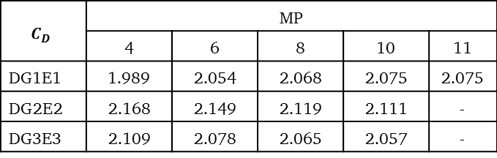
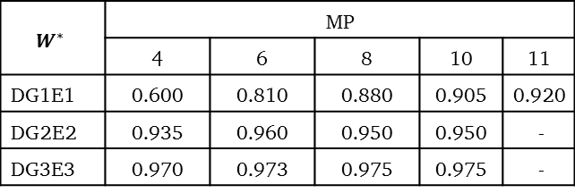
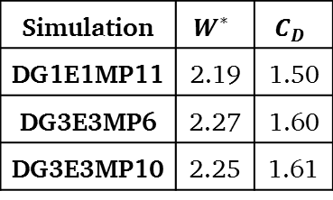
Reference
Re=20
$$W^{∗}$$ | MP
 | 4 | 6 | 8 | 10 | 11
DG1E1 | 0.600 | 0.810 | 0.880 | 0.905 | 0.920
DG2E2 | 0.935 | 0.960 | 0.950 | 0.950 | -
DG3E3 | 0.970 | 0.973 | 0.975 | 0.975 | -
$$C_{D}$$ | MP
 | 4 | 6 | 8 | 10 | 11
DG1E1 | 1.989 | 2.054 | 2.068 | 2.075 | 2.075
DG2E2 | 2.168 | 2.149 | 2.119 | 2.111 | -
DG3E3 | 2.109 | 2.078 | 2.065 | 2.057 | -
Re=40
Simulation | $$W^{∗}$$ | $$C_{D}$$
DG1E1MP11 | 2.19 | 1.50
DG3E3MP6 | 2.27 | 1.60
DG3E3MP10 | 2.25 | 1.61

Slide 36
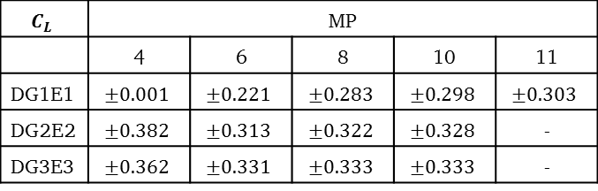
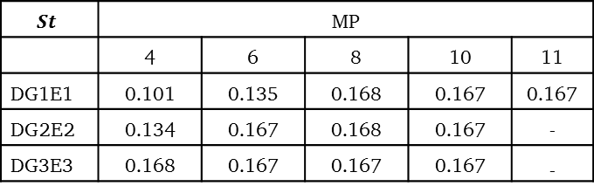
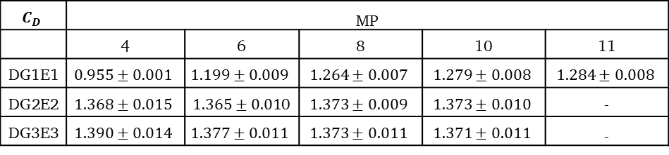
Reference
Re=100
$$St$$ | MP
 | 4 | 6 | 8 | 10 | 11
DG1E1 | 0.101 | 0.135 | 0.168 | 0.167 | 0.167
DG2E2 | 0.134 | 0.167 | 0.168 | 0.167 | -
DG3E3 | 0.168 | 0.167 | 0.167 | 0.167 | -
$$C_{L}$$ | MP
 | 4 | 6 | 8 | 10 | 11
DG1E1 | $$±0.001$$ | $$±0.221$$ | $$±0.283$$ | $$±0.298$$ | $$±0.303$$
DG2E2 | $$±0.382$$ | $$±0.313$$ | $$±0.322$$ | $$±0.328$$ | -
DG3E3 | $$±0.362$$ | $$±0.331$$ | $$±0.333$$ | $$±0.333$$ | -
$$C_{D}$$ | MP
 | 4 | 6 | 8 | 10 | 11
DG1E1 | $$0.955±0.001$$ | $$1.199±0.009$$ | $$1.264±0.007$$ | $$1.279±0.008$$ | $$1.284±0.008$$
DG2E2 | $$1.368±0.015$$ | $1.365±0.01$0 | $$1.373±0.009$$ | $$1.373±0.010$$ | -
DG3E3 | $$1.390±0.014$$ | $$1.377±0.011$$ | $$1.373±0.011$$ | $$1.371±0.011$$ | -

Slide 37
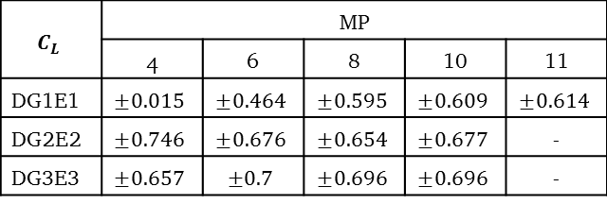
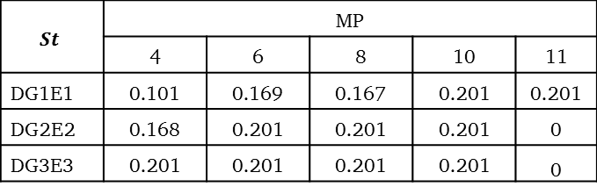
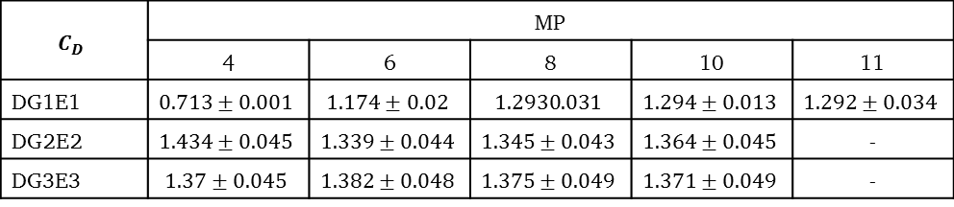
Reference
Re=200
$$St$$ | MP
 | 4 | 6 | 8 | 10 | 11
DG1E1 | 0.101 | 0.169 | 0.167 | 0.201 | 0.201
DG2E2 | 0.168 | 0.201 | 0.201 | 0.201 | 0
DG3E3 | 0.201 | 0.201 | 0.201 | 0.201 | 0
$$C_{L}$$ | MP
 | 4 | 6 | 8 | 10 | 11
DG1E1 | $$±0.015$$ | $$±0.464$$ | $$±0.595$$ | $$±0.609$$ | $$±0.614$$
DG2E2 | $$±0.746$$ | $$±0.676$$ | $$±0.654$$ | $$±0.677$$ | -
DG3E3 | $$±0.657$$ | $$±0.7$$ | $$±0.696$$ | $$±0.696$$ | -
$$C_{D}$$ | MP
 | 4 | 6 | 8 | 10 | 11
DG1E1 | $$0.713±0.001$$ | $$1.174±0.02$$ | $$1.2930.031$$ | $$1.294±0.013$$ | $$1.292±0.034$$
DG2E2 | $$1.434±0.045$$ | $$1.339±0.044$$ | $$1.345±0.043$$ | $$1.364±0.045$$ | -
DG3E3 | $$1.37±0.045$$ | $$1.382±0.048$$ | $$1.375±0.049$$ | $$1.371±0.049$$ | -

