Slide 1
Flight fare prediction
Staffin T Shabu

Slide 2

objective
To develop a ML based flight fare prediction system that would predict the future price of airline tickets based on the given inputs

Slide 3

Introduction
This project aims to develop an application which will predict the flight prices for various flights using machine learning model. The user will get the predicted values and with its reference the user can decide to book their tickets accordingly.
The proposed system can help save millions of rupees of customers by proving them the information to book tickets at the right time. The proposed problem statement is “Flight Fare prediction system”.

Slide 4
Data Sharing Agreement
Sample file name – Flight Fare data
Length of date stamp(8 digits)
Length of time stamp(6 digits)
Number of Columns 10
Column names- Airline,source, destination, departure date, departure time, number of stops, arrival time, Route, Additional info, prices
Column data type

Slide 5
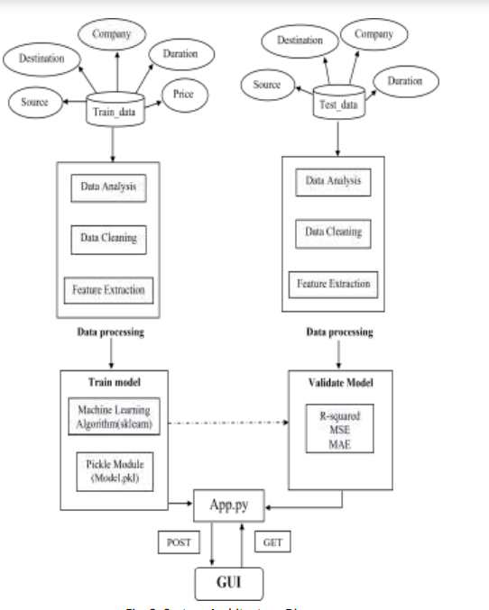
Architecture

Slide 6
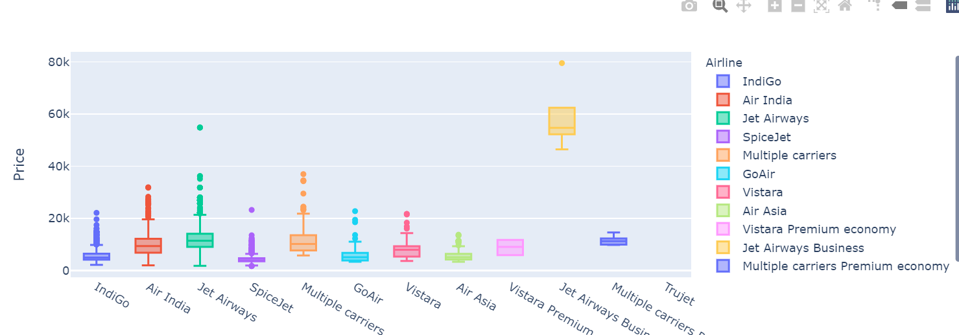
Data Visualization

Slide 7
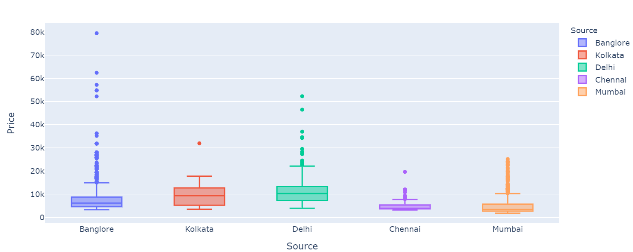
Data Visualization

Slide 8
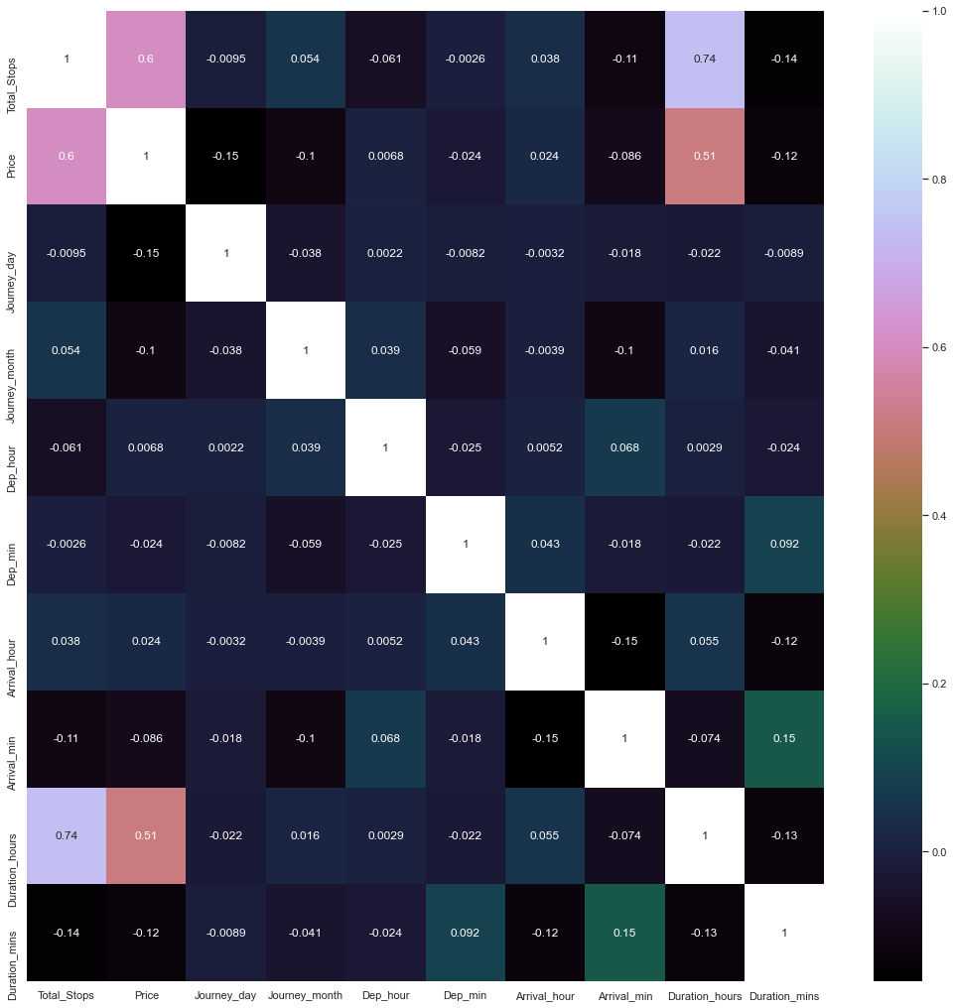
Data Visualization

Slide 9
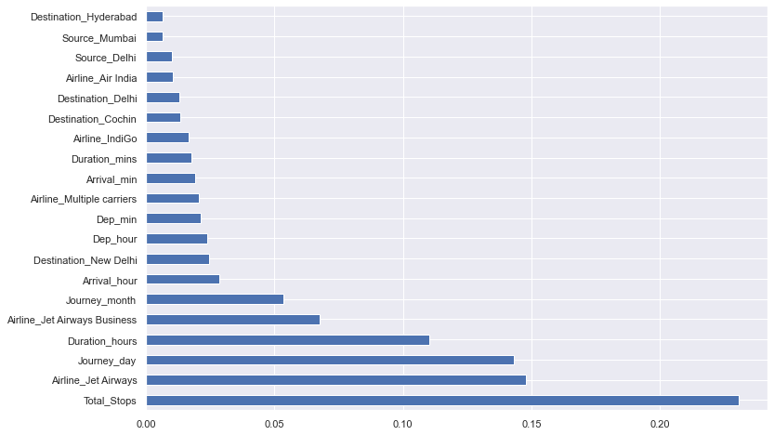
Data Visualization

Slide 10
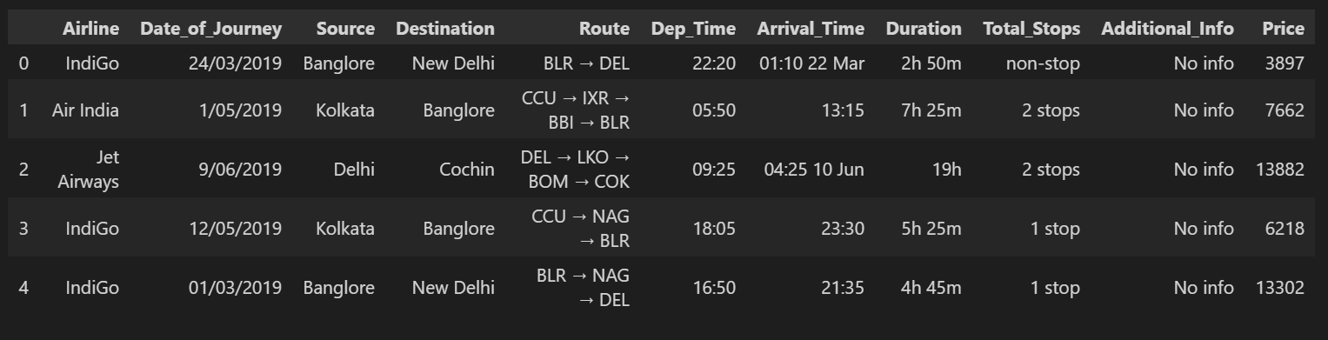
Data Set

Slide 11
Model Training
Data preparation
We load our data into a suitable place and prepare it for use in our machine learning training.\
Data pre processing
Cleaning the data and removing the columns that are not required
Choosing a model
Select the efficient model using by comparing he accuracies of various algorithms

Slide 12
Model Training
Training the model
In this step, we will use our data to incrementally improve our model’s ability to predict the flight fare.
Deployment
In this step we deploy our model locally using flask

Slide 13

Prediction
The inputs needed to predict the flight fare are given by the user
Based on these inputs the flight fare is predicted.

Slide 14
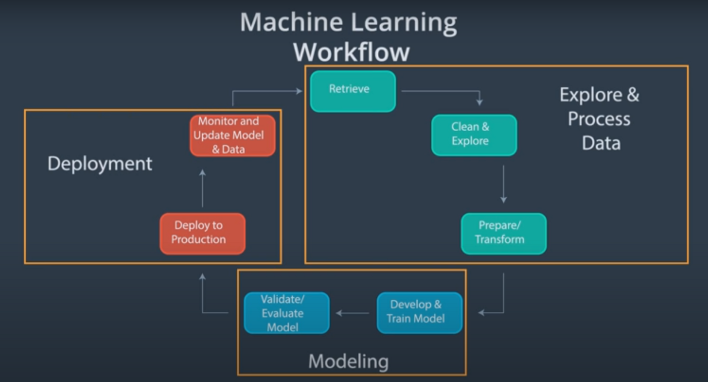
Machine Learning Process

Slide 15
Q&A
Q1) What’s the source of data?
The data for training is fetched from kaggle
Q 2) What was the type of data?
The data was the combination of numerical and Categorical values.
Q 3) What’s the complete flow you followed in this Project?
Refer slide 14th for better Understanding
Q 4) After the File validation what you do with incompatible file or files which didn’t pass the validation?
Files like these are moved to the Achieve Folder and a list of these files has been
shared with the client and we removed the bad data folder.

Slide 16
Q&A
5)What techniques were you using for data pre-processing?
Removing unwanted attributes
Visualizing relation of independent variables with each other and output variables
Checking and changing Distribution of continuous values
Removing outliers
Cleaning data and imputing if null values are present.
Converting categorical VARIABLES

Slide 17
Q&A
6)How logs are managed?
We are using different logs as per the steps that we follow in validation and modeling like File validation log , Data Insertion ,Model Training log , prediction log etc.
7) How training was done or what models were used?
The data is divided into training and test data The scaling was performed training data
Based on the accuracy we Random forest algorithm was selected.
8) How was Prediction done?
The algorithm is trained on a historical dataset and applied to new data when forecasting the likelihood of a particular outcome regarding the future flight fare.

Slide 18
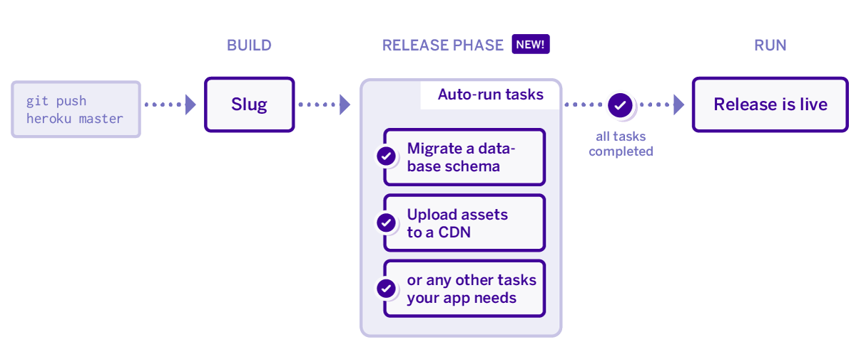
Q&A
Q 9) What are the different stages of deployment?
Flask Frame work is used.
The code along with the procfile is pushed into githib.
Requirement.text is added
Heroku app is linked to the github repository.
The application is deployed using Heroku.

Slide 19




Thank you
By
Staffin

