Slide 1
project detailed description
Google Search Gemini large language model chat link developed for this work:
https://share.google/aimode/mDqkxwan39dppnEyc

Slide 2
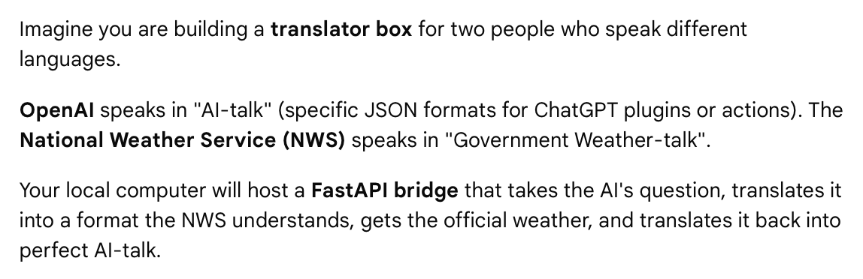
eli5 "set up a local Python development environment to build, host, and expose an API (e.g., using FastAPI) that translates OpenAI's requests into official National Weather Service (NWS) API calls"

Slide 3
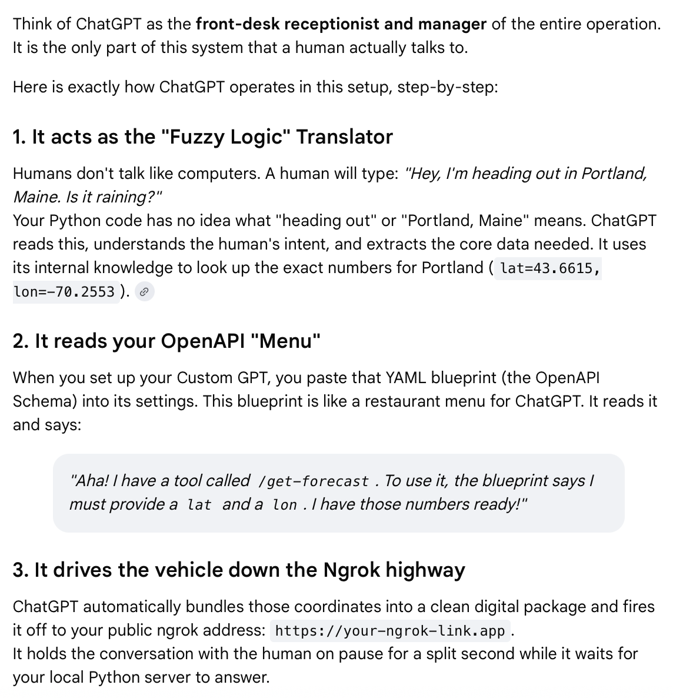
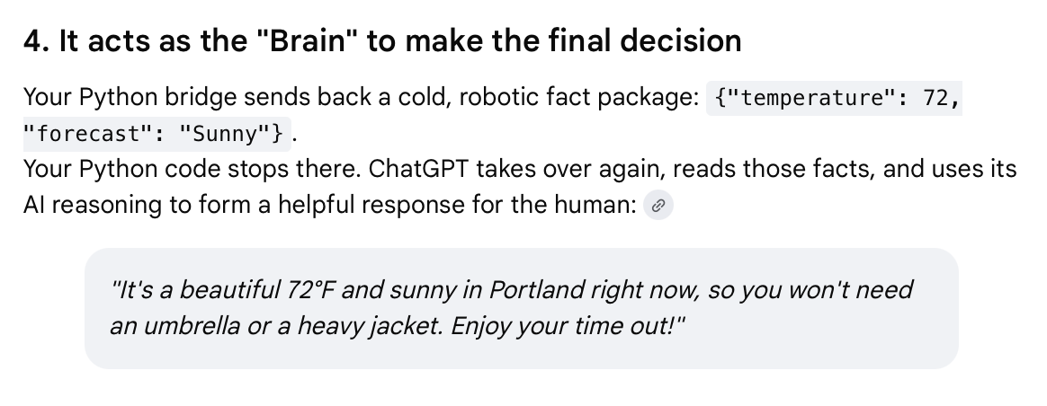
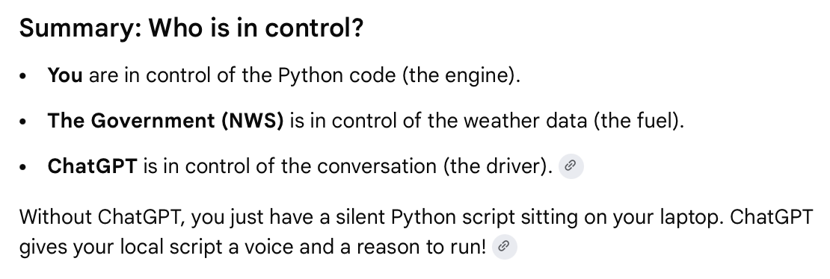
What role does ChatGPT play in this Project?

Slide 4
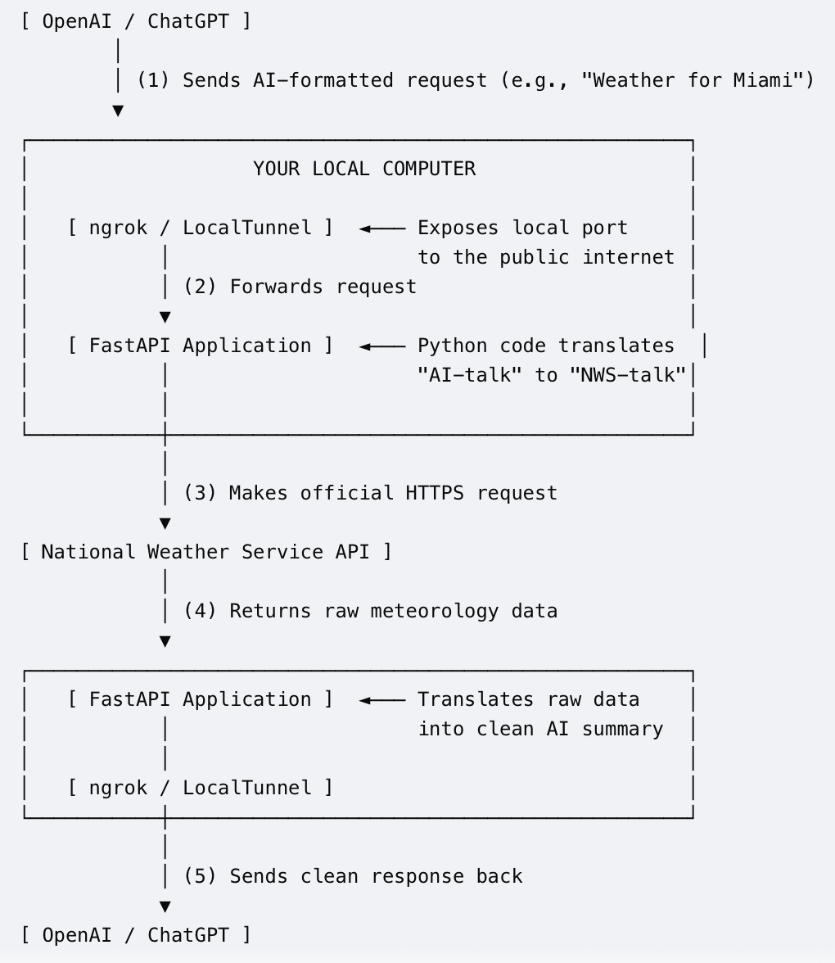
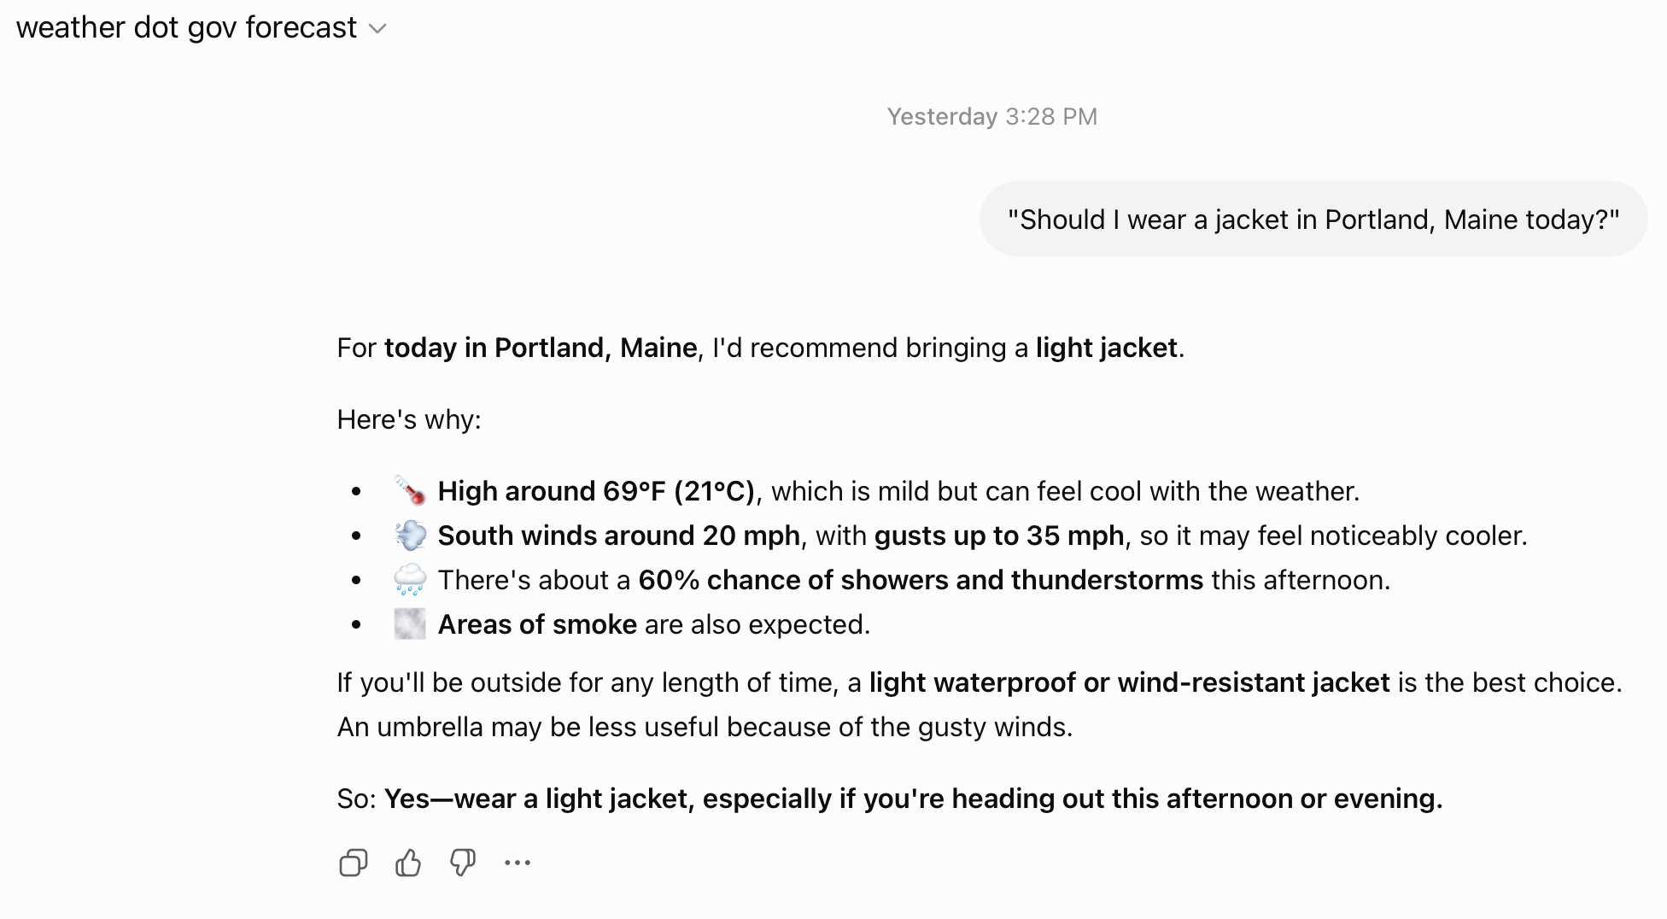
System Architecture
This is the custom GPT I created on ChatGPT.com.
By selecting this Chat GPT and initiating a chat I can use the FastAPI bridge hosted on my local computer to take a natural language question and translate it into a JSON the National Weather Service (NWS) API specifications. Once translated it gets the official weather and translates it back into natural language.
The box below is an example of the system at work.
prompt
response
my api

Slide 5
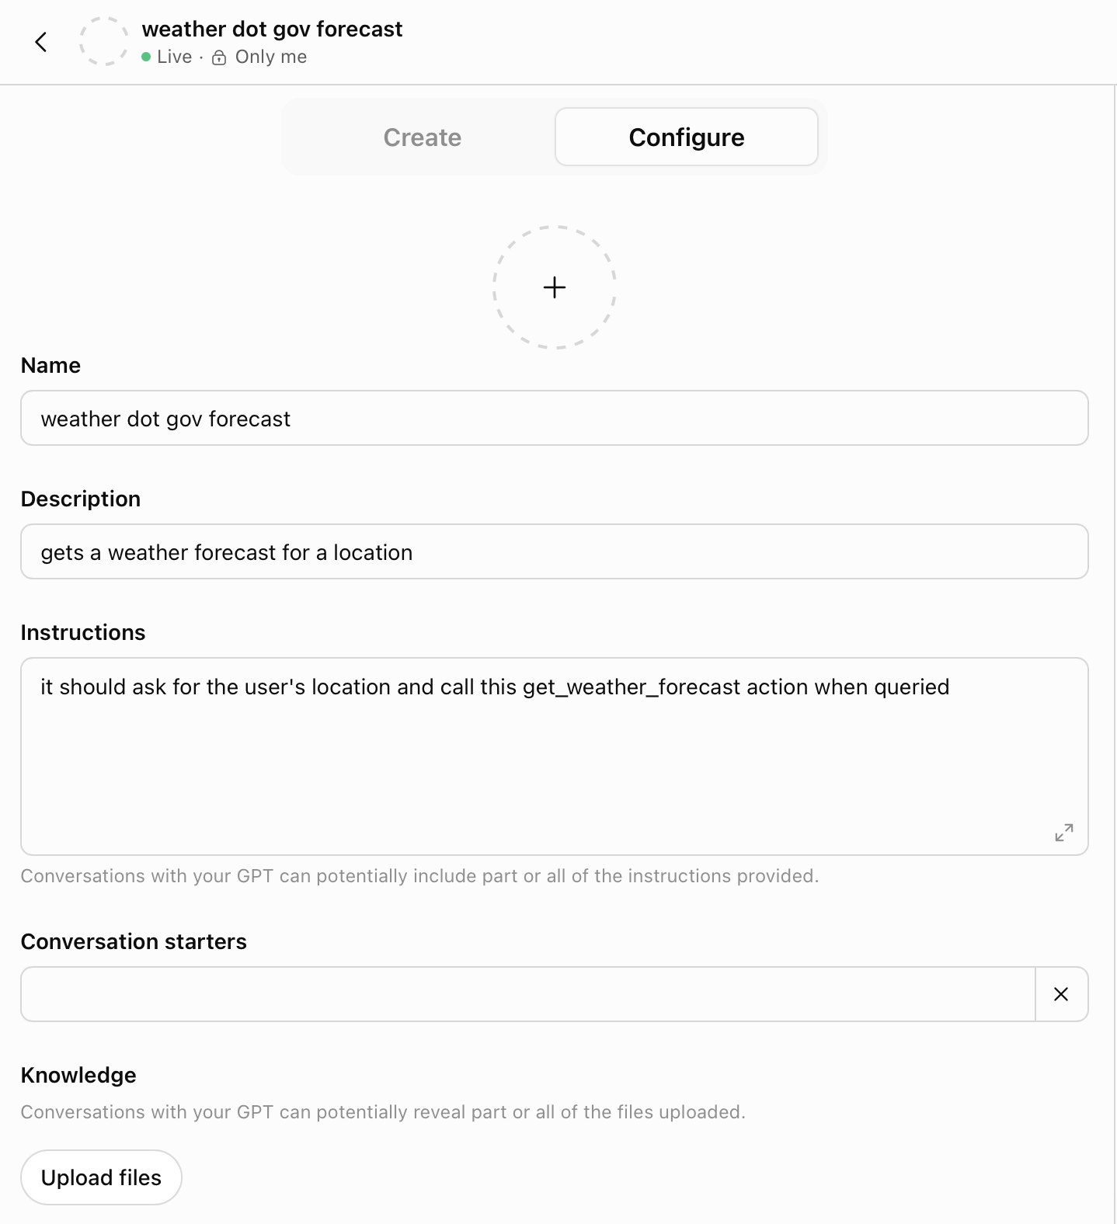
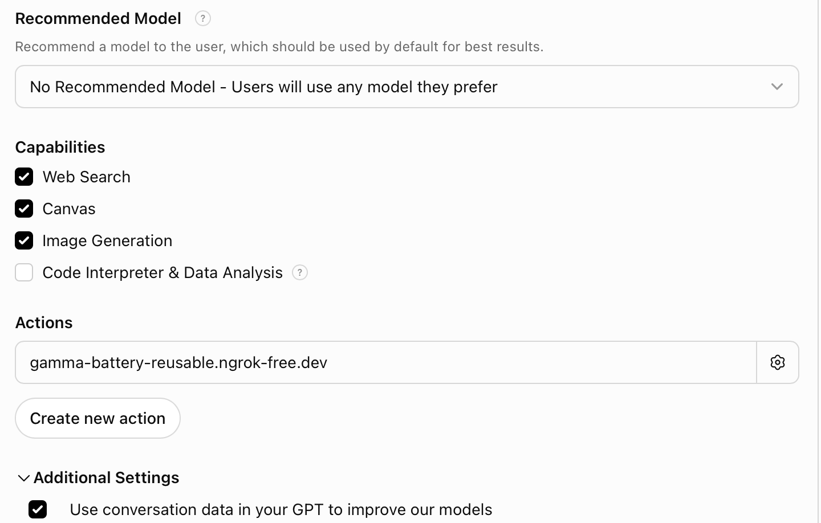
Configuring a GPT
A Custom GPT Action is a bridge that connects ChatGPT to external tools and software.
It acts as a set of hands for the AI, allowing it to "escape" the chat window and interact with other apps, databases, and APIs by making external software calls using natural language.
It is described further on the next slide.

Slide 6
Configuring a GPT – Custom GPT Action
What a Custom GPT Action Does
Actions allow your custom AI assistant to actively do work rather than just talking about it.
Instead of just drafting a meeting summary, for instance, the AI can actually book the meeting.
Specifically, Actions can:
Retrieve live data:
Query a live database, check an external inventory, or pull the latest information from an API.
Perform tasks in other apps:
Send a message in Slack, create a calendar event, or generate a support ticket in Jira.
Automate workflows:
Trigger external automations using platforms like Zapier or Make to perform multi-step processes.
What a Custom GPT Action Is
Under the hood, a Custom GPT Action is defined using an OpenAPI Specification (a standardized blueprint that tells ChatGPT how to talk to the external software) and an authentication method (like an API key or OAuth).
When you give a custom GPT specific instructions on how to use these Actions, the AI automatically translates your natural language requests into the structured code (like JSON) required to communicate with that external tool.

Slide 7
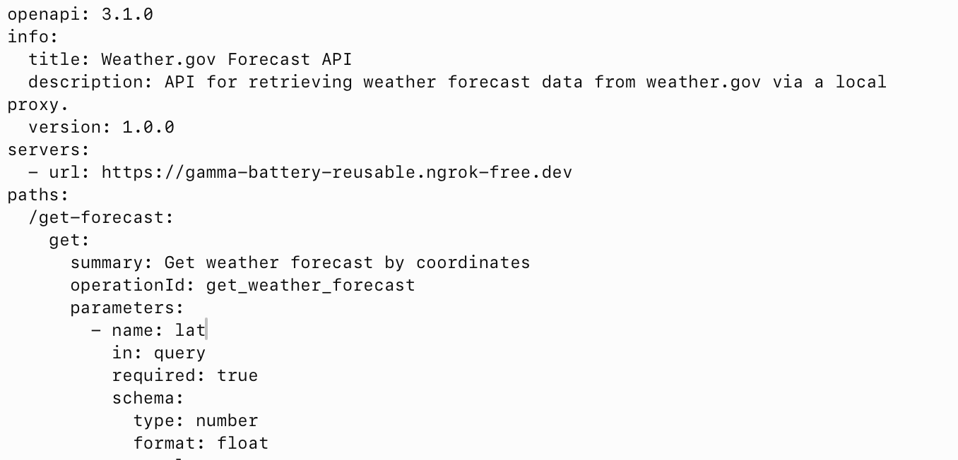
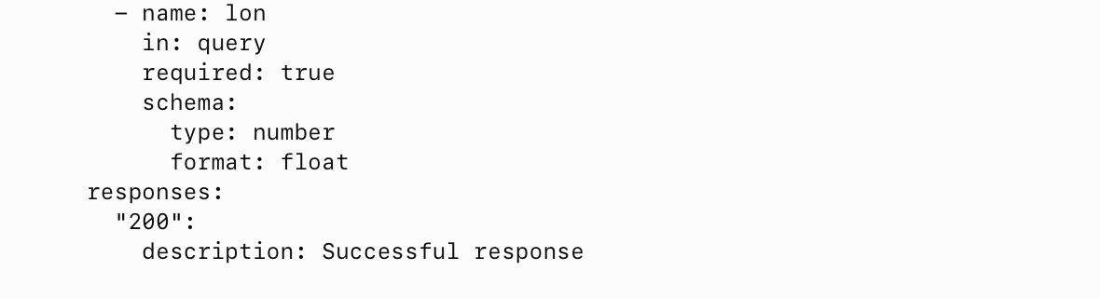
weather dot gov forecast Custom GPT Action YAML

Slide 8
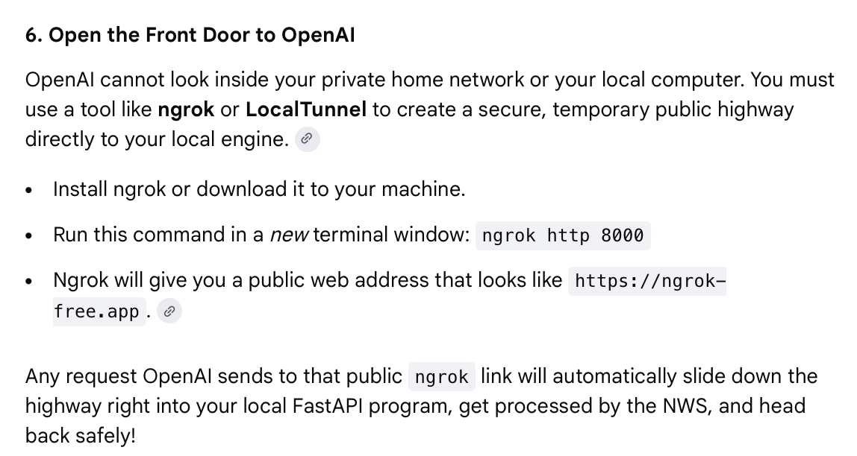
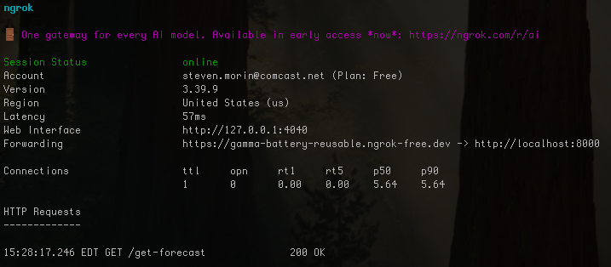
weather dot gov forecast Custom GPT Action YAML
How did this get configured?

Slide 9
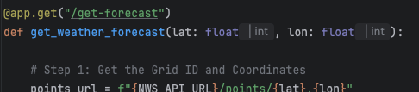
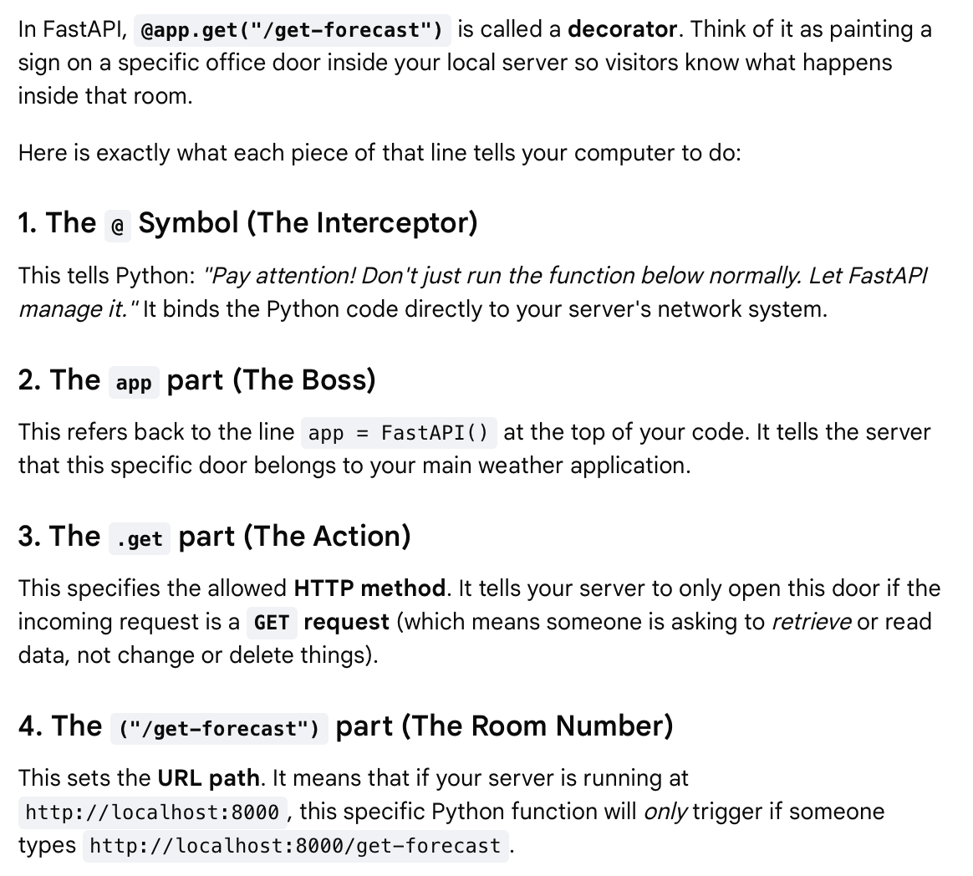
Custom GPT YAML Blueprint (continued)
What does this path point to?
Every time ChatGPT hits your ngrok link with that specific path, this decorator intercepts the call, wakes up the Python code below it, and passes the latitude and longitude numbers into the script.

Slide 10
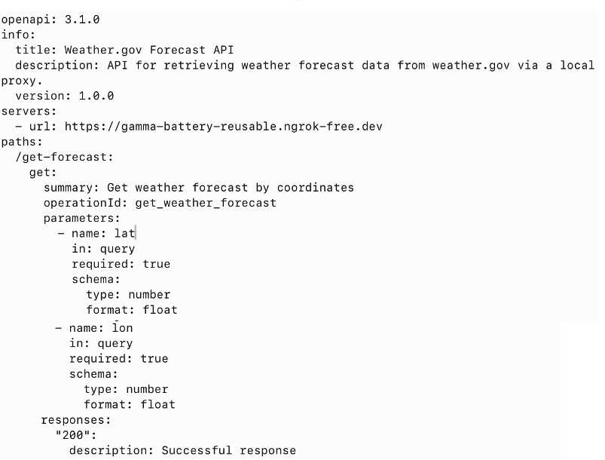
How does ChatGPT use YAML blueprint?
To make ChatGPT understand and trigger your API, you do not write Python code.
Instead, you write a text blueprint called an OpenAPI Schema (usually written in YAML format).
How ChatGPT Reads and Uses The YAML
The Server Link (servers/url):
ChatGPT uses this base address to know exactly where your local computer is hiding on the internet.
The Path (/get-forecast):
ChatGPT sees this and knows it needs to append this path to the end of your ngrok link.
The Parameters (lat and lon):
ChatGPT reads the descriptions.
Because it is smart, it says: "Oh! The user asked about Portland, Maine.
I know Portland is at latitude 43.6615 and longitude -70.2553.
I will plug those numbers right into these required slots.”
The Action:
ChatGPT bundles it all together and sends the final GET request directly down your ngrok tunnel to your FastAPI app.

Slide 11
Tt
Tt

Slide 12
Tt
Tt

Slide 13
Tt
Tt

