Slide 1
week2 of self guided cluster

Slide 2
This weeks submission implements a word_tokenizer (nltk) and a tf-idf model (genism) to create a similarity measure object (genism) in the td-idf space ( https://en.wikipedia.org/wiki/Tf%E2%80%93idf ).
Once the similarity measure object is complete 12 queries are generated and run against the similarity object. The output ranks the similarity of the query to the elemental documents of the similarity object.
The algorithmic flow is (comments extracted from source):
# start with a list of text documents (a list of lists where each document in the collection of documents is a list itself) to be considered
# convert the list of text documents into a list of tokenized documents
in order to correct artifacts from the nltk word_tokenizer
a custom punctuation remover function was implemented
a custom function designed to separate xxx.yyy tokens into xxx and yyy
# create a dictionary from the list of tokenized documents (a dictionary maps every token in the list of tokenized documents into a number (index))

Slide 3
algorithmic flow (continued):
# create a corpus (a corpus is a list of bags of words)
a bag of words is the term frequency (tf) of tf-idf.
each document in the list of tokenized documents is converted into an ordered list of two-element tuples where the first element is the dictionary term index and the second element is the frequency with which that term occurs in that document.
it is called a "bag of words" because the order of words in the original document is lost.
# create tf-idf model from corpus.
# create similarity measure object in tf-idf space
# run queries against the similarity measure object

Slide 4
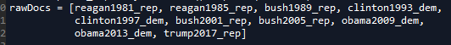
The last 10 presidential inaugural addresses (see below) serve as the collection of documents used to create the similarity measure object. Note that I chose these documents based on my interests. They were collected from http://www.presidency.ucsb.edu/inaugurals.php . The text from the site was highlighted, copied and pasted into a .txt file. These .txt were read into the algorithm.
On the next slide are extracts from each of the steps in the algorithm (except query – that will come after) for reagan1981_rep.txt (list 0 in rawDocs).

Slide 5
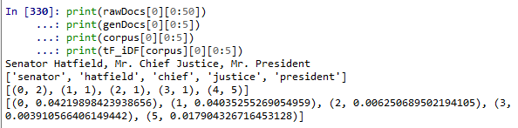

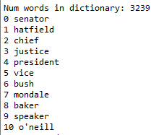
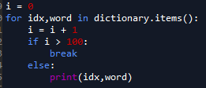
raw text (first 50 characters)
raw text after nltk word_tokenizer (first 5 tokens)
dictionary (first 10 entries)
first 5 tuples of the bag of words for the 0th document in the corpus
first 5 tuples of the tf-idf model for the 0th document in the corpus

Slide 6
13 queries were conducted against the similarity measure object.
theQuery0 = "I love love love the the Chief Justice and his minions"
theQuery1 = "I love the United States of America.“
theQuery2 = "I am the master of the universe."
theQuery3 = "I want to go to war.“
theQuery4 = "muslim muslims“
theQuery5 = "terror terrorist radical radicalized“
theQuery6 = hate and synonyms
theQuery7 = love and synonyms
theQuery8 = peace and synonyms
theQuery9 = war and synonyms
theQuery10 = prosperity and synonyms
theQuery11 = justice and synonyms
theQuery12 = immigration and synonyms
theQuery13 = racism and synonyms
All synonyms came from http://www.thesaurus.com.
The queries in red above are shown in the next slides.

Slide 7
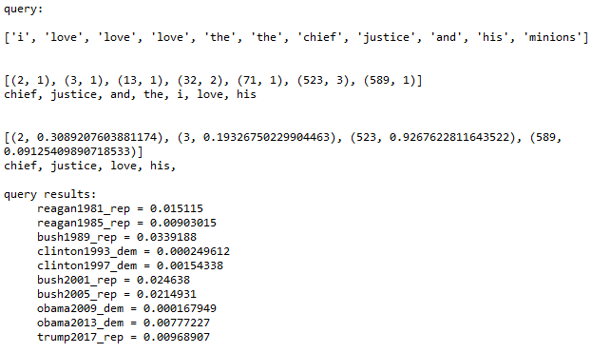
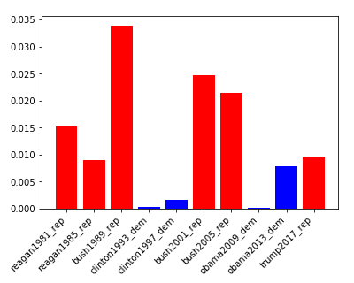

theQuery0 = "I love love love the the Chief Justice and his minions" - illustrative
the raw query
the query’s bag of words with the words extracted from the dictionary for illustrative purposes (note that minions is missing because it is not in the dictionary)
the query’s tf-idf model with the words extracted from the dictionary for illustrative purposes (note that and, the and i are not included because they occur in every document – their idf = 0)
t = term or token
N = total number of documents
# with t = number of documents with t
the query’s similarity measure of the query to each of the documents in the corpus – large value means higher similarity
red = republican, blue = democrat

Slide 8
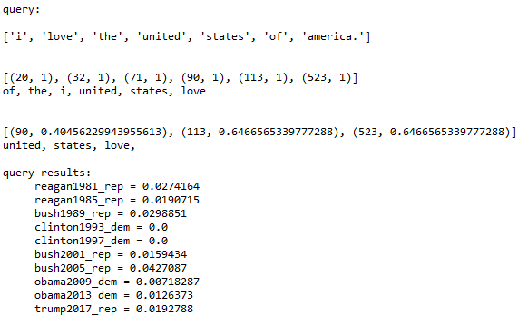
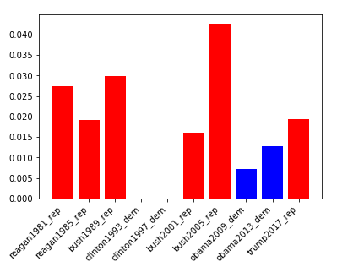
theQuery1 = "I love the United States of America.“
According to this query Bill Clinton’s inaugural speeches were the only two of the last ten that did not mention the words united and states.

Slide 9
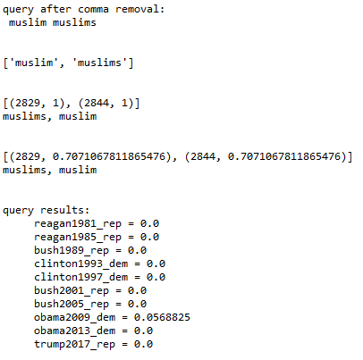
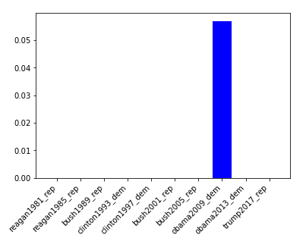
theQuery4 = "muslim muslims“
According to this query Obama was the only president to mention Muslims in his 2009 inaugural speech.

Slide 10
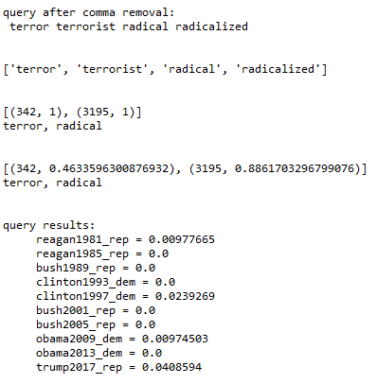
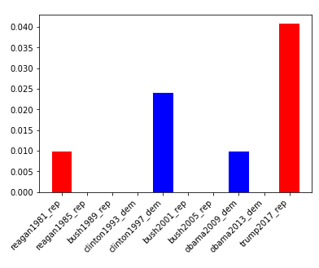
theQuery5 = "terror terrorist radical radicalized“
According to this query these words come up sporadically. Did specific events before the election cause this?
https://en.wikipedia.org/wiki/Terrorism_in_the_United_States

Slide 11
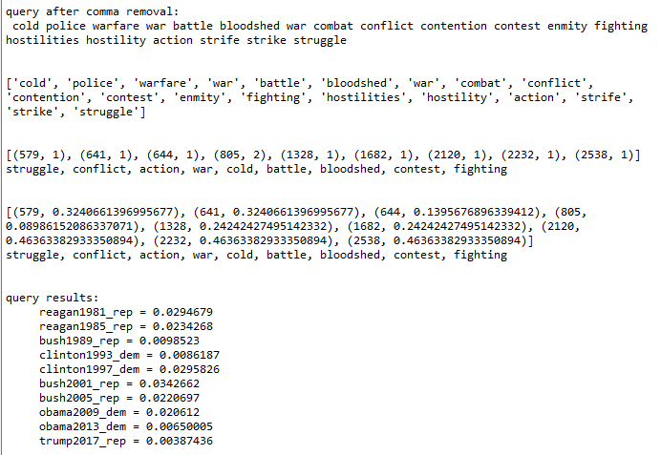
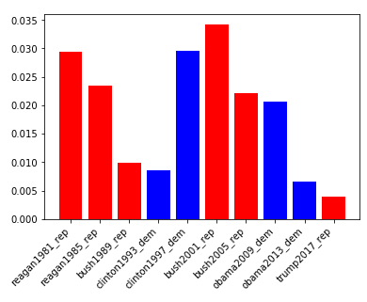
theQuery9 = war and synonyms
According to this query talk of war comes and goes in inaugural speeches.

Slide 12
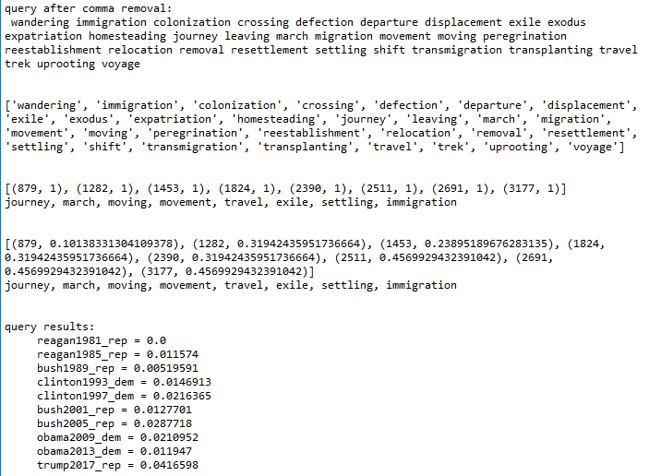
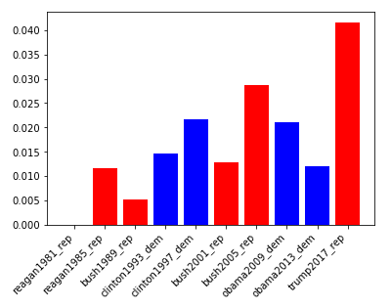
theQuery12 = immigration and synonyms
According to this query immigration and its synonyms have only come up more and more over time in the last 10 inaugural speeches.

Slide 13
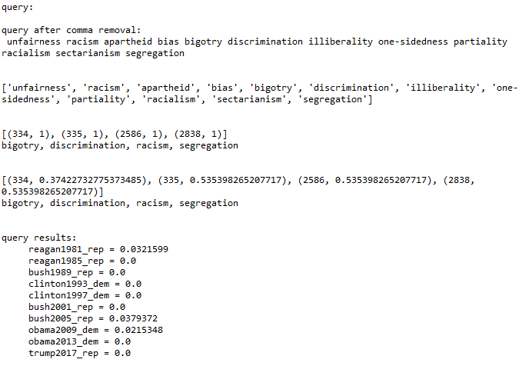
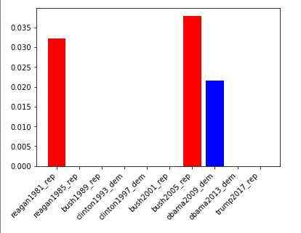
theQuery13 = racism and synonyms
According to this query racism and its synonyms have only come up in three of the last 10 inaugural speeches.

