Slide 2
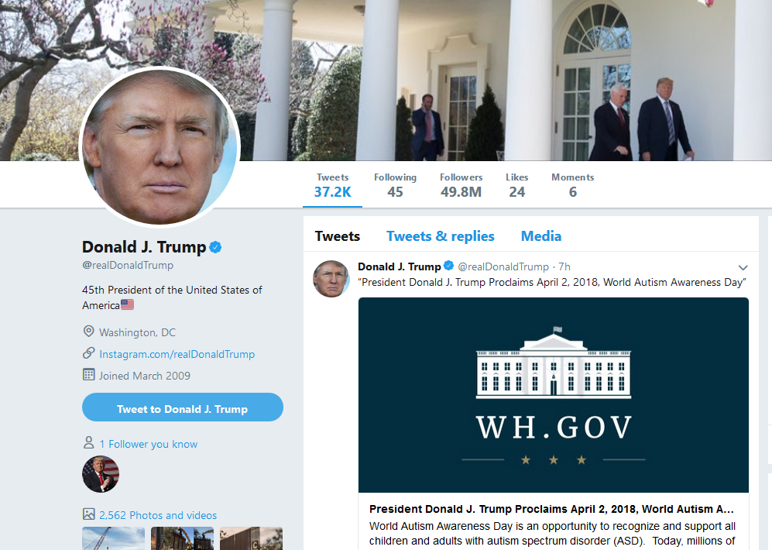
Trump Tweets from 1/20/17 to 3/29/18 (as POTUS)
no retweets
2610 tweets

Slide 3
Trump POTUS Tweets Word Clouds:
Unigrams, Bigrams and Trigrams

Slide 4
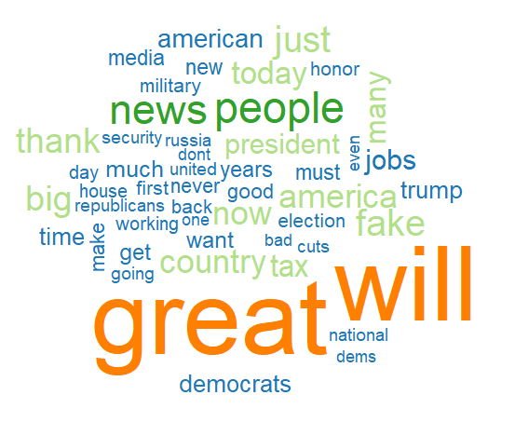
Trump POTUS Tweets TF Word Cloud: Unigrams

Slide 5
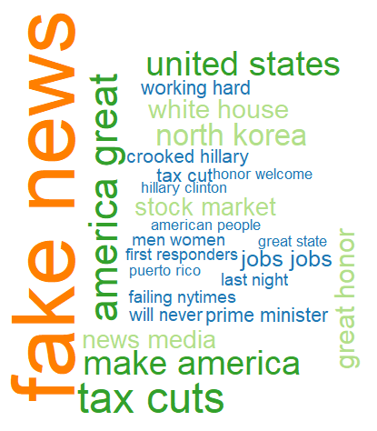
Trump POTUS Tweets TF Word Cloud: Bigrams

Slide 6
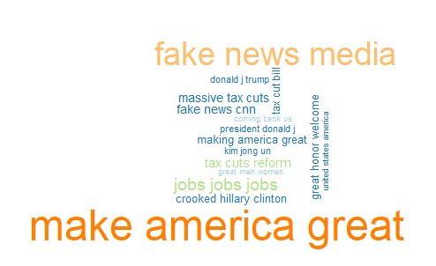
Trump POTUS Tweets TF Word Cloud: Trigrams

Slide 7
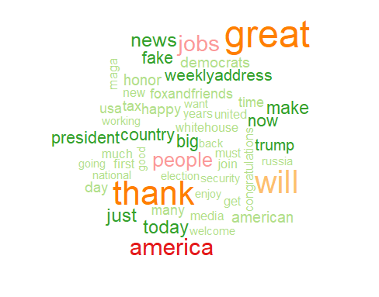
Trump POTUS Tweets TF-IDF Word Cloud

Slide 8
Trump POTUS Tweets Sentiment Analysis:
qdap Lexicon

Slide 9
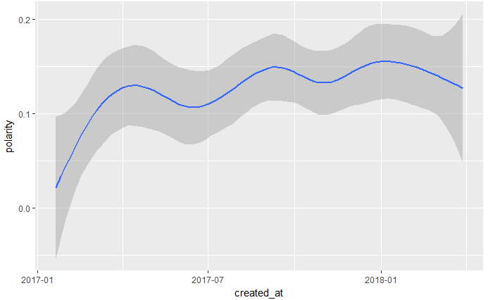
1/20/17
3/29/18
Trump Tweets Sentiment Analysis
1964 tweets with positive polarity
646 tweets with negative polarity

Slide 10
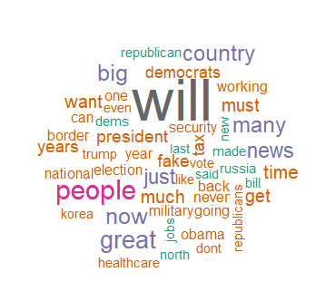
Trump Tweets: Positive and Negative Sentiment Commonality Cloud

Slide 11
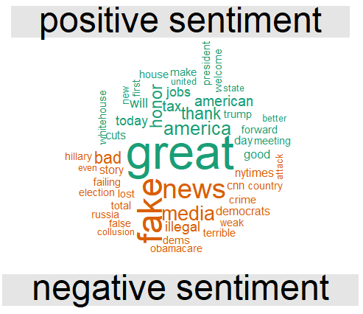
Trump Tweets: Positive and Negative Sentiment Comparison Cloud

Slide 12
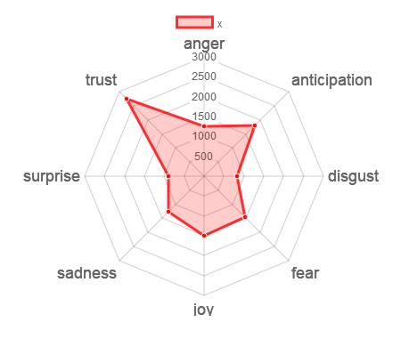
Trump Tweets: Emotional Analysis with NRC Lexicon
Trust Issues Feature Strongly in Trump POTUS Tweets

Slide 13
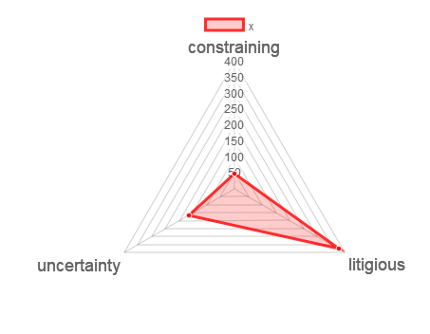
Trump Tweets: Emotional Analysis with Loughran Lexicon
Litigious Words Feature Strongly in Trump POTUS Tweets

