Slide 2
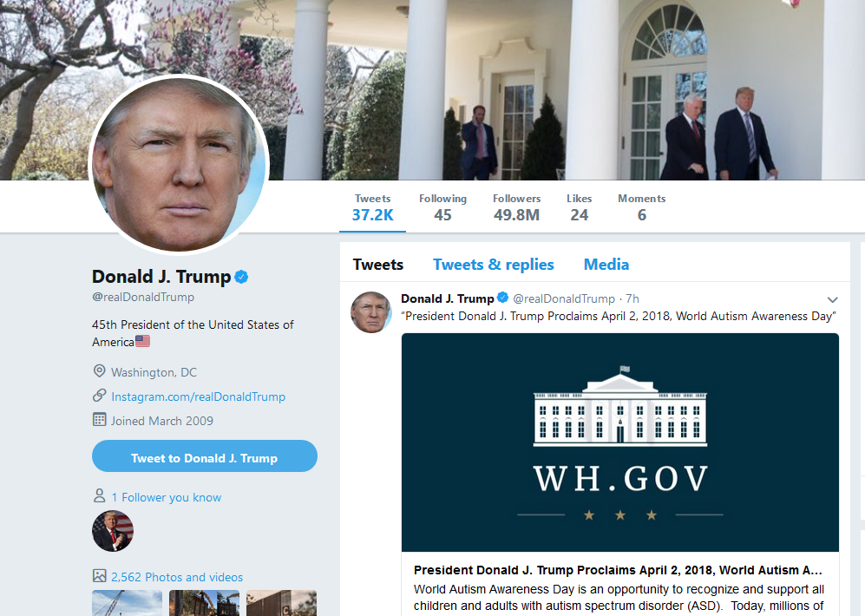
Trump Tweets from 1/20/17 to 3/29/18 (as POTUS)
no retweets
2610 tweets

Slide 3
Trump POTUS Tweets Word Clouds: Unigrams, Bigrams and Trigrams

Slide 4
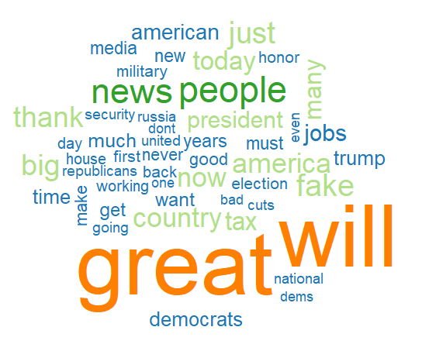
Trump POTUS Tweets TF Word Cloud: Unigrams

Slide 5
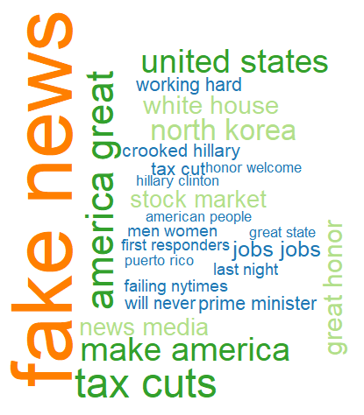
Trump POTUS Tweets TF Word Cloud: Bigrams

Slide 6
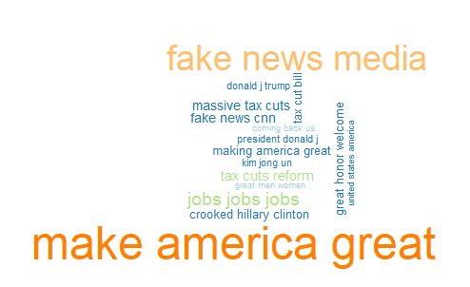
Trump POTUS Tweets TF Word Cloud: Trigrams

Slide 7
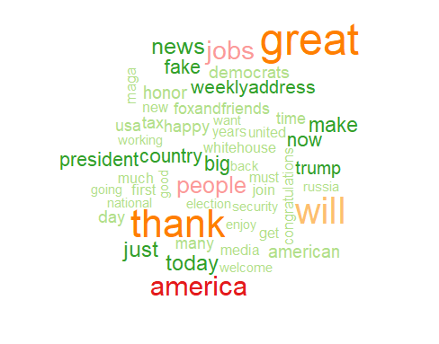
Trump POTUS Tweets TF-IDF Word Cloud

Slide 8
Trump POTUS Tweets Sentiment Analysis:
qdap Lexicon

Slide 9
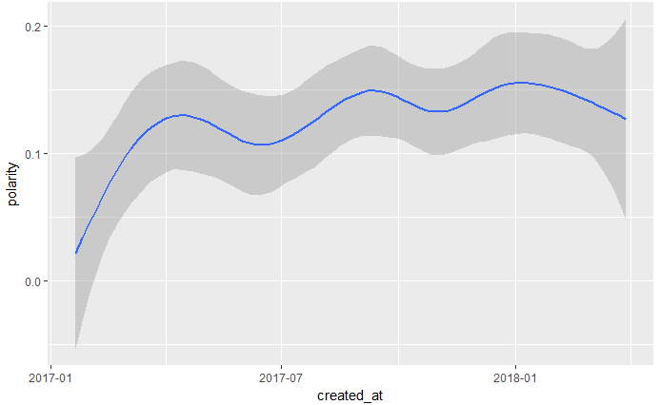
1/20/17
3/29/18
Trump Tweets Sentiment Analysis
1964 tweets with positive polarity
646 tweets with negative polarity

Slide 10
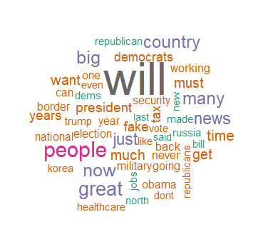
Trump Tweets: +ve and –ve Sentiment Commonality Cloud

Slide 11
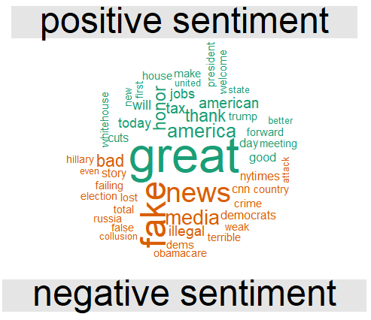
Trump Tweets: +ve and –ve Sentiment Comparison Cloud

Slide 12
Trump Word Clouds: Unigrams, Bigrams and Trigrams

