Slide 1
MURESSONS GLOBAL
CORPORATE SUSTAINABILITY SIMULATION
Player Briefing | 10 Rounds · 5 Years · 4 Business Units
Sovereign Intelligence Systems · Executive Education

Slide 2
WHAT IS MURESSONS?
You are a newly appointed Board Director of Muressons Group --
a multinational conglomerate with four business units.
Your mission:
Navigate 10 rounds of ESG crises, investment trade-offs,
and stakeholder dynamics across 5 simulated years.
Each round represents a 6-month semester. You will:
* Read crisis briefings from the Board
* Choose strategic responses (A, B, or C)
* Allocate capital across four business units
* Manage financial and sustainability KPIs
* Compete against peers on a live leaderboard
Your performance is measured by Terminal Valuation --
a formula that rewards both profit AND sustainability.

Slide 3
YOUR FOUR BUSINESS UNITS
PHARMA
ELECTRONICS
Rev: $18.0M | Margin: 36.1%
Rev: $16.5M | Margin: 34.5%
High-margin pharmaceutical division.
Governance risk: 15%. Highest revenue
but exposed to regulatory compliance
and social license pressures.
Technology and electronic components.
Governance risk: 20%. Carbon-intensive
manufacturing with supply chain
complexity and AI ethics exposure.
CONSUMER GOODS
SOFTWARE
Rev: $10.5M | Margin: 25.7%
Rev: $8.5M | Margin: 50.6%
Fast-moving consumer products.
Governance risk: 10%. Lower margins
but broad social license and circular
economy transition opportunities.
Digital services and SaaS platform.
Governance risk: 8%. Highest margins,
lowest carbon intensity, but vulnerable
to AI bias and data governance crises.

Slide 4
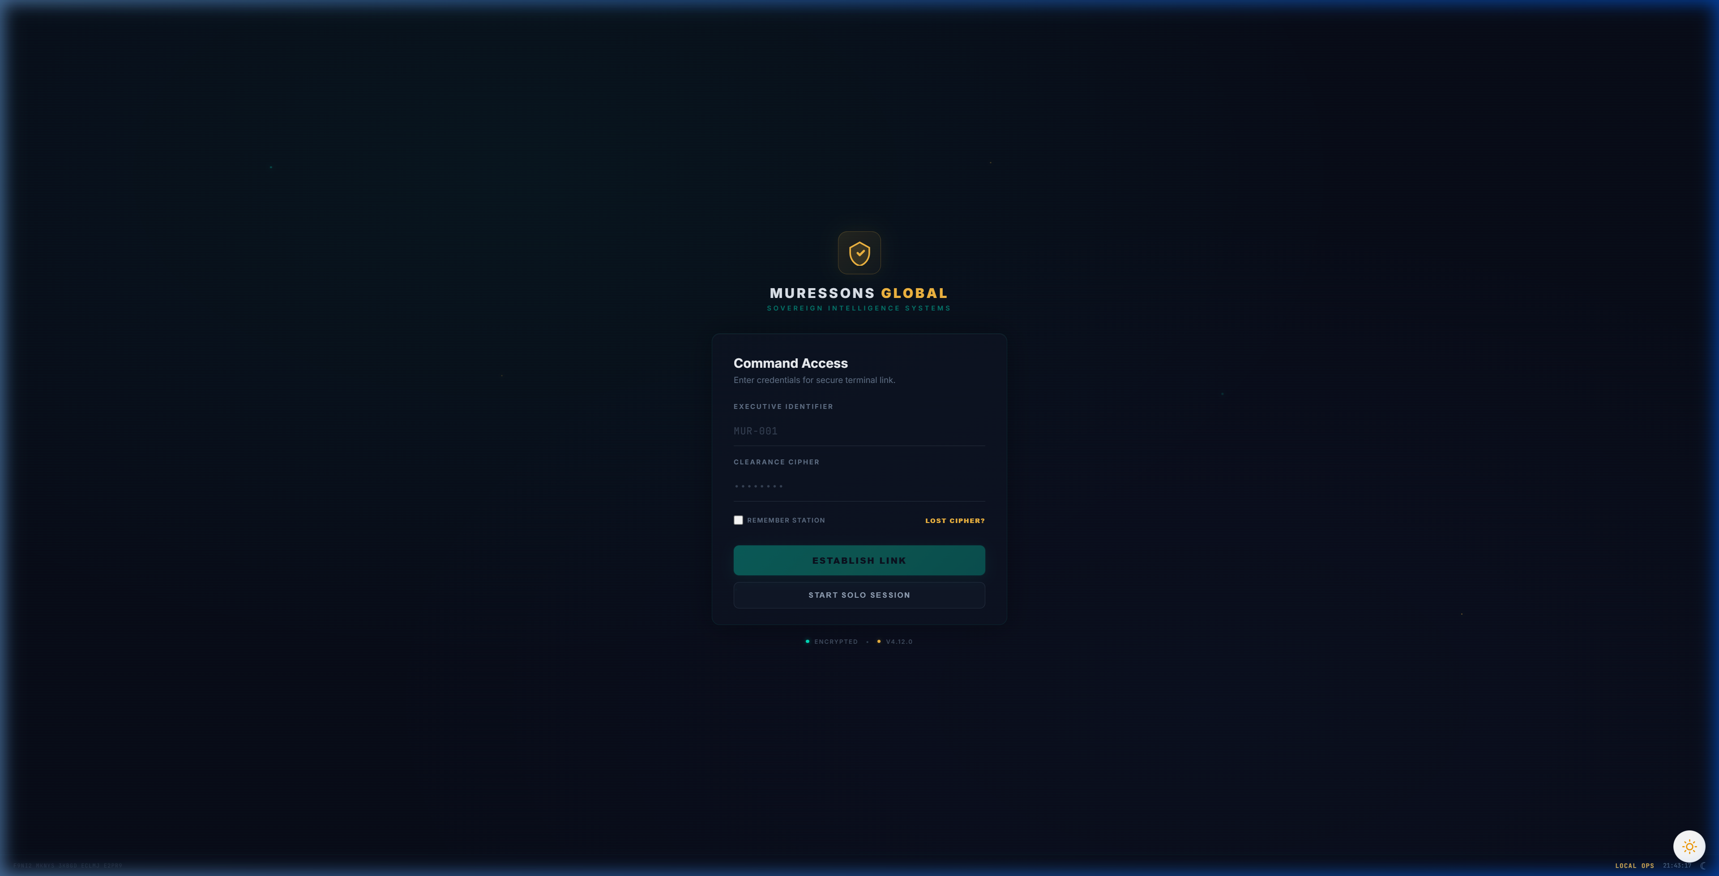
GETTING STARTED
1.
Enter your Executive Identifier (Player ID)
e.g. MUR-001
2.
Enter your Clearance Cipher (Password)
Provided by your facilitator
3.
Click 'Establish Link' to join your cohort
Or 'Start Solo Session' to practise alone
TIP: The simulation URL is http://localhost:3000 (or the IP address shown by your facilitator). Keep your Player ID handy -- you'll need it to rejoin if disconnected.

Slide 5
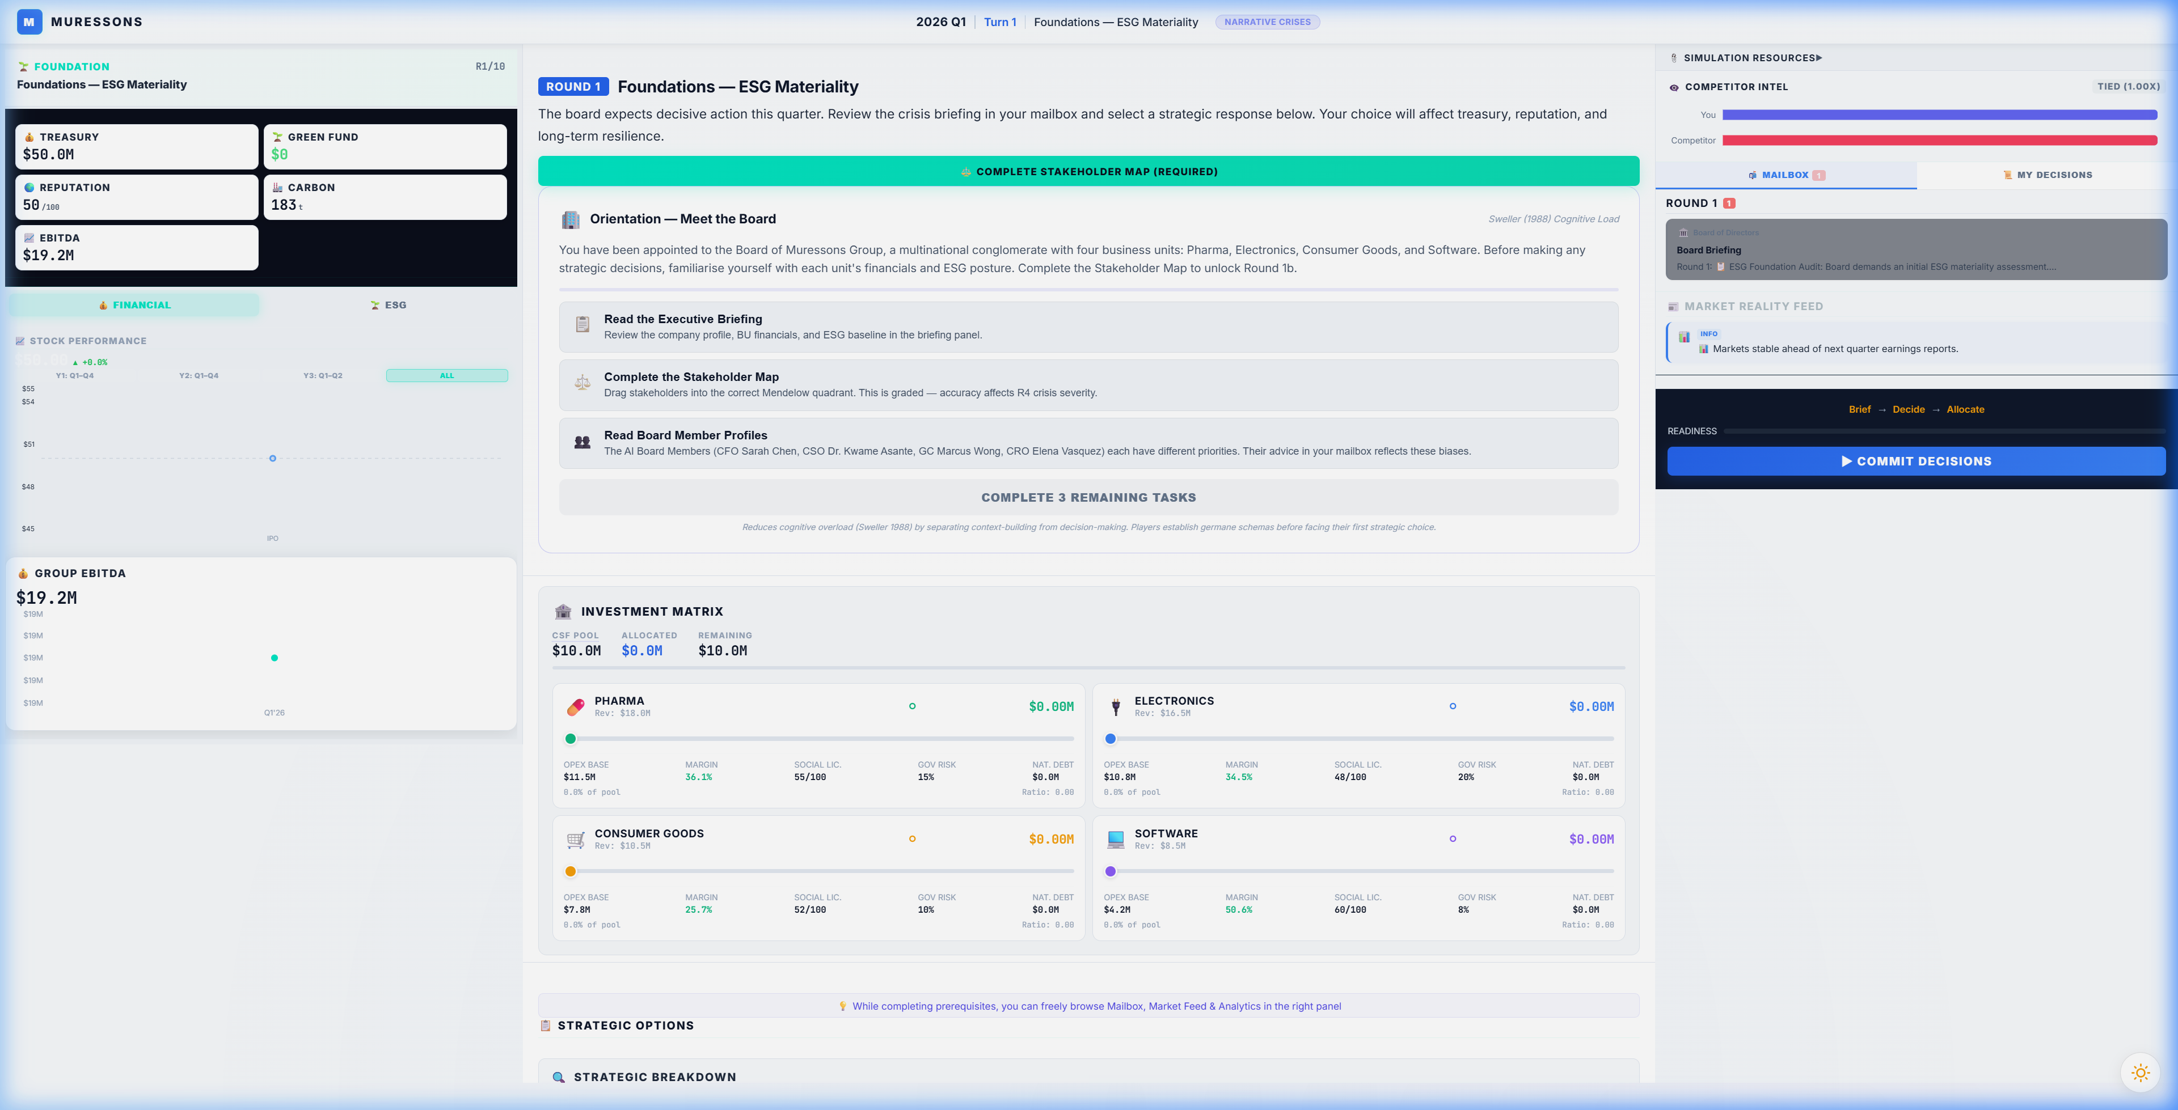
THE EXECUTIVE COCKPIT
This is your command centre. The 3-panel layout gives you everything you need:
LEFT PANEL
CENTRE PANEL
RIGHT PANEL
KPI Dashboard
Financials, Charts, Metrics
Briefing + Decisions
Crisis, Strategy, Allocation
Intel & Comms
Mailbox, Market Feed, AI Advisor

Slide 6
KEY PERFORMANCE INDICATORS
Monitor these critical metrics every round. All affect your final Terminal Valuation.
FINANCIAL
SUSTAINABILITY
Treasury (CSF)
Carbon (tCO2e)
Your capital pool for investments. Overspending triggers emergency credit.
Total emissions. Carbon tax bites harder each year. Net-zero is the goal.
EBITDA
Reputation
Earnings -- drives your terminal valuation. Protect revenue, control costs.
Stakeholder trust. Crisis contagion can crash it -- recovery is slow.
Revenue
Social License
Per-unit income. Grows with investment, shrinks with crises.
Community goodwill. Below 30 triggers protests and revenue loss.
Green Fund
Natural Capital Debt
Earmarked sustainability budget. Unlocks special bidding in Round 3.
Environmental debt that compounds. Ignore it and it spirals.
OPERATIONAL
KEY INSIGHT
Financial and ESG metrics are deeply interconnected.
Ignoring carbon leads to tax penalties that destroy EBITDA.
Ignoring reputation triggers contagion cascades.
Balance is everything.
Synergy Multiplier
Cross-BU collaboration savings. Grows with aligned investments.
Governance Risk
Board and compliance exposure. High risk = cash conversion penalty.
Staff Burnout
Above 20% triggers OPEX penalties. Above 70% is critical.

Slide 7
HOW EACH ROUND WORKS
1
READ THE BRIEFING
2
CHECK YOUR MAILBOX
Each round opens with a crisis scenario and Board directive.
Understand what's at stake before making decisions.
Board members (CFO, CSO, Legal, CRO) send advice.
Each has their own bias -- weigh their counsel carefully.
3
CHOOSE YOUR STRATEGY
4
ALLOCATE CAPITAL
Select Option A, B, or C. Each has different impacts
on financial performance, ESG metrics, and stakeholder trust.
Use the Investment Matrix to distribute your CSF pool
across the four BUs. You can allocate up to 120% (credit).
5
COMMIT & SEE RESULTS
Lock in your decisions. The engine calculates impacts.
Review your KPI changes and prepare for the next round.
Brief --> Decide --> Allocate --> Commit --> Results --> Next Round

Slide 8
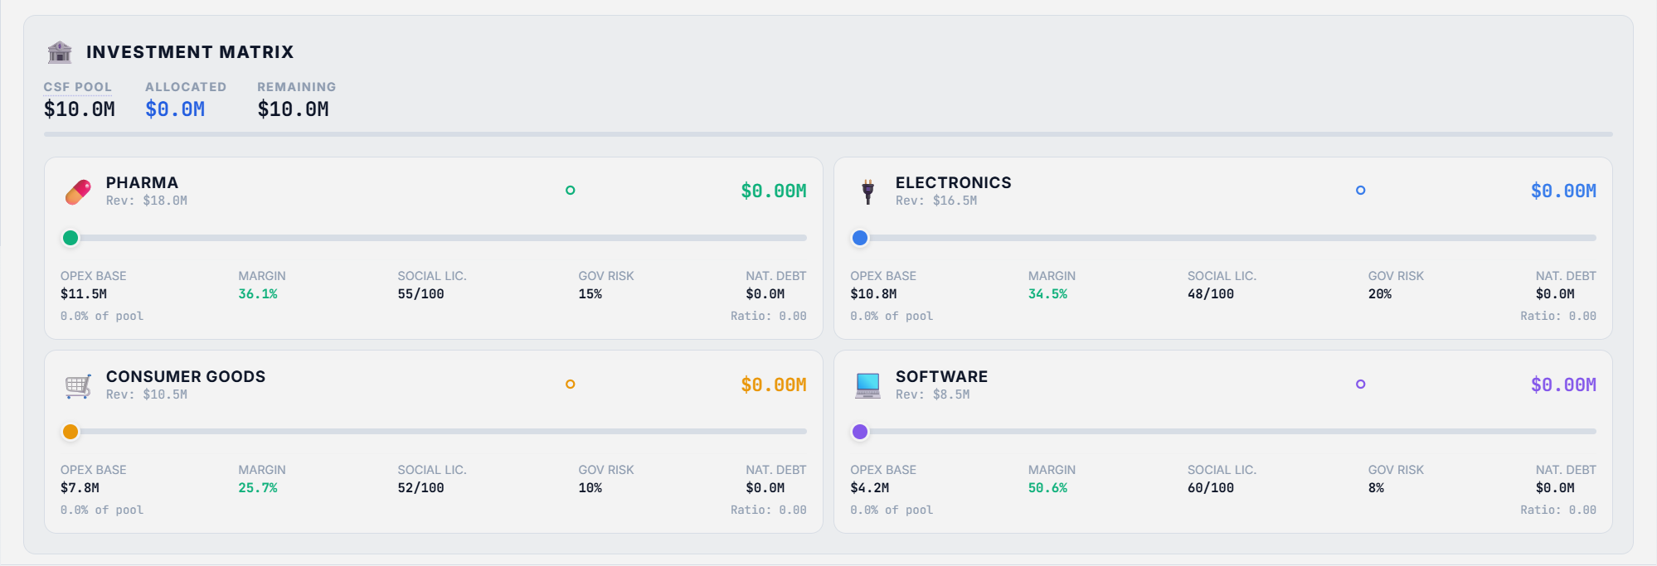
THE INVESTMENT MATRIX
CSF POOL
120% CAP
PER-UNIT METRICS
Your total capital budget.
Starts at $10M per round.
Grows/shrinks with performance.
You can allocate up to 120%
of your pool -- the excess is
emergency credit at a cost.
Each BU shows OPEX base,
margin, social license, gov risk,
and natural capital debt.

Slide 9
INVESTMENT STRATEGY GUIDELINES
CSF POOL MECHANICS
ALLOCATION PRINCIPLES
Starting Pool
$10M per round, adjusted by
performance and crisis impacts.
Protect Revenue Engines
Pharma ($18M) and Electronics ($16.5M)
generate 65% of group revenue. Under-
investing crashes top-line growth.
100% Target
Allocate within your pool for zero
interest cost. Optimal baseline.
Build Synergy
Aligned investments across BUs unlock
the Synergy Multiplier — an OPEX
reduction that compounds over rounds.
120% Credit Cap
You CAN over-allocate up to 120%
of your pool — the excess is borrowed
at punitive interest rates.
Front-Load Decarbonisation
Early carbon reduction avoids the
exponentially growing carbon tax.
$1 spent in R2 saves $3 by R8.
Under-Allocation
Unspent CSF is retained but unused
capital = missed growth opportunity.
Reserve for Crises
Keep a buffer for unexpected shocks.
Rounds 4-5 often hit treasury hard.
A $3-5M reserve is prudent.
Carbon Tax
Deducted from EBITDA, not treasury.
Grows each round. Decarbonise early.
Watch Governance Risk
High governance risk reduces cash
conversion efficiency. Every 10pts of
gov risk = ~3% EBITDA drag.
WARNING: Over-leveraging (>100%) triggers emergency credit. The interest compounds each round and is deducted from treasury. Two consecutive rounds at 120% can create a death spiral.
The best strategies balance growth investment, ESG compliance, and treasury preservation.

Slide 10
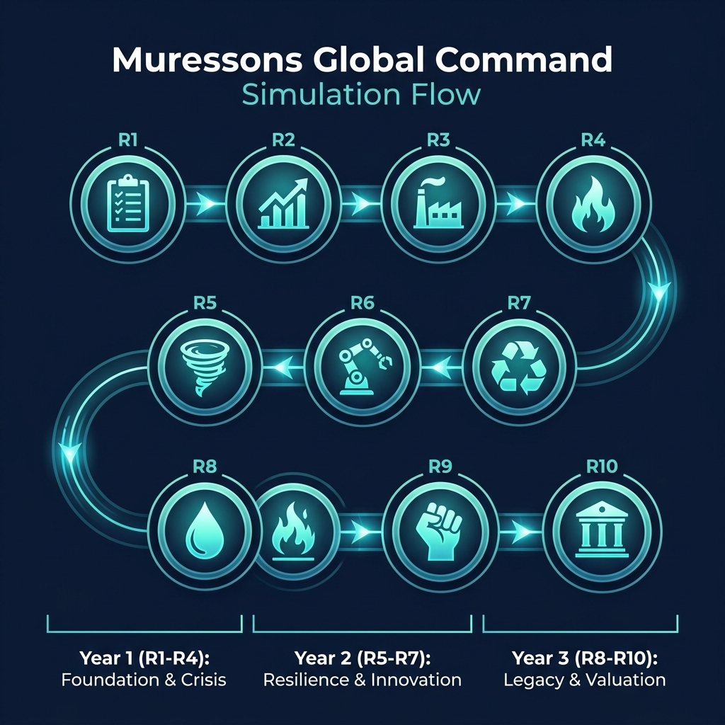
THE 10-ROUND JOURNEY
R1
Foundations
ESG Baseline
R2
Double Materiality
Budget Allocation
R3
Scope 3 Emissions
Supply Chain
R4
Contagion
Reputation Crisis
R5
Climate
Physical Risk
R6
AI Bias
Algorithmic Ethics
R7
Circularity
Circular Economy
R8
Blue Stress
Water Scarcity
R9
Just Transition
Workforce Justice
R10
Grand Finale
Activist Ultimatum
YEAR 1-2 | Foundation & Crisis
YEAR 3-4 | Resilience & Innovation
YEAR 5 | Legacy & Valuation

Slide 11
MINIGAMES & SPECIAL MODULES
Specialist modules unlock automatically as you progress through rounds:
Double Materiality Matrix
R2
Map ESG issues by impact + financial materiality (CSRD framework)
Green Fund Bidding
R3
Bid on sustainability projects using MAC curve economics
VCM Portfolio Builder
R5
Build a carbon credit portfolio across integrity tiers
Policy War Room
R8
Game-theoretic regulatory lobbying simulation
ESG Refinancing Simulator
R9
Model green bond pricing and brown penalty effects
Circular Strategy Dashboard
R10
Design product-as-a-service models using ReSOLVE framework
Boardroom Showdown
Final
High-stakes negotiation with an activist investor scenario
AI Podcast
Every Round
Briefing by Dr. Priya Sharma & Prof. James Walker

Slide 12
STAKEHOLDER ANALYSIS MATRIX
5 AI-driven stakeholder agents monitor your KPIs every round. Each has tolerance levels, grievance memory, and cascading triggers based on Mitchell et al. (1997) Stakeholder Salience:
Commissioner Carson — The Regulator
Red Lines: Gov Risk > 55 | Reputation < 35 | Carbon > 70
dormant > watching >
agitated > hostile > triggered
EU DG FISMA
Trigger Event: Regulatory Shutdown Order
Greta Berg — Gen Z Employee
Red Lines: Burnout > 55 | Reputation < 40 | Gov Risk > 50
dormant > watching >
agitated > hostile > triggered
Workers United
Trigger Event: Coordinated Strike Action
Marcus Chen-Hoffmann — Institutional Investor
Red Lines: Treasury < 0 | Reputation < 40 | Carbon > 65
dormant > watching >
agitated > hostile > triggered
Nordic Pension Alliance
Trigger Event: Institutional Divestment Fire Sale
Megha Patrike — Community Activist
Red Lines: SLO < 45 | Water Stress > 0.5 | NCD > 200K
dormant > watching >
agitated > hostile > triggered
Deccan Plateau Council
Trigger Event: Community Blockade & Injunction
Jay Buffet — Investigative Journalist
Red Lines: Reputation < 42 | Gov Risk > 48 | Carbon > 60
dormant > watching >
agitated > hostile > triggered
Deccan Herald
Trigger Event: Viral Expose
CASCADE EFFECT: When one agent triggers, it drags connected agents -10 to -15 tolerance. Interference pairs (e.g. Journalist + Regulator) accelerate each other's decay by 25-40%.

Slide 13
CSRD DOUBLE MATERIALITY MATRIX
In Round 2, you perform a Double Materiality Assessment under the CSRD framework. Drag ESG issues onto a 4-quadrant matrix to determine which are material:
Q2: MONITOR & ENGAGE
Q1: PRIORITISE & ALLOCATE
Top-Left: Low Financial + High Impact
IMPACT MATERIAL — Report Impact only.
Strategic watch list.
Top-Right: High Financial + High Impact
DOUBLE MATERIAL — Report under ESRS.
CapEx deducted from CSF pool.
Q4: LOW PRIORITY
Q3: WATCH & MANAGE
Bottom-Left: Low Financial + Low Impact
NOT MATERIAL — Monitor only.
No ESRS reporting required.
Bottom-Right: High Financial + Low Impact
FINANCIALLY MATERIAL — Report Risk.
Manage for enterprise value.
X-Axis: Financial Materiality (Enterprise Value) | Y-Axis: Impact Materiality (People & Planet)
Issue Bank
Stakeholder Panel
Q1 Budget Link
Custom Factors
15+ pre-loaded ESG issues tagged
E / S / G with ESRS topics, severity,
and time horizons (ST / MT / LT).
Commission a survey ($1M+) to
get expert issue ratings. Or use
the AI Advisor for free guidance.
Issues placed in Q1 have their
mitigation cost deducted from your
CSF pool. Budget is enforced.
Add your own ESG factors to the
Issue Bank. Tag them by category
and drag into any quadrant.

Slide 14
MID-TERM BOARD AUDIT & REVIEW
At Round 5, the Shadow Board convenes. Three AI personas present conflicting arguments about a climate crisis. You must publicly reject ONE — revealing your strategic DNA:
Marcus Chen-Hoffmann
Megha Patrike
Commissioner Carson
CIO, Nordic Pension Alliance
Head Panchayat, Deccan Council
EU DG FISMA
'Minimise CAPEX. Choose Insurance Only ($2M). Every dollar of CAPEX
is a dollar that won't flow to the dividend ratchet.'
'Choose Nature-Based Solutions ($5M). Hard engineering spikes our
Natural Capital Debt. Nature IS the infrastructure.'
'Option A — Hard Engineering ($8M) offers 85% resilience factor.
Choosing less is a failure of risk management.'
Reject = Sustainability-First archetype
Reject = Profit-Maximiser archetype
Reject = Risk-Taker archetype
Hostile Takeover pathway risk increases
Climate Black Swan / Stakeholder Revolt risk increases
Regulatory Shutdown pathway risk increases
CONSEQUENCES OF YOUR REJECTION
Strategic Archetype Set
Your rejection permanently classifies Muressons' strategic DNA (Sustainability-First / Profit-Maximiser / Risk-Taker).
Hidden Flags Planted
Flags like 'shareholder_alienated' or 'planet_expendable' are set silently. They cascade into Round 10's ending pathway.
Agent Tolerance -10
The rejected persona's stakeholder agent loses 10 tolerance immediately. Decay rate may accelerate by 20%.
Consequence DNA
A causal chain is recorded in the DNA Visualizer: Decision > Effect > R10 Risk.
Theory: Mitchell et al. (1997) Stakeholder Salience | Schon (1983) Reflection-in-Action | Hirschman (1970) Exit, Voice, Loyalty

Slide 15
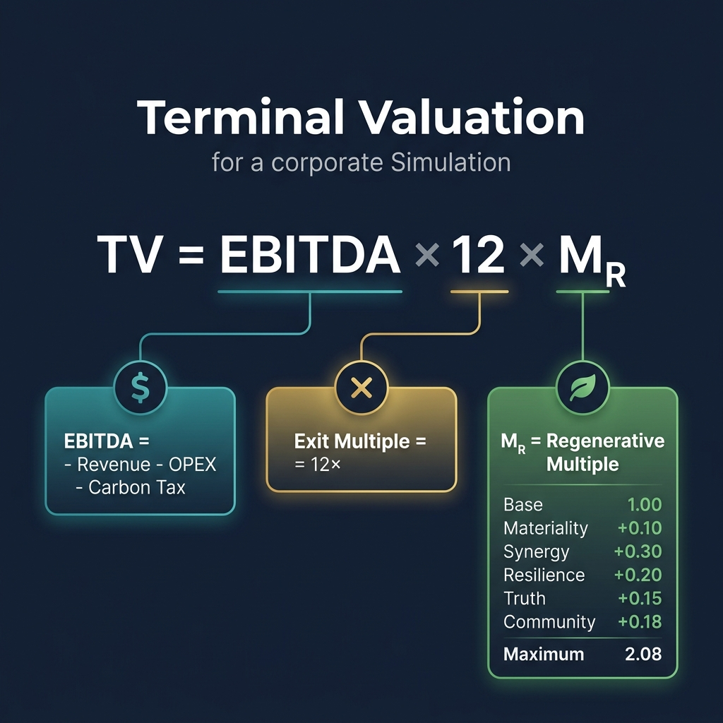
HOW YOU WIN: TERMINAL VALUATION
Your final score is your Terminal Valuation:
TV = EBITDA x 12 x M_R
Where:
EBITDA = Revenue - OPEX - Carbon Tax
Your core profitability metric.
Exit Multiple = 12x
Industry standard multiplier.
M_R = Regenerative Multiple
Base 1.00 + bonuses for:
Materiality +0.10
Synergy +0.30
Resilience +0.20
Truth +0.15
Community +0.18
Maximum M_R = 2.08

Slide 16
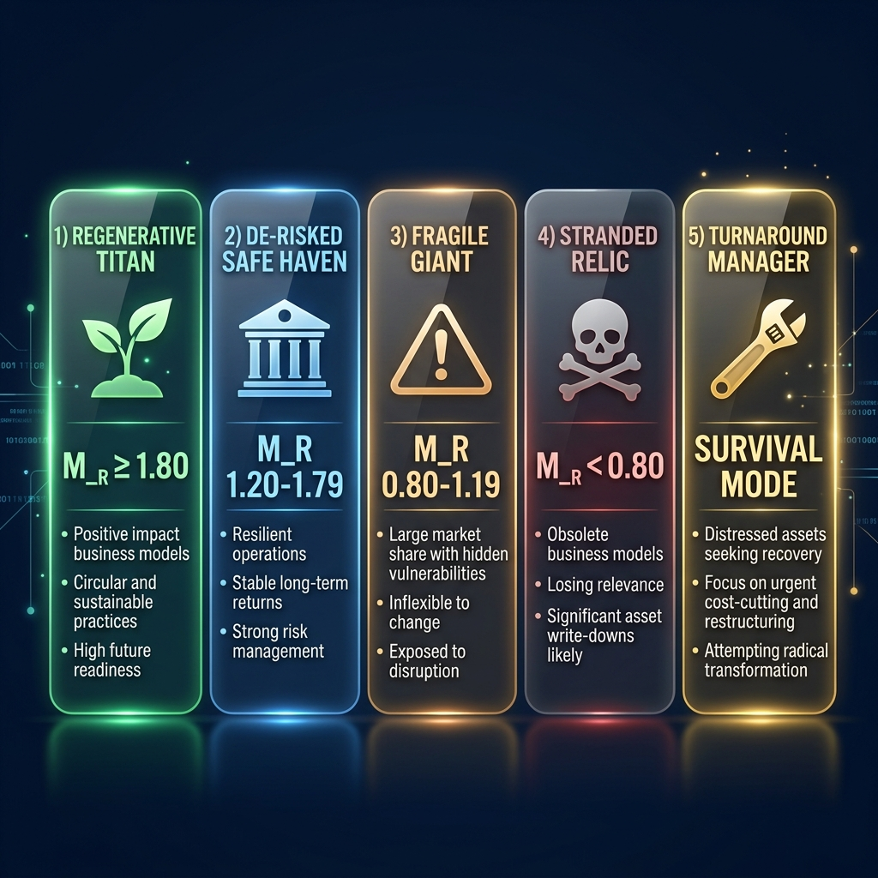
CORPORATE ARCHETYPES
Your M_R score determines your corporate archetype -- the story of how you led Muressons:

Slide 17
STRATEGIC TIPS FOR SUCCESS
Balance Profit & Planet
Chasing short-term EBITDA while ignoring ESG will destroy your M_R multiplier. The winning strategy finds synergies between financial and sustainability goals.
Protect Your Revenue Engines
Pharma and Electronics generate the most revenue. Neglecting their investment leads to margin compression and revenue decline.
Watch for Contagion
Reputation crises in one BU spread to others via sigmoid contagion. Early containment is cheaper than late recovery.
Don't Over-Leverage
The 120% credit facility is tempting but costly. The interest compounds. Smart allocation within 100% beats reckless overspending.
Read Your Board Advisors
The CFO cares about margins. The CSO pushes sustainability. Legal warns about risk. The CRO focuses on stakeholders. Synthesise their advice -- don't follow one blindly.
Build Synergy Across BUs
Aligned investments across business units unlock the synergy multiplier -- an OPEX reduction that compounds over rounds.

Slide 18
STRATEGIC PILLARS
Each round, you make independent decisions across 5 strategic areas. Each area offers 3 options with different cost/impact trade-offs:
E
ENERGY
Impacts:
Carbon Intensity, Reputation
Power Purchase Agreements, solar CapEx,
fleet electrification, green data centres
O
OPERATIONS
Impacts:
Governance Risk, Reputation, OPEX
Lean processes, digital twins,
AI governance, closed-loop manufacturing
S
SUPPLY CHAIN
Impacts:
Social License, Reputation, Supply Risk
Supplier audits, blockchain traceability,
geographic diversification, nearshoring
C
OFFSETTING
Impacts:
Natural Capital Debt, Social License
Nature-based offsets, carbon credits,
community funds, climate adaptation
H
HUMAN RESOURCES
Impacts:
Social License, Burnout, Workforce Readiness
DEI programmes, leadership dev,
green skills academy, crisis support
Each pillar choice costs treasury and sets flags that affect future rounds.

Slide 19
ALTERNATE ENDING PATHWAYS
Round 10 is not always the same! Your facilitator selects an ending pathway that shapes the final crisis. Foreshadowing clues appear from Round 5 onwards:
Activist Ultimatum
An activist consortium acquires a blocking stake and forces a strategic review: integrate, spin-off, or divest.
DEFAULT
Climate Black Swan
Cascading climate catastrophe triggers stranded asset write-downs. Carbon tax triples. Can you decarbonise in time?
CI-FOCUSED
Stakeholder Revolt
Employees strike, communities protest, consumers boycott. Triple stakeholder ultimatum demands a social compact.
SLO-FOCUSED
Hostile Takeover
A PE firm launches a hostile bid. Weak governance and low synergy make you vulnerable. Defend or accept?
SYNERGY-FOCUSED
Regulatory Shutdown
A whistleblower triggers a CSDDD investigation. The regulator threatens operational shutdown. Remediate or fight?
GOVERNANCE-FOCUSED
Watch for foreshadowing events in Rounds 5-8 -- they hint at which pathway is active!

Slide 20
PATHWAY: ACTIVIST ULTIMATUM
[!] The Board Under Siege
An activist consortium has acquired a blocking stake in Muressons Group. They demand a strategic review -- integration, spin-off, or full divestiture. The board must choose how to respond while protecting shareholder value and the company's long-term sustainability trajectory.
R10 STRATEGIC OPTIONS
A
Strategic Integration
Integrate activist demands into long-term strategy. High cost but preserves unity. M_R bonuses for synergy and materiality alignment.
B
Partial Spin-Off
Spin off underperforming BUs to satisfy activist. Moderate cost. Preserves core but reduces portfolio diversification.
C
Full Divestiture
Accept breakup. Short-term cash gain but destroys synergy. Exit multiple drops to 8x. M_R capped at 1.0.
M_R BONUSES
M_R PENALTIES
+0.10 Materiality alignment (CSRD governance in R2)
-0.40 Instability discount (avg SLO < 75)
+0.30 Synergy bonus (Synergy Score >= 80)
-0.20 Shadow Board rejection penalty
+0.20 Resilience bonus (survived R5/R8 crises)
+0.15 Truth premium (ethical AI overhaul in R6)
+0.18 Community champion (community fund in R9)
FORESHADOWING (R5-R8): R6: Activist files 13D (4.9% stake) | R7: Analyst restructuring note | R8: Blocking stake reached

Slide 21
PATHWAY: CLIMATE BLACK SWAN
[!!] The Stranded Asset Reckoning
The world has entered a climate emergency. Carbon pricing has tripled. Insurance markets refuse to underwrite high-exposure assets. A cascading climate catastrophe demands an immediate strategic response. Your carbon intensity history determines your fate.
R10 STRATEGIC OPTIONS
A
Emergency Decarbonisation
Halve all BU carbon intensities. NCD reduced 50%. Treasury -$20M. If avg CI < 25: +0.30 M_R Climate Leader bonus.
B
Climate Adaptation Portfolio
Divest BUs with CI > 40 at fire-sale prices (50% book value). Remaining BUs receive reallocation capital.
C
Deny & Delay
Lobby against carbon regulation. Carbon tax triples, NCD doubles. Exit multiple drops to 6x. M_R penalty -0.40.
M_R BONUSES
M_R PENALTIES
+0.30 Climate Leader (avg CI < 25 at R10)
-0.40 Stranded Asset Penalty (avg CI > 50 at R10)
+0.20 Adaptation Premium (nature-based + early decarboniser)
-0.20 Shadow Board planet rejection penalty
+0.15 Carbon Transition (CI reduced >= 40% from R1)
Exit multiple haircut based on avg CI
FORESHADOWING (R5-R8): R5: IPCC 1.5C overshoot | R6: Carbon futures +40% | R7: Uninsurable assets warning | R8: 1.5C breached

Slide 22
PATHWAY: STAKEHOLDER REVOLT
[!!!] The Social Reckoning
Employees, communities, and consumers have issued simultaneous ultimatums. Unionised workers demand burnout protections. Local councils threaten to revoke operating licences. A consumer boycott is reducing revenue. The board must respond to the triple stakeholder revolt.
R10 STRATEGIC OPTIONS
A
Total Stakeholder Compact
Legally binding charter: living wages, community agreements, quality standards. Treasury -$18M. Revenue +15%. If SLO >= 70 AND burnout < 30: +0.35 M_R.
B
Selective Appeasement
Address the loudest group only (auto-selects worst metric). Treasury -$8M. Fixes one dimension, unaddressed groups escalate (-10 SLO).
C
Corporate Hardball
Threaten overseas relocation. All SLO -25, burnout +20. Treasury +$10M. If any BU SLO hits 0, that BU is shuttered. M_R penalty -0.30.
M_R BONUSES
M_R PENALTIES
+0.35 Social Regeneration (SLO >= 70 AND burnout < 30)
-0.50 Social Collapse (avg SLO < 40 OR burnout > 70)
+0.15 Employee Champion (burnout < 25 AND readiness >= 70)
-0.20 Shadow Board shareholder alienation
+0.15 Community Trust (avg SLO >= 80)
FORESHADOWING (R5-R8): R5: Toxic culture review | R6: Community coalition | R7: #BoycottMuressons trends | R8: Triple ultimatum

Slide 23
PATHWAY: HOSTILE TAKEOVER
[!] The Corporate Raider
Cerberus Capital has launched a hostile tender offer at a 15% premium. The PE firm plans to break up the conglomerate and sell individual BUs. The board has 48 hours to respond. Your synergy multiplier and treasury strength determine whether shareholders side with management or the raider.
R10 STRATEGIC OPTIONS
A
White Knight Defence
Seek a friendly acquirer who preserves the integrated strategy. Treasury -$15M. If synergy >= 1.3 AND treasury > $30M: +0.25 M_R. Revenue -5% friction.
B
Poison Pill + Crown Jewel Lock-Up
Dilutive share issuance and lock-up agreements. Treasury -$25M. Preserves independence but exit multiple drops to 10x (debt overhang).
C
Accept the Bid
Take the premium. Treasury +$20M but conglomerate broken up. Exit multiple locked at 8x. M_R capped at 1.0, penalty -0.50.
M_R BONUSES
M_R PENALTIES
+0.25 Strategic Integration (synergy >= 1.3 AND treasury > $30M)
-0.40 Vulnerable Target (synergy < 1.1 AND treasury < $10M)
+0.20 Fortress Premium (EBITDA margin > 20% AND no scandals)
-0.20 Shadow Board shareholder alienation
+0.15 Conglomerate Premium (synergy >= 1.5)
FORESHADOWING (R5-R8): R6: Unusual share volume | R7: PE firm 'denies' interest | R8: Preliminary offer filed with regulator

Slide 24
PATHWAY: REGULATORY SHUTDOWN
[!] The Compliance Reckoning
The environmental regulator has completed its investigation triggered by a whistleblower. Muressons faces a Notice of Violation under the CSDDD, citing systematic failures in supply chain due diligence. The regulator can impose operational restrictions, heavy fines, or a consent decree requiring third-party monitoring.
R10 STRATEGIC OPTIONS
A
Full Remediation Programme
Exceed CSDDD requirements: full traceability, impact assessments, remediation fund. Cost $4M per BU. If ethical score > 7 AND no scandals: +0.30 M_R.
B
Negotiate Consent Decree
Accept $30M fine and 3-year third-party monitoring. Operations continue. Exit multiple reduced to 10x. Carbon tax increases to $350/t.
C
Contest the Ruling
Challenge in court. Legal costs $10M. If unsuccessful (likely if ethical score < 5): double fine ($60M), worst BU suspended, exit multiple to 7x, reputation -30.
M_R BONUSES
M_R PENALTIES
+0.30 Regulatory Exemplar (ethical score > 7, no scandals)
-0.45 Regulatory Failure (ethical score < 4)
+0.20 Supply Chain Transparency (scope 3 or full remediation)
-0.25 Shadow Board governance fragility
+0.15 Proactive Compliance (ethical score > 6 AND SLO > 60)
-0.35 Contest ruling M_R penalty (if unsuccessful)
FORESHADOWING (R5-R8): R5: CSDDD adopted | R6: Peers face $50M+ compliance | R7: Whistleblower contacts regulator | R8: Show cause notice

Slide 25
CONSEQUENCE DNA VISUALIZER
The Sankey diagram maps the causal chain from your decisions to their terminal value impact. It activates after the Round 5 Shadow Board Audit:
DECISIONS
CAUSAL FLAGS
SYSTEM AGENTS
METRIC SHIFTS
M_R PROJECTION
Your R1-R10 choices.
Each coded by Leverage
Point depth (LP1-LP12).
Deeper = more systemic.
Flags set by decisions
that persist across rounds.
e.g. renewable_ppa_signed,
sbti_committed.
AI stakeholder agents
that constrict value flow.
Stages: dormant, watching,
agitated, hostile, triggered.
Concrete KPI changes
caused by flag activation.
e.g. carbon -8, reputation
+5, SLO +3.
Final M_R contribution
of each causal chain.
Positive (green) or
negative (red) delta.
>
>
>
>
KEY CONCEPTS
Leverage Points (LP1-LP12)
Based on Donella Meadows' framework. LP1 (paradigm shift) = deepest intervention. LP12 (parameter tweak) = shallowest. Deeper decisions create more systemic change.
Constriction Agents
AI stakeholder agents that model real-world pressure groups. When triggered, they constrict value flow between metrics and M_R, reducing your terminal valuation.
Red DNA Nodes
Option C consequences that create permanent structural damage. These appear as red warning markers -- constrictions and value leaks that cannot be reversed.
The DNA Visualizer activates after R5 and is available as a frozen snapshot in the final scorecard.

Slide 26
THE ENDGAME
After Round 10, the simulation enters the endgame sequence:
1
TERMINAL VALUATION
2
BALANCED SCORECARD
The engine calculates your final TV = EBITDA x 12 x M_R.
All bonuses and penalties from 10 rounds are tallied.
A 4-perspective analysis of your performance:
Financial, Stakeholder, Internal Processes, Learning & Growth.
3
ARCHETYPE REVEAL
4
BOARDROOM SHOWDOWN
Your corporate archetype is revealed based on M_R score:
Regenerative Titan, De-risked Safe Haven, Fragile Giant, or Stranded Relic.
A high-stakes negotiation scenario where you face an activist
investor (or pathway-specific antagonist) in a final confrontation.
5
CEO INTERVIEW
6
LEADERBOARD & REPORT
An AI-powered CEO interviews you on your strategic decisions.
Your responses are scored on 6 competency dimensions.
Final rankings against other players. Download your
comprehensive HTML report with all metrics and analysis.
R10 >> Valuation >> Scorecard >> Showdown >> Interview >> Report

Slide 27
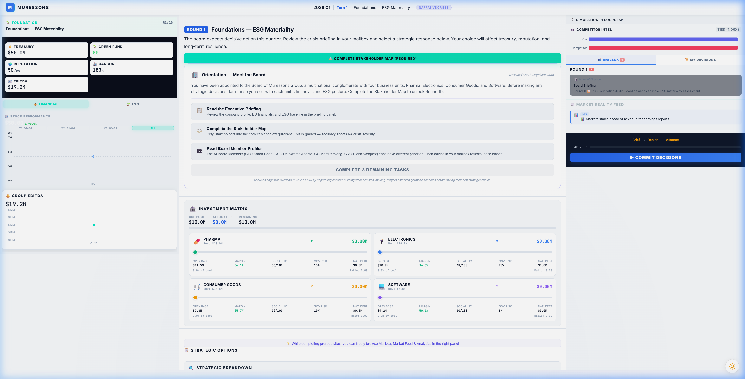
BALANCED SCORECARD
FINANCIAL
Adjusted EBITDA (after carbon tax)
Green Cost of Debt (NRRS)
STAKEHOLDER
Group Reputation (0-100)
Social License to Operate
INTERNAL
Industrial Synergy multiplier
Carbon Liability (tonnes)
LEARNING
Talent Retention Index
Just Transition & VRIO status
SCORECARD FEATURES
M_R Breakdown
See exactly how each bonus/penalty contributed to your Regenerative Multiple
Critical Analysis
AI-generated strengths, weaknesses, and missed opportunities
TBL Matrix
Triple Bottom Line view: People, Planet, Profit across all BUs
Performance Trends
Round-by-round charts: EBITDA, carbon, reputation, treasury, synergy
Downloadable Report
Export a comprehensive HTML report of your entire simulation performance

Slide 28
CEO INTERVIEW
After Round 10, the CEO of Muressons interviews you on your strategic decisions. An AI voice asks 5 questions and scores your responses across 6 competency dimensions:
6 COMPETENCY DIMENSIONS
HOW IT WORKS
Strategic Thinking
Long-term vs short-term trade-off awareness
4 Core Questions
Asked every session -- covering strategy,
trade-offs, systems effects, and hindsight.
Stakeholder Empathy
Articulating competing stakeholder interests
1 Pathway Question
Financial Acumen
Understanding of treasury, EBITDA, M_R mechanics
Tailored to your ending pathway --
tests domain-specific strategic insight.
Ethical Reasoning
Moral framework sophistication
50/50 Scoring
Final score blends simulation performance
data (50%) with interview response quality (50%).
Systems Thinking
Understanding cross-round flag dependencies
Adaptive Leadership
Spider Diagram
Willingness to change strategy with new info
Your results are visualised as a radar
chart showing strengths and growth areas.
The CEO interview is an optional post-game module. Your facilitator will tell you if it's enabled. Prepare by reflecting on your key decisions and their outcomes.

Slide 29
LEARNING OUTCOMES
By the end of this simulation, you will have developed competencies across 6 critical dimensions of corporate sustainability leadership:
Strategic Thinking
Understand trade-offs between short-term financial performance and long-term sustainability value creation. Navigate the tension between shareholder returns and stakeholder capitalism.
Rounds 1-10: Every A/B/C decision tests this
CSRD & Double Materiality
Apply the EU Corporate Sustainability Reporting Directive framework. Classify ESG issues by financial materiality and impact materiality using ESRS topic standards (E1-E5, S1-S4, G1).
Round 2: Double Materiality Matrix minigame
Stakeholder Salience
Evaluate competing stakeholder claims using Mitchell et al.'s framework of Power, Legitimacy, and Urgency. Understand how stakeholder agents escalate from dormant to triggered.
Round 5: Shadow Board Audit | All rounds: Agent system
Systems Thinking
Recognise cross-round causal dependencies and feedback loops. Understand how decisions in early rounds create path dependencies that constrain options in later rounds (Meadows' Leverage Points).
Round 5+: Consequence DNA Visualizer
Climate & Carbon Literacy
Manage carbon intensity, natural capital debt, Scope 1/2/3 emissions, and carbon credit markets. Understand the financial impact of carbon taxation and stranded asset risk.
Rounds 3, 5, 7: Carbon-focused crises
Ethical Leadership
Navigate moral dilemmas where profit-maximising and ethically-sound choices diverge. Articulate your reasoning under pressure in the CEO Interview. Develop a personal ethical framework for corporate decision-making.
Round 10: CEO Interview | All rounds: Option C tests
Pedagogy: Simulation covers Bloom's Taxonomy levels 3-6 (Apply, Analyse, Evaluate, Create) | Kolb Experiential Learning | Schon Reflection-in-Action

Slide 30
READY TO LEAD?
The Board of Muressons Global awaits your strategic direction.
10 Rounds | 5 Years | Every Decision Counts
Profit without purpose is a stranded asset
Purpose without profit is a failed enterprise
Good luck !
MURESSONS GLOBAL | Sovereign Intelligence Systems

