Slide 1
A Tool for Automatically Suggesting Source-Code Optimization for Complex GPU Kernels
Saeed Taheri, School of Computing, University of Utah
Martin Burtscher, Department of Computer Science, Texas State University
Apan Qasem, Department of Computer Science, Texas State University
PDPTA’15, 29 July 2015
Las Vegas, NV
(This work has been done as part of my master thesis at Texas State University under Dr. Martin Burtscher)

Slide 2
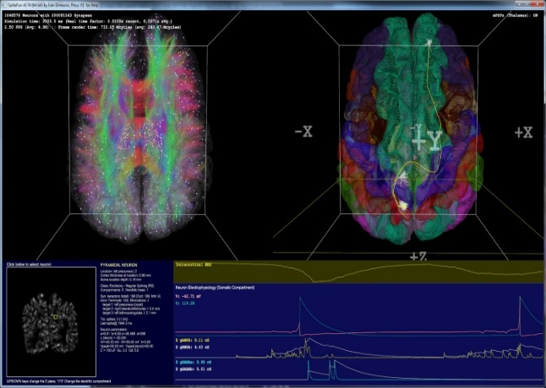

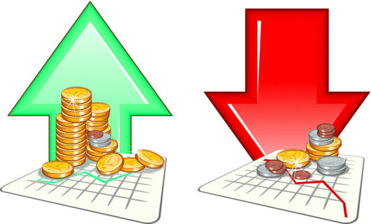
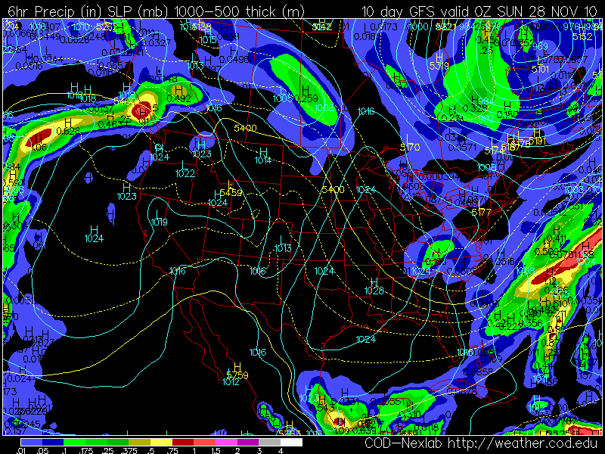
Introduction
Parallel Processing
Why?

Slide 3
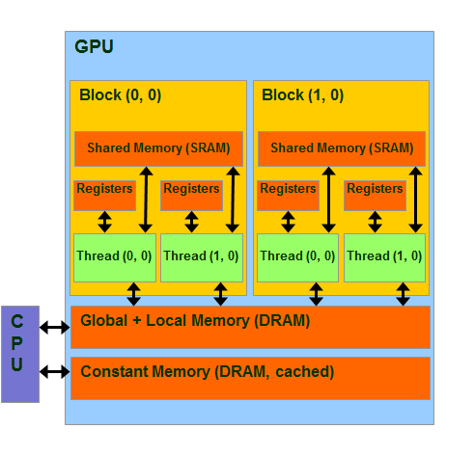
Introduction
Parallel Processing
Why?
GPU

Slide 4
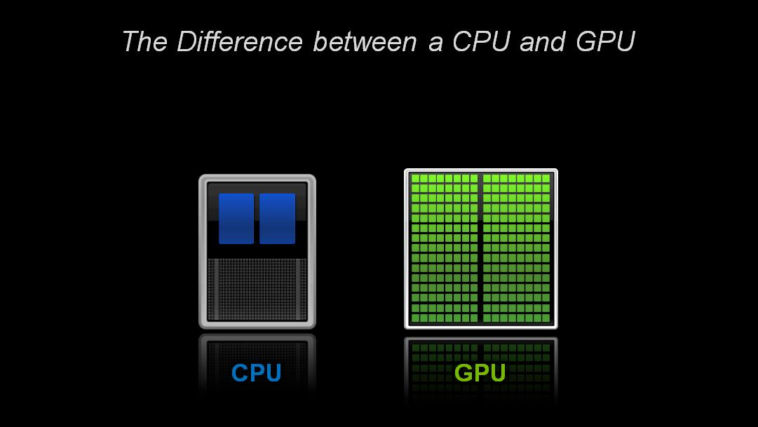
Introduction
Parallel Processing
Why?
GPU
CPU vs. GPU

Slide 5
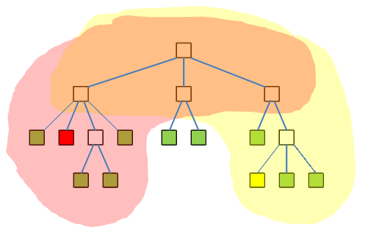
Introduction
Parallel Processing
Why?
GPU
CPU vs. GPU
Regular vs. Irregular

Slide 6
Main Idea
Difficulties with accelerators such as GPU
Execute certain types of programs efficiently
Sufficient parallelism
Data reuse
Regularity in memory accesses and control flow
Harder than CPUs to program
Architectural differences

Slide 7
Main Idea
Goal
Make parallel programming easier for programmers who are not experts in GPU programming.
Design a tool for GPU codes, irregular codes in particular, to find the performance bottlenecks of the codes and suggest some optimization hints to the user to make the code more efficient

Slide 8
Main Idea
Approach
Characterize/measure performance
Train a model
Find the estimated impact of several source-code optimizations based on the trained model
Rank and suggest optimizations to the user based on their impact

Slide 9
Main Idea
Experiments
Run experiments on Tesla K20 GPU
N-body problem simulation
NB (regular)
Barnes-Hut (BH) (Irregular)
Code-Embedded Optimizations
Machine Learning Predictions

Slide 10
Overview of Results
Train and test on same code :
Up to 97% accuracy of predictions
Train and test on different codes:
Up to 82% accuracy of predictions
Better results when training on larger datasets

Slide 11

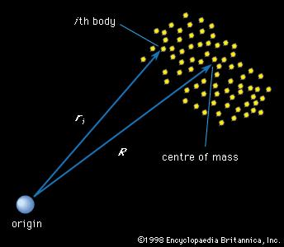
N-body Problem
Time evolution of physical system
System consists of bodies
“n” is the number of bodies

Slide 12
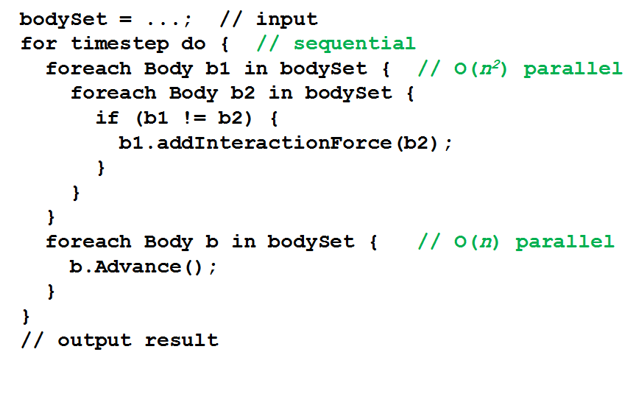
N-body Problem
NB : Regular parallel implementation, O(n²)

Slide 13
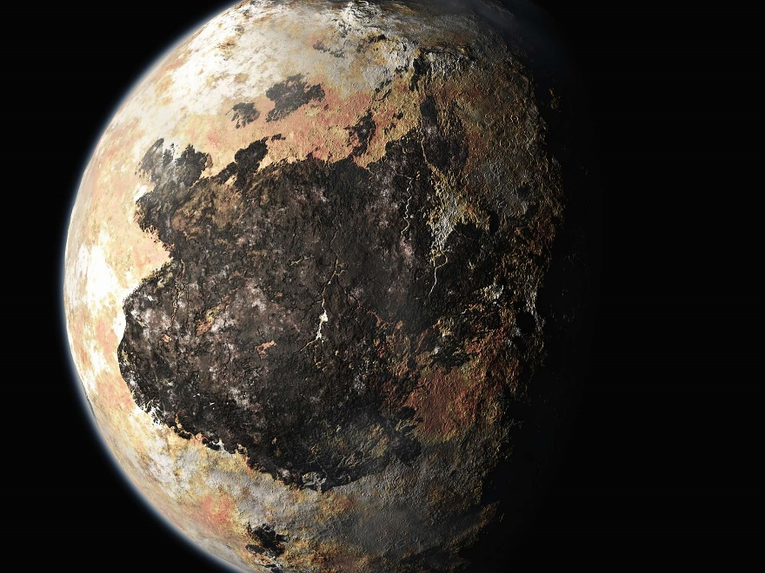
Barnes-Hut (1986)
Algorithm to approximately compute forces
Requires only O(n log n) operations
Idea is to “combine” far away bodies
Error should be small because force ∼ 1/distance²

Slide 14
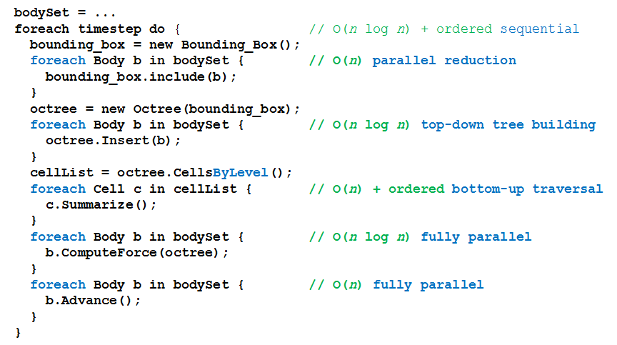
Barnes-Hut Parallel Simulation
BH : Irregular parallel implementation, O(n log n)

Slide 15
Optimizations
BH |  | NB
VOTE | employs thread voting instead of a shared-memory-based code sequence to perform a 32-element reduction. | FTZ | flush denormal numbers to zero when executing floating-point operations
WARP | switches from a thread-based to a warp-based implementation | RSQRT | CUDA “rsqrtf()” instead of “1.0f / sqrtf()”
SORT | approximately sorts the bodies by spatial distance | CONST | Copy immutable parameters into constant memory
RSQRT | CUDA “rsqrtf()” instead of “1.0f / sqrtf()” | PEEL | separates the innermost loop of the force calculation into two consecutive loops
FTZ | flush denormal numbers to zero when executing floating-point operations | SHMEM | employs blocking, reduces the number of global memory accesses
VOLA | strategically copies volatile variables into non-volatile variables, reduces memory accesses | UNROLL | unrolling of the innermost loop(s)

Slide 16
Optimizations
BH |  | NB
VOTE | employs thread voting instead of a shared-memory-based code sequence to perform a 32-element reduction. | FTZ | flush denormal numbers to zero when executing floating-point operations
WARP | switches from a thread-based to a warp-based implementation | RSQRT | CUDA “rsqrtf()” instead of “1.0f / sqrtf()”
SORT | approximately sorts the bodies by spatial distance | CONST | Copy immutable parameters into constant memory
RSQRT | CUDA “rsqrtf()” instead of “1.0f / sqrtf()” | PEEL | separates the innermost loop of the force calculation into two consecutive loops
FTZ | flush denormal numbers to zero when executing floating-point operations | SHMEM | employs blocking, reduces the number of global memory accesses
VOLA | strategically copies volatile variables into non-volatile variables, reduces memory accesses | UNROLL | unrolling of the innermost loop(s)

Slide 17
Profiling (quantifying)
Collecting numerical values for metrics such as:
Cache hit/miss rates in different layers
Different memory load/store throughput
Number of different instructions
Flops
Active warps/threads
Using NVIDIA Visual Profiler V6.5 (nvprof)
Total number of metrics/events : 250

Slide 18
Input Sizes
BH
Bodies | Time-steps
125,000 | 2
250,000 | 2
250,000 | 5
500,000 | 5
500,000 | 10
1,000,000 | 10
NB
Bodies | Time-steps
50,000 | 2
100,000 | 2
100,000 | 5
200,000 | 5

Slide 19
Machine Learning
Training
Testing different test instances
The ML tool predict how much speedup we get using specific optimization
Evaluating the accuracy of the predictions

Slide 20
Machine Learning
Three different model training and prediction methods:
Regression
IBK
M5P
The tool selects the best predicted values among these methods

Slide 21
Different versions of experiments
Version | Training Dataset | Dataset Entries | Testing Dataset | Dataset Entries | Tests includes Trainings | Train and test on same input
1 | BH | 64 | BH | 192 | Yes | Yes
2 | BH | 64 | BH | 128 | No | Yes
3 | BH | 128 | BH | 64 | No | Yes
4 | BH | 192 | BH | 64 | No | No
5 | BH | 192 | NB | 64 | No | No
6 | NB | 192 | BH | 64 | No | No

Slide 22
Different versions of experiments
Version | Training Dataset | Dataset Entries | Testing Dataset | Dataset Entries | Tests includes Trainings | Train and test on same input
1 | BH | 64 | BH | 192 | Yes | Yes
2 | BH | 64 | BH | 128 | No | Yes
3 | BH | 128 | BH | 64 | No | Yes
4 | BH | 192 | BH | 64 | No | No
5 | BH | 192 | NB | 64 | No | No
6 | NB | 192 | BH | 64 | No | No

Slide 23
Evaluation Methodology
Comparing the predicted (expected) speedup (EX) and actual speedup (AC) by calculating the ratio of AC over EX.
The closer the ratio to 1, the more accurate prediction we got.

Slide 24
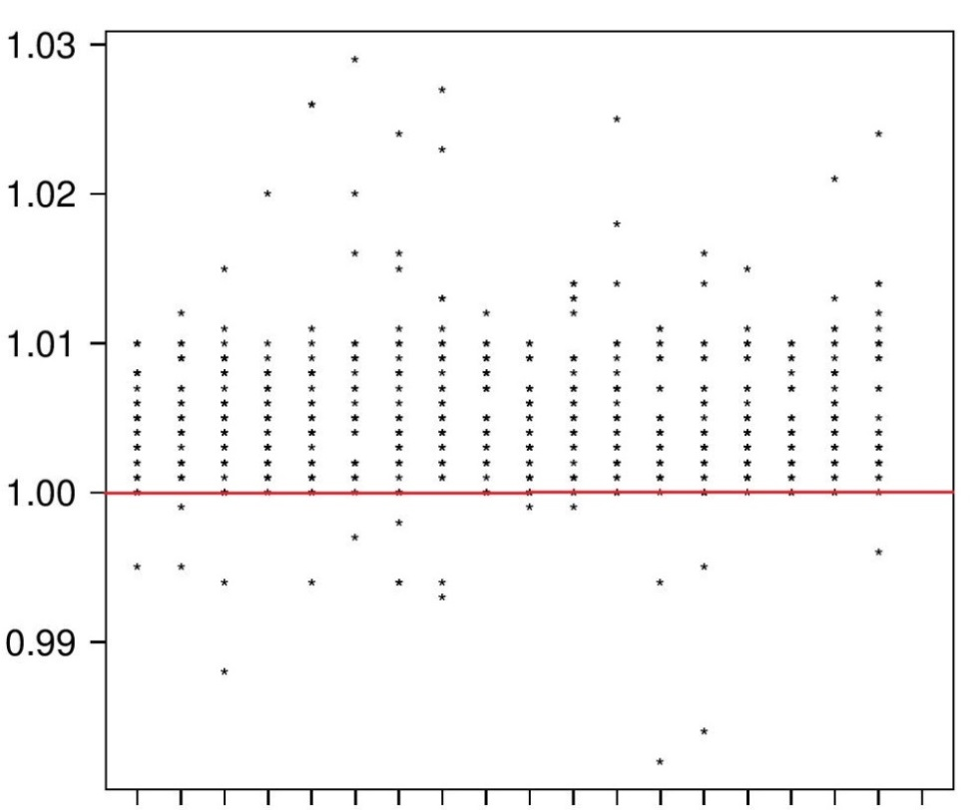

Evaluation Methodology
Using strip charts to show the results
X axis : groups of models and test instances for different input sizes

Slide 25
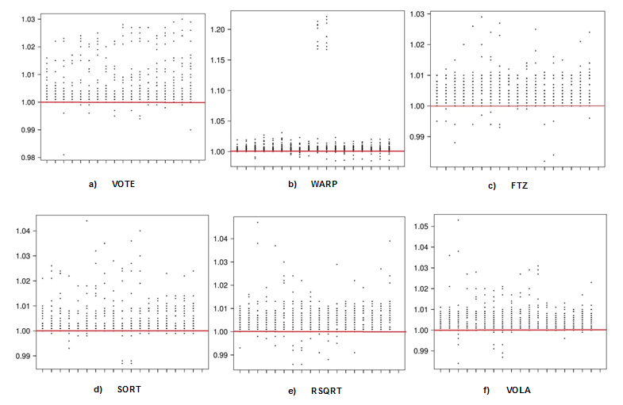
Experiment 1 Training : BH (64) Testing : BH (192) (Include training) (Same input) ML Method : IBK

Slide 26
Experiment 1 Training : BH (64) Testing : BH (192) (Include training) (Same input) ML Method : IBK
Range of ratios: (0.8, 1.2)
 | PP | PN | NP | NN | Accuracy
VOTE | 75.0 | 0.0 | 0.0 | 25.0 | 100.0
WARP | 100.0 | 0.0 | 0.0 | 0.0 | 100.0
SORT | 85.4 | 0.0 | 0.0 | 14.6 | 100.0
RSQRT | 90.3 | 4.9 | 0.7 | 4.2 | 94.4
FTZ | 52.3 | 7.3 | 3.6 | 36.8 | 89.1
VOLA | 100.0 | 0.0 | 0.0 | 0.0 | 100.0
 |  |  |  | Total | 97.3

Slide 27
Results Summary
Version | Training Dataset | DatasetEntries | Testing Dataset | Dataset Entries | Tests Includes Training | Train and test on same input | Accuracy IBK (%) | Acuracy M5P (%)
1 | BH | 64 | BH | 192 | Yes | Yes | 97.3 | 86.4
2 | BH | 64 | BH | 128 | No | Yes | 96 | 86.4
3 | BH | 128 | BH | 64 | No | Yes | 96.3 | 33.3
4 | BH | 192 | BH | 64 | No | No | 92 | 81.6
5 | BH | 192 | NB | 64 | No | No | 83.6 | 33.3
6 | NB | 192 | BH | 64 | No | No | 55.7 | 60.1

Slide 28
Summary and Conclusion
Profile GPU code to gather a number of performance metrics
Train models using different machine learning methods.
Predict likely speedup of several known code optimizations.
Suggest the most promising optimization based on predicted speedups.

Slide 29
Summary and Conclusion
Train and test on same code :
Up to 97% accuracy of predictions
Train and test on different codes:
Up to 82% accuracy of predictions
Better results when training on larger datasets
Better results when training and testing on larger input sizes
Better results when training on irregular code and test on regular code rather than vice versa.

Slide 30
Future Work
Experiment on different GPU devices
Experiment with different irregular codes
Experiment with different optimizations
Experiment with different number of input sizes
Train the models using different machine learning methods

Slide 31

Questions?
staheri@cs.utah.edu

