Slide 1


ParLOT: Efficient Whole-Program Call Tracing for HPC Applications
ParLOT: Efficient Whole-Program Call Tracing for HPC Applications
Saeed Taheri Sindhu Devale Ganesh Gopalakrishnan Martin Burtscher
School of Computing, University of Utah
Department of Computer Science, Texas State University

Slide 2

Outline
HPC Debugging
Tracing Challenges
ParLOT Design
Binary Instrumentation
Compression Mechanism
Evaluation
Conclusion
ParLOT: Efficient Whole-Program Call Tracing for HPC Applications
Notes:
HPC Debugging:
The tradeoff: sufficient information, reasonable overhead
GOAL: Collect information as efficiently as possible and in as general and comprehensive a manner as possible.
We achieve this goal by Dynamic Binary Instrumentation and a novel compression mechanism
Our evaluation shows the effectiveness and potentials of our approach

Slide 3
HPC Debugging
HPC bugs are expensive because:
ParLOT: Efficient Whole-Program Call Tracing for HPC Applications

Slide 4
HPC Debugging
HPC bugs are expensive because:
Program failures waste resources (time, energy, SUs, etc.)
ParLOT: Efficient Whole-Program Call Tracing for HPC Applications
Notes:
Days or months of running
Crashes
Hangs
Wrong answer

Slide 5
HPC Debugging
HPC bugs are expensive because:
Program failures waste resources (time, energy, SUs, etc.)
HPC bugs are often not reproducible
ParLOT: Efficient Whole-Program Call Tracing for HPC Applications
Notes:
Non-deterministic nature of concurrent applications

Slide 6
HPC Debugging
HPC bugs are expensive because:
Program failures waste resources (time, energy, SUs, etc.)
HPC bugs are often not reproducible
Information collection to detect/locate failure points introduces overhead
ParLOT: Efficient Whole-Program Call Tracing for HPC Applications

Slide 7
HPC Debugging
HPC bugs are expensive because:
Program failures waste resources (time, energy, SUs, etc.)
HPC bugs are often not reproducible
Information collection to detect/locate failure points introduces overhead
In this work, we propose an efficient whole-program tracing infrastructure to help the HPC debugging community.
ParLOT: Efficient Whole-Program Call Tracing for HPC Applications

Slide 8
Desired Tracing Features
“Always-on” tracing capability
No source-code modification
No recompilation
Dynamic instrumentation
Portability
Low overhead (runtime and storage)
ParLOT: Efficient Whole-Program Call Tracing for HPC Applications
Notes:
Towards always-on tracing
Most of the existing tools need
- source code modification for instrumentation
- Recompilation with the tracing wrapper
Dynamic instrumentation to reflect program behavior at runtime
Portability from system to system
Overheads introduced

Slide 9
Desired Tracing Features
MINDSET: Pay a little bit more upfront to significantly reduce the number of overall debug iterations
“Always-on” tracing capability
No source-code modification
No recompilation
Dynamic instrumentation
Portability
Low overhead (runtime and storage)
ParLOT: Efficient Whole-Program Call Tracing for HPC Applications
Notes:
Our results show that we are getting there. Towards an always-on tracing

Slide 10
Desired Tracing Features
“Always-on” tracing capability
No source-code modification
No recompilation
Dynamic instrumentation
Portability
Low overhead (runtime and storage)
Towards automated debugging/tracing system
ParLOT: Efficient Whole-Program Call Tracing for HPC Applications
Notes:
Our results show that we are getting there. Towards an always-on tracing

Slide 11
Desired Tracing Features
“Always-on” tracing capability
No source-code modification
No recompilation
Dynamic instrumentation
Portability
Low overhead (runtime and storage)
Studying behavior of application at runtime
ParLOT: Efficient Whole-Program Call Tracing for HPC Applications
Notes:
Our results show that we are getting there. Towards an always-on tracing

Slide 12
Desired Tracing Features
“Always-on” tracing capability
No source-code modification
No recompilation
Dynamic instrumentation
Portability
Low overhead (runtime and storage)
Regardless of system, OS, compiler and hardware
ParLOT: Efficient Whole-Program Call Tracing for HPC Applications
Notes:
Our results show that we are getting there. Towards an always-on tracing

Slide 13
Desired Tracing Features
“Always-on” tracing capability
No source-code modification
No recompilation
Dynamic instrumentation
Portability
Low overhead (runtime and storage)
Main goal of our work
ParLOT: Efficient Whole-Program Call Tracing for HPC Applications
Notes:
Our results show that we are getting there. Towards an always-on tracing

Slide 14
Desired Tracing Features
Contribution 1: We use Pin, a dynamic binary instrumentation tool by Intel, to instrument binaries (regardless of source language and compiler) and capture all functions` entry/exit points including library calls for every thread/process.
“Always-on” tracing capability
No source-code modification
No recompilation
Dynamic instrumentation
Portability
Low overhead (runtime and storage)
ParLOT: Efficient Whole-Program Call Tracing for HPC Applications

Slide 15
Desired Tracing Features
Contribution 1: We use Pin, a dynamic binary instrumentation tool by Intel, to instrument binaries (regardless of source language and compiler) and capture all functions` entry/exit points including library calls for every thread/process.
“Always-on” tracing capability
No source-code modification
No recompilation
Dynamic instrumentation
Portability
Low overhead (runtime & storage)
Contribution 2: An incremental data compression algorithm that drastically reduces the overhead of on-the-fly whole-program tracing
ParLOT: Efficient Whole-Program Call Tracing for HPC Applications
Notes:
For example, collecting just one byte of information per executed instruction yields on the order of a gigabyte of data per second on a single high-end core. Storing the resulting multi-gigabyte traces from many cores can be a challenge, even on today’s large hard disks.
The novelty offered by PARLOT lies in the combination of compression speed, efficacy, and low timing jitter made possible by its incremental lossless compression algorithm

Slide 16
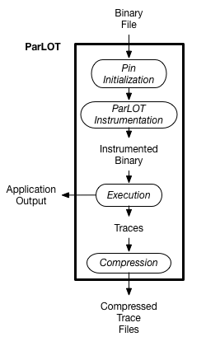
ParLOT Design
Parallel Low Overhead Tracing Tool
Tracing Operations
Incremental Compression
Compression Algorithm
Call-stack Correction
ParLOT: Efficient Whole-Program Call Tracing for HPC Applications

Slide 17
Binary Instrumentation
ParLOT instrumentation
Every thread launch and termination
Every function entry and exit
Separate trace file for each thread
Each file contains ordered sequence of function calls and returns
ParLOT: Efficient Whole-Program Call Tracing for HPC Applications

Slide 18
Binary Instrumentation
ParLOT instrumentation
Every thread launch and termination
Every function entry and exit
Separate trace file for each thread
Each file contains ordered sequence of function calls and returns
Per-thread information
Thread ID
Current function ID
Current call stack
Current SP value (for stack correction)
ParLOT: Efficient Whole-Program Call Tracing for HPC Applications

Slide 19
Incremental Compression
Conventional compression approaches
Trace first written to buffer (in memory), buffer is compressed once full
Threads sporadically block to compress data → highly non-uniform latency
Distorts trace when one thread polls data from another blocked thread
Incremental Compression
Every trace element is compressed right away before writing it to memory
Resulting compression latency is much more uniform
Greatly improves fidelity of trace data
ParLOT: Efficient Whole-Program Call Tracing for HPC Applications

Slide 20
Compression Algorithm
CRUSHER: automatic compression algorithm synthesis tool
Trained on traces from the Mantevo miniapps
Resulting best algorithm: LZ followed by ZE
Delivers high compression ratio with low overhead
ParLOT: Efficient Whole-Program Call Tracing for HPC Applications
Notes:
CRUSHER : a library of data transformations extracted from various compression algorithms.
It combines these transformations in all possible ways to generate algorithm candidates, which it then evaluates on a set of training data.
Initial Experiments on

Slide 21
Compression Algorithm
CRUSHER: automatic compression algorithm synthesis tool
Trained on traces from the Mantevo miniapps
Resulting best algorithm: LZ followed by ZE
Delivers high compression ratio with low overhead
LZ
ZE
Trace entries
- Word-level transformation
- Removes repeating patterns
Sequence of bytes
- Byte-level transformation
- Eliminates zeros
Bitmap + non-zero bytes
ParLOT: Efficient Whole-Program Call Tracing for HPC Applications
Notes:
CRUSHER : a library of data transformations extracted from various compression algorithms.
It combines these transformations in all possible ways to generate algorithm candidates, which it then evaluates on a set of training data.
Initial Experiments on

Slide 22
Call-Stack Correction
PIN cannot identify some function exit points
E.g., the instructions of an inlined function may be interleaved with the caller’s instructions
ParLOT: Efficient Whole-Program Call Tracing for HPC Applications

Slide 23
Call-Stack Correction
PIN cannot identify some function exit points
E.g., the instructions of an inlined function may be interleaved with the caller’s instructions
ParLOT’s solution
Records the SP value at each function entry and exit
Pops the internal call stack until consistent with SP value
ParLOT: Efficient Whole-Program Call Tracing for HPC Applications

Slide 24
Call-Stack Correction
PIN cannot identify some function exit points
E.g., the instructions of an inlined function may be interleaved with the caller’s instructions
ParLOT’s solution
Records the SP value at each function entry and exit
Pops the internal call stack until consistent with SP value
Other DBIs might [not] need such correction
ParLOT: Efficient Whole-Program Call Tracing for HPC Applications

Slide 25
Evaluation
MPI-based NAS Parallel Benchmarks (input classes B and C)
San Diego Supercomputer Center – Comet
1, 4, 16 and 64 compute nodes (each with 16 cores)
Compute nodes: Xeon E5-2680 v3 processors – 28 cores – 128 GB memory
Measured metrics
Tracing overhead
Tracing bandwidth
Compression ratio
ParLOT: Efficient Whole-Program Call Tracing for HPC Applications

Slide 26
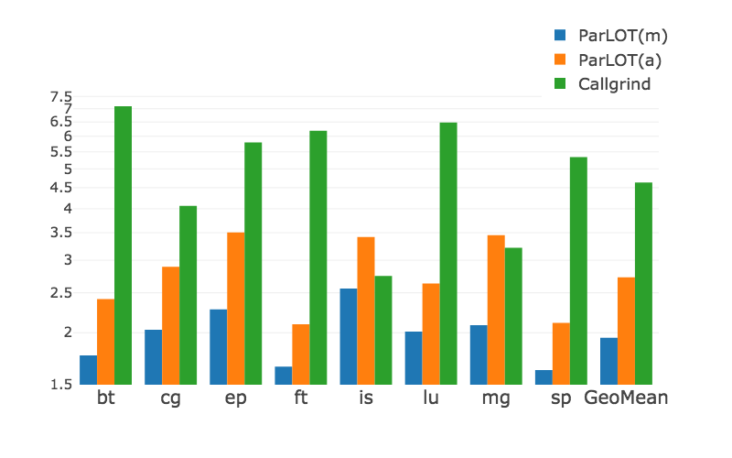
Tracing Overhead
ParLOT(m): collects traces from the main image ParLOT(a): collects traces from all images (including library function calls) Callgrind: DBI-based tracing tool that collects function-call graphs and performance data
Average overheads (input C)
- ParLOT(m): 1.94
- ParLOT(a): 2.73
- Callgrind: 4.63
ParLOT: Efficient Whole-Program Call Tracing for HPC Applications

Slide 27
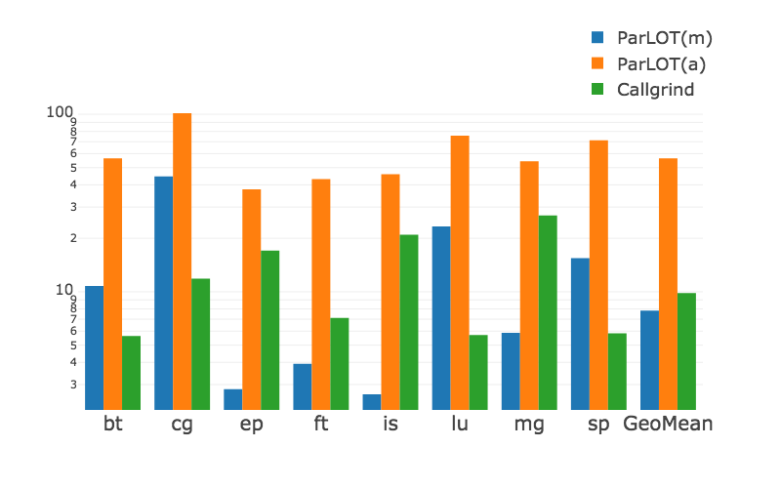
Required Bandwidth
ParLOT(m): collects traces from the main image ParLOT(a): collects traces from all images (including library function calls) Callgrind: DBI-based tracing tool that collects function-call graphs and performance data
Average required bandwidth on input C
- ParLOT(m): 7.8 kB/s
- ParLOT(a): 56.4 kB/s
- Callgrind: 9.8 kB/s
ParLOT: Efficient Whole-Program Call Tracing for HPC Applications

Slide 28
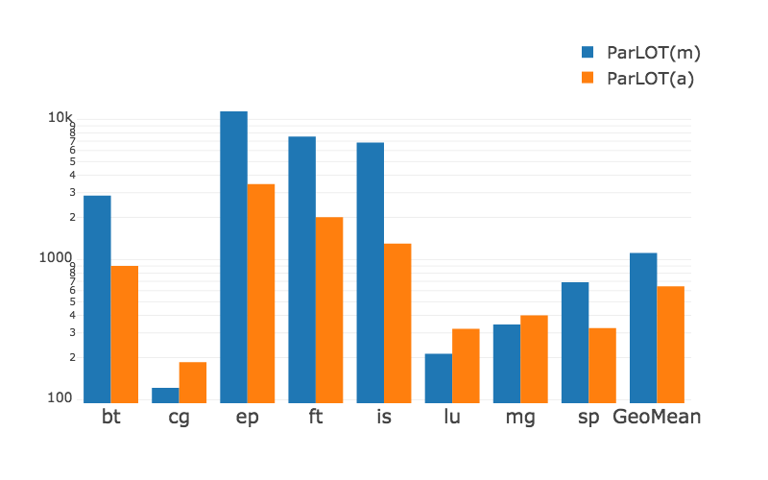
Compression Ratio
Average compression ratio of ParLOT(a) on input C: 644.3
Corresponding required bandwidth: 56.4 kB/s
ParLOT can collect 36 MB worth of data per core per second while only requiring 56 kB/s
CG behavior: conjugate gradient method with irregular memory accesses and communication – larger number of distinct calls with more complex patterns
ParLOT: Efficient Whole-Program Call Tracing for HPC Applications

Slide 29
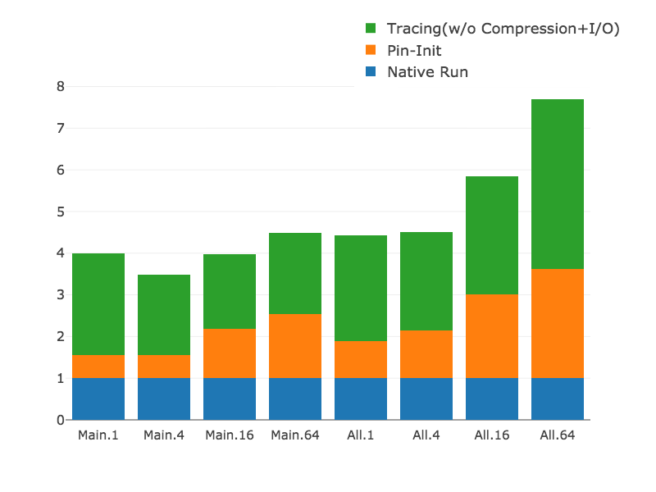
Overheads
Breakdown of average ParLOT overhead on NAS - Input C - 1, 4, 16 and 64 nodes
ParLOT: Efficient Whole-Program Call Tracing for HPC Applications

Slide 30
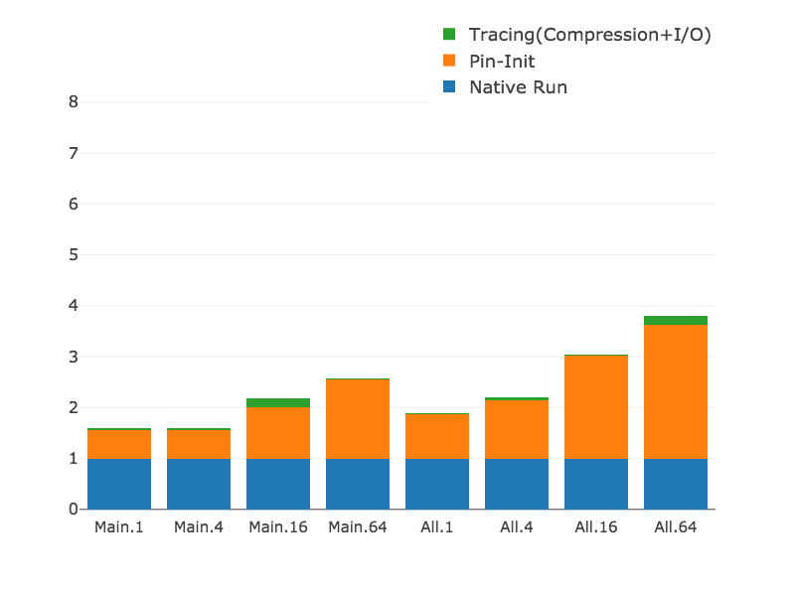
Overheads
Breakdown of average ParLOT overhead on NAS - Input C - 1, 4, 16 and 64 nodes
ParLOT: Efficient Whole-Program Call Tracing for HPC Applications

Slide 31
Overheads
Compression Impact
Other DBIs might do better
Breakdown of average ParLOT overhead on NAS - Input C - 1, 4, 16 and 64 nodes
ParLOT: Efficient Whole-Program Call Tracing for HPC Applications

Slide 32
Summary & Conclusion
ParLOT: a portable low-overhead whole-program tracing approach that collects and compresses function-call traces on-the-fly
ParLOT: Efficient Whole-Program Call Tracing for HPC Applications

Slide 33
Summary & Conclusion
ParLOT: a portable low-overhead whole-program tracing approach that collects and compresses function-call traces on-the-fly
Includes new trace compression approach
Incrementally compresses trace data to make latency uniform
ParLOT: Efficient Whole-Program Call Tracing for HPC Applications

Slide 34
Summary & Conclusion
ParLOT: a portable low-overhead whole-program tracing approach that collects and compresses function-call traces on-the-fly
Includes new trace compression approach
Incrementally compresses trace data to make latency uniform
Yields high compression ratio to drastically reduce bandwidth and storage requirement
ParLOT: Efficient Whole-Program Call Tracing for HPC Applications

Slide 35
Summary & Conclusion
ParLOT: a portable low-overhead whole-program tracing approach that collects and compresses function-call traces on-the-fly
Includes new trace compression approach
Incrementally compresses trace data to make latency uniform
Yields high compression ratio to drastically reduce bandwidth and storage requirement
Efficiently implemented to minimize runtime overhead
ParLOT: Efficient Whole-Program Call Tracing for HPC Applications

Slide 36
Summary & Conclusion
ParLOT: a portable low-overhead whole-program tracing approach that collects and compresses function-call traces on-the-fly.
Includes new trace compression approach
Incrementally compresses trace data to make latency uniform
Yields high compression ratio to drastically reduce bandwidth and storage requirement
Efficiently implemented to minimize runtime overhead
Enables comprehensive post-mortem analysis on traces (debugging, performance analysis, program understanding, etc.)
ParLOT: Efficient Whole-Program Call Tracing for HPC Applications

Slide 37
Thanks.
Any questions?
ParLOT: Efficient Whole-Program Call Tracing for HPC Applications

