Slide 1
From Excel to AI: PowerShell's Not Just for Admins Anymore!
Wes Stahler GSTRT, GCWN, GCIH, CISSP, MCSD Associate Directory Data Security The Ohio State University Wexner Medical Center https://go.osu.edu/ramblecon

Slide 2
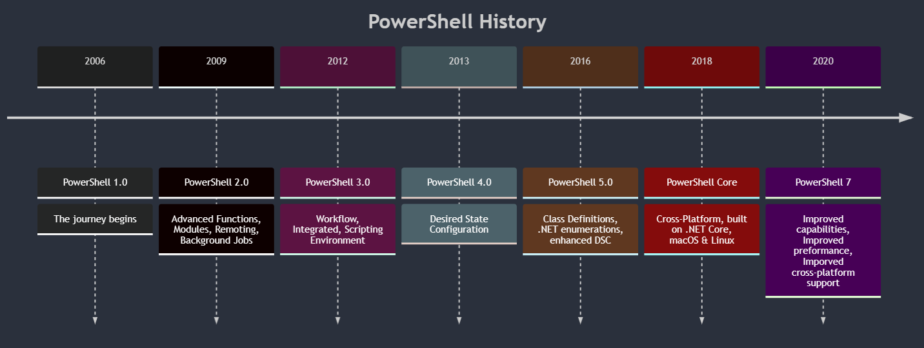
History of PowerShell
Notes:
Mermaid FTW

Slide 3
What Is It?
A task automation and configuration management framework from Microsoft.
Consists of a command-line shell and scripting language.
Built on the .NET Framework.
Aids IT professionals and power users in controlling and automating Windows OS administration (and so much more)
Combines traditional command-line shell capabilities with access to object-oriented .NET classes.
Versatile tool for a wide range of administrative and automation tasks.

Slide 4
Security Aspects of PowerShell
Execution policies and their implications
Just a safety feature
Easily bypassed
Logging and auditing in PowerShell
Transcription
Script block logging
Module
Protecting against PowerShell-based attacks
Constrained PowerShell
Notes:
https://www.mandiant.com/resources/blog/greater-visibility
https://docs.splunk.com/Documentation/UBA/5.3.0/GetDataIn/AddPowerShell

Slide 5
Cmdlets, Pipelining, and Scripting
Understanding cmdlets and the Verb-Noun naming convention
Demo of most important cmdlets
Power of pipelining (`|`)

Slide 6
Useful Modules
ActiveDirectory - Manage Active Directory
ImportExcel – Automate Excel
PowerShellAI – Interface with ChatGPT
SQLServer – Interface with SQL Server
ServiceNow - Automate against ServiceNow service and asset management.
Microsoft.PowerShell.SecretManagement/SecretStore - Store and retrieve secrets

Slide 7
Best Practices, Tips, and Resources
Writing secure scripts
Monitoring and alerting with PowerShell
Resources for further learning and community engagement

Slide 8
Relevant Links (https://go.osu.edu/ramblecon)
Active Directory Module
ActiveDirectory Module | Microsoft Learn
ImportExcel Module
PowerShell Gallery | ImportExcel 7.8.5
dfinke/ImportExcel: PowerShell module to import/export Excel spreadsheets, without Excel (github.com) – use the issues and discussions
Videos: (939) PowerShell Excel Module - ImportExcel – YouTube
PowerShellAI
PowerShell Gallery | PowerShellAI 0.9.1
dfinke/PowerShellAI: PowerShell AI module for OpenAI GPT-3 and DALL-E (github.com)
(939) PowerShellAI - YouTube
SQLServer
PowerShell Gallery | SqlServer 22.1.1
SQL Server PowerShell - SQL Server | Microsoft Learn
Invoke-Sqlcmd (SQLServer) | Microsoft Learn
ServiceNow
PowerShell Gallery | ServiceNow 4.0.1
Microsoft.PowerShell.SecretManagement/SecretStore - Store and retrieve secrets
PowerShell Gallery | Microsoft.PowerShell.SecretManagement 1.1.2
PowerShell Gallery | Microsoft.PowerShell.SecretStore 1.0.6

Slide 9
