Slide 1




Measurement of W bosons in p-Pb at 8.16 TeV and of charmonia in
Pb-Pb at 5.02 TeV with the
CMS detector at the LHC
André Govinda Ståhl Leitón
Rapporteurs: | Boris Hippolyte
 | Lydia Roos
Examinateurs: | Albert de Roeck
 | Begoña de la Cruz Martínez
 | Carlos A. Salgado
 | Sophie Henrot-Versillé
Directeur de thèse: | Raphaël Granier de Cassagnac

Slide 2
Outline
Theoretical context
The CMS detector at the LHC
W-boson production in p-Pb at 8.16 TeV
  Introduction
  Analysis
  Results
Charmonium production in Pb-Pb at 5.02 TeV
    Introduction
    Analysis
    Results
Conclusions

Slide 3
Outline
Theoretical context
The CMS detector at the LHC
W-boson production in p-Pb at 8.16 TeV
  Introduction
  Analysis
  Results
Charmonium production in Pb-Pb at 5.02 TeV
    Introduction
    Analysis
    Results
Conclusions

Slide 4
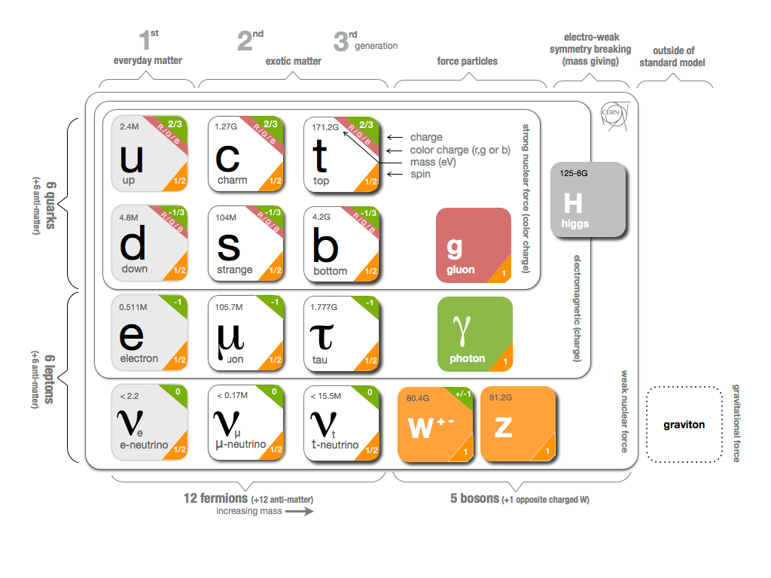
Standard Model of particles
The standard model describes three fundamental interactions
-
1

Slide 5

Standard Model of particles
The weak interaction
-
Mediators
W and Z bosons
1

Slide 6

Standard Model of particles
The electromagnetic interaction
-
Mediator
Photon
1

Slide 7
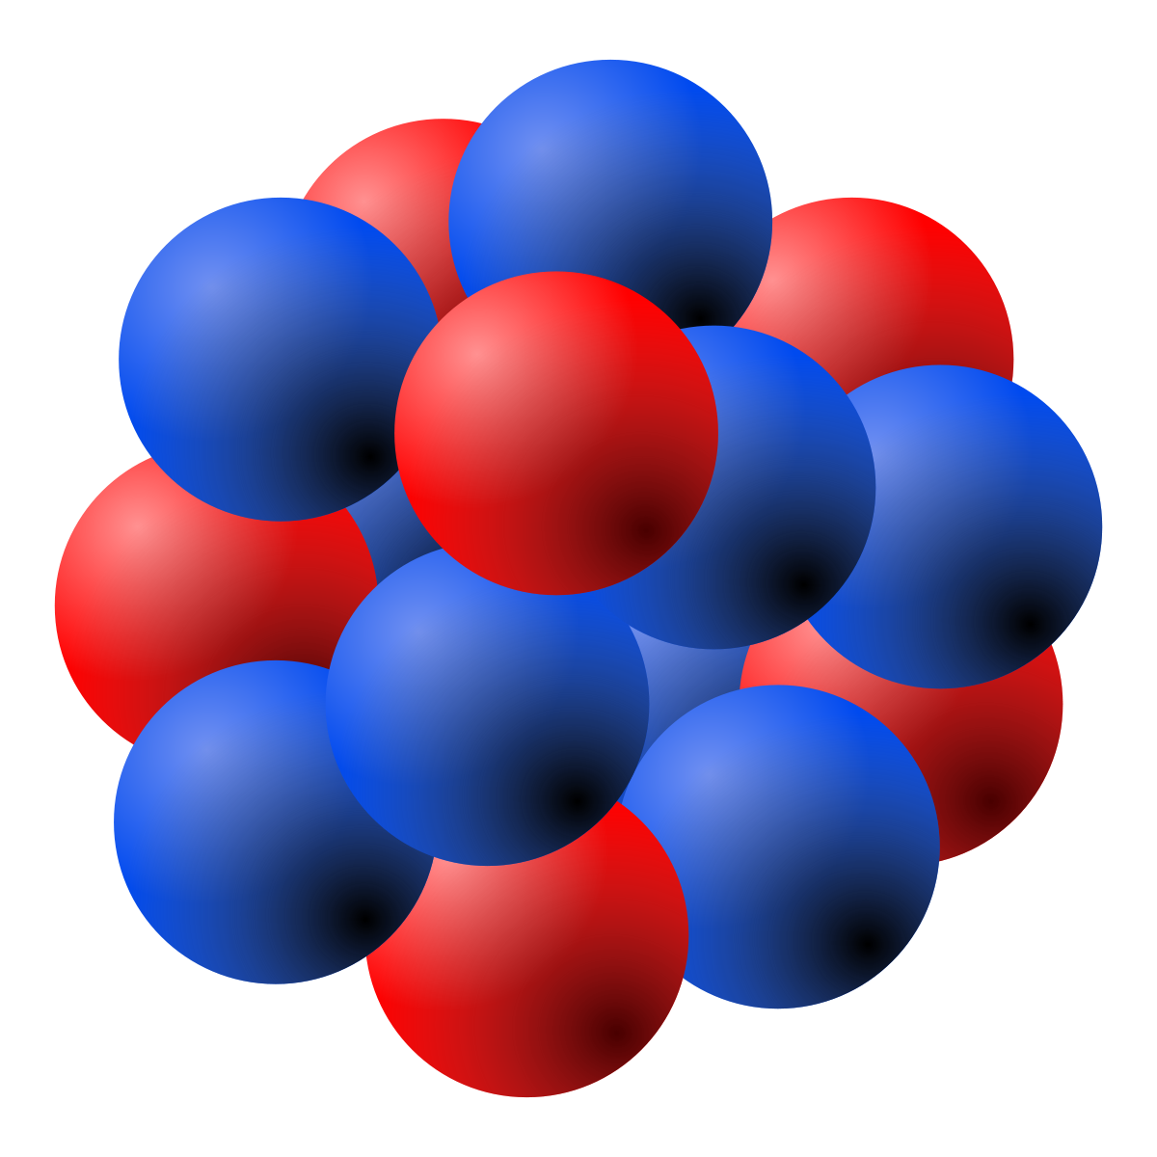
Standard Model of particles
The strong interaction
-
Mediators
Gluons
1

Slide 8
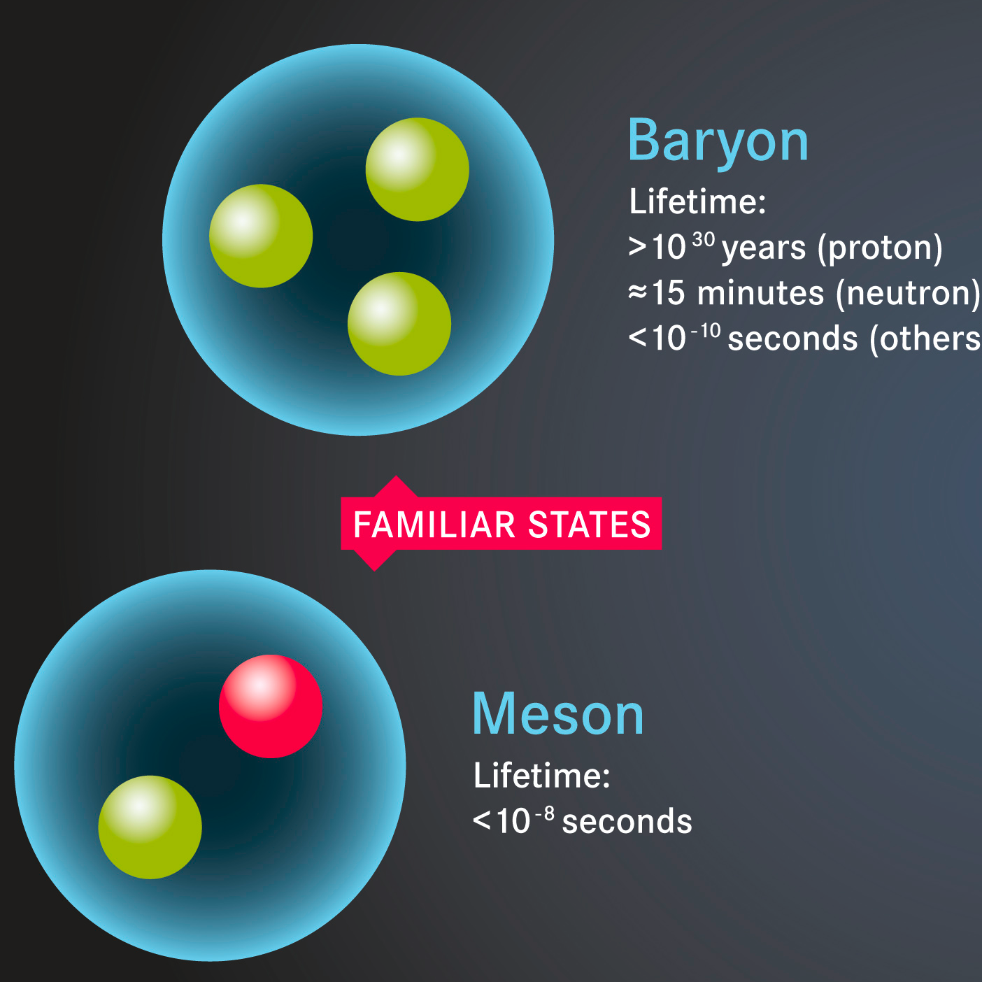
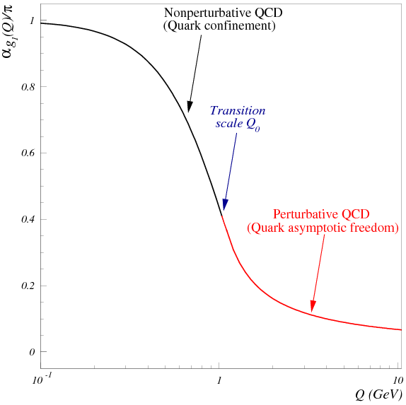
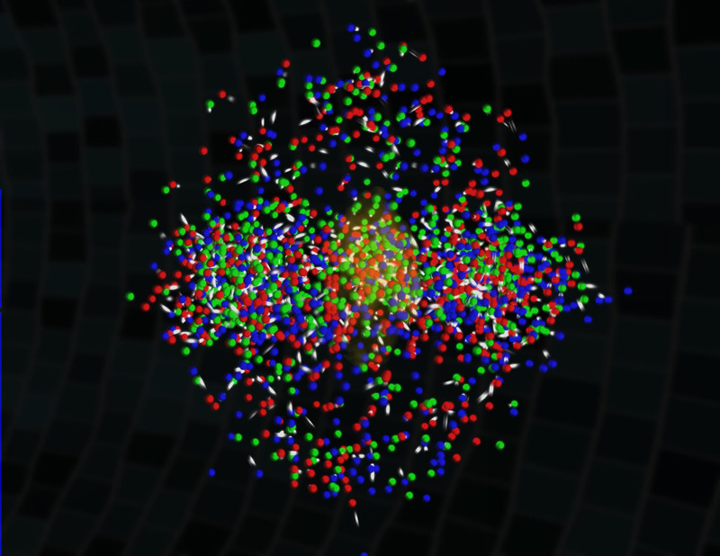
Quantum Chromodynamics (QCD)
QCD is the theory of the strong force
Describes the interactions between quarks and gluons
Hadrons
Coupling Strength vs Energy
Asymptotic Freedom
Confinement
Deconfined matter
2

Slide 9
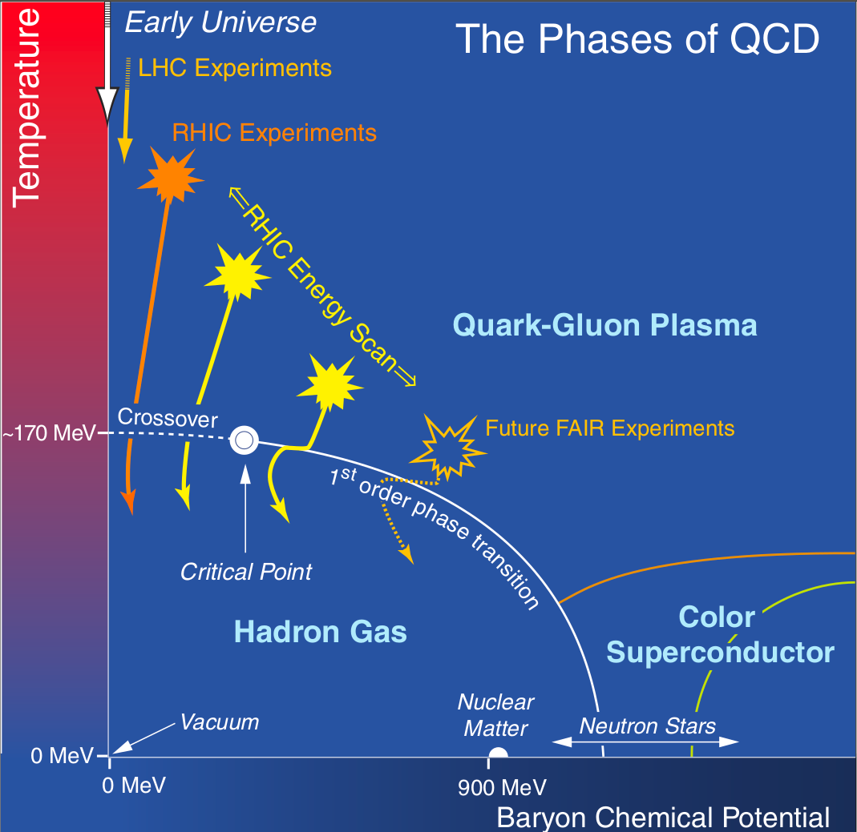
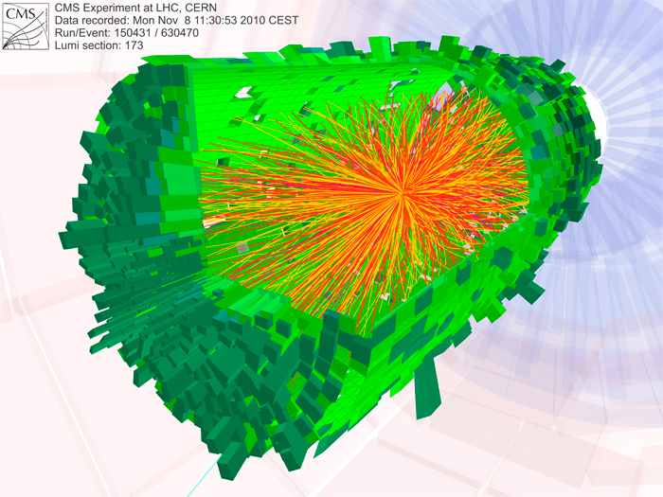
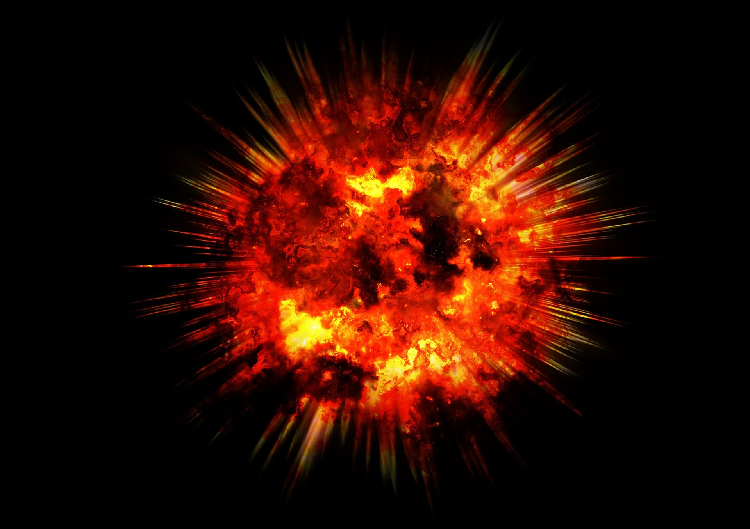
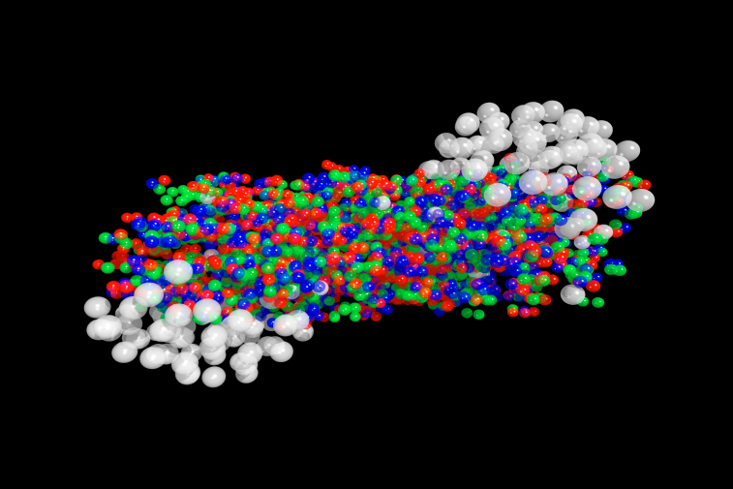
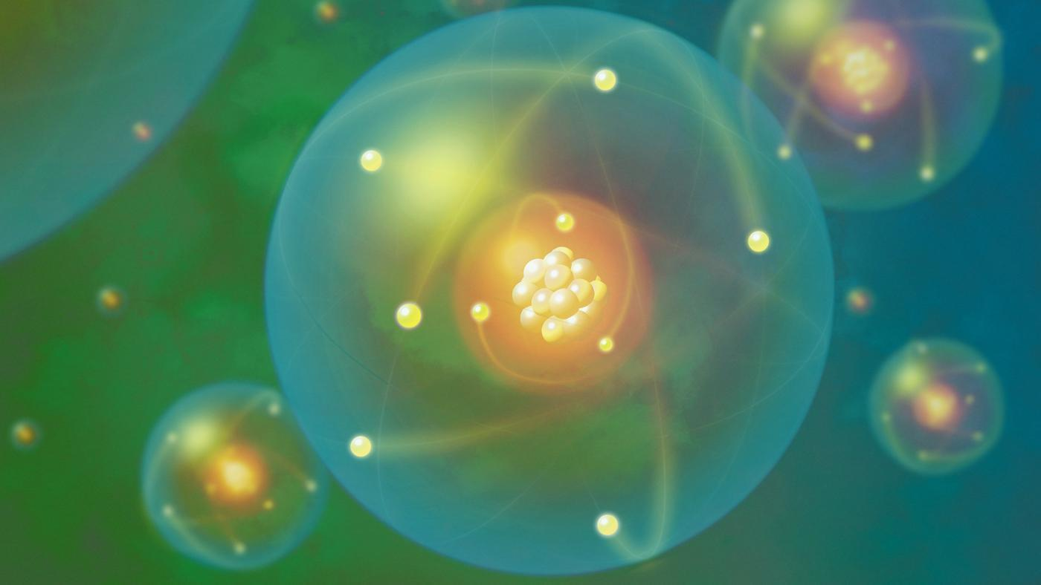
Quark-Gluon Plasma (QGP)
A state of matter where quarks and gluons are deconfined is predicted by QCD at high temperature
QGP is formed in relativistic heavy ion collisions
Experiment
Early Universe
Quark-Gluon Plasma
Nuclear Matter
3

Slide 10
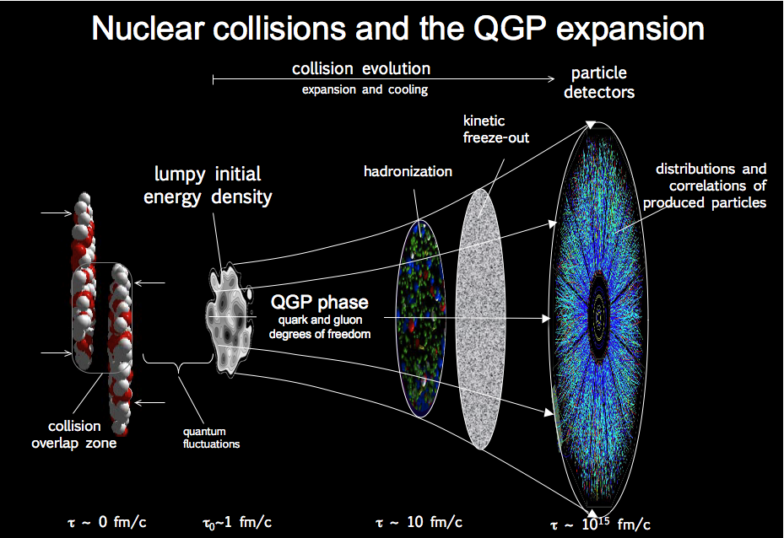
Heavy-ion collisions
4

Slide 11
Heavy-ion collisions
ν
W
μ
4

Slide 12
Heavy-ion collisions
μ⁻
c
-
c
J/Ψ
μ⁺
4

Slide 13
Outline
Theoretical context
The CMS detector at the LHC
W-boson production in p-Pb at 8.16 TeV
  Introduction
  Analysis
  Results
Charmonium production in Pb-Pb at 5.02 TeV
    Introduction
    Analysis
    Results
Conclusions

Slide 14
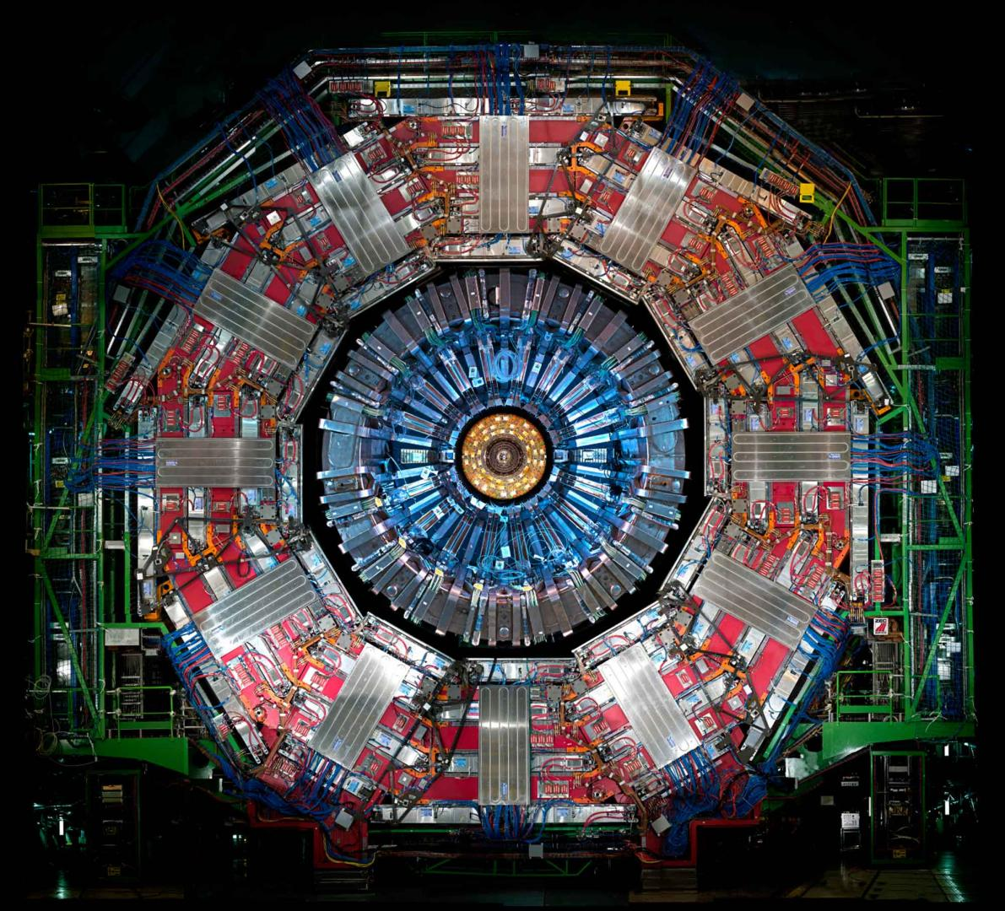
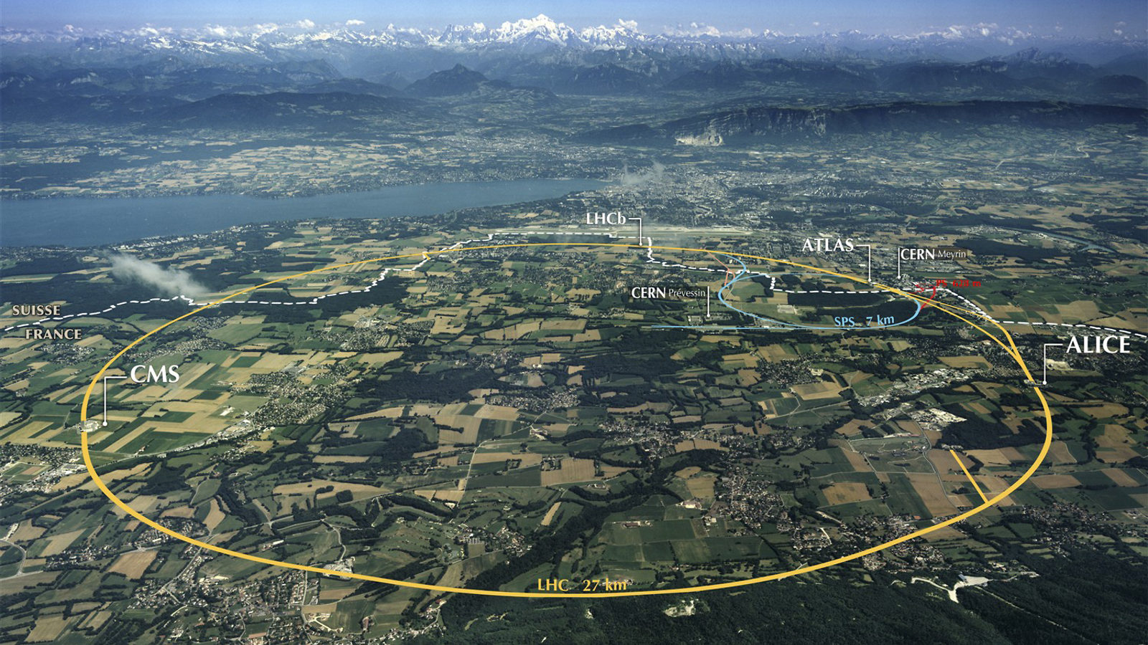
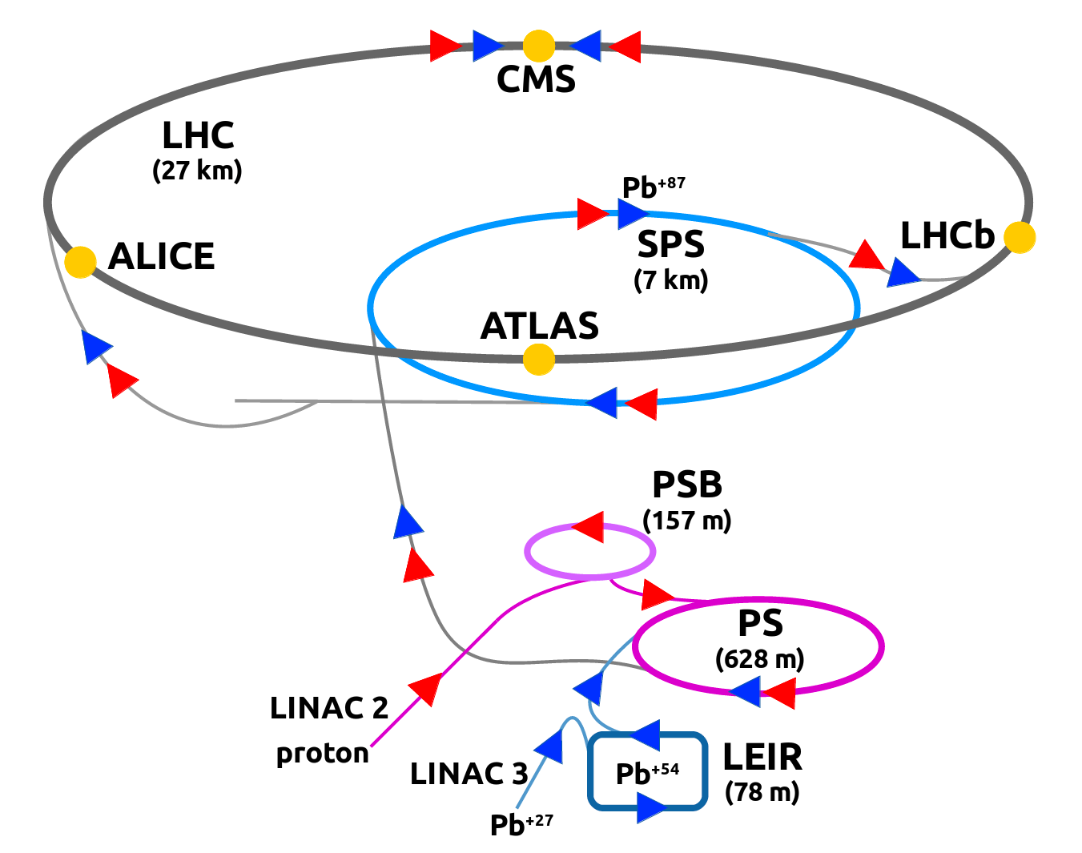
Large Hadron Collider
Detector
Large Hadron Collider
Compact Muon Solenoid
5

Slide 15
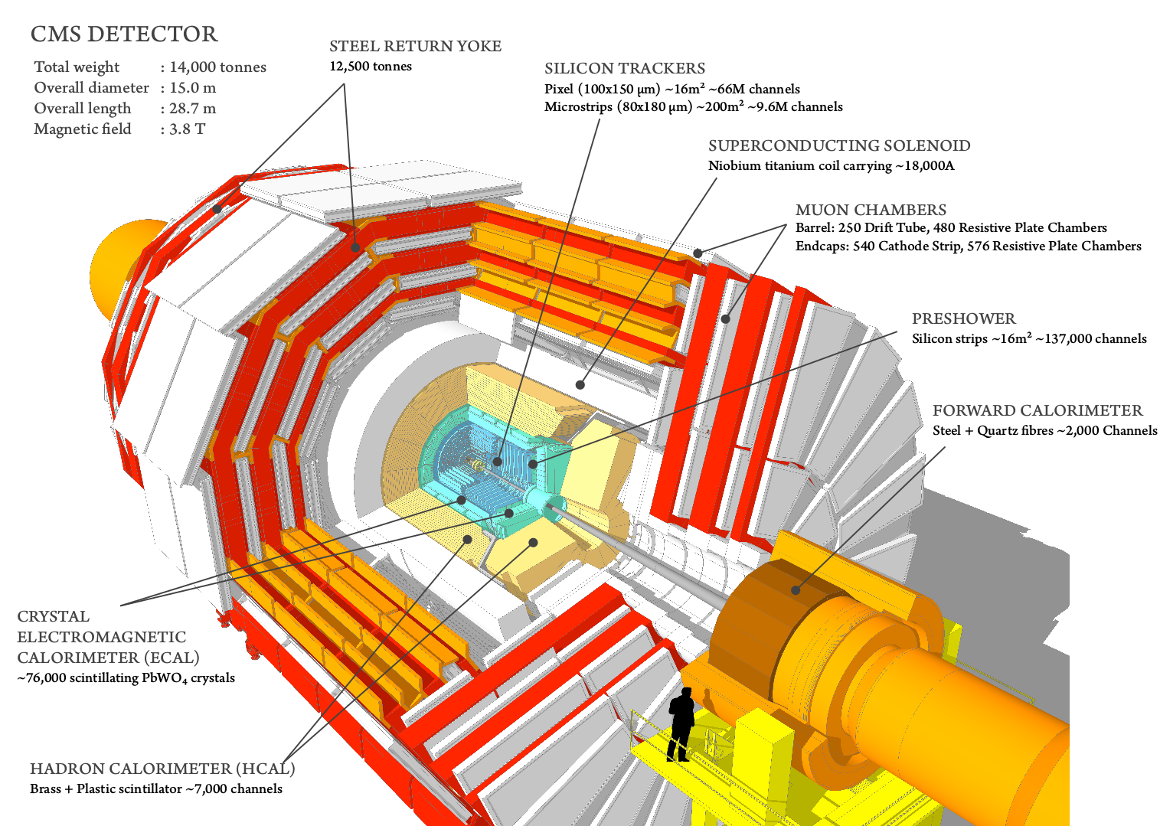
Compact Muon Solenoid
6

Slide 16
Compact Muon Solenoid
6

Slide 17
Compact Muon Solenoid
6

Slide 18
Compact Muon Solenoid
6

Slide 19
Compact Muon Solenoid
6

Slide 20
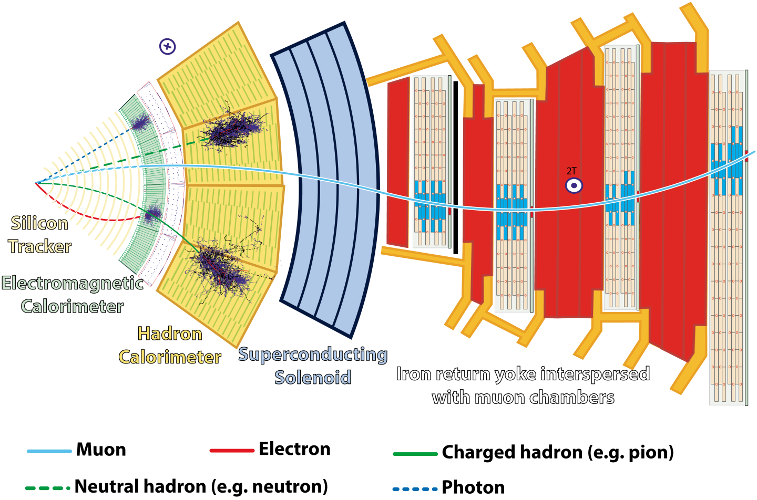
Particle reconstruction
7

Slide 21
Particle reconstruction
μ
7

Slide 22
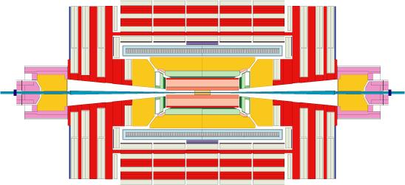


CMS trigger system
CMS uses a two-tier trigger system to select events of interest
CMS
Computer cluster
CERN Data Center
~ 40 MHz
Level 1 Trigger
(Hardware)
High Level Trigger
(Software)
~ 100 kHz
~ 1 kHz
I was responsible for implementing the muon trigger selections for:
  proton-lead collisions at 8.16 TeV in 2016
  proton-proton collisions at 5.02 TeV in 2017
8

Slide 23
Outline
Theoretical context
The CMS detector at the LHC
W-boson production in p-Pb at 8.16 TeV
  Introduction
  Analysis
  Results
Charmonium production in Pb-Pb at 5.02 TeV
    Introduction
    Analysis
    Results
Conclusions

Slide 24
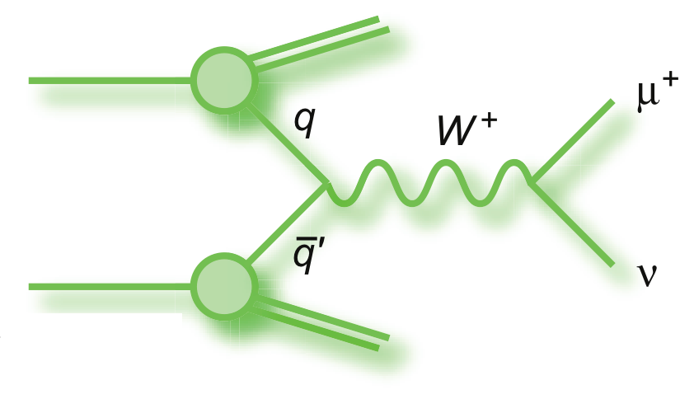
How are W bosons produced at LHC?
-
    proton
    proton
Hadronic
cross section
Parton distribution
function (PDF)
Partonic
cross section
    Dominant production mode: u d→W⁺ , d u→W⁻
    W bosons is sensitive to quark PDFs
-
-
9

Slide 25
How are W bosons produced at LHC?
-
    proton
    proton
Hadronic
cross section
Parton distribution
function (PDF)
Partonic
cross section
    Dominant production mode: u d→W⁺ , d u→W⁻
    W bosons is sensitive to quark PDFs
-
-
9

Slide 26
How are W bosons produced at LHC?
-
    proton
    proton
Hadronic
cross section
Parton distribution
function (PDF)
Partonic
cross section
    Dominant production mode: u d→W⁺ , d u→W⁻
    W bosons is sensitive to quark PDFs
-
-
9

Slide 27
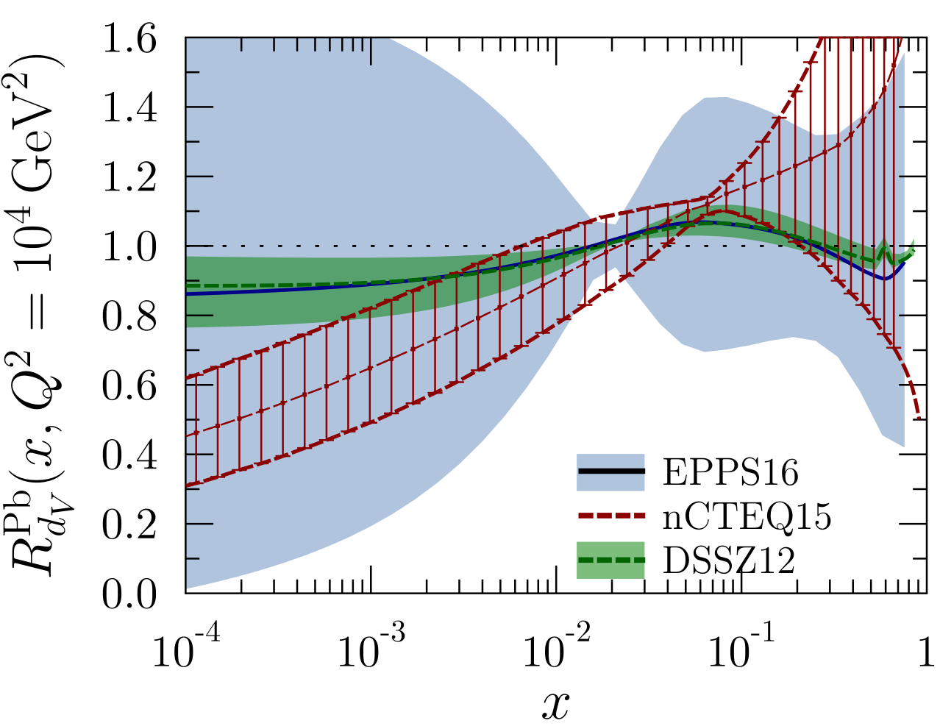
Nuclear modification of PDF
-
Pb PDF / free-proton PDF
PDFs of nucleons inside nuclei are modified compare to free proton PDFs
10

Slide 28
Nuclear modification of PDF
-
Shadowing
Pb PDF / free-proton PDF
PDFs of nucleons inside nuclei are modified compare to free proton PDFs
10

Slide 29
Nuclear modification of PDF
-
Anti-Shadowing
Shadowing
Pb PDF / free-proton PDF
PDFs of nucleons inside nuclei are modified compare to free proton PDFs
10

Slide 30
Nuclear modification of PDF
-
Anti-Shadowing
Shadowing
Pb PDF / free-proton PDF
EMC
PDFs of nucleons inside nuclei are modified compare to free proton PDFs
10

Slide 31
Nuclear modification of PDF
-
Anti-Shadowing
Shadowing
Pb PDF / free-proton PDF
EMC
    W in p-Pb 8.16 TeV at CMS
PDFs of nucleons inside nuclei are modified compare to free proton PDFs
W boson production in p-Pb collisions at CMS probe nuclear PDFs in
10⁻³ < x < 0.17
10

Slide 32
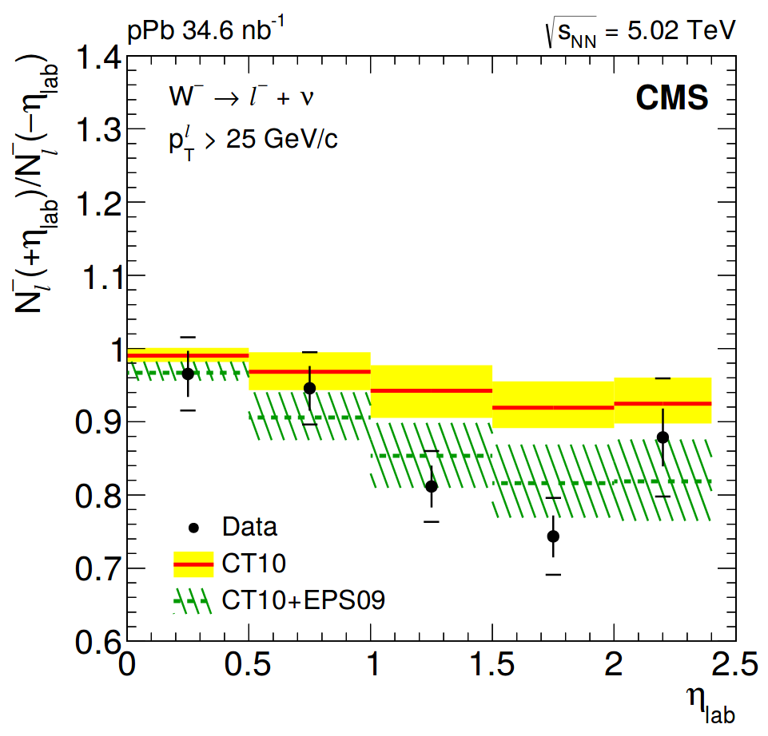
W bosons in p-Pb collisions
    Previous measurement of W production at 5.02 TeV by CMS helped to improve nPDF sets
    Provided a hint of nuclear modifications with poor significance
    Alice Florent, PhD thesis (LLR)
Phys. Lett. B750 (2015)
Phys. Lett. B750 (2015)
11

Slide 33
W bosons in p-Pb collisions
    Previous measurement of W production at 5.02 TeV by CMS helped to improve nPDF sets
    Provided a hint of nuclear modifications with poor significance
    Alice Florent, PhD thesis (LLR)
Phys. Lett. B750 (2015)
Phys. Lett. B750 (2015)
    This thesis: proton-lead collisions at 8.16 TeV
Year |  | Luminosity (CMS)
2013 | 5.02 TeV | 35 nb⁻¹
2016 | 8.16 TeV | 174 nb⁻¹
    W boson yield increased by ~10x in 2016 data w.r.t. 2013
11

Slide 34
Outline
Theoretical context
The CMS detector at the LHC
W-boson production in p-Pb at 8.16 TeV
  Introduction
  Analysis
  Results
Charmonium production in Pb-Pb at 5.02 TeV
    Introduction
    Analysis
    Results
Conclusions

Slide 35
Proton-lead collisions
    Proton-lead asymmetric collisions:
    1st p-Pb period
    2nd p-Pb period
    Lead
    Lead
    Proton
    Proton
    6.5 TeV
    6.5 TeV
    2.56 TeV
    per nucleon
    2.56 TeV
    per nucleon
-η
η_{CM}
+η
+η
η_{CM}
-η
    Positive pseudorapidity (+η) defined along the proton-going direction
    Center-of-mass frame boosted by 0.465 units of rapidity
12

Slide 36
Missing transverse momentum
    Muonic decays of W bosons produce a high p_{T} muon and neutrino (p_{T} ~ 40 GeV/c)
    Neutrinos are not detected, but their p_{T} can be infer from the missing p_{T}
    Side view
    Transverse plane
    detected
    μ
    y
    y
    x
    undetected
    z
    undetected
    ν
    Missing transverse momentum is the imbalance in p_{T} of all observed particles:
13

Slide 37
Background
    Several sources of background events can produce p_{T}^{miss} and high p_{T} muons
14

Slide 38
Background
    Several sources of background events can produce p_{T}^{miss} and high p_{T} muons
    QCD jet background: Muon decays of heavy-flavour quarks or light hadrons (π or K)
        Large cross section at LHC
        Muons produced in jets
        jet
    μ
        Muons not isolated
14

Slide 39
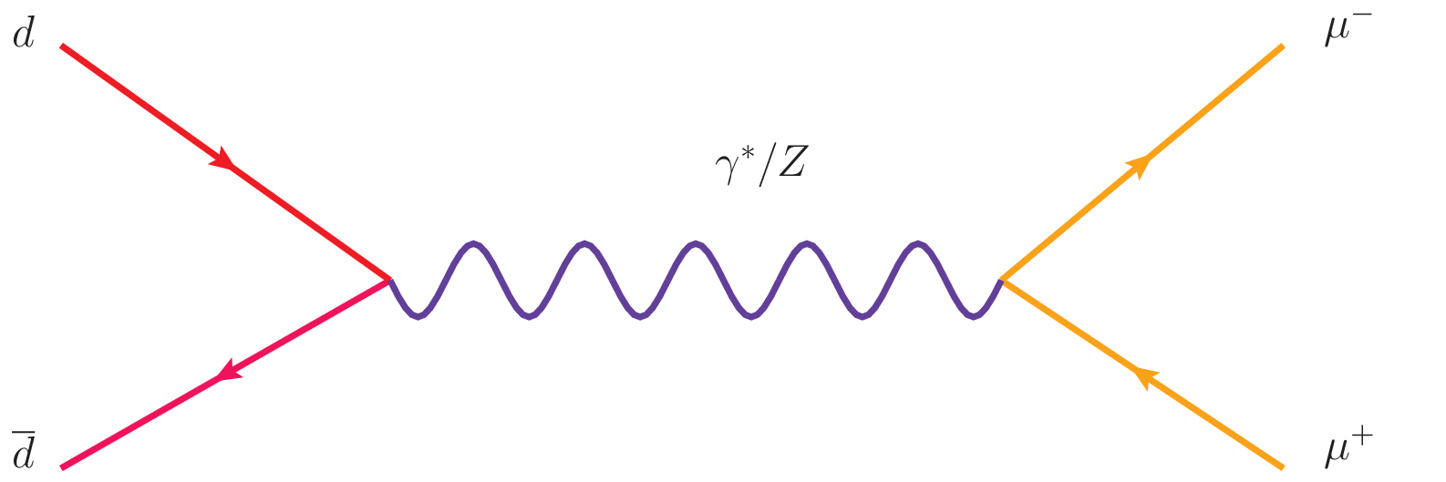
Background
    Several sources of background events can produce p_{T}^{miss} and high p_{T} muons
    QCD jet background: Muon decays of heavy-flavour quarks or light hadrons (π or K)
        Large cross section at LHC
        Muons produced in jets
        jet
    μ
        Muons not isolated
    Electroweak background: Muon decays of Z bosons, virtual photons or tau leptons
    μ⁺
        Z/γ*
    τ⁺
    ν
        W⁻
    ν
    ν
        Z/γ*
    ν
    ν
    τ⁻
    τ⁻
    μ⁻
        W⁻
    μ⁻
        W⁻
    μ⁻
        Z/γ* →μ⁺ μ⁻
        Z/γ* →τ⁺ τ⁻ → μ ν + X
        W →τ ν → μ ν + X
14

Slide 40
Background
    Several sources of background events can produce p_{T}^{miss} and high p_{T} muons
    QCD jet background: Muon decays of heavy-flavour quarks or light hadrons (π or K)
        Large cross section at LHC
        Muons produced in jets
        jet
    μ
        Muons not isolated
    Electroweak background: Muon decays of Z bosons, virtual photons or tau leptons
    μ⁺
        Z/γ*
    τ⁺
    ν
        W⁻
    ν
    ν
        Z/γ*
    ν
    ν
    τ⁻
    τ⁻
    μ⁻
        W⁻
    μ⁻
        W⁻
    μ⁻
        Z/γ* →μ⁺ μ⁻
        Z/γ* →τ⁺ τ⁻ → μ ν + X
        W →τ ν → μ ν + X
    Top-quark background: Muon decays from top quark and anti-quark pairs
    t
    b
    ν
        W⁺
    μ⁺
14

Slide 41
Data selection
    Events in data are selected using the following criteria:
15

Slide 42
Data selection
    Events in data are selected using the following criteria:
        Trigger: requires the presence of a muon with p_{T} > 12 GeV/c
        Analysis selection: muon p_{T} > 25 GeV/c and |η_{LAB}| < 2.4
15

Slide 43
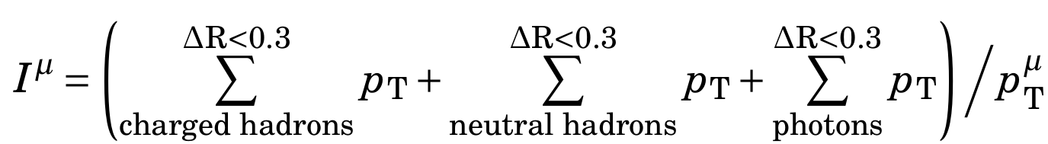
Data selection
    Events in data are selected using the following criteria:
        Trigger: requires the presence of a muon with p_{T} > 12 GeV/c
        Analysis selection: muon p_{T} > 25 GeV/c and |η_{LAB}| < 2.4
        Muon isolation: requires isolated muons
      μ
        < 0.15
        Sum of p_{T} of particles (γ , h± & h⁰) around the muon < 15% of muon p_{T}
        Suppress muons from jets
    ΔR=0.3
15

Slide 44
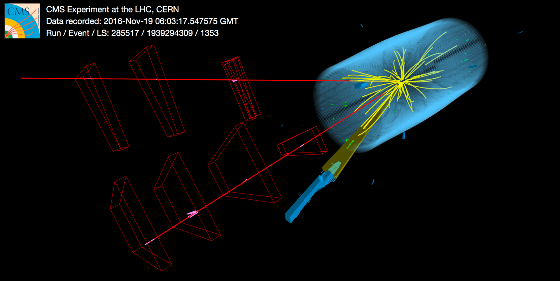
Data selection
    Events in data are selected using the following criteria:
        Trigger: requires the presence of a muon with p_{T} > 12 GeV/c
        Analysis selection: muon p_{T} > 25 GeV/c and |η_{LAB}| < 2.4
        Muon isolation: requires isolated muons
      μ
        < 0.15
        Sum of p_{T} of particles (γ , h± & h⁰) around the muon < 15% of muon p_{T}
        Suppress muons from jets
    ΔR=0.3
        Z/γ* →μ⁺ μ⁻ veto: rejects events containing μ⁻ μ⁺ pairs, each muon with p_{T} > 15 GeV/c
    μ⁺
    μ⁻
    Z → μ⁺ μ⁻
15

Slide 45
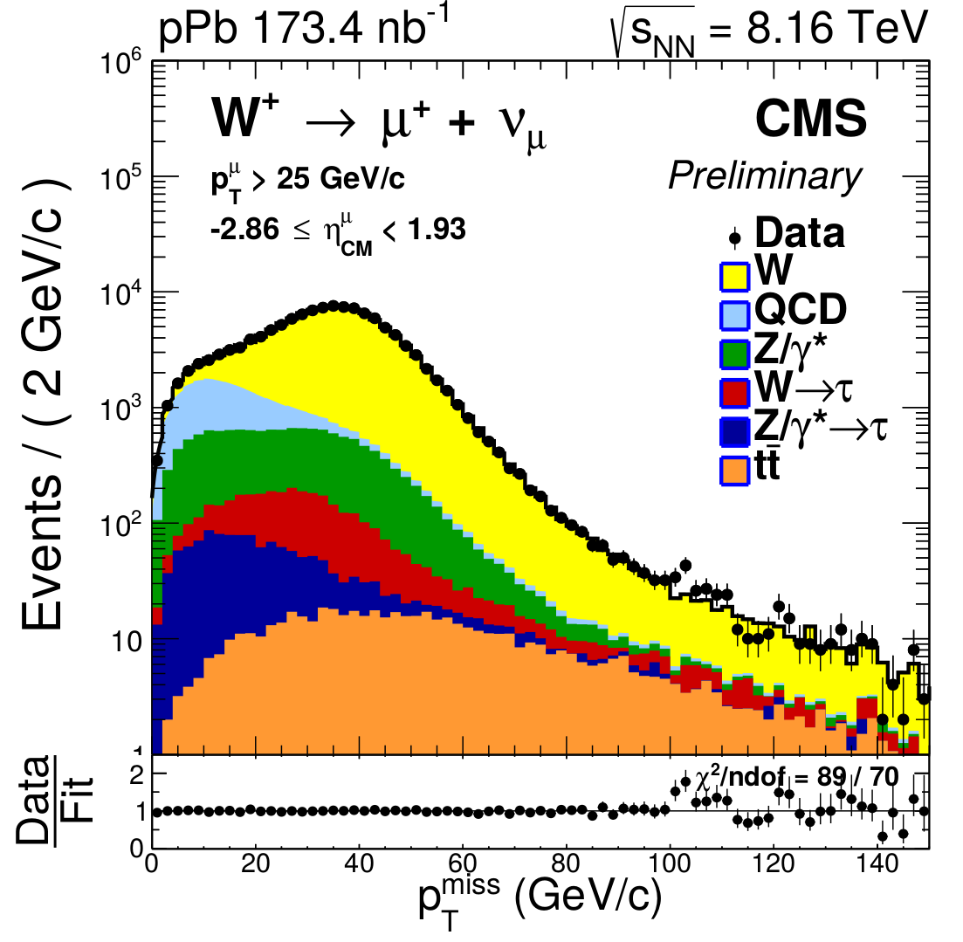
Extraction of W-boson yields
Missing Transverse Momentum p_{T}^{miss}
MC corrections
Signal
Background
W→μ ν
(from MC)
EW and top
(from MC)
QCD jet
(from data)
p_{T}^{miss} fits
N_{W} & N_{QCD}
Efficiency
(from MC)
Observables
16

Slide 46
Extraction of W-boson yields
Missing Transverse Momentum p_{T}^{miss}
MC corrections
Signal
Background
W→μ ν
(from MC)
EW and top
(from MC)
QCD jet
(from data)
p_{T}^{miss} fits
N_{W} & N_{QCD}
Efficiency
(from MC)
Observables

Slide 47
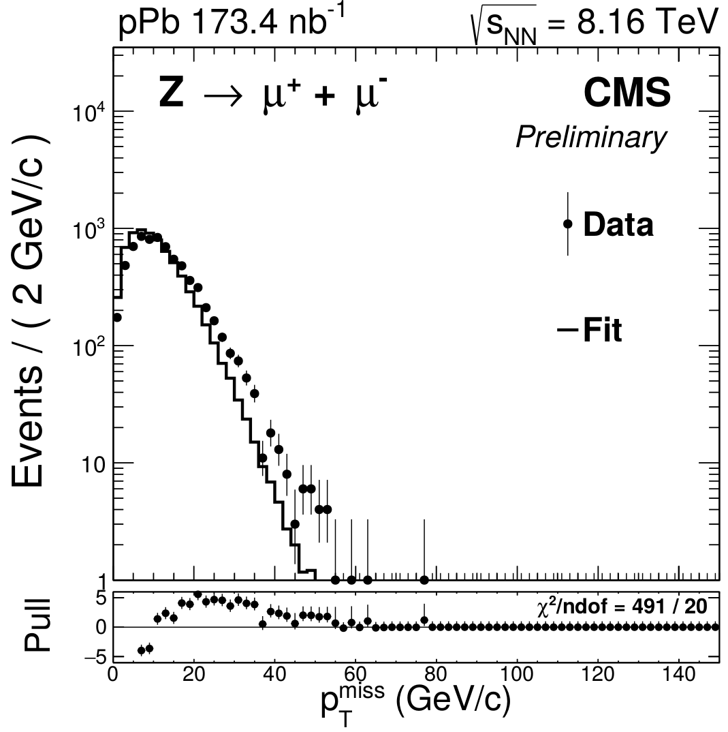
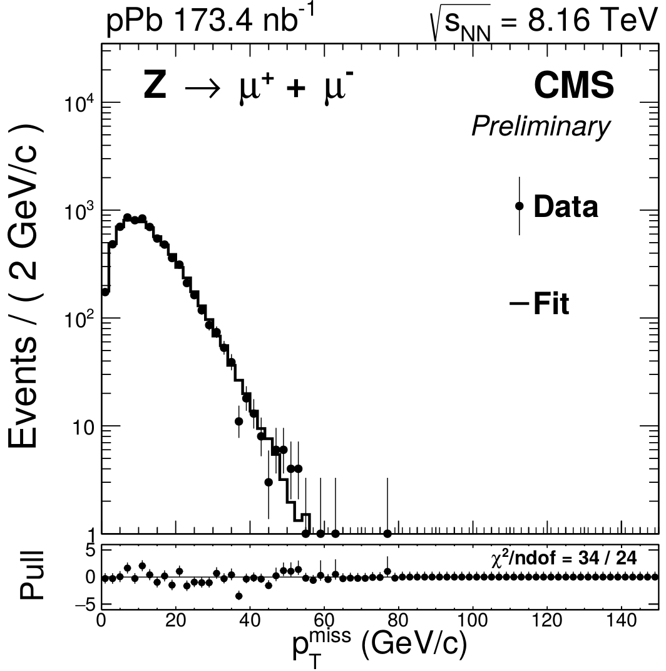
MC corrections
    (1)
    (4)
MC corrections
    p_{T}^{miss}
    p_{T}^{miss}
    Simulations are used to describe p_{T}^{miss} shape of signal and (EW, top) background events
    At first, the simulated p_{T}^{miss} distribution does not describe data → correct the simulations
    Use a Z→μ⁺μ⁻ sample to derive the corrections (similar to the W but background-free)
    Three corrections are implemented:
        Event activity weighing
        Weak boson p_{T} weighing
        Recoil calibration
17

Slide 48
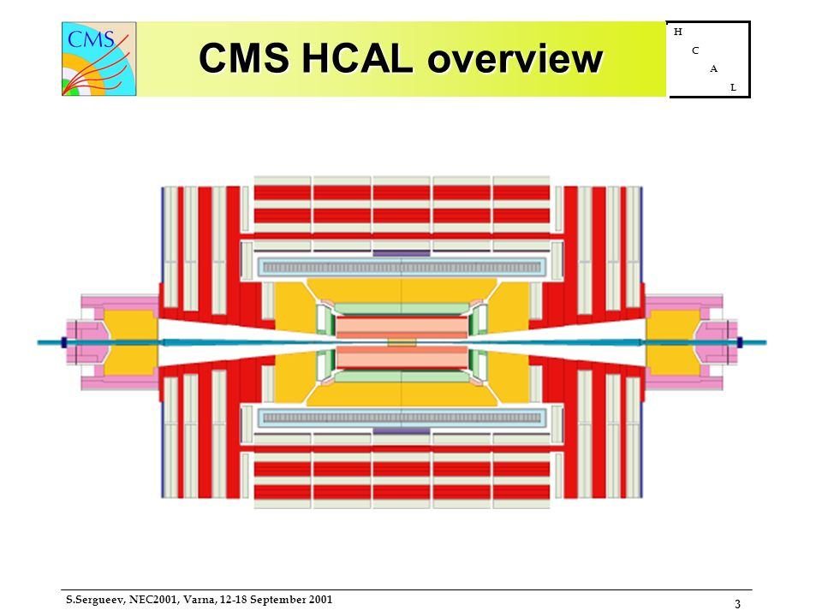
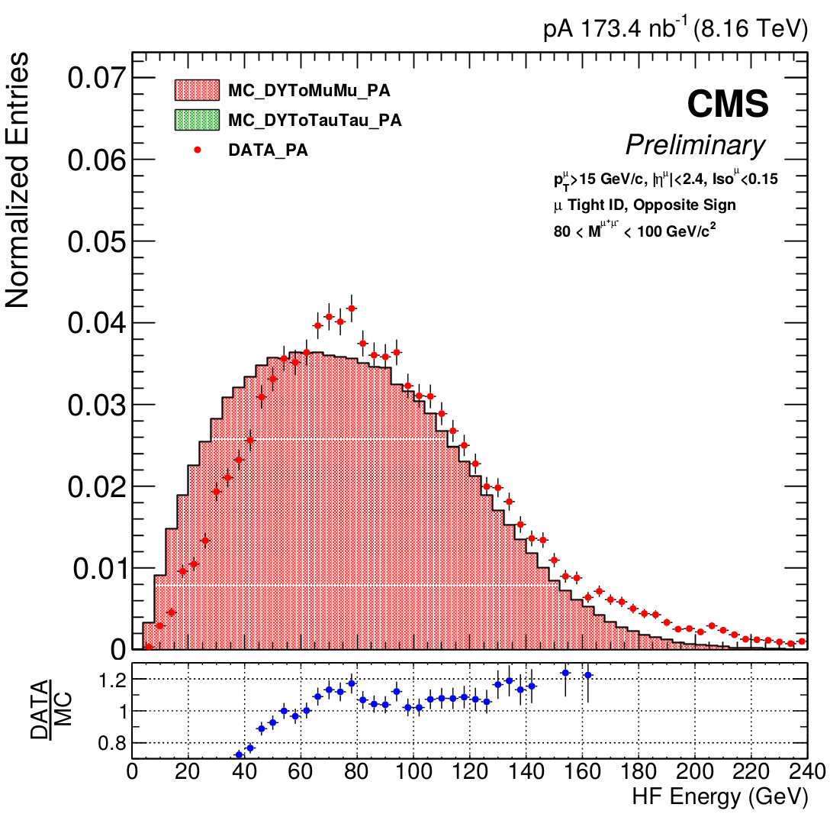
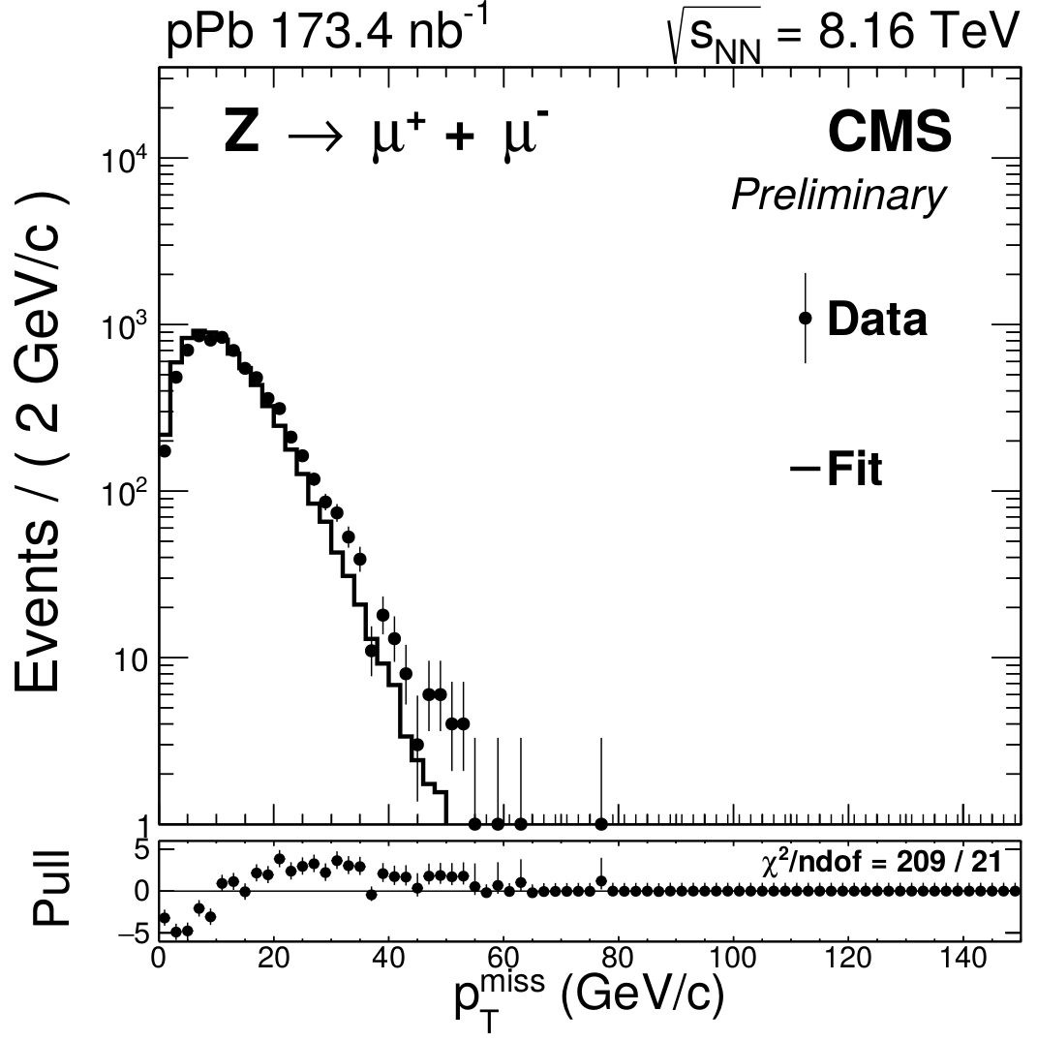

Event activity weighing
    Energy in forward calorimeter (HF) correlated with event activity
    (1)
μ
    HF-
    HF+
    p_{T}^{miss}
    HF energy
    (2)
    p_{T}^{miss}
    Data
    MC
18

Slide 49
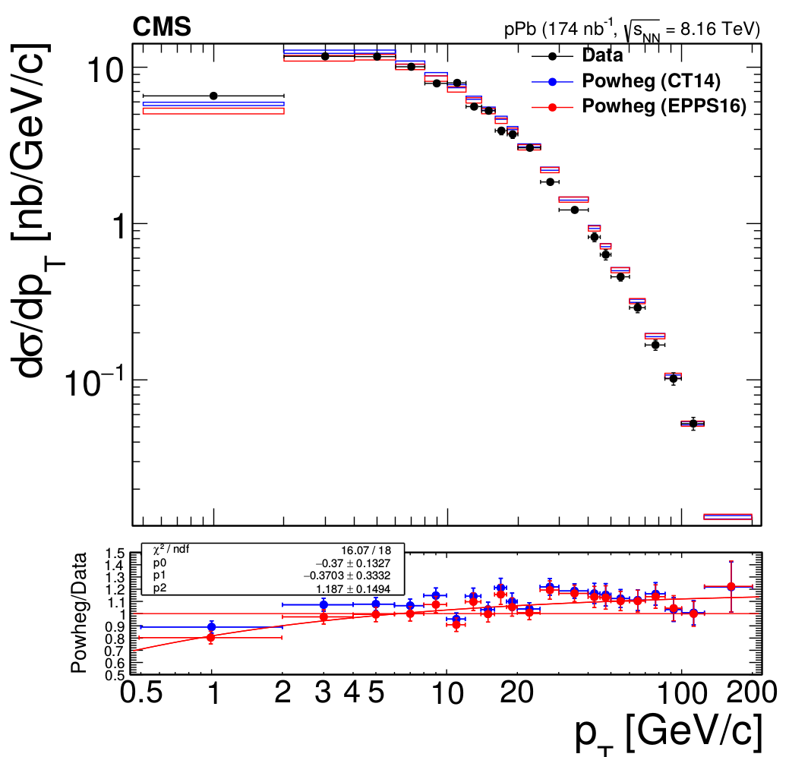

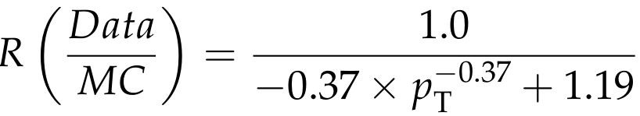

Weak boson p_{T} weighing
    Simulated weak boson p_{T} does not match data → affects p_{T}^{miss} and muon p_{T}
    Z→μ⁺ + μ⁻
    p_{T}^{Z}
    MC
    Data
    (2)
    (3)
    p_{T}^{miss}
    p_{T}^{miss}
19

Slide 50
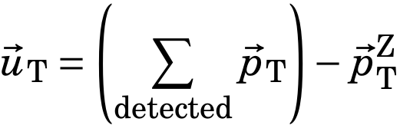

Recoil calibration
    Z Events
Recoil is the p_{T} sum of all observed particles excluding the Z boson p_{T}
    p_{T}^{Z}
    Muon
    Underlying E.
    Muon
    Recoil
Use data-driven technique to calibrate the recoil considering correlation between underlying events and weak boson p_{T}
    (3)
    p_{T}^{miss}
20

Slide 51
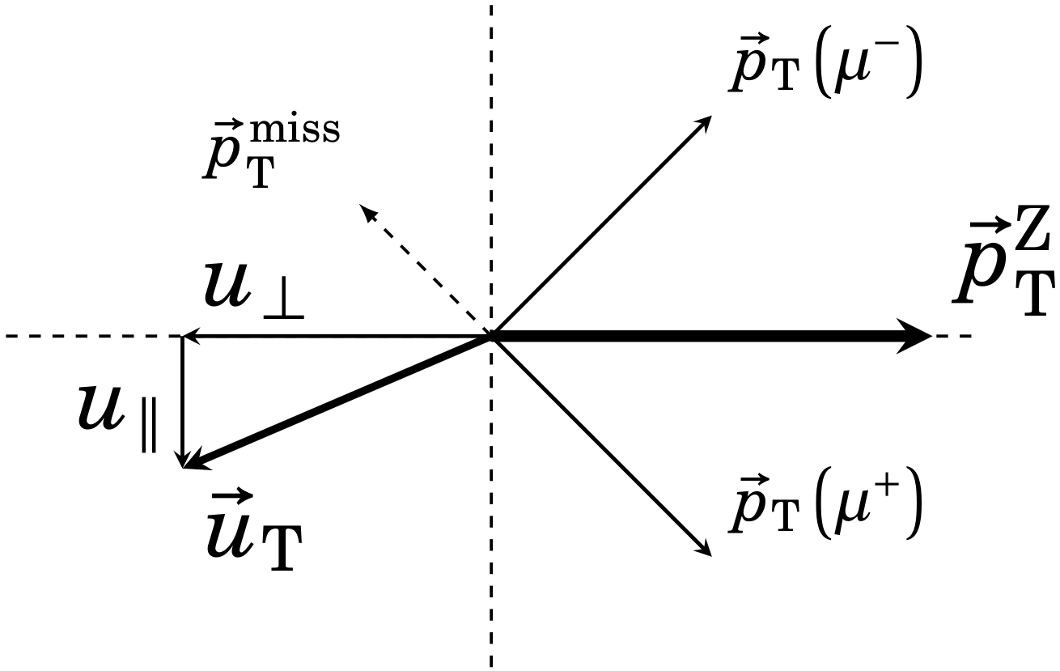
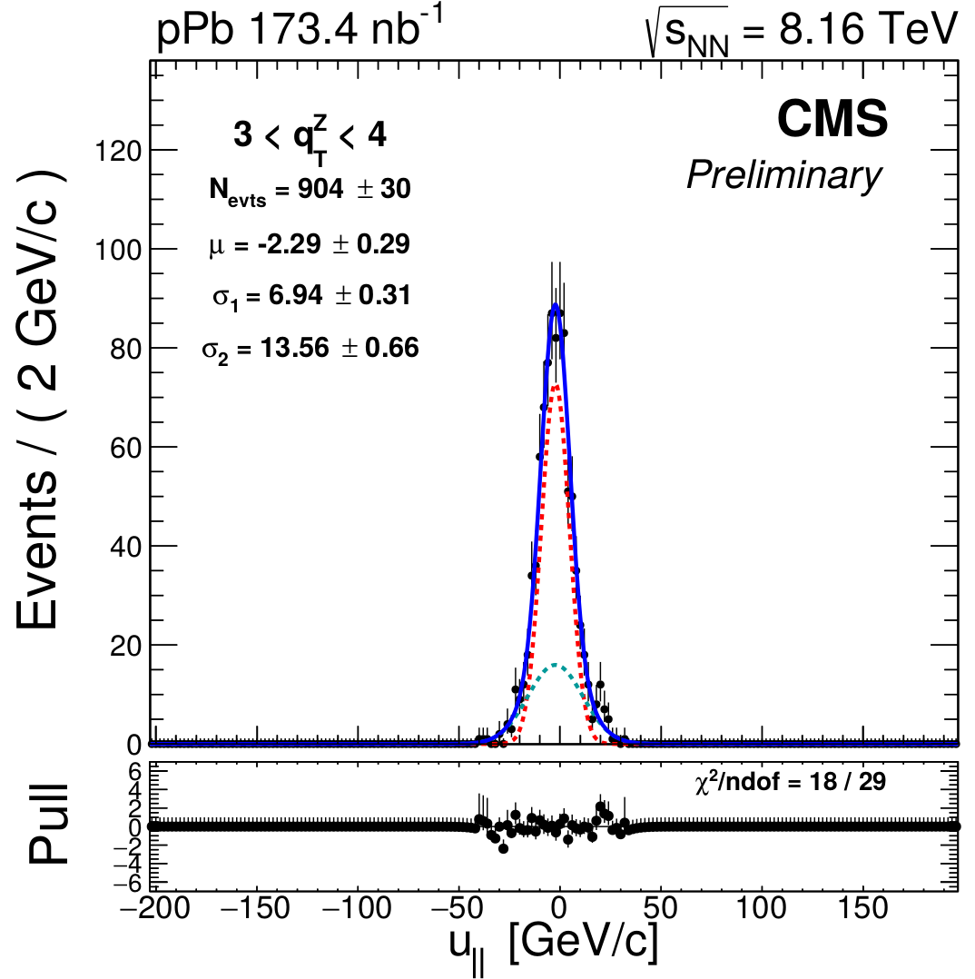
Recoil calibration
    Z Events
Recoil:
    p_{T}^{Z}
    Muon
    Underlying E.
    Muon
Recoil parallel and
perpendicular to p_{T}^{Z}
    Recoil
1st step
Fit recoil distr.
2 Gaussians
    (3)
    p_{T}^{miss}
20

Slide 52
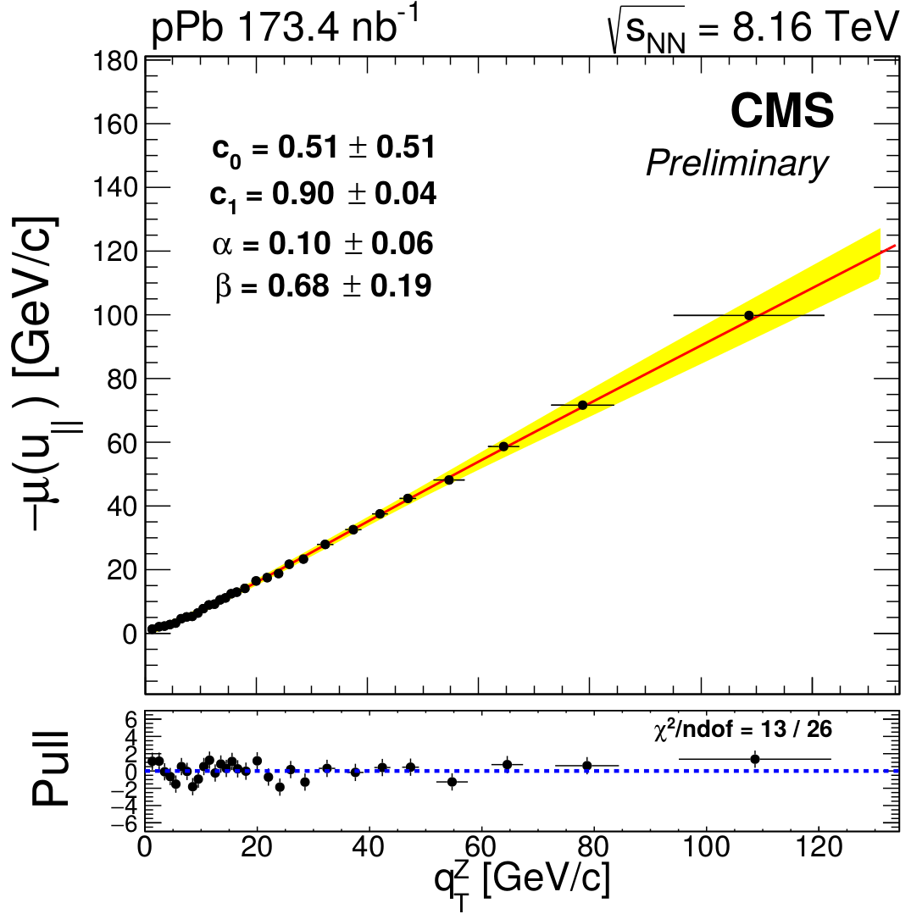
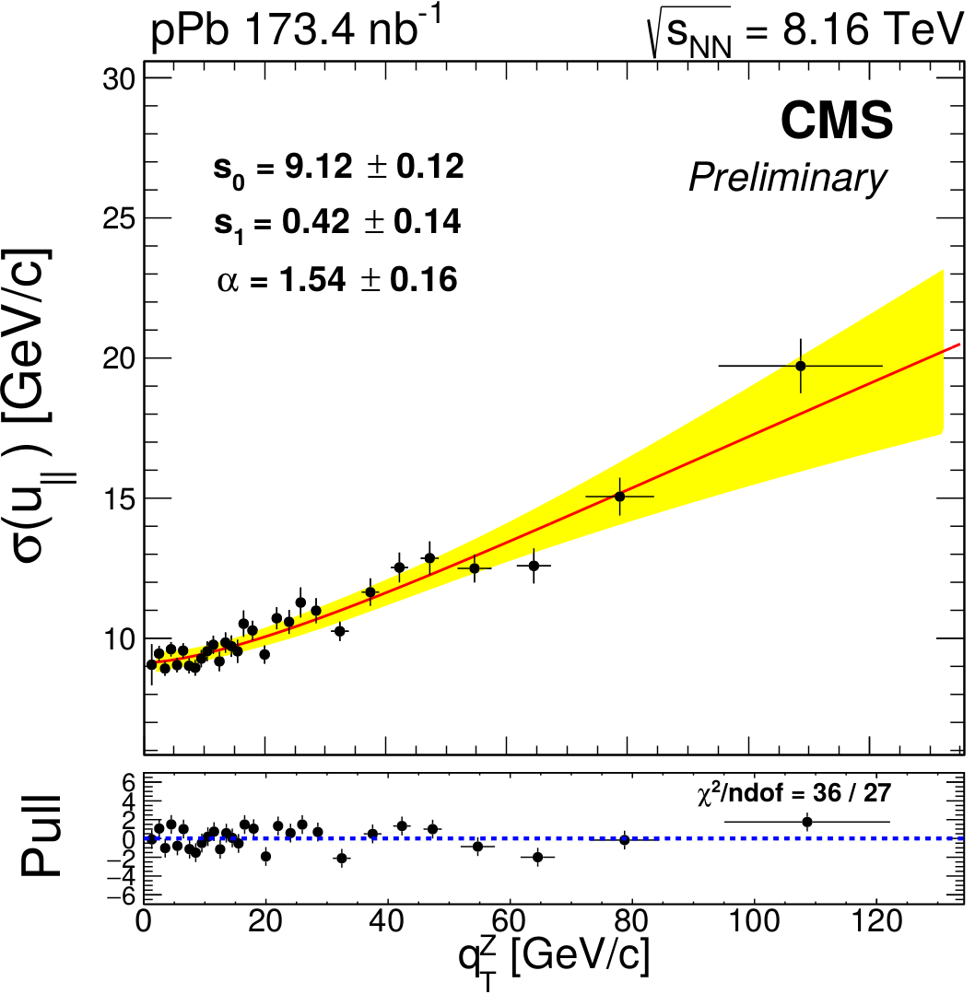
Recoil calibration
    Z Events
Recoil:
    p_{T}^{Z}
    Muon
    Underlying E.
    Muon
Recoil parallel and
perpendicular to p_{T}^{Z}
    Recoil
2nd step
Fit mean vs p_{T}^{Z}
1st step
Fit recoil distr.
2 Gaussians
    (3)
Fit width vs p_{T}^{Z}
    p_{T}^{miss}
20

Slide 53
Recoil calibration
    Z Events
Recoil:
    p_{T}^{Z}
    Muon
    Underlying E.
    Muon
Recoil parallel and
perpendicular to p_{T}^{Z}
    Recoil
2nd step
Fit mean vs p_{T}^{Z}
1st step
Fit recoil distr.
2 Gaussians
3rd step
    (3)
Scale recoil
in simulation
using boson p_{T}
Fit width vs p_{T}^{Z}
    p_{T}^{miss}
average mean and
width match data
20

Slide 54
Recoil calibration
    (4)
    p_{T}^{miss}
Recoil parallel and
perpendicular to p_{T}^{Z}
2nd step
Fit mean vs p_{T}^{Z}
1st step
Fit recoil distr.
2 Gaussians
3rd step
    (3)
Scale recoil
in simulation
using boson p_{T}
Fit width vs p_{T}^{Z}
    p_{T}^{miss}
average mean and
width match data
20

Slide 55
Extraction of W-boson yields
Missing Transverse Momentum p_{T}^{miss}
MC corrections
Signal
Background
W→μ ν
(from MC)
EW and top
(from MC)
QCD jet
(from data)
p_{T}^{miss} fits
N_{W} & N_{QCD}
Efficiency
(from MC)
Observables

Slide 56
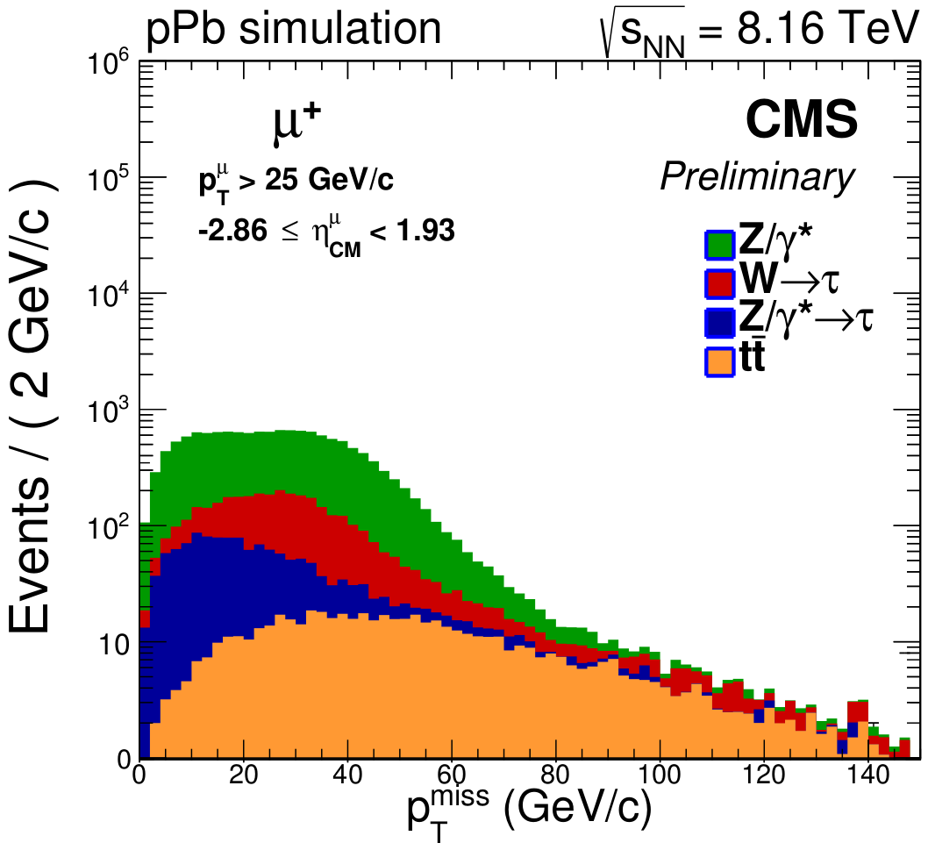
p_{T}^{miss} templates from simulation
The p_{T}^{miss} distribution of signal, electroweak background and top background is described with simulations (next-to-leading order + EPPS16 nPDF)
Electroweak backgrounds
Top background
21

Slide 57
Extraction of W-boson yields
Missing Transverse Momentum p_{T}^{miss}
MC corrections
Signal
Background
W→μ ν
(from MC)
EW and top
(from MC)
QCD jet
(from data)
p_{T}^{miss} fits
N_{W} & N_{QCD}
Efficiency
(from MC)
Observables

Slide 58
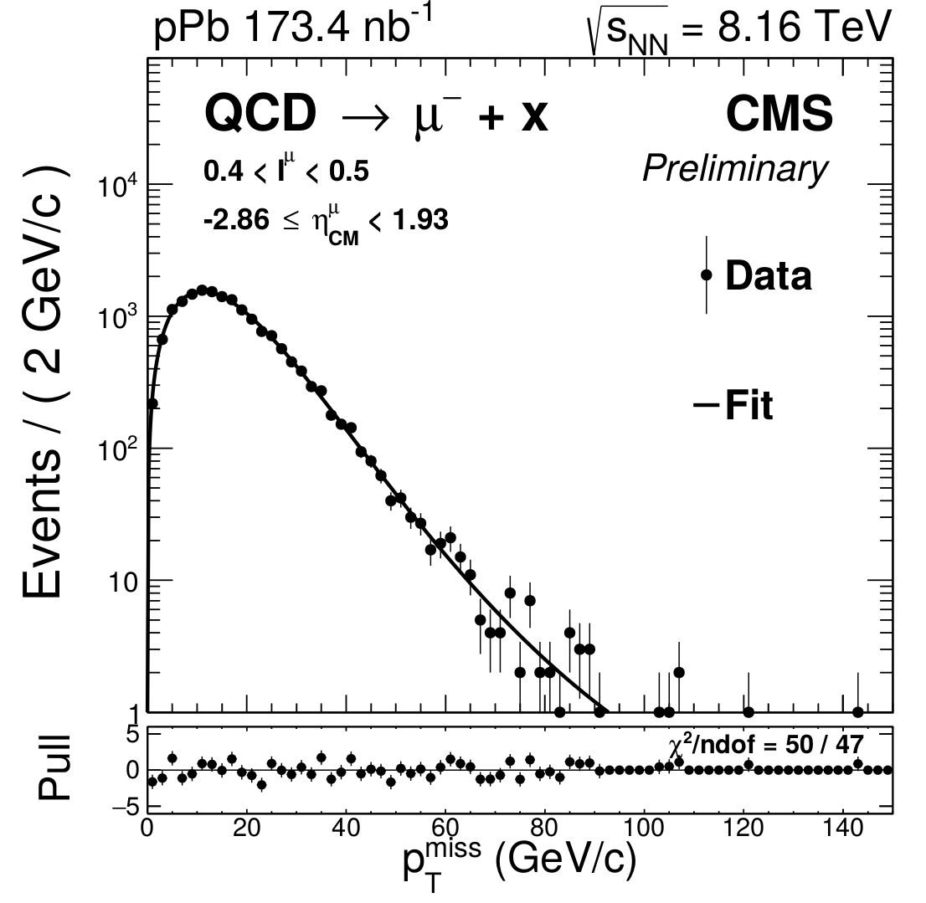
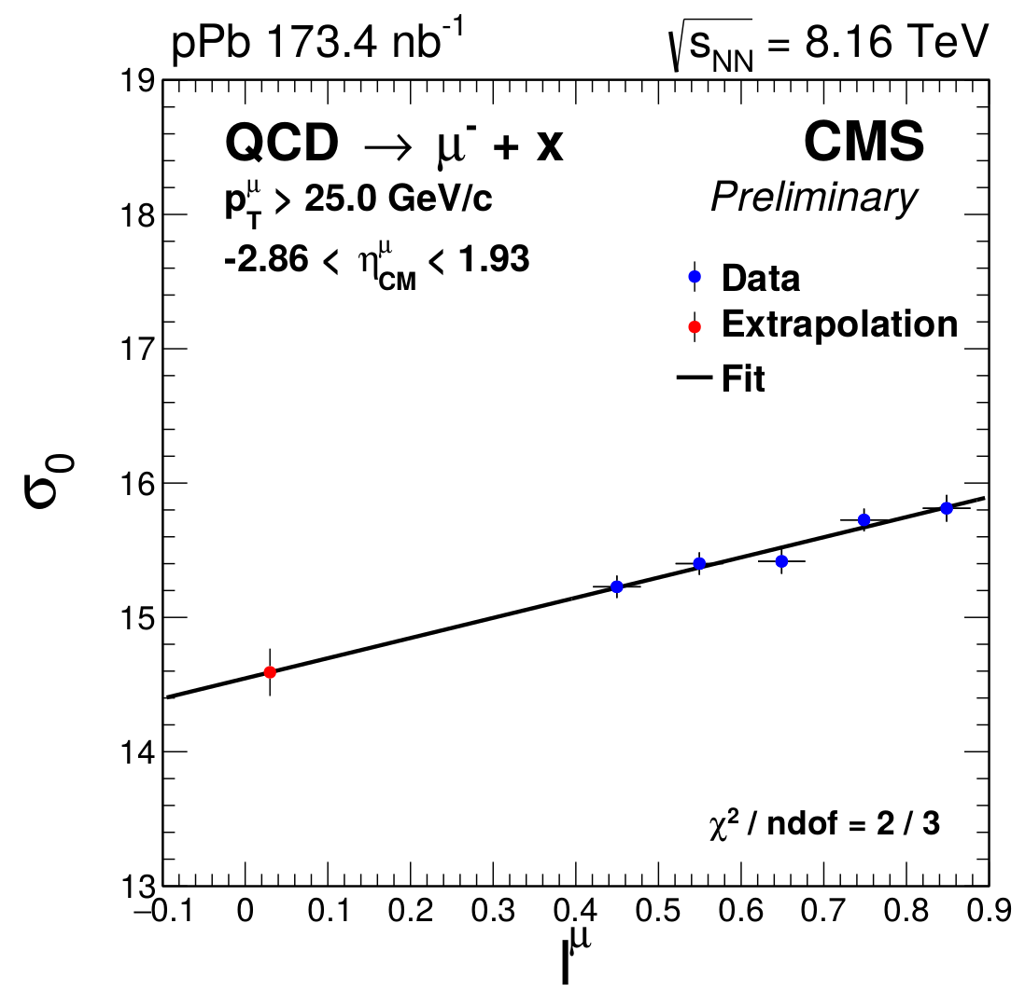
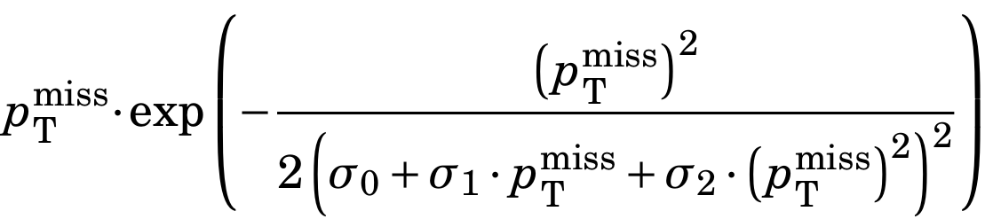
QCD jet p_{T}^{miss} function
      μ
    Derived using a sample of non-isolated muons from data (I^{μ} > 0.4)
1st step
2nd step
    Extrapolate p_{T}^{miss} parameters (σ₀ , σ₁ and σ₂) to low muon isolation (signal region)
Modified Rayleigh distribution
22

Slide 59
Extraction of W-boson yields
Missing Transverse Momentum p_{T}^{miss}
MC corrections
Signal
Background
W→μ ν
(from MC)
EW and top
(from MC)
QCD jet
(from data)
p_{T}^{miss} fits
N_{W} & N_{QCD}
Efficiency
(from MC)
Observables

Slide 60
p_{T}^{miss} fit
    W yields extracted from fits to the p_{T}^{miss} distribution
      The relative fractions of the EW and top backgrounds w.r.t the signal (r = N_{bkg} / N_{W}) are fixed to simulation, assuming similar modification of their yields
    Free parameters:
      N_{W} : Number of signal events
      N_{QCD} : Number of QCD jet events
    Background Sources :
    QCD jet (~13%) , Z/γ*→μ (~9%), W→τ (~2%), Z/γ*→τ (~1%) and tt (~0.5%)
23

Slide 61
Extraction of W-boson yields
Missing Transverse Momentum p_{T}^{miss}
MC corrections
Signal
Background
W→μ ν
(from MC)
EW and top
(from MC)
QCD jet
(from data)
p_{T}^{miss} fits
N_{W} & N_{QCD}
Efficiency
(from MC)
Observables

Slide 62
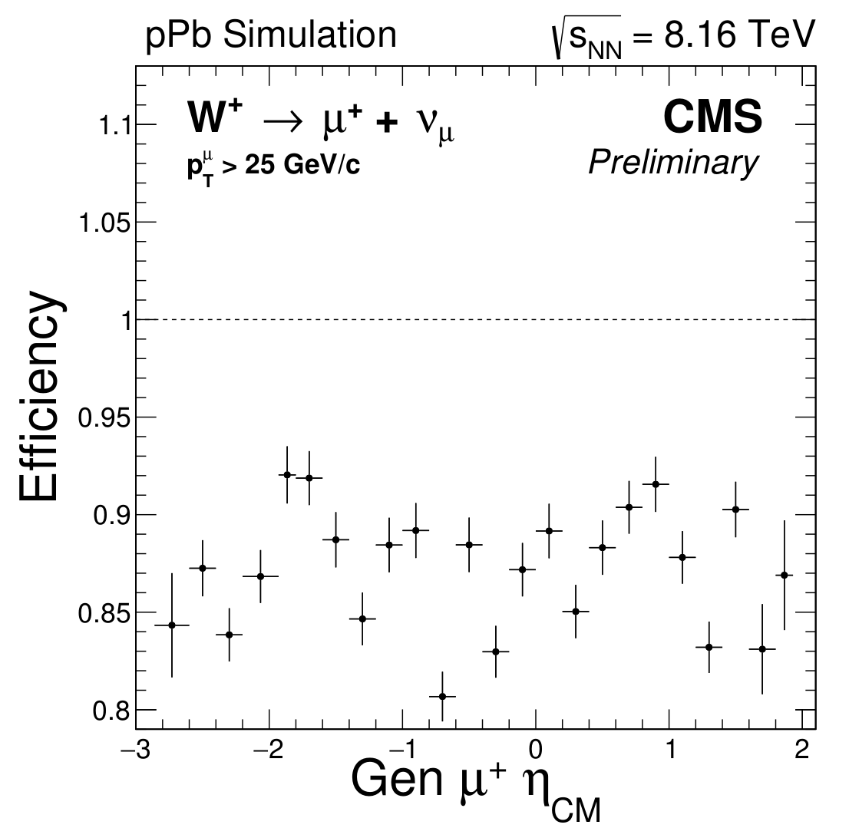
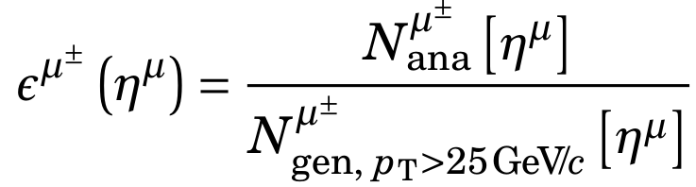
Muon efficiency
    Muon efficiency computed from W→μν simulation:
    Number of muons passing analysis selection
    Number of muons with p_{T} > 25 GeV/c
    Muon efficiency between 80% and 95%, corrected with data-driven method (Tag-and-Probe)
24

Slide 63
Extraction of W-boson yields
Missing Transverse Momentum p_{T}^{miss}
MC corrections
Signal
Background
W→μ ν
(from MC)
EW and top
(from MC)
QCD jet
(from data)
p_{T}^{miss} fits
N_{W} & N_{QCD}
Efficiency
(from MC)
Observables

Slide 64
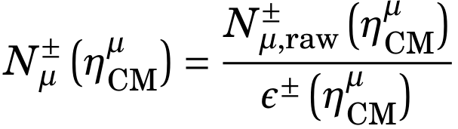
Observables
Measured number of signal events:
Extracted from p_{T}^{miss} fit
25

Slide 65
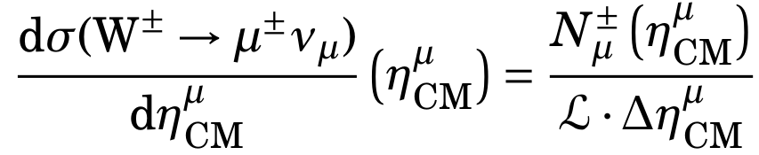
Observables
Measured number of signal events:
Extracted from p_{T}^{miss} fit
Cross section of W→μν:
25

Slide 66
Observables
Measured number of signal events:
Extracted from p_{T}^{miss} fit
Cross section of W→μν:
p-Pb integrated luminosity (173.4 ± 6.1 /nb)
25

Slide 67
Observables
Measured number of signal events:
Extracted from p_{T}^{miss} fit
Cross section of W→μν:
p-Pb integrated luminosity (173.4 ± 6.1 /nb)
η_{CM} bin width
25

Slide 68
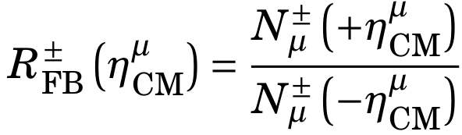
Observables
Measured number of signal events:
Extracted from p_{T}^{miss} fit
Cross section of W→μν:
p-Pb integrated luminosity (173.4 ± 6.1 /nb)
η_{CM} bin width
Forward-backward ratio:
25

Slide 69
Observables
Measured number of signal events:
Extracted from p_{T}^{miss} fit
Cross section of W→μν:
p-Pb integrated luminosity (173.4 ± 6.1 /nb)
η_{CM} bin width
Forward-backward ratio:
proton-going (η_{CM} > 0)
25

Slide 70
Observables
Measured number of signal events:
Extracted from p_{T}^{miss} fit
Cross section of W→μν:
p-Pb integrated luminosity (173.4 ± 6.1 /nb)
η_{CM} bin width
Forward-backward ratio:
proton-going (η_{CM} > 0)
Pb-going (η_{CM} < 0)
25

Slide 71
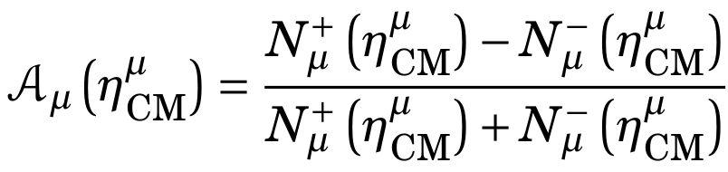
Observables
Measured number of signal events:
Extracted from p_{T}^{miss} fit
Cross section of W→μν:
p-Pb integrated luminosity (173.4 ± 6.1 /nb)
η_{CM} bin width
Forward-backward ratio:
proton-going (η_{CM} > 0)
Pb-going (η_{CM} < 0)
Muon charge asymmetry:
25

Slide 72
Uncertainties
Max. relative uncertainty
Source of uncertainty
Luminosity | 3.5 | 3.5
Efficiency | 3.0 | 3.2
QCD jet background | 1.2 | 0.7
EW and top backgrounds | 0.4 | 0.3
Weak boson p_{T} | 0.5 | 0.4
Event activity | 0.6 | 0.4
Recoil calibration | 0.2 | 0.3
W-boson generator | 0.9 | 0.5
Total systematic uncertainty | 4.8 | 4.8
Statistical uncertainty | 2.4 | 2.0
Dominant sources of uncertainties: luminosity (cross section) and efficiency
Correlations in muon charge and η_{CM} considered in the uncertainties of the muon charge asymmetry and forward-backward ratios
26

Slide 73
Outline
Theoretical context
The CMS detector at the LHC
W-boson production in p-Pb at 8.16 TeV
  Introduction
  Analysis
  Results
Charmonium production in Pb-Pb at 5.02 TeV
    Introduction
    Analysis
    Results
Conclusions

Slide 74
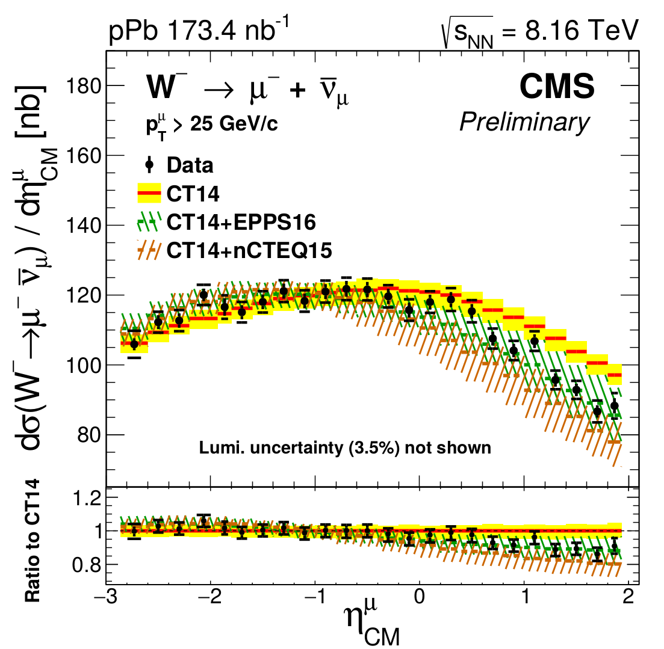
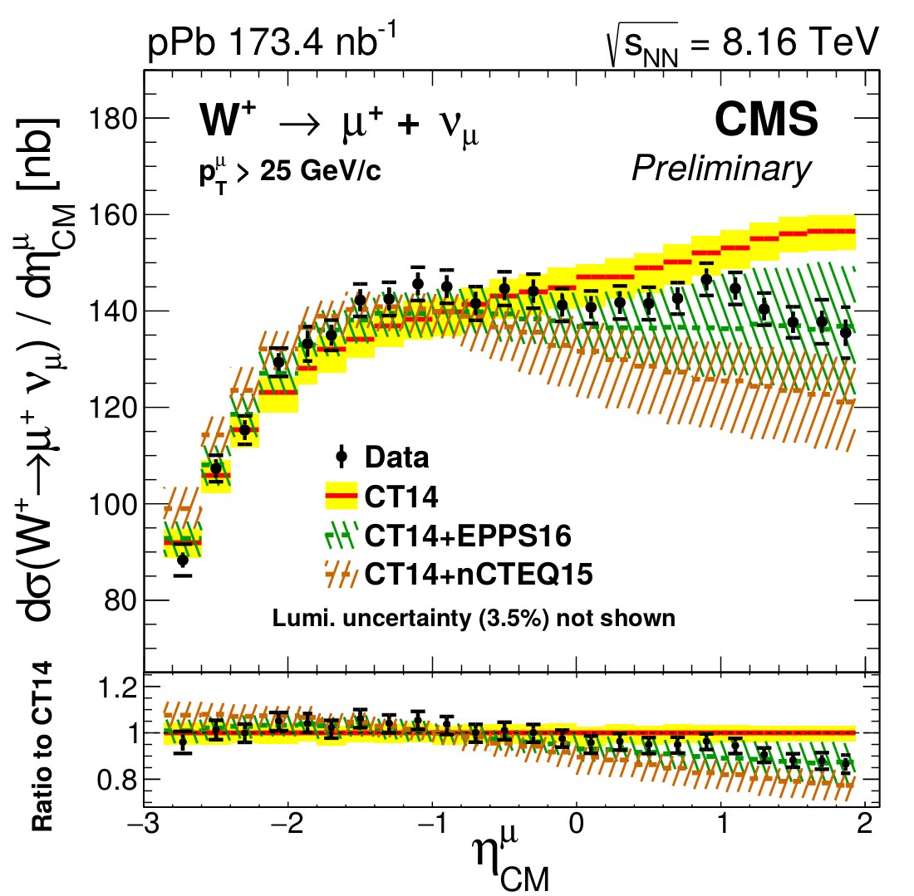
W-boson cross sections
    P(χ² ) = <0.01% CT14 , 79% nCTEQ15 , 96% EPPS16
    W⁻
    W⁺
27

Slide 75
W-boson cross sections
    P(χ² ) = <0.01% CT14 , 79% nCTEQ15 , 96% EPPS16
    W⁻
    W⁺
    anti-shadowing
    anti-shadowing
    η_{CM} < 0 (large x_{Pb}): Results agree with PDF and nPDF calculations
27

Slide 76
W-boson cross sections
    P(χ² ) = <0.01% CT14 , 79% nCTEQ15 , 96% EPPS16
    W⁻
    W⁺
    shadowing
    shadowing
    η_{CM} < 0 (large x_{Pb}): Results agree with PDF and nPDF calculations
    η_{CM} > 0 (small x_{Pb}): Results favor the nuclear PDF calculations
27

Slide 77
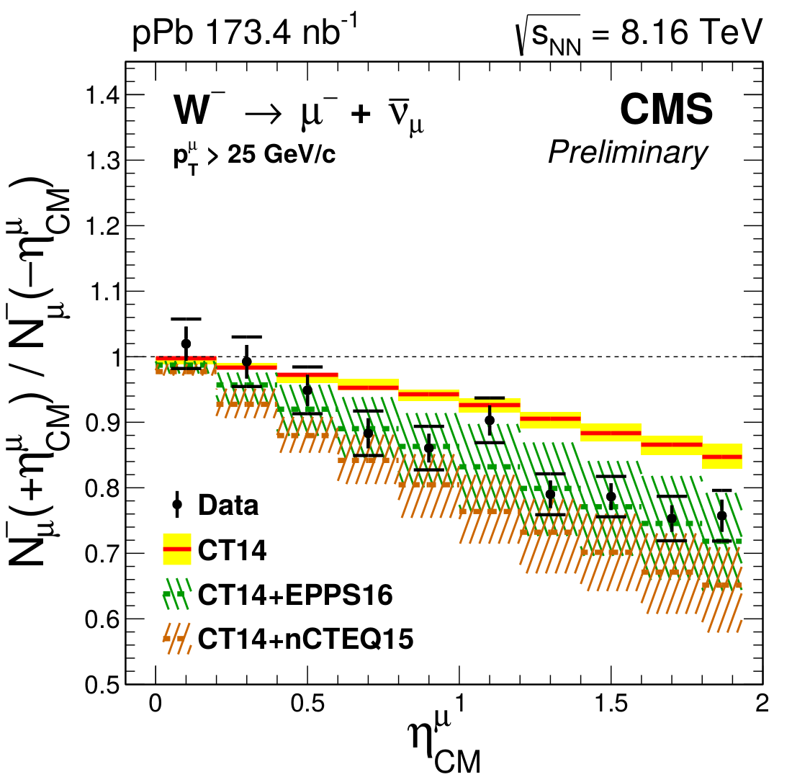
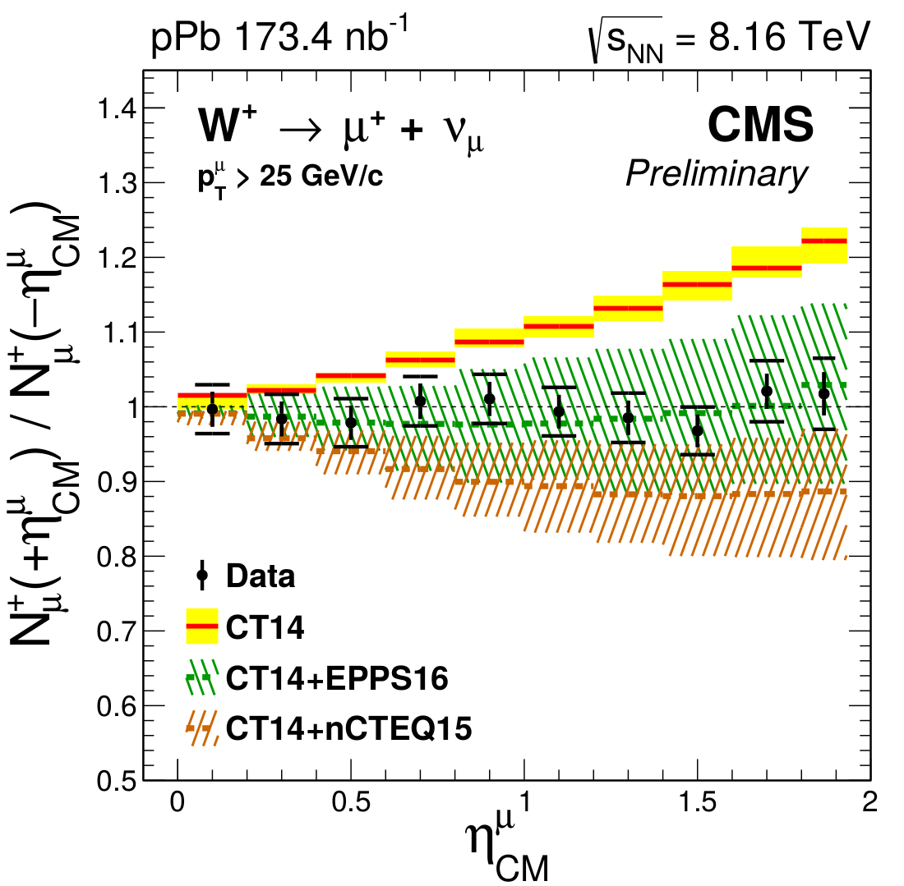
Muon forward-backward ratio
    P(χ² ) = <0.01% CT14 , 83% nCTEQ15 , 95% EPPS16
    W⁻
    W⁺
28

Slide 78
Muon forward-backward ratio
    P(χ² ) = <0.01% CT14 , 83% nCTEQ15 , 95% EPPS16
    W⁻
    W⁺
    Deviate (>7σ) from free-nucleon PDF calculations
28

Slide 79
Muon forward-backward ratio
    P(χ² ) = <0.01% CT14 , 83% nCTEQ15 , 95% EPPS16
    W⁻
    W⁺
    Deviate (>7σ) from free-nucleon PDF calculations
    Experimental uncertainties smaller than nPDF uncertainties
28

Slide 80

Muon charge asymmetry
    P(χ² ) = 54% CT14 , 23% nCTEQ15 , 80% EPPS16
29

Slide 81
Muon charge asymmetry
    P(χ² ) = 54% CT14 , 23% nCTEQ15 , 80% EPPS16
    Sensitive to isospin effect (neutrons and protons in Pb ion)
29

Slide 82
Muon charge asymmetry
    P(χ² ) = 54% CT14 , 23% nCTEQ15 , 80% EPPS16
    Sensitive to isospin effect (neutrons and protons in Pb ion)
    All (n)PDF calculations reproduce the measurements
29

Slide 83
Summary of W-boson measurement
    Observation of nuclear modifications of the (anti) quark PDFs
    Experimental uncertainties smaller than nuclear PDF uncertainties
30

Slide 84
Outline
Theoretical context
The CMS detector at the LHC
W-boson production in p-Pb at 8.16 TeV
  Introduction
  Analysis
  Results
Charmonium production in Pb-Pb at 5.02 TeV
    Introduction
    Analysis
    Results
Conclusions

Slide 85


Charmonia in Pb-Pb collisions
Charmonia (cc mesons) are produced in the early stages of the collision
The Quark-Gluon Plasma is expected to modify the charmonia production
QGP
@ high energy density
QGP
c
c
c
c
c
c
c
c
Suppresion
Debye screening
+Enhancement
Regeneration
Charmonia are good probes of the medium evolution
31

Slide 86

Prompt and nonprompt J/Ψ
Inclusive J/Ψ
Prompt J/Ψ
Nonprompt J/Ψ
Direct J/Ψ
Feed-down from Ψ(2S) and χ_{c}
From B hadron decays
J/Ψ
B
J/Ψ
Beam
Beam
Beam
Beam
Collision
Collision
Prompt J/Ψ:
                Directly affected by the QGP
Nonprompt J/Ψ:
                Reflects energy loss of b quarks in the QGP
Separation based on pseudo-proper decay length (l_{J/Ψ})
    μ⁻
decay length in the laboratory frame
J/Ψ
B
L
    μ⁺
secondary vertex
primary vertex
32

Slide 87


Centrality
Peripheral collision
Semi-peripheral collision
Central collision
100%
centrality
0%
100%
Centrality percentile determined from the energy distribution in the hadron forward calorimeter
Geometry of the heavy-ion collision:
T_{AA}
N_{part}
Glauber model relates centrality to number of participants (N_{part}) and the nuclear overlap function (T_{AA})
33

Slide 88
Outline
Theoretical context
The CMS detector at the LHC
W-boson production in p-Pb at 8.16 TeV
  Introduction
  Analysis
  Results
Charmonium production in Pb-Pb at 5.02 TeV
    Introduction
    Analysis
    Results
Conclusions

Slide 89
Data selection
    Events in data are selected using the following criteria:
34

Slide 90
Data selection
    Events in data are selected using the following criteria:
        Dimuon L1 trigger: requires the presence of two muons
    μ⁺
        c
        γ*
J/Ψ
        c
    μ⁻
34

Slide 91
Data selection
    Events in data are selected using the following criteria:
        Dimuon L1 trigger: requires the presence of two muons
        Dimuon vertex selection: requires the probability that
        the two muons derive from the same vertex to be larger than 1%
    μ⁺
        c
        γ*
J/Ψ
        c
    μ⁻
34

Slide 92

Data selection
    Events in data are selected using the following criteria:
        Dimuon L1 trigger: requires the presence of two muons
        Dimuon vertex selection: requires the probability that
        the two muons derive from the same vertex to be larger than 1%
    μ⁺
        c
        γ*
J/Ψ
        c
    μ⁻
        Muon kinematic selection: requires muons to be within the CMS kinematic acceptance
        Muon p_{T}
        Muon η
34

Slide 93


Measurement of J/ψ R_{AA}
1st step
2nd step
Invariant mass m_{μμ}
Pseudo-proper decay length l_{J/ψ}
Signal shape
(tuned on MC)
σ_{l} dist.
(from data)
l_{J/ψ} resol.
(from data)
Background shape
(from data)
Background shape
(from data)
B-decay length
(from MC)
3rd step
2D fits (m_{μμ} , l_{J/ψ})
N_{J/ψ} and nonprompt fraction
Acceptance
& efficiency
(from MC)
J/ψ meson R_{AA}
34

Slide 94
Measurement of J/ψ R_{AA}
1st step
2nd step
Invariant mass m_{μμ}
Pseudo-proper decay length l_{J/ψ}
Signal shape
(tuned on MC)
σ_{l} dist.
(from data)
l_{J/ψ} resol.
(from data)
Background shape
(from data)
Background shape
(from data)
B-decay length
(from MC)
3rd step
2D fits (m_{μμ} , l_{J/ψ})
N_{J/ψ} and nonprompt fraction
Acceptance
& efficiency
(from MC)
J/ψ meson R_{AA}

Slide 95

Invariant mass fit
Data
35

Slide 96

Invariant mass fit
Data
Signal shape:
2 Crystal Balls
J/ψ simulation
Power-law tail
FS radiation
Gaussian core
mass resolution
35

Slide 97
Invariant mass fit
Data
Signal shape:
2 Crystal Balls
J/ψ simulation
Tail parameters tuned on J/ψ simulation and fixed on data
Power-law tail
FS radiation
Gaussian core
mass resolution
35

Slide 98
Invariant mass fit
Data
Background shape:
Chebyshev polynomial
Signal shape:
2 Crystal Balls
Best order selected with Log-Likelihood-ratio test
J/ψ simulation
Tail parameters tuned on J/ψ simulation and fixed on data
Power-law tail
FS radiation
Gaussian core
mass resolution
35

Slide 99
Measurement of J/ψ R_{AA}
1st step
2nd step
Invariant mass m_{μμ}
Pseudo-proper decay length l_{J/ψ}
Signal shape
(tuned on MC)
σ_{l} dist.
(from data)
l_{J/ψ} resol.
(from data)
Background shape
(from data)
Background shape
(from data)
B-decay length
(from MC)
3rd step
2D fits (m_{μμ} , l_{J/ψ})
N_{J/ψ} and nonprompt fraction
Acceptance
& efficiency
(from MC)
J/ψ meson R_{AA}

Slide 100

l_{J/ψ} resolution
Parametrized from l_{J/ψ} < 0 distribution from a signal data sample
Data
l_{J/ψ} resolution shape:
3 Gaussians
36

Slide 101

l_{J/ψ} resolution
Parametrized from l_{J/ψ} < 0 distribution from a signal data sample
Data
l_{J/ψ} resolution shape:
3 Gaussians
l_{J/ψ} uncertainty
Data
Gaussian resolution model adjusted per event to l_{J/ψ} uncertainty provided by the vertex reconstruction algorithm
36

Slide 102

l_{J/ψ} parametrisation
Data
37

Slide 103
l_{J/ψ} parametrisation
Signal l_{J/ψ} shape:
Prompt: delta
Nonprompt: exp.
⊗ l_{J/ψ} res.
Data
37

Slide 104

l_{J/ψ} parametrisation
Signal l_{J/ψ} shape:
Prompt: delta
Nonprompt: exp.
⊗ l_{J/ψ} res.
Data
B-hadron decay length tuned on nonprompt J/ψ simulation
NonPr J/ψ
simulation
37

Slide 105
l_{J/ψ} parametrisation
Signal l_{J/ψ} shape:
Prompt: delta
Nonprompt: exp.
⊗ l_{J/ψ} res.
Data
B-hadron decay length tuned on nonprompt J/ψ simulation
Background l_{J/ψ} shape:
Prompt: delta
Nonprompt: 3 exp.
NonPr J/ψ
simulation
⊗ l_{J/ψ} res.
37

Slide 106
Measurement of J/ψ R_{AA}
1st step
2nd step
Invariant mass m_{μμ}
Pseudo-proper decay length l_{J/ψ}
Signal shape
(tuned on MC)
σ_{l} dist.
(from data)
l_{J/ψ} resol.
(from data)
Background shape
(from data)
Background shape
(from data)
B-decay length
(from MC)
3rd step
2D fits (m_{μμ} , l_{J/ψ})
N_{J/ψ} and nonprompt fraction
Acceptance
& efficiency
(from MC)
J/ψ meson R_{AA}

Slide 107
2D (m_{μμ}, l_{J/ψ}) fit
Fix the invariant mass and l_{J/ψ} shapes derived in previous steps
Fit the 2D (m_{μμ} , l_{J/ψ}) distribution:
  N_{J/ψ} and N_{bkg}
  b_{J/ψ}: J/ψ nonprompt fraction
  λ: b-hadron decay length
38

Slide 108
Measurement of J/ψ R_{AA}
1st step
2nd step
Invariant mass m_{μμ}
Pseudo-proper decay length l_{J/ψ}
Signal shape
(tuned on MC)
σ_{l} dist.
(from data)
l_{J/ψ} resol.
(from data)
Background shape
(from data)
Background shape
(from data)
B-decay length
(from MC)
3rd step
2D fits (m_{μμ} , l_{J/ψ})
N_{J/ψ} and nonprompt fraction
Acceptance
& efficiency
(from MC)
J/ψ meson R_{AA}

Slide 109


Acceptance and Efficiency
Signal acceptance and efficiency derived using simulations
Acceptance
Efficiency
39

Slide 110
Measurement of J/ψ R_{AA}
1st step
2nd step
Invariant mass m_{μμ}
Pseudo-proper decay length l_{J/ψ}
Signal shape
(tuned on MC)
σ_{l} dist.
(from data)
l_{J/ψ} resol.
(from data)
Background shape
(from data)
Background shape
(from data)
B-decay length
(from MC)
3rd step
2D fits (m_{μμ} , l_{J/ψ})
N_{J/ψ} and nonprompt fraction
Acceptance
& efficiency
(from MC)
J/ψ meson R_{AA}

Slide 111


Measurement of J/ψ R_{AA}
Measured number of signal events:
Extracted from 2D fit
Nuclear modification factor:
40

Slide 112
Measurement of J/ψ R_{AA}
Measured number of signal events:
Extracted from 2D fit
Nuclear modification factor:
p-p integrated luminosity (28.0 ± 0.6 /pb)
40

Slide 113
Measurement of J/ψ R_{AA}
Measured number of signal events:
Extracted from 2D fit
Nuclear modification factor:
p-p integrated luminosity (28.0 ± 0.6 /pb)
nuclear overlap function
(5.6 ± 0.2 /mb, centrality-integrated)
40

Slide 114
Measurement of J/ψ R_{AA}
Measured number of signal events:
Extracted from 2D fit
Nuclear modification factor:
p-p integrated luminosity (28.0 ± 0.6 /pb)
nuclear overlap function
(5.6 ± 0.2 /mb, centrality-integrated)
number of equiv. min. bias events ( (2.37 ± 0.05)x10⁹ )
40

Slide 115
Measurement of J/ψ R_{AA}
Measured number of signal events:
Extracted from 2D fit
Nuclear modification factor:
p-p integrated luminosity (28.0 ± 0.6 /pb)
nuclear overlap function
(5.6 ± 0.2 /mb, centrality-integrated)
Fraction of minimum bias events within centrality range
([20%, 50%] → 30%)
number of equiv. min. bias events ( (2.37 ± 0.05)x10⁹ )
40

Slide 116
Measurement of J/ψ R_{AA}
Nuclear modification factor:
Relative uncertainty
Source of uncertainty
Prompt [%]
Nonprompt [%]
Efficiency | 3.6 - 16.7 | 3.6 - 16.6
Invariant mass parametrization | 0.5 - 3.4 | 0.9 - 3.3
Decay length parametrization | 2.0 - 10.6 | 1.7 - 23.7
Luminosity | 2.3
Number of minimum bias events | 2
Nuclear overlap function T_{AA} | 2 - 16
41

Slide 117
Outline
Theoretical context
The CMS detector at the LHC
W-boson production in p-Pb at 8.16 TeV
  Introduction
  Analysis
  Results
Charmonium production in Pb-Pb at 5.02 TeV
    Introduction
    Analysis
    Results
Conclusions

Slide 118


Prompt J/ψ R_{AA}: Low p_{T}
42

Slide 119
Prompt J/ψ R_{AA}: Low p_{T}
Similar p_{T} trend for different rapidities bins
42

Slide 120
Prompt J/ψ R_{AA}: Low p_{T}
Similar p_{T} trend for different rapidities bins
Less suppression at low p_{T} in central events (cent < 30%)
42

Slide 121
Prompt J/ψ R_{AA}: Low p_{T}
Similar p_{T} trend for different rapidities bins
Less suppression at low p_{T} in central events (cent < 30%)
Regeneration of J/ψ at p_{T} > 3 GeV/c ?
~
42

Slide 122


Prompt J/ψ R_{AA}: High p_{T}
43

Slide 123
Prompt J/ψ R_{AA}: High p_{T}
Similar level of suppression between prompt J/ψ and D⁰ mesons
43

Slide 124
Prompt J/ψ R_{AA}: High p_{T}
Similar level of suppression between prompt J/ψ and D⁰ mesons
Contribution from E_{loss} on J/ψ?
43

Slide 125


Nonprompt J/ψ R_{AA}
44

Slide 126
Nonprompt J/ψ R_{AA}
Similar suppression between nonprompt J/ψ, D⁰ mesons and charged hadrons at high p_{T}
44

Slide 127
Nonprompt J/ψ R_{AA}
Similar suppression between nonprompt J/ψ, D⁰ mesons and charged hadrons at high p_{T}
Universal flavor dependence of E_{loss} at high p_{T} ?
44

Slide 128
Outline
Theoretical context
The CMS detector at the LHC
W-boson production in p-Pb at 8.16 TeV
  Introduction
  Analysis
  Results
Charmonium production in Pb-Pb at 5.02 TeV
    Introduction
    Analysis
    Results
Conclusions

Slide 129


Conclusion
Probing nuclear PDF: W bosons in p-Pb collisions
    Presented in
      ICHEP 2018
      QM 2018
    Observation of nuclear modifications of the (anti) quark PDFs
Probing QGP effects: J/ψ mesons in Pb-Pb collisions
    Published in
      Eur. Phys. J. C 78 (2018) 509
Suppression and regeneration of J/ψ
Contribution of E_{loss} on J/ψ?
Universal flavor dependence of E_{loss}?
45

Slide 130
Thank you for your attention!

Slide 131
BACKUP

Slide 132
W-boson production in p-Pb
W⁺
W⁺
W⁺
W⁺
W⁺
W⁺
W⁺
u
u
u
u
u
u
u
u
Neutron
Proton
Proton
Proton
u
u
u
u
d
d
u
u
d
d
d
d
d
d
d
d
W⁻
W⁻
W⁻
W⁻
W⁻
82 x ( 4W⁺ and 2W⁻ ) = 328 W⁺ and 164 W-
124 x ( 3W⁺ and 3W⁻ ) = 372 W⁺ and 372 W-
W⁺
≈ 1.3
W⁻

Slide 133

W-boson muonic decay
right-handed anti-neutrinos
left-handed
neutrinos
The black arrows represent the particle direction of motion whereas the blue arrows correspond to its spin

Slide 134

Bjorken-x vs muon η

Slide 135

CT14 PDF set

Slide 136

Nuclear PDF sets
    u
    d
    u
    d
    d
    s
    g

Slide 137

Nuclear PDF sets

Slide 138

Muon p_{T} after correction
    Impact on muon p_{T} of applying the weak boson p_{T} weighing
    Before
    After

Slide 139

W-boson p_{T}^{miss} after recoil calibration
    Impact on W-boson p_{T}^{miss} of calibrating the recoil
    Before
    After

Slide 140

QCD jet p_{T}^{miss} parameters vs muon η
    σ₀
    σ₁
    σ₂
    μ⁻
    σ₀
    σ₁
    σ₂
    μ⁺
Modified Rayleigh distribution

Slide 141


Tag and Probe

Slide 142

Muon efficiency

Slide 143

Forward-backward ratio
    P(χ² ) = <0.01% CT14 , 90% nCTEQ15 , 99% EPPS16
    All W bosons

Slide 144


Muon charge asymmetry
    Good agreement between measurement at 8.16 TeV and 5.02 TeV after shifting the η_{CM} taking into account the difference in energy

Slide 145
Prompt and nonprompt J/ψ

Slide 146

Quarkonia excited states

Slide 147





Glauber Model
In heavy collisions we need to characterize the size and shape of overlap region
b = impact parameter
N_{part} = number of participants
N_{col} = number of binary collisions
Not possible to be measured experimentally → use Glauber MC model
Inputs:
  Inelastic nucleon-nucleon cross section
  Nucleus density profile
Nucleons distributed with ρ (wood-saxon)
Impact parameter generated:
N-n collision happens if

Slide 148


Acceptance and Efficiency
Need to correct for the detector acceptance (A) and efficiency (ε) → use simulations
Simulated events are weighed to match the y and p_{T} distributions of J/ψ in data
Number of J/ψ mesons within CMS acceptance
Acceptance:
All J/ψ mesons
Number of J/ψ mesons passing analysis cuts
Efficiency:
Correction weights of data / MC muon efficiency ratios (derived with Tag&Probe) applied to J/ψ efficiency

Slide 149

ALICE J/ψ R_{AA}

Slide 150
Measurement of
prompt ψ(2S) / J/ψ double ratio

Slide 151
Measurement of ψ(2S) / J/ψ double ratio
Lack of ψ(2S) statistics in Pb-Pb data→ 2D fits not possible
Use alternative method to separate prompt and nonprompt charmonia
1st step
2nd step
3rd step
Rejects nonprompt μ⁺μ⁻
while keeping prompt μ⁺μ⁻
Selection
Invariant mass fit
Correction
Select low l_{J/ψ} events
(cut tuned on MC)
Extract ratio of
ψ(2S) / J/ψ
Subtract remaining
nonprompt charmonia
Double ratio:
(ψ(2S) / J/ψ)^{PbPb}
(ψ(2S) / J/ψ)^{pp}
Advantage:
Efficiency cancels in double ratio

Slide 152
Measurement of ψ(2S) / J/ψ double ratio
1st step
2nd step
3rd step
Rejects nonprompt μ⁺μ⁻
while keeping prompt μ⁺μ⁻
Selection
Invariant mass fit
Correction
Select low l_{J/ψ} events
(cut tuned on MC)
Extract ratio of
ψ(2S) / J/ψ
Subtract remaining
nonprompt charmonia
Double ratio:
(ψ(2S) / J/ψ)^{PbPb}
(ψ(2S) / J/ψ)^{pp}

Slide 153





l_{J/ψ} prompt selection
l_{J/ψ} distribution
l_{J/ψ} cut efficiency
l_{J/ψ} cut vs p_{T}
J/ψ simulation
Pr J/ψ
NonPr J/ψ
J/ψ simulation
l_{J/ψ} threshold set to
keep 90% of prompt J/ψ
l_{J/ψ} cut efficiency
depends on p_{T}
l_{J/ψ} cut efficiency
90%
10%
Prompt
B fraction
Nonprompt
l_{J/ψ} cut
l_{J/ψ}

Slide 154
Measurement of ψ(2S) / J/ψ double ratio
1st step
2nd step
3rd step
Rejects nonprompt μ⁺μ⁻
while keeping prompt μ⁺μ⁻
Selection
Invariant mass fit
Correction
Select low l_{J/ψ} events
(cut tuned on MC)
Extract ratio of
ψ(2S) / J/ψ
Subtract remaining
nonprompt charmonia
Double ratio:
(ψ(2S) / J/ψ)^{PbPb}
(ψ(2S) / J/ψ)^{pp}

Slide 155

Invariant mass fit
Data
ψ(2S) shape:
2 Crystal Balls
J/ψ shape:
2 Crystal Balls
Fixed to J/ψ shape
Tail parameters tuned on J/ψ simulation and fixed on data
Background shape:
Chebyshev polynomial
Extract from fit:
N^{J/ψ} = number of J/ψ mesons
R = ratio of ψ(2S) / J/ψ yields
Best order selected with Log-Likelihood-ratio test

Slide 156
Measurement of ψ(2S) / J/ψ double ratio
1st step
2nd step
3rd step
Rejects nonprompt μ⁺μ⁻
while keeping prompt μ⁺μ⁻
Selection
Invariant mass fit
Correction
Select low l_{J/ψ} events
(cut tuned on MC)
Extract ratio of
ψ(2S) / J/ψ
Subtract remaining
nonprompt charmonia
Double ratio:
(ψ(2S) / J/ψ)^{PbPb}
(ψ(2S) / J/ψ)^{pp}

Slide 157


Nonprompt J/ψ subtraction
Number of charmonia
extracted from mass fits
applying l_{J/ψ} cut
Number of charmonia
extracted from mass fits
without l_{J/ψ} cut
Number of
prompt charmonia
l_{J/ψ} cut efficiency
l_{J/ψ} cut efficiency
90%
PASS
FAIL
Prompt
simulation
B fraction
Nonprompt
<20%
l_{J/ψ} cut
l_{J/ψ}

Slide 158
Measurement of ψ(2S) / J/ψ double ratio
1st step
2nd step
3rd step
Rejects nonprompt μ⁺μ⁻
while keeping prompt μ⁺μ⁻
Selection
Invariant mass fit
Correction
Select low l_{J/ψ} events
(cut tuned on MC)
Extract ratio of
ψ(2S) / J/ψ
Subtract remaining
nonprompt charmonia
Double ratio:
(ψ(2S) / J/ψ)^{PbPb}
(ψ(2S) / J/ψ)^{pp}

Slide 159
Measurement of ψ(2S) / J/ψ double ratio
Double ratio of prompt ψ(2S) over J/ψ meson yields is derived as:
P
P
P
P
Source of uncertainty
Max. uncertainty
Signal extraction | 0.11
Cancellation of efficiencies | 0.05
Nonprompt subtraction | 0.07
Signal extraction is the dominant source of uncertainty

Slide 160


ψ(2S) / J/ψ double ratio
|y| < 1.6 ; 6.5 < p_{T} < 30 GeV/c
1.6 < |y| < 2.4 ; 3 < p_{T} < 30 GeV/c
ψ(2S) is more suppressed than J/ψ at 5.02 TeV
No strong N_{part} dependence at 5.02 TeV
Double ratio at 5.02 TeV consistently lower than at 2.76 TeV in 1.6 < y < 2.4,
3 < p_{T} < 30 GeV/c, especially for most central collisions (~3 s.d. in 0-100%)

