Slide 1
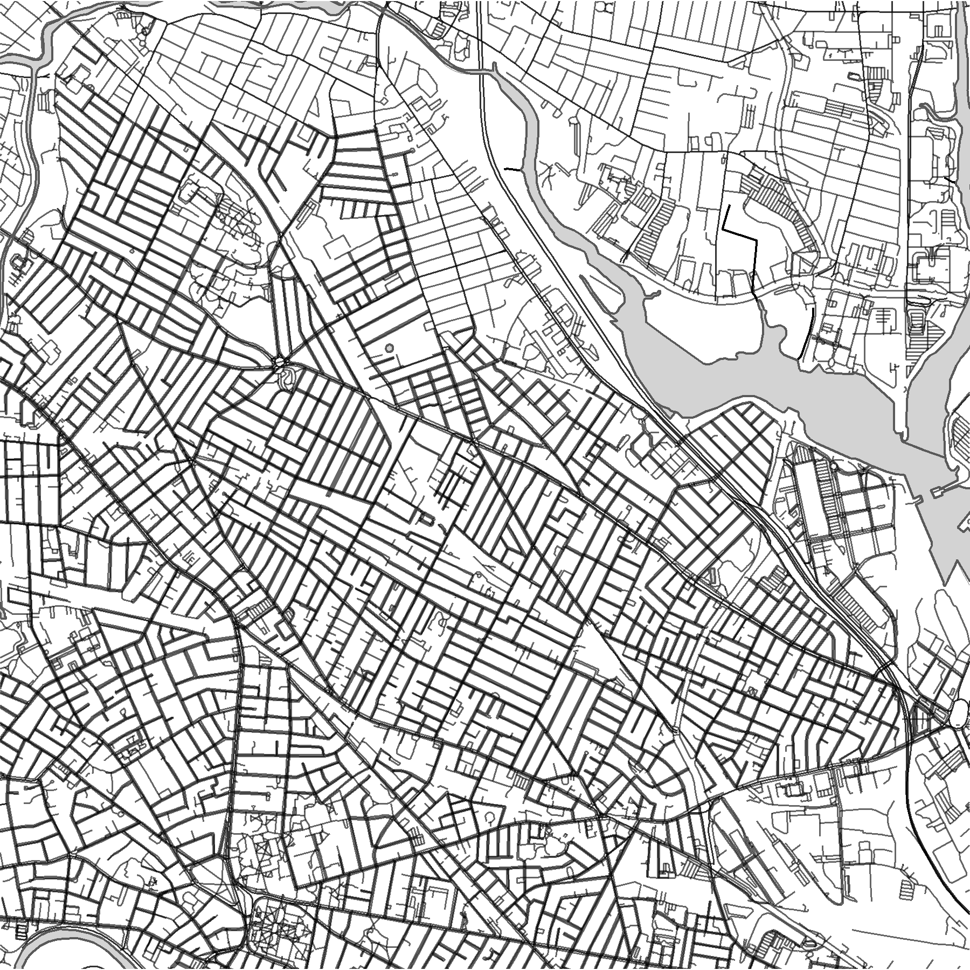
SOMERVILLE
42.395°N/-71.103°W

Slide 2
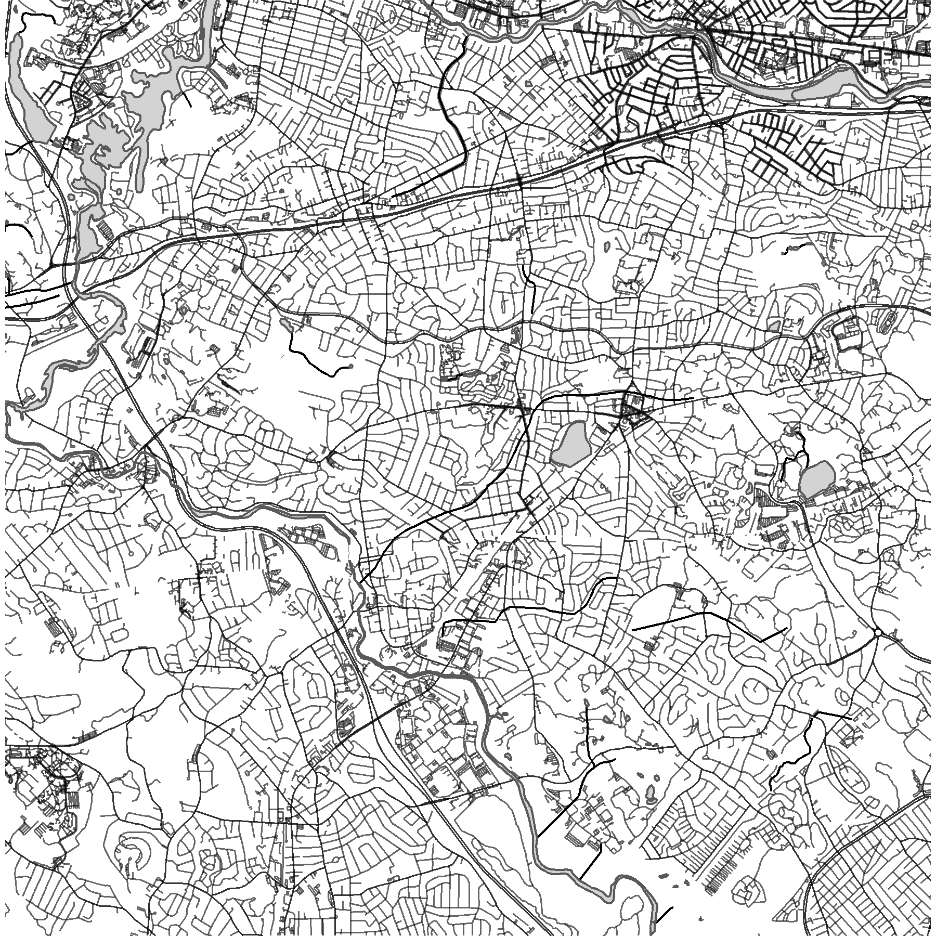
NEWTON, MA
42.325°N/-71.213°W

Slide 3
NEWTON, MA
42.325°N/-71.213°W

Slide 4
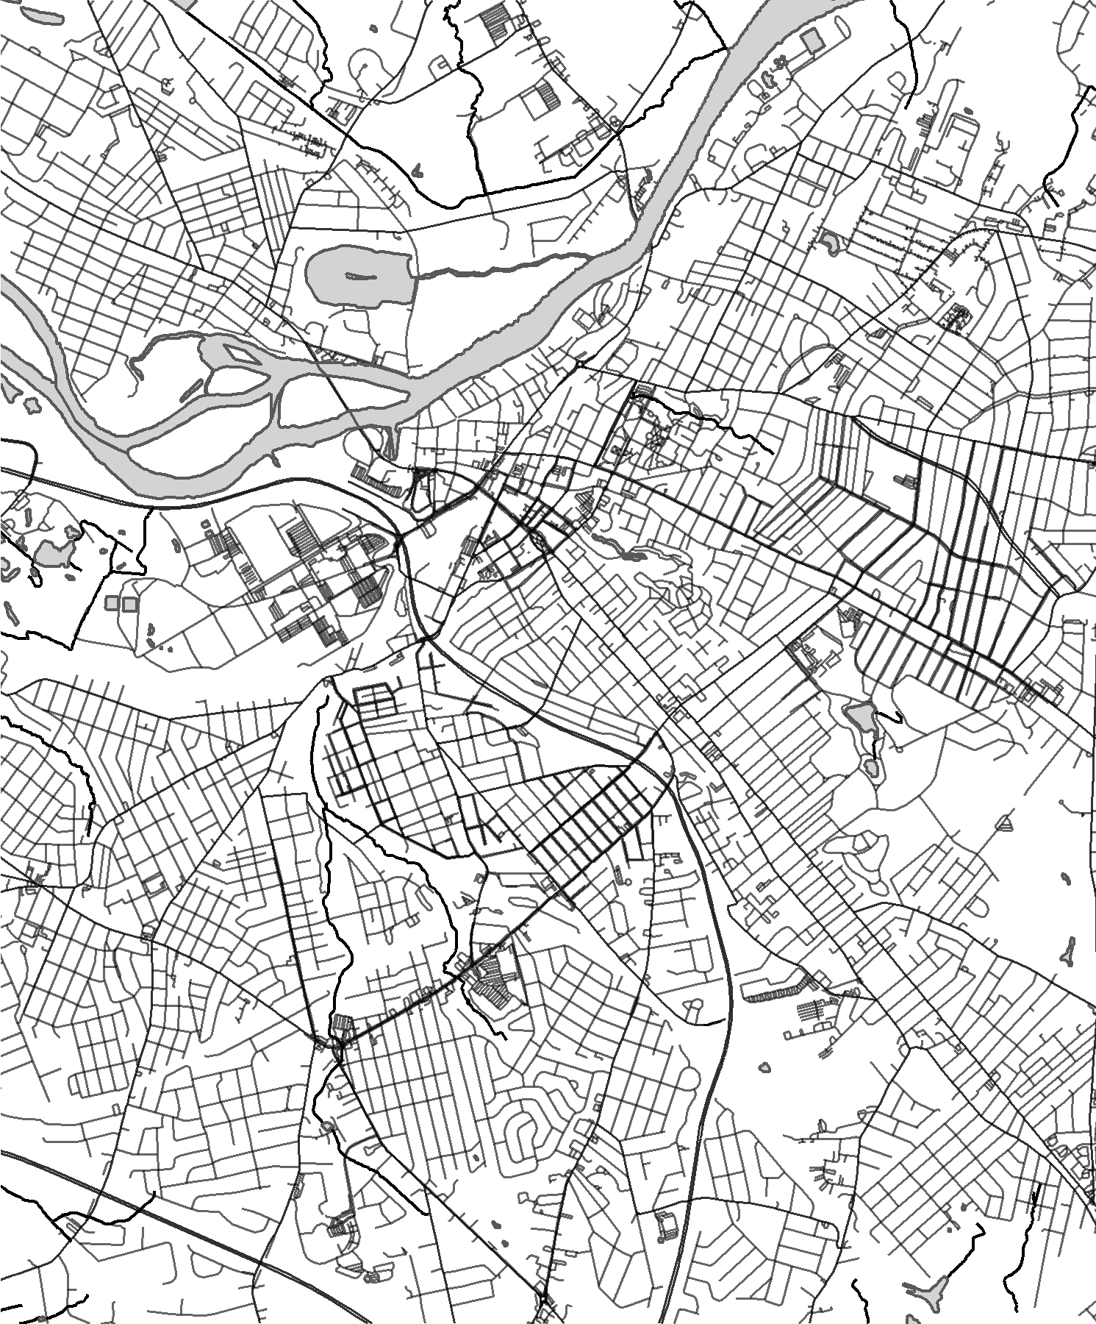
SCHENECTADY
42.803°N/-73.938°W

Slide 5
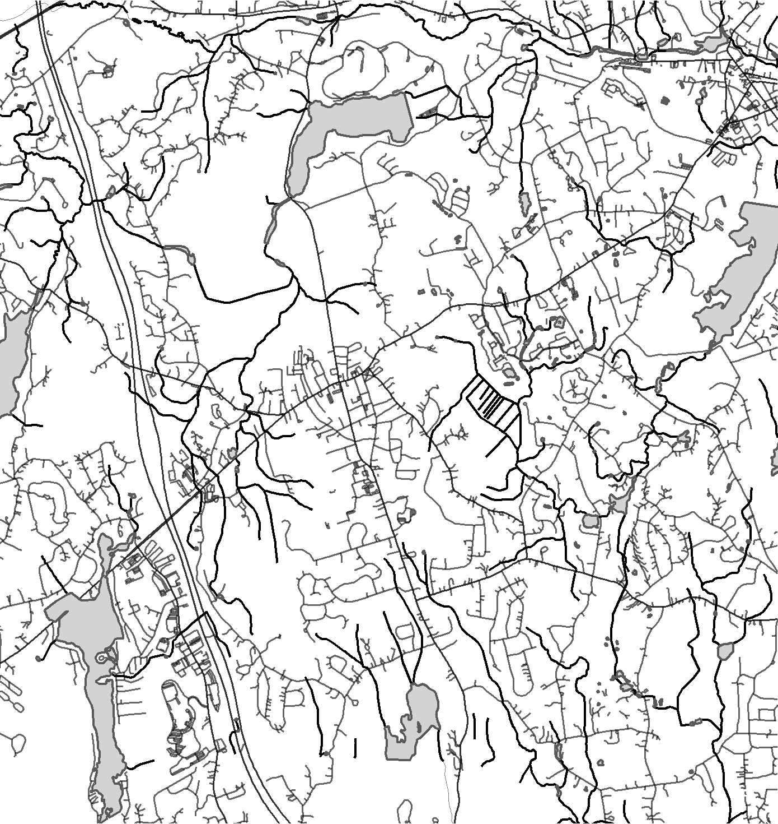
HOPKINTON
42.225°N/-71.531°W

Slide 6
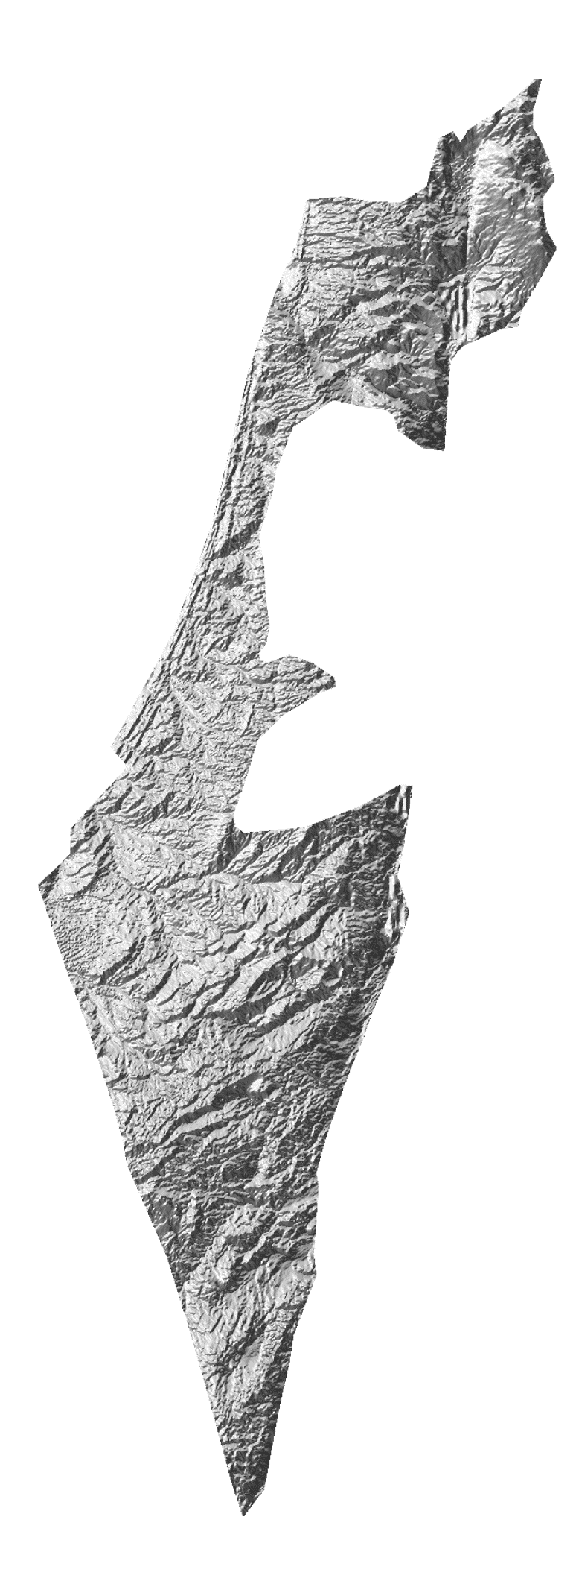
ISRAEL
ELEVATION MAP
MAX ELEV: 2,236 M
MIN ELEV: -417 M

Slide 7
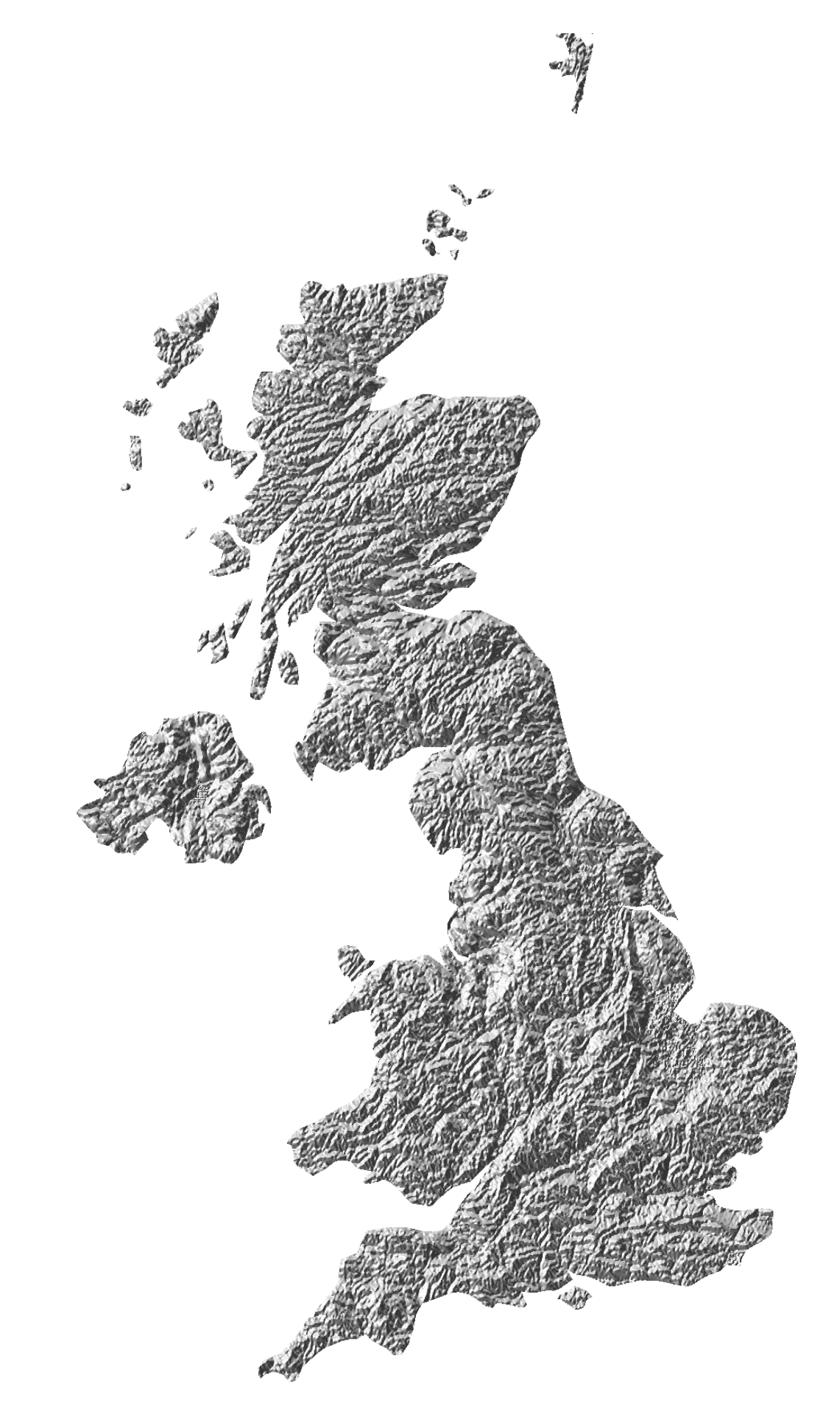
United Kingdom
ELEVATION MAP
MAX ELEV: 1,344 M
MIN ELEV: -4 M

