Slide 1
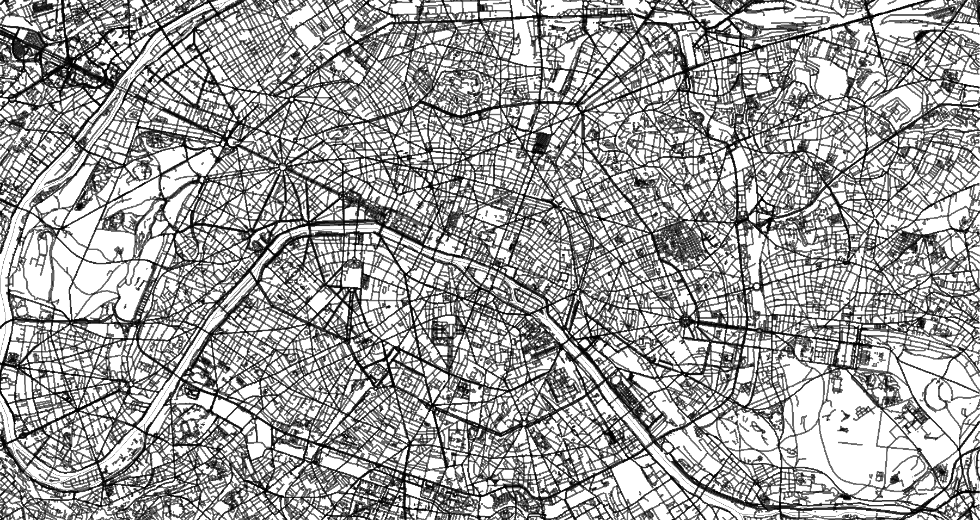
Paris, France
48.858°N/2.346941°E

