Slide 1
Water available for human use
Renewable freshwater supply (RFWS)
Total quantity
Distribution in time
Distribution in space
Notes:
RFWS = P_land = ET_land + R
Timing: Example in Asia, 80% of runoff occurs during the five months from May to October

Slide 2
Renewable freshwater supply (RFWS)
Units: km³/yr
Postel (Science, 1996)
Notes:
RFWS = P_land = ET_land + R
km^3/yr
110,000 RFWS
70,000 goes to ET, part of which drives primary productivity
40,000 goes to streamflow

Slide 3
RFWS: Flows and appropriations
Postel (Science, 1996)
Notes:
Annual human consumption increased by 3,600 km^3/yr between 1901-1954 to 1955-2008 (Jaramillo and Destouni, 2015)

Slide 4
Types of dams
Embankment dam
Concrete dam
Gravity
Buttress
Arch
Notes:
https://damsafety.org/different-types-dams

Slide 5
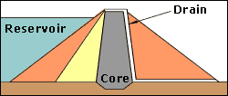
Embankment dam
Notes:
A cross-section (or slice) through an embankment dam shows that it is shaped like a bank, or hill. Most embankment dams have a central section, called the core, made from an impermeable material to stop water passing through the dam. Clayey soils, concrete or asphaltic concrete can be used for the core.
Overtopping or overflow of an embankment dam beyond its spillway capacity will cause its eventual failure. The erosion of the dam's material by overtopping runoff will remove masses of material whose weight holds the dam in place and against the hydraulic forces acting to move the dam. Even a small sustained overtopping flow can remove thousands of tons of overburden soil from the mass of the dam within hours

Slide 6
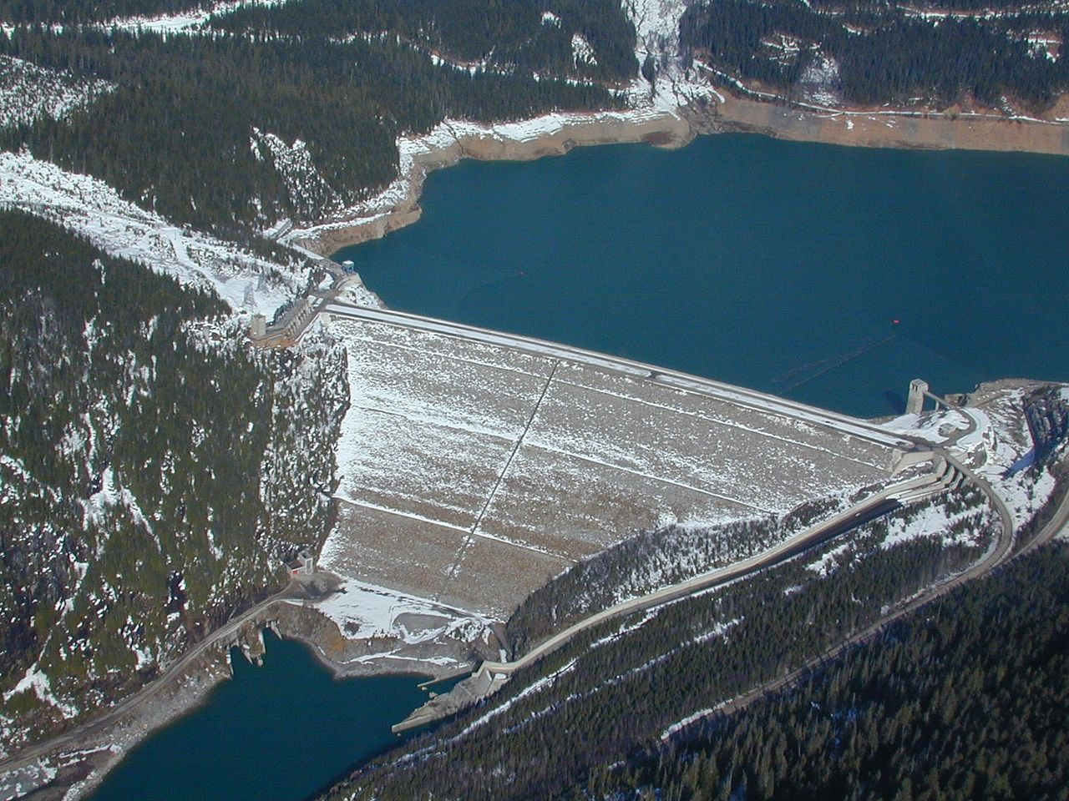
Embankment dam
https://en.wikipedia.org/wiki/Embankment_dam#/media/File:MicaDam.JPG
Notes:
Embankment dam in Canada
Embankment dams are the most common type of dam in use today.
Materials used for embankment dams include natural soil or rock, or waste materials obtained from mining or milling operations.
An embankment dam is termed an “earthfill” or “rockfill” dam depending on whether it is comprised of compacted earth or mostly compacted or dumped rock.
The ability of an embankment dam to resist the reservoir water pressure is primarily a result of the mass weight, type and strength of the materials from which the dam is made.
Embankment dams are usually chosen for sites with wide valleys. They can be built on hard rock or softer soils, as they do not exert too much pressure on their foundations.

Slide 7
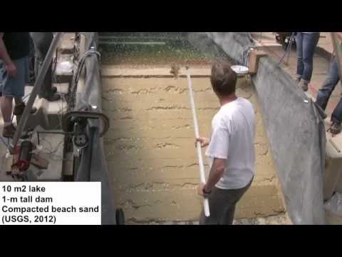
https://youtu.be/hmKLxoAPU1c

Slide 8
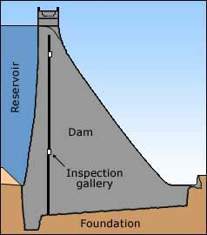
Gravity dam
Notes:
A gravity dam is made from concrete or masonry, or sometimes both. It is called a gravity dam because gravity holds it down to the ground stopping the water in the reservoir pushing it over.
Gravity dams are suited to sites with either wide or narrow valleys, but they do need to be built on sound rock.

Slide 9
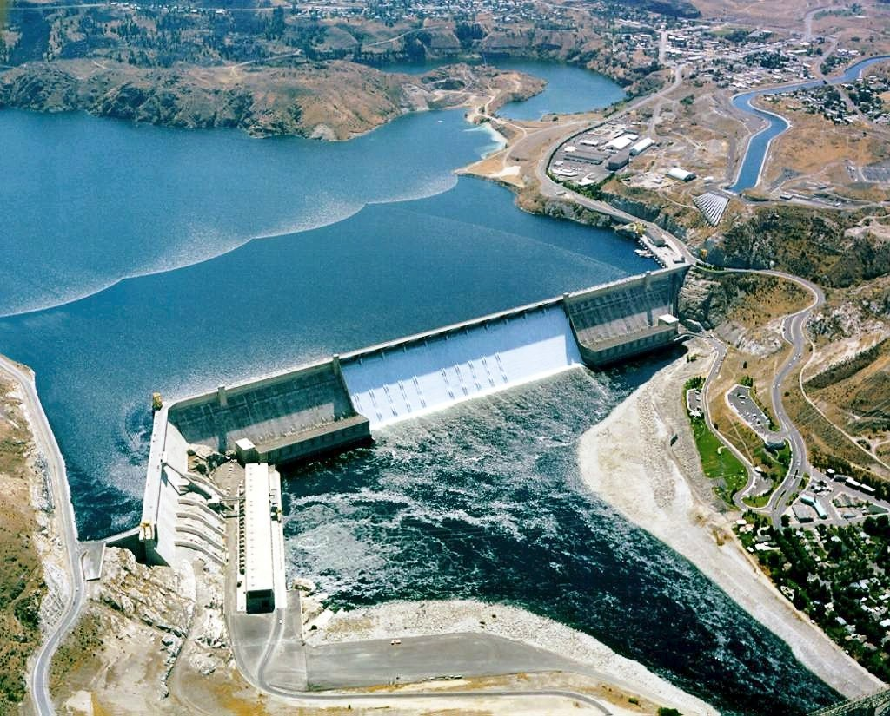
Gravity dam
https://en.wikipedia.org/wiki/Grand_Coulee_Dam
Notes:
Grand Coulee Dam is a concrete gravity dam on the Columbia River in the U.S. state of Washington, built to produce hydroelectric power and provide irrigation water. Constructed between 1933 and 1942,
Power from the dam fueled the growing industries of the Northwest United States during World War II
Three Gorges Dam is a gravity dam
The dam's powerhouse began production around the time World War II began, and its electricity was vital to the war effort. The dam powered aluminum smelters in Longview and Vancouver, Washington, Boeing factories in Seattle and Vancouver, and Portland's shipyards.

Slide 10
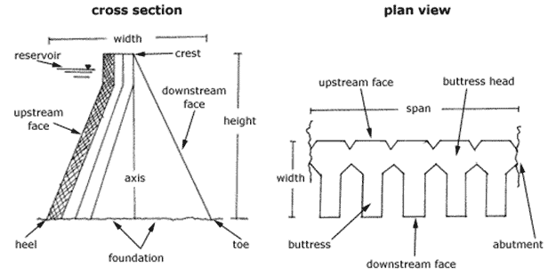
Buttress dam
Notes:
The buttress dam was developed from the idea of the gravity dam, except that it uses a lot less material due to the clear spaces between the buttresses. Like gravity dams, they are suited to both narrow and wide valleys, and they must be constructed on sound rock.
Buttress or hollow gravity dams were originally built to retain water for irrigation or mining in areas of scarce or expensive resources but cheap labour. A buttress dam is a good choice in wide valleys where solid rock is rare

Slide 11
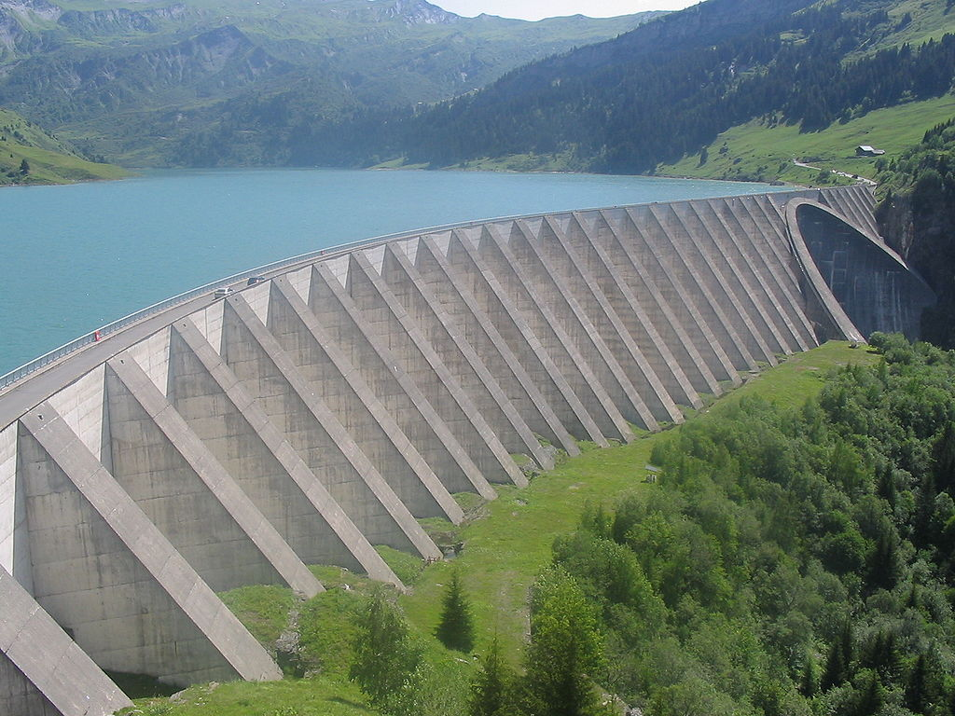
Buttress dam
https://en.wikipedia.org/wiki/Buttress_dam#/media/File:Barrage_de_Roselend_2.jpg
Notes:
Buttresses and an arch of the Roselend Dam in France

Slide 12
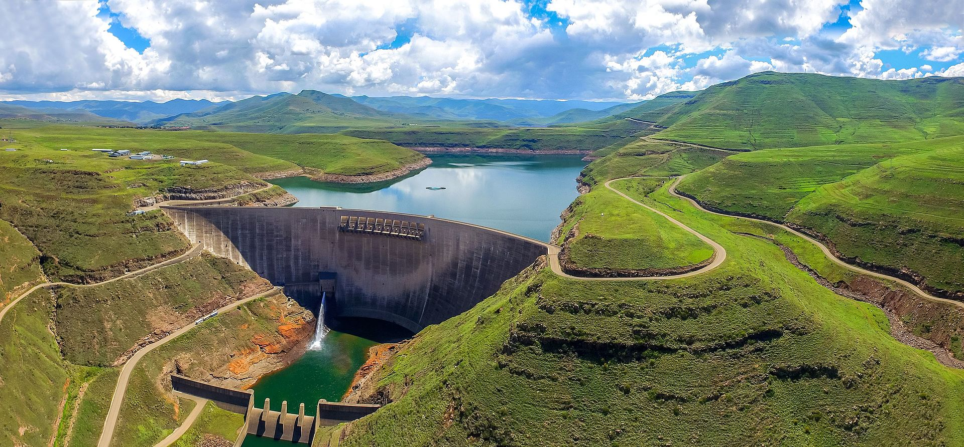
Arch dam
https://en.wikipedia.org/wiki/Arch_dam#/media/File:Katse_Dam.jpg
Notes:
An arch dam is a concrete dam that is curved upstream in plan.^{[1]}
The arch dam is designed so that the force of the water against it, known as hydrostatic pressure, presses against the arch, compressing and strengthening the structure as it pushes into its foundation or abutments.
An arch dam is most suitable for narrow canyons or gorges with steep walls of stable rock to support the structure and stresses.^{[2]} Since they are thinner than any other dam type, they require much less construction material, making them economical and practical in remote areas.

Slide 13
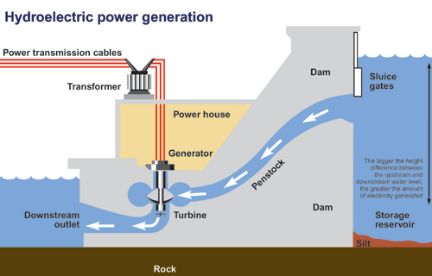
https://www.ec.gc.ca/eau-water/default.asp?lang=En&n=00EEE0E6-1
Notes:
Hydropower generates ~16% of world’s energy
TPS – pair up and think about the factors that might control the amount of power generated
Penstock: Enclosed pipe that delivers water to hydroelectric turbines from the reservoir; Turbine spins and generates power
Sluice gates control the outflow of water from the reservoir and into the penstock
Power = rho * gravity * head * Q
Three Gorges dam has H = 80 m, and one generator receives 700 m^3/s of flow (there are 30 generators)
Has a total of 22,500 MW capacity (~1% of global power consumption)
1 W = kg*m^2/s^3

Slide 14
Impacts of dams and reservoirs
Alter flow timing
Fragment/alter river ecosystems
Slow rivers
Impacts ecosystems
Impacts sediment transport
Impacts water physical/chemical conditions
Affects flood-dependent ecosystems
Potential for methane emissions
Displacement/relocation of people
Evaporative losses
Notes:
Actual evaporation from artificial lakes and reservoirs is 346 km3 /year (FAO Aquastat) ~ 90% of the flow of the Mississippi River

Slide 15
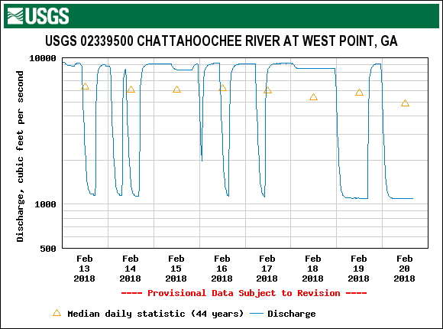
Flow regulation
Notes:
Hydrograph here shows an example of hydropeaking
Draw on board hydrograph that reduces peak flow and increases low flows
Discuss advantages and disadvantages of flow regulation

Slide 16
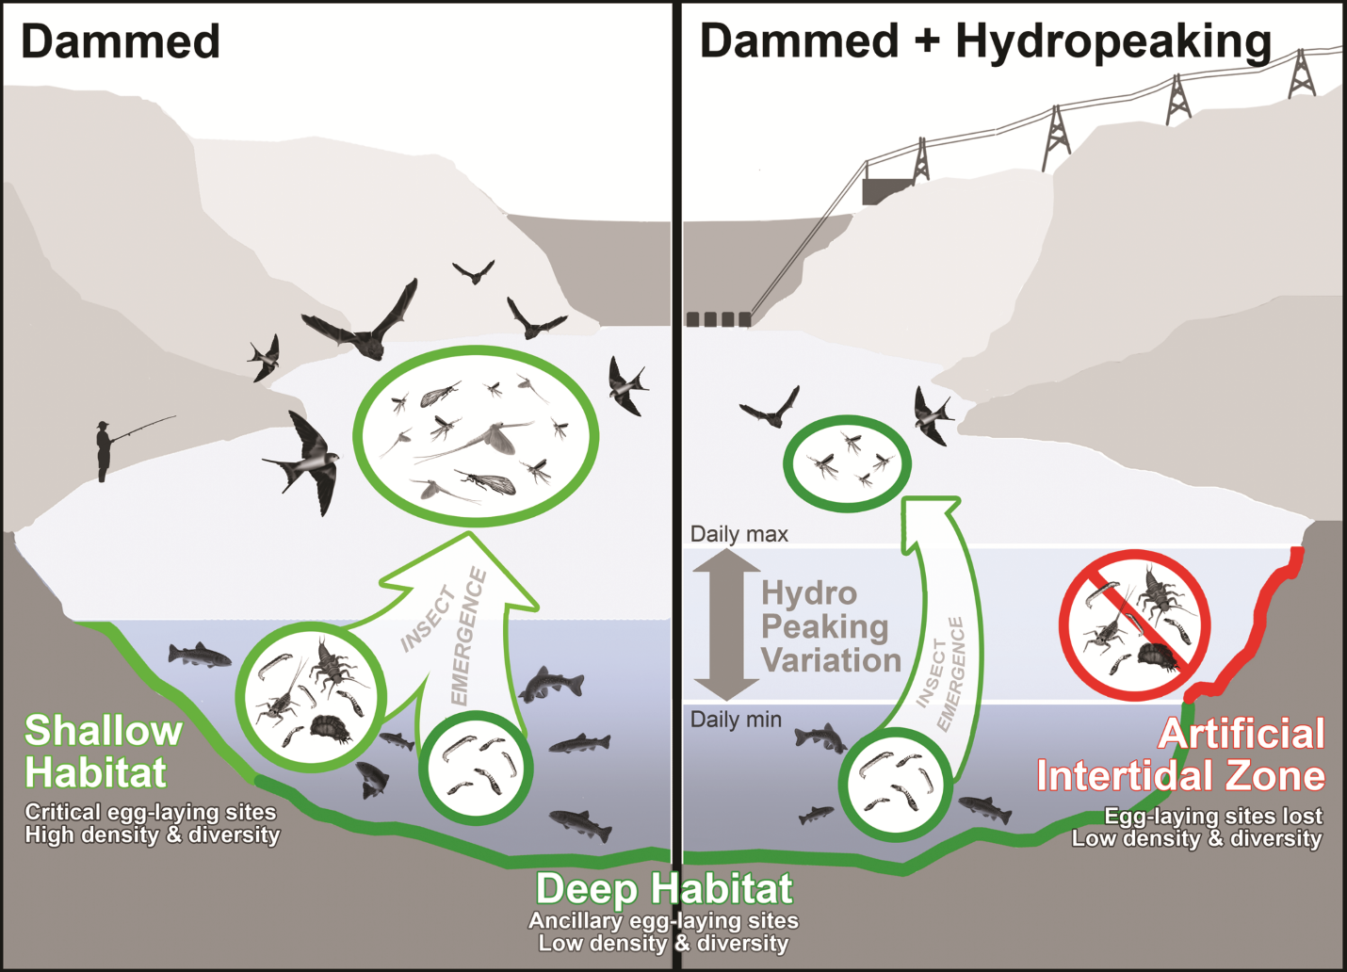
From: Flow Management for Hydropower Extirpates Aquatic Insects, Undermining River Food Webs
BioScience. 2016;66(7):561-575. doi:10.1093/biosci/biw059
BioScience | Published by Oxford University Press on behalf of American Institute of Biological Sciences 2016. This work is written by (a) US Government employee(s) and is in the public domain in the US.
Notes:
Figure 8. Aquatic insects play an essential role in river and riparian food webs. Aquatic insects are ubiquitous in freshwaters and are the primary prey for myriad species of wildlife living in and along rivers. These insects have complex life cycles that include a terrestrial winged adult life stage, whereas egg, larval, and pupal stages are aquatic. Ecologically important insect groups such as mayflies, stoneflies, and caddisflies cement their eggs along river-edge habitats, making them especially sensitive to dam water management practices such as hydropeaking that affect these edge habitats.
16

