Slide 1
Survey Management System http://laurian.ipd9.info/
Laurian Staicu IPD9
staicu4@gmail.com

Slide 2
Marketing Event Surveys
Event
Promotional campaign
Sales discounts
Marketing promotion
Representative gets information from Customer
Email, Phone Number
Follow up with marketing emails
System is tailored to company specific needs

Slide 3
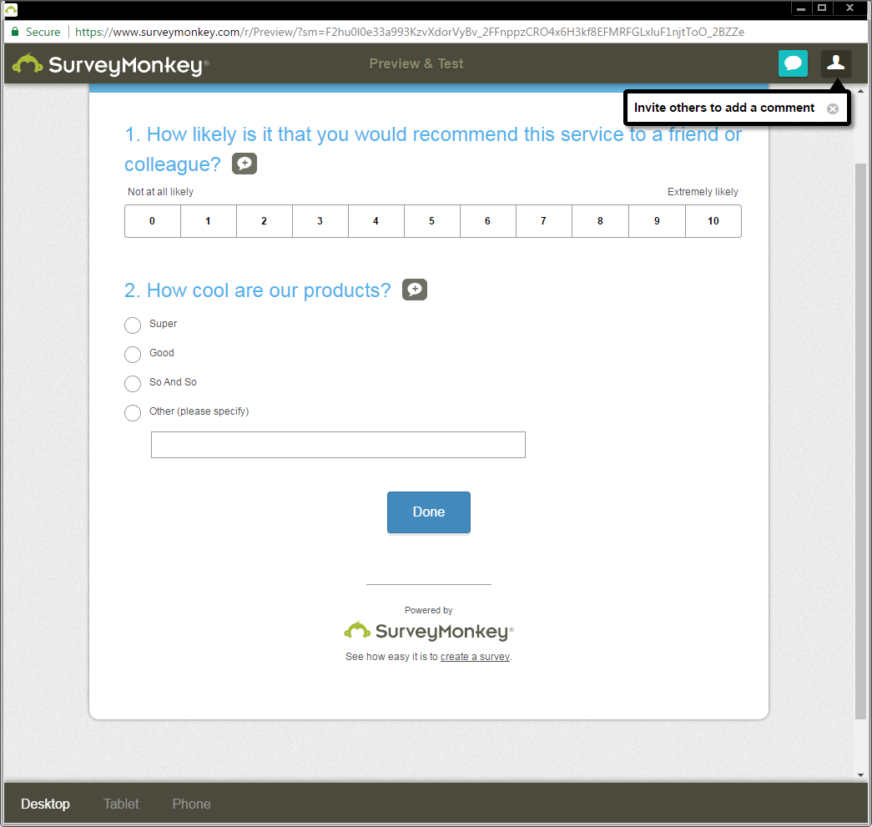
Existing Solution - Survey Monkey

Slide 4
Tailored Survey Solution
Specific needs of that industry
Representative as main user of the application
Assists the customer during the survey
Main features:
1) Manage Customer Profile
2)Complete Survey
3)Manage Survey Template
4)Marketing Metrics

Slide 5
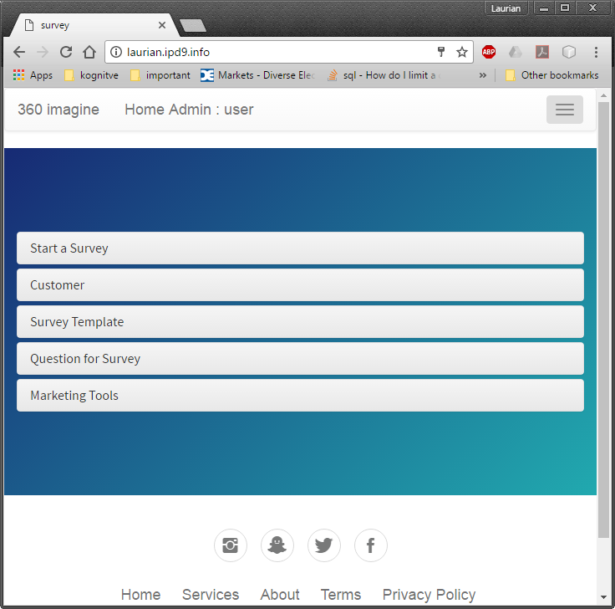
Our Solution - Usability

Slide 6
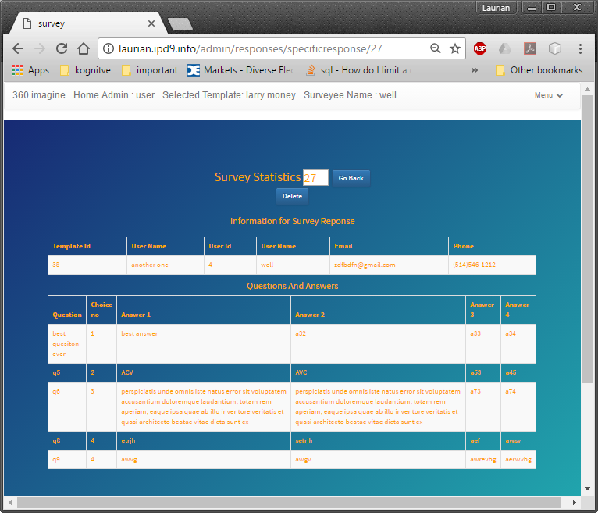
Customize Display

Slide 7
Challenges and Solutions:
Database design
Interface for desktop and mobile
Php , Composer , Slim , Twig
MeekroDB , Session superGlobals
Multidimensional Arrays PHP

Slide 8
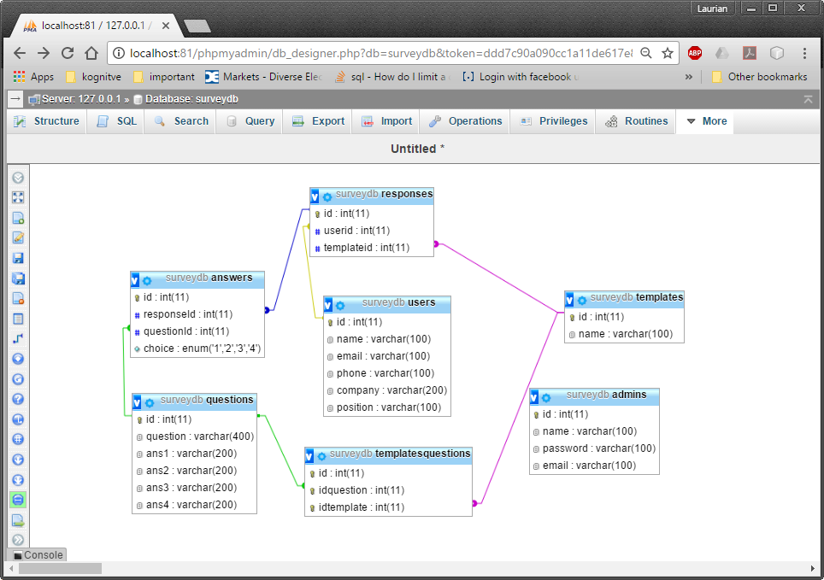

Slide 9
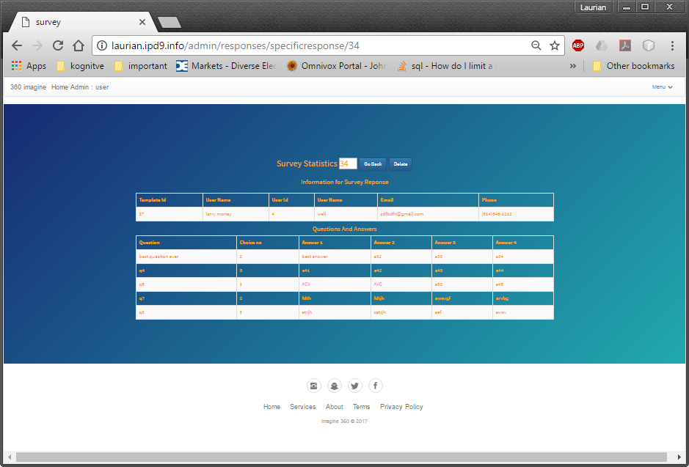
Php Array Merge for Html Table display

Slide 10
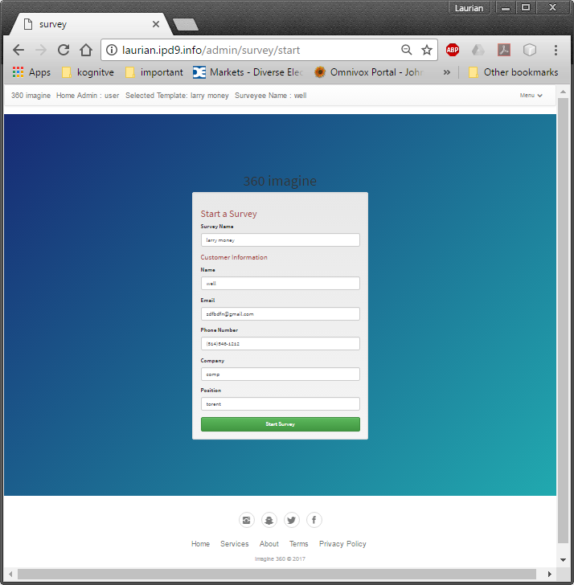
Header with Customer and Survey Info

Slide 11
What I learned:
Multidimensional Arrays PHP
Superglobal in Php – Session
Complex Database queries on 5 tables connected in pentagon shape
Twig Programming

Slide 12
Combine Array on same index - Php
$allResponses4 = array();
foreach ($allResponses2 as $key => $val) { // Loop though one array
$val2 = $allResponses3[$key]; // Get the values from the other array
$allResponses4[$key] = $val + $val2; // combine 'em
}

Slide 13
Twig Programming
{%set previousTemplateId = "" %}
{% for t in templatesUsedInSurveys %}
{%if previousTemplateId != t.templateId%}
{%set previousTemplateId = t.templateId %}
<tr>
<td>{{t.templateId}}</td>
<td> {{t.templateName}}</td>
<td></td>
</tr>
{%endif%}
<tr>
<td></td>
<td></td>
<td> {{t.question}}</td>
</tr>
{% endfor %}

Slide 14
Super Globals
//function to udpdate composer global variable
function updateGlobalAll($twig) {
//selected questions to create a template
$twig->addGlobal('$selectedQuestions', $_SESSION['$selectedQuestions']);
//active admin
$twig->addGlobal('todouser', $_SESSION['todouser']);
//active template
$twig->addGlobal('templateselected', $_SESSION['templateselected']);
//active surveyee
$twig->addGlobal('userselected', $_SESSION['userselected']);
//name of the current survey
$twig->addGlobal('activesurvey', $_SESSION['activesurvey']);
//link to go back
$twig->addGlobal('linkToGoBack', $_SESSION['$linkToGoBack']);
}

Slide 15
Database - Testing Data integrity
CREATE TEMPORARY TABLE allSurvey (
SELECT *
FROM templates as t,
responses as r,
answers as a,
questions q,
users as u
WHERE
t.id = r.templateId AND
r.userid = u.id AND
r.id = a.responseId AND
a.questionId=q.id
)

Slide 16
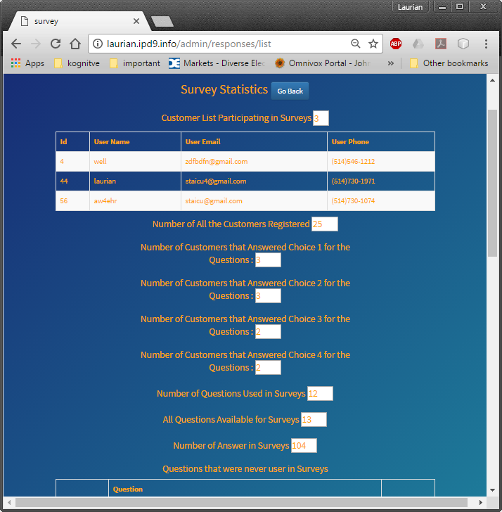
Marketing Statistics

Slide 17
Future Work
Input Data validation
Define better user Cases
Testing
Market Analysis Tools
Very Beneficial in Event Information Collection
Specifically design UI and functionality for company events

Slide 18
Conclusion
PHP project is the best learning experience in IPD
Database design and queries
MultiDimensional Array , Session SuperGlobal Php
Completed all proposal’s objectives
Company will use the app in events

