Slide 1
Survey Management System

Slide 2
* 1-2 slides: Background - Background of the project, e.g. . explain a game you were implementing, . explain what was the purpose of system you were implementing and what problem does it solve.

Slide 3
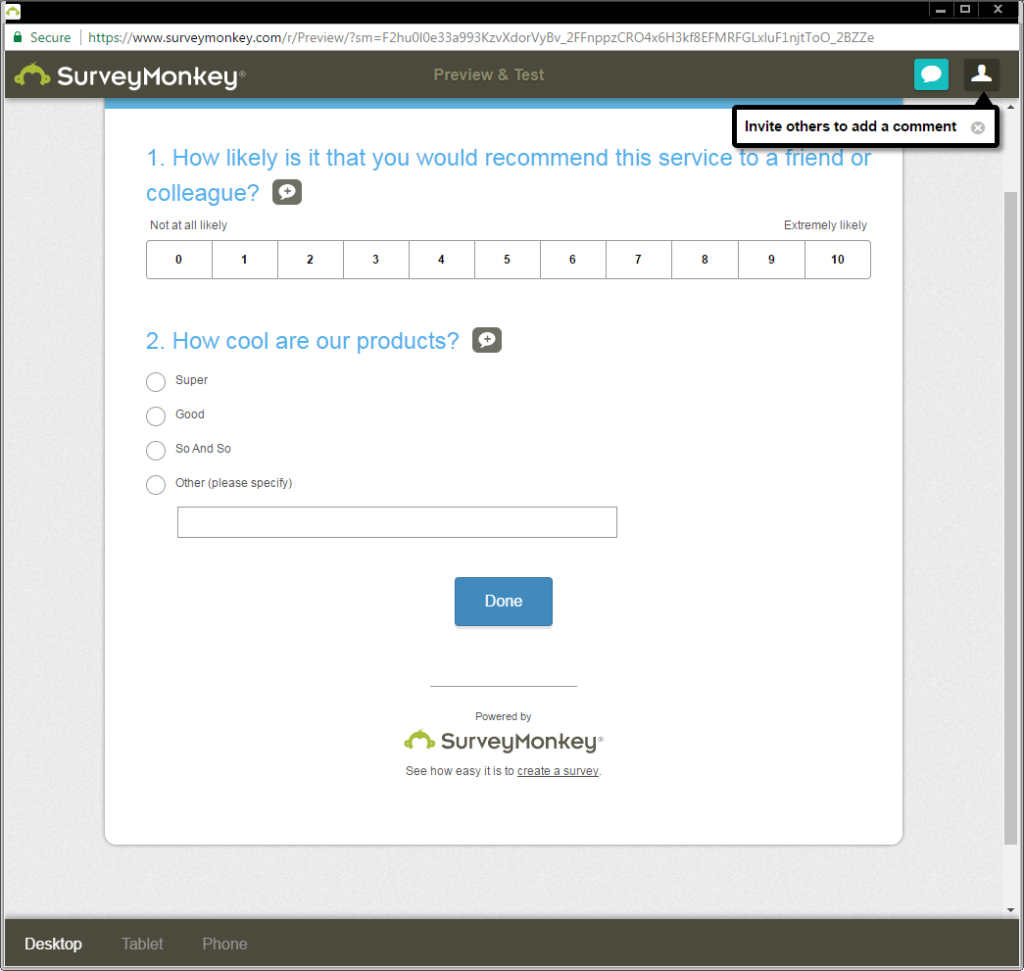

Slide 4
2-3 slides: Your solution overview
- show your solution from high level, e.g.
screenshot(s), list main features from
user point of view, features, functionalities.
Say WHAT was implemented BUT NO DETAILS ON HOW.

Slide 5
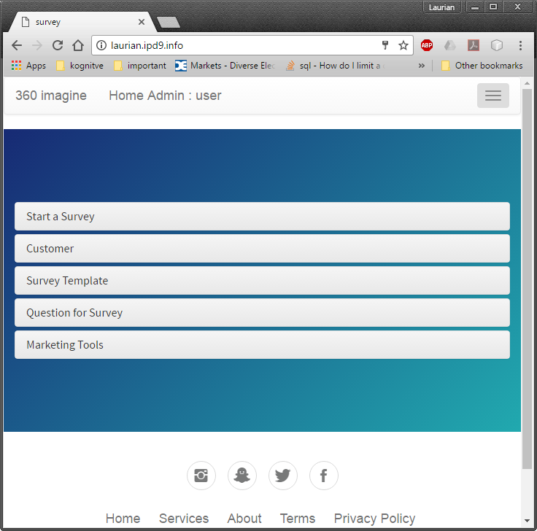

Slide 6
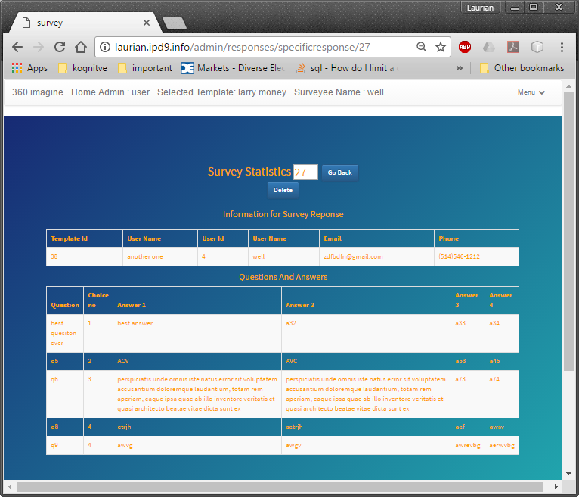

Slide 7
4-6 slides: Challenges and solutions
- talk about each of the technologies you used
and each major problem you had to solve on your own
to make the solution work.

Slide 8
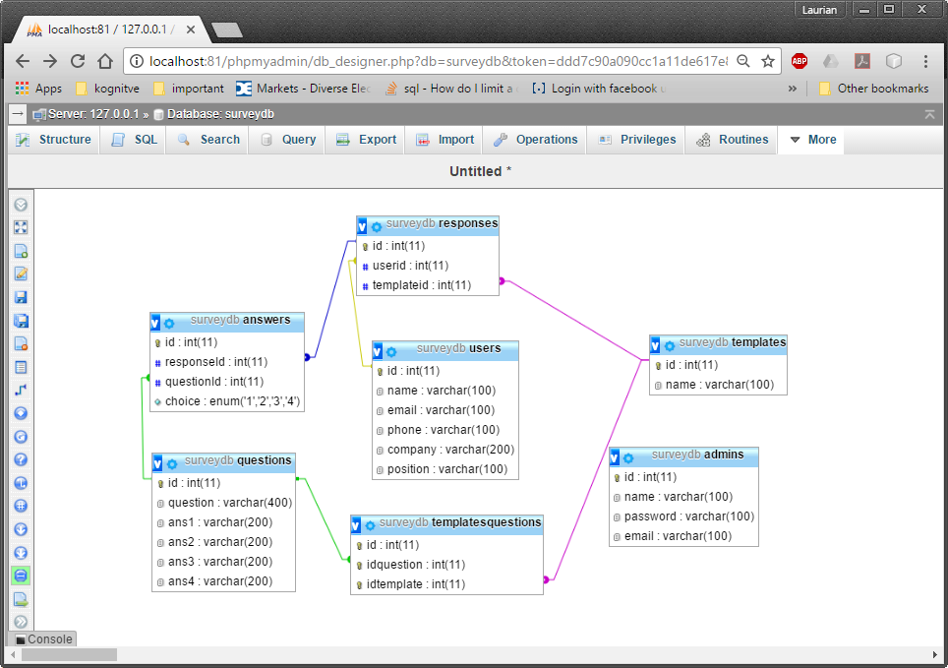

Slide 11
2-4 slides: What we learned - teach it!
- talk about specific, low-level solutions
and teach them to the students and teacher
= Teach me how to solve ONE problem.

Slide 14
1 slide: Future work
- say what was not done yet and could be
solved if your project continued.

Slide 15
1 slide: Summary
- what was done and with what result.

