Slide 1
Developers love code – we help them set it free
Software Freedom Conservancy is a public charity that acts as a non-profit home for dozens of Free, Libre, and Open Source Software (FLOSS) projects. Conservancy’s charitable mission is to help improve, develop, and defend FLOSS, and we do that by providing business, legal, and administrative services to our member projects.
Our member projects are comprised of developers who are romantics at heart. Some devote years of their spare time to their beloved project. Others create career paths that let them follow their passion. The fruits of their labors of love range from some of the most fundamental utilities in computing today to bleeding edge innovations that will shape how software will be created in the future. And, every contributor demonstrates their heart for the public at large by releasing their software under a license that benefits everyone.
Conservancy provides all of our member projects with a comprehensive suite of services, and then we get out of their way to let them do what they do best: write great freely-licensed software for the public’s benefit.
Our structure
Conservancy acts as a fiscal sponsor to our member projects. We’ve engaged the leadership of each member project’s developer community and executed a fiscal sponsorship agreement that allows us to adopt that project as an official part of Conservancy’s corporate structure. As a result, our member projects all operate under Conservancy’s legal and tax-exempt status.
Conservancy handles all donations, expenditures, and contractual obligations on behalf of our member projects. We also provide member projects with mentorship on fundraising, community governance, and other best practices. Our member projects are free to write code as they please, as long as their work is freely-licensed for the public’s benefit.
If you are part of a FLOSS project that would like to join Conservancy, visit sfconservancy.org/members/apply/ for more information.

Slide 2
FY2012, in numbers
Here’s a numerical overview for Conservancy’s Fiscal Year 2012 (“FY2012”), which ended on February 28, 2013. For a more details on Conservancy’s financials, visit sfconservancy.org/about/filings/ to download our independent auditor’s report.
1,070 | # of developers who contributed code to Conservancy member projects
~1,600,000 | Total # lines of code added and/or edited, with all of the updates freely-licensed for the public's benefit
3 | # of international conferences organized to promote FLOSS (not including numerous Code Sprints, Hack Fests, and Summits for developers to write code)
717 | Total # of people who attended member Project conferences
12 | # of developers funded full- or part-time to work on FLOSS development
$617,234 | Total revenue raised for the support of our member projects’ technical objectives and Conservancy’s mission

Slide 3
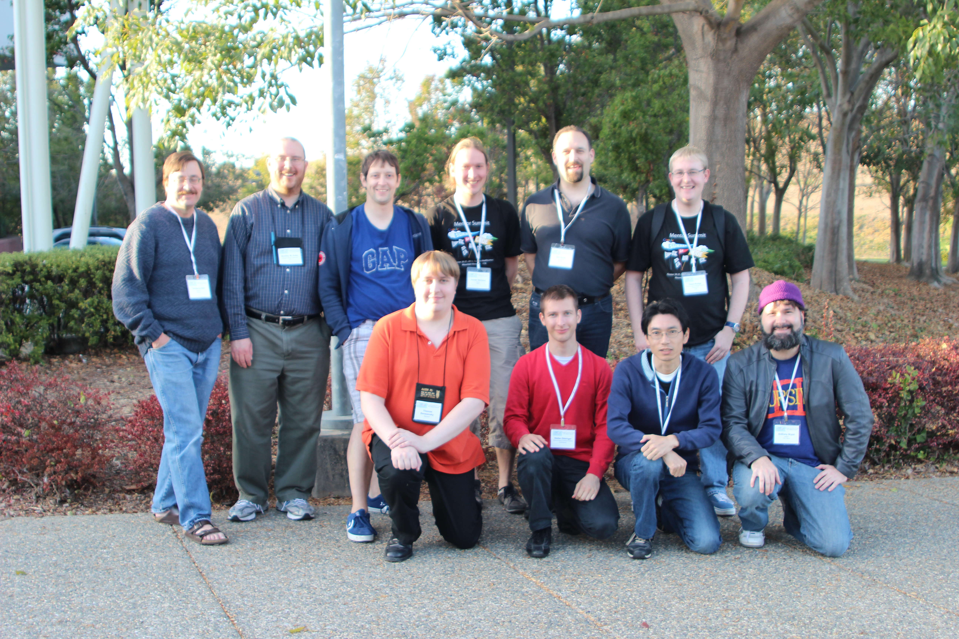
jQuery grew up so fast
Part of Conservancy’s mission is to mentor FLOSS projects and help them determine whether and when to form their own independent organization, if they so desire. FY2012 marked the first year that one of Conservancy’s member projects decided to leave the nest. In March 2012, Conservancy and the jQuery project committee announced the formation of the jQuery Foundation, an independent non-profit trade association.
The jQuery Foundation has since gone on to represent the interests of its member companies by hosting multiple conferences for the jQuery community all around the world. For more information on the jQuery Foundation’s current activities, visit jquery.org.
Metalink joined the fold
In November 2012, Conservancy welcomed Metalink as its newest member project. The Metalink Project is dedicated to making it much easier for people – especially those in areas with inferior Internet connections – to download Open Source and Free Software. Metalink’s open standard increases the effectiveness and efficiency of downloads by combining the speed, bandwidth distribution, and redundancy of an optimized hybrid mirror/peer-to-peer network.
Conservancy member projects active in Google Summer of Code
Twenty-nine developers from Conservancy member projects participated in Google’s Summer of Code 2012 program, during which they mentored student software developers and helped them to get involved with FLOSS development and contribute new code freely­licensed to the public.
Conservancy also provided administrative services to an unaffiliated FLOSS project to facilitate their participation in the program.
Conservancy’s Executive Director, Bradley M. Kuhn (back row, second
from left) with Conservancy member project developers who served as
Google Summer of Code mentors in 2012. © 2012 Anthony Bryan,
used under a CC By-SA 4.0 International license.

Slide 4
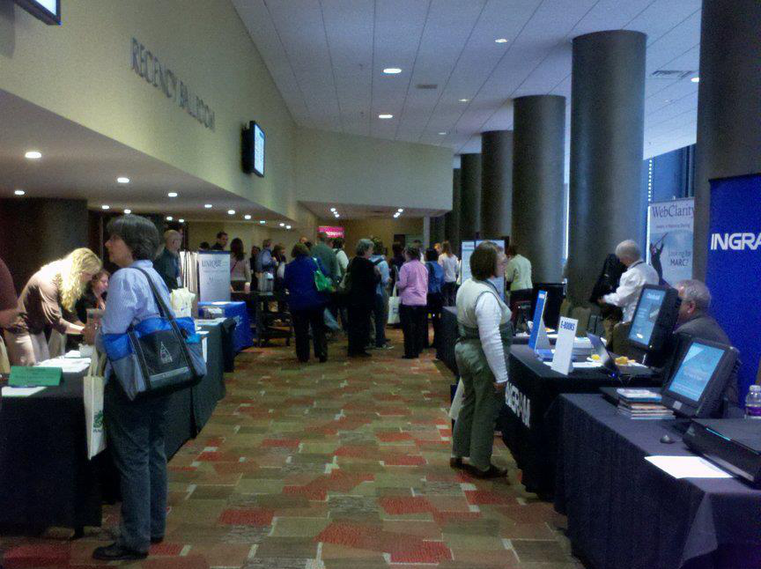
Member project conferences
Conservancy member projects hosted three software conferences in FY2012. The conferences consisted of lectures and workshops relating to FLOSS development.
  The Boost Project, which provides peer-reviewed portable C++ source libraries, has hosted BoostCon, an annual conference for the Boost community, since 2007. In FY2012, Boost rechristened their annual conference C++ Now, to reflect their desire to engage the broader C++ community in conversations about open source software usage and developments in the C++ developer and user community. Boost held its sixth annual conference, C++ Now 2012, in Aspen in May 2012. For more information on C++ Now 2012, visit 2012.cppnow.org.
  The Evergreen project, which maintains an integrated library system used by hundreds of libraries across the world, hosted the 2012 Evergreen International Conference in Indianapolis. The conference included a hackfest, presentations about organizations who had successfully migrated to the Evergreen platform, and discussions about Evergreen’s technical roadmap.
  The Selenium Project, maintainers of a suite of tools for browser automation, hosted Selenium Conference 2012 in London. SeConf 2012 was Selenium’s first conference outside of the United States, and attracted over 300 Selenium users who exchanged ideas and learned about automated testing. Selenium recorded and archived all of sessions for the public’s benefit. Videos can be viewed at youtube.com/seleniumconf.
Attendees at the 2012 Evergreen
International Conference.
© 2012 Ruth Frasur. Used under
a CC By-SA 4.0.license.

Slide 5


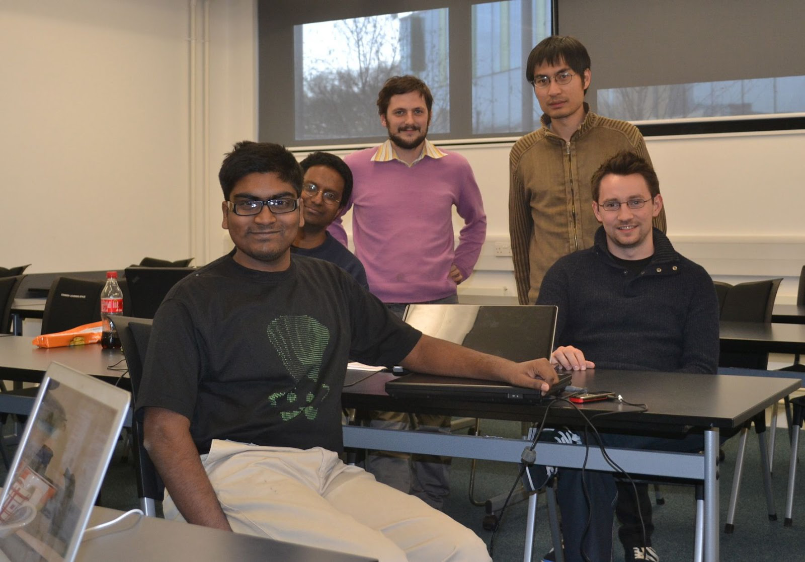
Additional highlights
The Boost Project, long regarded as “one of the most highly regarded and expertly designed C++ library projects in the world,” [1] announced four major releases in FY2012, and added ten new C++ libraries: Algorithm, Atomic, Context, Coroutine, Functional/OverloadedFunction, LocalFunction, Lockfree, Multiprecision, Odeint, and Utility/IdentityType.
Boost also updated forty-six additional libraries in FY2012.
The Darcs Project, which is developing a distributed revision control system written in Haskell, hosted a two-phase hacking sprint in March 2012 that started in Cardoba, Argentina and ended in Southampton, England. Darcs hosted another three-day hacking sprint in Paris, France in February 2013.
Darcs also announced release 2.8 in FY2012, adding support for multiple emails in for the author in the global prefs file and improvements for the workflow for sending patches by email.
Darcs community members at
a Darcs hack sprint. © 2012
Eric Kow, used under a
CC By-SA 4.0 license.
[1] C++ Coding Standards, Sutter and Alexandrescu, November 4, 2004.

Slide 6


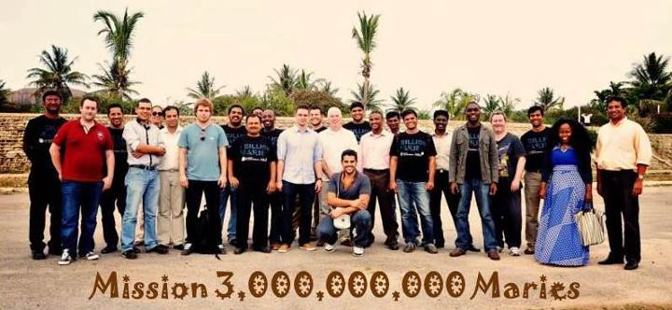
The Evergreen Project announced two releases – versions 2.2.0 and 2.3.0 – in FY2012. These releases introduced a new public catalog redesign, as well as Kids Pac, a new public catalog interface for children. Evergreen also became the first library system to publish schema.org structured data.
Evergreen was one of three projects selected for the Google Doc Sprint in December 2012, resulting in the book Evergreen in Action, released under a CC By-SA 3.0 license. And, in addition to the Evergreen 2012 International Conference, Evergreen hosted code and documentation hackfests in October 2012.
Libraries and library consortia are continuing to adopt Evergreen as their integrated library system of choice. More than 250 library branches switched over to Evergreen in FY2012.
The Mifos Project, a community that maintains an innovative microfinance software platform, saw their user base expand in FY2012 to more than 50 institutions providing microfinance services to 1.1 million clients. Mifos also began work on the Mifos X platform, a complete re-write of the Mifos software as a modular platform with all the core functionality fully exposed through RESTful APIs. In October 2012, Mifos hosted an inaugural Mifos Summit in Bangalore, India with more than 40 attendees from around the world.
Mifos developers and community volunteers at the Mifos Summit in Bangalore, India.
“Mission 3,000,000,000 Maries” is Mifos’ slogan articulating its mission of using technology to
grow microfinance. © 2012 The Community for Open Source Microfinance, used under a
CC By 4.0 license.

Slide 7
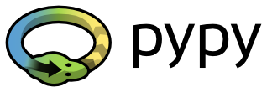
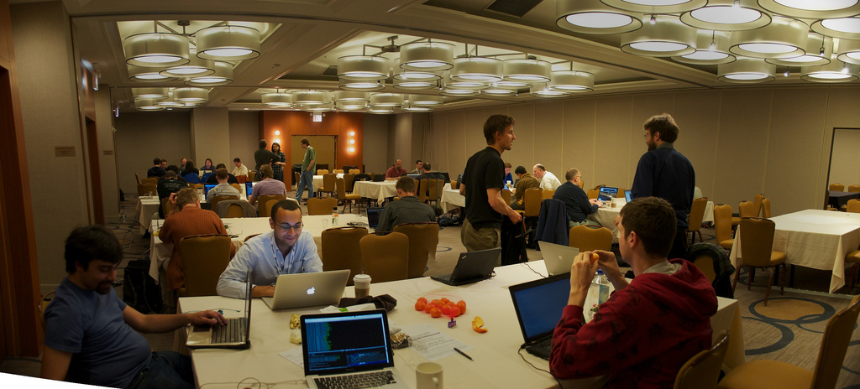

The PyPy Project, home of the popular Python interpreter and Just-In-Time compiler, organized five “sprints” (one-week gatherings of core developers and newcomers), held all over the world: in the United States, South Africa, Germany, and Italy. PyPy developers gave three talks about the project at PyCon 2012, an annual conference held for the Python developer community. PyPy was also the featured subject of a keynote address at the EuroPython developer conference in Florence, Italy.
PyPy also made significant technical progress in FY2012, thanks to ongoing fundraising campaigns to improve NumPy support for scientific computing, enable PyPy to implement Python 3, and research how to implement Software Transactional Memory in PyPy. The early results of these campaigns were present in PyPy version 1.9, released in June 2012. Version 2.0-beta-1, released in November 2012, introduced official Just-In-Time support for ARM machines, as well as support for CFFI, which provides developers with a convenient way to call C code from Python.
PyPy code sprint at PyCon 2012.
© 2012 Taavi Burns, used under
a CC By 2.0 Generic license.
The Samba Project, home to a FLOSS suite that provides seamless file and print services to Server Message Block (SMB)/Common Internet File System (CIFS) clients, brought the long-awaited Samba Active Directory Domain Controller to fruition in FY2012. The release of Samba 4.0 in December 2012 brought Samba back to the center of small and medium business infrastructure, providing directory and authentication services compatible with Active Directory clients, and vastly improving interoperability with Windows infrastructure.
Samba also responded to the announcement of the SMB 3.0 protocol with development on numerous projects which will vastly improve the performance, security, reliability, and flexibility of Samba in data centers, virtualization, and branch offices.

Slide 8
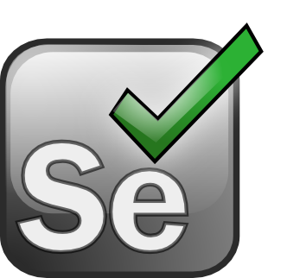
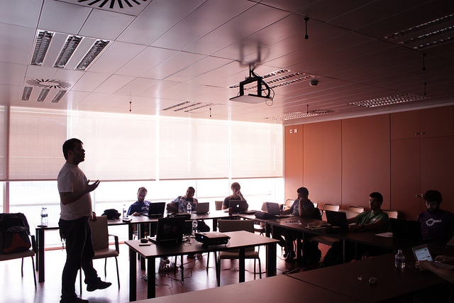

The Selenium Project announced 13 releases of Selenium in FY2012. These new releases added support for Apple’s Safari browser, and extended the wire protocol and approach of Selenium Webdriver to native testing on mobile platforms.
Developer Oskar Calvo leads
a workshop on Selenium at
the Drupal Day conference
in Valencia, Spain.
© 2012 David Hernández
Ruiz, used under a
CC By-SA 2.0 license.
The Squeak Project, a portable, full-featured implementation of the powerful Smalltalk programming language and environment, had a busy FY2012, most notably releasing version 4.4, Ulam Spiral, in December 2012. Ulam Spiral brought IPv6 support to Squeak along with lots of smaller improvements.
In the same month, Squeak developers released a cluster of new applications, tools and frameworks for version 4.4, including:
Altitude, a brand-new web-framework and approach to web-development
A new implementation of the Zippers data framework
New version 1.4 of Magma, Squeak’s ODBMS
Less than one month later, the Squeak community was rocked by the unexpected loss of its most prolific contributor, Dr. Andreas Raab. This affected everyone profoundly but, after a period of collective grieving, the community has emerged even more determined to fulfill its aspirations for Squeak.

Slide 9
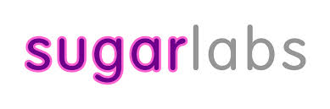


Sugar Labs, a software development and learning community that maintains the Sugar learning platform, added a framework for integrating web services into Sugar in FY2012. Users are now able to take advantage of file sharing and social networking utilities directly from within the Sugar Journal application. Sugar Labs has also seen their “app store” grow, thanks in large part to contributions from Sugar users who have made the transition to Sugar developers. The trend of apps written by children who grew up with Sugar is holding: still more than 10% of Sugar apps were written by children and at least 30% are maintained by children. In FY2012, Sugar Labs added the ability to export Python code from Turtle Art, one of the block-based programming environments in Sugar.
Sugar developers also added Javascript/HTML5 support to Sugar. Now, users can write Sugar activities in Javascript and have them behave in a manner equivalent to Python/Gtk3 activities, with Journal support, Sugar toolbars, and more. Since these activities can run in a web browser, they can readily be ported to other platforms, including Android.
The SWIG Project, home of a software development tool that connects programs written in C and C++ with a variety of high-level programming languages, added support for making C/C++ code easily available on Android. SWIG also continued making incremental improvements and bug fixes. SWIG also migrated over to GitHub for development and Travis for testing which has noticeably eased the development process and increased the number of contributors.
The Wine Project, maintainers of a FLOSS implementation of the Windows API on top of X and Unix, participated in FOSDEM, the world's largest free and non-commercial conference organized by free software volunteers. Wine developers took the opportunity to network with developers from other projects, and to increase interest in Wine throughout the free software community.
Wine developers presented a talk on the performance of the OpenGL graphics driver, and gave a demonstration of a prototype of the upcoming Wine for Android, which generated a lot of buzz in the press[1][2].
[1] A. Santos, “Wine coming to Android, will run Windows apps on Google's Mobile OS.” Engadget, February 4, 2013.
[2] J. Brodkin, “Windows apps coming to Android with Wine port.” Ars Technica, February 4, 3024.

Slide 10
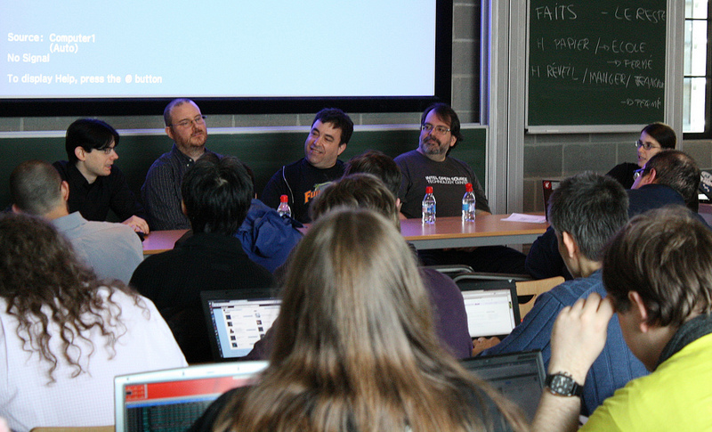
Defending our projects
Every member project has selected the specific FLOSS license they want to use to release their software for the public's benefit. Some member projects release software under the GNU General Public License (GPL), which requires code recipients to pass along the same freedoms they received under the license to the recipients of their redistributed code and modifications. The terms our member projects ask for under the GPL and other FLOSS licenses are easy to meet. But, when the little they ask for is disregarded, we help our member projects encourage compliance with – and at times even enforce – their license terms. Conservancy supports our member projects by promoting general awareness of the GPL and the best practices for GPL compliance, and by engaging users who have overlooked or ignored the GPL’s terms to bring them into compliance.
In May 2012, Samba, Evergreen, Inkscape, Mercurial, Sugar Labs, and Wine all joined BusyBox in publicly showing their support for Conservancy's compliance efforts, and in officially requesting Conservancy to handle compliance issues for their projects should they occur. In addition, Conservancy accepted a new member project, the GPL Compliance Project for Linux Developers, comprised of copyright holders in the Linux kernel who have also asked Conservancy to engage in compliance efforts on their behalf.
Bradley (back row, second from left) and Karen Sandler, Conservancy's
Corporate Secretary and Pro Bono Counsel (back row, fifth from left),
in the Legal Room at FOSDEM 2013, via Flickr. © Rikard Fröberg,
used under a CC By 2.0 license.
After receiving this mandate from our
member projects, we have redoubled our
efforts to protect the public’s rights to use,
study, and redistribute our member projects’ software. As always, the majority of our discussions entailed us giving out-of-compliance distributors a basic tutorial on FLOSS, and on software development in general. We rarely advertise this work, in part because the companies we help bring into compliance often ask us to show discretion as they navigate the learning curve. But we do it gladly because our member projects ask us to do it, and because it results in the right code being made available to the public.
Conservancy also spent part of FY2012 reaching a settlement agreement with the final remaining defendant in a law suit originally filed in 2009 against fourteen consumer electronics companies regarding their noncompliant distribution of member project software. Litigation is always a last resort for us, and we are glad that all aspects of this matter are finally resolved.

Slide 11
Your support
On behalf of our member projects, we would like to thank all of the donors – both large and small – that enabled us to do our work in FY2012. The developers in our member projects love what they do, and we love providing them with the support they need to create software for the public.
If you would like to donate to Conservancy, visit us on the web at sfconservancy.org/donate/.
Thanks!
.
Bradley M. Kuhn President & Executive Director | bkuhn@sfconservancy.org IRC: bkuhn on freenode
Tony Sebro General Counsel | tony@sfconservancy.org IRC: keynote2k on freenode
Denver Gingerich FLOSS License Compliance Engineer | denver@sfconservancy.org IRC: ossguy on freenode
Copyright © 2012 – 2014 by Software Freedom Conservancy. Except as otherwise noted, this work is made available under the terms of the Creative Commons Attribution-ShareAlike 4.0 International license (CC BY-SA 4.0).

