Slide 1
We're software roadies.
Software Freedom Conservancy is a public charity that acts as a non-profit home for dozens of Free, Libre, and Open Source Software (FLOSS) projects. Conservancy's charitable mission is to help improve, develop, and defend FLOSS, and we do that by providing business, legal, and administrative services to our member projects.
We have the honor of working with member projects comprised of, in our humble opinion, many of the best software developers in the world. Some of our member projects develop system software so ubiquitous that it permeates virtually every part of our society's electronics-driven lifestyle. Other member projects are redefining how software will be written and even how computer science will be taught to the next generation of developers. Still others find their niche by solving a small-but-persistent problem better than anyone else – and attract a cult following of users because of it. And, best of all, all of our member projects release their software under a license that allows the public to study, use, improve, and share the source code.
Conservancy provides all of our “rock star” member projects with a comprehensive suite of services, and then we get out of their way to let them do what they do best: write great software for the public's benefit.
Our structure.
Conservancy acts as a fiscal sponsor to our member projects. We've engaged the leadership of each member project's developer community and executed a fiscal sponsorship agreement that allows us to adopt that project as an official part of Conservancy's corporate structure. As a result, our member projects all operate under Conservancy's legal and tax-exempt status.
Conservancy handles all donations, expenditures, and contractual obligations on behalf of our member projects. We also provide member projects with mentorship on fundraising, community governance, and other best practices. Our member projects are free to write code as they please, so long as their work is freely-licensed for the public's benefit.
If you are part of a FLOSS project that would like to join Conservancy, visit sfconservancy.org/members/apply/ for more information.

Slide 2
FY2011, in numbers.
Here's a numerical overview for Conservancy's Fiscal Year 2011 (“FY2011”), which ended on February 29, 2012. For a more details on Conservancy's financials, visit http://sfconservancy.org/about/filings/ to download our independent auditor's report.
1,260 | # of developers who contributed code to Conservancy member projects
1,500,000+ | Total # lines of code added and/or edited, with all of the updates freely-licensed for the public's benefit
4 | # of conferences organized to promote FLOSS (not including numerous Code Sprints and Hack Fests for developers to write code)
1,400+ | Total # of people who attended member Project conferences
9 | # of developers funded full- or part-time to work on FLOSS development
$1,768,095 | Total revenue raised for the support of our member projects' technical objectives and Conservancy's mission

Slide 3
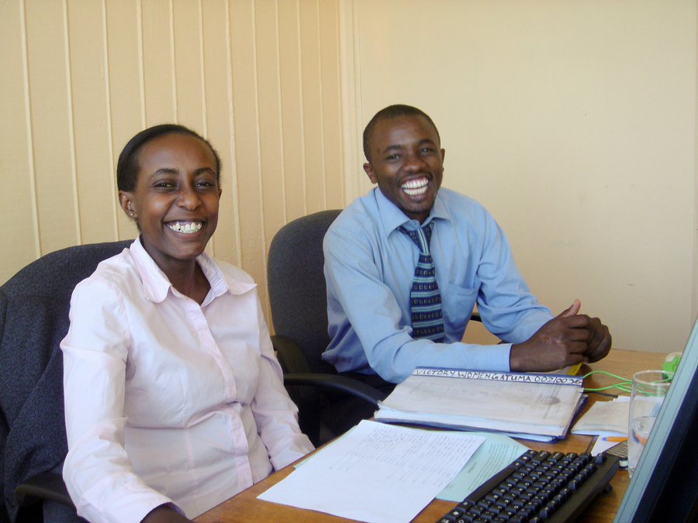
Changes in Conservancy.
Conservancy hired two new staff members FY2011. In April 2011, Denver Gingerich joined Conservancy in a part-time capacity as a FLOSS License Compliance Engineer. A seasoned software developer and FLOSS enthusiast, Denver manages the technical side of Conservancy's license compliance efforts on behalf of our member projects.
Conservancy added its second full-time staff member, Tony Sebro, as General Counsel in September 2011. Tony provides legal support on all matters relating to Conservancy and its member projects, including contract negotiation, trademark portfolio management, license compliance negotiation, and non-profit tax law analysis.
Member Project Highlights.
We've included selected highlights from a few of our projects below. To get the latest announcements from all of our member projects, feel free to visit their websites, listed at sfconservancy.org/members/current/.
  Two new member projects joined Conservancy in FY2011:
    The Evergreen Project, a community of developers, library and information science specialists, and system administrators that maintain an integrated library system used by hundreds of libraries, joined in June 2011.
    The Mifos Project, an initiative handed off to Conservancy by the Grameen Foundation that maintains a microfinance software platform used to support economic developmental relief in developing countries, joined in February 2012.
Mifos users with KEEF Microfinance, Kiambu, Kenya. © 2009 George Conrad, via Flickr, used under a Creative Commons Attribution-NonCommercial 2.0 license.

Slide 4
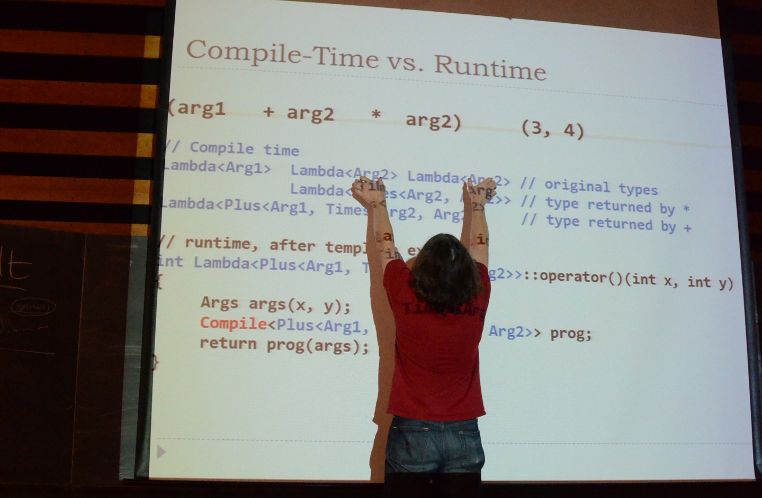
Member Project Conferences.
Conservancy member projects hosted four software conferences in FY2011. The conferences consisted of lectures and workshops relating to FLOSS development.
  The Selenium Project, which maintains a suite of web browser automation tools, held its first annual Selenium Conference (SeConf) in San Francisco in April 2011. SeConf 2011 featured workshops on automated test creation, client-side performance testing, and more. All of the sessions were recorded and archived for the public's benefit; they can be viewed at 2011.seleniumconf.org/videos/.
  The Boost Project, which provides peer-reviewed portable C++ source libraries, held its fifth-annual BoostCon in Aspen, Colorado in May 2011. The conference included sessions on process management in C++, new internet protocols, and Boost infrastructure.
  The jQuery Project, home to a lightweight JavaScript library, held two conferences in FY2011 – jQuery SF Conference in April 2011, and jQuery Boston Conference in October 2011. Slides from the presentations are available at http://events.jquery.org/2011/sf-bay-area/schedule/ and http://events.jquery.org/2011/boston/schedule/, respectively.
    In addition, Conservancy contracted out the hosting of a third jQuery conference, held in London in February 2012, to White October.
Session at BoostCon '11. © 2011 Danny Havenith, via Rurandom.org, used under
a Creative Commons Attribution-ShareAlike 3.0 Unported license.

Slide 5



Additional Highlights.
Forty developers from Conservancy's member projects participated in Google's Summer of Code 2011 program, during which they mentored student software developers and helped them to get involved with FLOSS development and contribute new code freely-licensed to the public.
The Boost Project, long regarded as “one of the most highly regarded and expertly designed C++ library projects in the world,” [1] announced three major releases in FY2011, adding eight new C++ libraries. Boost was also extremely active in the broader C++ community. The first major update to the ANSI/ISO C++ Standard (dubbed “C++11”), released during FY2011, roughly doubled the size of the Standard Library. Boost led the way: the majority of these library extensions were proposed, implemented, reviewed, documented, tested, maintained, popularized, and distributed through Boost.
The Git Project spent FY2011 announcing five major feature releases to git, the distributed version control system that Linux Journal referred to as “revision control perfected.” [2] The Git Project introduced internationalization and translation of git's user interface, thereby promoting its use and adoption by developers around the world. And, when hackers attempted to compromise several servers at Kernel.org, the internet home of the Linux kernel, Linux project maintainers were able to confirm that the source code for the kernel itself was safe, thanks to their use of git as a revision control system. [3] The Git Project responded to the incident by enhancing security even further through the support of cryptographic signatures on commits and pull requests. Many high-profile FLOSS projects – including the Linux kernel itself – still use this feature to help protect their development from malicious attacks.
The PyPy Project released several updates to PyPy, its popular Python interpreter and Just-In-Time compiler, including the first version of PyPy that allowed Python users needing high speed execution to use it as a drop-in replacement for traditional Python interpreters. Enhancements introduced in version 1.7, released in November 2011, enabled PyPy to perform 30% faster than in previous versions. PyPy also enabled the use of Stackless Python, an enhanced version of the Python language, in FY2011.
[1] C++ Coding Standards, Sutter and Alexandrescu, November 4, 2004.
[2] H. Van Styn, “Git – revision control perfected.” Linux Journal, August 24, 2011.
[3] F. Rashid, “Kernel.org hacked, but Linux kernel safe thanks to git,” DesktopLinux.com, September 2, 2011.

Slide 6
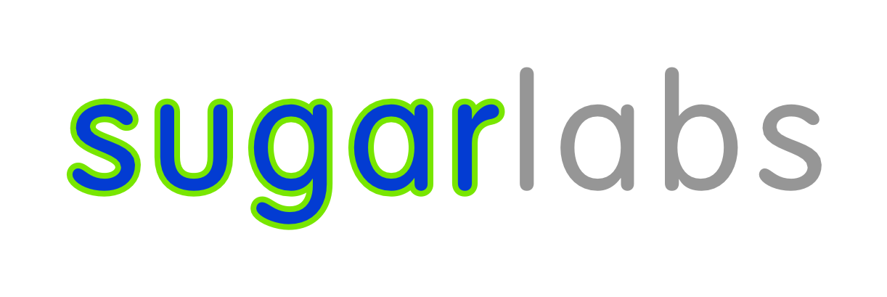
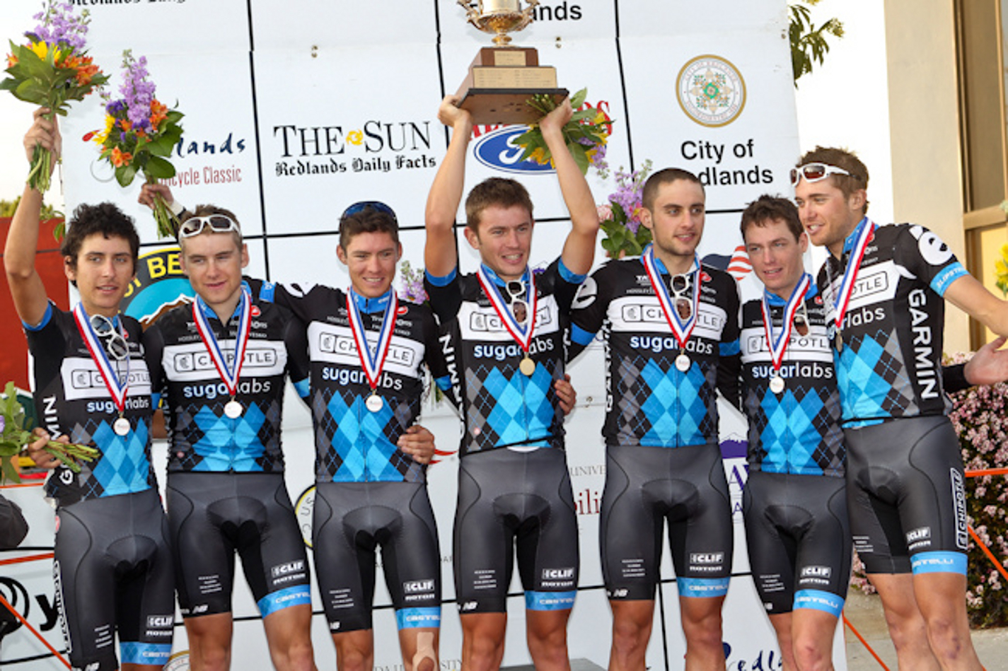

Sugar Labs, home of the Sugar learning platform used in grade school environments around the world to teach children how to use and program a computer, entered into an innovative co-sponsorship relationship with Slipstream Sports, a professional cycling team, to promote Sugar Labs. As part of the agreement, Slipstream athletes wore uniforms bearing the Sugar Labs logo throughout their 2011 international racing season — seven countries in five continents — in order to raise awareness about Sugar Labs, and FLOSS in general.
Chipotle Development Team at the Redlands Cycling Classic. © 2011 Slipstream
Sports. All rights reserved. Used with permission.
In addition, Sugar Labs community members participated in the 2011 Bike Boston Tour wearing Sugar Labs t-shirts to generate further awareness. In parallel, Sugar Labs volunteers taught grade school students how to write FLOSS to program sensors to measure and study cycling performance. The code written was released freely to the general public.
The Wine Project spent all of FY2011 preparing the v.1.4 stable release of Wine, a compatibility layer that allows Linux users to install and run Windows applications. v.1.4, which wasn't released until the first week of FY2012, incorporated 16,000 individual changes, a redesigned audio stack, better mouse control, and full support for bidirectional text and character shaping.

Slide 7
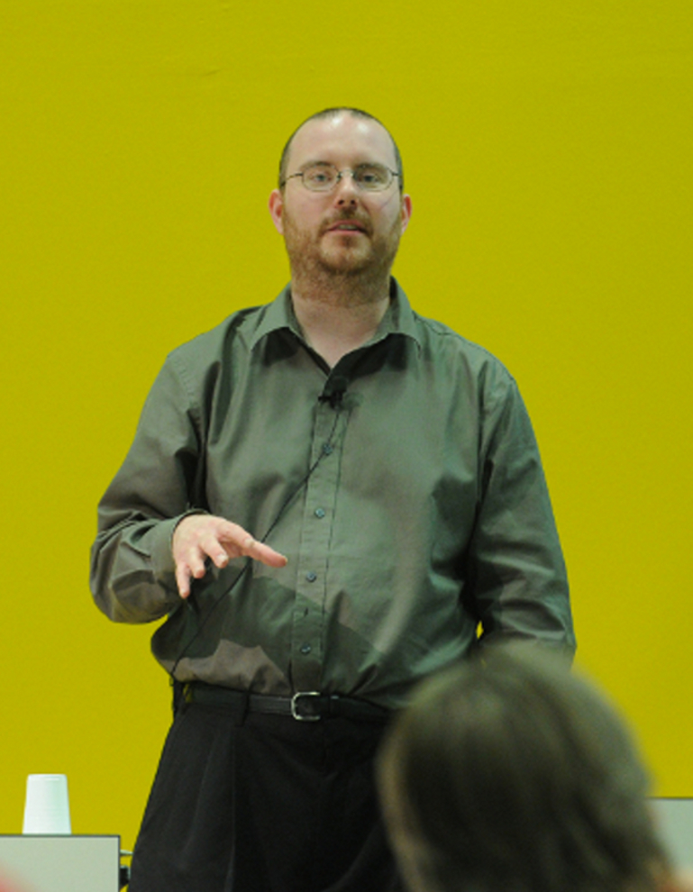
Defending Our Projects.
Every member project has selected the specific FLOSS license they want to use to release their software for the public's benefit. Some member projects release software under the GNU General Public License (GPL), which requires code recipients to pass along the same freedoms they received under the license to the recipients of their redistributed code and modifications. The terms our member projects ask for under the GPL and other FLOSS licenses are easy to meet. But, when the little they ask for is disregarded, we help our member projects encourage compliance with – and at times even enforce – their license terms. Conservancy supports our member projects by promoting general awareness of the GPL and the best practices for GPL compliance, and by engaging users who have overlooked or ignored the GPL's terms to bring them into compliance.
Conservancy's Executive Director Bradley M. Kuhn is an active speaker at many FLOSS conferences: in FY2011, Bradley gave 11 talks at 10 conferences in North America and Europe relating to FLOSS, including six presentations specifically on GPL compliance and associated best practices. All of Bradley's talks are designed to raise awareness about the importance of FLOSS, the developer communities that comprise FLOSS projects, and the non-profit infrastructure Conservancy uses to support those communities.
Conservancy also engaged in discussions with entities who distributed our member projects' software out of compliance with their associated FLOSS license. The majority of our discussions entailed us giving out-of-compliance distributors a basic tutorial on FLOSS, and on software development in general. We rarely advertise this work, in part because the companies we help bring into compliance often ask us to show discretion as they work through the learning curve. But we do it gladly because our member projects ask us to do it, and because it results in the right code being made available to the public.
Conservancy also spent part of FY2011 continuing a litigation filed in 2009 against fourteen consumer electronics companies regarding their distribution of member project software. The vast majority of those companies had settled with Conservancy prior to FY2011; during the fiscal year, Conservancy was able to reach a settlement agreement with four additional distributors, leaving one defendant remaining in the litigation. [1]
Bradley talking about FLOSS compliance at
LinuxTag '11, via Flickr (Kuhn, Bradley M.
/LinuxTag). © 2011 Linux Tag e.V. All
rights reserved. Used with permission.
[1] Conservancy settled with the fourteenth and final defendant in the litigation in FY2012.

Slide 8
Your Support.
On behalf of our member projects, we would like to thank all of the donors, both large and small, that enabled us to do our work in FY2011. We've grown as an organization, and we're glad that we're able to do even more to support the amazing work the developers in our member projects do to create software for the public.
If you would like to donate to Conservancy, visit us on the web at sfconservancy.org/donate/.
Thanks!
.
Bradley M. Kuhn President & Executive Director | bkuhn@sfconservancy.org IRC: bkuhn on freenode
Tony Sebro General Counsel | tony@sfconservancy.org IRC: keynote2k on freenode
Denver Gingerich FLOSS License Compliance Engineer | denver@sfconservancy.org IRC: ossguy on freenode
Copyright © 2011 – 2013 by Software Freedom Conservancy. Except as otherwise noted, this work is made available under the terms of the Creative Commons Attribution-ShareAlike 3.0 US license.

