Slide 1
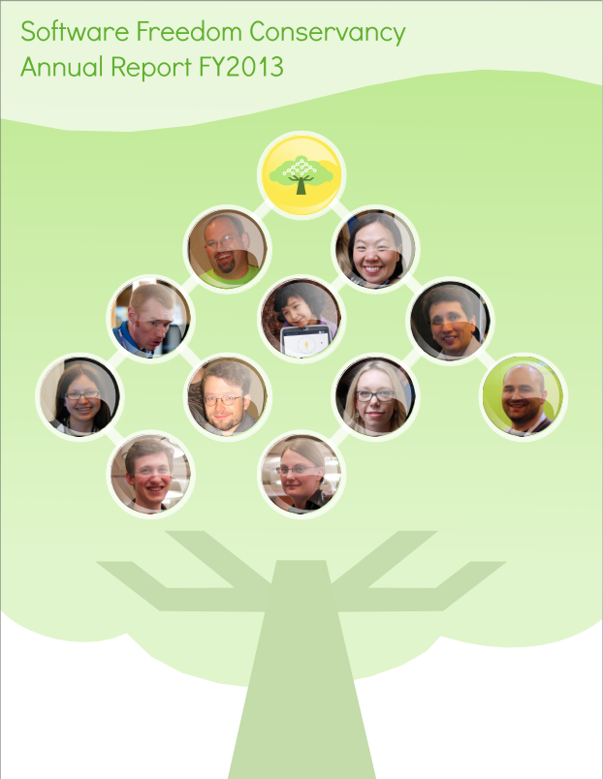

Slide 2
Overview
Software Freedom Conservancy is a public charity that serves as a home to Free, Libre, and Open Source Software (FLOSS) projects. Our mission is to promote, improve, develop, and defend software freely licensed for the public’s benefit. We work towards that mission by serving as home to dozens of FLOSS projects and providing an atmosphere that allows our projects to grow and flourish.
Conservancy acts as a fiscal sponsor to our member projects, which means that each project enjoys the long-term stability of a mature non-profit structure without having to build and maintain it themselves. Conservancy’s staff manage the organization and provide centralized business, legal, and administrative services – freeing developers up to focus on developing software.
In addition to handling finances and donations, Conservancy provides mentorship and thought leadership on community building, fundraising, and community governance. We help our member projects manage the intangibles, and assist them in building up the connective tissue that will keep their communities vibrant for years to come.
Conservancy and our member projects depend on public support to continue our program activities. If you would like to support our work, visit https://sfconservancy.org/supporter/ and become a Conservancy Supporter. If your employer would like to support Conservancy and our member projects, visit https://sfconservancy.org/donate/ for more information, or email us at donate@sfconservancy.org.
If you’re part of a FLOSS project that would like to join Conservancy, go to https://sfconservancy.org/members/apply for more information.

Slide 3
Here’s a numerical overview for Conservancy’s Fiscal Year 2013 (“FY2013”), which ended on February 28, 2014. For a more details on Conservancy’s financials, visit https://sfconservancy.org/about/filings/ to download our independent auditor’s report.

Slide 4
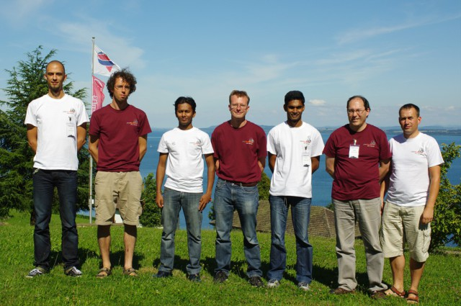
Highlights
New Member Projects Join Conservancy
Three new projects joined Conservancy in FY2013: phpMyAdmin, Buildbot and OpenTripPlanner.
phpMyAdmin provides a FLOSS web interface for several popular database platforms, including MySQL, MariaDB and Drizzle. phpMyAdmin has been adopted by thousands of web hosting companies around the world. Learn more about phpMyAdmin at https://phpmyadmin.net.
Buildbot is a continuous integration tool that automates the build/test/release cycle that developers have to perform so often. Using Buildbot saves developers time and energy by providing a clean, easy and automated way to compile their software, run it through automated tests and finally package it up for others to use. You can learn more about Buildbot at https://buildbot.net.
OpenTripPlanner is a FLOSS platform for transportation routing. OTP can provide itineraries for travel within a municipality via combinations of driving, cycling, walking, and public transit segments. It can even do large scale network analysis and prediction modeling, allowing for simulations which can be used for design or emergency preparedness. Learn more about OpenTripPlanner at http://opentripplanner.org.
phpMyAdmin developers @ DebConf ‘13. © 2013 Michal Čihař. Used under a CC By-SA 2.0 license.

Slide 5


Highlights
Conservancy Launched NPO Initiative
In May 2013, Conservancy launched our NPO Accounting Initiative, an effort to spearhead the development of a user-friendly accounting system for non- profit organizations based solely on FLOSS. Our dream is to offer non-profits a viable FLOSS alternative, and to enable the charitable sector to reallocate millions of dollars currently spent on proprietary accounting software back towards program activities that benefit the public. Recognizing that this will be a multi-year initiative, given our resources, we launched a fundraiser to fund our work. As a result, we were able to successfully complete an initial survey of existing FLOSS systems designed for for-profit accounting to determine which codebase, if any, was suitable to serve as the foundation for our initiative.
We’re currently looking to raise additional money to launch a coordinated FLOSS development effort to create a system for all non-profits to use. Resources permitting, our next step will be to improve the FLOSS system selected in the initial phase to create a basic accounting system suitable for small-to-medium sized USA-based non-profit organizations – including fiscal sponsors like Conservancy. For more information about Conservancy’s NPO Accounting initiative, visit the initiative’s website at https://sfconservancy.org/npoacct/.
Conservancy and COSM Announced Mifos Initiative
Mifos is an award-winning FLOSS project built around providing financial services to the poor. In February 2012, Conservancy assumed stewardship of the project. At the same time, Mifos project leaders started their own public charity, the Community for Open Source Microfinance (COSM), with the intent of growing COSM into a home for Mifos and other related program activities. Conservancy served as Mifos’ fiscal sponsor for nineteen months, and we shared our nonprofit and FLOSS community-building expertise with COSM’s founders during their organization’s early days.
We are happy to report that in September 2013, COSM reached a point of maturity that allowed Conservancy and COSM to work together to transfer stewardship of Mifos to COSM. Upon the transfer, COSM renamed itself the Mifos Initiative to match its flagship project. Conservancy is honored to have played a role in both Mifos and the Mifos Initiative’s development.

Slide 6
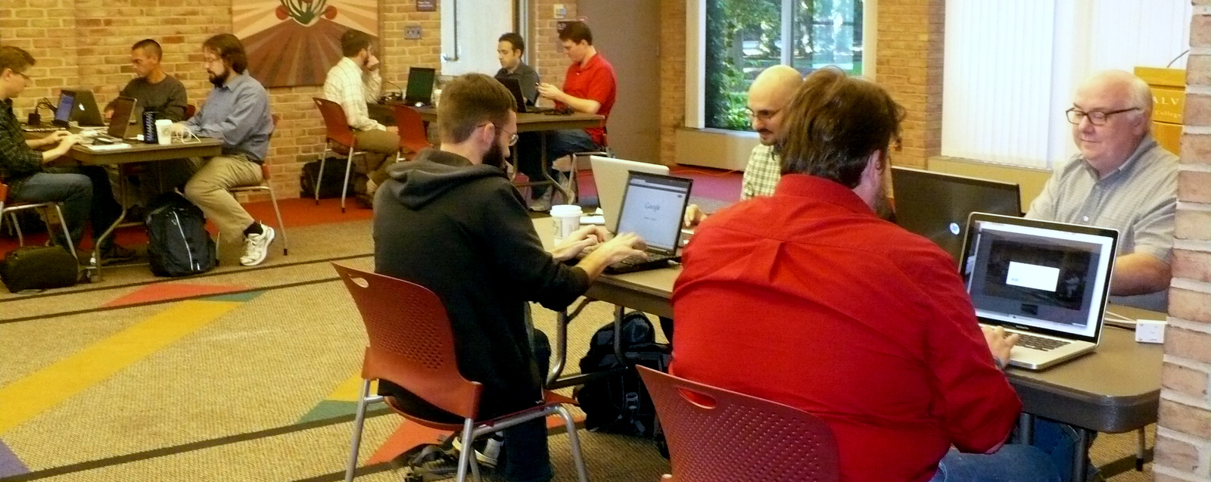
Highlights
Conservancy Hosted Three FLOSS Conferences
Conservancy and our member projects hosted three conferences in FY2013. The conferences focused on various aspects of FLOSS development and were open to the public.
The Evergreen project, which maintains a popular integrated library hosting software platform, held its 5th annual conference in Vancouver, British Columbia on April 10-13, 2013. The conference featured a developer hackfest, several interest group meetings, and two tracks of programs, one aimed at end users and another aimed at technical users and developers.
On May 12-17, 2013, the Boost project, maintainers of portable C++ libraries, hosted C++ Now 2013, a conference focusing on discussion and education about FLOSS usage relating to C++. The conference, held in Aspen, Colorado, featured presentations from many of the leading developers in the C++ community.
The Selenium project, maintainers of a FLOSS automated browser testing software suite, hosted Selenium Conference 2013 in Boston, Massachusetts on June 10- 12, 2013. SeConf ’13 was Selenium’s largest conference yet, attracting over 500 attendees from all over the world to network, attend workshops, and learn more about the project.
Hack-a-way at the Evergreen Conference. © 2013 Software Freedom Conservancy, available under a CC By-SA 4.0 license.
Conservancy Displayed Commitment to Students
Once again, Conservancy’s member projects have shown their commitment to diversity and outreach through involvement with student participation programs such as Google Summer of Code, which encourages student involved in FLOSS development, as well as C++Now, which encourages involvement in the C++ community. Boost, Buildbot and Inkscape all participated in Google Summer of Code, with well over twenty students participating. Boost also funded seven students from five different countries to participate in Boost’s C++ Now Conference. Conservancy supports these efforts to bring students into our member projects, as well as the greater FLOSS community.

Slide 7



Projects
FY2013 was an exciting year for Conservancy and its member projects. With conferences, grants, and a plethora of new releases, our member projects, new and old, continue to expand and improve with each iteration. Below are some of the biggest highlights of the year.
Boost
Boost is a C++ library collection that contains algorithms for many types of applications. Boost lies at the core of many FLOSS software programs. In FY2013, Boost released two new versions of their software and included features such as a new Asynchronous File I/O library as well as extensions to many of their existing libraries
Buildbot
Buildbot is a continuous integration software for the automation of the compile/test/deployment process involved in software development. In August 2013, Buildbot released a new version of their software (release 0.8.8) which added a number of bug fixes, general improvements, and allowed for software developers to more easily automate their development process.
Darcs
Darcs is a FLOSS cross platform version control system that focuses on changes, rather than snapshots, which allows for a freer and more streamlined approach to version control.
In FY2013, the Darcs team announced the Darcsden project, a FLOSS repository hosting platform for Darcs, written in Haskell. It currently offers several features like authentication from Github/OpenID, password recovery, online repository file editing, and comparisons between a repository and its forks.

Slide 8



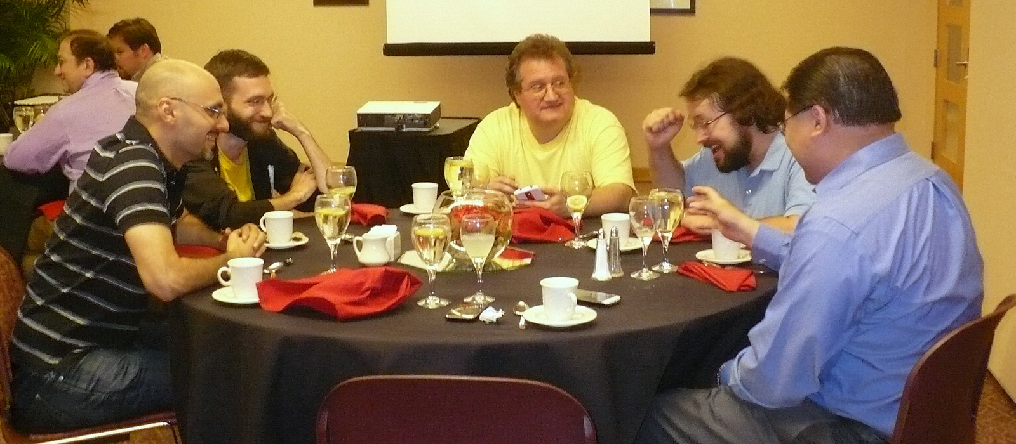
Projects
Evergreen
The Evergreen project announced two major releases – 2.4 and 2.5 – during FY2013. These new releases featured a responsive design for Evergreen’s public catalog, the ability for users to self-register for a library account, and many workflow improvements and new features for library staff using Evergreen.
Evergreen also held a developer Hack-a-Way in Grand Rapids, Michigan in September 2013. During the Hack-a-Way, Evergreen developers made big steps in building a more responsive public web catalog, specifically with support for more mobile devices in mind. The developer community also began plans to move Evergreen from a XULRunner-based application to a web application.
Inkscape
Inkscape is a FLOSS vector graphics editor similar to Adobe Illustrator or Corel Draw. What sets Inkscape apart is its use of Scalable Vector Graphics (SVG) as its native format. In FY2013, Inkscape made significant improvements to the security, stability and functionality of its software including improvements to its CAD support, document template support, vectorizing pixelized images and improvements to the visual elements of the software.
phpMyAdmin
phpMyAdmin is a FLOSS web interface to several popular database systems including mySQL, MariaDB and Drizzle. In FY2013, Conservancy welcomed phpMyAdmin to its list of sponsored projects. phpMyAdmin also released a new version of their software which included a significant improvement to their web interface.
Evergreen Hack-a-way dinner, sponsored by Equinox Software. © 2013 Software Freedom Conservancy, available under a CC By-SA 4.0 license.

Slide 9

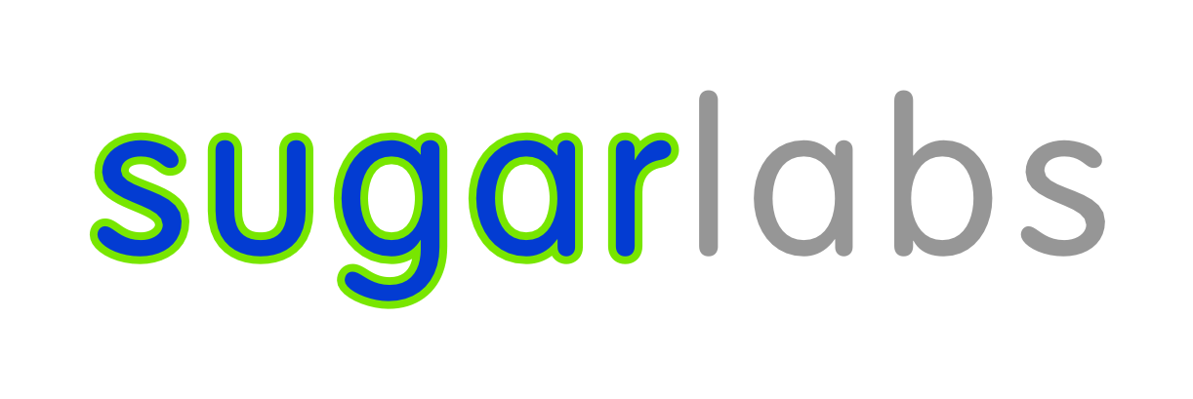

Projects
Squeak
Squeak is a full-featured FLOSS programming environment based on the Smalltalk programming language. In FY2013, Squeak made a number of improvements to its design to allow it to run more easily on low powered devices such as the Raspberry Pi, OPLC or PIC microcontrollers. These improvements allowed Squeak developers to port the Scratch codebase to Squeak, bringing improved performance to Raspberry Pi users in particular. By focusing on small, low-powered devices, Squeak will be better able to work in educational environments with embedded processors or robots.
Sugar Labs
The Sugar Learning Platform promotes collaborative learning through the use of FLOSS tools. Designed from the ground up especially for children, Sugar’s estimated three million users worldwide are offered an alternative to traditional “office-desktop” software.
In FY2013, Sugar Labs made strides in making JavaScript/HTML5 a first class programming environment while continuing to work closely with the Fedora and GNOME upstream communities. Over 30% of the patches in their newest release come directly from Sugar users: the children themselves.
Children Programming using Sugar Labs. © 2013 Walter Bender. Used under a CC By-SA 4.0 license.

Slide 10
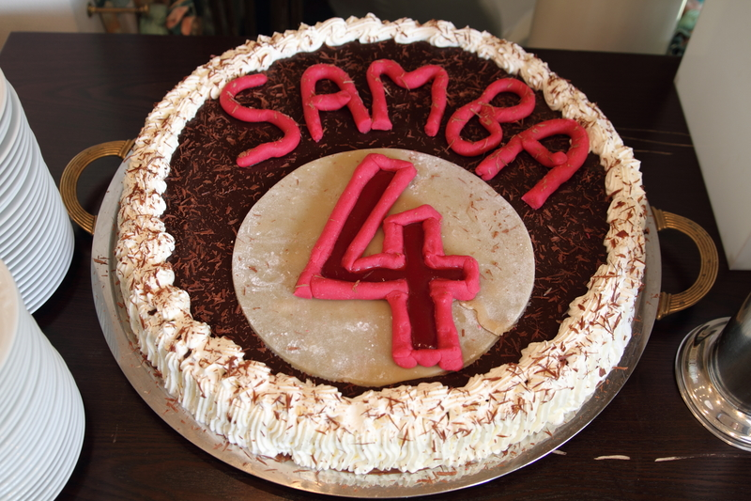
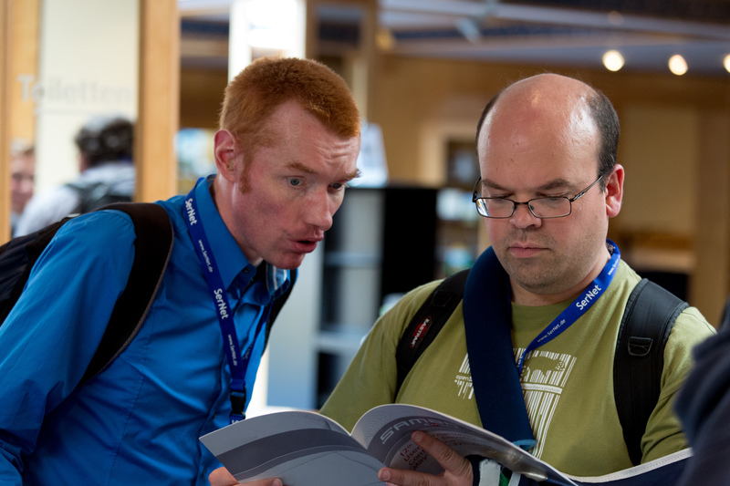


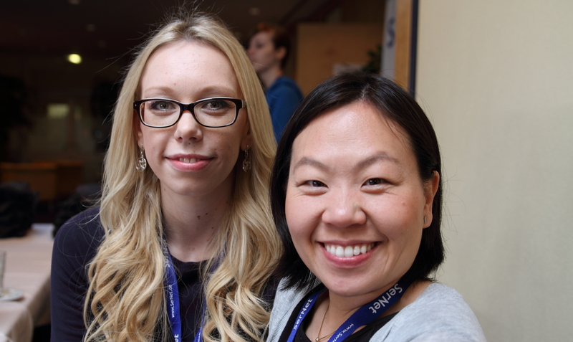
Projects
SWIG
SWIG is a FLOSS development tool that connects programs written in low level languages like C and C++ with a variety of high-level programming languages such as as Javascript, Perl, PHP, Python, Tcl and Ruby. In FY2013 the SWIG team released version 3.0.0, including better C++ support, support for the new C++11 standard as well as nested classes.
Wine
Wine is a FLOSS implementation of Windows programming interfaces, allowing Windows software to run on other platforms such as GNU/Linux and Mac OS. In July 2013, after sixteen months of development, Wine released version 1.6, which included a large number of changes including better Mono (.NET) support, better support for Mac OS, and significantly improved support for new apps and games.
Top L: Cake for Samba 4. Top R: SambaXP attendees. Bottom: Additional SambaXP attendees. All photos © 2013 SerNet. Used under a CC By-SA 4.0 license.

Slide 11
Project Support
Software Freedom Conservancy is dedicated to the cause of FLOSS. Some of our member projects release their software under a “copyleft” license such as the GNU General Public license, which has a reciprocal agreement to pass along changes made using the same terms as the original license. Other member projects select more permissive licenses, such as the Apache license, which do not have the same requirements. Each member project is free to choose the license that they feel fits their project, and Conservancy works to defend that choice by ensuring that each of our projects’ licenses are adhered to.
In FY2013, Conservancy welcomed phpMyAdmin, Buildbot and OpenTripPlanner to its list of member projects, meaning that each of these projects will gain the benefit of Conservancy status, including license enforcement.
Conservancy receives dozens of reports of potential FLOSS license violations from the public every year. We do our best to investigate each report, confirm its veracity based on publicly-available information, and engage those who we have confirmed are distributing our member projects’ software without complying with their chosen license. Many of our conversations with such distributors are amicable and result in the distributor coming into compliance with the FLOSS license in question, but we rarely discuss them in public at the distributors’ request.
As a rare exception to this rule, in August 2013, Conservancy publicly announced our role in assisting Samsung with a GPL compliance issue related to the Linux kernel and the exFAT filesystem driver. Conservancy and our GPL Compliance Project for Linux Developers are proud to have been able to resolve the issue collaboratively with Samsung, and we appreciate Samsung’s openness about the matter.

Slide 12
Thank You!
We here at Conservancy would like to thank all of the donors – both large and small – that enabled us to do our work in FY2013. Some of you supported us by donating to our member projects; others made general contributions. All of your donations helped us promote, develop, and defend FLOSS for the public’s benefit.
We also salute the thousands of volunteers – the developers, maintainers, designers, documenters, sys admins, and website admins who support us by contributing time, skill, code, and more to our member projects. We wouldn’t exist without you.
If you would like to donate to Conservancy, visit https://sfconservancy.org/donate/. If you would like to become an official Conservancy Supporter, visit us at https://sfconservancy.org/supporter/. If you would like to volunteer for one of our member projects, you can find links to our member projects’ websites at https://sfconservancy.org/members/current/. And, if you would like to contribute to Conservancy in other ways, contact us at volunteer@sfconservancy.org.
Karen M. Sandler Executive Director | karen@sfconservancy.org IRC: karen on freenode
Bradley M. Kuhn President & Distinguished Technologist | bkuhn@sfconservancy.org IRC: bkuhn on freenode
Tony Sebro General Counsel | tony@sfconservancy.org IRC: keynote2k on freenode
Denver Gingerich FLOSS License Compliance Engineer | denver@sfconservancy.org IRC: ossguy on freenode
Copyright © 2012 – 2015 by Software Freedom Conservancy. Except as otherwise noted, this work is made available under the terms of the Creative Commons Attribution-ShareAlike 4.0 International license (CC By-SA 4.0). This report was created by Serge Wroclawski, Rebecca Chang, and Daniel Galleguillos, with the support of Conservancy staff. We really appreciate your contributions!

