Slide 1









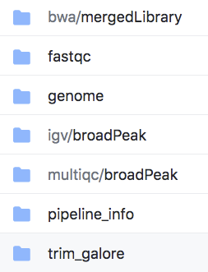






Identify
Completeness
Access
Describe and Relate
Explain
LFS
results/
Exemplify
Execute
Attribution
License
Software Packages

Slide 2




manifest-sha512.txt
a0ae93…77fb data/ro-crate-metadata.json
a2f562…f3fa data/workflow.cwl 481bb7…10b7 data/chipseq_20200910.json
Completeness
ro-crate-metadata.json
{ "@context": "https://w3id.org/ro/crate/1.1/context",
"@graph": [
{
"@type": "CreativeWork",
"@id": "ro-crate-metadata.json",
"conformsTo": {"@id": "https://w3id.org/ro/crate/1.1"},
"about": {"@id": "./"}
}, {…} ]}
chipseq_20200924.json
{
"object_id": "chipseq_20200924",
"spec_version": "https://w3id.org/ieee/ieee-2791-schema/",
"etag": "abcd",
"provenance_domain": {…},
"usability_domain": […],
"description_domain": {…},
"execution_domain": {…},
"io_domain": {…}
}
fetch.txt
data/seq.fasta ark:/57799/b9dd5t
Relate
Explain
Execute
results/
Exemplify
nf-core/chipseq/1.2.1/main.nf

