Slide 1









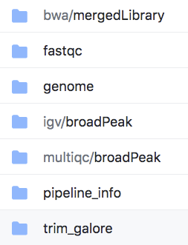






Identify
Completeness
Access
Describe and Relate
Explain
LFS
results/
Exemplify
Execute
Attribution
License
Software Packages

