Slide 1
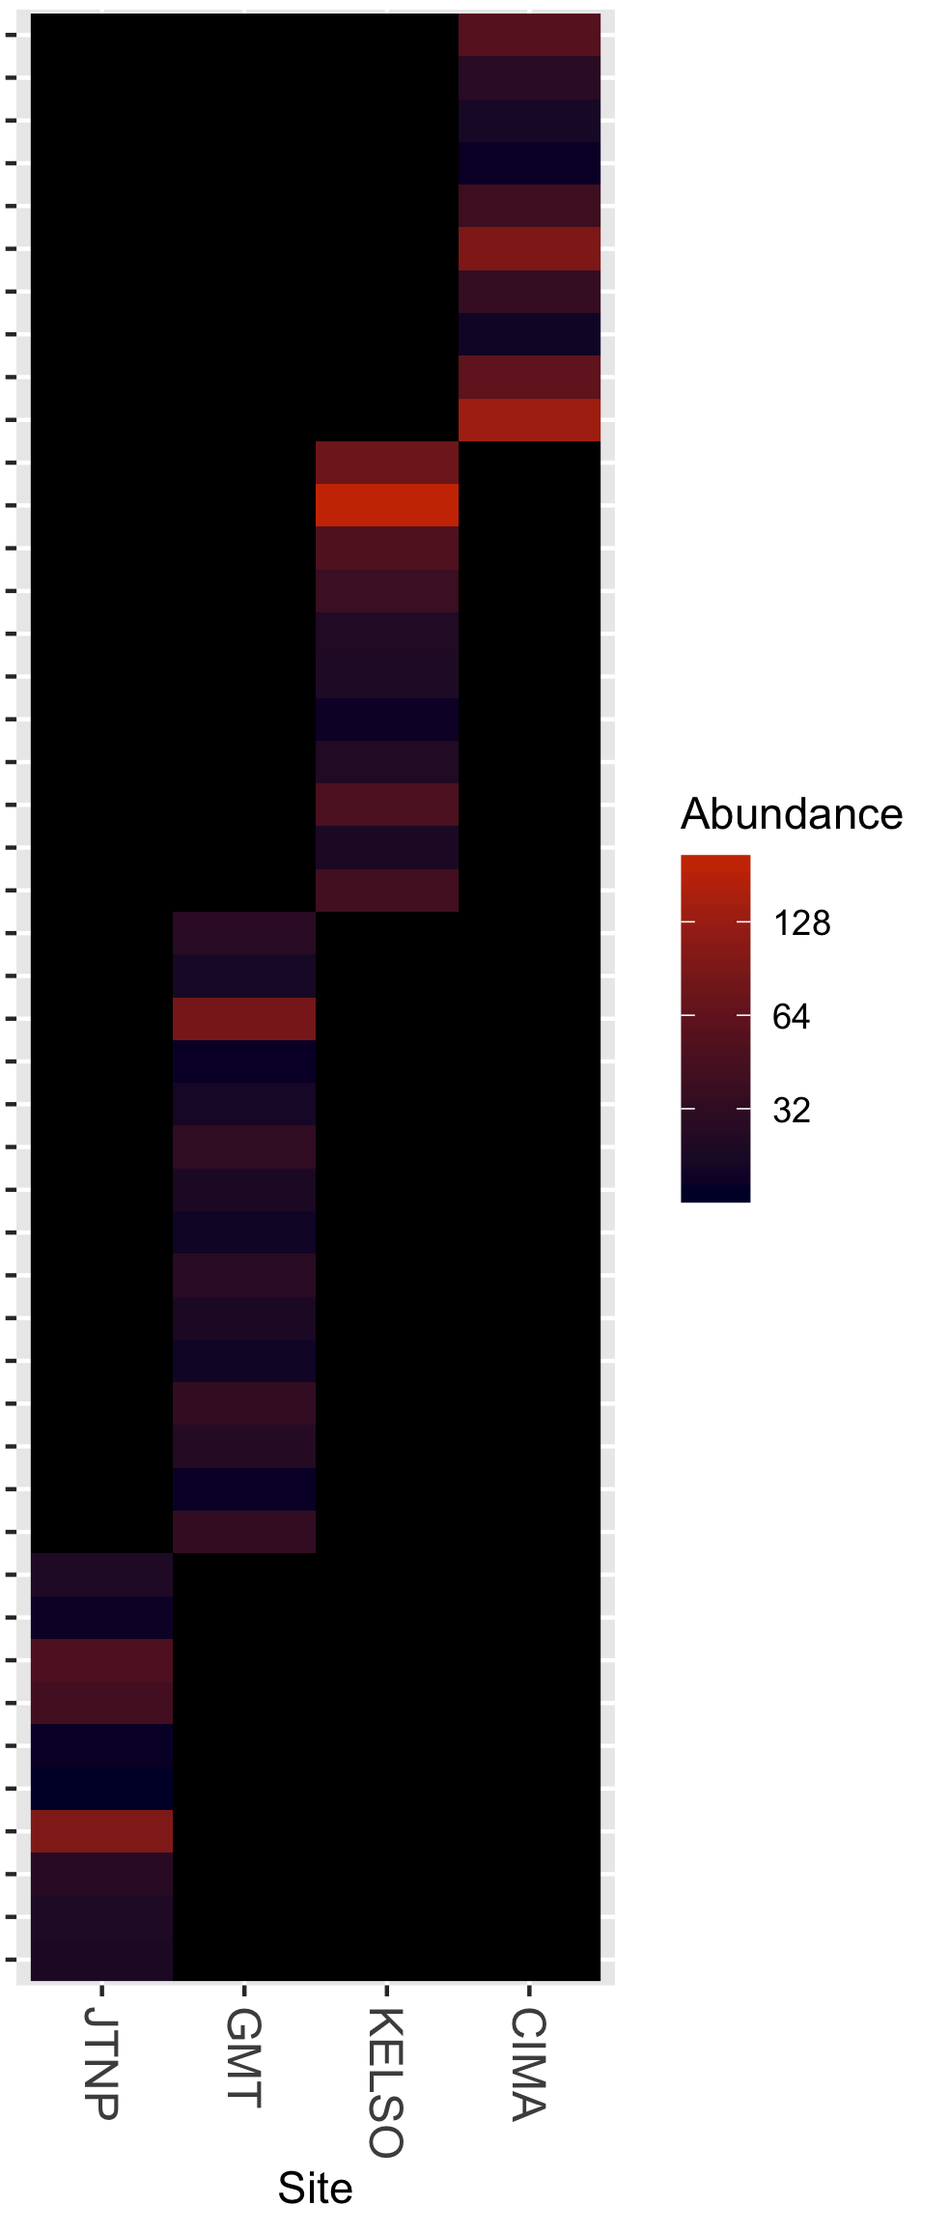
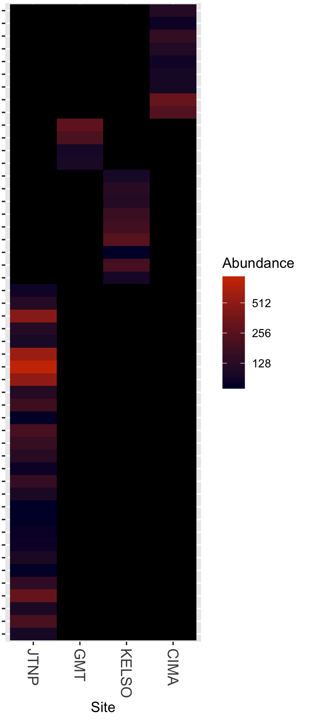
Endemic Fungi
Endemic Bacteria
Pleosporales
Unidentified Nostocaceae
Agaricales
Unidentified Nostocaceae
Pezizales
Chroococcidiopsis SAG 2023
Mortierellales
Chroococcidiopsis SAG 2023
Lecanorales
Limnothrix
Orbiliales
CENA518
Unidentified Ascomycota
Unidentified Geodermatophilaceae
Pezizales
Lechevalieria
Pezizales
RB41
Unidentified Ascomycota
Symplocastrum CPER-KK1
Chaetothyriales
Wilmottia Ant-Ph58
Ostropales
Pseudonocardia
RB41
Helotiales
Unidentified Nostocaceae
Eurotiales
Unidentified Acetobacteraceae
Unidentified Ascomycota
Chthoniobacter
Unidentified Ascomycota
Unidentified Archangiaceae
Unidentified Ascomycota
Cystobacter
Sordariales
Blastococcus
Umbillicariales
Umbillicariales
Verrucariales
Tumebacillus
Peltigerales
Adhaeribacter
Chaetothyriales
Tychonema CCAP 1459-11B
Unidentified Ascomycota
Unidentified Chroococcidiopsaceae
Wilmottia Ant-Ph58
Unidentified Ascomycota
Unidentified Kallotenuales
Unidentified Dothideomycetes
Hymenobacter
Unidentified Fungi
Mastigocladopsis PCC-10914
Pleosporales
Mastigocladopsis PCC-10914
Unidentified Ascomycota
Coleofasciculaceae
Filobasidiales
Tychonema CCAP 1459-11B
Sordariales
Chthoniobacter
Unidentified Fungi
Chthoniobacter
Eurotiales
Chthoniobacter
Pleosporales
Unidentified Myxococcales
Acarosporales
Sphingomonas
Acarosporales
Unidentified Rhodobacteraceae
Helotiales
Microvirga
Unidentified Beijerinckiaceae
Pleosporales
Unidentified Bacteria
Unidentified Ascomycota
Unidentified Chloroflexi
Unidentified Fungi
Unidentified Frankiales
Unidentified Eurotiomycetes
Blastocatella
Chaetothyriales
RB41
Pleosporales
Unidentified Spirosomaceae
Sordariales
Unidentified Spirosomaceae
Geoglossales
Unidentified Microscillaceae
Pleosporales
Rhodocytophaga
Capnodiales
Flavisolibacter
RB41

