Slide 1
Hate Speech Detection in YouTube Music Video Comments related to Metal gender

Slide 2
INTRODUCTION:
On platforms like YouTube, comments on music videos can contain offensive messages targeting vulnerable communities. Detecting and mitigating this type of discourse can improve the environment and reduce the psychological impact on users.

Slide 3
OBJECTIVES:
General:
Analyze and compare the performance of Transformer-based models and Mamba-based architectures in detecting hate speech in YouTube comments across metal bands.
Specific:
Train and evaluate Transformer-based and Mamba-based models on labeled datasets to detect hate speech in metal music video youtube comments.
Test models on multiple labeled datasets and measure the variation in performance to assess dataset bias and generalization potential.

Slide 4
JUSTIFICATION:
YouTube is one of the most popular social media platforms, and music videos often receive millions of comments. Identifying and mitigating hate speech in these comments can contribute to a safer and more inclusive online environment.
The metal community have distinct linguistic and expressive styles. A comparative analysis can reveal unique patterns of hate speech in each genre and help tailor moderation strategies accordingly.

Slide 5
PROBLEMATIC:
Low accuracy in detecting hate speech in music comments:
Many existing hate speech detection models fail to accurately classify toxic comments in music-related discussions due to slang, sarcasm, and cultural nuances.
Contextual misinterpretation of hate speech in different genres:
The metal community use language differently, making it difficult to distinguish between aggressive musical discourse and actual hate speech.

Slide 6
RESEARCH QUESTIONS:
What is the performance of a transformer base model (Bert Uncased) compared with a transformer pre-trained model with toxic speech (HateBert - RoBerTa) ?
How does the consideration of the datasets impact the performance of the classification results, and how many of them are false positives?

Slide 7
RELATED WORK

Slide 8
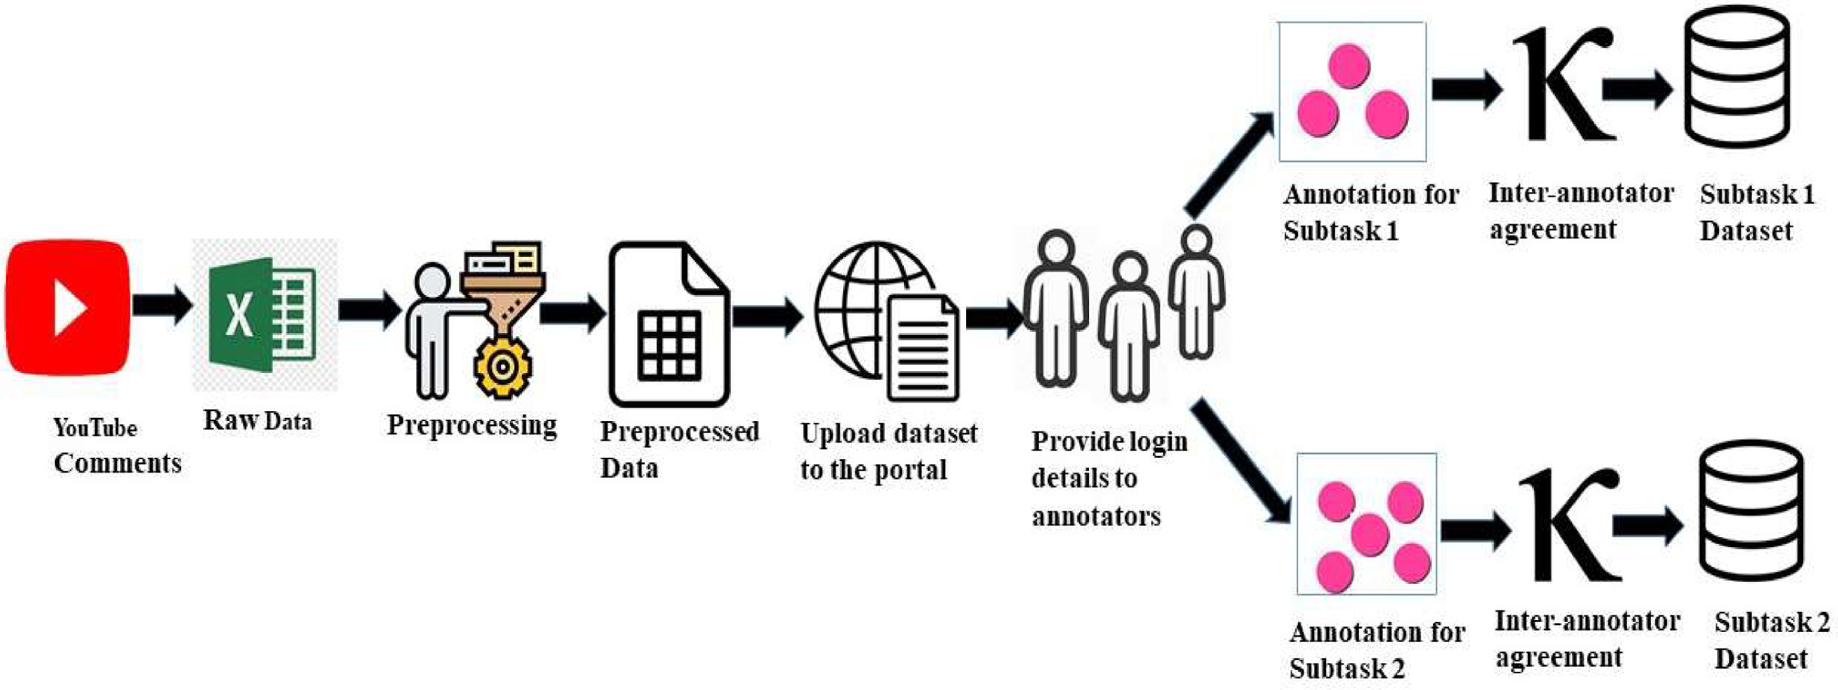
1. Misogynistic attitude detection in YouTube comments and replies: A high-quality dataset and algorithmic models

Slide 9
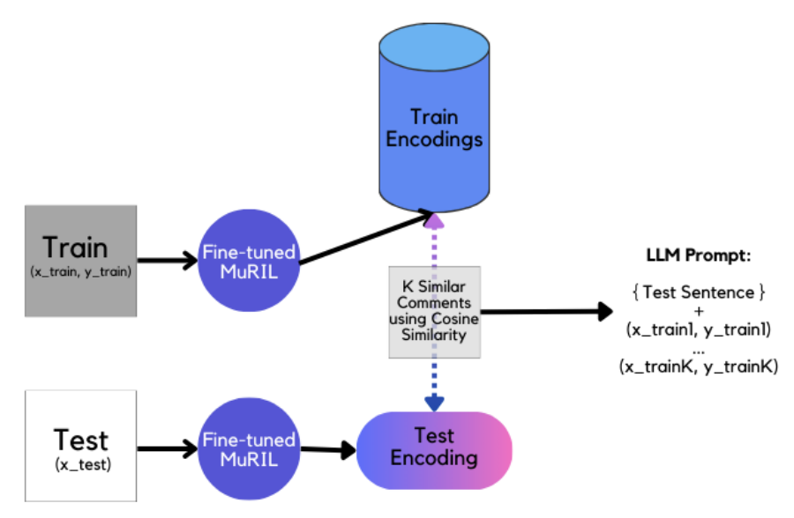
2. DweshVaani: An LLM for Detecting Religious Hate Speech in Code-Mixed Hindi-English

Slide 10
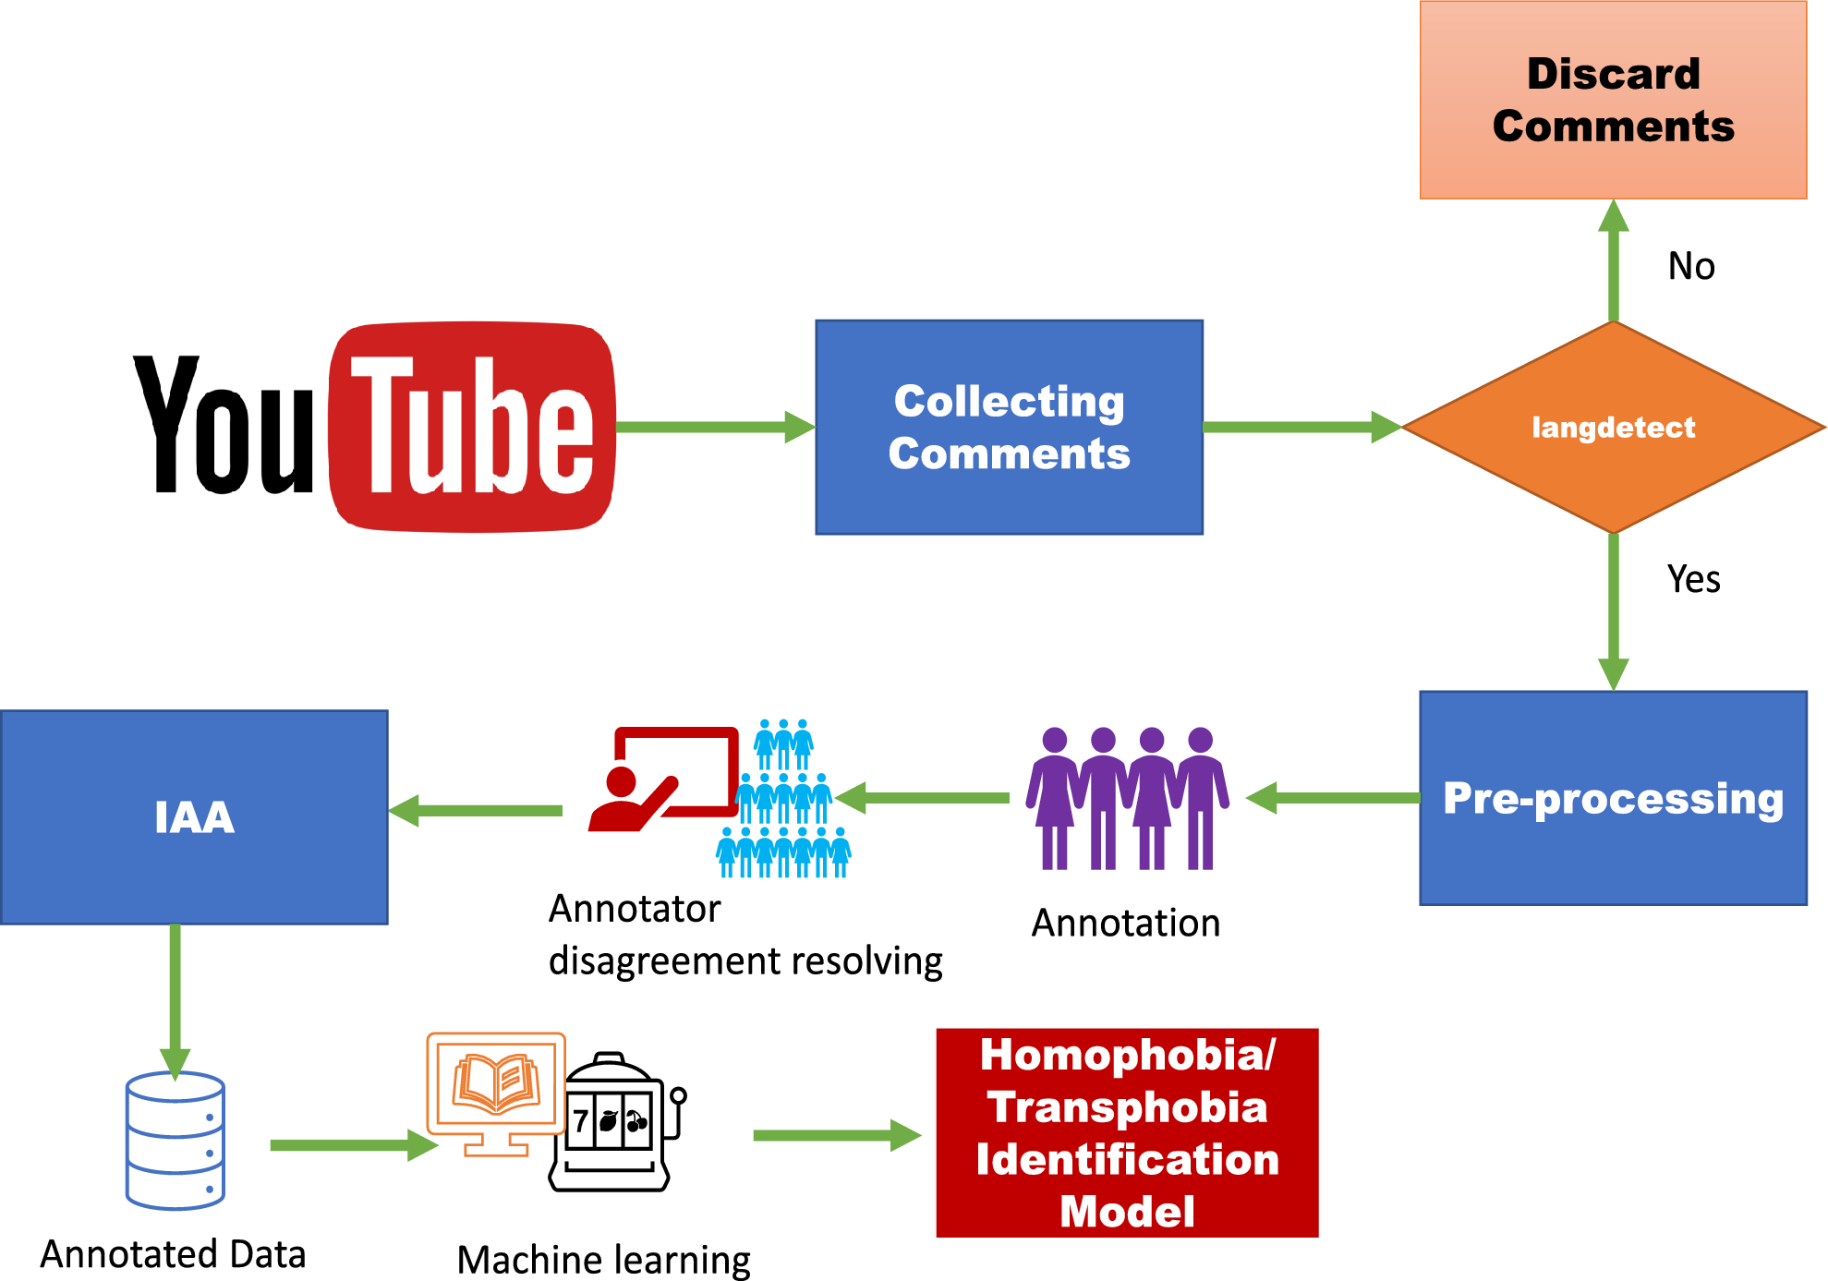
3. Detection of homophobia and transphobia in YouTube comments

Slide 11
RAW PROCESSING
Phase to determine all the necessary resources before moving on to the preprocessing stage.

Slide 12
Databases to be used for the classifier training stage:
ETHOS Dataset: Contains comments classified as hate speech and its different types. [2020]
HateXplain: A Benchmark Dataset for Explainable Hate Speech Detection. [2020]
Consider the datasets produced in each of the papers.
- If two or more databases are selected, the normalization process for both databases will be considered.

Slide 13
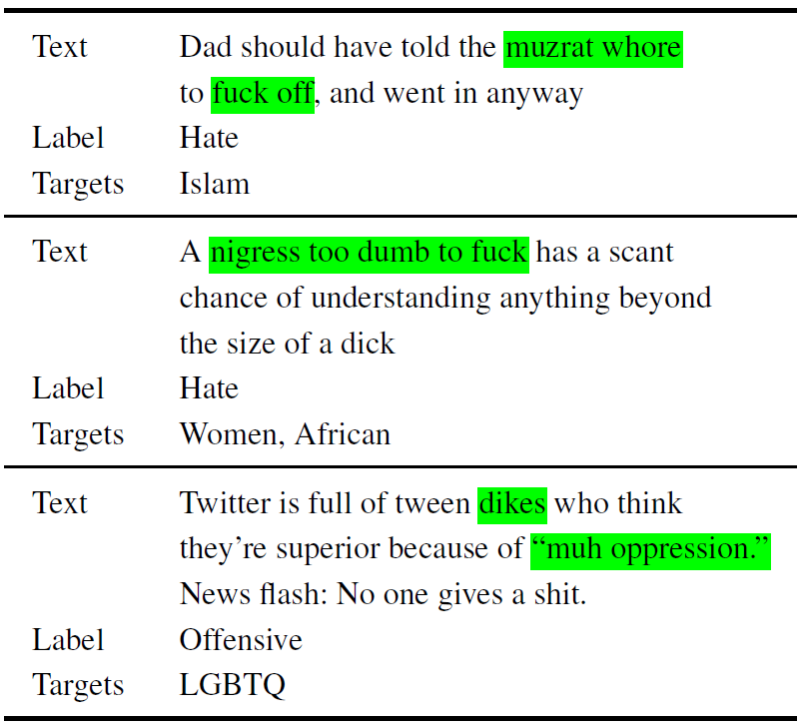
HateXplain

Slide 14
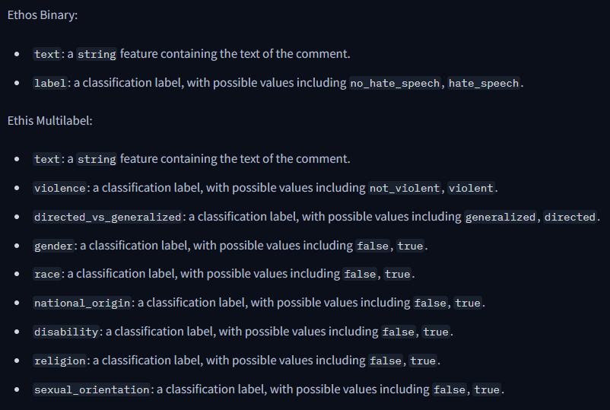
ETHOS Dataset

Slide 15
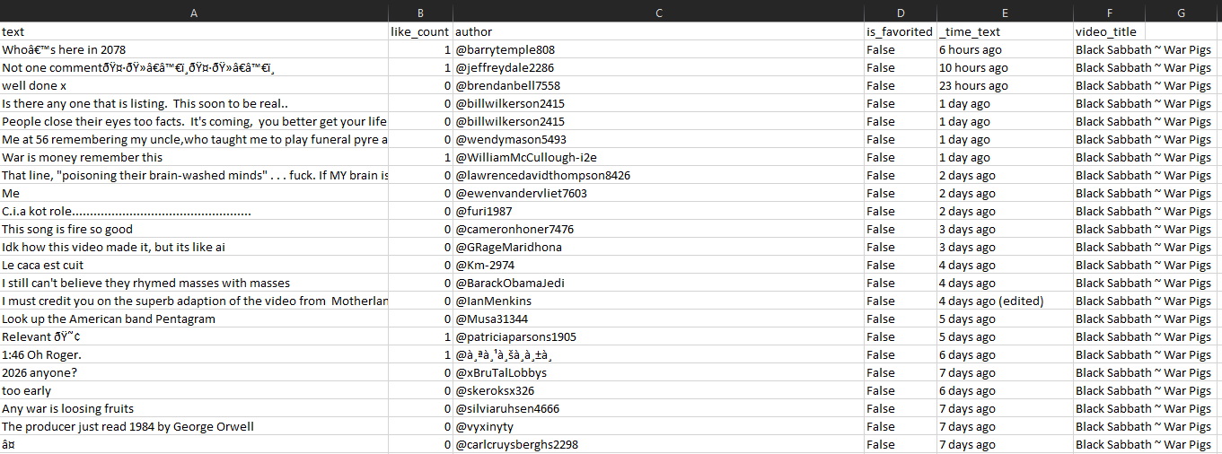

Slide 16
TEXT PREPROCESS
¿What would the preprocessing steps for classifier training look like?
Removal of duplicates and irrelevant comments.
Text normalization (lowercase, removal of special characters).
Removal of stopwords (including articles).
Application of lemmatization and stemming.
Conservate the English language comments only.
From the tagged datasets how can I expand the training examples.

Slide 17
MODEL BASED ON TRANSFORMERS
How would a classifier be built to take into account a Transformers-based model of words or phrases that involve hate speech or not?
Construction of the binary labeled data corpus (hate speech or not).
Text preprocessing (tokenization, stopword removal, lemmatization).
Construction of the classifier with Transformers.
Performance evaluation in the youtube comments dataset builded.

Slide 18
MODEL BASED ON MAMBA:
How would a classifier be built to take into account a Mamba-based model of words or phrases that involve hate speech or not?
Construction of the binary labeled data corpus (hate speech or not).
Text preprocessing (tokenization, stopword removal, lemmatization).
Construction of the classifier with Mamba.
Performance evaluation in the youtube comments dataset builded.

Slide 19
EVALUATION

Slide 20
METRICS TO CONSIDER:
CLASSIFIER: F1-Score, Accuracy. (Compare with LLM models to see performance for each selected model, considering ZeroShot learning).
REPRESENTATION: Cosine Distance (Hate Speech Prototypes), Euclidean Distance, Perplexity.
INFORMATION RECOVERY: Mean Average Precision (MAP), NDCG (Normalized Discounted Cumulative Gain).

Slide 21
METRICS TO CONSIDER:
Validation Loss:
Low validation loss: The model generalizes well to unseen data.
High validation loss: The model struggles to generalize, possibly due to:
Underfitting: If both training and validation losses are high.
Overfitting: If training loss is low but validation loss is high.

Slide 22
METRICS TO CONSIDER:
Training Loss:
High training loss: The model is struggling to fit the training data and needs adjustments (e.g., better hyperparameters, more training time).
Low training loss: The model is learning well, but we must also check validation loss to avoid overfitting.
Training loss decreasing: The model is improving as training progresses.c

Slide 23
RESULTS

Slide 24
EXPERIMENT 1:
TRANSFORMERS: Bert uncase base transformer tokenizer architecture.
Only using (HATEXPLAIN).
10 Epochs ~ 1 h.

Slide 25
Epoch | Training Loss | Validation Loss | Accuracy | F1
1 | 0.4766 | 0.753503 | 0.836725 | 0.738474
2 | 0.3093 | 0.932341 | 0.843672 | 0.738589
3 | 0.3045 | 1.083901 | 0.827295 | 0.690391
4 | 0.2357 | 1.138283 | 0.825806 | 0.718299
5 | 0.1512 | 1.177098 | 0.824566 | 0.703066
6 | 0.0628 | 1.282215 | 0.829777 | 0.703544
7 | 0.0614 | 1.362857 | 0.827047 | 0.687864
8 | 0.0309 | 1.331932 | 0.827792 | 0.698523
9 | 0.1128 | 1.475481 | 0.829032 | 0.704165
10 | 0.0002 | 1.524164 | 0.830273 | 0.715474

Slide 26
Music Video | English Comments | Hate Speech Comments
Black Sabbath ~ War Pigs | 29068 | 337
Hallowed Be Thy Name (2015 Remaster) | 1793 | 9
Master of Puppets (Remastered) | 10149 | 32
Pantera - Cowboys From Hell | 10724 | 81
Slayer - Raining Blood | 17852 | 182

Slide 27
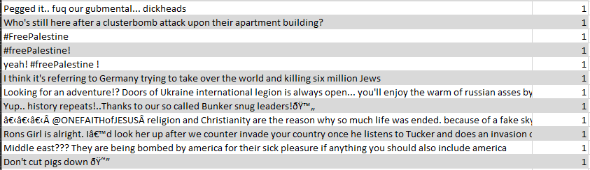
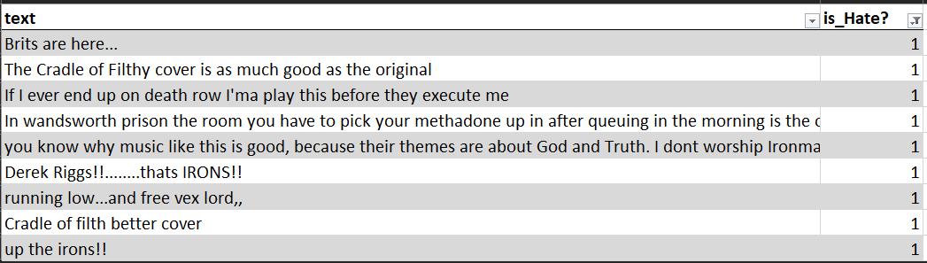
Black Sabbath ~ War Pigs
Hallowed Be Thy Name

Slide 28
EXPERIMENT 2:
TRANSFORMERS: Bert uncase base transformer tokenizer architecture.
Only using (HATEXPLAIN).
30 Epochs ~ 3 h.

Slide 29
Epoch | Training Loss | Validation Loss | Accuracy | F1
21 | 0.461200 | 1.056068 | 0.823573 | 0.649235
22 | 0.515600 | 0.948947 | 0.816625 | 0.628457
23 | 0.587200 | 0.955669 | 0.786352 | 0.513284
24 | 0.631100 | 1.025427 | 0.794045 | 0.554243
25 | 0.266700 | 0.969202 | 0.831266 | 0.719008
26 | 0.192400 | 1.049532 | 0.832010 | 0.712037
27 | 0.318200 | 1.065290 | 0.823821 | 0.675799
28 | 0.202600 | 1.014721 | 0.832010 | 0.707307
29 | 0.105900 | 1.093944 | 0.830025 | 0.705882
30 | 0.295800 | 1.098807 | 0.830273 | 0.705933

Slide 30
Music Video | English Comments | Hate Speech Comments
Black Sabbath ~ War Pigs | 29068 | 154
Hallowed Be Thy Name (2015 Remaster) | 1793 | 7
Master of Puppets (Remastered) | 10149 | 14
Pantera - Cowboys From Hell | 10724 | 45
Slayer - Raining Blood | 17852 | 94

Slide 31
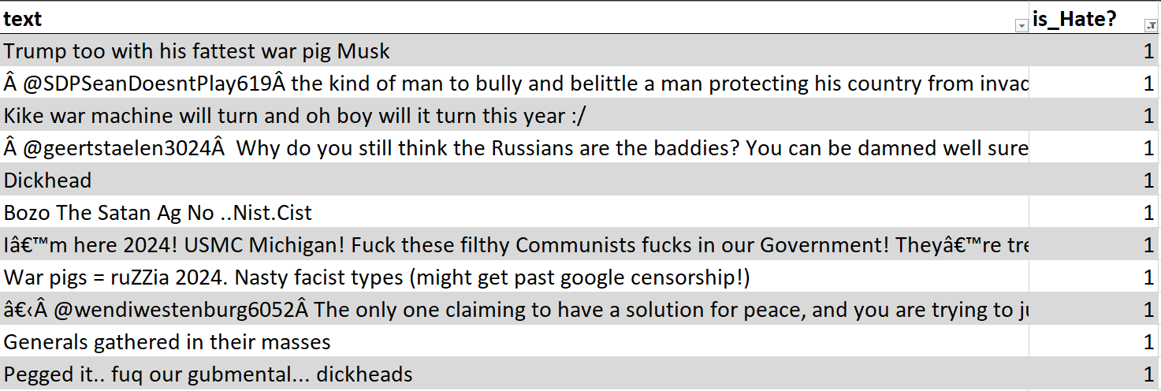
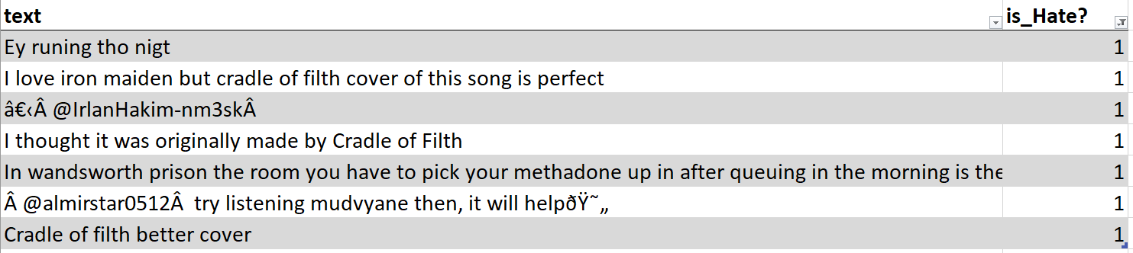
Black Sabbath ~ War Pigs
Hallowed Be Thy Name

Slide 32
EXPERIMENT 3:
TRANSFORMERS: Bert uncase base transformer tokenizer architecture.
Only using (HATEXPLAIN).
100 Epochs ~ 100 min. (GPU optimizations)

Slide 33
Epoch | Training Loss | Validation Loss | Accuracy | F1
90 | 0.001000 | 1.698157 | 0.847643 | 0.738501
91 | 0.002400 | 1.696244 | 0.847643 | 0.746700
92 | 0.000600 | 1.702129 | 0.847395 | 0.745131
93 | 0.000500 | 1.691137 | 0.846650 | 0.744205
94 | 0.000700 | 1.690722 | 0.847395 | 0.747018
95 | 0.000200 | 1.695175 | 0.848387 | 0.746368
96 | 0.000700 | 1.696243 | 0.848387 | 0.746368
97 | 0.000900 | 1.698236 | 0.848387 | 0.746368
98 | 0.000500 | 1.699480 | 0.848139 | 0.746058
99 | 0.001000 | 1.700083 | 0.847891 | 0.745749
100 | 0.000400 | 1.698839 | 0.847643 | 0.745650

Slide 34
Music Video | English Comments | Hate Speech Comments
Black Sabbath ~ War Pigs | 29068 | 225
Hallowed Be Thy Name (2015 Remaster) | 1793 | 6
Master of Puppets (Remastered) | 10149 | 20
Pantera - Cowboys From Hell | 10724 | 52
Slayer - Raining Blood | 17852 | 144

Slide 35
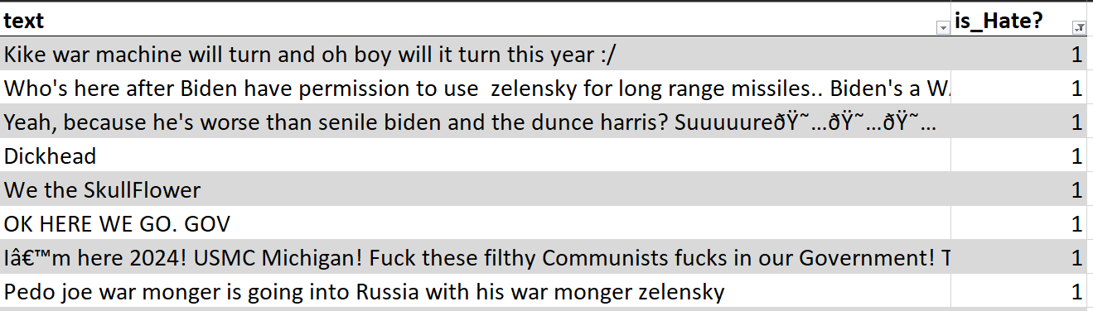
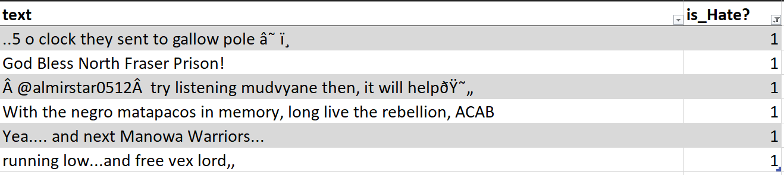
Black Sabbath ~ War Pigs
Hallowed Be Thy Name

Slide 36
Conclusions of First 3 Experiments:
The model gets overfitting after 2~3 Epochs.

Slide 37
EXPERIMENT 4:
TRANSFORMERS: Bert uncase base transformer tokenizer architecture.
Only using (HATEXPLAIN).
2 Epochs ~ 2 min. (GPU optimizations)

Slide 38
Epoch | Training Loss | Validation Loss | Accuracy | F1
1 | 0.376900 | 0.366010 | 0.850372 | 0.737026
2 | 0.310000 | 0.362552 | 0.853102 | 0.758761
Training Time: 2:35 min

Slide 39
Music Video | English Comments | Hate Speech Comments
Black Sabbath ~ War Pigs | 29068 | 170
Hallowed Be Thy Name (2015 Remaster) | 1793 | 0
Master of Puppets (Remastered) | 10149 | 10
Pantera - Cowboys From Hell | 10724 | 32
Slayer - Raining Blood | 17852 | 78

Slide 40
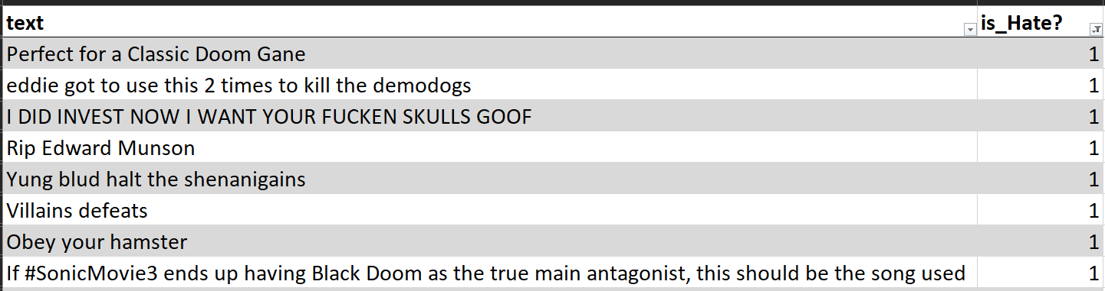
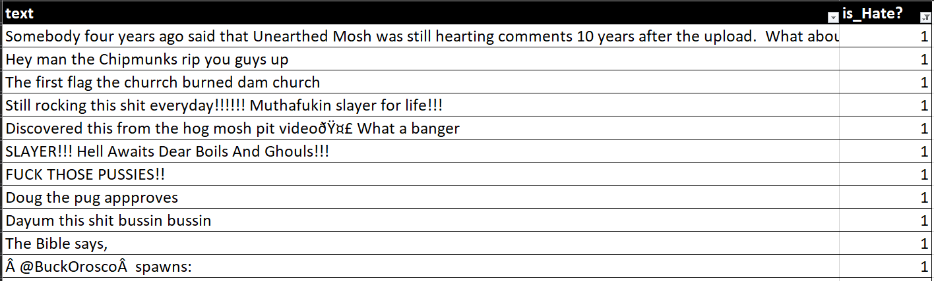
Master of Puppets
Slayer - Raining Blood

Slide 41
EXPERIMENT 5:
TRANSFORMERS: Bert uncase base transformer tokenizer architecture.
Using (HATEXPLAIN & ETHOS).
2 Epochs ~ 1 min. (GPU optimizations)

Slide 42
Music Video | English Comments | Hate Speech Comments
Black Sabbath ~ War Pigs | 29068 | 207
Hallowed Be Thy Name (2015 Remaster) | 1793 | 3
Master of Puppets (Remastered) | 10149 | 9
Pantera - Cowboys From Hell | 10724 | 30
Slayer - Raining Blood | 17852 | 61

Slide 43
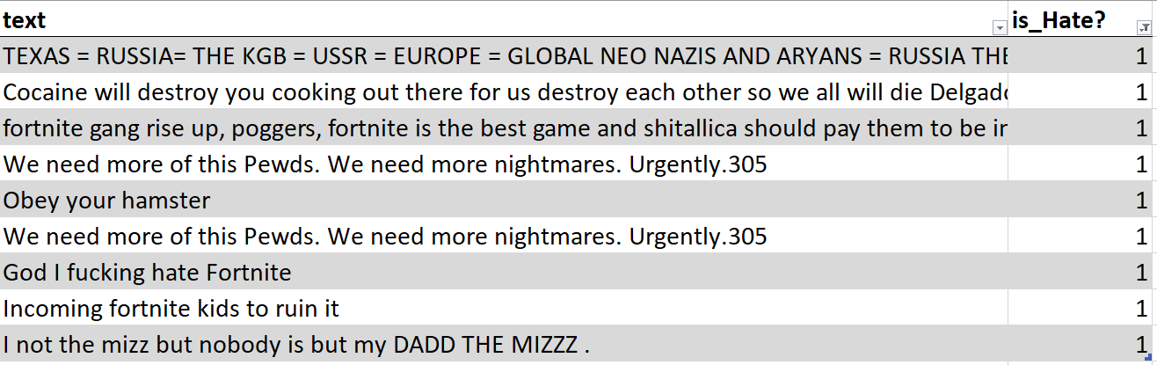
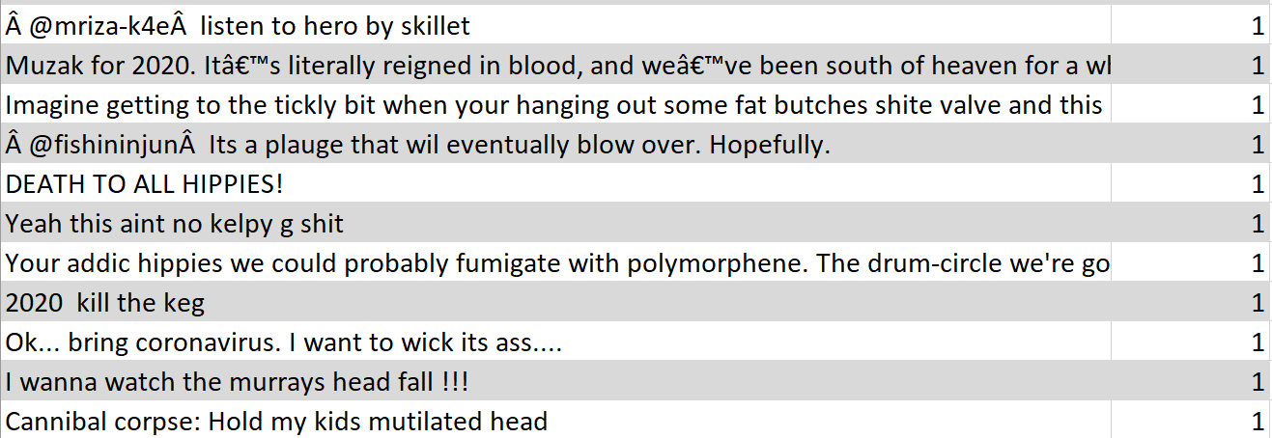
Master of Puppets
Slayer - Raining Blood

Slide 44
EXPERIMENT 6:
TRANSFORMERS: Best variant of Bert for Hate Speech detection (HateBERT, RoBERTa variant trained with toxic comments of reddit).
Without Fine Tuning.
2 Epochs ~ 1 min. (GPU optimizations)

Slide 45
Music Video | English Comments | Hate Speech Comments
Black Sabbath ~ War Pigs | 29068 | 3388
Hallowed Be Thy Name (2015 Remaster) | 1793 | 265
Master of Puppets (Remastered) | 10149 | 1664
Pantera - Cowboys From Hell | 10724 | 1686
Slayer - Raining Blood | 17852 | 2424

Slide 46
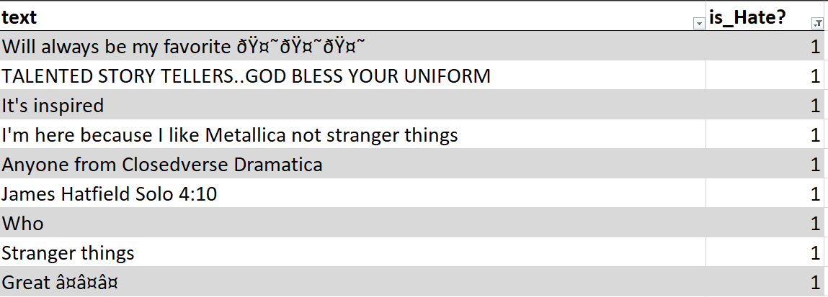
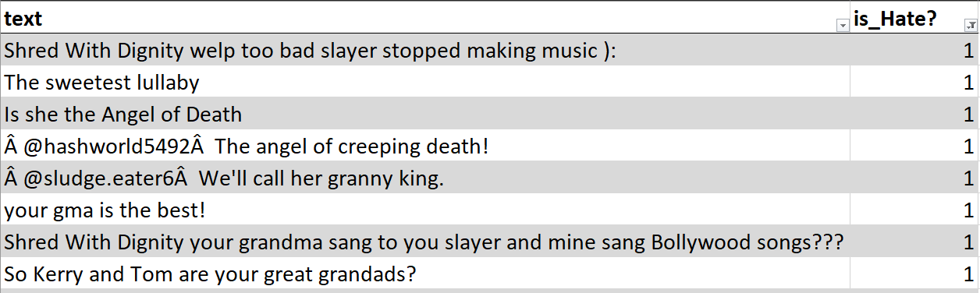
Master of Puppets
Slayer - Raining Blood

Slide 47
EXPERIMENT 7:
TRANSFORMERS: Best variant of Bert for Hate Speech detection (HateBERT).
Fine tuning using (HATEXPLAIN, ETHOS).
2 Epochs ~ 10 min. (GPU optimizations)

Slide 48
Music Video | English Comments | Hate Speech Comments
Black Sabbath ~ War Pigs | 29068 | 209
Hallowed Be Thy Name (2015 Remaster) | 1793 | 1
Master of Puppets (Remastered) | 10149 | 3
Pantera - Cowboys From Hell | 10724 | 31
Slayer - Raining Blood | 17852 | 70

Slide 49
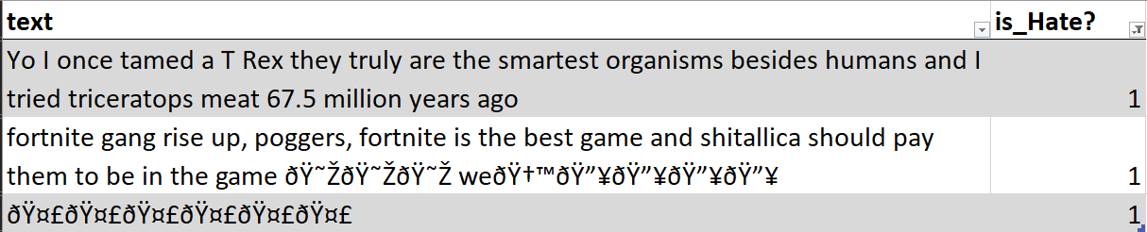
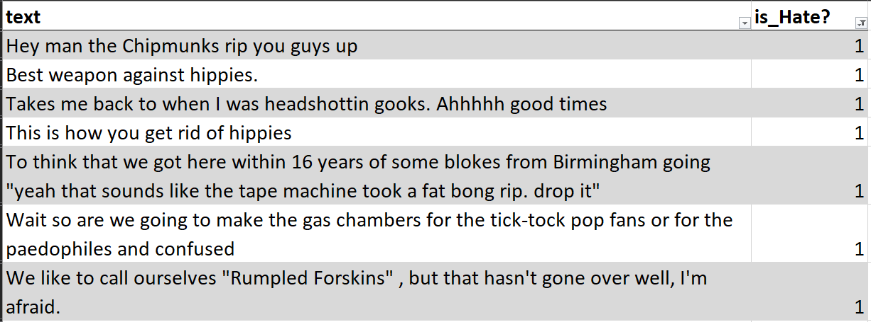
Master of Puppets
Slayer - Raining Blood

Slide 50
EXPERIMENT 8:
TRANSFORMERS: Best variant of Bert for Hate Speech detection (HateBERT).
Fine tuning using (HATEXPLAIN, ETHOS).
10 Epochs ~ 10 min. (GPU optimizations)

Slide 51
Music Video | English Comments | Hate Speech Comments
Black Sabbath ~ War Pigs | 29068 | 229
Hallowed Be Thy Name (2015 Remaster) | 1793 | 3
Master of Puppets (Remastered) | 10149 | 7
Pantera - Cowboys From Hell | 10724 | 39
Slayer - Raining Blood | 17852 | 111

Slide 52
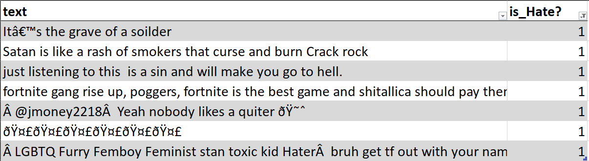
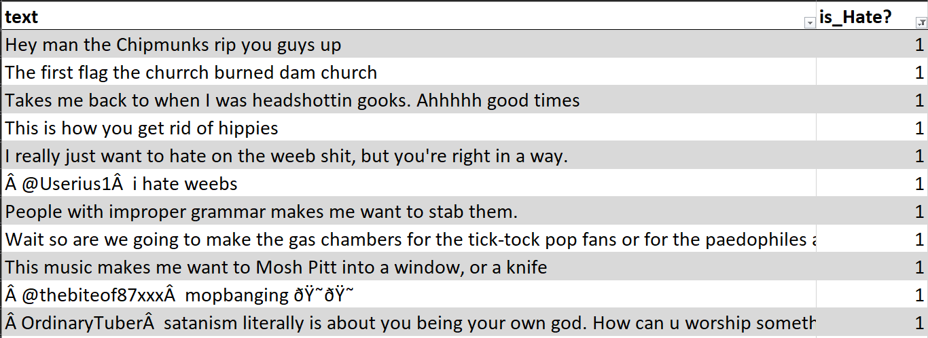
Master of Puppets
Slayer - Raining Blood

Slide 53
NOTES:
The transformers results are only considering the training datasets (HATEXPLAIN & ETHOS).
To consider the comments of the metal music youtube videos it’s necessary to expand the quantity of languages considered (translate each of the tagged comment with hate speech inside the training datasets).
Only consider one music gender due to the difference in the magnitude order of the quantity of comments.

Slide 54
NOTES:
Using more transformer tokenizer models (e.g. variations of Bert) [for the transformers based architecture].
Use of heavy LLM’s to artificially tag the youtube comments making use of Agentic AI?

Slide 55
Datasets References:
YT-30M: A multi-lingual multi-category dataset of YouTube comments: https://arxiv.org/pdf/2412.03465
ETHOS Hate Speech Dataset: https://github.com/intelligence-csd-auth-gr/Ethos-Hate-Speech-Dataset
Hate Speech Classifier for Social Media Content in English Language:
https://huggingface.co/IMSyPP/hate_speech_en
HateXplain: https://github.com/hate-alert/HateXplain

Slide 56
References :
Misogynistic attitude detection in YouTube comments and replies: A high-quality dataset and algorithmic models: https://www.sciencedirect.com/science/article/pii/S0885230824000652
DweshVaani: An LLM for Detecting Religious Hate Speech in Code-Mixed Hindi-English: https://aclanthology.org/2025.chipsal-1.5.pdf
Detection of homophobia and transphobia in YouTube comments:
https://link.springer.com/article/10.1007/s41060-023-00400-0/figures/1

