Slide 1
Optimizing Radical Evolution: TOPAS Simulations for High-Intensity Polarized Targets
TOPAS Monte Carlo Simulation - Geant4
Samuel Takwirira, Karl Slifer, PhD – UNH Nuclear Physis Group

Slide 2
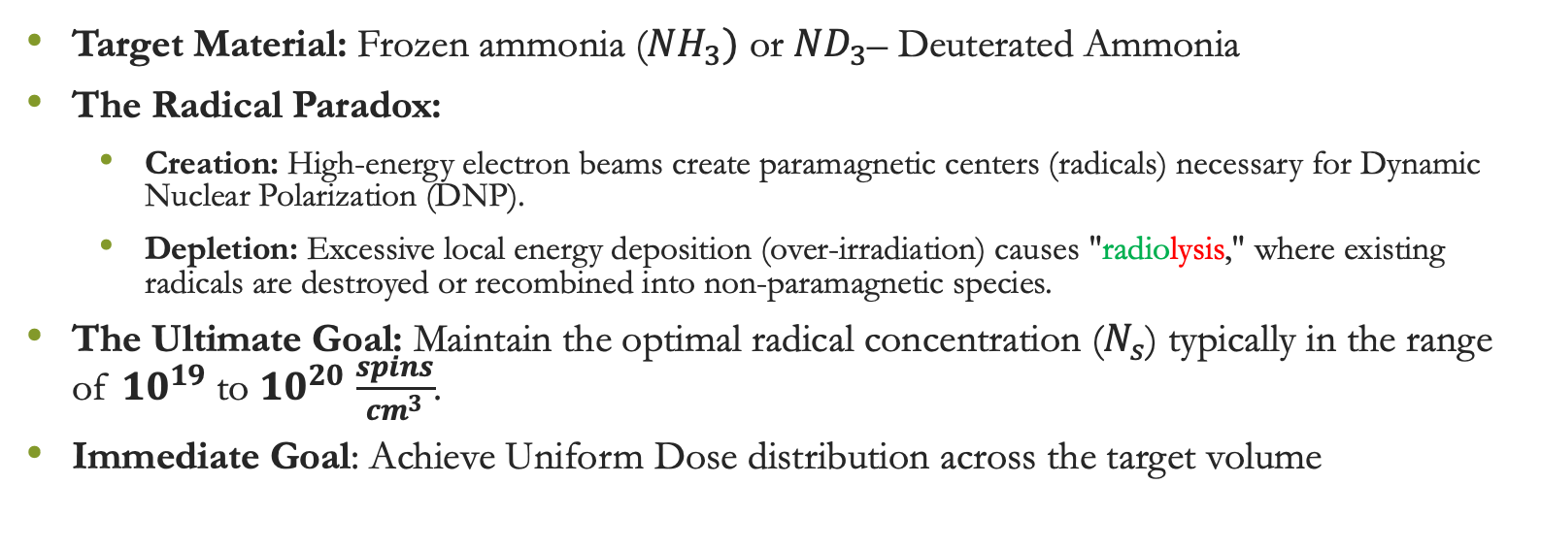
The Physics of Radiolytic Depletion
Target Material: Frozen ammonia (${NH}_{3})$ or ${ND}_{3}\text{–}$ Deuterated Ammonia
The Radical Paradox:
  Creation: High-energy electron beams create paramagnetic centers (radicals) necessary for Dynamic Nuclear Polarization (DNP).
  Depletion: Excessive local energy deposition (over-irradiation) causes "radiolysis," where existing radicals are destroyed or recombined into non-paramagnetic species.
The Ultimate Goal: Maintain the optimal radical concentration ($N_{s}$) typically in the range of ${10}^{19}$ to ${10}^{20}$ $\frac{spins}{{cm}^{3}}$.
Immediate Goal: Achieve Uniform Dose distribution across the target volume

Slide 3
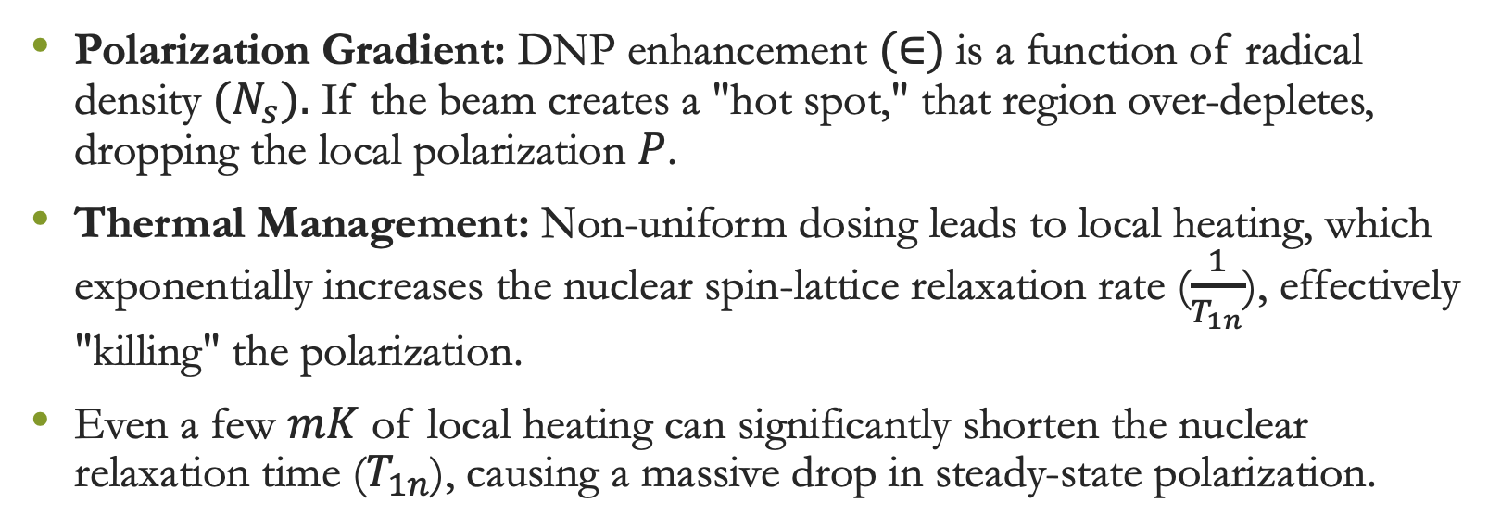
Why Uniform Dose is Critical
Polarization Gradient: DNP enhancement $(∈)$is a function of radical density ${(N}_{s}).$ If the beam creates a "hot spot," that region over-depletes, dropping the local polarization $P$.
Thermal Management: Non-uniform dosing leads to local heating, which exponentially increases the nuclear spin-lattice relaxation rate ($\frac{1}{T_{1n}}$), effectively "killing" the polarization.
Even a few $mK$ of local heating can significantly shorten the nuclear relaxation time ($T_{1n}$), causing a massive drop in steady-state polarization.

Slide 4
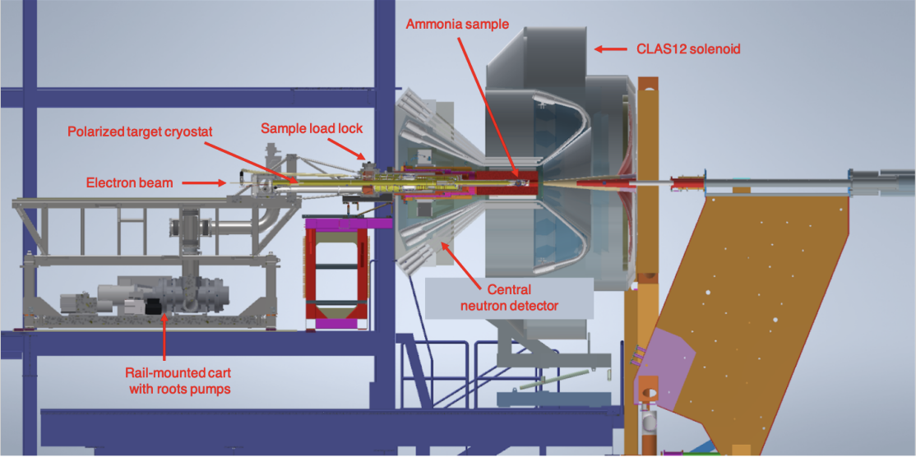
Experimental Set Up
First Use of a Longitudinally Polarized Target with CLAS12 C.D. Keith, J. Brock, C. Carlin, T. Kageya V. Lagerquist, J. Maxwell, and P. Pandey

Slide 5
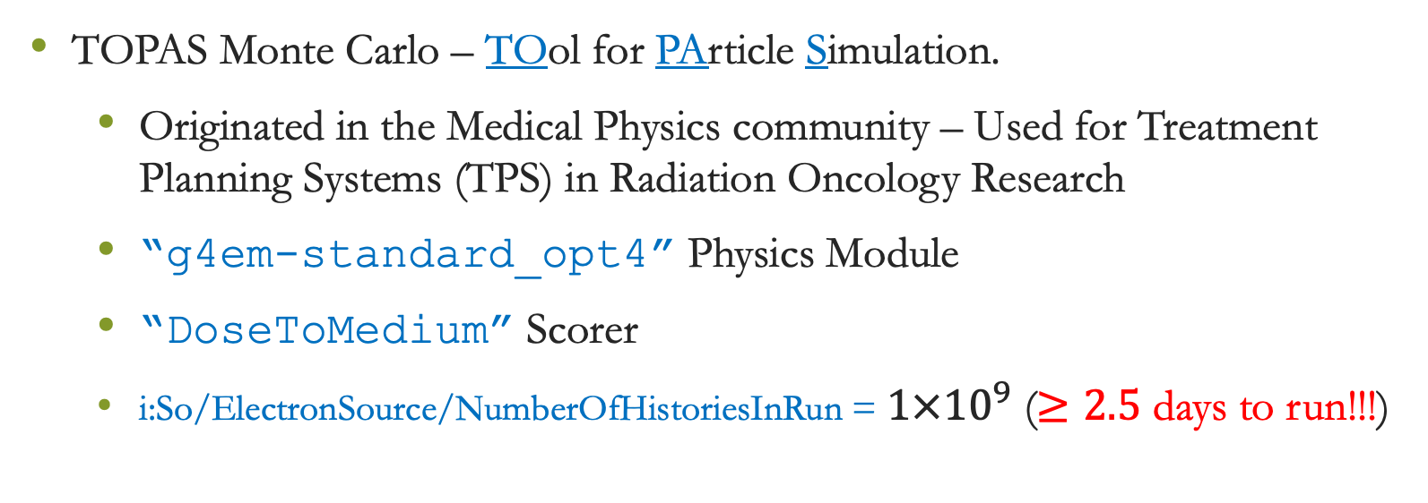
Methods & Tools
TOPAS Monte Carlo – TOol for PArticle Simulation.
  Originated in the Medical Physics community – Used for Treatment Planning Systems (TPS) in Radiation Oncology Research
  “g4em-standard_opt4” Physics Module
  “DoseToMedium” Scorer
  i:So/ElectronSource/NumberOfHistoriesInRun = ${1×10}^{9}$ ($≥2.5$ days to run!!!)

Slide 6


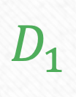
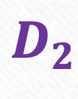
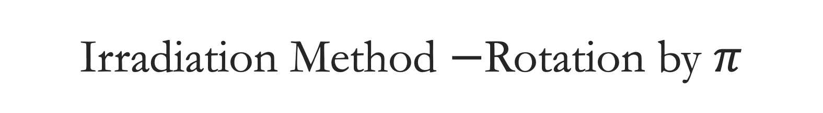
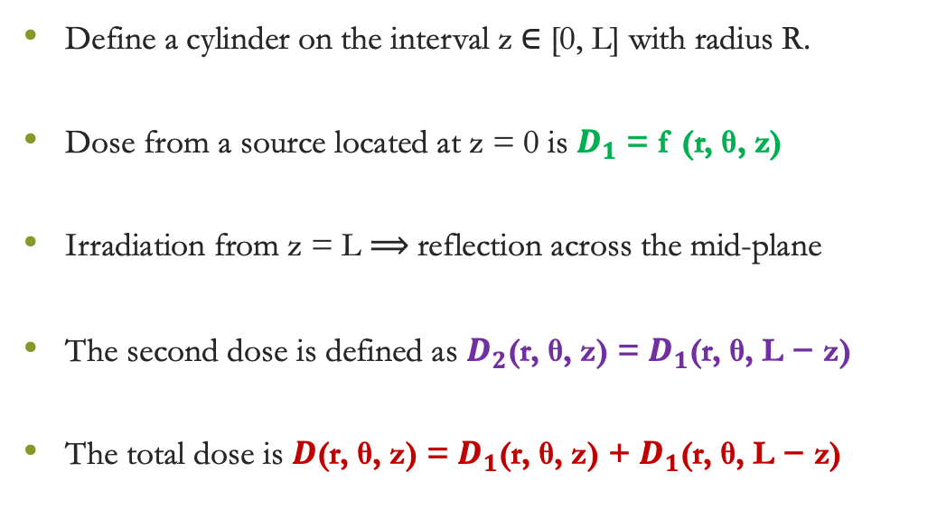
Irradiation Method $−$Rotation by $π$
Define a cylinder on the interval z ∈ [0, L] with radius R.
Dose from a source located at z = 0 is $D_{1}$ = f (r, θ, z)
Irradiation from z = L $⟹$reflection across the mid-plane
The second dose is defined as $D_{2}$(r, θ, z) = $D_{1}$(r, θ, L − z)
The total dose is $D$(r, θ, z) = $D_{1}$(r, θ, z) + $D_{1}$(r, θ, L − z)
Mirror Plane
R
z=0
z=L

Slide 7
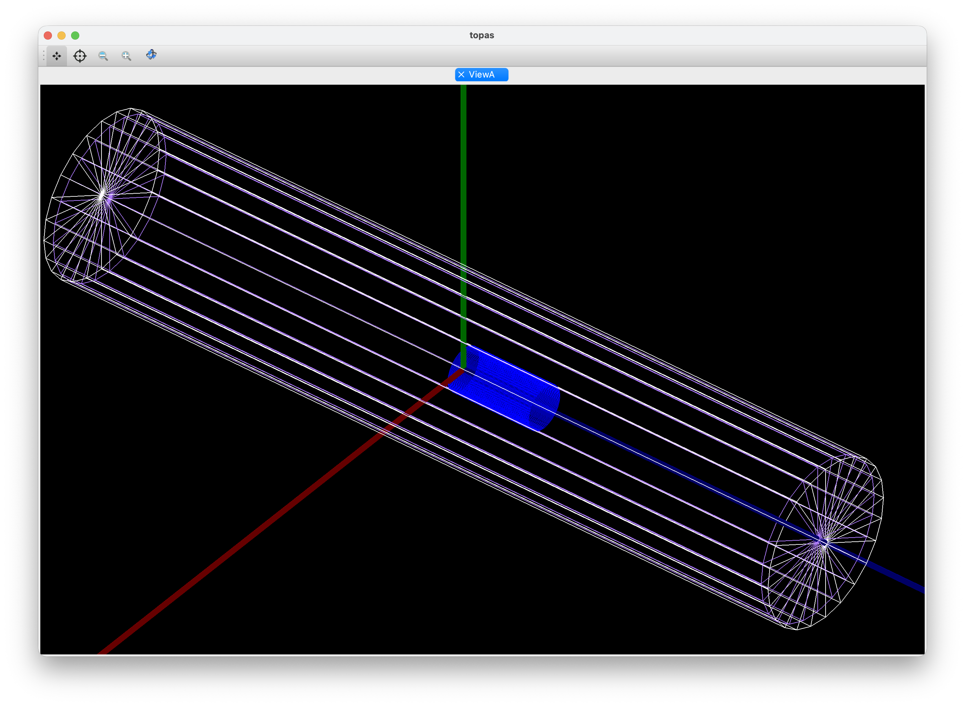
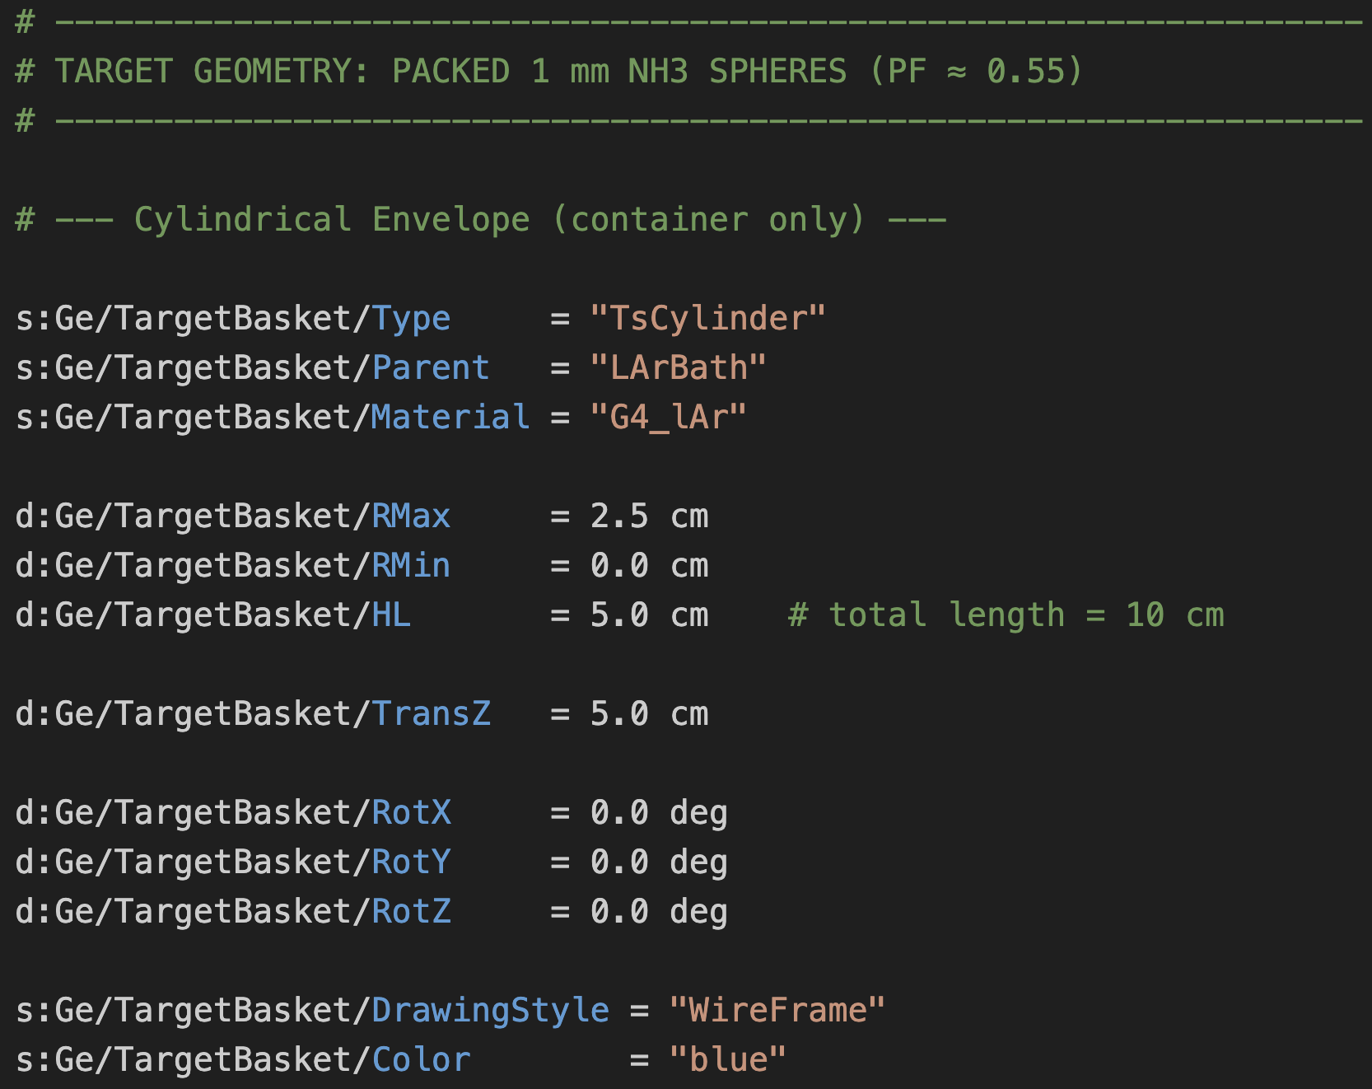
Modeling the Lab Set Up

Slide 8
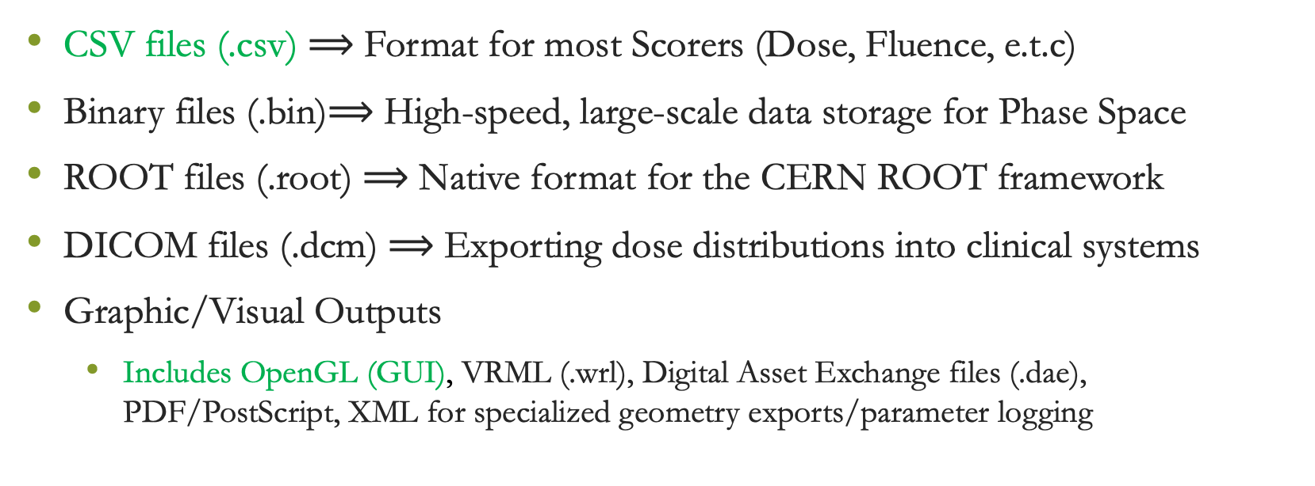
The TOPAS Outputs
CSV files (.csv) $⟹$ Format for most Scorers (Dose, Fluence, e.t.c)
Binary files (.bin)$⟹$ High-speed, large-scale data storage for Phase Space
ROOT files (.root) $⟹$ Native format for the CERN ROOT framework
DICOM files (.dcm) $⟹$ Exporting dose distributions into clinical systems
Graphic/Visual Outputs
  Includes OpenGL (GUI), VRML (.wrl), Digital Asset Exchange files (.dae), PDF/PostScript, XML for specialized geometry exports/parameter logging

Slide 9
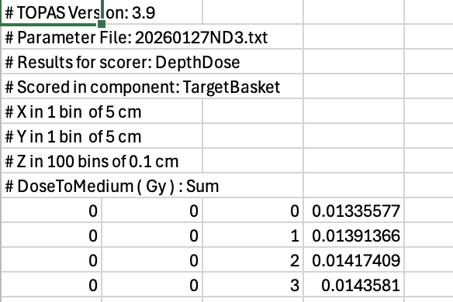
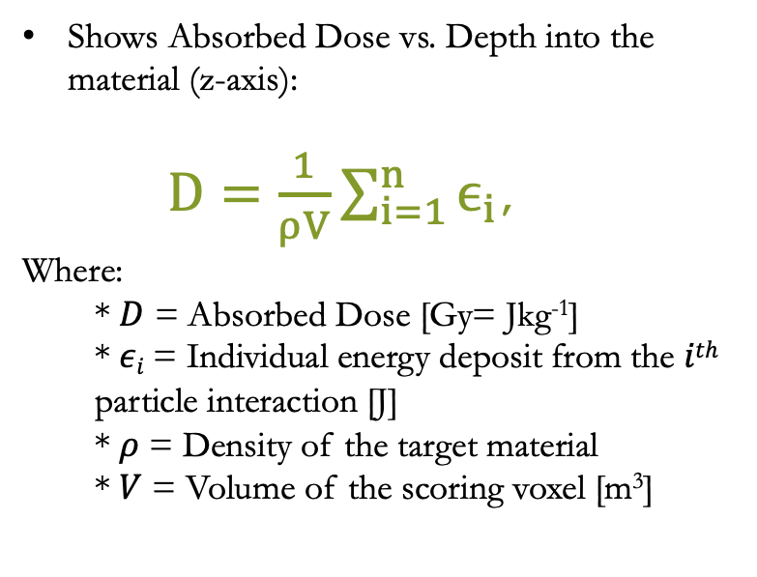
What is in the CSV File?
Shows Absorbed Dose vs. Depth into the material (z-axis):
$D=\frac{1}{ρV}\sum_{i=1}^{n}{ϵ_{i}}$,
Where:
* $D$ = Absorbed Dose [Gy= Jkg⁻¹]
  * $εi$= Individual energy deposit from the $ith$ particle interaction [J]
  * $ρ$ = Density of the target material
  * $V$ = Volume of the scoring voxel [m³]

Slide 10
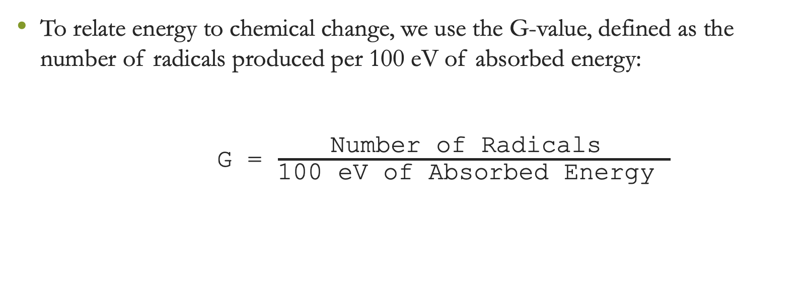
The Chemical Yield (the G-Value)
To relate energy to chemical change, we use the G-value, defined as the number of radicals produced per 100 eV of absorbed energy:
    G = $\frac{\text{Number} \text{of} \text{Radicals} }{\text{100 }\text{eV} \text{of} \text{Absorbed} \text{Energy} }$

Slide 11
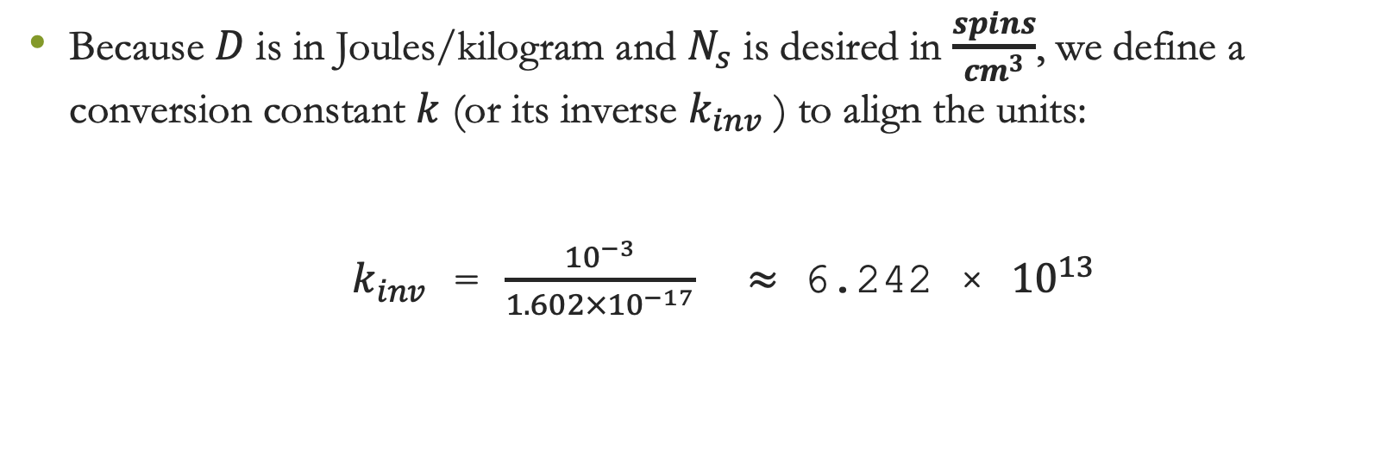
The Unit Conversion Constant (k)
Because $D$ is in Joules/kilogram and $N_{s}$ is desired in $\frac{spins}{{cm}^{3}}$, we define a conversion constant $k$ (or its inverse $k_{inv}$ ) to align the units:
$k_{inv}$ = $\frac{{10}^{−3}}{1.602×{10}^{−17}}$ $≈$ 6.242 × ${10}^{13}$

Slide 12
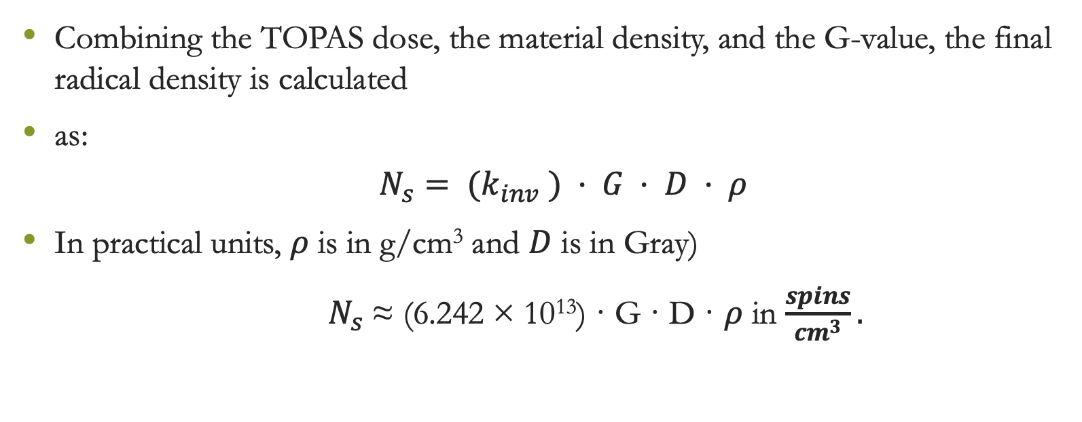

Final Radical Density ($N_{s}$)
Combining the TOPAS dose, the material density, and the G-value, the final radical density is calculated
as:
              $$N_{s}= (k_{inv} ) · G · D · ρ$$
In practical units, $ρ$ is in g/cm³ and $D$ is in Gray)
$N_{s}$≈ (6.242 × 10¹³) · G · D · $ρ$ in $\frac{spins}{{cm}^{3}}.$

Slide 13
Definitions and Acronyms
DICOM: Digital Imaging and Communications in Medicine
DNP: Dynamic Nuclear Polarization
TOPAS: Tool for Particle Simulation (Monte Carlo – Geant 4)

Slide 14
Sources Cited
Framework: Perl J, et al. TOPAS: An innovative proton therapy simulation framework. Med Phys. 2012;39(11):6818-35.
Radical Physics: Crabb DG, Meyer W. Solid Polarized Targets for Nuclear and Particle Physics. Annu. Rev. Nucl. Part. Sci. 1997. 47:67-109.
Radiolysis Modeling: Ramos-Méndez J, et al. TOPAS-nBio: An extension to the TOPAS simulation toolkit for cellular and sub-cellular radiobiology. Phys Med Biol. 2019.
Target Kinetics: London GW, et al. Radiation damage in polarized target materials. NIM A. 1994.

Slide 15
806 Research Requirements
Poster presentation (3/13—2:10-3PM) based on what you know and remember from what you have learned.
Maker Space to print the poster by Friday morning at the latest –somewhere in Kingsbury – Mention it is for a class so that I don’t have to pay.
GRC Presentations – register by 3/16 – 4/13 (Oral) and 4/15 (Poster)
End of April/Early May – Last Day of Class
Proposal – Written: Due at the end of finals (Pages Max)

