Slide 1

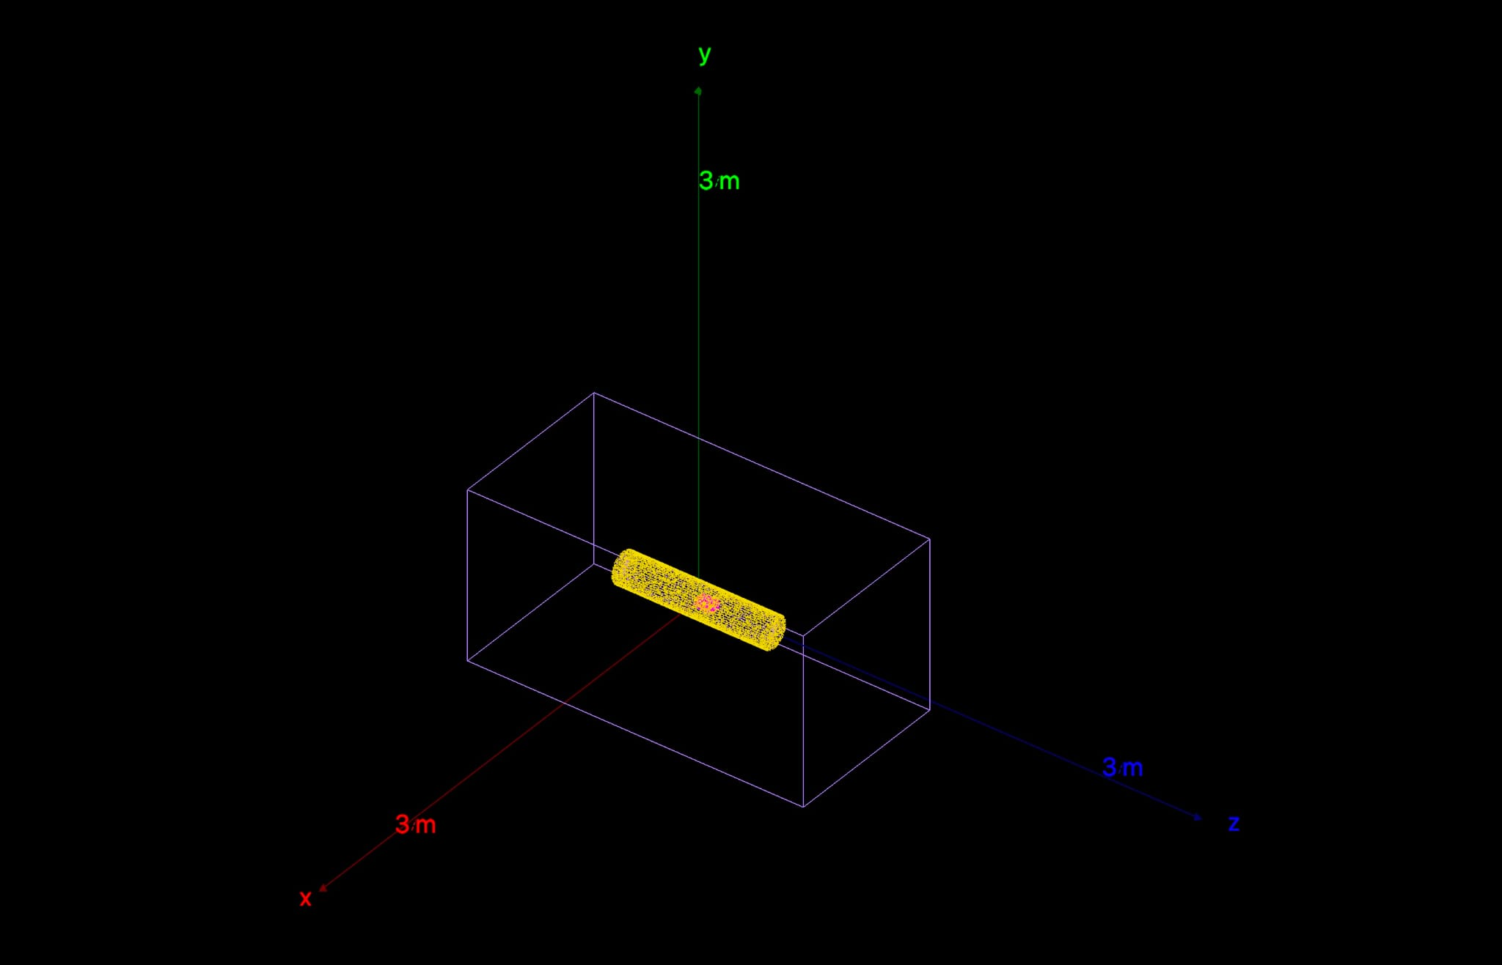
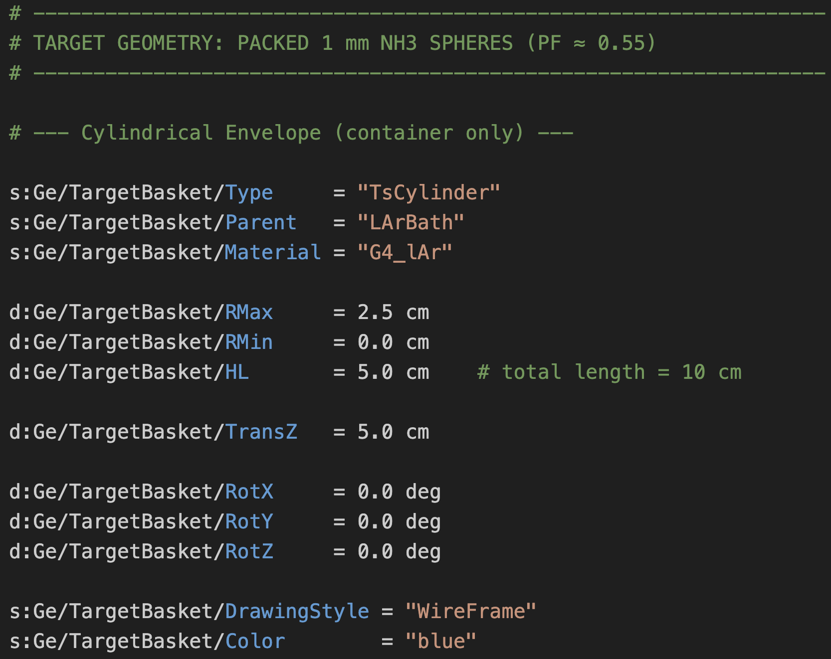
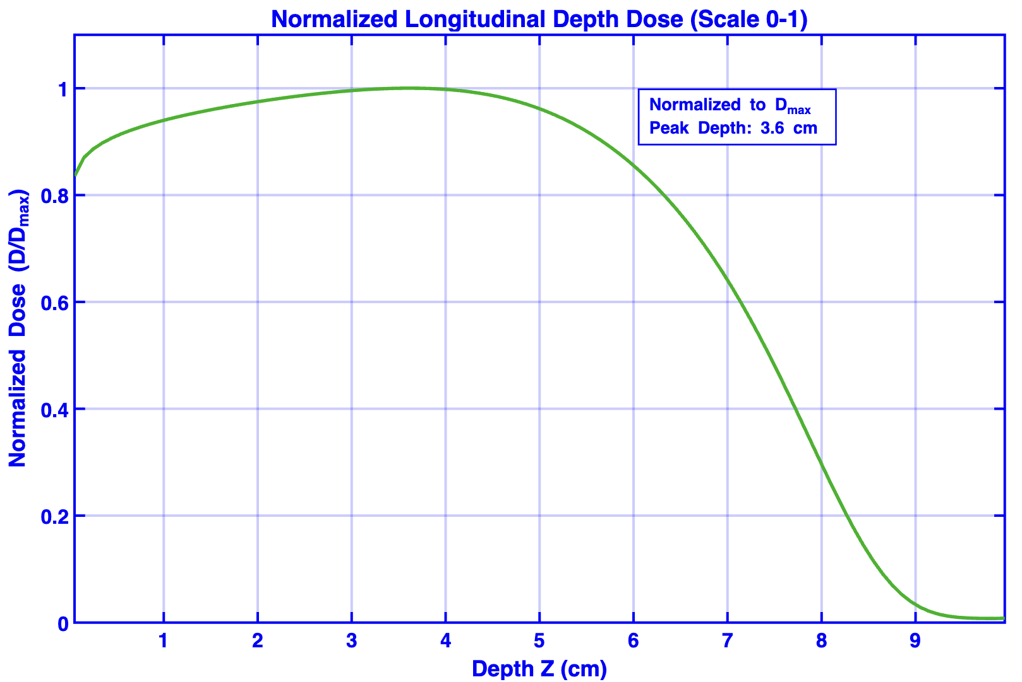
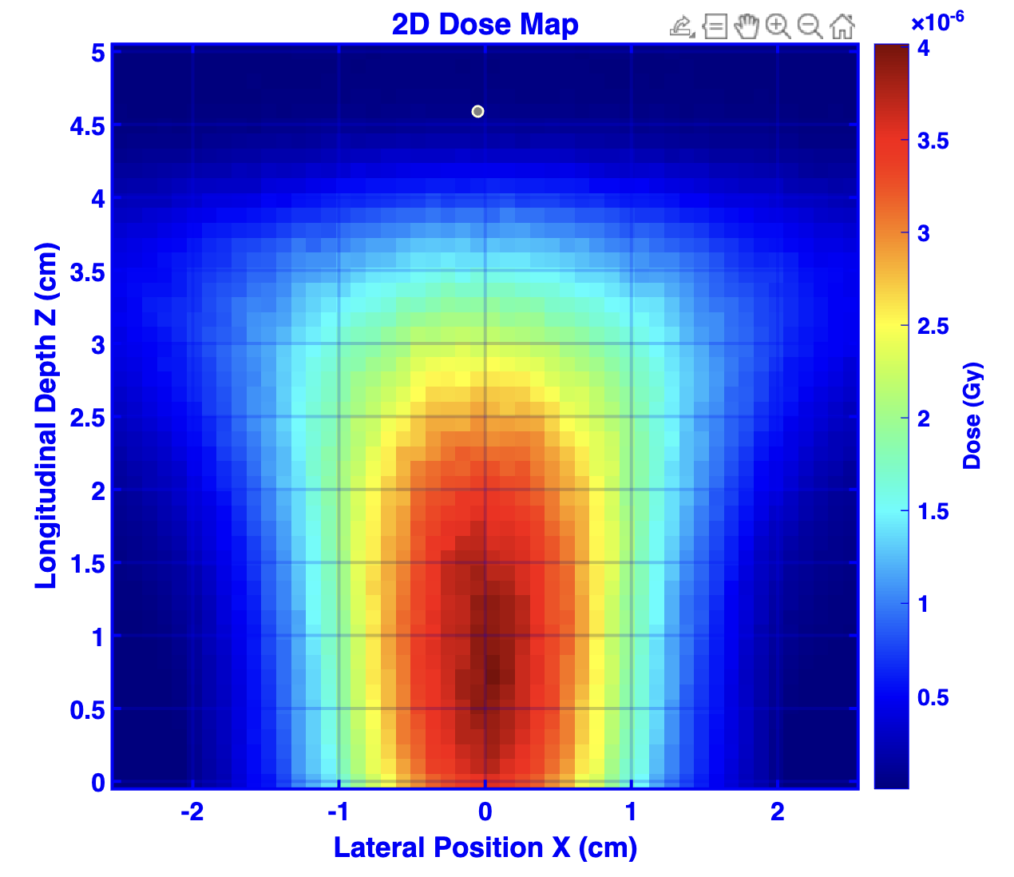
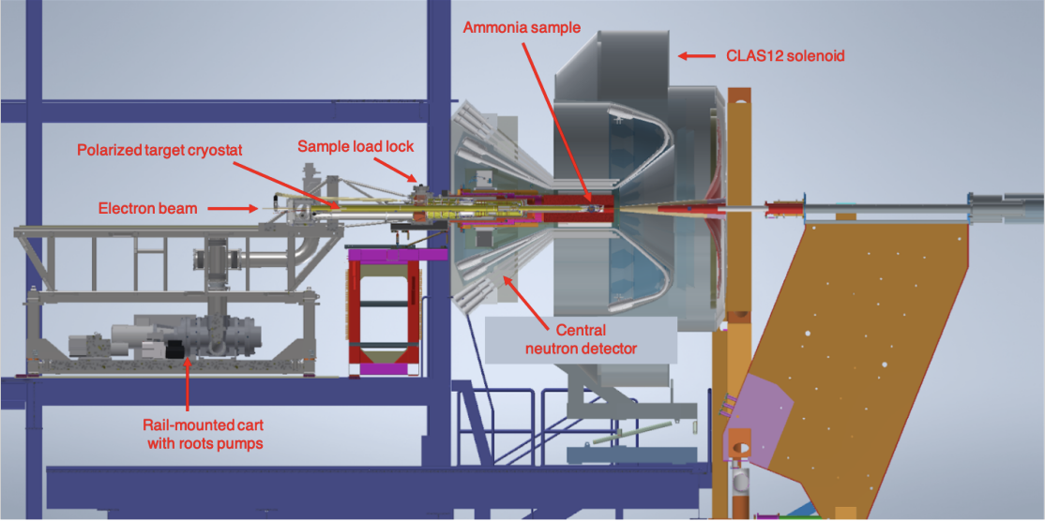
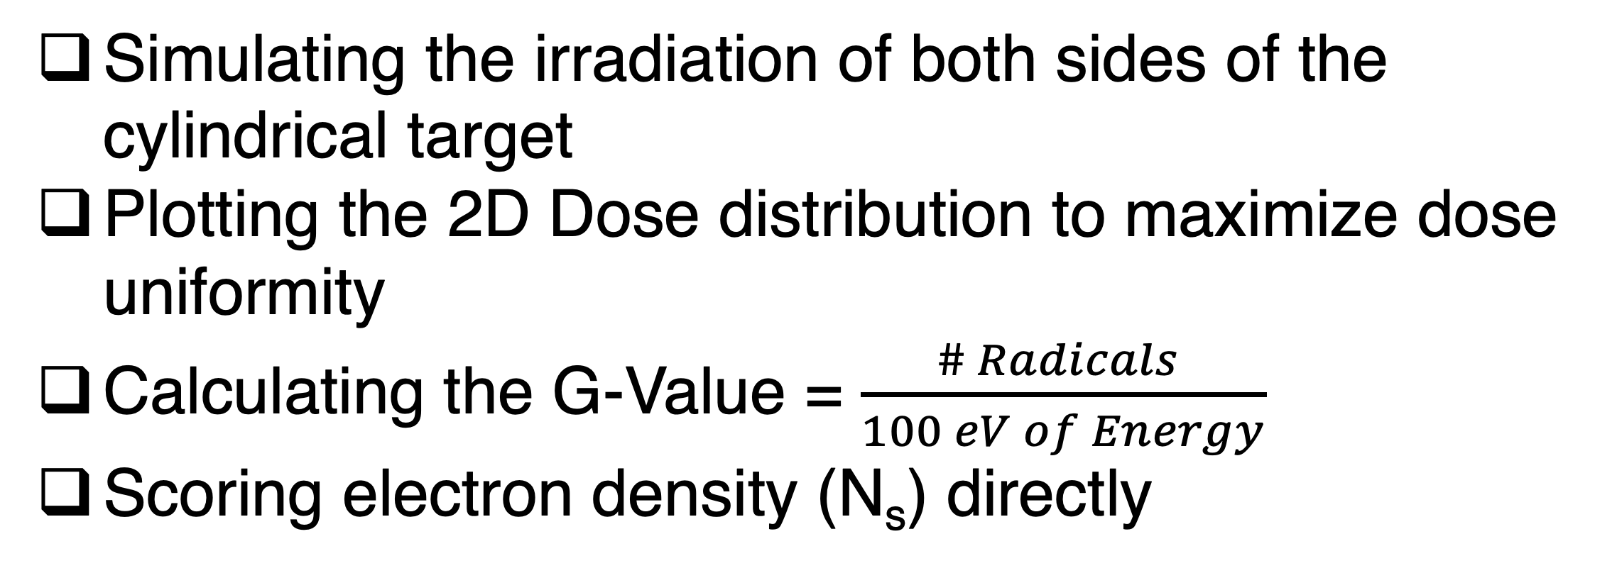
Optimizing Radical Evolution for Polarized Targets in DNP
TOPAS Geant4 – Monte Carlo Simulation
Samuel Takwirira, Mentor: Dr. Karl Slifer
Nuclear Physics Group
Introduction
Figures
Discussion
Context: Dynamic Nuclear Polarization (DNP) is a critical technique used to significantly enhance the sensitivity of Magnetic Resonance signals
Problem: While radicals are essential for polarization, the expensive process (thousands) used to create them can also inadvertently destroy them
Aim: We aim to identify depletion factors and eliminate thermal instability to ensure a stable environment for optimized DNP enhancement
Factors that affect dose uniformity:
Target Geometry (Symmetry, Target length)
Energy Level
Material Purity/Homogeneity (100% pure in silico)
Irradiation Time?
Methods
Fig. 1.01 ––Recreating the Lab Space
Future Work
Monte Carlo Simulation (TOPAS)– To optimize radical production for DNP, we utilized TOPAS (Tool for Particle Simulation), a Geant4-based Monte Carlo platform. The simulation was configured via parameter files using the g4em-standard_opt4 physics module to provide high-precision tracking of electron trajectories, energy loss, and interactions within the defined World volume.
Data Analysis & Visualization– The simulation outputted absorbed dose in CSV format. Data was processed in MATLAB to evaluate dose distribution.
Depth-Dose Curves– Plotted to determine energy deposition vs. material depth.
2D Mapping– Generated using MATLAB’s imagesc function to visualize spatial dose uniformity across the target material.
Simulating the irradiation of both sides of the cylindrical target
Plotting the 2D Dose distribution to maximize dose uniformity
Calculating the G-Value = $\frac{\# Radicals }{100 eV of Energy}$
Scoring electron density (N_{s}) directly
Fig. 1.02 –– Simulation Results
References
Framework: Perl J, et al. TOPAS: An innovative proton therapy simulation framework. Med Phys. 2012;39(11):6818-35.
Radical Physics: Crabb DG, Meyer W. Solid Polarized Targets for Nuclear and Particle Physics. Annu. Rev. Nucl. Part. Sci. 1997. 47:67-109.
Radiolysis Modeling: Ramos-Méndez J, et al. TOPAS-nBio: An extension to the TOPAS simulation toolkit for cellular and sub-cellular radiobiology. Phys Med Biol. 2019.
Target Kinetics: London GW, et al. Radiation damage in polarized target materials. NIM A. 1994.
Contacts
.
      Samuel.Takwirira@unh.edu, Karl.Slifer@unh.edu
Fig. 1.03 – Details on target set up.

