Slide 1

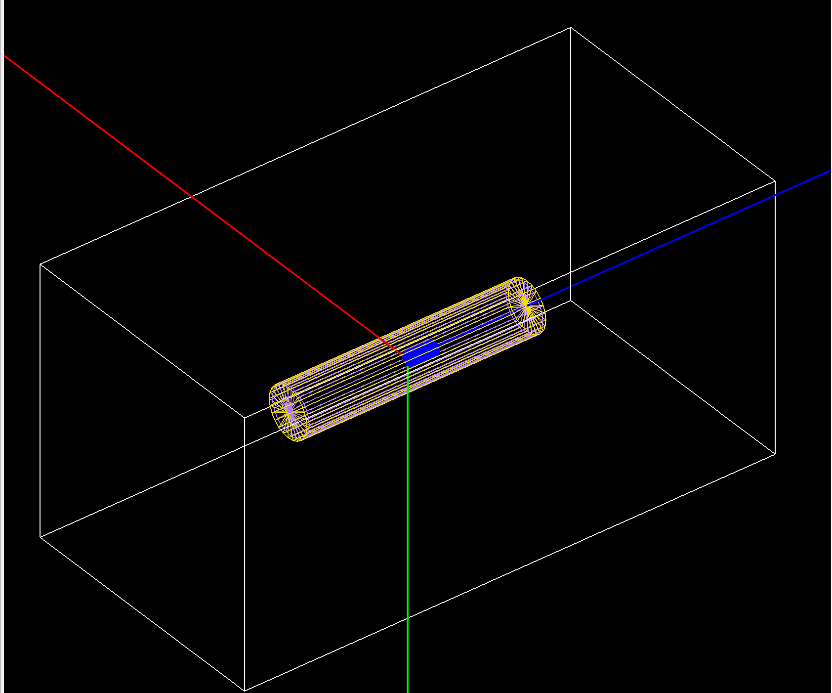
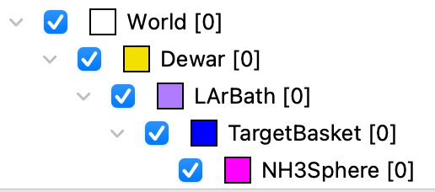
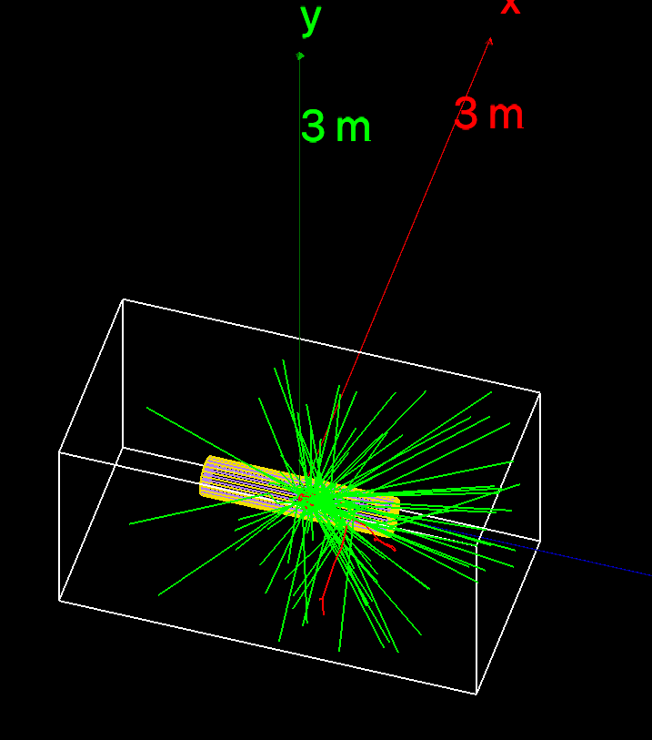
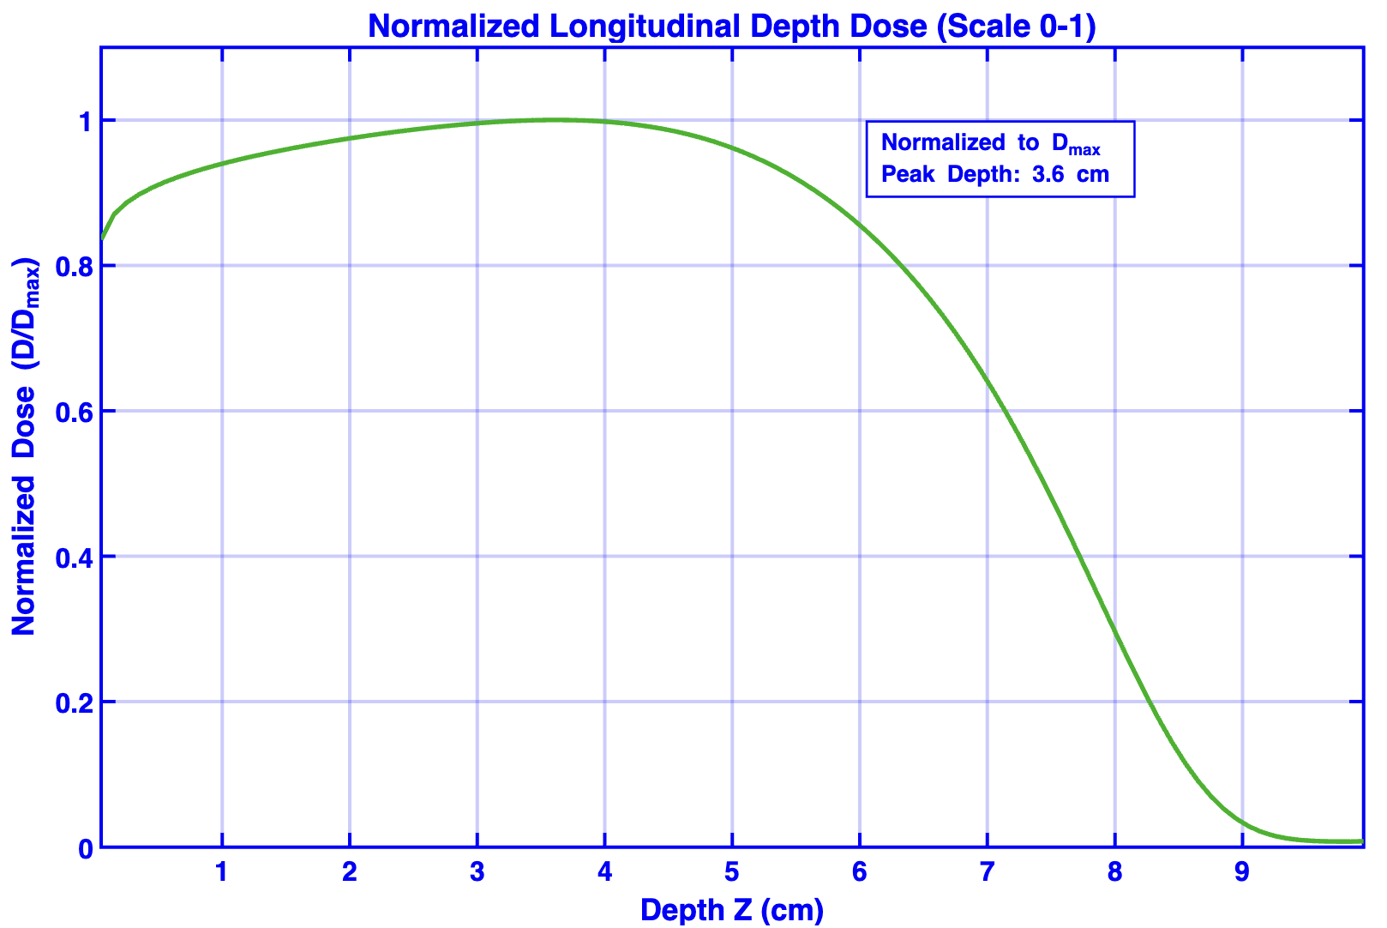
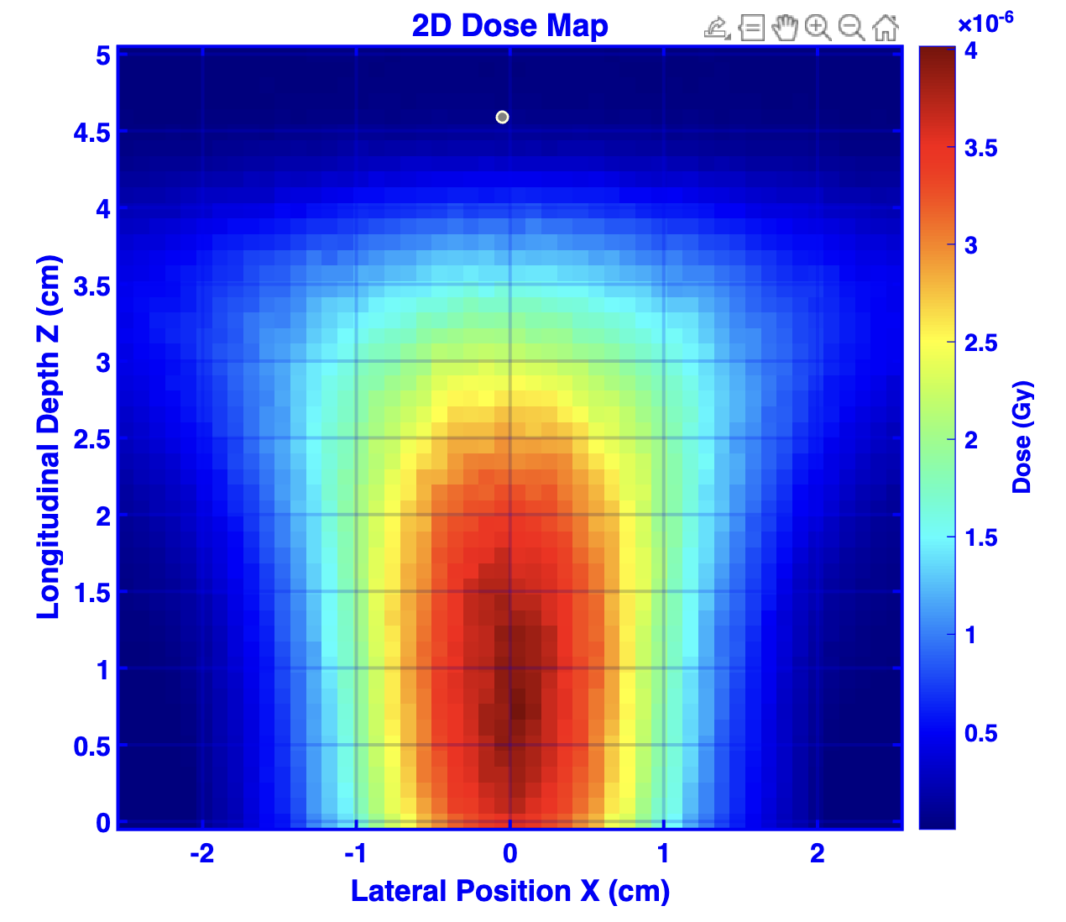
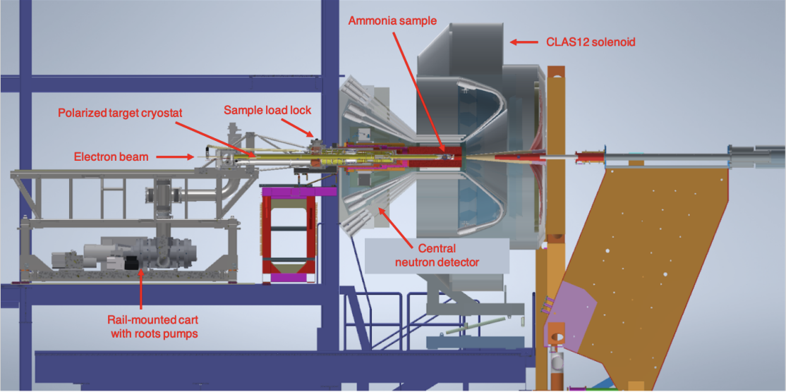

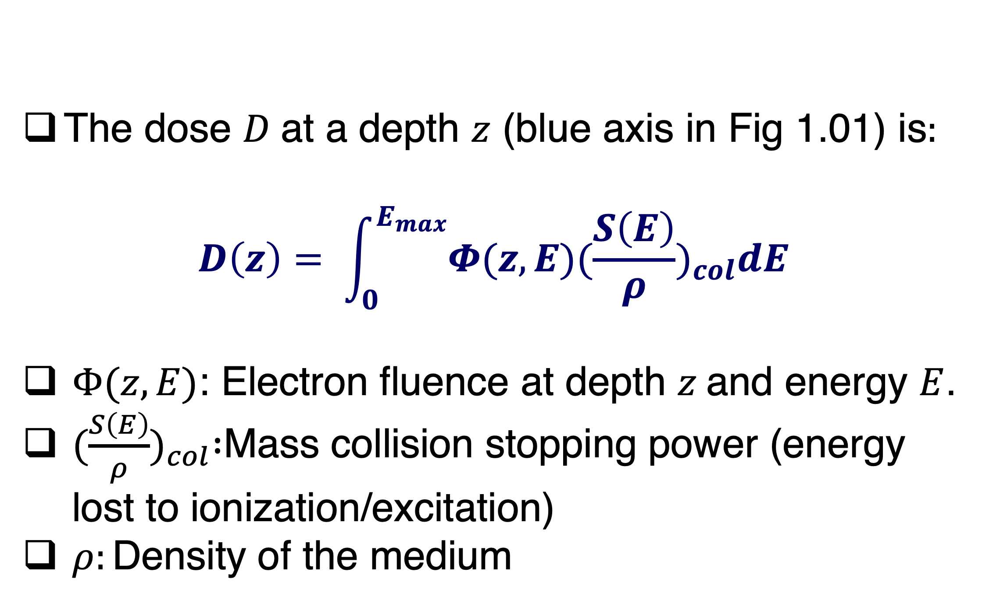
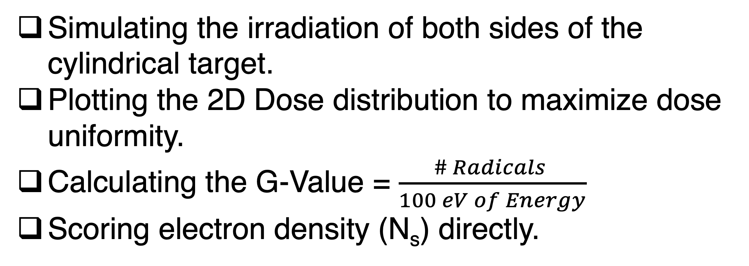
Optimizing Radical Evolution for Polarized ${NH}_{3}$ Targets
TOPAS Geant4 – Monte Carlo Simulation
Samuel Takwirira, Mentored by Dr. Karl Slifer
Nuclear Physics Group
Introduction
Figures
Discussion
Context: Dynamic Nuclear Polarization (DNP) is a critical technique used to significantly enhance the sensitivity of Magnetic Resonance signals.
Problem: While radicals are essential for polarization, the process used to create them can also inadvertently destroy them [1], [3].
Aim: We aim to ensure a stable dose distribution for optimized DNP enhancement.
The dose $D$at a depth $z$ (blue axis in Fig 1.01) is$:$
$$D\left(z\right)= \int_{0}^{E_{max}}{Φ(z,E}){(\frac{S\left(E\right)}{ρ})}_{col}dE$$
$Φ(z,E)$: Electron fluence at depth $z$and energy $E$.
${(\frac{S\left(E\right)}{ρ})}_{col} :$Mass collision stopping power (energy lost to ionization/excitation)
$ρ:\text{Density} \text{of} \text{the} \text{medium}$
Scene Tree
Methods
Fig. 1.01 – Recreating the lab space
Future Work
Monte Carlo Simulation (TOPAS) – To optimize radical production for DNP, we use TOPAS (Tool for Particle Simulation), a Geant4-based Monte Carlo platform [2].
The simulation is configured via parameter files using the g4em-standard_opt4 physics module to provide high-precision tracking of electron trajectories, energy loss, and interactions within the defined World volume.
Data Analysis & Visualization – The simulation outputs absorbed dose in CSV format. Data is processed in MATLAB to evaluate dose distribution.
Depth-Dose Curves – Plotted to determine energy deposition vs. material depth.
2D Mapping – Generated using MATLAB’s imagesc function to visualize spatial dose uniformity across the target material.
Simulating the irradiation of both sides of the cylindrical target.
Plotting the 2D Dose distribution to maximize dose uniformity.
Calculating the G-Value = $\frac{\# Radicals }{100 eV of Energy}$
Scoring electron density (N_{s}) directly.
Fig. 1.02 – Simulation results
References
Radiation damage in polarized target materials, London GW, et al NIM A. 1994.
TOPAS: An innovative proton therapy simulation framework, Perl J, et al. Med Phys. 2012;39(11):6818-35.
Solid Polarized Targets for Nuclear and Particle Physics, Crabb DG, Meyer W, Annu. Rev. Nucl. Part. Sci. 1997. 47:67-109.
First Use of a Longitudinally Polarized Target with CLAS12 C.D Keith, J. Brock, C. Carlin, T. Kageya, V. Lagerguist, J. Maxwell, and P. Pandey
.
Contacts
      Samuel.Takwirira@unh.edu, Karl.Slifer@unh.edu
Fig. 1.03 – Details on target set up [4].

