Slide 1
REST-service
Alexey Biryukov
Artyom Akimov
CS&IT 341 group

Slide 2
Client-server model
REST-service
ASP.NET Web API Technology
Visualization application

Slide 3

Client-server model

Slide 4
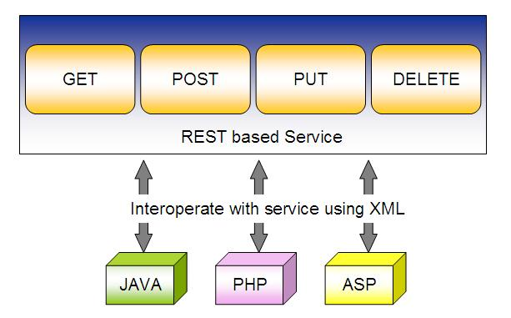
REST-service

Slide 5
ASP.Net WEB API

Slide 6
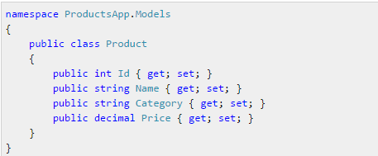
Entities

Slide 7
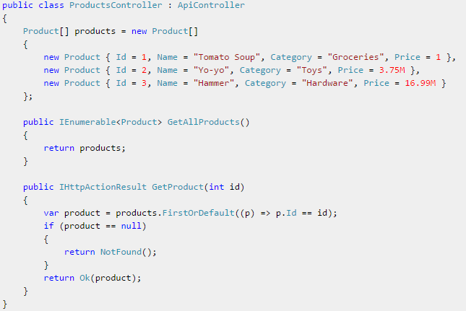
Application Controller

Slide 8
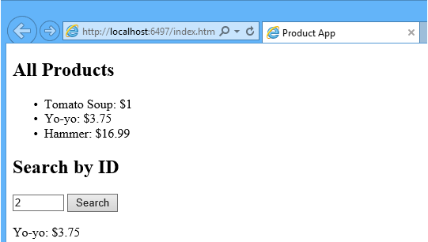
Visualization

Slide 9
Где используется

Slide 10
Thank you for your attention!

