Slide 1
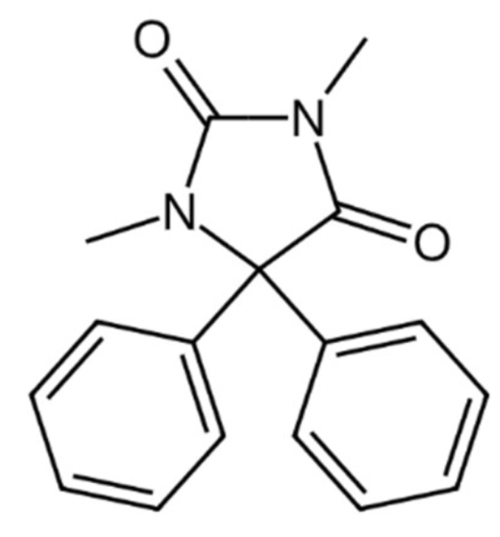
Funytoin
Transition from IV to a tablet
Denis Schatzmann

Slide 2
Research question

Slide 3
Research question
Primary objective:
What dose for tablets matches the AUC 0h-6h of 150 mg Funytoin IV in patients weighting 70 kg?

Slide 4
Research question
Secondary objectives:
What is the absolute bioavailability (F) of the oral tablet?
What is the variability between patients?
What is the impact of the covariates on the clearance and volume of distribution?

Slide 5
Data overview

Slide 6
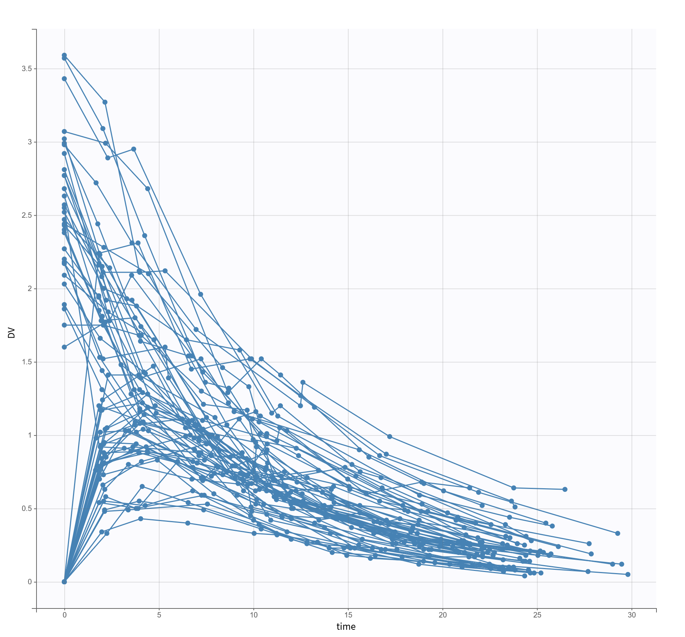
Observed data
64 Patients
9 measurements each
IV and oral route

Slide 7
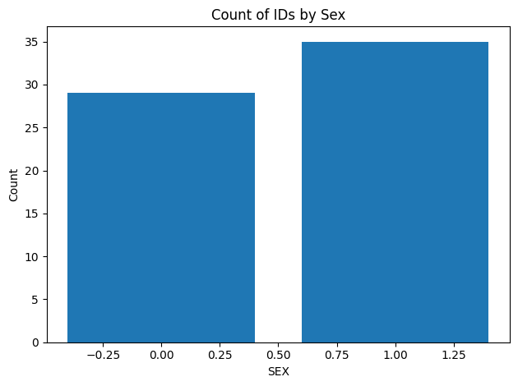
Distribution of gender

Slide 8
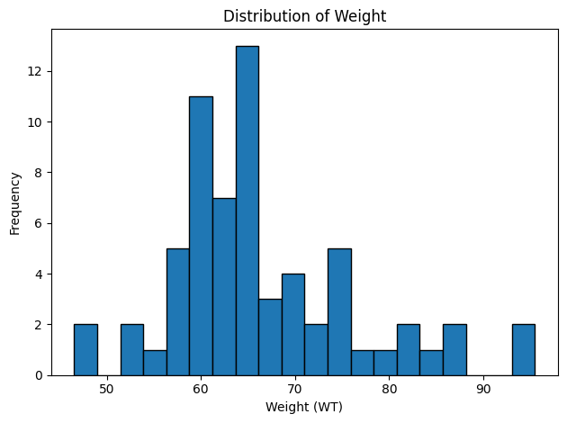
Distribution of weight

Slide 9
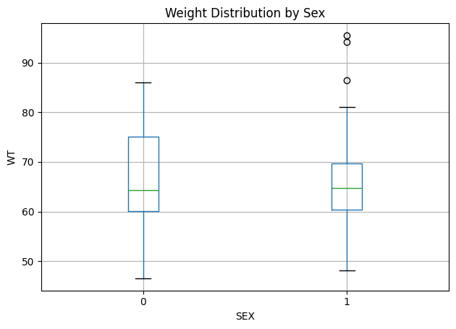
Gender vs Weight

Slide 10
Final model

Slide 11
Strucutral model
PK
One-compartment model
First order
Linear elimination
Administration IV and oral
Estimations for Cl, V, ka, F
[LONGITUDINAL]
input = {F, ka, V, Cl}
PK:
; PK model definition
compartment(cmt = 1, volume = V, concentration = Cc)
; IV Administration (Matches Data ADM=2)
iv(adm = 2, cmt = 1)
; Oral Administration (Matches Data ADM=1)
; Uses First-Order Absorption (ka) and Bioavailability (F)
oral(adm = 1, cmt = 1, ka, p = F)
elimination(cmt = 1, Cl)
OUTPUT:
output = {Cc}
Notes:
Change of Administration ID

Slide 12
Error model
Combined error model (additive + proportional)

Slide 13
Random effects model IIV
Log-normal distribution: CL, V, ka
Logit-normal distribution: F
Notes:
Inter-individual variability (IIV)

Slide 14
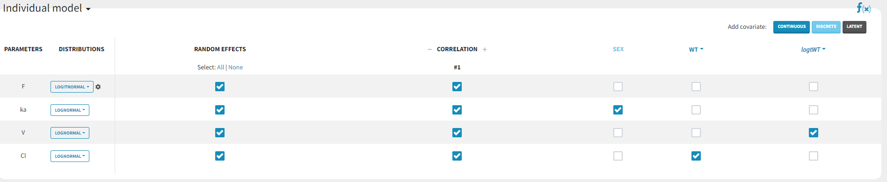
Used covariates
Bodyweight used for clearance
Log-bodyweight used for Volume of distribution
Sex used for absorbtion rate
Correlations between all PK parameters

Slide 15
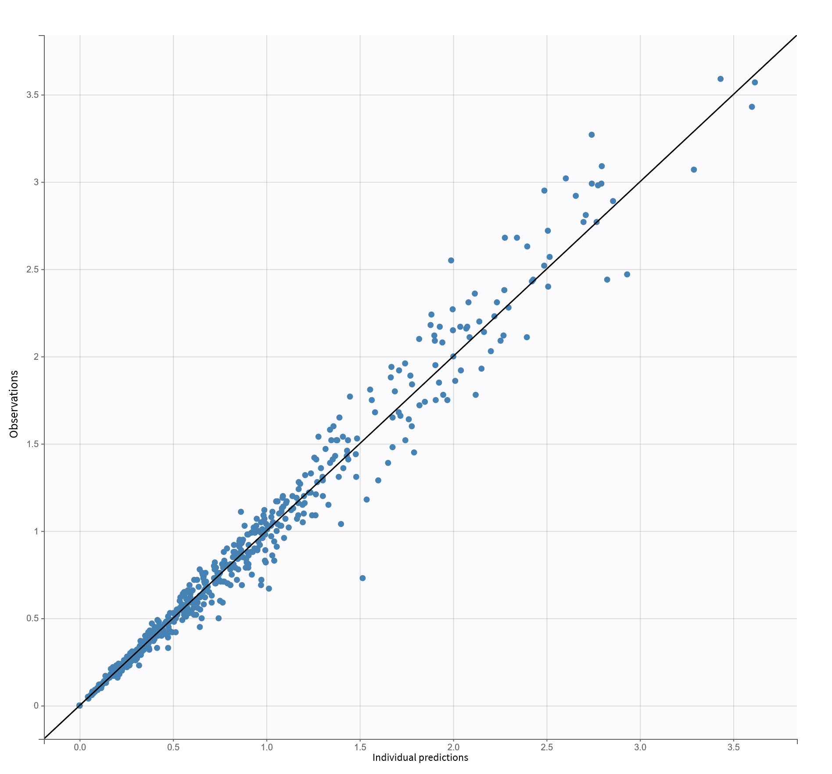
Results

Slide 16
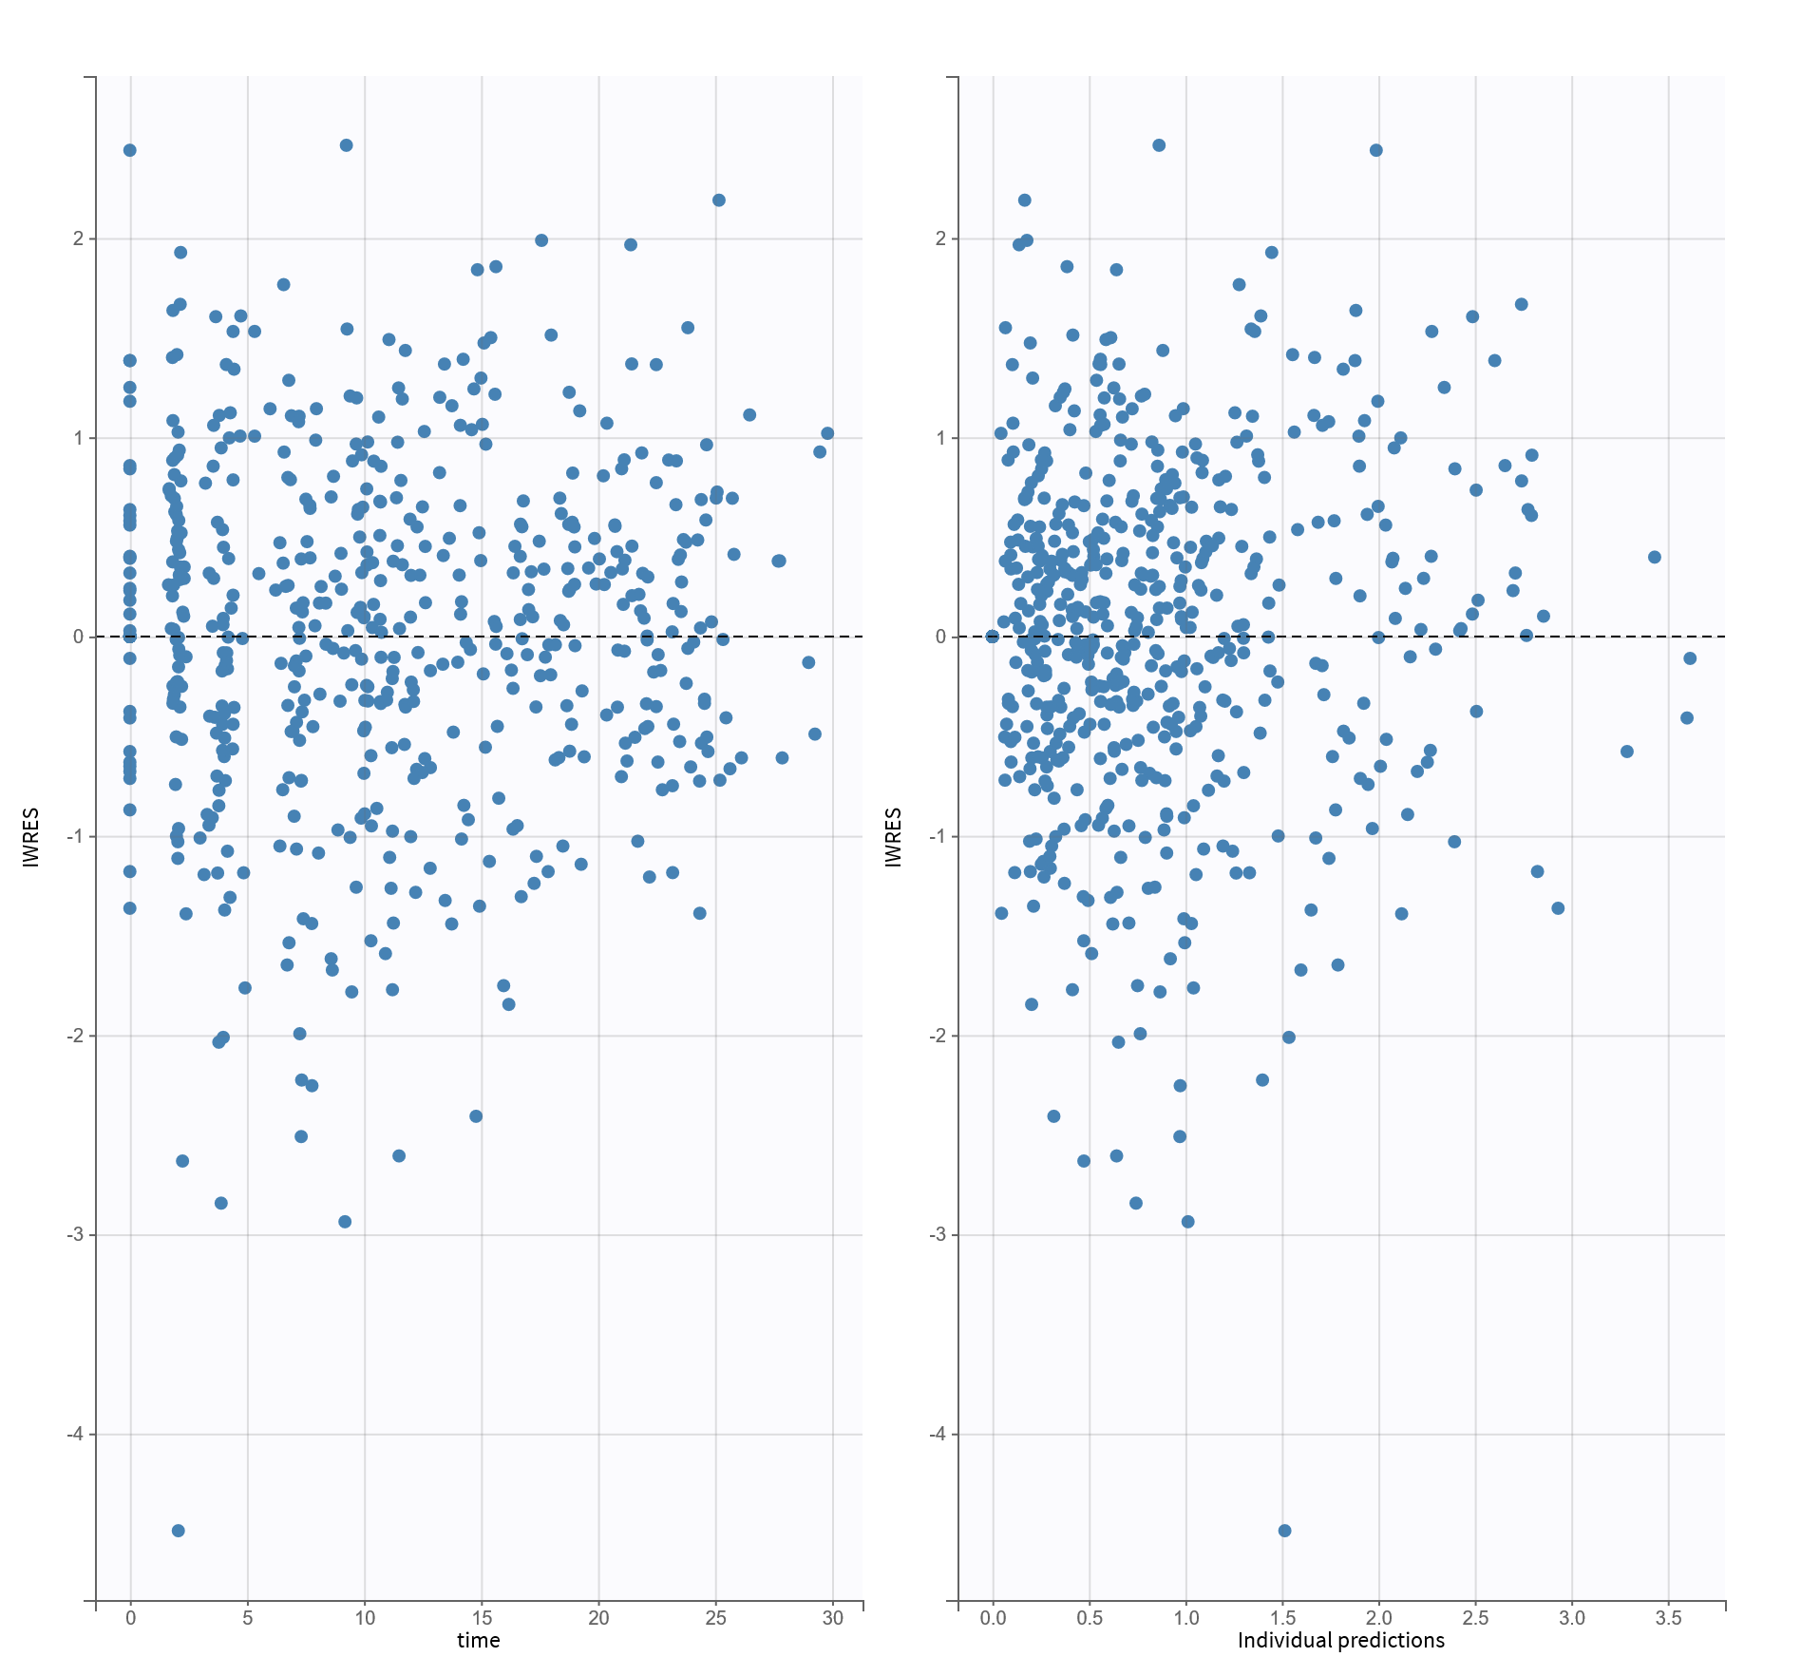
Residuals

Slide 17
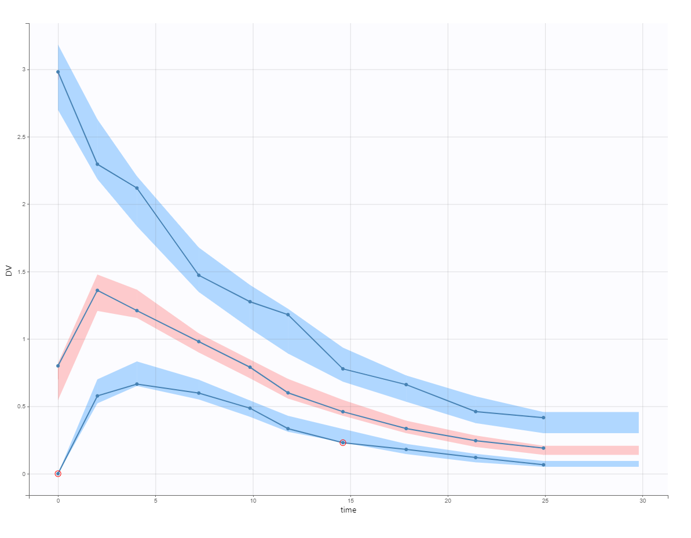
VPC

Slide 18
Estimated parameters
 |  | S.E. | R.S.E.(%)
Fixed Effects
F_pop | 0.7 | 0.06 | 8.51
ka_pop | 0.56 | 0.05 | 8.90
beta_ka_SEX_1 | -0.28 | 0.098 | 35.6
V_pop | 70.07 | 2.29 | 3.27
beta_V_logtWT | 1.16 | 0.15 | 13.3
Cl_pop | 2.24 | 0.56 | 25.1
beta_Cl_WT | 0.016 | 0.0036 | 22.4

Slide 19
Dosage calculation
Dosage oral: 150mg / Fpop = 214.3mg

Slide 20
Simulations

Slide 21
Scenario patients
Two covariates:
Weight: 70kg
Sex: 1
Simulated 1000 patients

Slide 22
Scenario treatments
Reference IV 150mg
Oral 150mg
Oral: 210mg
Oral: 250mg
Oral: 300mg

Slide 23
Scenario outputs
Grid from 0 to 6h for AUC with 0.1 stepsize
Grid from 0 to 6h for concentration with 0.1 stepsize
Grid from 0 to 30h for AUC with 1 stepsize
Grid from 0 to 30h for concentration with 1 stepsize

Slide 24
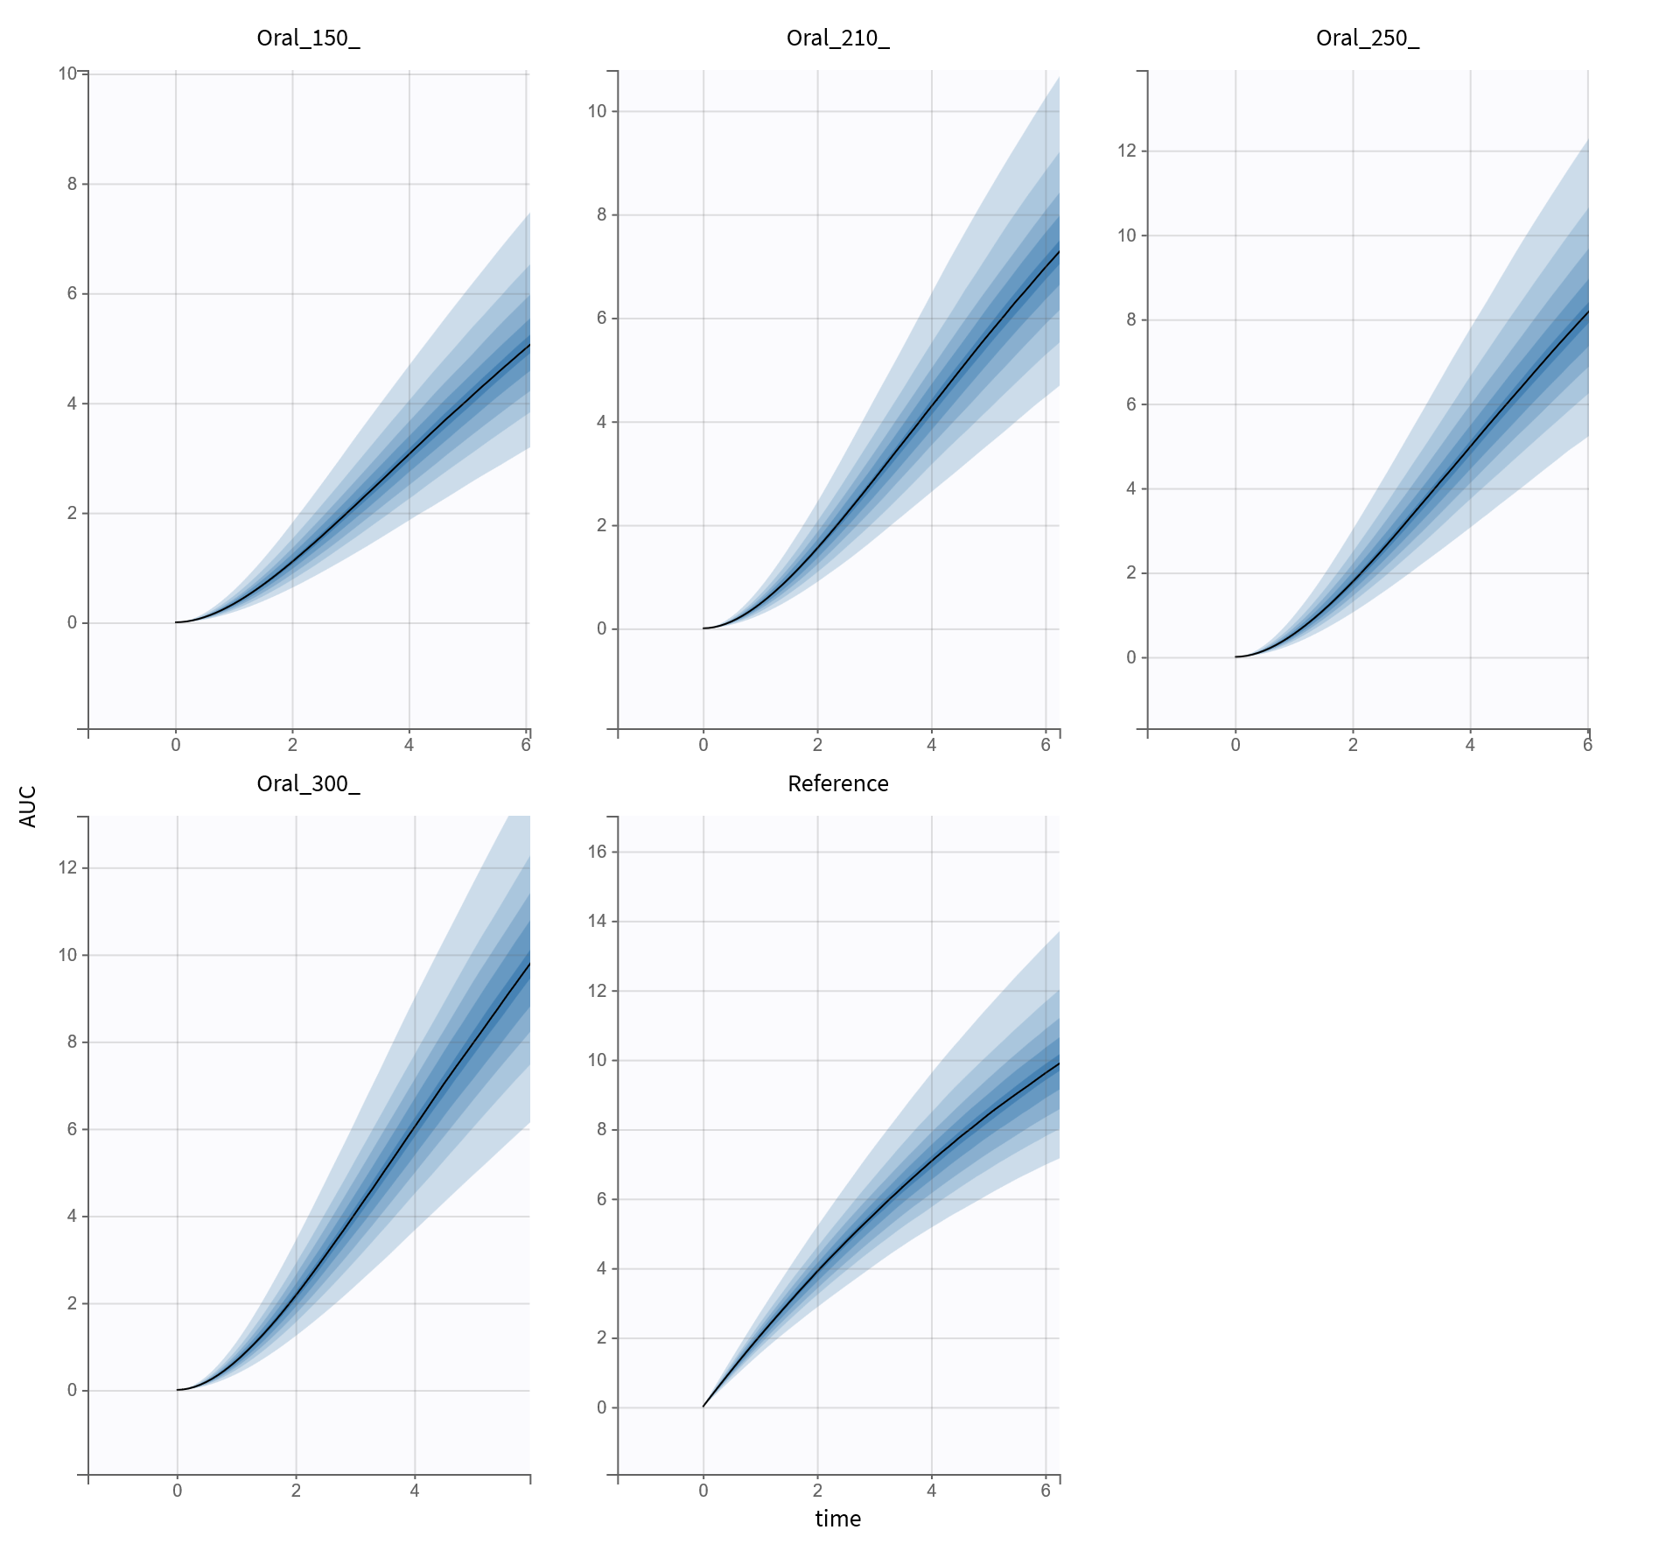
AUC0-6h Median
IV Ref | Oral 150 | Oral 210 | Oral 250 | Oral 300
9.61 | 4.98 | 6.97 | 8.14 | 9.87

Slide 25
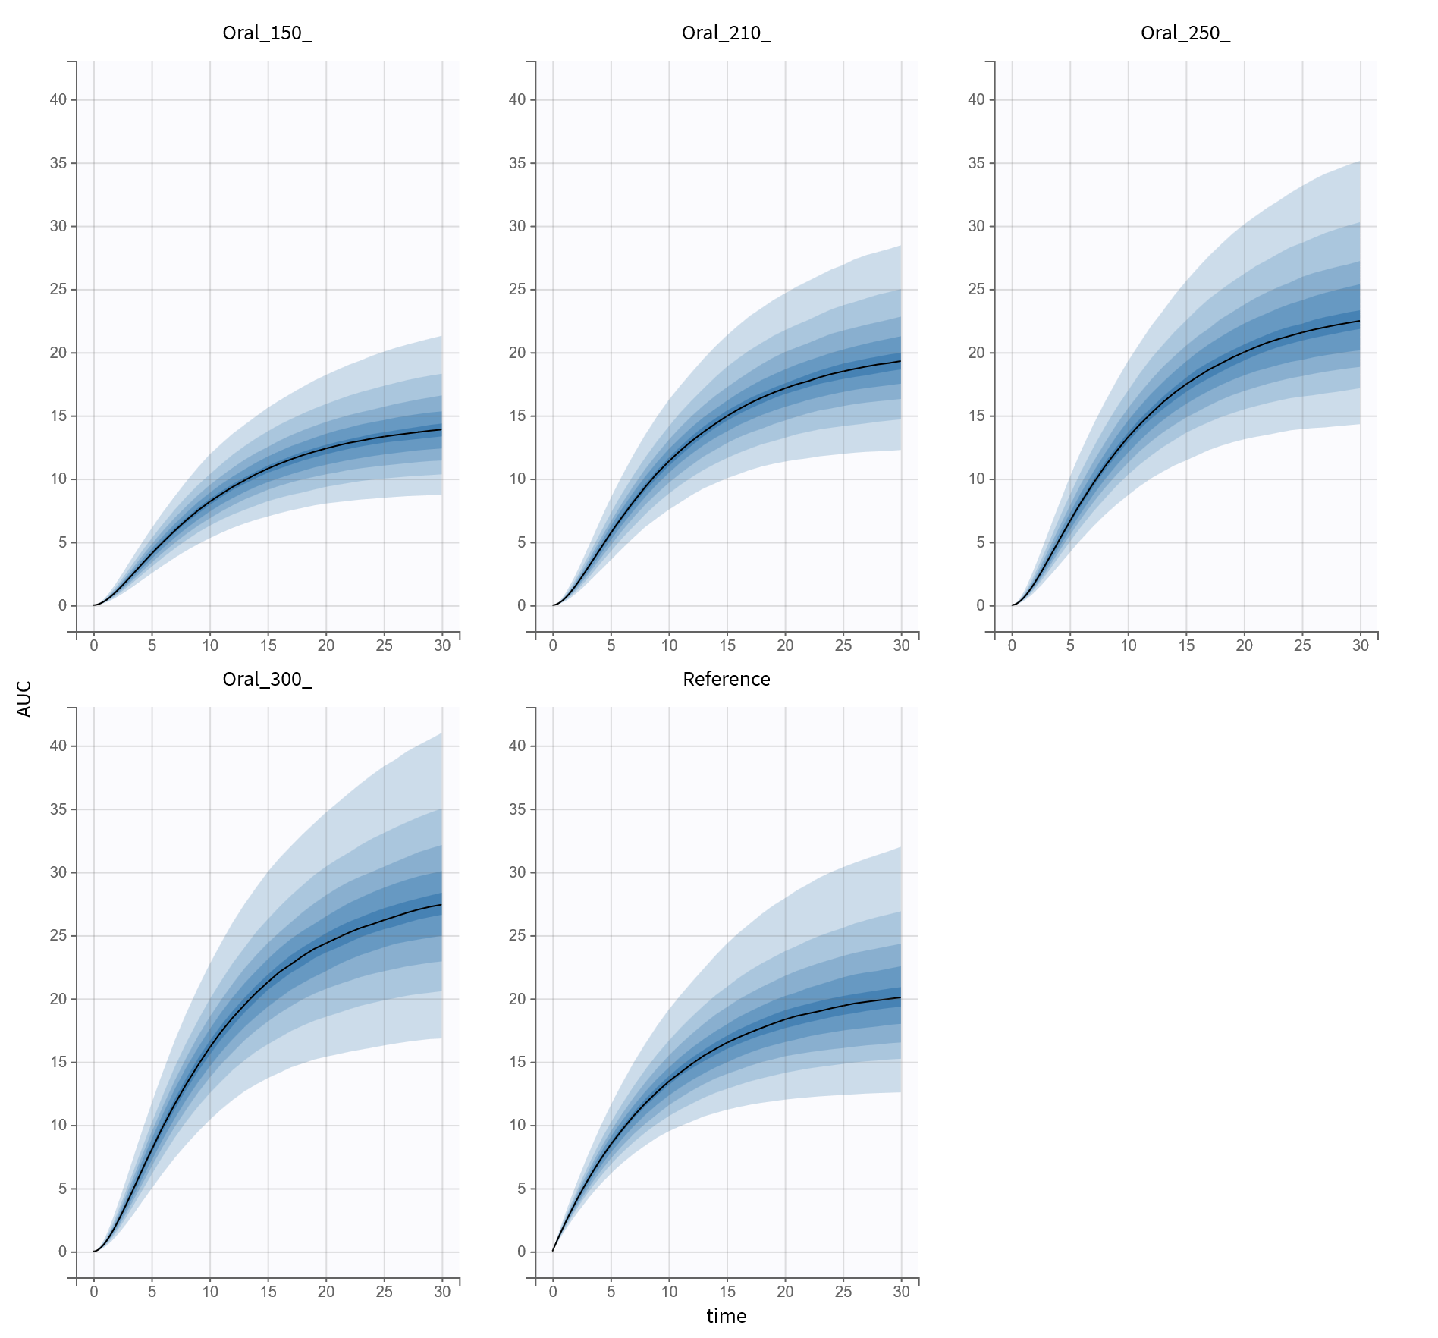
AUC0-30h Median
IV Ref | Oral 150 | Oral 210 | Oral 250 | Oral 300
20.08 | 13.88 | 19.3 | 22.48 | 27.42

Slide 26
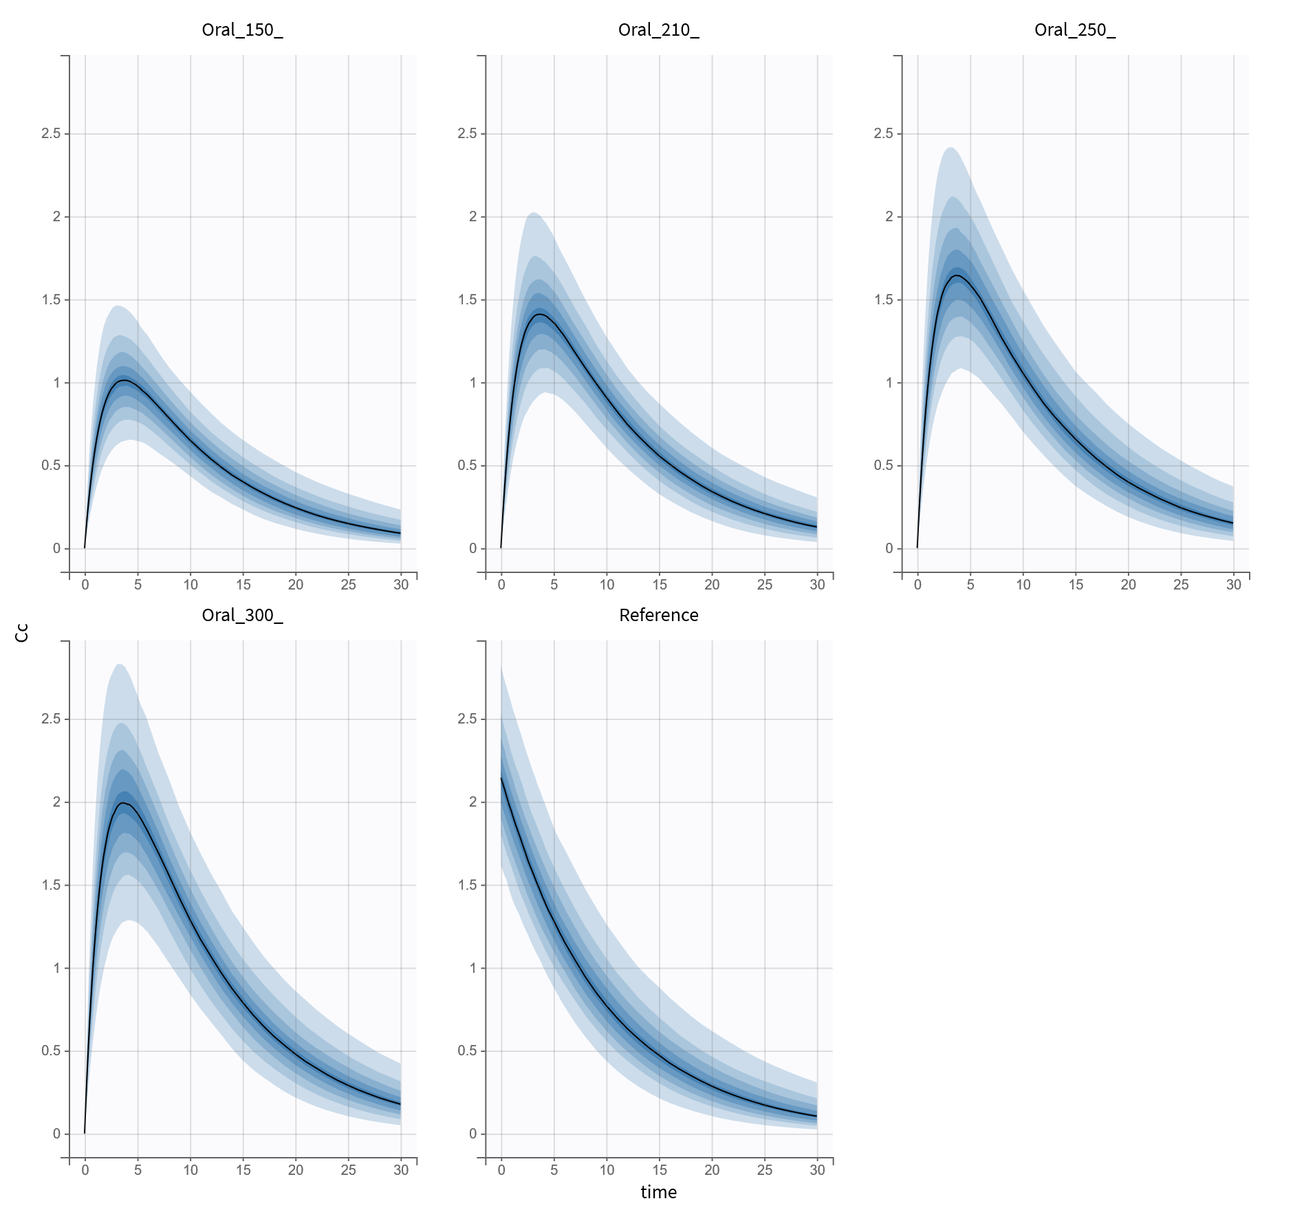
Cc6h Median
IV Ref | Oral 150 | Oral 210 | Oral 250 | Oral 300
1.16 | 0.92 | 1.28 | 1.50 | 1.82

Slide 27
Conclusions

Slide 28
Research question
Primary objective:
What dose for tablets matches the AUC 0h-6h of 150 mg Funytoin IV in patients weighting 70 kg?
Answer:
300mg
But:
Concentration matches better with the 210mg tablet

Slide 29
Research question
Secondary objectives:
What is the absolute bioavailability (F) of the oral tablet?
    F = 0.7 = 70%
What is the variability between patients?
What is the impact of the covariates on the clearance and volume of distribution?
    Log-weight on volume of distribution: 1.16
    Weight on clearance: 0.016
 | Value | C.V.(%)
omega_F | 0.6 | 17.35
omega_ka | 0.25 | 25
omega_V | 0.16 | 16.31
omega_Cl | 0.32 | 32.76
Notes:
C.V.(%) means Inter-individual variability is 25%

Slide 30
Questions?

