Slide 1
PORTFOLIO REPORT
Prepared for Jane Doe
Report Date: 2026-02-06 | Portfolio Value: 250,000.00 EUR
Strategy: Max Sharpe
Generated by Portfolio Optimizer

Slide 2
KEY METRICS
1.20%
3.40%
9.10%
18.40%
1M
YTD
1Y
Since Inception
14.50%
1.12
-8.70%
+22,750 EUR
Volatility
Sharpe
Max Drawdown
Exp. Return (EUR)

Slide 3
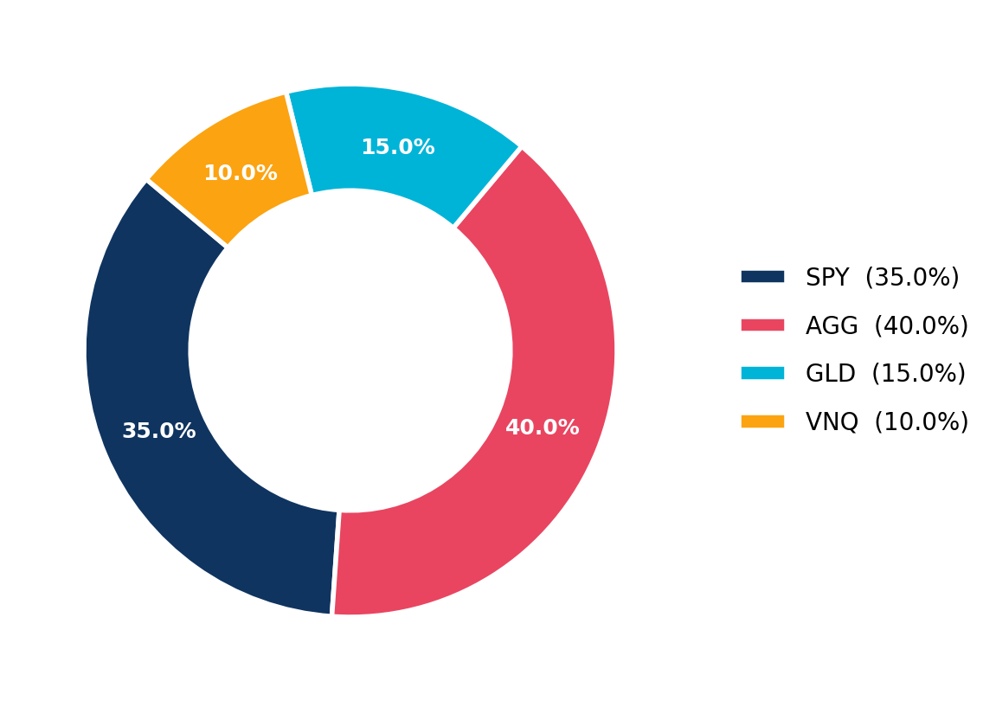
ASSET ALLOCATION

Slide 4
HOLDINGS
Ticker | Weight | Market Value | P/L
SPY | 35.0% | 87,500.00 | +4,200.00 EUR
AGG | 40.0% | 100,000.00 | +1,500.00 EUR
GLD | 15.0% | 37,500.00 | +2,100.00 EUR
VNQ | 10.0% | 25,000.00 | -300.00 EUR

Slide 5
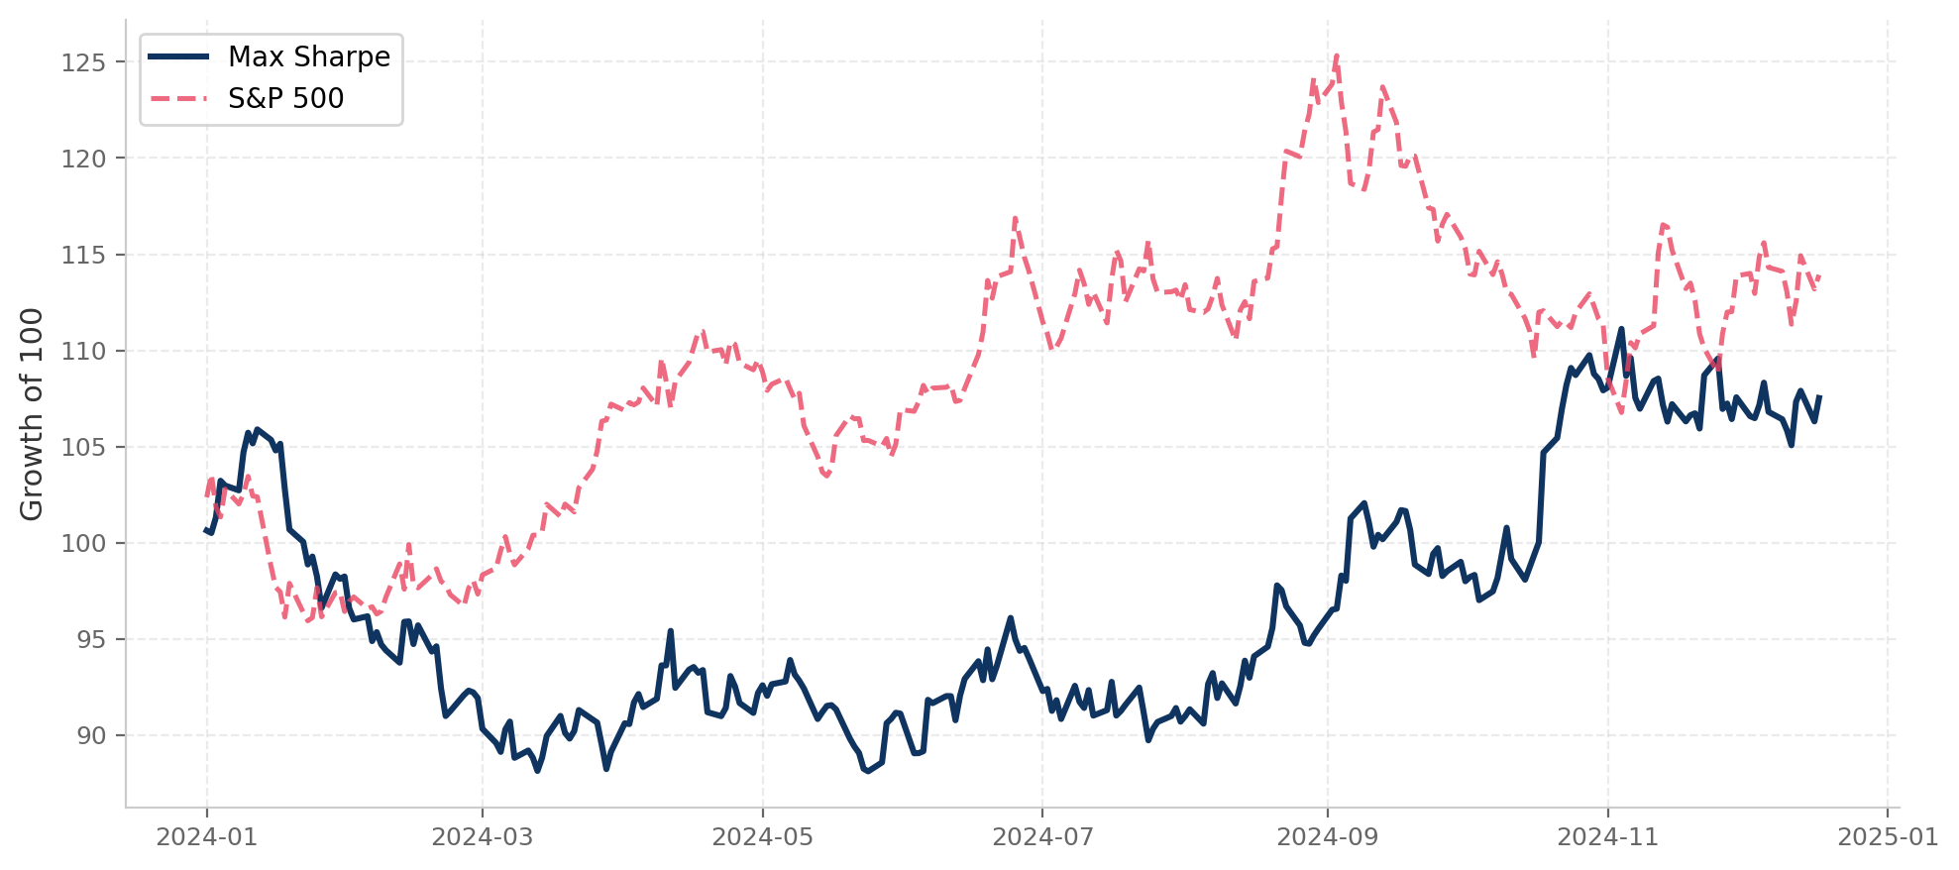
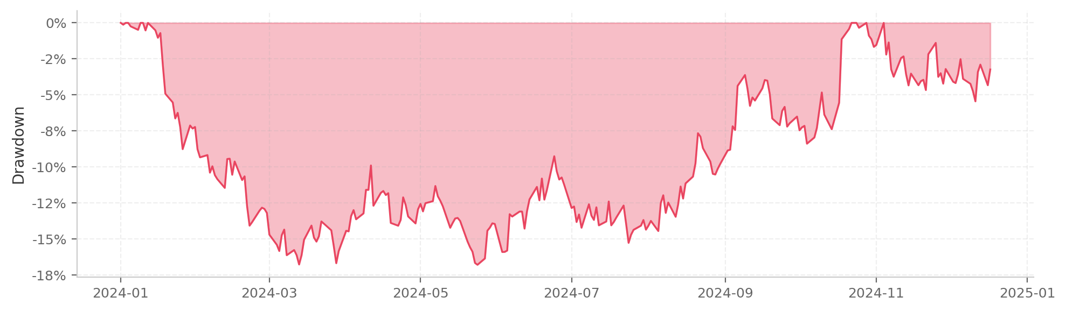
PERFORMANCE
DRAWDOWN

Slide 6
COMMENTARY
The portfolio maintained a defensive tilt with 40% allocation to bonds.
Equity exposure via broad market ETFs captured the late-year rally.
This report is for informational purposes only and does not constitute investment advice.

