Slide 1
Covid-19 new case prediction based on the reopening growth factor
Shahram Talei
Justification:
- “More is different”, this is
- Fewer statwide studies compared to national studies, especially in smaller states

Slide 2

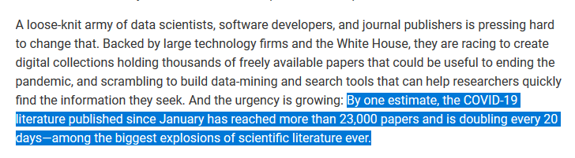
Justification:
- “More is different”,
- Data science can’t get more important than
- Fewer statewide studies compared to national studies, especially in smaller states
- It’s important to be fast and efficient.

Slide 3
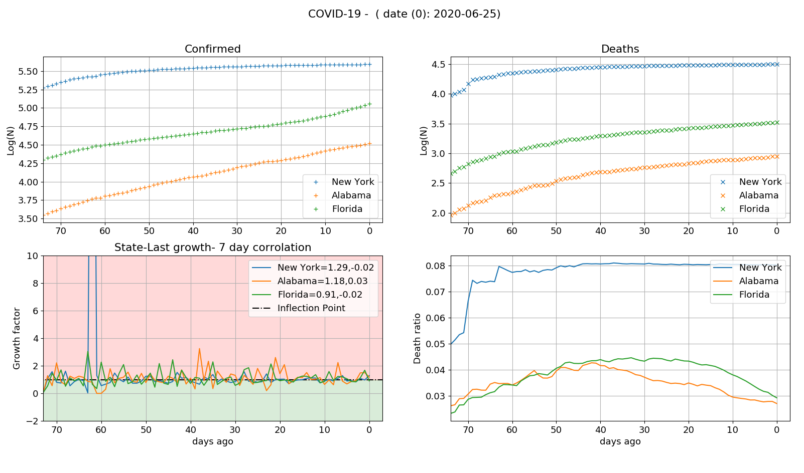

Data Scraper and primary analysis:
cross-corellation and lag between confirmed cases and death:
New York
Cross-Corellation:1.02575-lag:14
Alabama
Cross-Corellation:0.991008-lag:0
Florida
Cross-Corellation:0.990245-lag:0

Slide 4
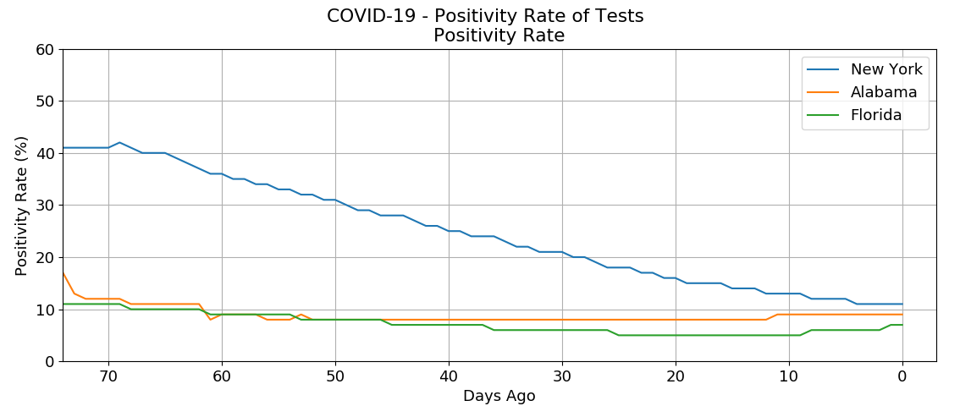
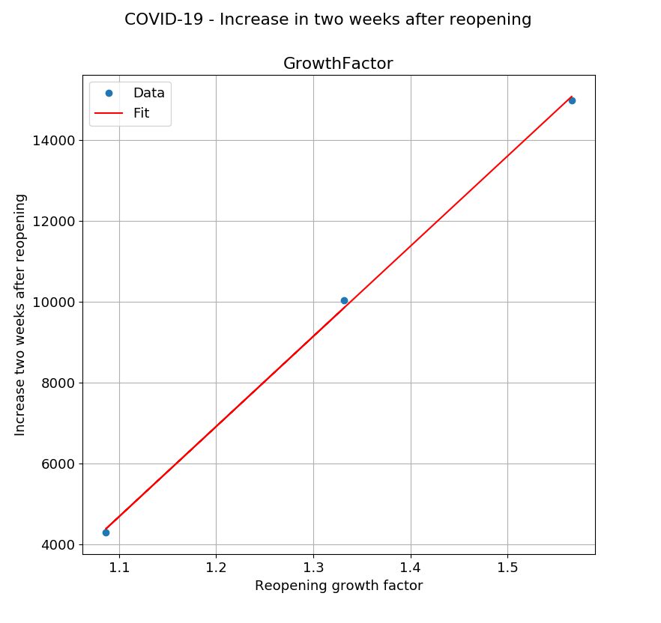
More analysis:
fit parameters:
[-19861.12495688 22312.70488886]
Enter an opening growth rate to see the prediction: 1.13
Increase prediction is:5352

Slide 5
Next Steps
More predictors
Parallel version (MPI or CUDA)
More states

