Slide 1
May 13-31
News Streams
Members: Jamison Bradley, Lance Staley, Charles Litfin
Advisor: Srikanta Tirthapura
Client: IBM Rochester
Notes:
Charles

Slide 2
Problem
May 13-31
News Streams
With today's online news sources there are plenty of multi-national news websites. For the user to view all articles of interest on all of their favorite sites becomes impossible as that list grows. Then adding to the frustration, several of the news sources report on the same topic. Current news aggregators face the challenge of converting such an information deluge into a flow that can be consumed more smoothly by a user.
Notes:
Charles

Slide 3
Solution
May 13-31
News Streams
To design a real-time streaming news aggregator which will enhance the user experience. The key results would be to aggregate duplicate articles in view, hence preventing them from pushing other prominent articles out of view and increasing the consumability of news articles.
Notes:
Charles

Slide 4
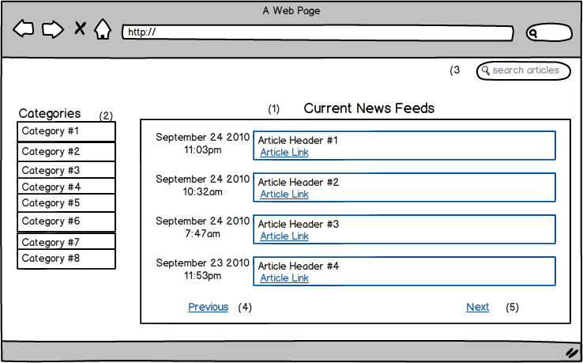
Concept Sketch
May 13-31
News Streams
Notes:
Lance

Slide 5
Functional Requirements
May 13-31
News Streams
Obtaining Articles
Scanning
Aggregation
Categories
Customization
Article Access
User Access
Notes:
Lance

Slide 6
Non-Functional Requirements
May 13-31
News Streams
Security
Username
Performance Requirements
Speed
Interface
Notes:
Charles

Slide 7
Technologies/Platforms Used
May 13-31
News Streams
IBM’s Infosphere Streams
MySQL Database
Twitter Bootstrap libraries
Notes:
Jamison

Slide 8
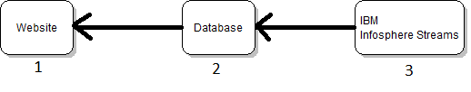
System Architecture
May 13-31
News Streams
Notes:
Jamison

Slide 9
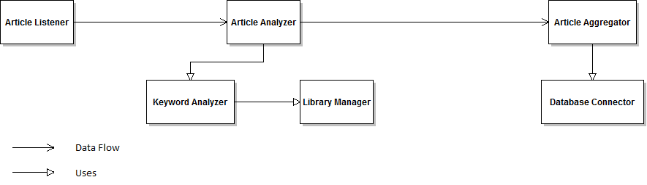
Functional Module Design
May 13-31
News Streams
Notes:
Jamison

Slide 10
Functional Decomposition
May 13-31
News Streams
Overall Function
Infosphere Streams - Article Listener
Infosphere Streams - Article Analyzer
Infosphere Streams - Keyword Analyzer
Removal of Common Words
Key Word Detection
Infosphere Streams - Article Aggregator
Match Story
Infosphere Streams - Database Connector
Retrieve Information
Store Information
Notes:
jamison

Slide 11
Planned Sources
#1 CNN (US)
#2 New York Times (US)
#3 Des Moines Register (US/Iowa)
#4 The Guardian (UK)
#5 BBC (UK)
#6 Toronto Sun (Canada)
#7 The Australian (Australia)
#8 Al Jazeera English (Qatar)
#9 New Zealand Herald (New Zealand)
#10 The Local (Sweden)

Slide 12
Interface Definition
May 13-31
News Streams
Our interfaces will be a website.
It should be clear, concise and easy to use.
The interface will be implemented in HTML, CSS, and JavaScript
Notes:
Lance

Slide 13
User Interfaces
May 13-31
News Streams
Notes:
lance

Slide 14
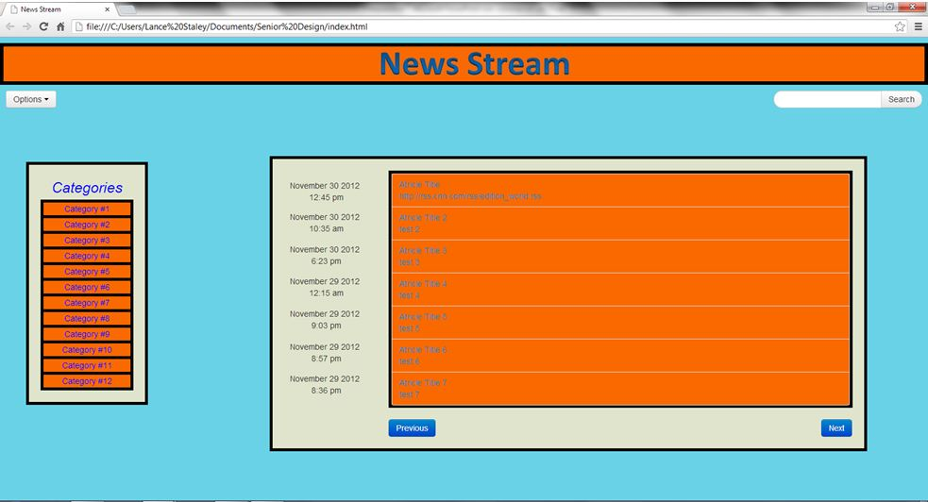
Prototypes
May 13-31
News Streams
Notes:
Lance –add talk into twitter bootstrap

Slide 15
Prototypes
May 13-31
News Streams
Keyword Analysis
Page source parsing
Streams tutorial programs
Notes:
Jamison – add talk about keyword costing etc

Slide 16
Test Plan
May 13-31
News Streams
Will vary from module to module
Unit Testing
Black Box Testing
Notes:
Jamison

Slide 17
Risks and Mitigation
May 13-31
News Streams
Risk | Probability of Occurrence | Criticality (0-100) | Risk Factor (Prob. Of Occurrence x Criticality) | Mitigation strategy
The IBM Streams software has not been used by any of our members and could be difficult to learn and implement | .50 | 80 | 40 | Hold a meeting with our IBM contact about streams as well as prototyping small streams applications for experience
Lack of experience with web development | .40 | 60 | 24 | Research web development as well as prototype some web development
We are unable to get streams to work with our java and webpage. | .20 | 50 | 10 | Research alternate design options as well as using streams with external code
Distributed system that is available for many different web browser | .40 | 50 | 20 | Research and develop for a number of browsers
Notes:
Charles

Slide 18
Market Survey
May 13-31
News Streams
There are a number of similar news aggregators currently on the market. Our research leads our team to believe our system will be the only one currently using IBM’s Infosphere streams as part of its system. Also the majority of other news aggregators do not allow the user to customize the sources from which the articles are gathered from. This provides our system with a major difference to other systems, which should give us a distinctive edge over current systems. Also our user interface should be clear, simpler, and more concise then those currently available.
Notes:
Charles

Slide 19
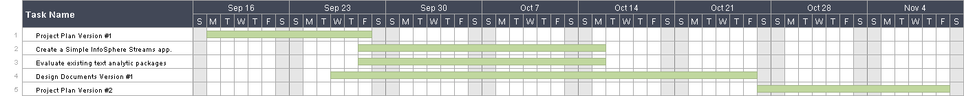
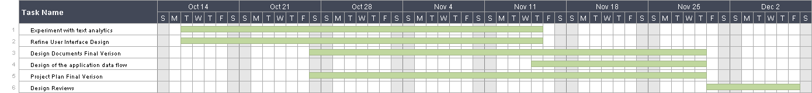
Work Breakdown Structure
May 13-31
News Streams
Notes:
Charles

Slide 20
Current Project Status
May 13-31
News Streams
Project Plan and Design Documents have been finished
Initial Research has been finished
Plan for implementation for next semester is in place
Prototyping both the website and algorithms have been finished
Notes:
Jamison

Slide 21
Plan for next Semester
May 13-31
News Streams
Jamison
Implementation of text analytic algorithm with IBM’s Infosphere Stream.
Lance
Implementation of website design
Charles
Implementation of database
Notes:
Jamison

Slide 22
Questions?
May 13-31
News Streams
Notes:
Jamison- All

