Slide 1
WEB AND SOCIAL MEDIA SEARCH AND ANALYSIS
Machine Translation Discourse on Bluesky
Tool, threat, or both? What 3,864 posts and their social network reveal
Linda Stalidzane • Pelinsu Topaloglu
Bachelor of Science in Artificial Intelligence — Prof. Marco Viviani
Notes:
10-second cold open: 'Machine translation is now part of everyday language work. We asked Bluesky how it really feels about that.' Move on immediately.

Slide 2

01 — OBJECTIVE
Tool, threat, or both?
DeepL, Google Translate, and LLM-based translation are now used by casual users, professional translators, and developers alike. We studied how Bluesky talks about it — and whether professionals and the general public frame it differently.
RQ1
RQ2
RQ3
RQ4
Sentiment & framing
Professional impact
Utility vs. displacement
Network structure
Tool, threat, or both?
How do translators discuss career effects?
Do people hold both views at once?
Do professionals and the public form separate communities?
Linda Stalidzane
2
Notes:
35s. State the four RQs briefly, point at the cards, don't read them verbatim. RQ1-3 = content analysis (my part), RQ4 = network analysis (Pelinsu's part).

Slide 3

02 — DATA
Collecting a year of MT discourse
Bluesky API (atproto), 12-month window: seed search on MT keywords/hashtags → full reply-thread crawl → follower crawl + profile fetch for bio-based labeling.
3,864
2,303
133,428
12
posts analyzed
author profiles
network edges
months collected
Author type, by bio keyword match:
general
73.6% (2,843)
“unknown” = profile fetched, no bio — kept separate from “general” deliberately
professional
15.8% (610)
unknown
5.6% (218)
tech
5.0% (193)
Linda Stalidzane
3
Notes:
30-35s. Quick pipeline + the 4 headline stats. Mention unknown-vs-general distinction in one sentence, don't dwell.

Slide 4
03 — MODELS
Content analysis: two tools per task, on purpose
For sentiment and emotion, we deliberately used a lexicon-based tool and a transformer, and cross-checked them — this surfaced real weaknesses in the lexicon tools rather than hiding them.
Sentiment
Emotion
Entities
VADER (lexicon) vs.
cardiffnlp RoBERTa (transformer)
NRCLex (dictionary) vs.
j-hartmann DistilRoBERTa (transformer)
spaCy NER + curated list of
known MT tools/companies
Why compare? Because “trust me, it's positive” isn't good enough science — see next slides.
Linda Stalidzane
4
Notes:
25-30s. One sentence per column, don't over-explain — the payoff comes in the results slides.

Slide 5
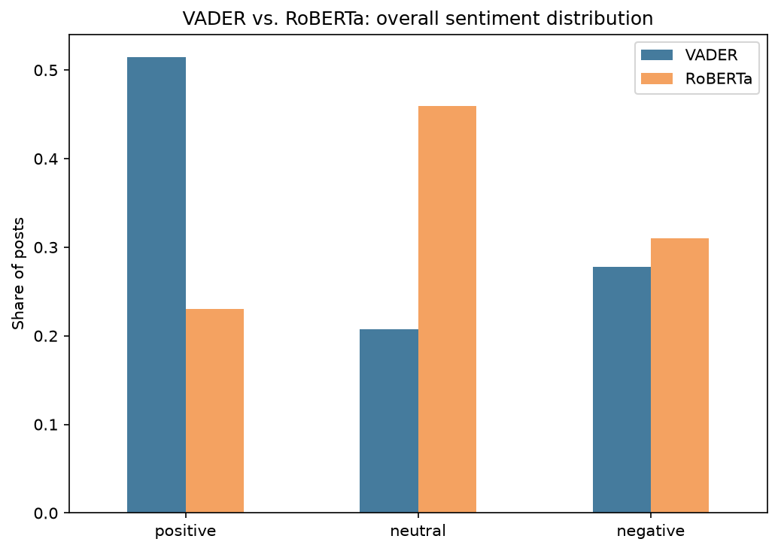
04 — RESULTS · RQ1
Sentiment: the tools disagree — a lot
54.1% agreement
between VADER and RoBERTa — 458 posts (11.9%) in outright opposite-polarity disagreement.
VADER: fooled by individually-positive words.
“Perfect example of how machine translation is totally untrustworthy” → VADER: +0.57 positive (from “perfect”). RoBERTa: negative — correctly.
Takeaway: the discourse is genuinely mixed (23%/46%/31%), not predominantly positive as VADER alone suggests. Professionals score most positive on average (mean 0.201 vs. 0.139 general) — consistent with acknowledging MT's day-to-day utility, not framing it purely as a threat.
Linda Stalidzane
5
Notes:
45-50s. This is the headline finding — spend real time here. Point at the bars: VADER positive-heavy, RoBERTa balanced. Read the quote example. Land on the takeaway box.

Slide 6
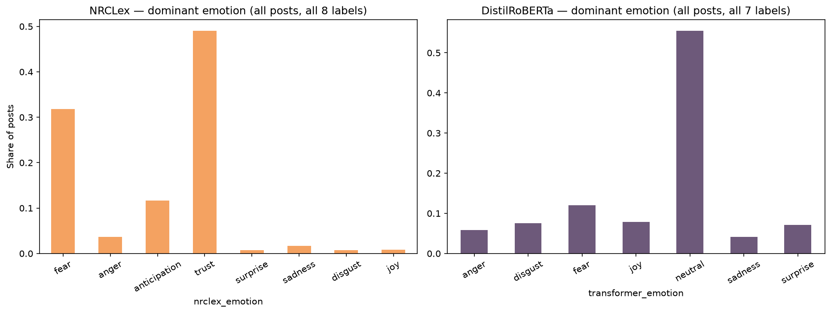
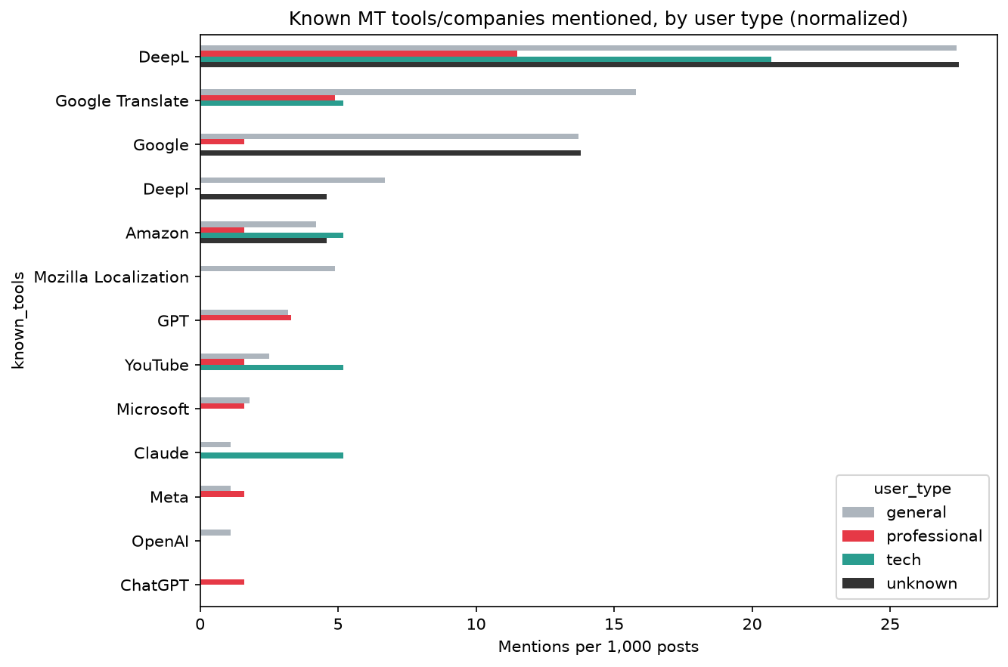
04 — RESULTS · EMOTION & ENTITIES
When the tool matters more than the topic
NRCLex says “trust” or “fear” on ~80% of posts — almost regardless of content. Conditioned on posts where DistilRoBERTa confidently detects a specific emotion, the two tools still agree only 15.6% of the time.
Why: “trust” is an oversized NRC lexicon category that fires on ordinary vocabulary — not genuine signal.
Entities: 5,523 extracted. DeepL & Google Translate dominate for every group; tech users lean toward Claude/LLM-based translation at a disproportionate rate.
Linda Stalidzane
6
Notes:
40-45s. Emotion: point at how flat/similar the two bar charts LOOK different (NRCLex has 2 huge bars, DistilRoBERTa is flatter with neutral dominant). NER: just say DeepL/Google Translate win everywhere, tech leans LLM. Then hand off to Pelinsu.

Slide 7

03 — MODELS
Network analysis: who talks to whom
Follow graph and reply graph kept separate (different social relations). Structural analysis restricted to the post-authors subgraph — the full follow graph is an ego-network sample, capped per account by API pagination.
Centrality
In/out-degree, PageRank, betweenness, closeness — who's visible, who bridges groups
Community detection
Louvain, Greedy Modularity, FluidC, Girvan–Newman — compared on the same graph
Reproducibility note: Louvain/FluidC results shift slightly run-to-run (Python hash randomization) — acknowledged, not hidden.
Pelinsu Topaloglu
7
Notes:
30-35s. Two model families, one sentence each. Mention the reproducibility caveat briefly — it's a strength (honesty), not a weakness, say it that way.

Slide 8
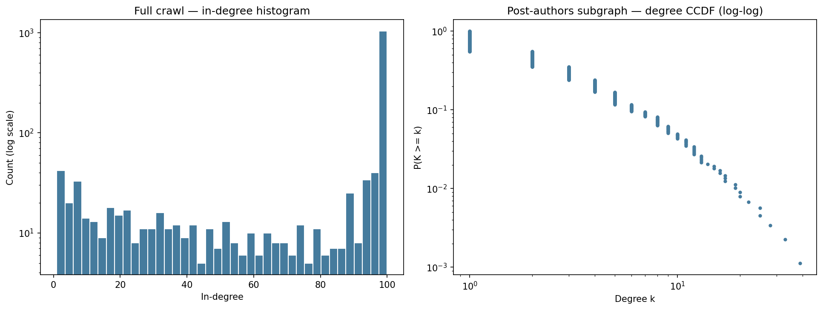
04 — RESULTS · STRUCTURE & CENTRALITY
A loosely connected discourse
1,339 nodes, 1,320 edges (density 0.0007), 535 fragments — largest component covers only 676 nodes (~half). Low reciprocity (0.16): attention flows one way.
Spike at in-degree ≈100 = API pagination cap, a collection artifact, not real structure.
Follow attention concentrates on professionals: 13 of top 15 by in-degree, 10 of top 15 by closeness. Betweenness splits exactly 5/5 — professionals bridge, but don't monopolize.
The reply network inverts this: most-replied accounts are mostly general users — one viral thread (364 replies, ~5.6× the runner-up) from far outside the translation community. Professionals are followed; virality happens around general accounts.
Pelinsu Topaloglu
8
Notes:
40-45s. Structure is sparse/fragmented — say that plainly. Centrality: professionals dominate follow-attention but reply-attention is a completely different, event-driven story (the viral thread).

Slide 9
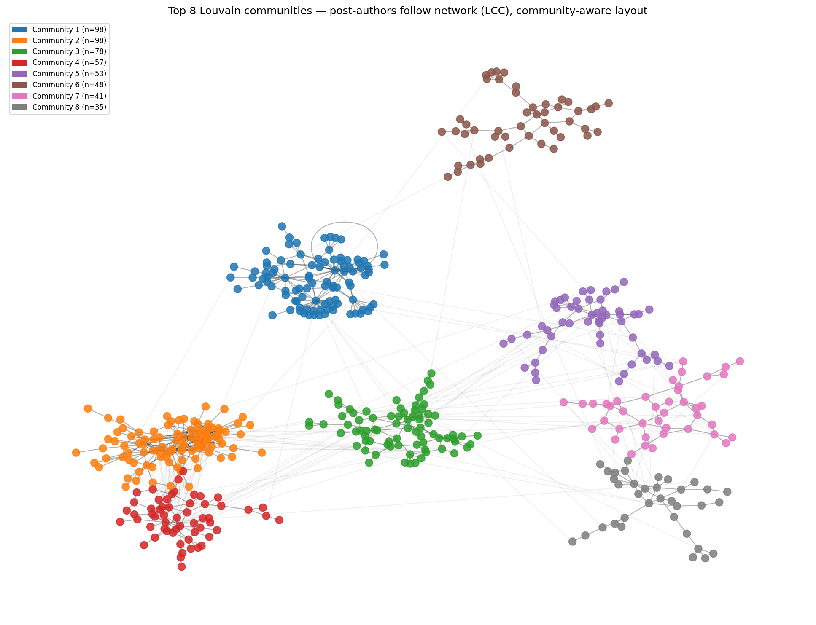
04 — RESULTS · RQ4
Community detection: not one hub, a few
16 communities found (Louvain, modularity 0.728, consistent with 3 other algorithms). Two are professional-majority — not the single hub we expected.
98 nodes — 134 professional vs. 112 general
MTPE rates, working conditions, industry news
57 nodes — 57 professional vs. 49 general
Narrower margin, more heterogeneous
The rest: general-dominated, organized by fandom/topic (game localization, fan translation) — not by profession.
RQ4: “professionals vs. the public” is too simple — it's a few professional hubs surrounded by many independent fan conversations.
Pelinsu Topaloglu
9
Notes:
50s. This is Pelinsu's headline slide. Point at the network image — the two colored professional clusters vs. many general-dominated ones. Land on the RQ4 answer in the navy box.

Slide 10
OVERALL CONCLUSION
Tools and products, not tribes
Professional translators are the most visible, most-followed, and — most positive on average: they discuss MT with nuance, acknowledging utility while contesting working conditions.
General users don't oppose them as a bloc — they scatter across many product- and fandom-centered conversations (game localization, fan translation), each triggered by a specific encounter with MT.
Conversational attention is event-driven (one viral thread dominates replies), while follow-attention is sustained and professional-led — two different kinds of “importance.”
DeepL and Google Translate dominate the conversation for every group: the discourse organizes around concrete tools, not an abstract pro/anti divide.
Linda Stalidzane & Pelinsu Topaloglu
10
Notes:
40s, split the 4 bullets between the two of you or have whoever's more comfortable closing take it. Speak slowly here — it's the payoff of the whole talk.

Slide 11

05 — LIMITATIONS
What this analysis can't claim
—
Single platform, one ~12-month window — findings may not generalize.
—
Keyword-based topical filter and author labeling, not validated classifiers.
—
Generic NER (spaCy) mis-tags domain acronyms (MTPE, LLM) as organizations.
—
Lexicon tools (VADER, NRCLex) diverge substantially from transformers — no gold-standard annotation to say which is “correct,” only that they disagree.
—
Ego-network sample with a 100-follower cap per account; Louvain/FluidC community results vary slightly run-to-run.
Linda Stalidzane & Pelinsu Topaloglu
11
Notes:
20-25s. Read fast, this is a checklist not a discussion. Shows the grader we know our own limitations.

Slide 12
Thank you
Questions?
Linda Stalidzane • Pelinsu Topaloglu
Notes:
5-10s. Just say thank you, open the floor.

