Slide 1
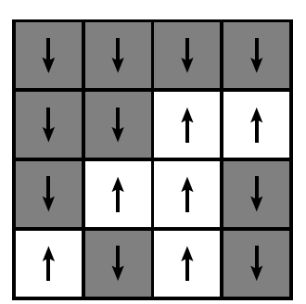


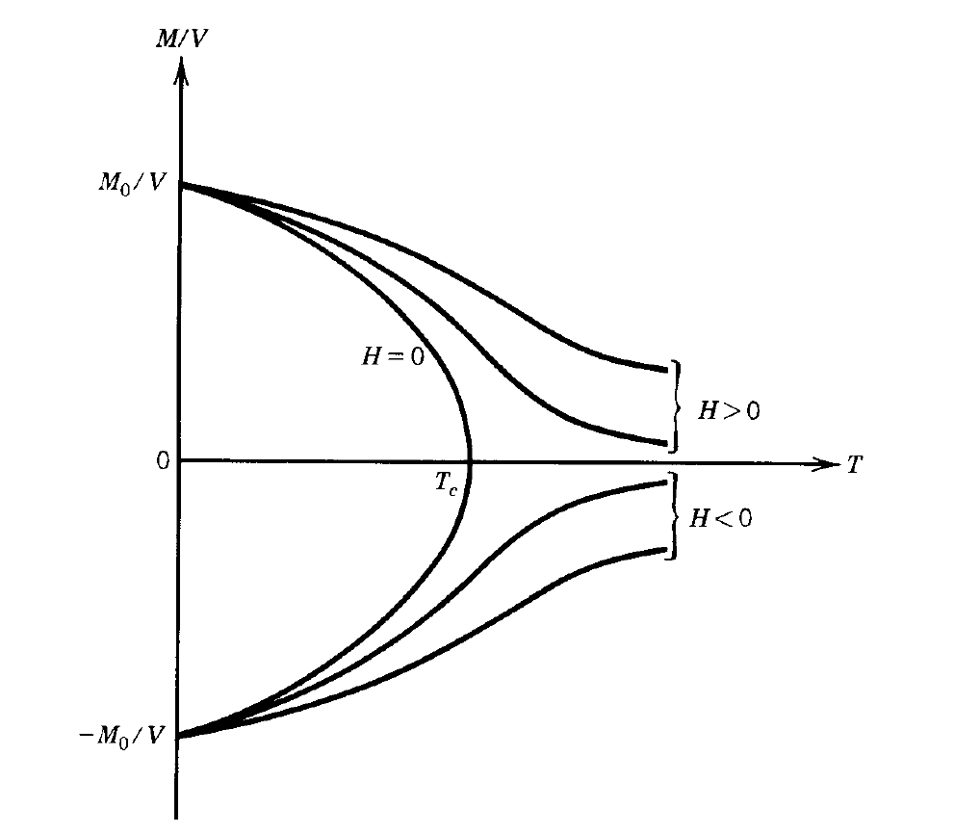
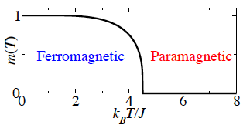
The Ising model
J > 0 ferromagnetic
J < 0 antiferromagnetic

Slide 2
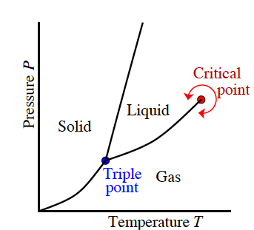
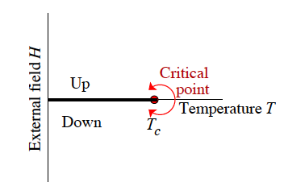
Critical points

Slide 3
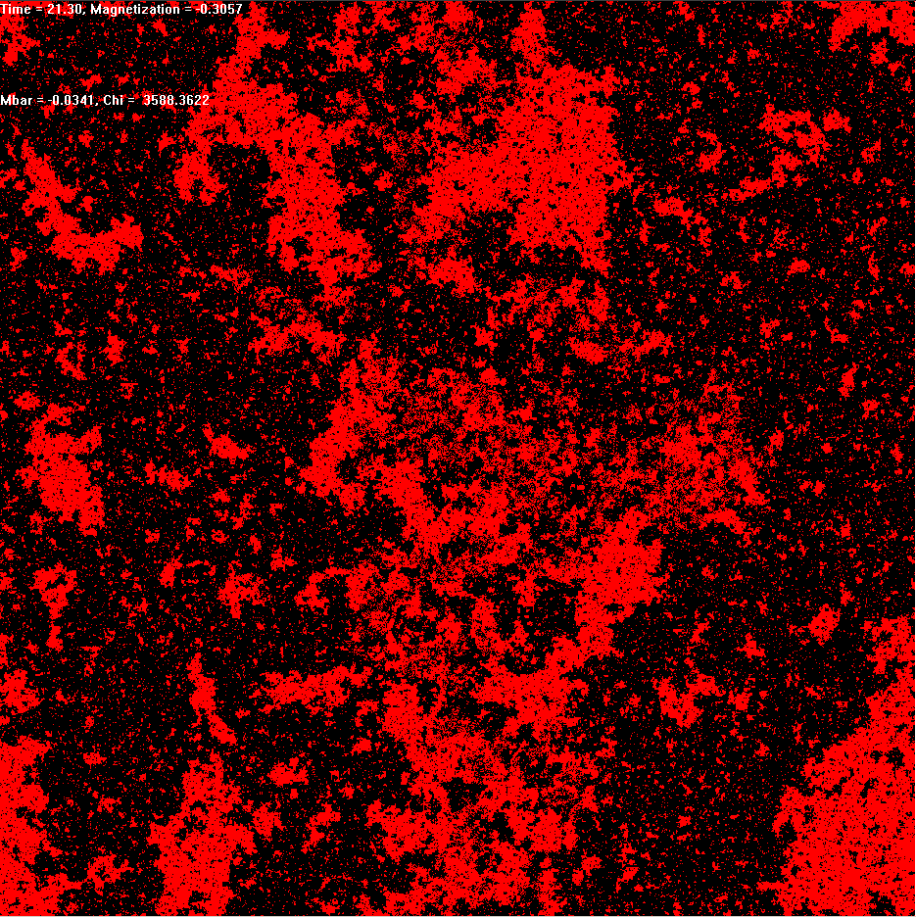
The Ising Model at T_{c}
Structure on All Scales
Continuous Phase Transition
Competition Entropy vs. Energy
Thermal Disorder
High Temperature:
Random ξ~(T-T_{c})^{-ν}
Critical Point
T_{c} = 2/log(1+√2) ~ 2.27
Scale invariant C(r)~r^{2-d+η}
Low Temperature
Long-Range Order M~(T_{c}-T)^{β}
Notes:
3
Peierls: Proved long-range order at low temperatures (broken symmetry), no long-range order at high temperatures. Hence there must be a phase transition, where the up-down symmetry of the ground state is first broken.
Onsager: Calculated the properties exactly, showing (1) that there was a continuous phase transition, and (2) that it wasn’t described by Landau theory, and had weird power-law singularities in most properties.
Key idea: A continuous transition between short-range and long-range order may be characterized by fluctuating order on all scales.
Ken Wilson, Michael Fisher: Studied the Ising model in different dimensions. Above four dimensions, Landau (mean-field) theory gives the correct critical exponents: thermal fluctuations average out on large length scales. They were able to calculate the critical exponents in a power series about four dimensions, the so-called epsilon-expansion, where epsilon here is 4-d.
Plot M(T).
Plot C(R) = <M(x+R) M(x)>.

Slide 4

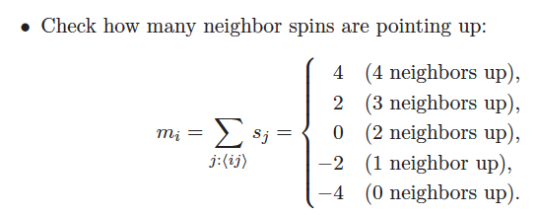

Monte Carlo Simulations

Slide 5
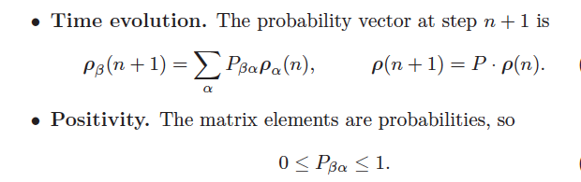



Markov chains
Detailed balance:

Slide 6
Metropolis algorithm
A single update of the Metropolis algorithm works as follows:
Pick a site (𝑖,𝑗) at random.
Calculate the energy change Δ𝐸 that flipping the spin 𝑠_{𝑖𝑗} would produce.
If Δ𝐸<0, flip the spin with probability 1
If Δ𝐸>0, flip the spin with probability𝑒^{−𝛽Δ𝐸}.

Slide 7
Coarsening
Start form T > Tc then set T <Tc

Slide 8
Coarsening

Slide 9
Notebook
Simulate Ising model with Monte Carlo method
Study coarsening
Segregation in the Schelling model
Population of A and B in a lattice
- Check your neighbors
- If too many are different from you (fraction is larger
than tolerance threshold):
move somewhere else
Which toleration threshold
leads to segregation?

