Slide 1
Cloning Github Repository

Slide 2
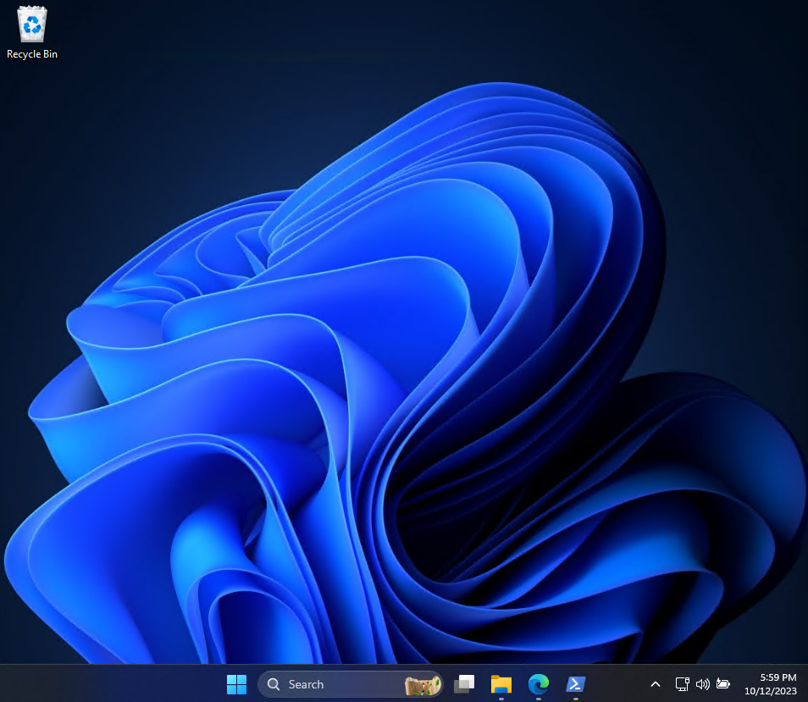
Run the File Explorer

Slide 3
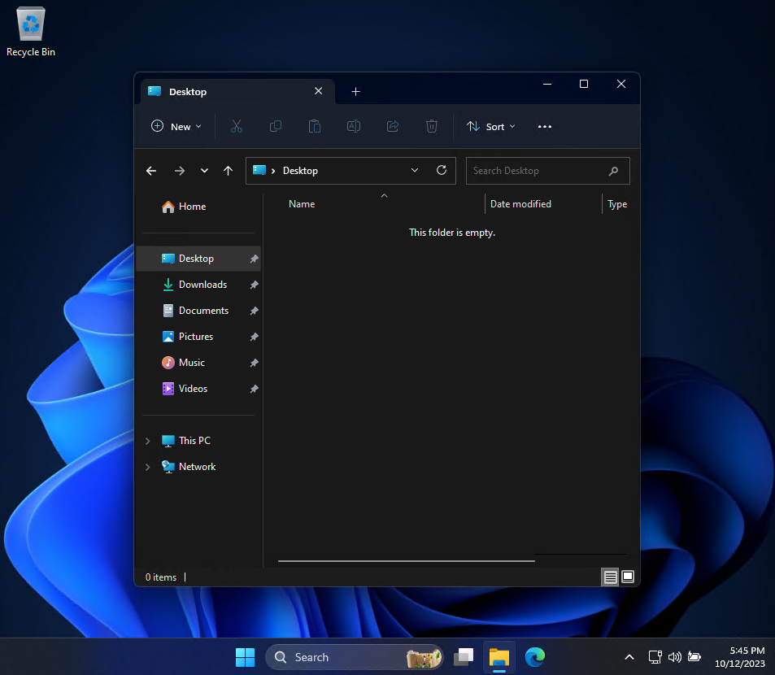
Display content of Windows desktop

Slide 4

Open Powershell terminal window
Type ‚powershell’ and press Enter

Slide 5
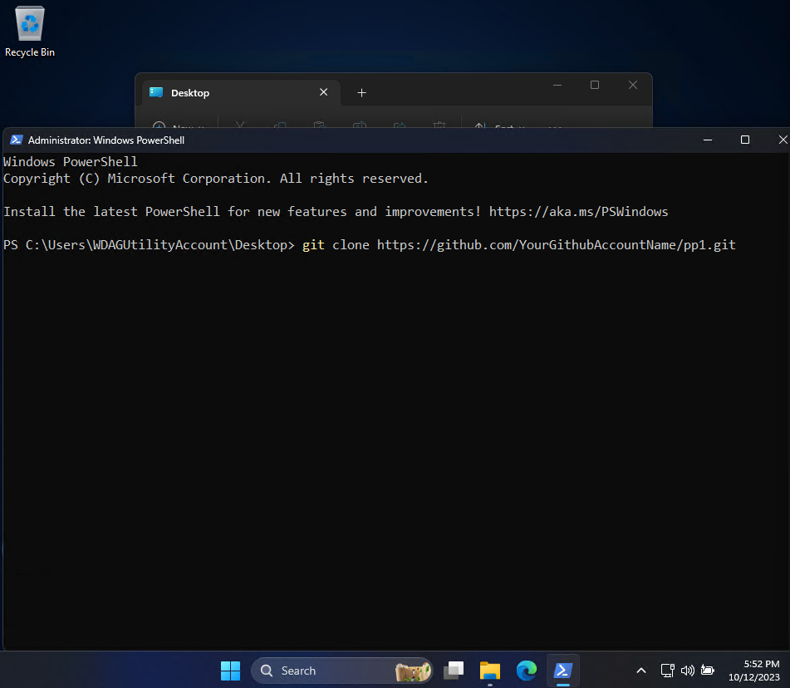
Clone your PP1 repository

Slide 6

Here is your cloned PP1 repository

