Slide 1
Pushing Repository Changes to Github

Slide 2
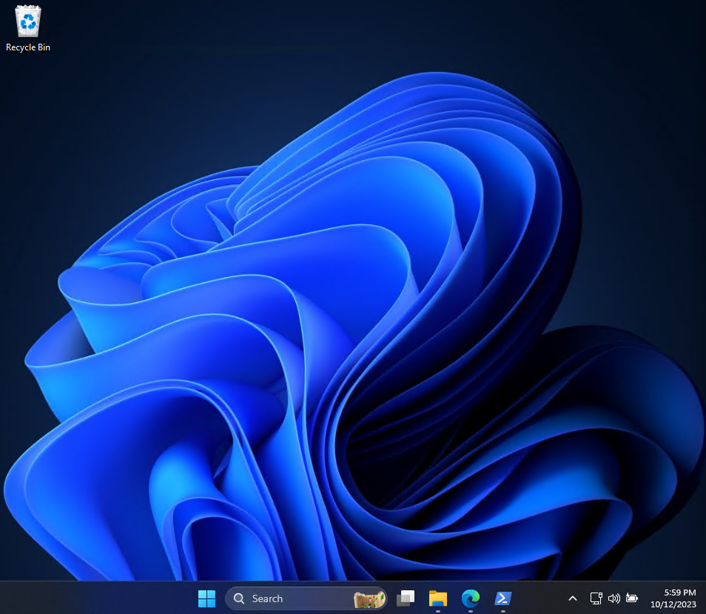
Run the File Explorer

Slide 3
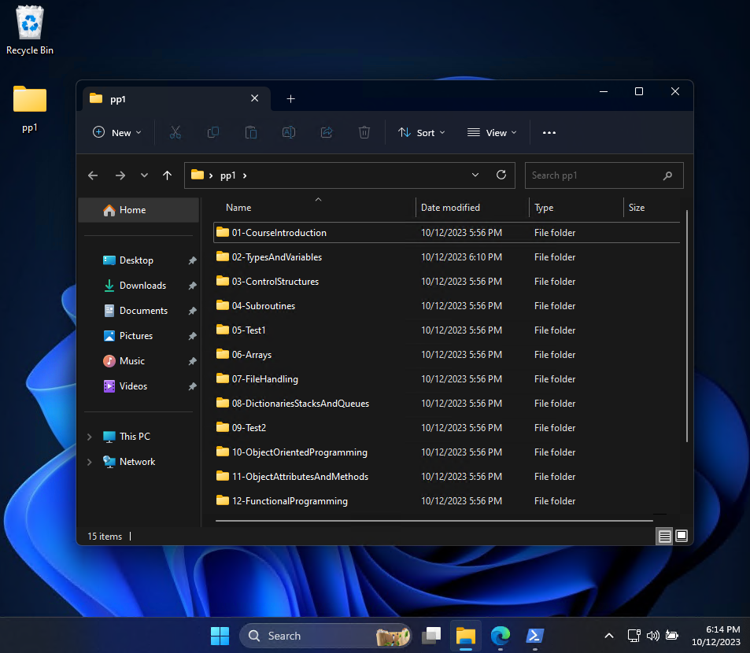
Display content of PP1 repository

Slide 4
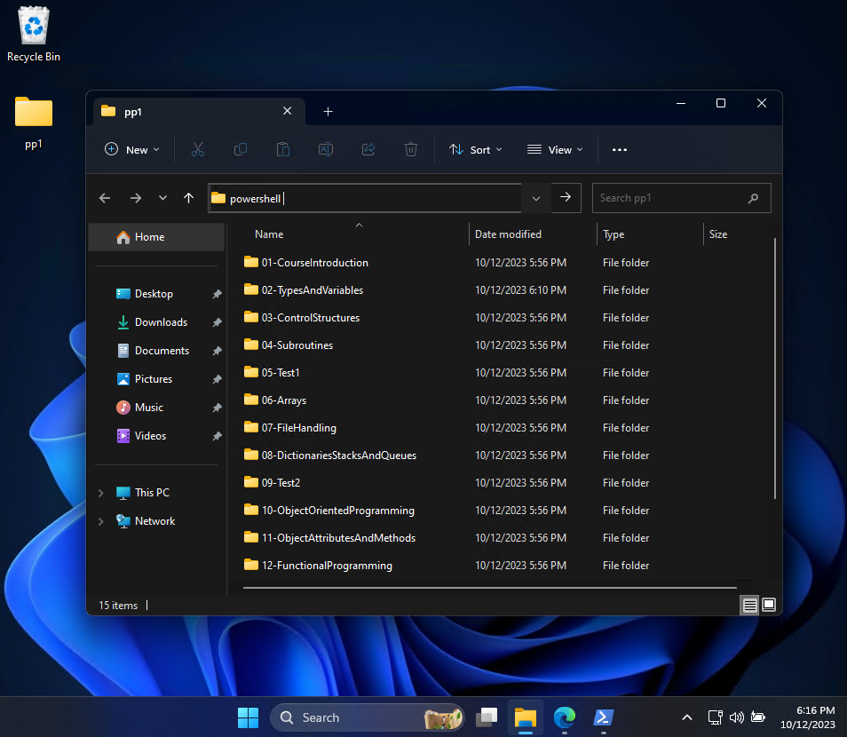
Open Powershell terminal window
Type ‚powershell’ and press Enter

Slide 5
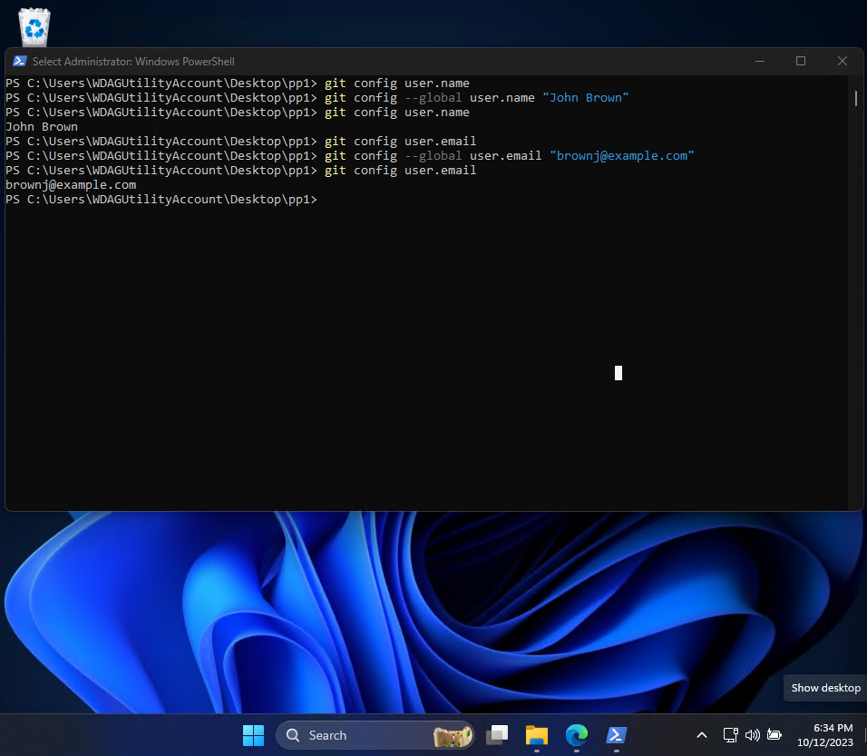
Let Git to know who you are

Slide 6
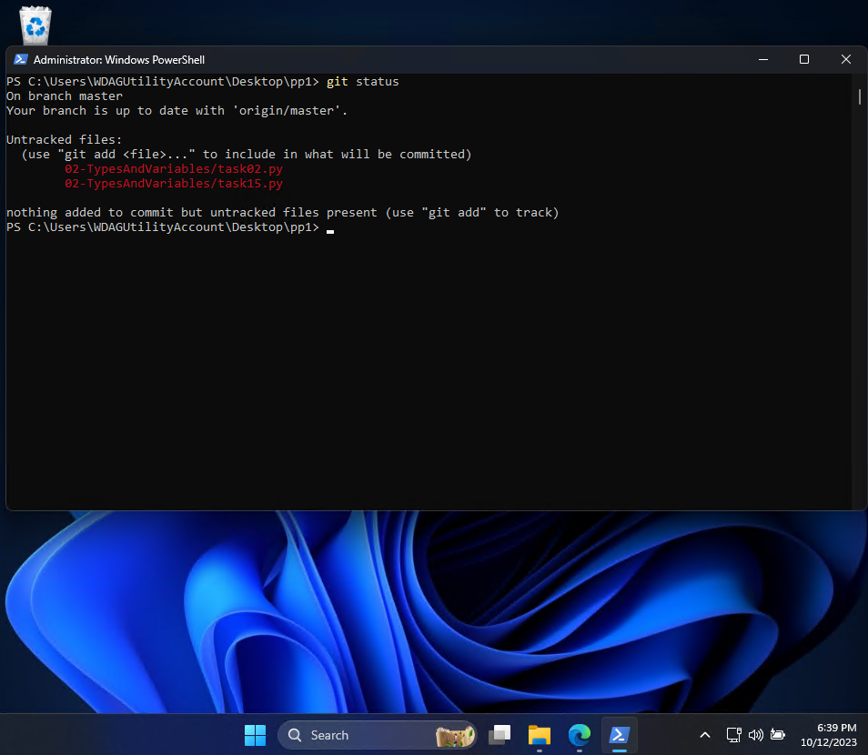
List new created or changed programs

Slide 7
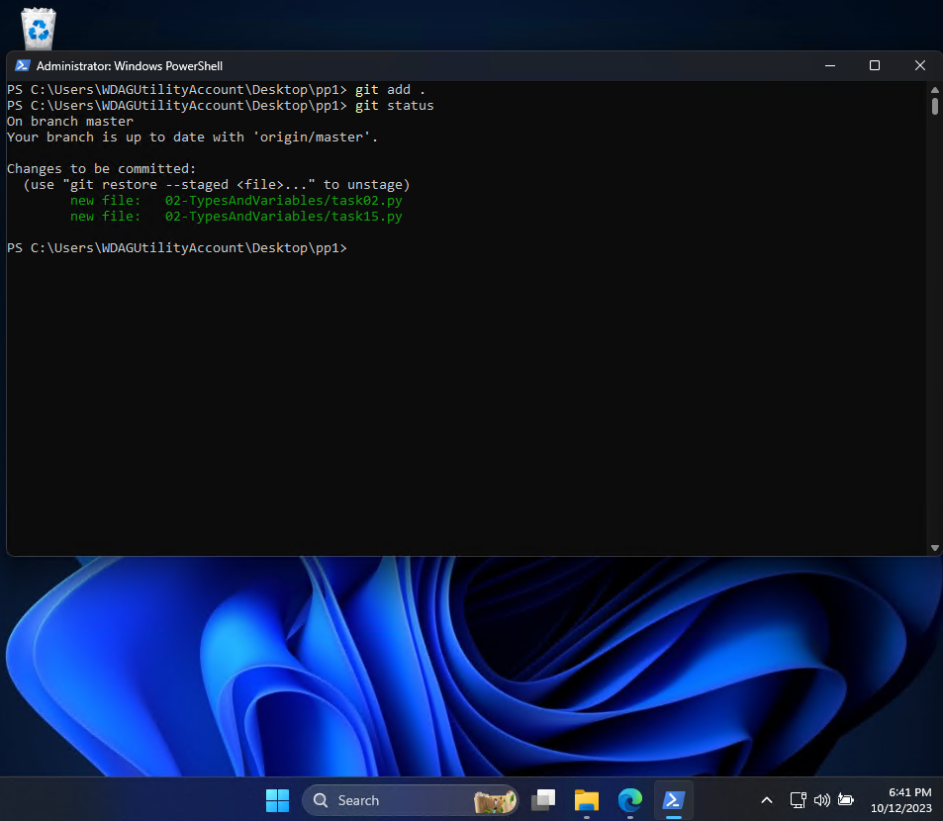
Add files to track changes

Slide 8
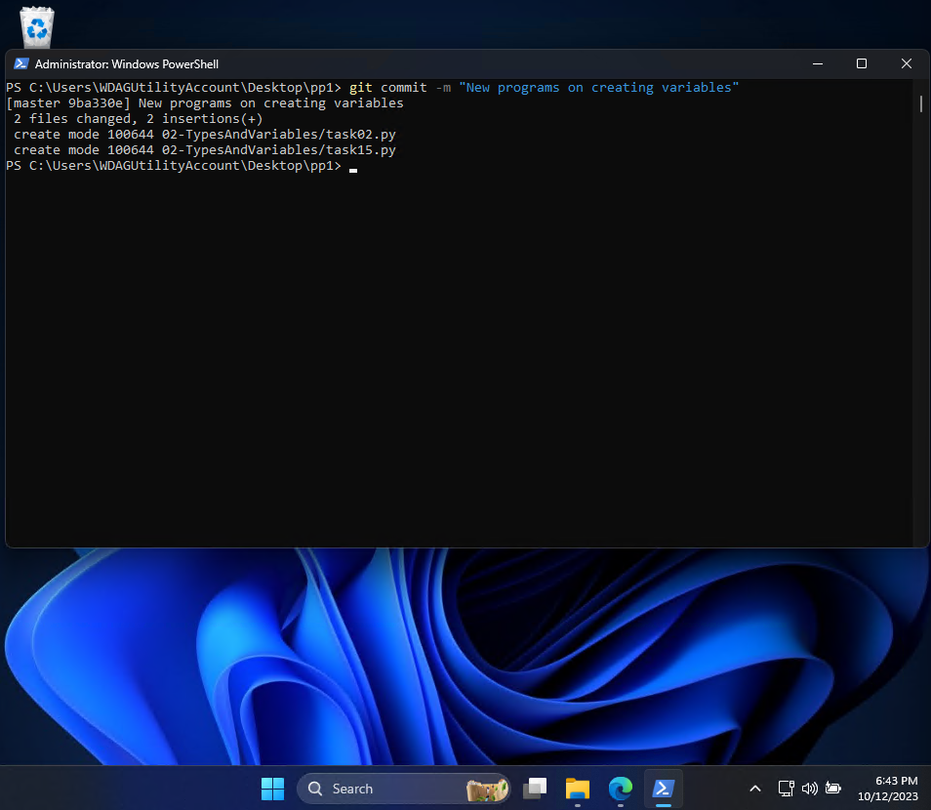
Commit changes

Slide 9
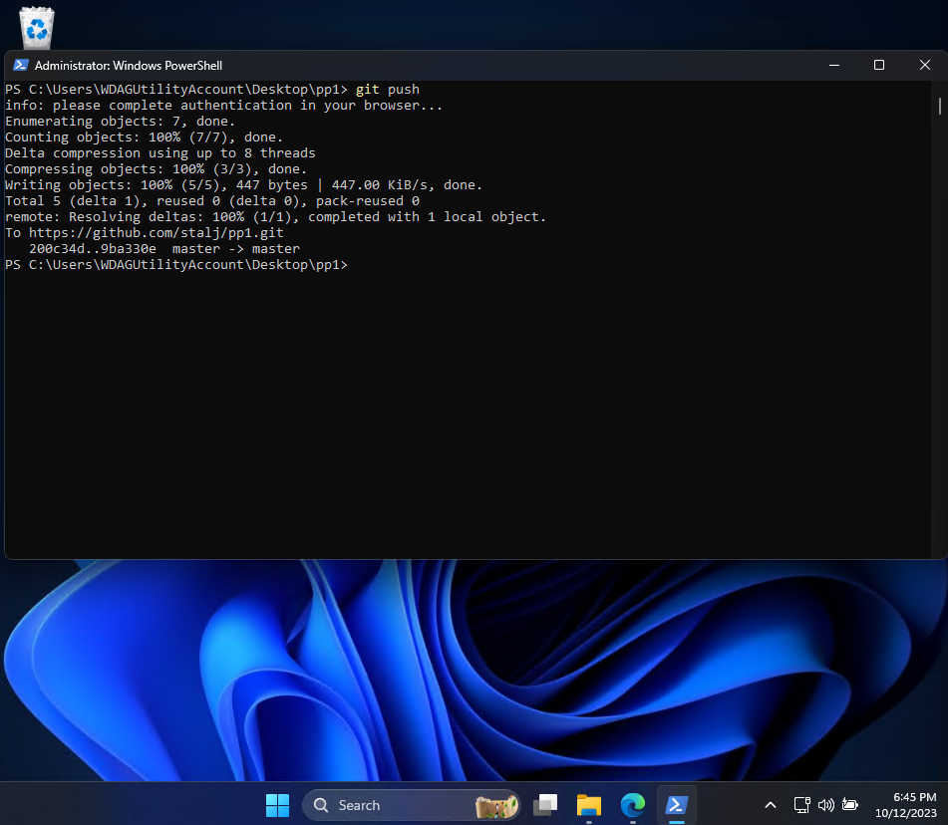
Push changes to Github
You will be asked to log in to Github

Slide 10
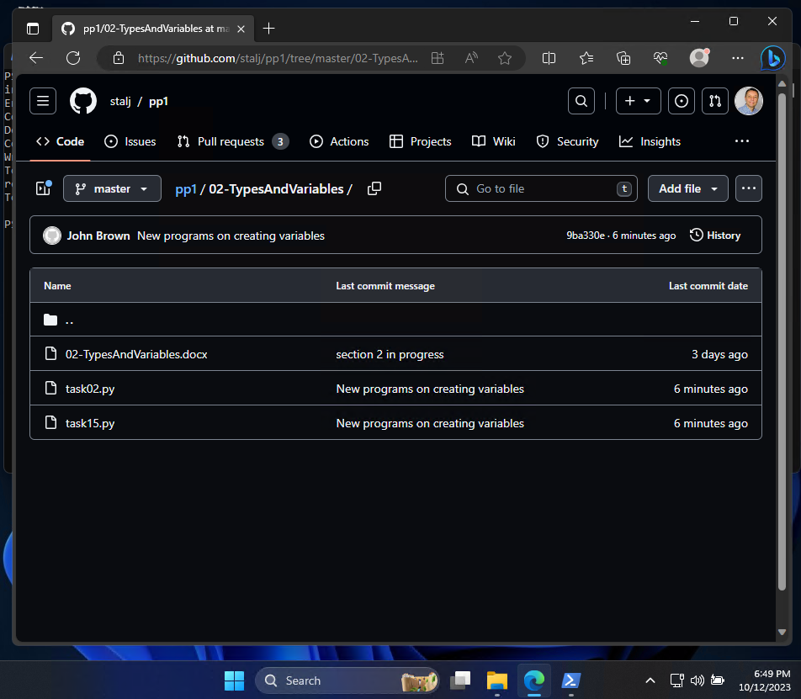

Check if programs have been added to Github

