Slide 1
Feature analysis using interpretable artificial intelligence of EEG-based emotion classification
202224897
Kim Kyu Hyeong

Slide 2
Abstract
Project Outline
(1) To understand the basic contents of EEG.
(2) SVM, Random Forest, and Gradient Boosting models are designed to predict emotional expression through EEG data.
(3) Comprehensive evaluation of Accuracy, F1-score, and Micro-average ROC-AUC of SVM, Random Forest, and c Gradient Boosting models to find an appropriate model
(4) Exploration of important features for judgment through the selected model Random Forest, ICE of Gradient Boosting, and LIME

Slide 3
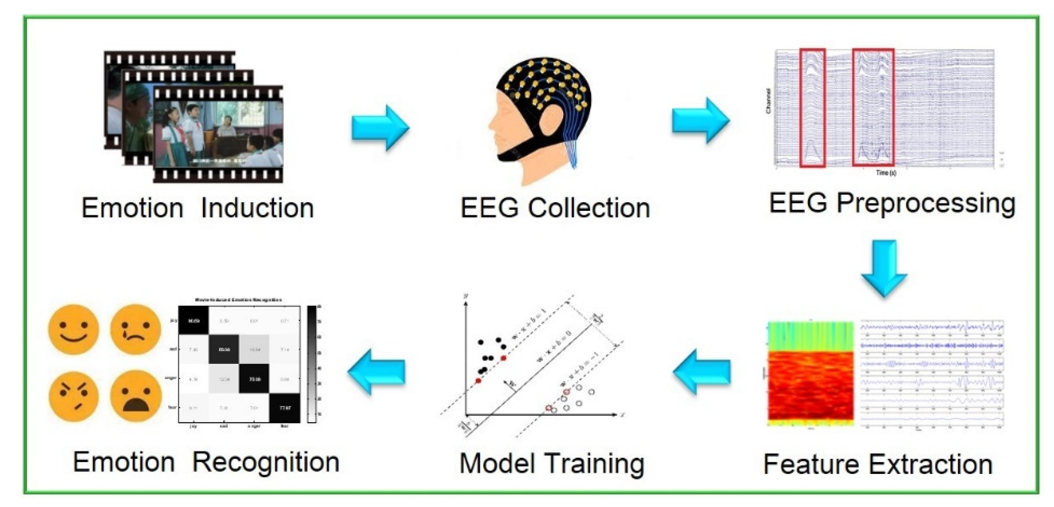
Introduction
(1) EEG is a non-invasive technique that records and measures the electrical activity of the brain using electrodes placed on the scalp, providing insights into brain function and aiding in the diagnosis of neurological conditions.
(2) EEG can help in studying the neural correlates of emotional expression by monitoring brain activity patterns associated with different emotional states.
(3) Models such as SVM, Random Forest, and eXtreme Gradient Boosting are designed and analyzed according to emotion expression prediction through EEG

Slide 4
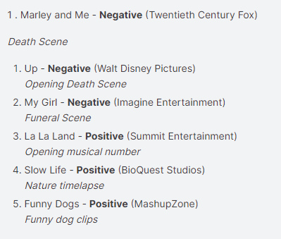
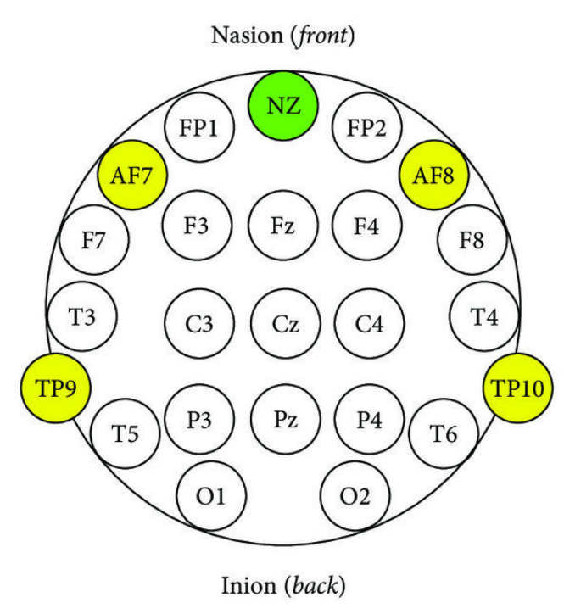
Introduction
(1) The data was collected from two people (1 male, 1 female) for 3 minutes per state - positive, neutral, negative.
(2) Used a Muse EEG headband which recorded the TP9, AF7, AF8 and TP10 EEG placements via dry electrodes.
(3) Six minutes of resting neutral data is also recorded, the stimuli used to evoke the emotions are below

Slide 5


Method
PreProcessing
A simple EEG is difficult to judge because noise and various information are mixed.
Features must be created through the preprocessing process. Features were created with averages, frequency domain data through FFT (Fast Fourier Transform), and correlations.
EX 1) Auto Correlation
EX 2) DFT

Slide 6
Method
Support Vector Machine(SVM)
SVM is robust to outliers because they find the decision boundary in a way that maximizes the margin. Even if there are outliers or noise in the EEG data, SVM can effectively classify them.
SVM can be extended to multi-class classification problems starting from binary classification models. EEG data can be effectively classified using SVMs when different states or classes need to be distinguished.
Parameter | value
Max_iter | 5,000
C | 0.005
penalty | l1
dual | False
(3) The returned probabilities are calibrated using LinearSVC+CalibratedClassifierCV to address the issue of LinearSVC not being well calibrated.

Slide 7
Method
Random Forest
Random forests can capture non-linear interactions between variables. In EEG data, a classification model can be built by considering complex interactions between various features.
Random Forest can estimate the importance of each feature. This allows us to figure out which features in the EEG data are most useful for classification.
Random forests use an ensemble of decision trees, so you can avoid overfitting individual trees. This improves generalization performance and helps build models that are insensitive to noise or outliers in EEG data.
Parameter | value
Max_depth | 5
Min_samples_leaf | 10

Slide 8
Method
eXtreme Gradient Boosting(XGBoost)
XGBoost improves prediction performance by sequentially training a weak model while reducing errors. Therefore, more accurate classification can be performed by utilizing various features in EEG data.
XGBoost is less sensitive to outliers. This allows the model to perform robust classification even in the presence of outliers in the EEG data.
XGBoost models can estimate the relative importance of each feature. This can help identify the most useful features from EEG data and help interpret the model.
Parameter | value
Max_depth | 3
Learning_rate | 0.1
N_estimators | 20
subsample | 0.4
Reg_alpha(L1 regularization coefficient) | 0.1
Reg_lambda(L2 regularization coefficient) | 10.0

Slide 9
Method
PDP(Partial Dependence Plots) and ICE(Individual Conditional Expectation)
Random Forest and Gradient Boosting are ensemble models, which combine multiple decision trees to make predictions. These ensemble models can make it difficult to understand the complex interactions between individual trees and the influence of traits.
PDP and ICE are useful for visualizing and explaining the influence of features on a model's predictions. By graphing the model's predictions as the features change, they can understand how each feature affects the prediction.

Slide 10
Method
LIME(Local Interpretable Model-agnostic Explanations)
LIME creates an interpretable model of individual predictions to provide local explanations for the model. In other words, it creates an explanatory model that can interpret the model's predictions for individual data points.
EEG data are individual observations, and each observation has unique characteristics. LIME can be used to describe predictions of individual EEG data points. LIME can be used to understand how a model classifies a particular data point.

Slide 11
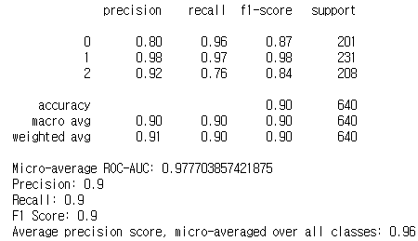

Result
SVM

Slide 12
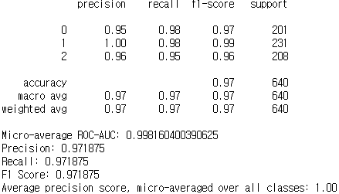
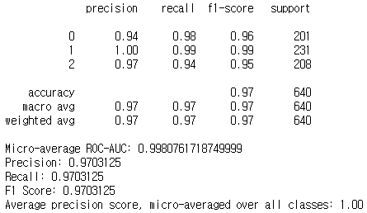
Result
Random Forest
XGBoost

Slide 13
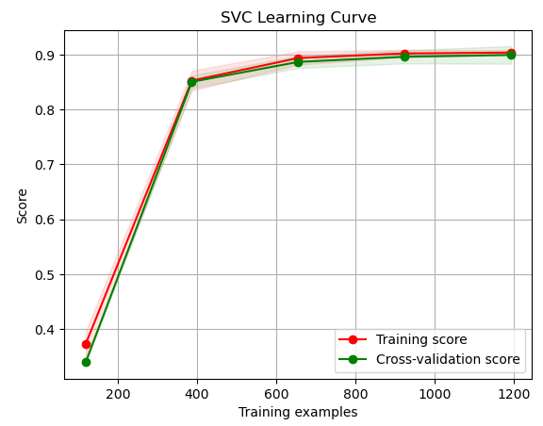
Result
SVM

Slide 14
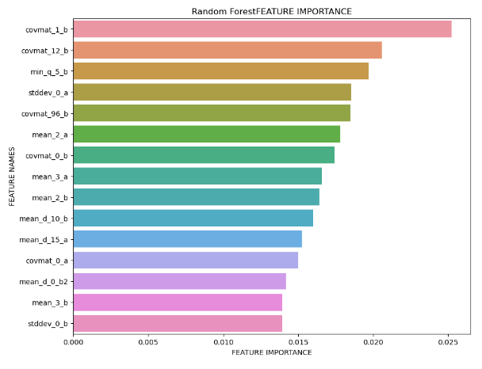
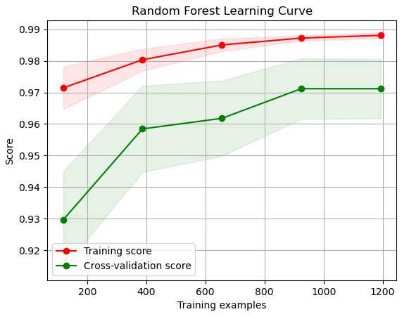
Result
Random Forest

Slide 15
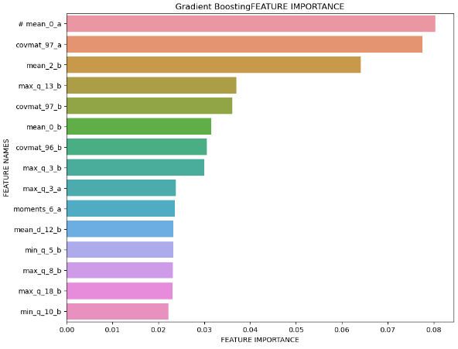
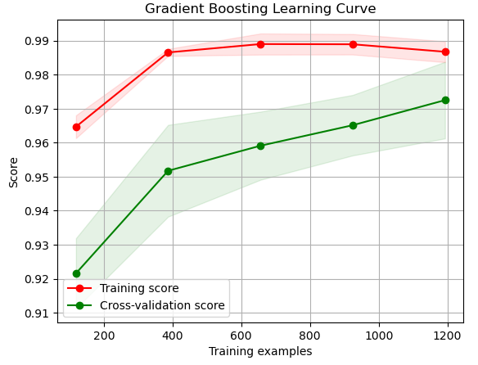
Result
XGBoost

Slide 16
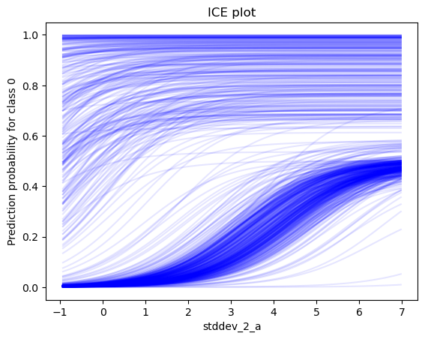
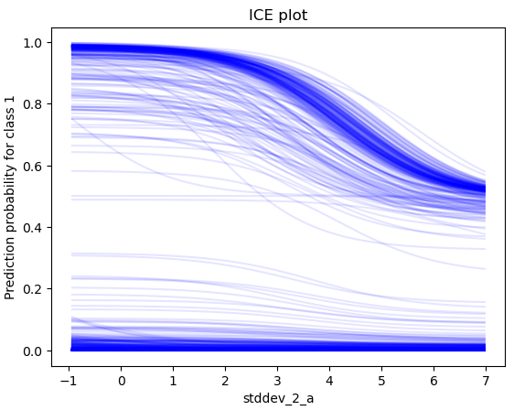
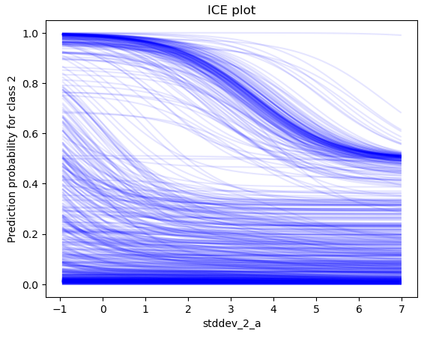
Result
SVM
Negative
Neutral
Positive

Slide 17
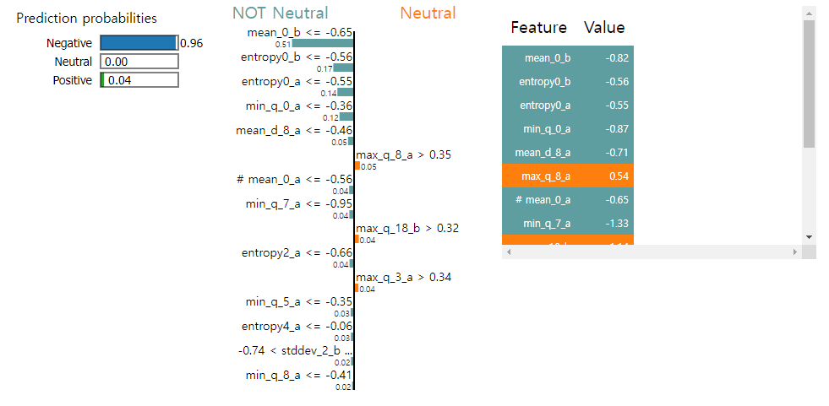
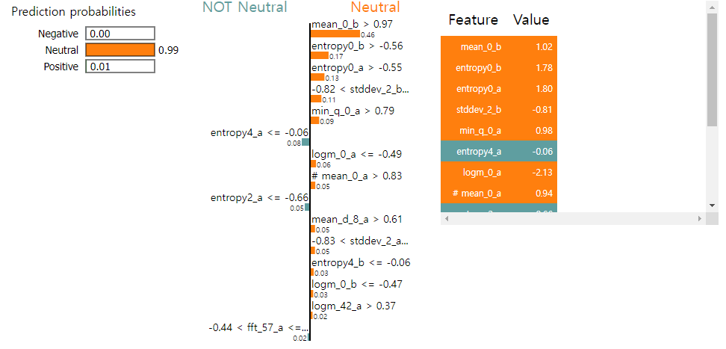
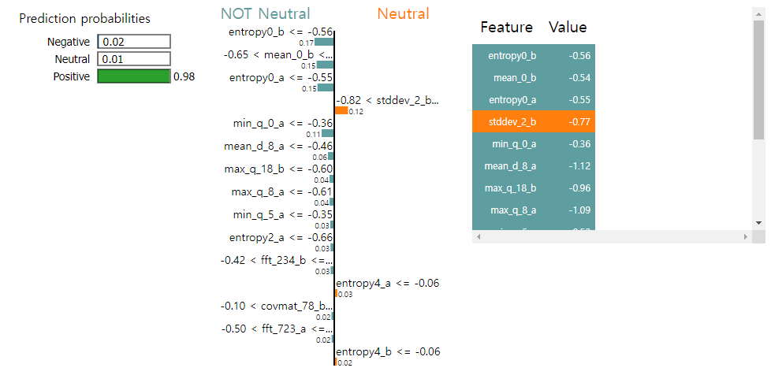
Result
SVM
Negative
Neutral
Positive

Slide 18
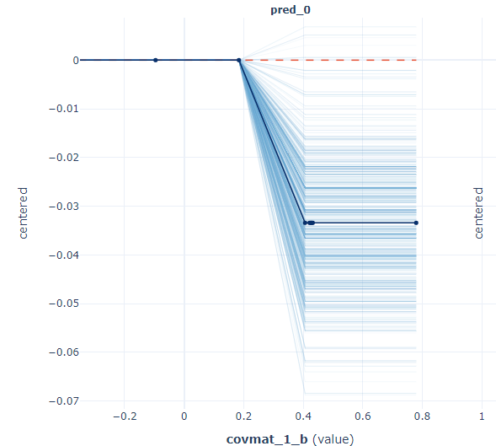
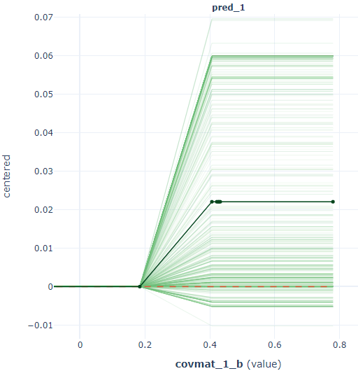
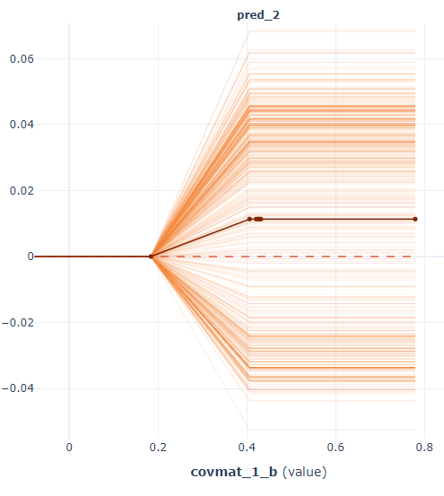
Result
Random Forest
Negative
Neutral
Positive

Slide 19
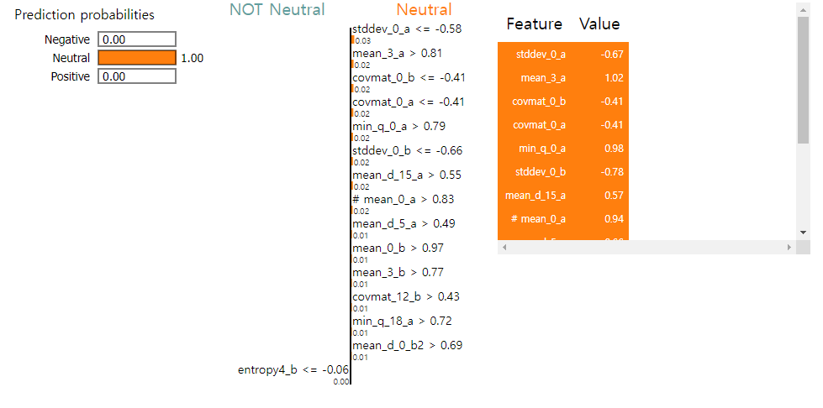
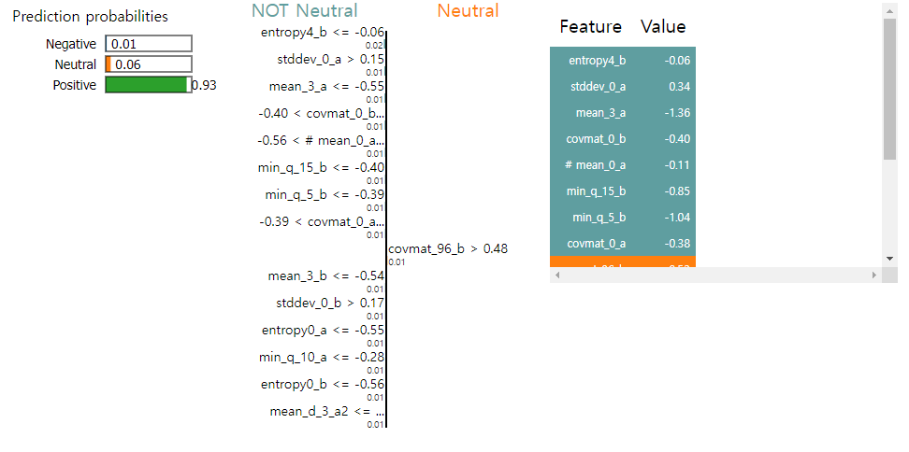
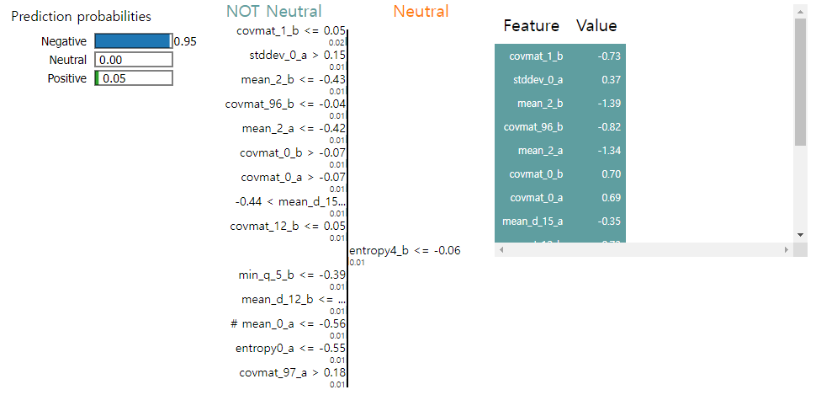
Result
Random Forest
Negative
Neutral
Positive

Slide 20
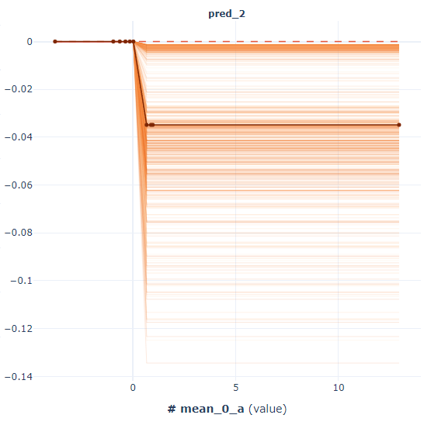
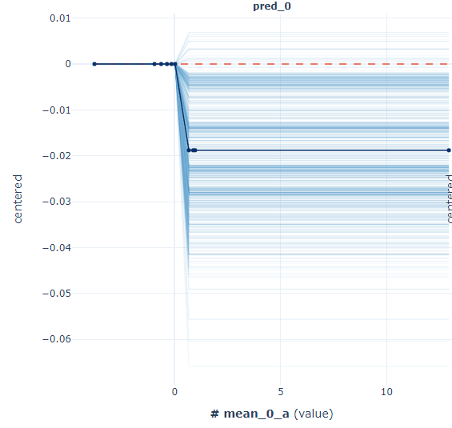
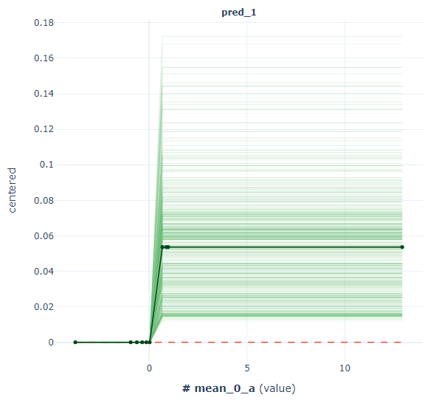
Result
XGBoost
Negative
Neutral
Positive

Slide 21
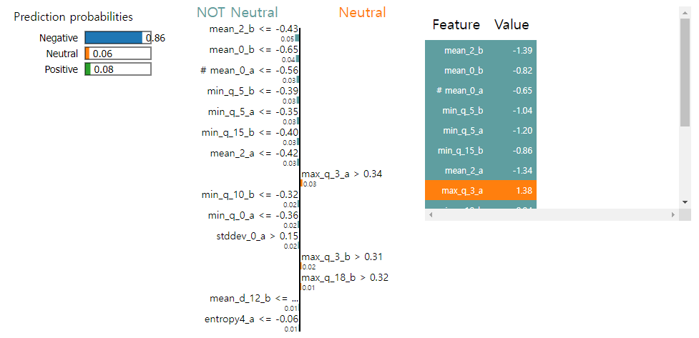
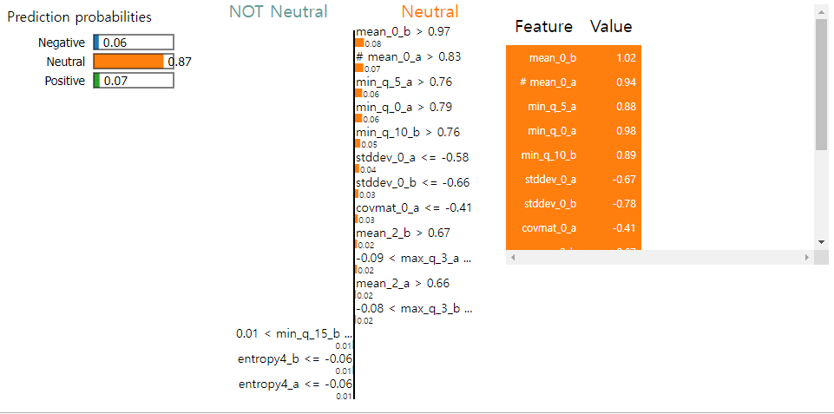
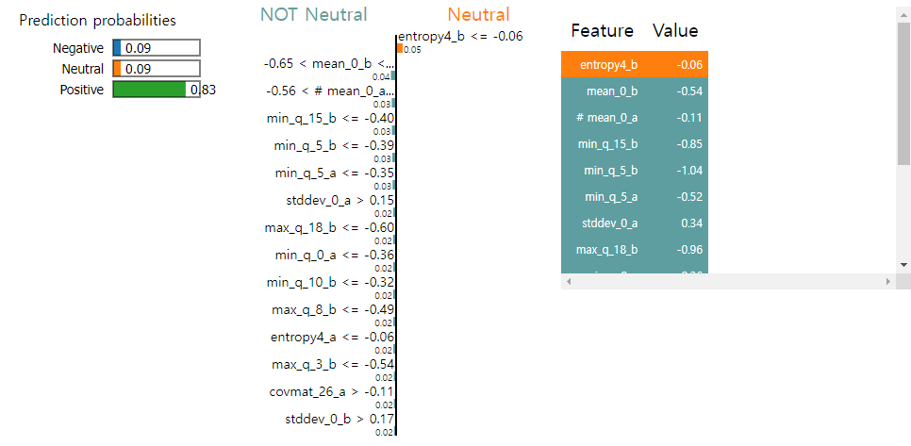
Result
XGBoost
Negative
Neutral
Positive

Slide 22
Conclusion
(1) When analyzed through ICE, it was confirmed that the reason for the higher accuracy of the two ensemble models than SVM was that the feature tendencies were clear.
(2) The distinction between Negative and Neutral is clear, but it was confirmed that it is relatively difficult to distinguish between Positive.
(3) It was confirmed that the value of mean has a great influence on emotion classification.
(4)If you take the average, it acts like a moving average filter, so it seems to have a big impact on removing noise to some extent.
(5) In the future, we will be able to analyze the features one by one through the PDP and find out which feature has a great influence on the expression of emotion.

Slide 23
References
- Bird, Jordan J. and Diego Resende Faria. “Mental Emotional Sentiment Classification with an EEG-based Brain-machine Interface.” (2018).
- Bird, J., Faria, D., Manso, L. J., Ekárt, A., & Buckingham, C. D. (2019). A Deep Evolutionary Approach to Bioinspired Classifier Optimisation for Brain-Machine Interaction. Complexity, 2019, [4316548]. https://doi.org/10.1155/2019/4316548
- C. Qing, R. Qiao, X. Xu and Y. Cheng, "Interpretable Emotion Recognition Using EEG Signals," in IEEE Access, vol. 7, pp. 94160-94170, 2019, doi: 10.1109/ACCESS.2019.2928691.

