Slide 1
Crab Molt Size estimation
Anita, Rahul, Satish, Tejaswi, Vinay

Slide 2
Regressing the pre and post sizes
Iteration 1 : PreSz ~ presz~postsz+y1+y2+y3+lf
  Summary : R2 adj : 98% still
  Lf, y3, are insignificant with pvalues of 0.69, 0.268
Iteration 2 : Presz~postsz+y1+y2
  Summary : R2 adj : 98% still
  Y1 is insignificant with pvalue of 0.38
Iteration 3 : Presz~postsz+y2
  Summary : R2 adj : 98% , and y2 is also significant
Iteration 4 : Presz~postsz
  Summary : R2 adj : 98%
GAM: Nearly same result as above. Even a visual inspection shows a good linearity fit.
CONCLUSION: 82 pre sizes are different from sizes in other years. (slope is steeper with a larger –ve intercept in 82)

Slide 3
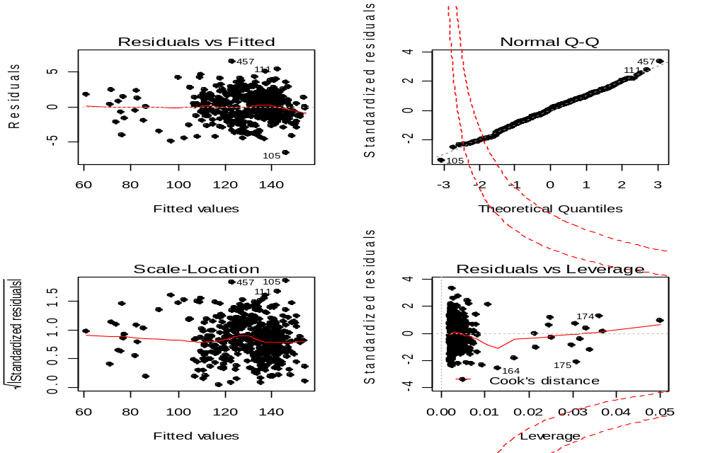
Removing three outliers sequentially gives good results (R2 : 98.26%)

Slide 4
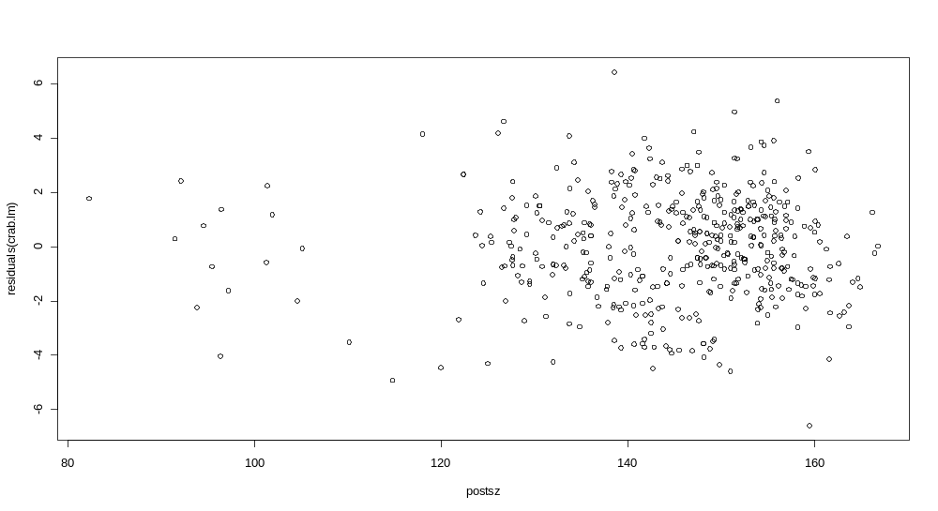
Consistent prediction of preSize across clusters
  Residuals don’t go Hayward across any of the clusters (vary mostly between -4 to 4 )

Slide 5
Final regression model
Y : Presize ; X : postsize
Y = 1.1072 * X – 30.21
Since coefficient of “lf” is insignificant, captivity or lab based study doesn’t alter the shell sizes
Coefficient for year 82 is significant, but the presize histograms didn’t differ much with different slopes, So we are ignoring the year effect
Since the fit is good
  Average squared error is the Residual std error : 1.935 as given in the summary

Slide 6
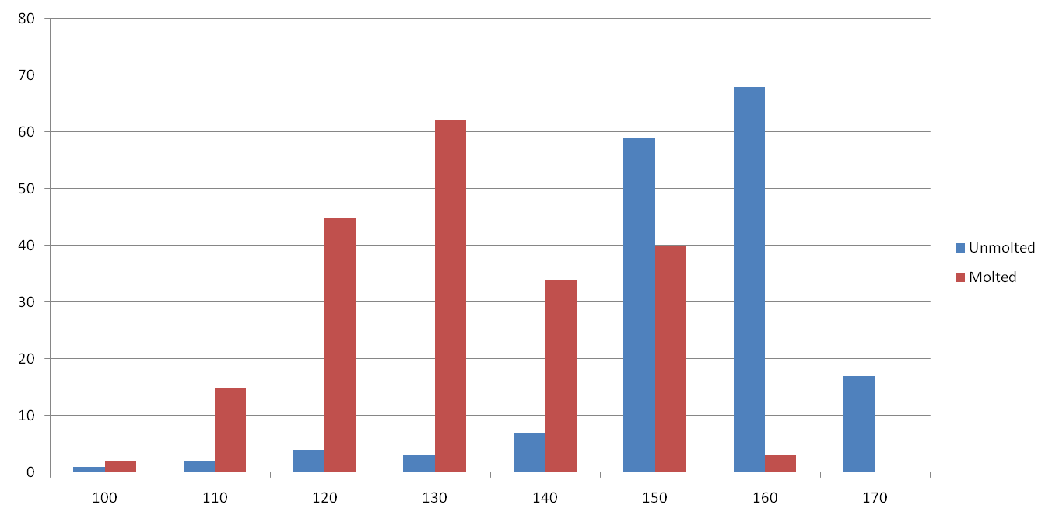
Histogram of presizes of Molted/Unmolted crabs
Crab sizes > 145 are mostly unmolted pointing to the fact that they are old and might not grow any further
Gives a clue about growth rates/maturity. ie, > 147.5 → no growth

