Slide 1
3_6
ST

Slide 2
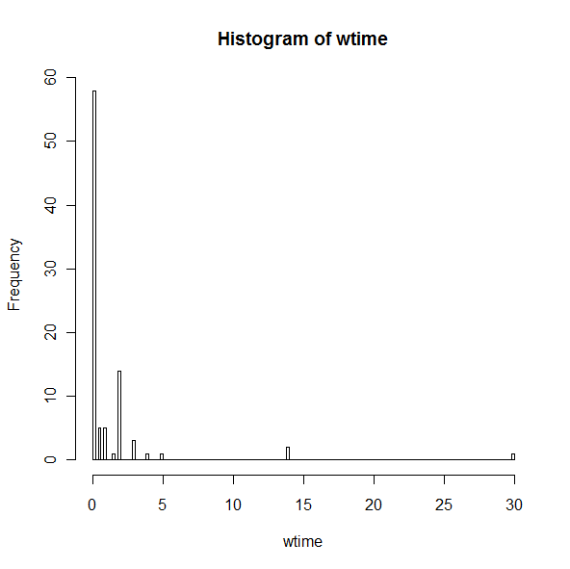
Avg gaming time in the week prior to survey

Slide 3
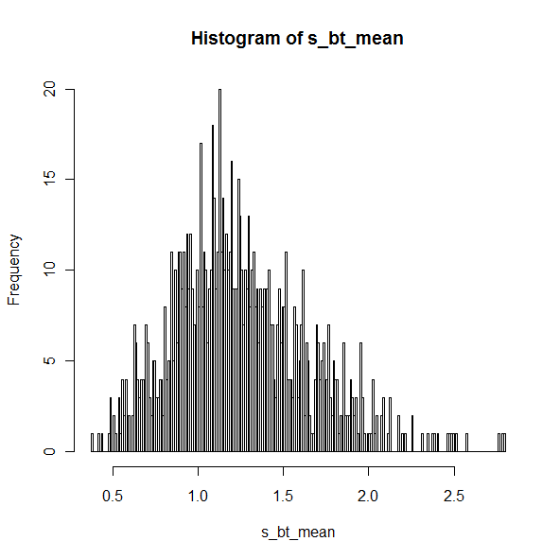
With out pruning of outlier data
Gaming time in prev week
Mean: 1.242857 hr/week
95% Confidence Interval 0.589011 < -- >2.089588

Slide 4
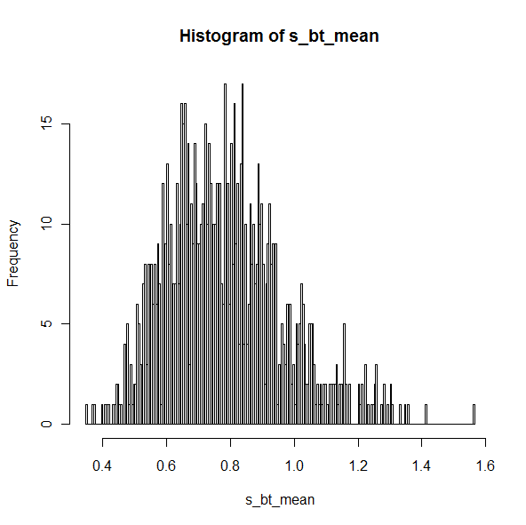
With pruning of data
Gaming time in prev week
Mean = 0.7764045 is:
Confidence Interval : 0.4628933 < --- >1.168596

Slide 5
Grade correlations
H0 : Actual grade distribution :
A : 0.2 ; B : 0.3 ; C: 0.4 ; D or lower : 0.1
H1 : Sample distribution
A : 0.34 ; B : 0.57 ; C: 0.087 ; D or lower : 0
Using chi-square test ::
P(X^2 > 62.06) = 2.12e-13,
Since p-value is very low, H0 is rejected , so correlation is pretty poor.
Even after adjusting for non-respondents,
P is 4e-12, So Ho is again rejected.
Expectations from students are higher !!!

